Slide 1
Public Debt and Economic Growth in LAC
Thomas Rauzi
Notes:
Good morning. My name is Thomas Rauzi, and my topic is investigating the relationship between public debt and economic debt.

Slide 2
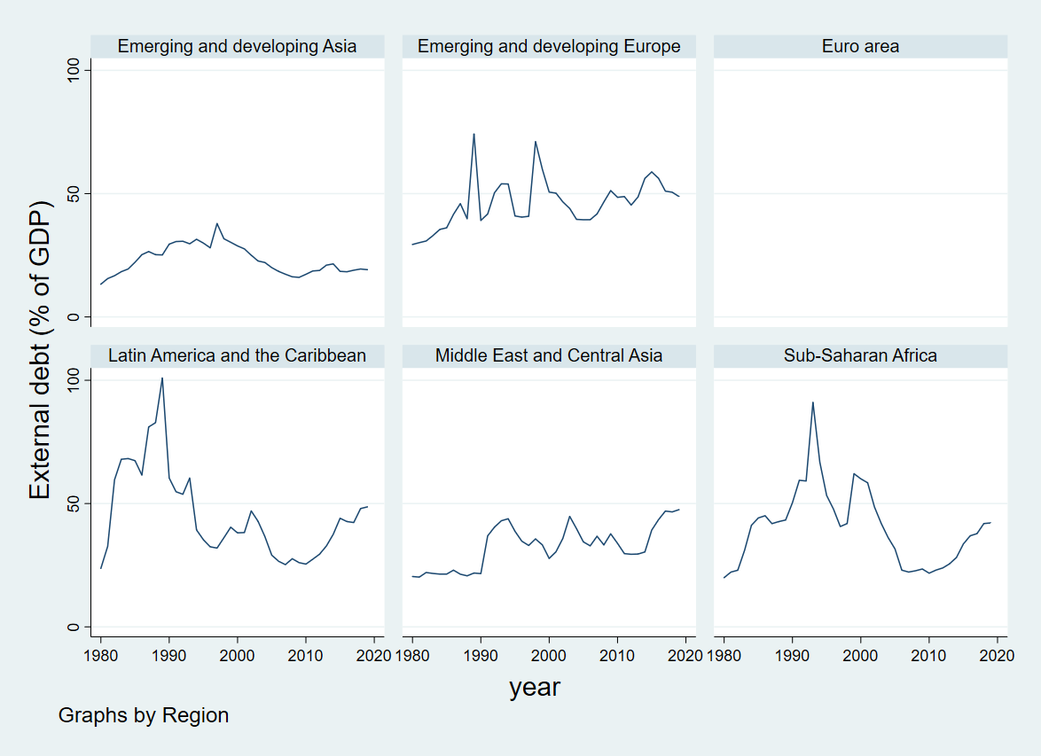
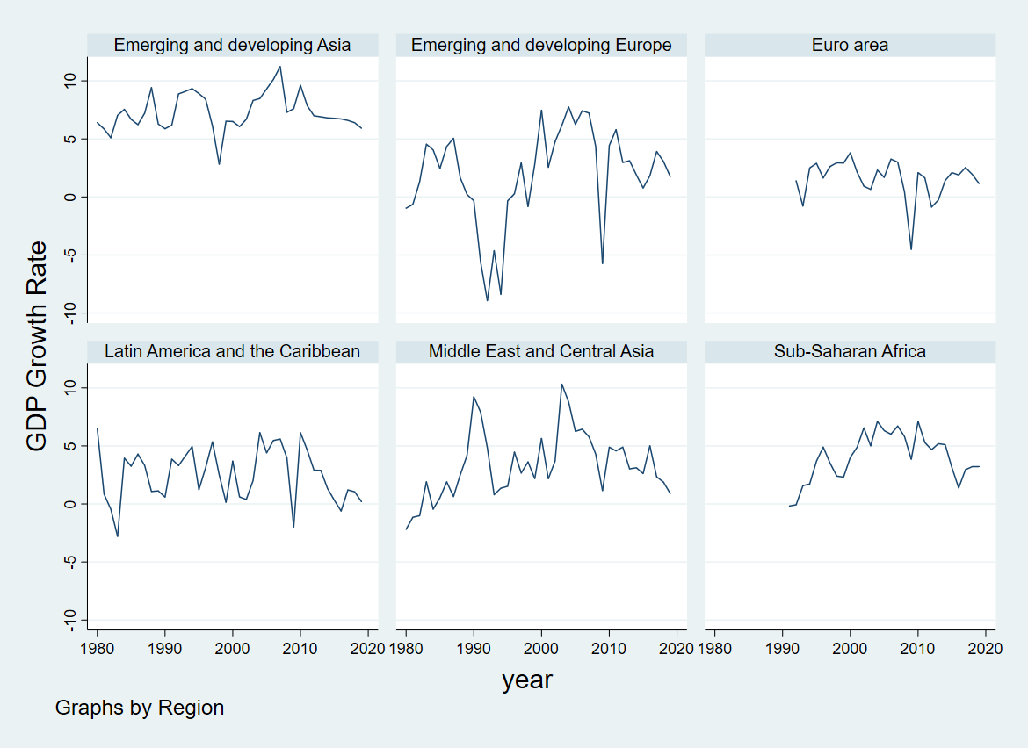
Motivation

Slide 3
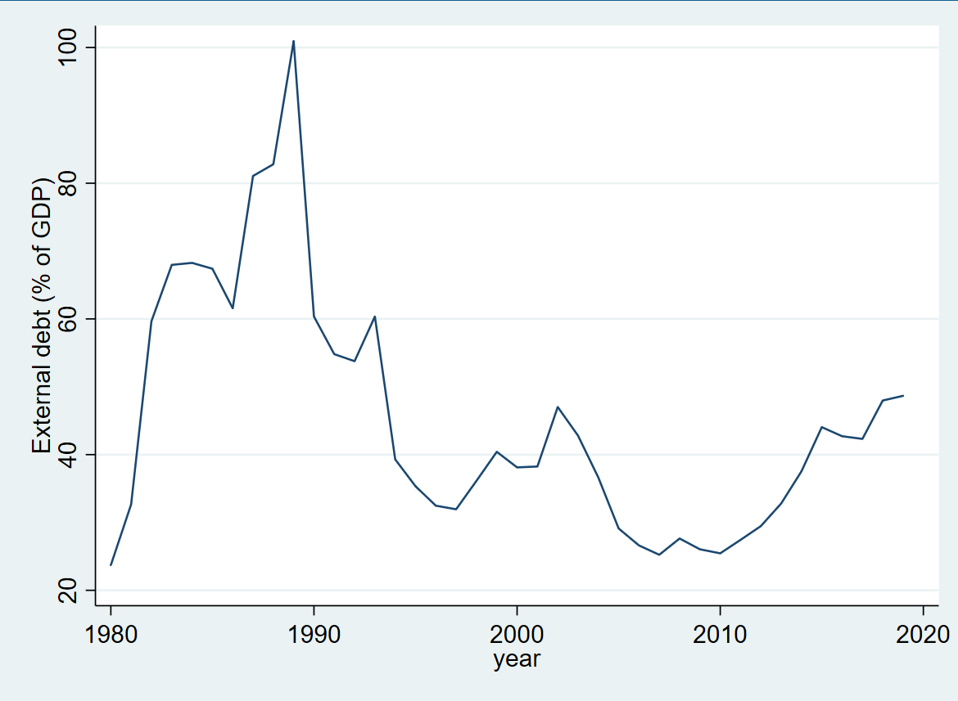
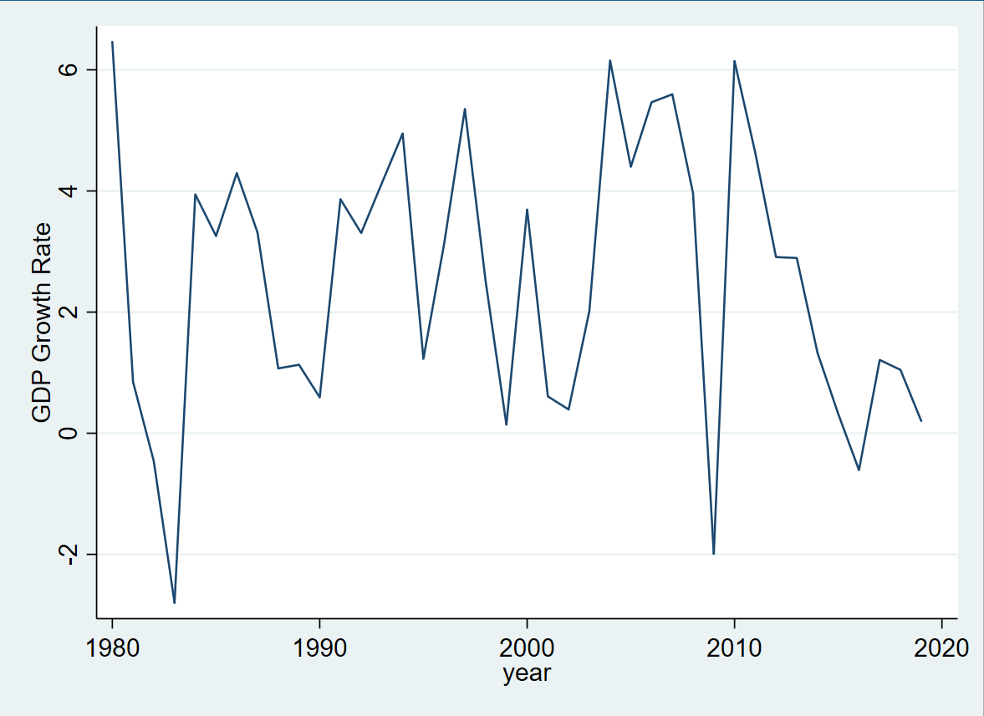
Motivation

Slide 4
Introduction
What is the causal relationship between public debt and economic growth in LAC?
Mechanism
Growth causing debt: counter-cyclical
Debt causing growth: Ricardian, Crowding out, and productivity
Toda and Yamamoto VAR
29 LAC from 1982-2015
Contribution:
Toda and Yamamoto method
Control for capital, imports, and government revenue

Slide 5
Literature Review
OLS
Negative: Geiger (1990)
Insignificant: Lin and Sosin (2001)
FE
Inverted U: Checherita-Westphal and Rother (2012)
Negative: Kumar and Woo (2010)
Unidirectional Causality
IV
Negative: Megersa and Cassimon (2015)
Insignificant: Panizza and Presbitero (2014)
ECM:
Negative Non-linear: Égert (2015)
Negative: Balassone, Francese, and Pace (2011)
ARDL: Onafowora and Owoye (2019)
VAR: Butts(2009)

Slide 6
Theoretical Framework
Debt’s impact on Growth
Crowding Out
Ricardian Principle
Productivity
Growth impacts Debt: Counter-cyclical

Slide 7

Empirical Method
$Y_{c,t}=β_{0,c}+β_{c,2}Y_{c,t−1}+…+ β_{c,p+1}Y_{c,t−p}+…+β_{c,p+1+q}Y_{c,t−p−q}+ε_{c,t}$
$Y_{c,t}=\left[\begin{matrix}log\left({gdp}_{c,t}\right) \\ \begin{matrix}log\left({debt}_{c,t}\right) \\ log\left(k_{c,t}\right) \\ \begin{matrix}log\left({im}_{c,t}\right) \\ log\left({gr}_{c,t}\right)\end{matrix}\end{matrix}\end{matrix}\right]$

Slide 8
Toda and Yamamoto
Toda and Yamamoto:
Step 1: maximum order of integration
Step 2: Lag Selection
Step 3: Granger causality
Impulse Response Functions

Slide 9
Data
Initially 34 Countries
Five Removed
British Virgin Islands, Cuba, Suriname, and Turks and Caicos
Puerto Rico
Ten Countries Data Limitations
Missing capital: Antigua, Dominica, and Grenada
Capital and import data: Trinidad and Tobago:
Limited capital: St. Vincent
Gov. revenue: Ecuador, Guyana, Haiti, and Panama
Venezuela (1992-1997)
1982-2015

Slide 10
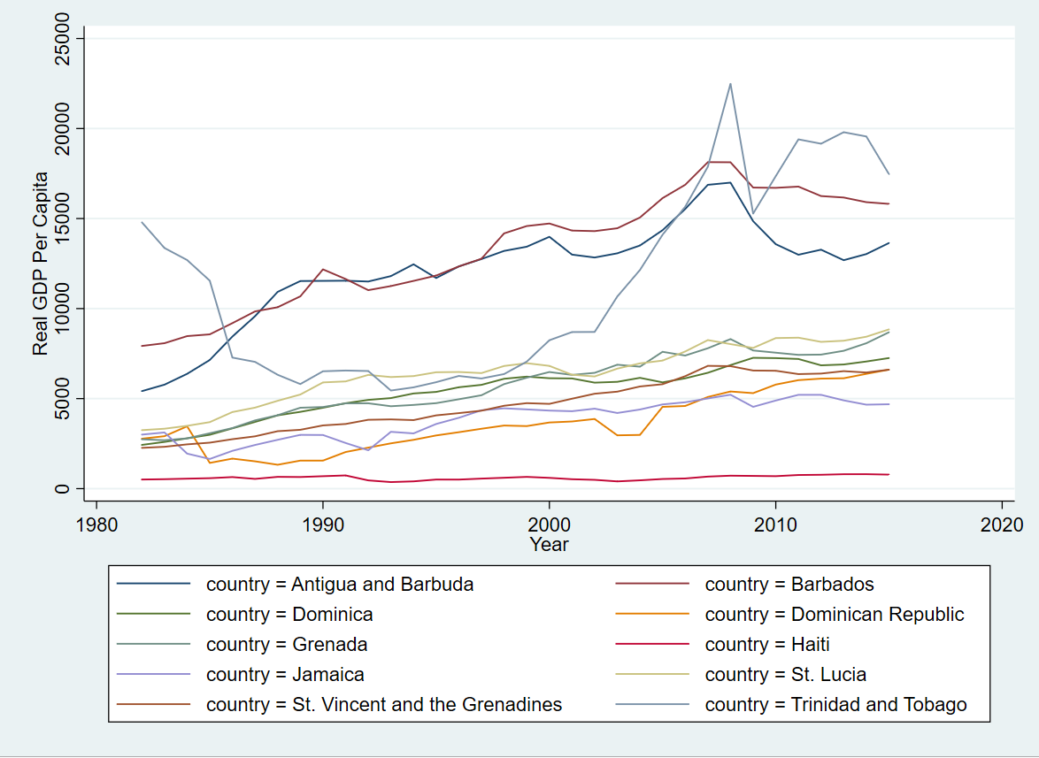
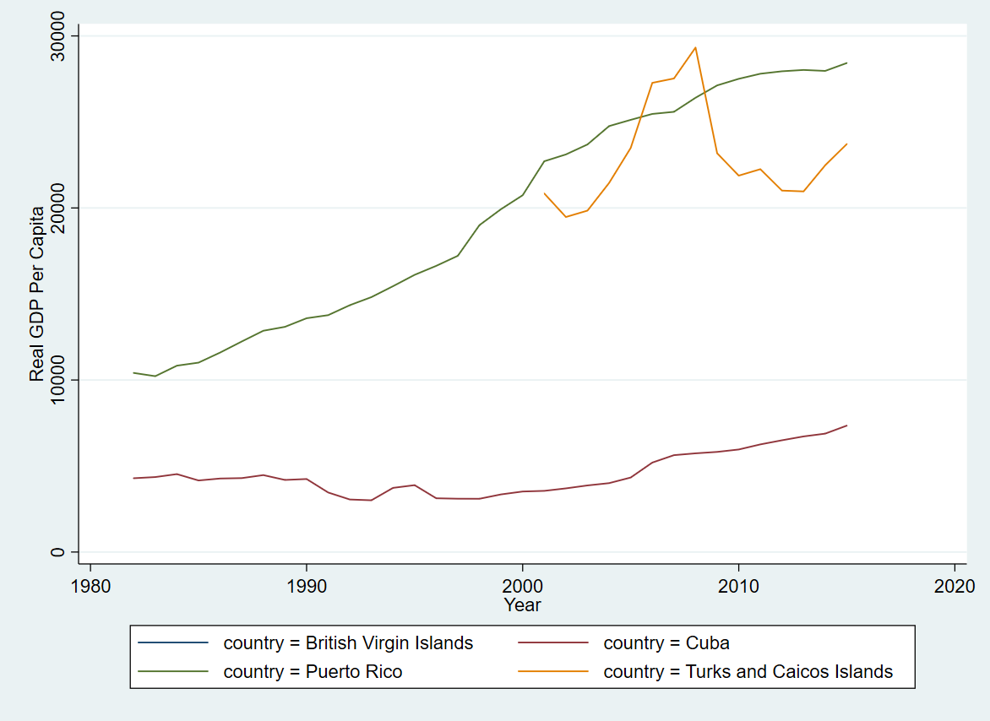
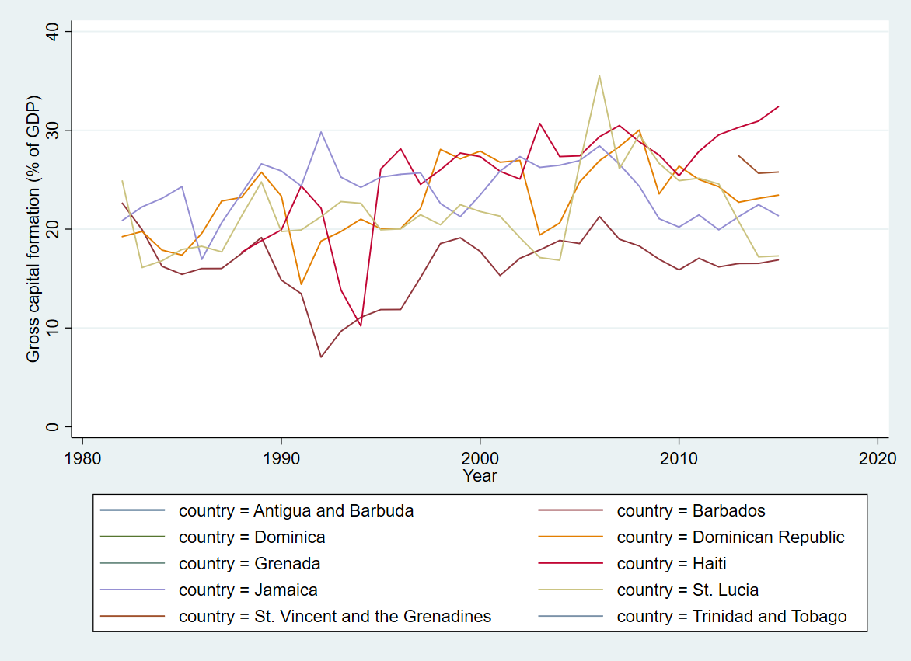
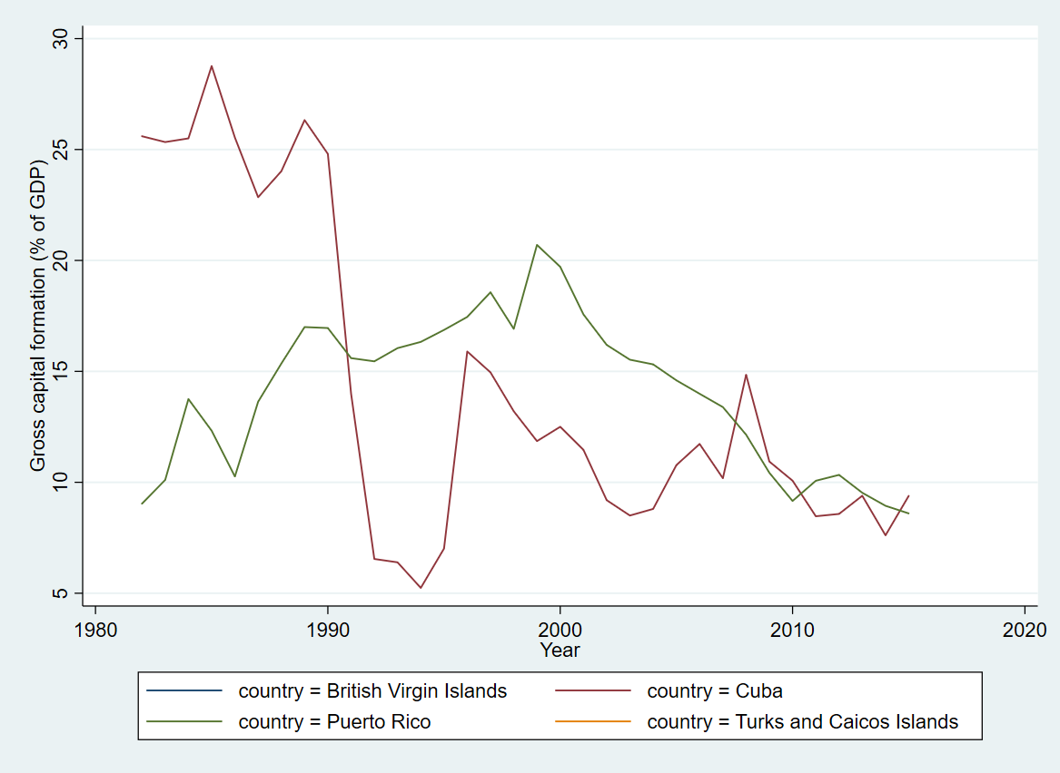
Data Continued
Figure 2: Caribbean Island Countries
Figure 2(a): Included in Sample
Figure 2(b): Excluded from Sample
Figure 2(c): Included in Sample
Figure 2(d): Excluded in Sample

Slide 11
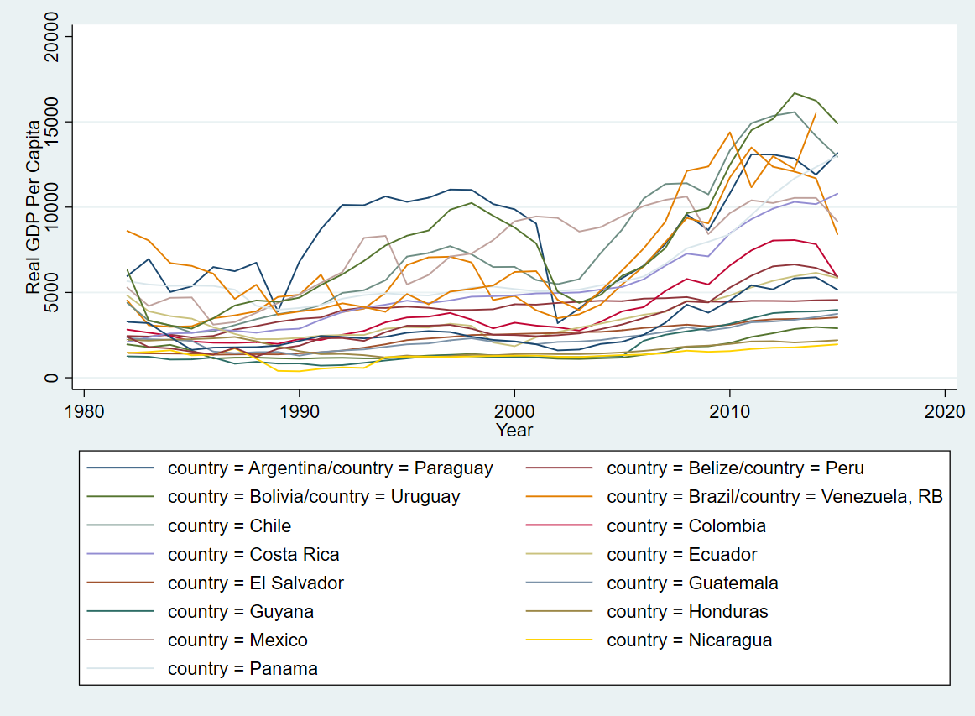
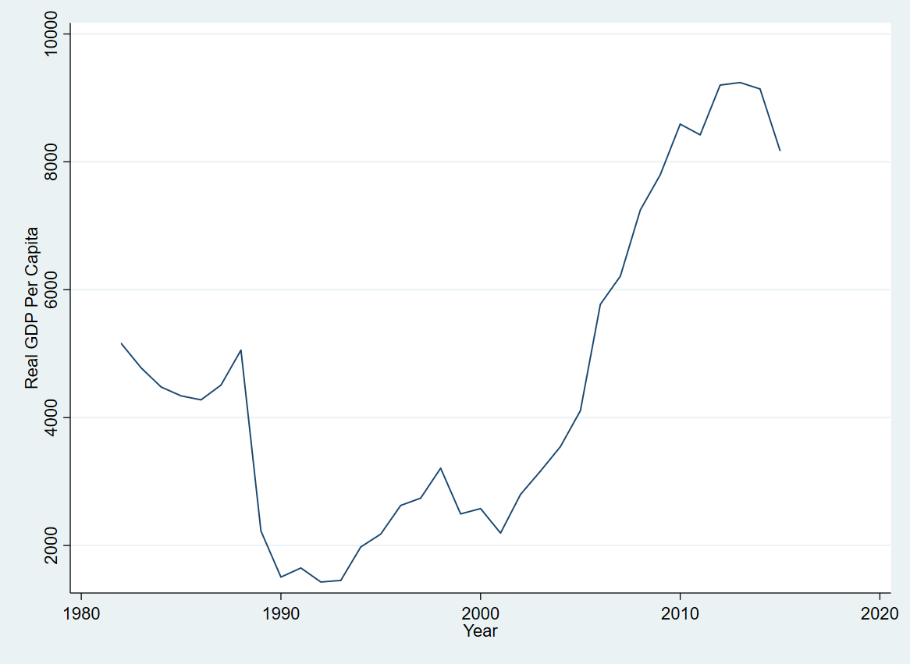
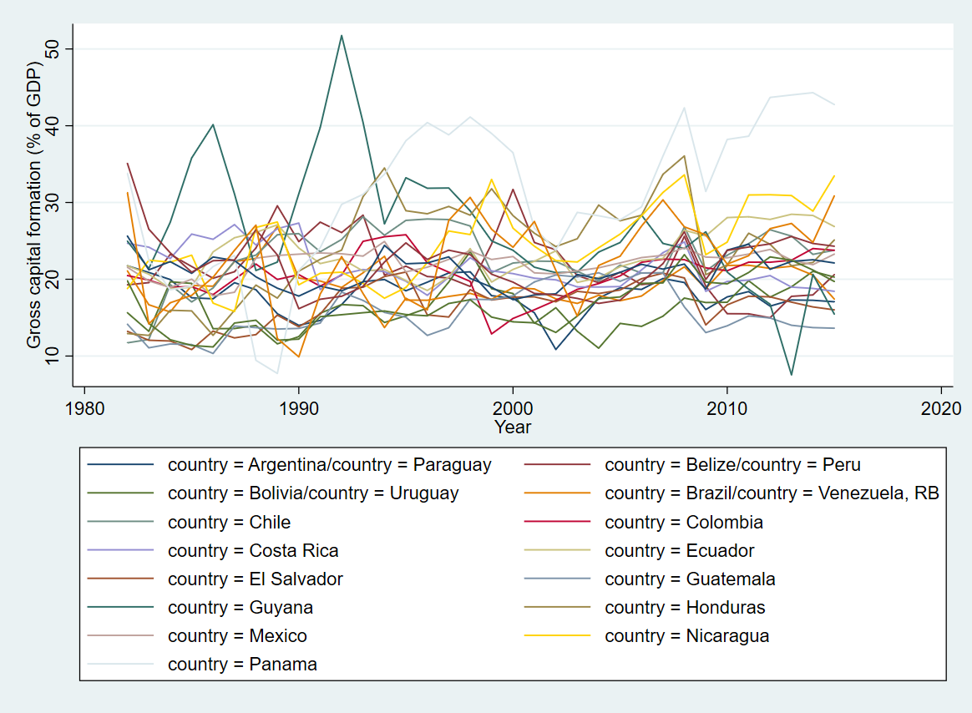
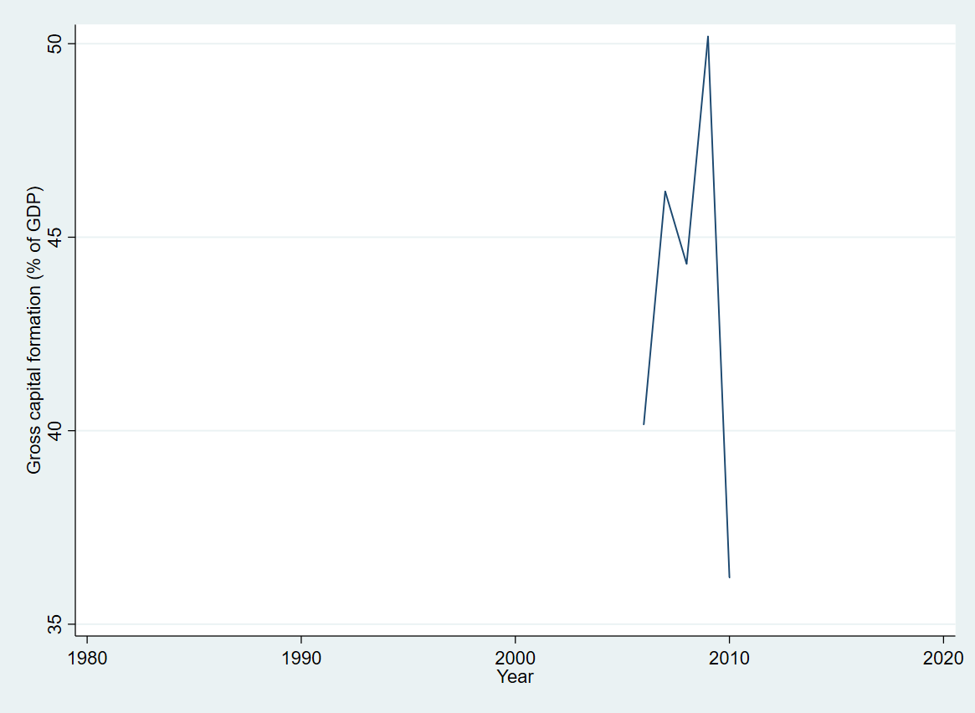
Data Continued
Figure 3 Non-island Countries
Figure 3(a): Included in Sample
Figure 3(b): Excluded from Sample
Figure 3(c): Included in Sample
Figure 3(d): Excluded from Sample

Slide 12
Results: unit Roots
Unit Root Summary
number | Country | Log Real GDP per capita | Log debt per GDP | Log Capital Formation | Log Imports | Log Revenue
1 | Bolivia | I(1) | I(0) | I(1) | I(1) | I(1)
2 | Colombia | I(1) | I(1) | I(1) | I(1) | I(2)
3 | El Salvador | I(2) | I(1) | I(1) | I(1) | I(1)
4 | Guatemala | I(1) | I(0) | I(1) | I(1) | I(1)
5 | Guyana | I(1) | I(0) | I(1) | I(1) | NA
6 | St. Vincent | I(1) | I(1) | I(0) | I(1) | I(1)

Slide 13
Results: Granger Causality
Country | Same Results
 | This Paper | Butts (2009)
Paraguay | GDP-Debt | GDP-Debt
Peru | Bidirectional | Bidirectional
 | No Relationship (1) | Debt causes Growth (2) | Growth Causes Debt (3) | Unidirectional |  | Bidirectional(6)
 |  |  |  | Debt causes Growth (4) | Growth Causes Debt (5)
This paper | 24% | 48% | 69% | 7% | 28% | 41%
Butts (2009) | 22% | 34% | 61% | 17% | 44% | 17%

Slide 14
Results: Impulse Response Function
IRF
 | Debt causes Growth |  |  |  | Growth Causes Debt
 | Negative (1) | Positive (2) | None (3) | Total (4) | Negative (5) | None (6) | Mixed (7) | Total (8)
Number of Countries | 7 | 3 | 4 | 14 | 14 | 5 | 1 | 20
Percentage | 50% | 21% | 29% | 100% | 70% | 25% | 5% | 100%
Mixed Results
number | Country | Debt causes GDP |  | GDP causes debt
 |  | Granger Causality | relationship | Granger Causality | relationship
1 | Ecuador | Yes | Negative | Yes | Negative Positive
Red: Data Limitation

Slide 15
Results: Bidirectional IRF
Stable Relationships
number | Country | Debt causes GDP |  | GDP causes debt
 |  | Granger Causality | relationship | Granger Causality | relationship
1 | Brazil | Yes | Positive | Yes | Negative
2 | St. Lucia | Yes | Positive | Yes | Negative
Unstable Relationships
number | Country | Debt causes GDP |  | GDP causes debt
 |  | Granger Causality | relationship | Granger Causality | relationship
1 | Haiti | Yes | Negative | Yes | Negative
2 | Mexico | Yes | Negative | Yes | Negative
3 | Nicaragua | Yes | Negative | Yes | Negative
Red: Data Limitation

Slide 16
Conclusion
Results
Debt-Growth: Mixed
GDP-Debt: Negative
Bidirectional relationship
Stable Relationship
Unstable Relationship
Data Limitations
Missing Political Events
IRF
Type of government spending

Slide 17
Questions?

