Slide 1


COM682 Cloud Native Development CW1
UniShare Document Sharing Platform
A scalable web application enabling students and educators to upload, share, and search academic material
Presented by : Lok-Hung Lui
B00938238

Slide 2

Problem Definition
While platforms like Blackboard are crucial for official course content, they lack tools for peer-to-peer sharing. In practice this means students resort to fragmented methods of sharing files e.g. emails and messaging apps, leading to disorganised knowledge, difficult to recover later, prevents the community benefiting from useful notes and materials.
Creating a dedicated platform for this purpose creates a centralised, shared resource pool, though introduces many technical challenges, mainly around handling unpredictable traffic bursts. An example is during exam season, the system must support a large influx of students uploading, downloading and searching notes. A traditional self-managed server would likely be overwhelmed by these sudden spikes, which is the problem cloud-native architecture was made to solve.

Slide 3
Chosen Architecture
UniShare employs a serverless microservices architecture using Azure.
A traditional N-Tier monolith was rejected due to its coupling and inefficient scaling. Since any update requires a full re-deployment, and its static scaling model proves costly for variable workloads
The Microservices approach provides the necessary independence, each de-coupled service enables independent development, deployment, and scaling. This improves efficiency and cost effectiveness
Using Azure Functions makes this model serverless, delivering automatic, event-driven scaling with a cost-effective pay-per-use model which makes it suitable for the applications unpredictable traffic, ability to scale to zero when not in use

Slide 4

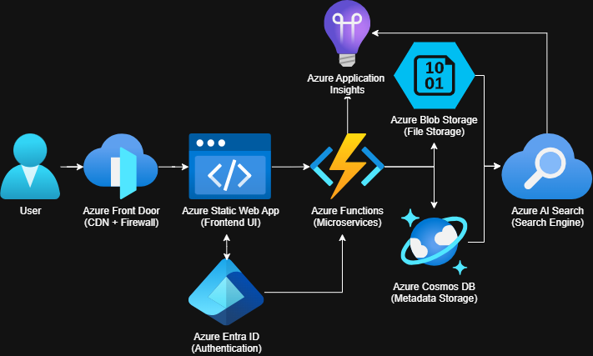
Solution Architecture Diagram
Source : Own Work

Slide 5
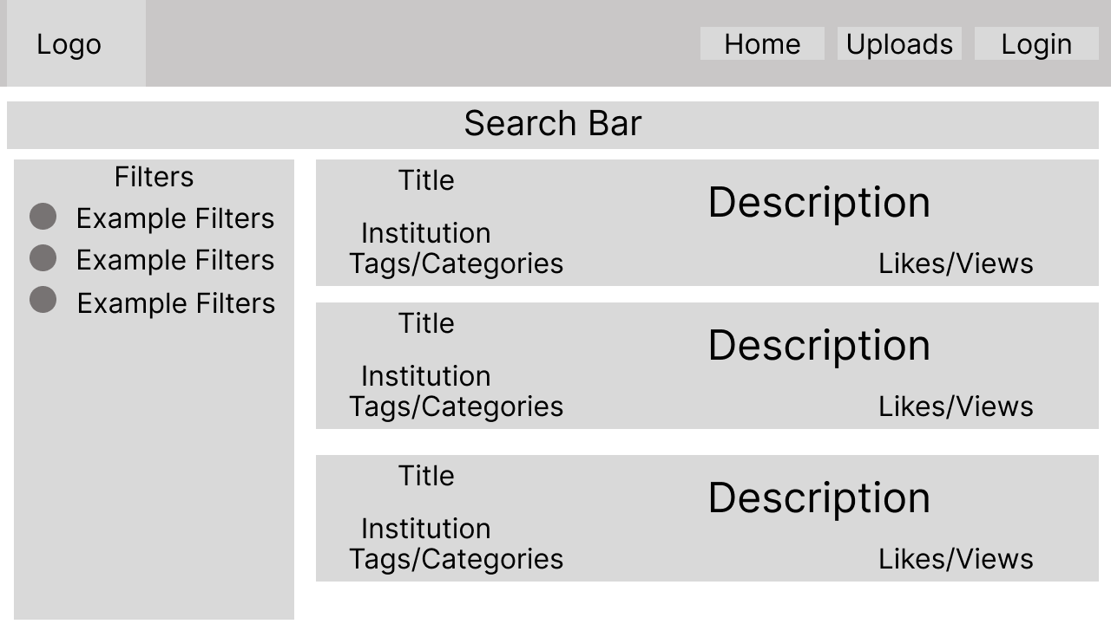
Webpage Wireframe
Home Page, Home/Upload/Login Buttons, Search Bar, Example Uploads, Example Filters,
Source : Own Work

Slide 6
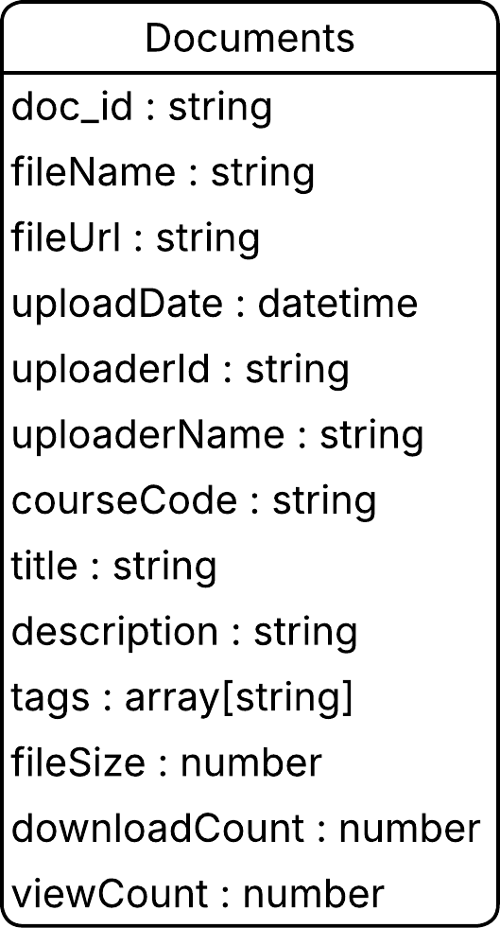
Database Schema
Hybrid Data Architecture
UniShare uses a combination of Azure Cosmos DB and Azure Blob Storage to efficiently handle different data types :
Azure Cosmos DB (NoSQL)
Stores document metadata and user information
Flexible JSON format, perfect for the titles, description, tags, and engagement data
Fast queries for searching and filtering
Azure Blob Storage
Stores the actual PDFs, PPTXs, and images
Cost-effective for large binary data
Scales automatically with demand
Database Service | Purpose | Data Types
Azure Cosmos DB | File Metadata, User Profiles, Search Data | NoSQL Document Store
Azure Blob Storage | Actual Files, PDF’s, PPTX, Images | Object Storage
Source : Own Work

Slide 7
REST API Design
HTTP Methods | Endpoints | Descriptions
POST | /api/files | Upload new files (Returns upload URL)
GET | /api/files | List all files (has optional filters)
GET | Api/files/{id} | Lists specific file details
PUT | /api/files/{id} | Update files metadata
DELETE | /api/files/{id} | Delete file and metadata
GET | /api/search?q={query} | Search files using AI Search
API Architecture & Integration
The REST API follows standard conventions providing a clean interface between front-end and Azure Services.
Azure Service Integration
Azure Functions : Hosts all API endpoints as serverless functions
Azure Cosmos DB : Stores and retrieves document metadata via API calls
Azure AI Search : Provides search endpoint with intelligent query processing
Azure Blob Storage : Handles actual file uploads/downloads using SAS URLs
File Management : Full CRUD operations for documents(/api/files)
Azure AI Search : Provides a intelligent search endpoint
Metadata Operations : Separate endpoints for file data and file content

Slide 8
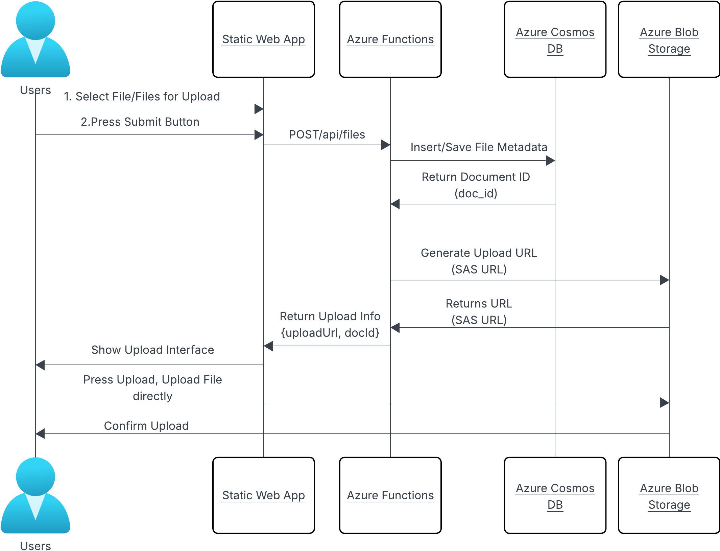
REST API Design (UML)
The UML sequence diagram illustrates a POST (/api/files) endpoint, which handles new document uploads.
Source : Own Work

Slide 9



Selected Azure Services & Justification
Azure Front Door : Chosen as the global entry point for its integrated CDN and traffic management capabilities. Ensuring fast worldwide access for all users, provides built-in firewall. Alternative was Application Gateway, but it lacks global distribution
Azure Entra ID : Secure identity and access management. Provides single sign-on authentication integrated across the Azure Ecosystem
Azure Static Web App : Hosts the applications front-end with automatic scaling, global distribution, with built-in CI/CD, automatically handles SSL certificates, Azure App services was considered but would be overly complex for static content
Microsoft Azure Services Logos

Slide 10



Selected Azure Services & Justification
(cont.)
Azure Functions : Chosen for the backend API due to its serverless nature and event-driven scaling. The pay-per-execution model makes it a cost-effective option for the unpredictable workloads. Azure App Services was considered, but it requires constant running, making it costly
Azure Cosmos DB : Chosen for its NoSQL Flexibility, providing fast queries and global distribution, making it ideal for the document metadata. Azure SQL was rejected due to its rigid schema requirements
Azure Blob Storage : Chosen for unstructured data storage of PDFs, PPTXs, and images. It is massively scalable, has secure access using SAS URL’s, traditionally storing files in a database(SQL) would’ve been inefficient for large files, is costly to scale.
Microsoft Azure Services Logos

Slide 11


Advance Features
Azure AI Search : Has been chosen since it transforms the platform from a simple document repository, into a knowledge discovery tool. Allowing intelligent, text searching across document content and metadata. Features such as fuzzy matching will handle user typos and spelling variations, it also has relevance scoring, showing useful academic resources first. This is far superior to basic search queries, makes the application much more helpful.
Azure Application Insights : Chosen for its comprehensive performance monitoring and usage analytics. Providing real-time insights into the applications health, allowing for early error detection, its data also enhances recommendations, alternatively I could’ve implemented a basic logging feature within Azure Functions, though this approach would be less beneficial and not centralized.
Microsoft Azure Services Logos

Slide 12
Assessment of Limitations
Operational Complexity : Designing this domain using microservices architecture introduces more moving parts compared to a monolithic domain, making debugging and monitoring more challenging.
Using microservices, each service is responsible for its own data persistence, which can raise concerns for data consistency across the whole system
The complexity of the distributed architecture could lead to latency while services are communicating, especially when a request calls multiple functions
Azure Functions can have cold start issues, resulting in latency when scaling from zero, and Azure Cosmos DB is highly scalable, but can become very costly during high demand.
Dependency on the Azure Ecosystem, making migration to other cloud providers very difficult in the future.

Slide 13
Assessment of Scalability
Strengths :
Serverless Architecture with Azure Static Web Apps and Azure Functions provide a serverless environment, allowing the application to automatically scale based on demand.
The microservices model means that each service can independently scale based on demand, which enhances the overall scalability of the application.
The chosen storage services Azure Cosmos DB and Azure Blob Storage, are designed to handle large volumes of data and scale automatically to meet demand
Weaknesses :
A weakness of my microservices approach is the more complex management and coordination required for multiple services.
The distributed nature of my chosen architecture can cause latency, especially when a request calls multiple services at once.
Though serverless services are cost-effective at the start, the consumption-based pricing can lead to higher costs at a significant scale, which require careful monitoring and management to maintain.

Slide 14
Concluding Comments
I believe I have built an effective, scalable and highly-available cloud-native platform which solves my problem definition. Using Azure Static Web Apps and Functions, I have built a fully serverless architecture that can automatically scale with demand and handle unpredictable bursts of demand.
The microservice model ensures services can be scaled independently, my chosen data services provide a robust, scalable foundation for data and files.
However, there are limitations to consider, such as management, coordination complexity, potential latency and unpredictable costs.
In conclusion, the UniShare platform is designed to be flexible, robust, and dynamic, fulfilling the needs stated in the problem definition. I have acknowledged limitations and have potential solutions, to prepare for future challenges.

Slide 15
References
Azure Documentation :
Microsoft Azure. (2024). Azure Static Web Apps documentation. Available at: https://learn.microsoft.com/en-us/azure/static-web-apps/
Microsoft Azure. (2024). Azure Functions documentation. Available at: https://learn.microsoft.com/en-us/azure/azure-functions/
Microsoft Azure. (2024). Azure Cosmos DB documentation. Available at: https://learn.microsoft.com/en-us/azure/cosmos-db/
Microsoft Azure. (2024). Azure Blob Storage documentation. Available at: https://learn.microsoft.com/en-us/azure/storage/blobs/
Microsoft Azure. (2024). Azure AI Search documentation. Available at: https://learn.microsoft.com/en-us/azure/search/
Microsoft Azure. (2024). Azure Application Insights documentation. Available at: https://learn.microsoft.com/en-us/azure/azure-monitor/app/app-insights-overview
Icons and Logos :
Microsoft Azure. (2024). Azure Architecture Icons. Available at : https://learn.microsoft.com/en-us/azure/architecture/icons/
Course Material :
Ulster University Blackboard COM682 Cloud-Native Development Lecture Notes Weeks 1 - 6

Slide 16
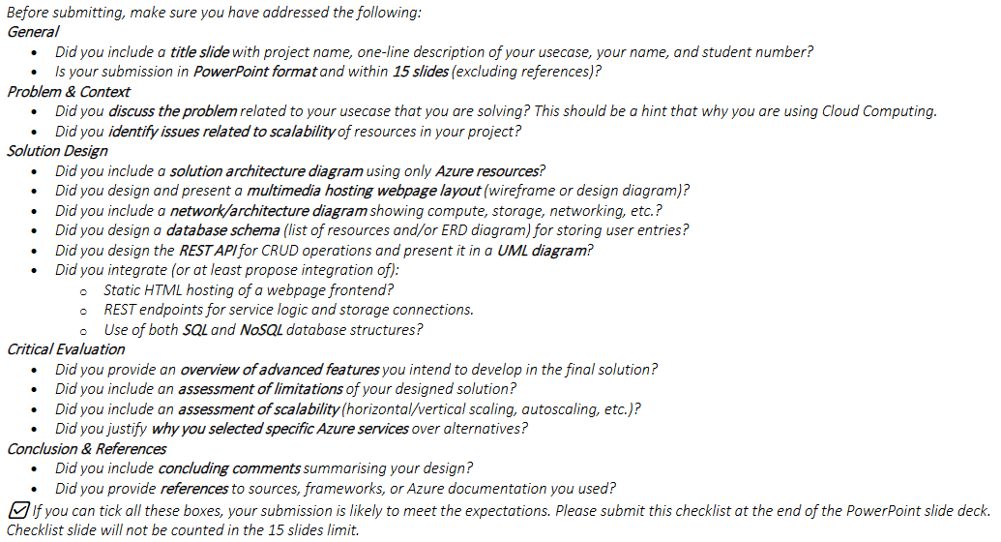
Appendix III. Coursework 1 Submission Checklist

