Slide 1
Travis Payne
Information Visualisation

Slide 2
Motivations
Began searching for an interesting data set first, before looking at a way to answer questions
In 2015/16, over 15,000 first-year students in UK universities reported that they had a mental health problem, compared to approximately 3,000 in 2006. [1]
UEA has recently seen a wave of public backlash due to overloading of campus mental health services, with petitions for the University to address the growing crisis on campus. [2]
Useful for other organisations to identify risk factors.

Slide 3
Version Control
Github Link: https://github.com/ChesterDraws/InfoViz

Slide 4
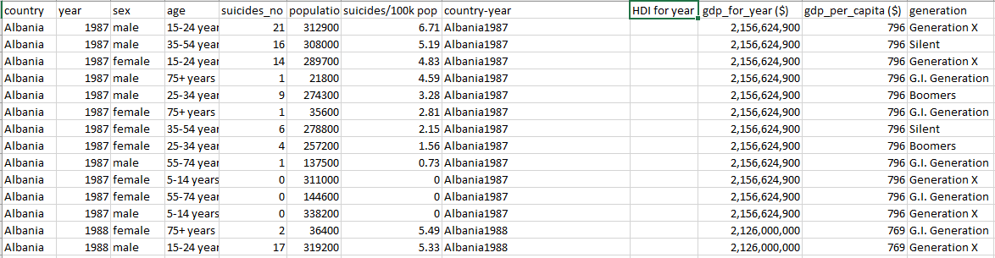
Raw Data Snapshot
27821 Rows
12 Attributes

Slide 5
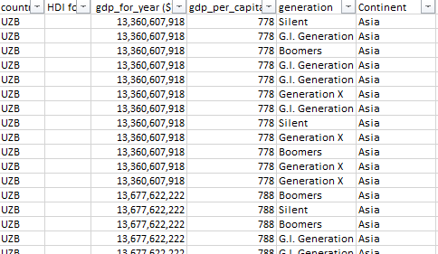
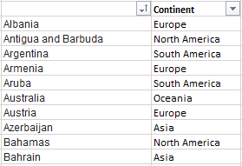
Data Pre-Processing
Made use of Excels filtering and formulas functions to aggregate data.
Two new columns created, country code and continent using VLOOKUP.
=VLOOKUP($C27558,Sheet2!$C$4:$D$106,2,FALSE)
=TEXTJOIN(",",TRUE,A:A) - Formula used to covert Excel column to Comma separated list.
Very large dataset, quite time consuming to process.

Slide 6
Choice of Visualisations – Page 1
Page 1
Pie charts are widely used, visually displays disparity, simple and effective.
Interactive drilldown for the user to further explore.
Side by side view for comparison

Slide 7
Choice of Visualisations – Page 2
Page 2
Innovate “Bubble” Chart
Easy to visually establish largest countries
Retains user attention, different way to explore data
Packed bubble chart for further exploration, looking at trends between continents
Map view for a more “real-world” display of the data.

Slide 8
Choice of Visualisations – Page 3
Page 3
Stacked bar charts to overlay 2 factors on the same graph, easy to see trends/correlations.
Alternative view of both ends of the data, user able to switch between the two.

Slide 9
User Testing
Qualitative “Hallway” Testing done on website.
Briefly explained problem domain, and asked 2 users to explore the website and data.
Feedback was taken and acted on, future room to improve.

Slide 10
User Testing Results – User A
Feels like it’s missing an intro/splash page.
Pie chart simple and intuitive, however does not know what “Drilldown” means.
Side by side comparison is the preferred view.
Bubble chart is aesthetically pleasing, not easiest to use.
Map tool really good, tooltip useful and informative.
Final page is simple and effective, although there is no clear correlation, the presented data makes it easy to see that.
Perhaps increase number of min/max suicide rates.

Slide 11
User Testing Results – User B
Intro page would be useful.
First page is easy to use, data is accessible.
Bubble chart is easy for finding biggest countries, not so much for smaller ones.
Potentially add a search function.
Map view very easy to operate.
Final page, more data points.
Overall easy to navigate.

Slide 12
Findings
Males are by far at the highest risk of suicide with over 75% of suicides being committed by men.
The most at risk age group for both genders is 35-54.
European ex-soviet union countries appear to share very high suicide rates.
Many small “island” countries e.g Jamaica, Antigua, Bahamas share a very low suicide rate.

Slide 13
References
1) https://www.mentalhealth.org.uk/blog/declining-state-student-mental-health-universities-and-what-can-be-done
2) http://norfolksuffolkmentalhealthcrisis.org.uk/petition-directly-address-the-mental-health-crisis-at-uea/

