Slide 1
Project
By: Andrew Duong & Travis Vo

Slide 2
System Description
Our project is made for a car dealership
Users will be able to select a brand, a model, and some extra packages from the database.
From there it will give the users a total price of all the choices they made.
The database will also break down a monthly payment for the user to pay off the car.

Slide 3
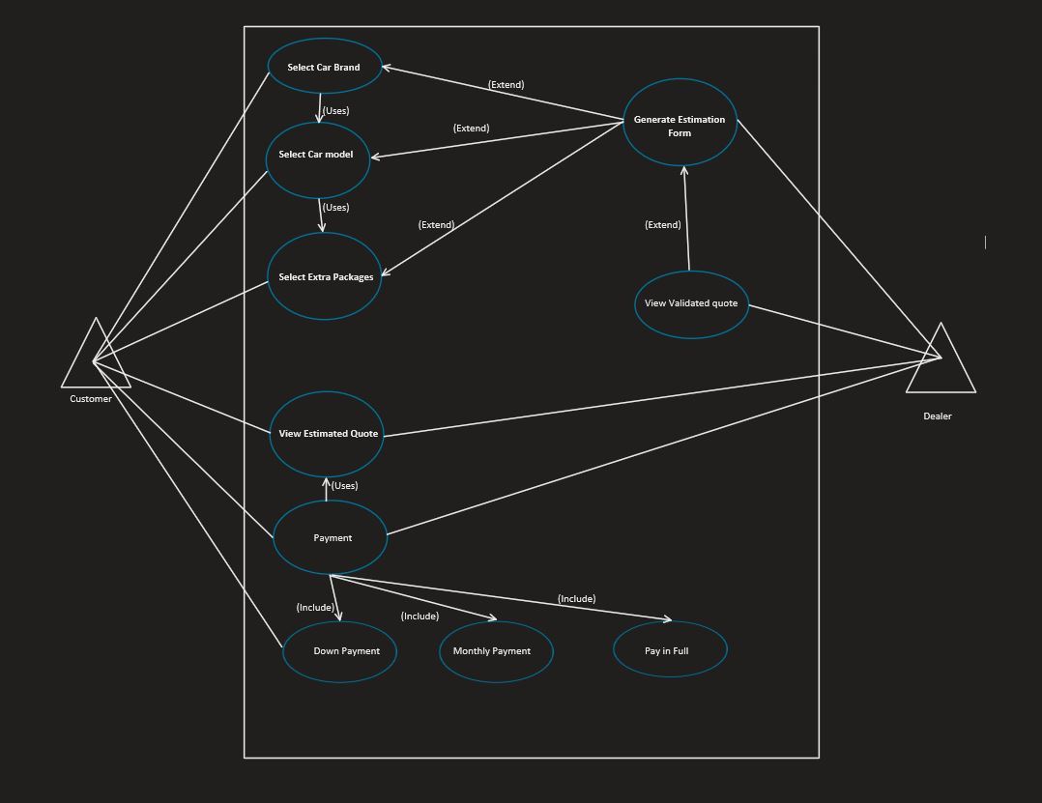
Use-Case Diagram

Slide 4
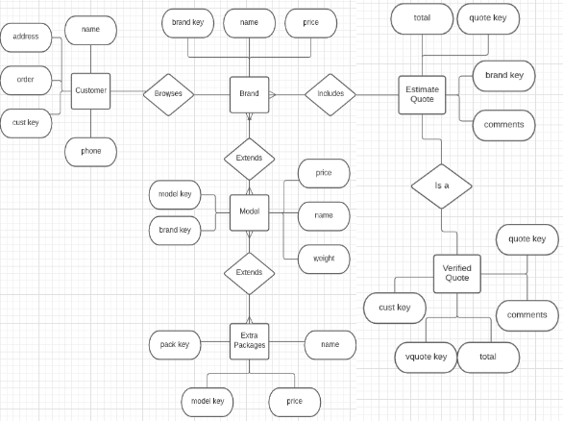
E/R Diagram and Schema

Slide 5
Relational Schema
Customer
c_name, c_phone, c_address, c_order, c_custkey
Brand
b_brandkey, b_name, b_price
Model
m_modelkey, m_name, m_brandkey, m_weight, m_price
Extra Packages
e_packkey, e_name, e_modelkey, e_price
Estimated Quote
q_total, q_quotekey, q_brandkey, q_comments
Verified Quote
vq_total, vq_quotekey, vq_vquotekey, vq_custkey, vq_comments

