Slide 1

Capital Market History

Slide 2
What Can We Learn from History?
Goal: Return/risk relation
Assess historical relation
Apply it forward

Slide 3
Measuring Returns
Dollar
Percentage
Which is more convenient?

Slide 4
Average Returns
Arithmetic (default)
Risk premium: arithmetic average less risk-free rate
Geometric
Average buy-and-hold return

Slide 5
Example 1 (Average Returns)
Listed are the annual returns on the S&P 500 stock index over the past ten years.
What is the average annual return?
What is the average annual return earned by buy-and-hold investor?
What is the risk premium if the average T-bill return is 2%?

Slide 6
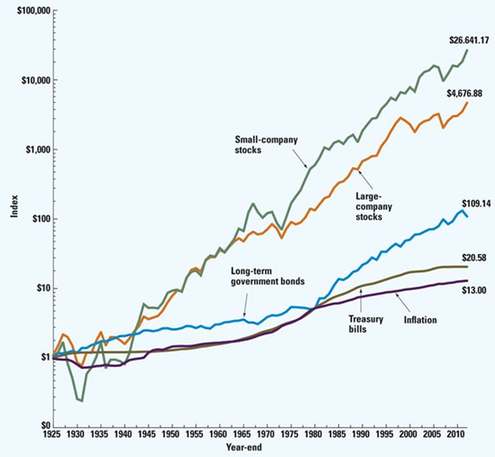
Historical Returns

Slide 7
Historical Average Returns

Slide 8
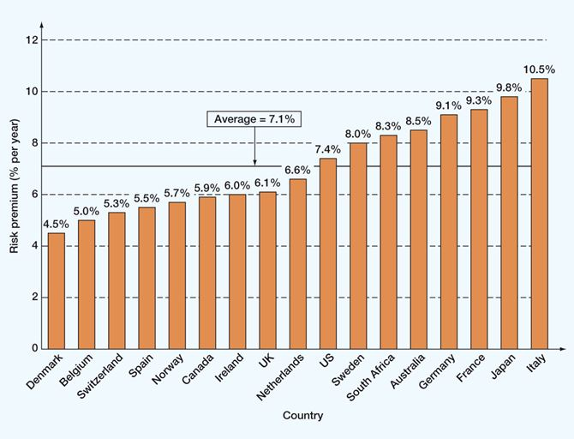
Stock Market Risk Premiums

Slide 9
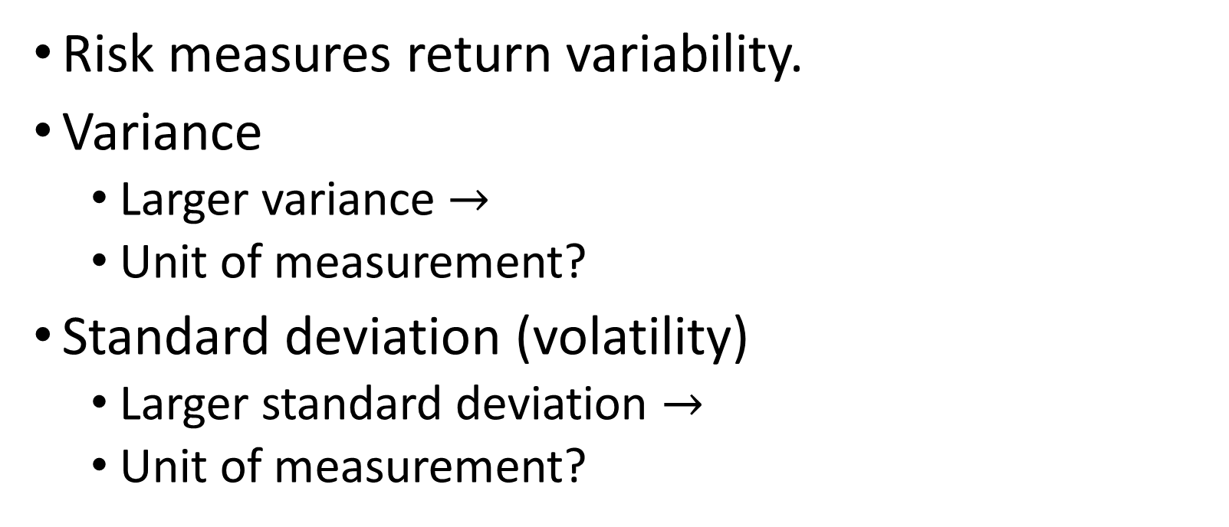
Measuring Risk
Risk measures return variability.
Variance
Larger variance $→$
Unit of measurement?
Standard deviation (volatility)
Larger standard deviation $→$
Unit of measurement?

Slide 10
Example 2 (Measuring Risk)
Crazy Cruise Line’s stock returns for the last five years have been +18%, -10%, +22%, -12%, and +12%. What are the variance and standard deviation of returns?

Slide 11
Example 2 (Measuring Risk)

Slide 12
Historical Return and Risk

Slide 13
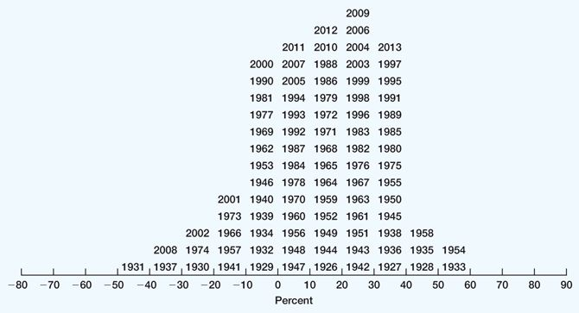
Historical Return Distribution (Large-Co)

Slide 14
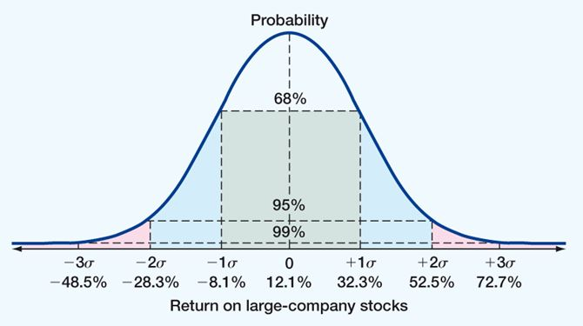
Normal Distribution

Slide 15
Capital Market Efficiency
Stock prices change on the arrival of new information.
What information should stock prices reflect?
When should information be reflected in stock prices?

Slide 16
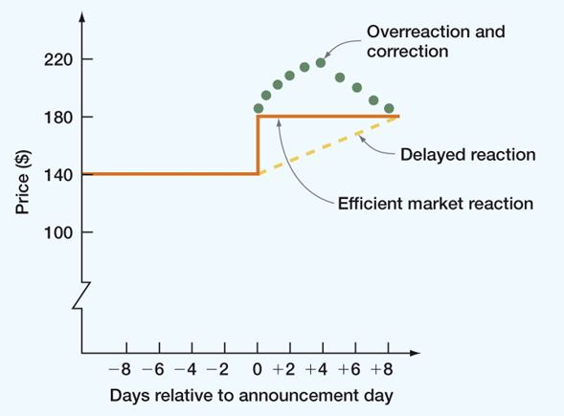
Stock Price Reaction to Information

Slide 17
Efficient Market Hypothesis (EMH)
EMH: Well-organized capital markets are efficient markets.
Strong form
Semistrong form
Weak form

Slide 18
Putting It All Together
A stock has had returns of 3%, 38%, 21%, -15%, 29%, and -13% over the last six years.
What is stock’s average return?
What is the stock’s geometric average return?
If the average T-bill return was 2%, what is the stock’s risk premium?
What is the stock’s volatility?

