Slide 1
Intuition Check from Last Class
Suppose that in a capital market, you cannot predict future stock prices based on historical price movements. However, whenever an M&A deal is announced, then during the next day the price of the acquirer decreases, and the price of the target increases. Is the market:
Strong-form efficient?
Semistrong-form efficient?
Weak-form efficient?

Slide 2
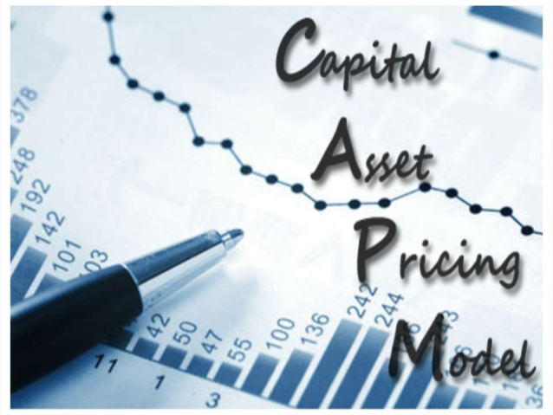
Return, Risk, and the SML I

Slide 3
History vs. Expectations
What does history tell us about future returns?
Possible return level
Probability

Slide 4
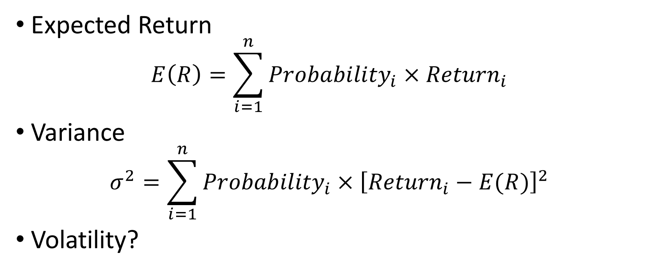
Expected Return and Volatility
Expected Return
$$E\left(R\right)=\sum_{i=1}^{n}{{Probability}_{i}×{Return}_{i}}$$
Variance
$$σ^{2}=\sum_{i=1}^{n}{{Probability}_{i}{×\left[{Return}_{i}−E(R)\right]}^{2}}$$
Volatility?

Slide 5
Example 1 (Expected Return and Vol)
Two stocks:
Intercontinental Hotels (IHG)
Wendy’s (WEN)

Slide 6
Example 1 (Expected Return and Vol)
What are the expected returns of the two stocks?
If the risk-free rate is 1%, what are their risk premiums?
What are the volatilities of the two stocks?

Slide 7
Example 1: What Have We Learned?
About these two stocks?
About the risk-return tradeoff?
Which stock would you buy?

Slide 8
Example 2 (What If We Buy Both?)
Suppose you invest half your money in IHG and half in WEN. What will be the expected return and expected volatility on your portfolio?
Portfolio weights?
Portfolio expected return?
Portfolio volatility?

Slide 9
Example 2: Portfolio Expected Return
Two ways:
Construct portfolio return in every state and calculate portfolio expected return directly.
Calculate expected return of each stock and take weighted average.

Slide 10
Example 2: Portfolio Return Volatility
Only one way:
Construct portfolio return in every state and calculate portfolio return volatility directly.

Slide 11
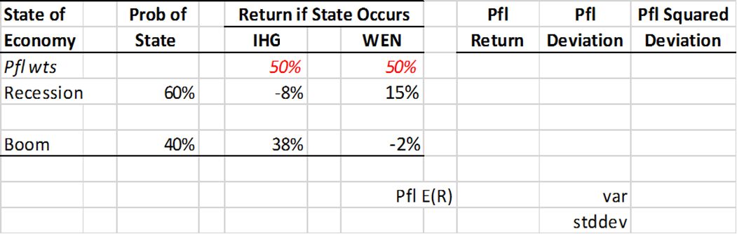
Example 2: Summary

Slide 12
Example 2: What Have We Learned?
How does portfolio volatility compare to individual stock volatilities?
How does portfolio volatility compare to weighted average of individual stock volatilities?
Diversification reduces investment risk.

Slide 13
Putting It All Together
Consider a portfolio with $1000 invested in IHG and $4000 invested in WEN. Assume a 25% chance of a recession and predicted returns in each state as in Example 1.
What are the portfolio weights for IHG and WEN?
What is the portfolio’s expected return?
What is the portfolio’s volatility?

