Slide 1
Champion circuits across Stages A through G
best test_acc cell per (stage, dataset) rendered from saved per-cell .pt weights
Ryan_cookin / exaqc -- branch Quantum-Congressman-Vogt-Cooking

Slide 2
What each stage evolves
A trained encoder + FIXED ansatz (RY-CNOT chain), N swept manually
B trained encoder + EVOLVED ansatz (CircuitGenome), N swept manually
C trained encoder + evolved ansatz + EVOLVED N (grow/shrink_register)
D adds linear_proj + reupload_euler encoders, consumed by B/C
E v1/v2 EVOLVED encoder (enc_ry/rx/rz) + evolved ansatz + evolved N -- interleaved
F v1 enc_rot universal-1q feat-dep + scalar Ising entanglers -- interleaved
F v2 enc_rot + enc_xx/yy/zz universal 2q feat-dep -- interleaved (data reuploading)
G same vocab as F v2, but ENFORCED encoder block then ansatz block

Slide 3
Headline numbers (test_acc)
stage n cells seeds mean acc best notes
A 64 1 0.707 0.967 baseline, fixed ansatz
B all encoders 96 1 0.794 1.000
B winners only 144 3 0.954 1.000 learned 0.903 / linear_proj 0.977 / reupload_euler 0.981
C all encoders 24 1 0.862 1.000
C winners only 36 3 0.952 1.000 learned 0.891 / linear_proj 0.976 / reupload_euler 0.989
E v1 4 1 0.790 0.851 120 genomes, weak encoder gates
E v2 4 1 0.787 0.877 300 genomes -- no improvement
F v1 4 1 0.804 0.842 universal-1q only
F v2 4 1 0.904 0.967 universal-1q + feat-dep 2q
F v2 (3 seeds) 12 3 0.891 1.000 error bars on v2
F v2 (300 gen) 4 1 0.899 0.967 breast_cancer +0.035
G 4 1 0.873 0.921 block-enforced (no interleaving)

Slide 4
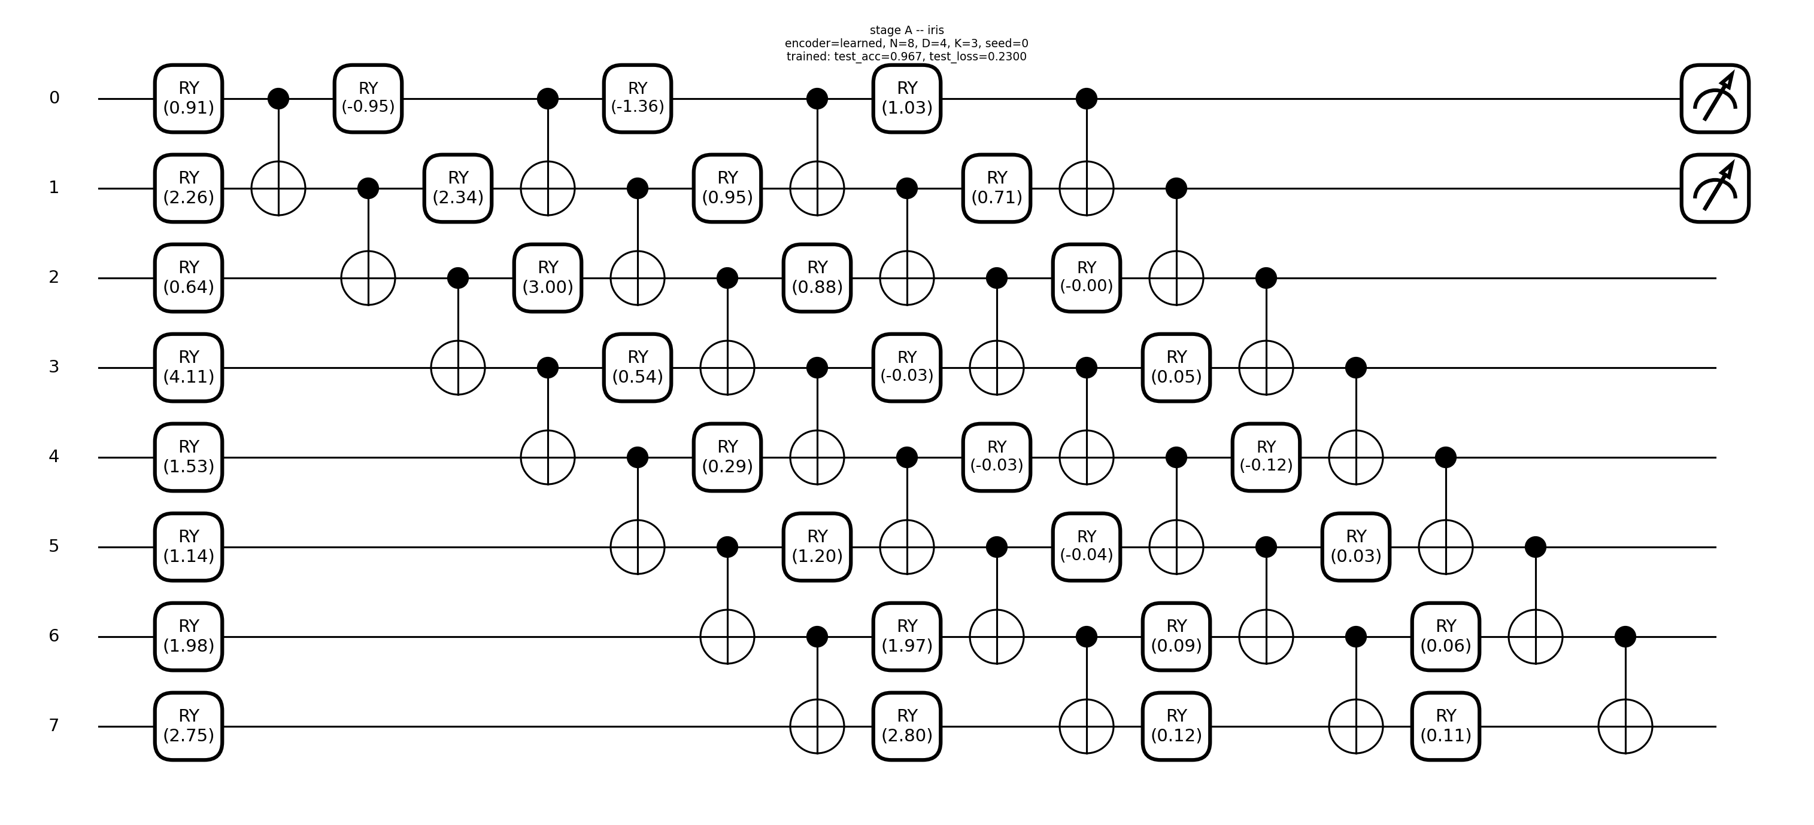
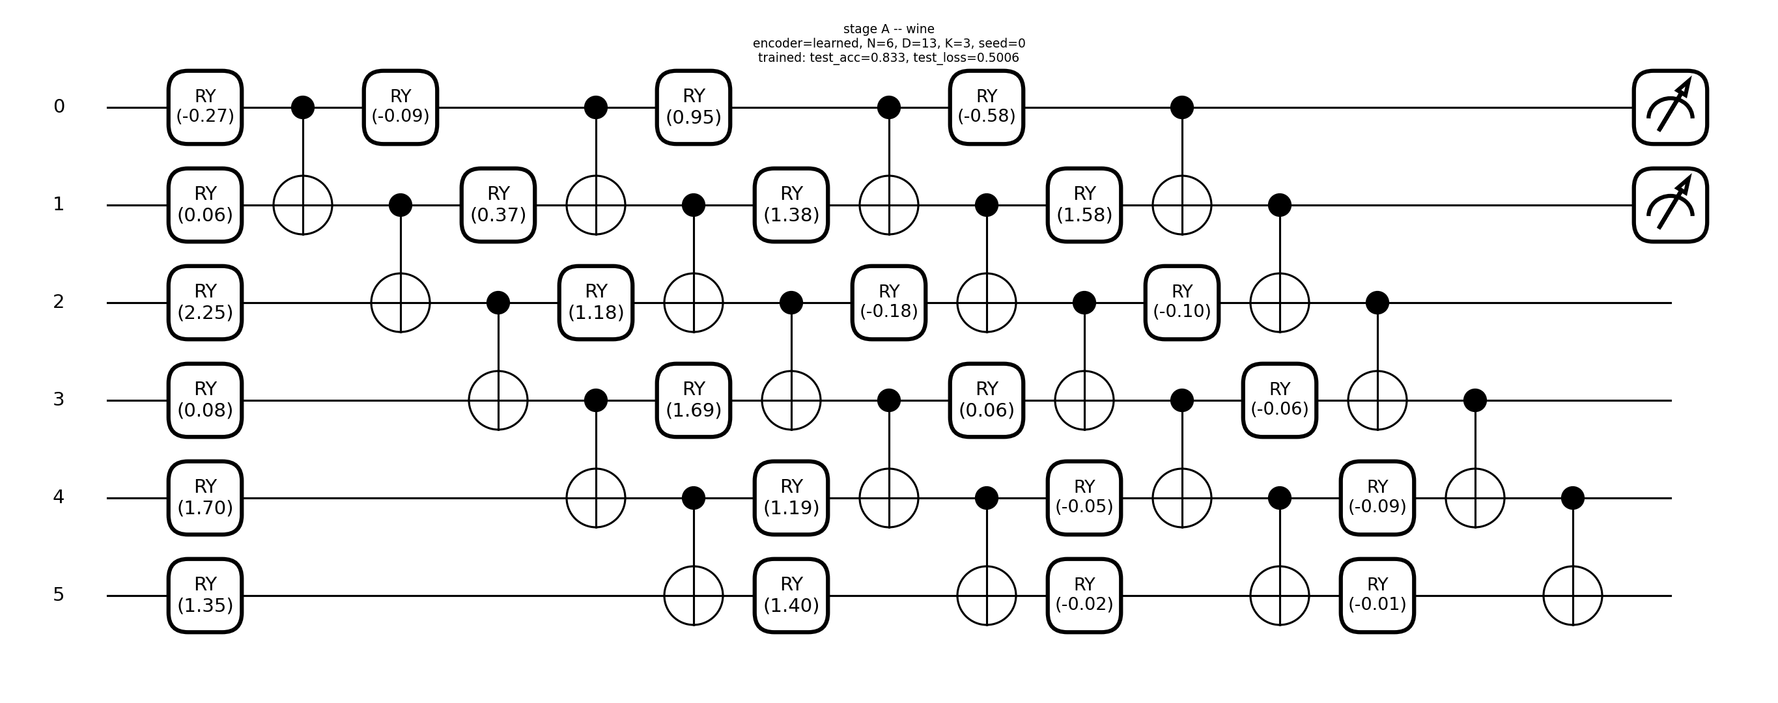

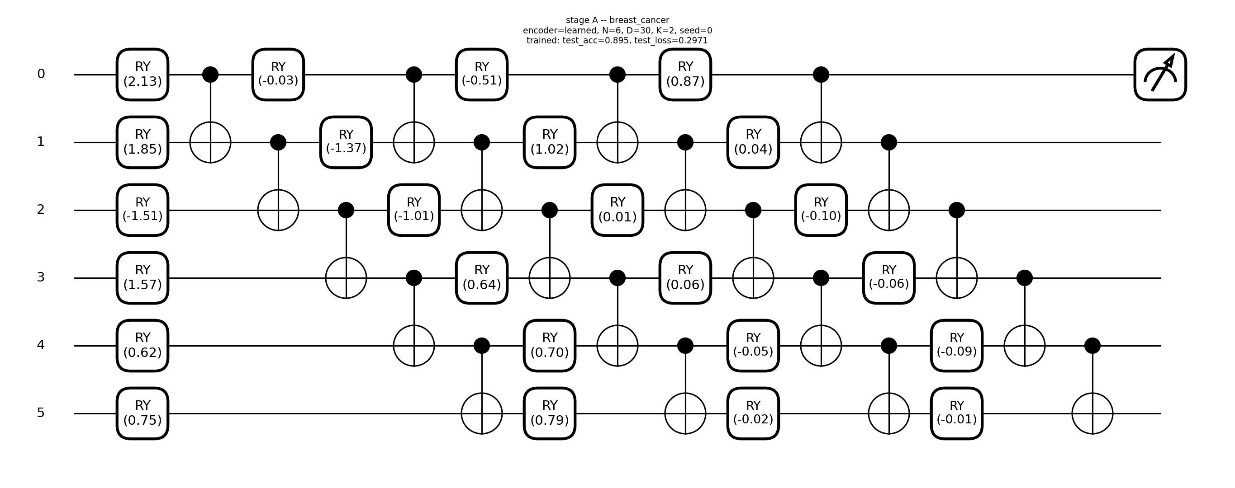
Stage A: fixed RY-CNOT ansatz, encoder external
iris N=8 test_acc=0.967 encoder=learned
wine N=6 test_acc=0.833 encoder=learned
seeds N=8 test_acc=0.881 encoder=learned
breast_cancer N=6 test_acc=0.895 encoder=learned

Slide 5
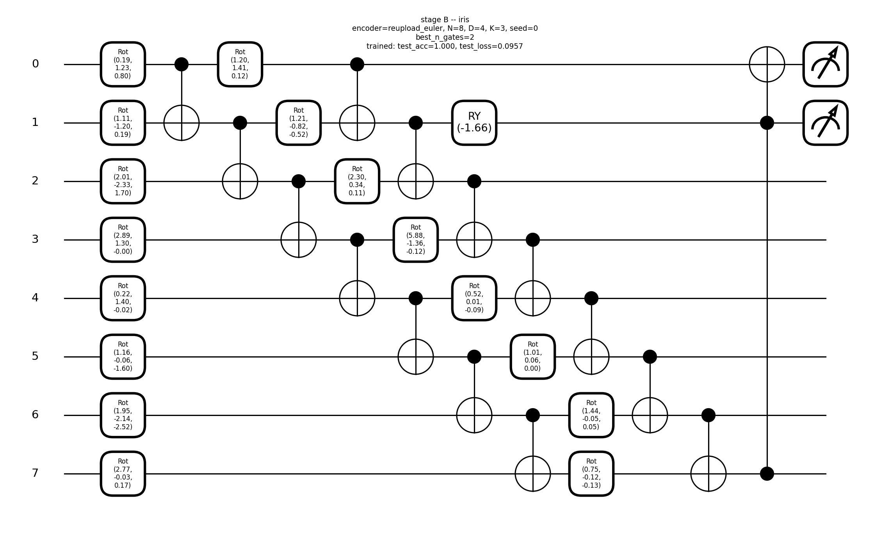
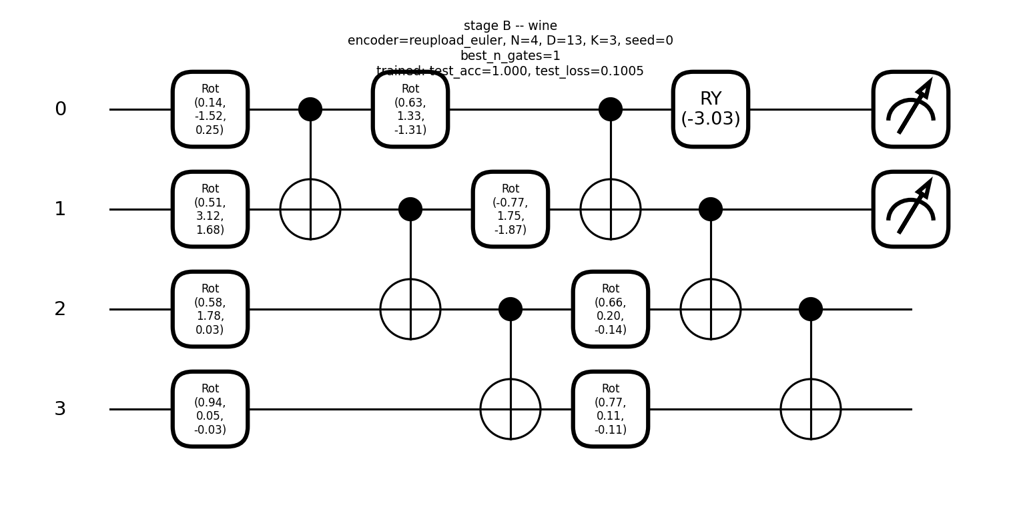
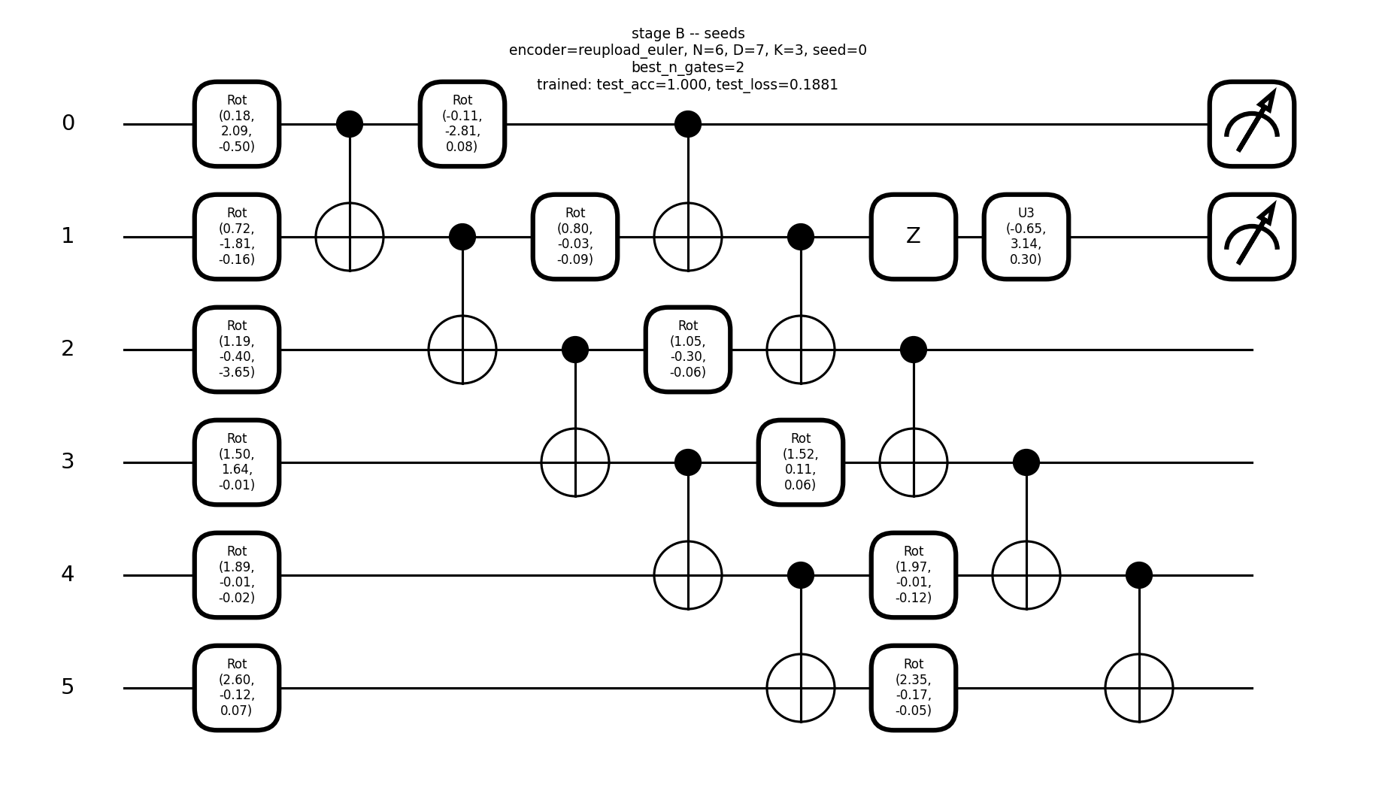
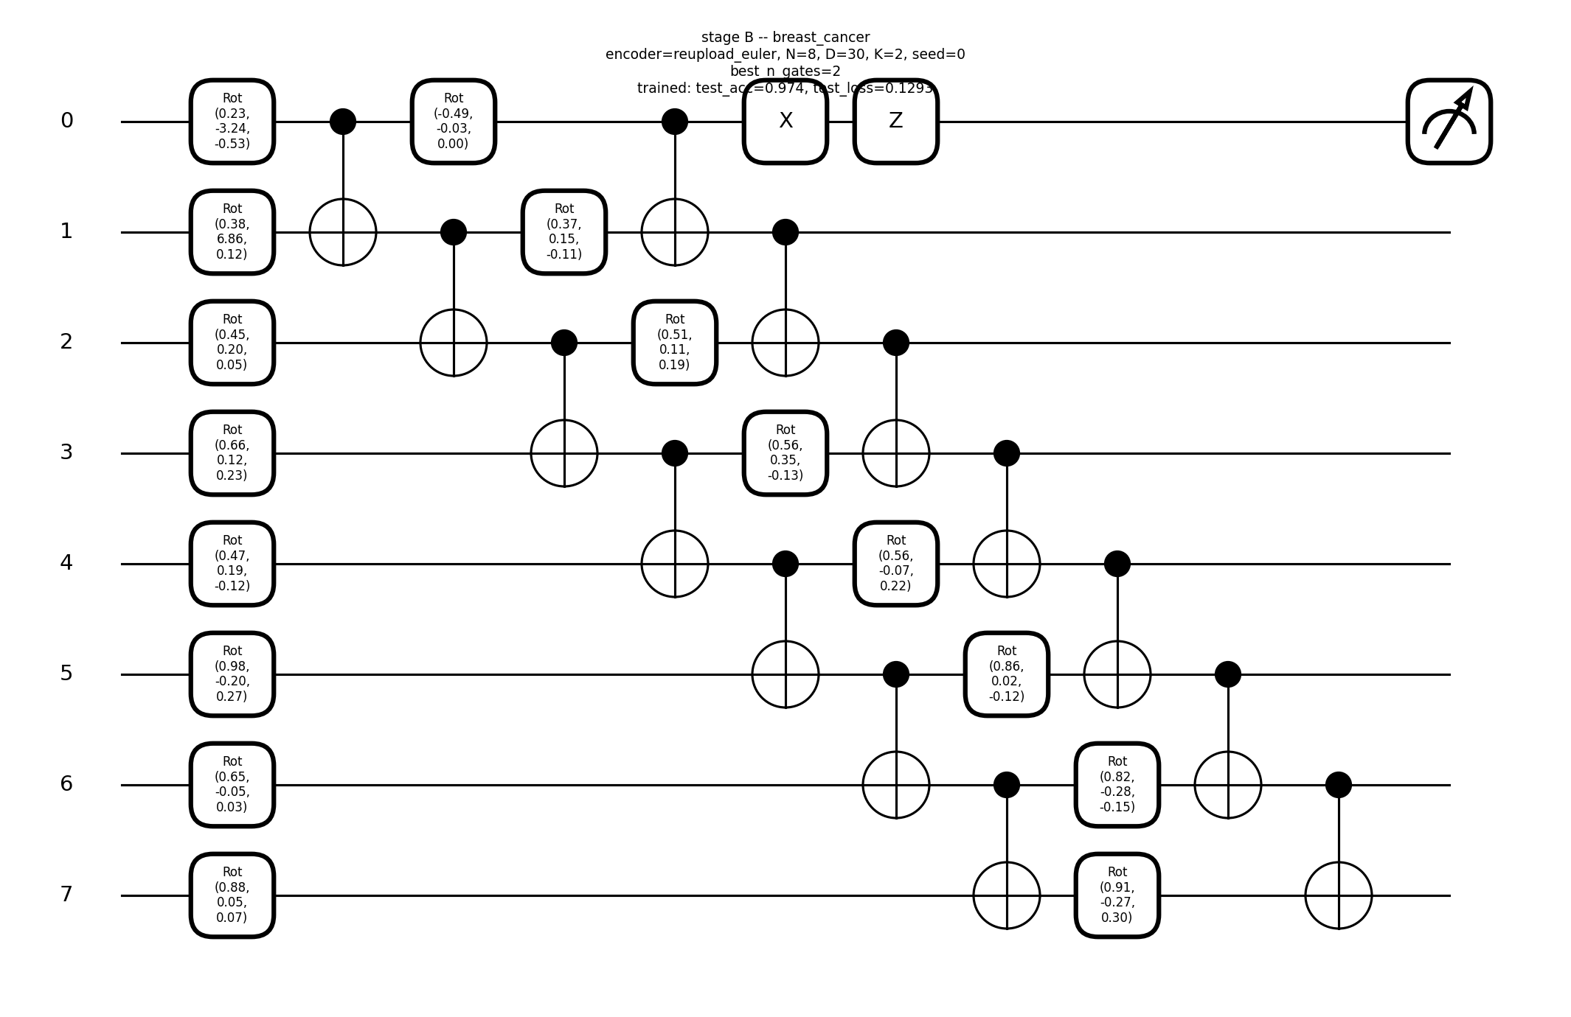
Stage B: evolved ansatz, encoder external (seed 0)
iris N=8 test_acc=1.000 encoder=reupload_euler
wine N=4 test_acc=1.000 encoder=reupload_euler
seeds N=6 test_acc=1.000 encoder=reupload_euler
breast_cancer N=8 test_acc=0.974 encoder=reupload_euler

Slide 6
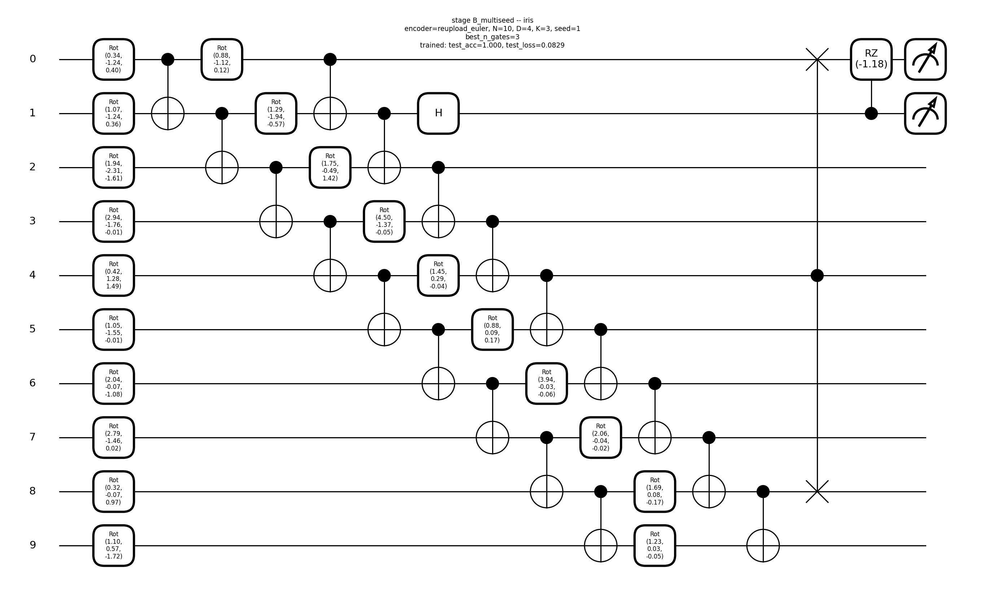
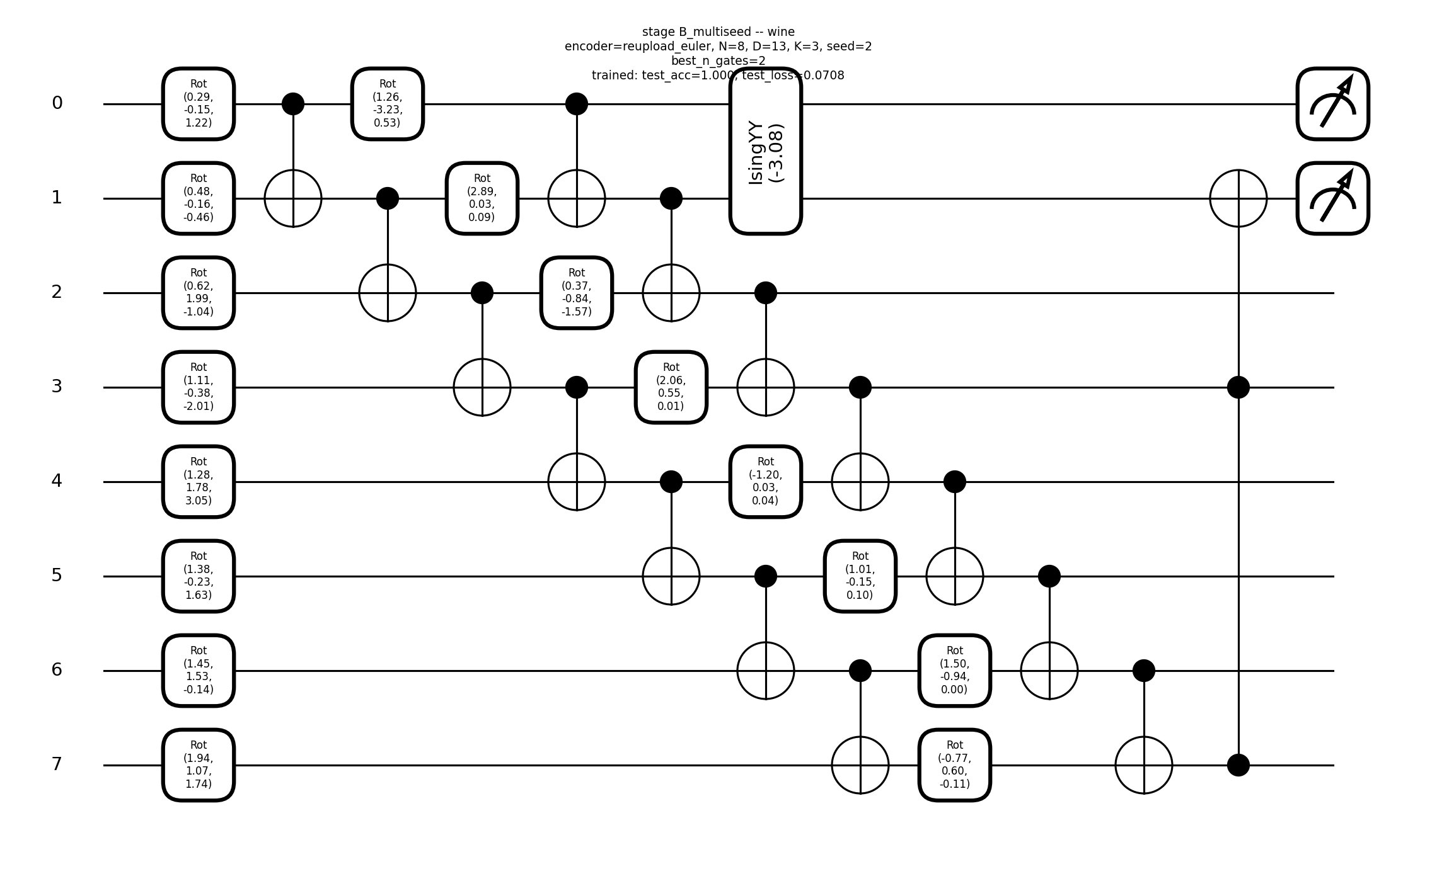
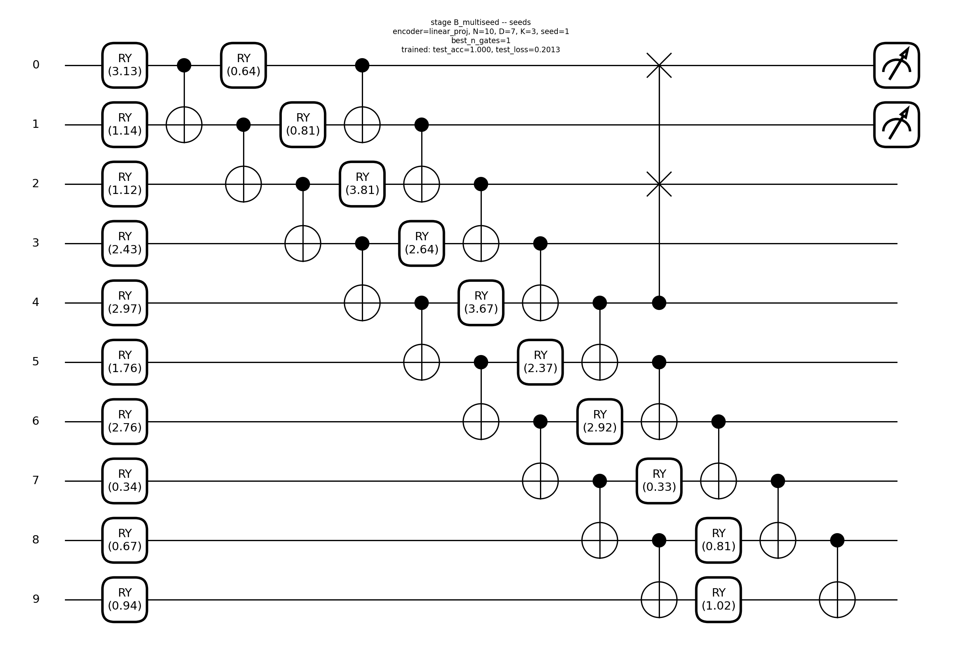
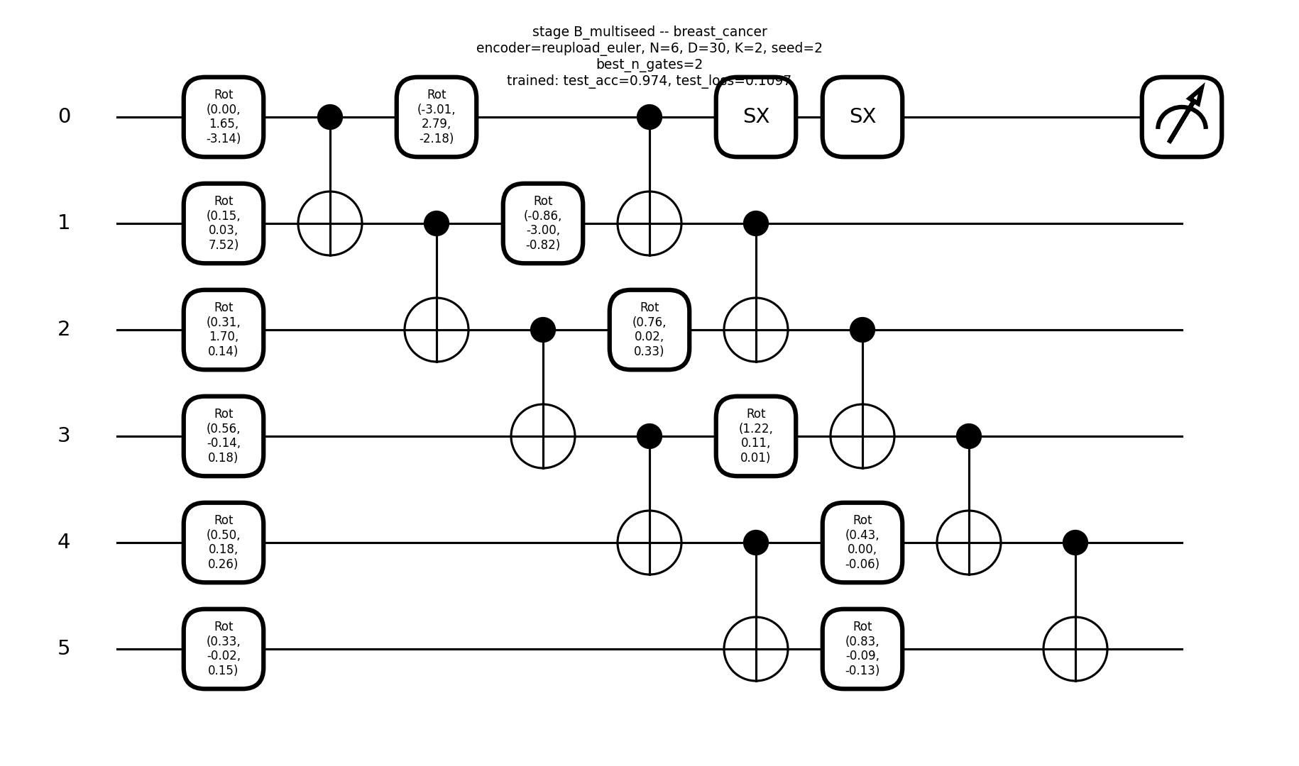
Stage B: 3-seed champion (winners only)
iris N=10 test_acc=1.000 encoder=reupload_euler
wine N=8 test_acc=1.000 encoder=reupload_euler
seeds N=10 test_acc=1.000 encoder=linear_proj
breast_cancer N=6 test_acc=0.974 encoder=reupload_euler

Slide 7
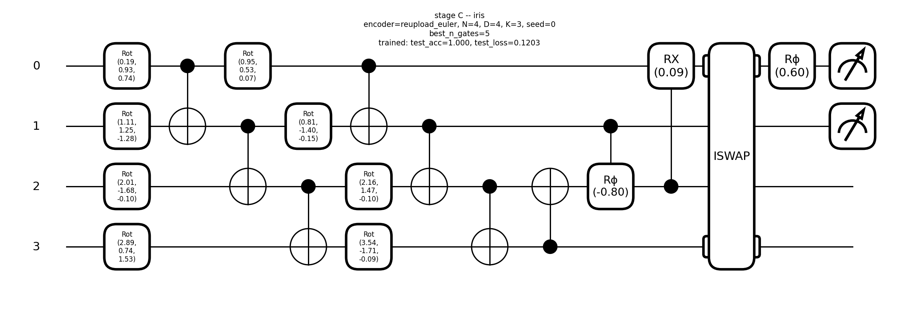
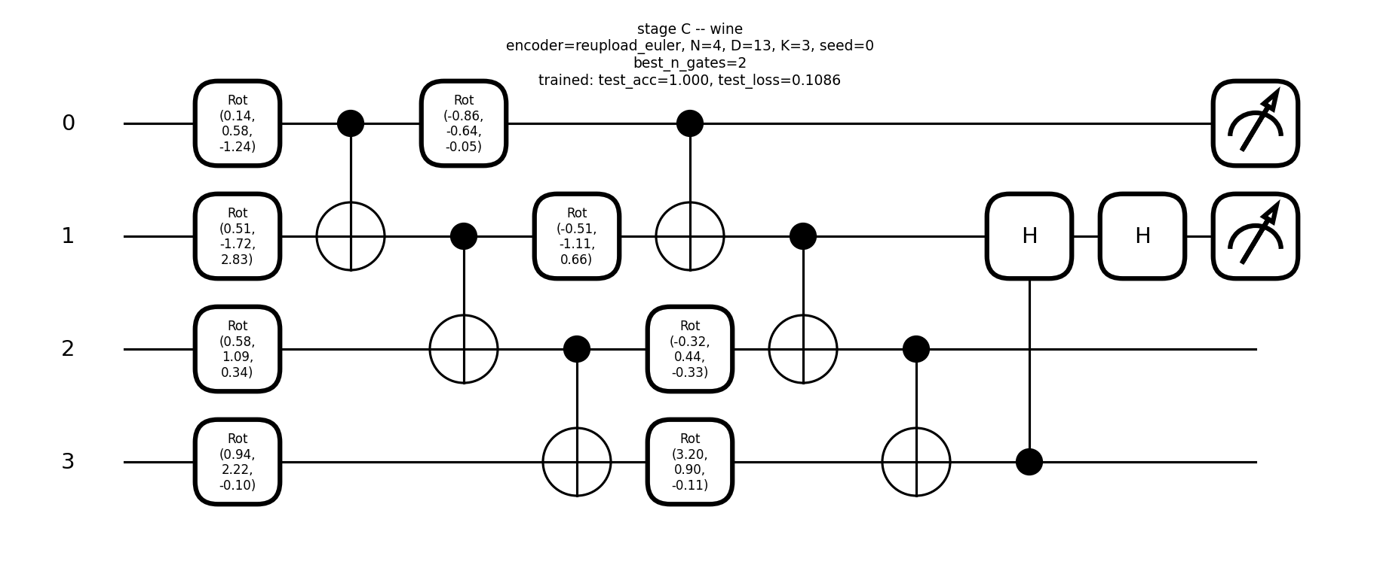
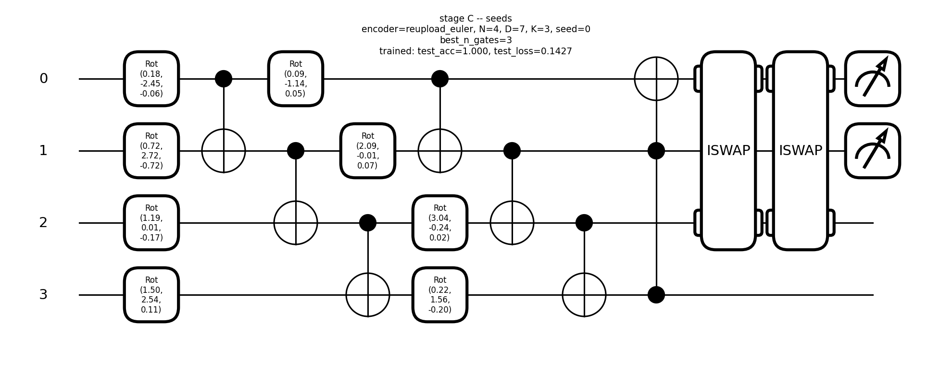
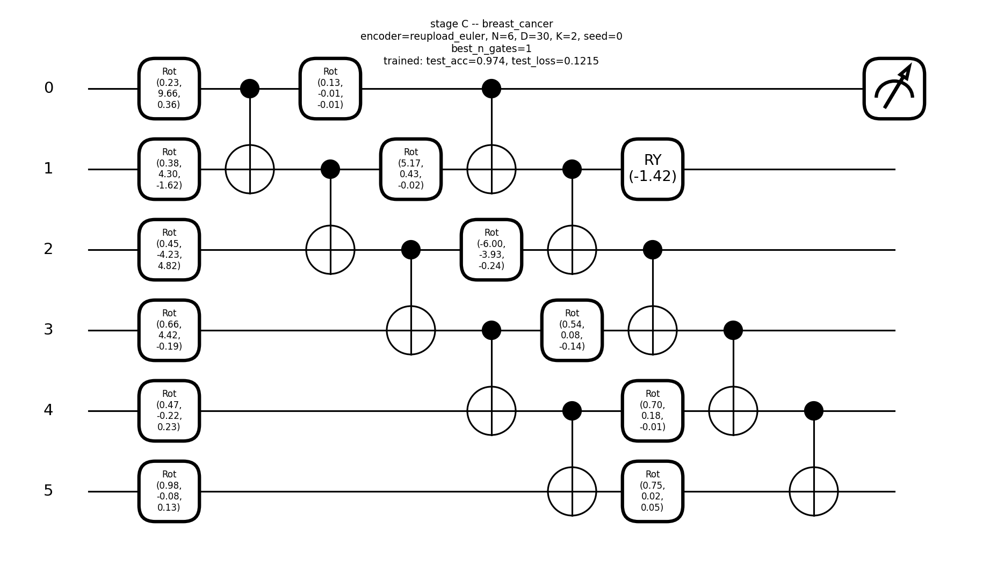
Stage C: evolved ansatz + evolved N, encoder external (seed 0)
iris N=4 test_acc=1.000 encoder=reupload_euler
wine N=4 test_acc=1.000 encoder=reupload_euler
seeds N=4 test_acc=1.000 encoder=reupload_euler
breast_cancer N=6 test_acc=0.974 encoder=reupload_euler

Slide 8
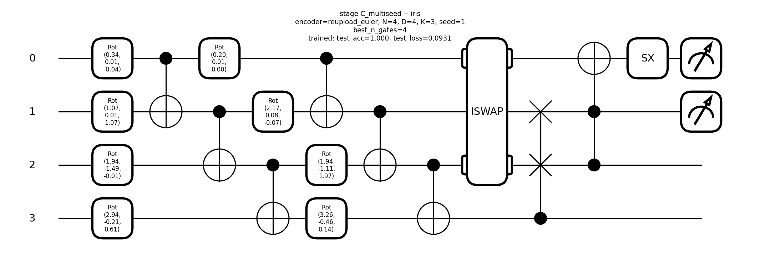
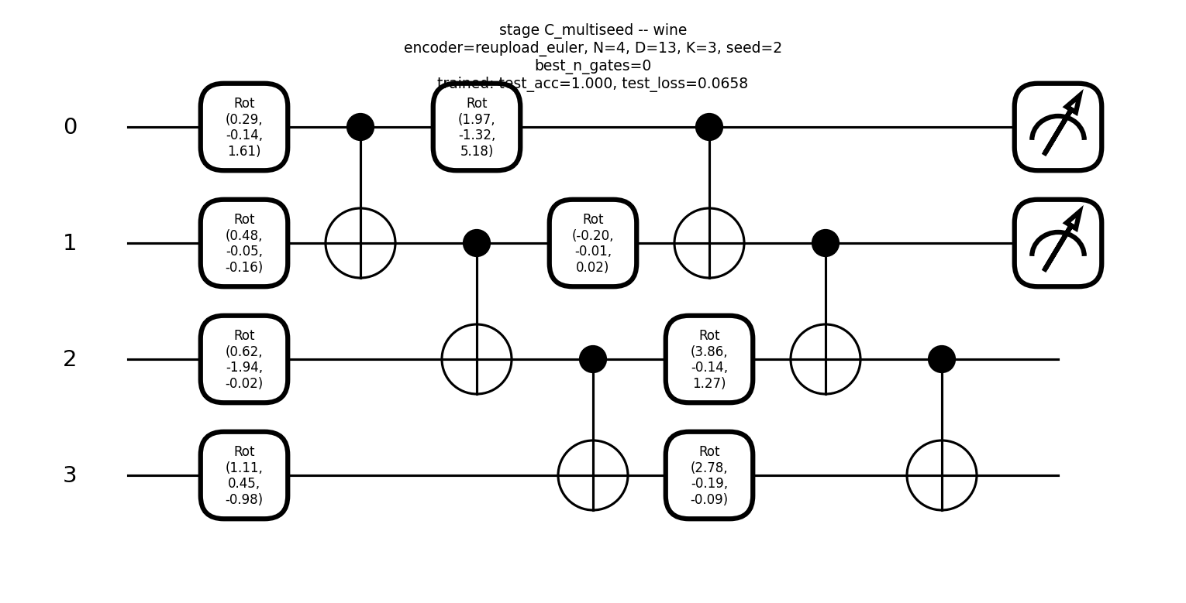
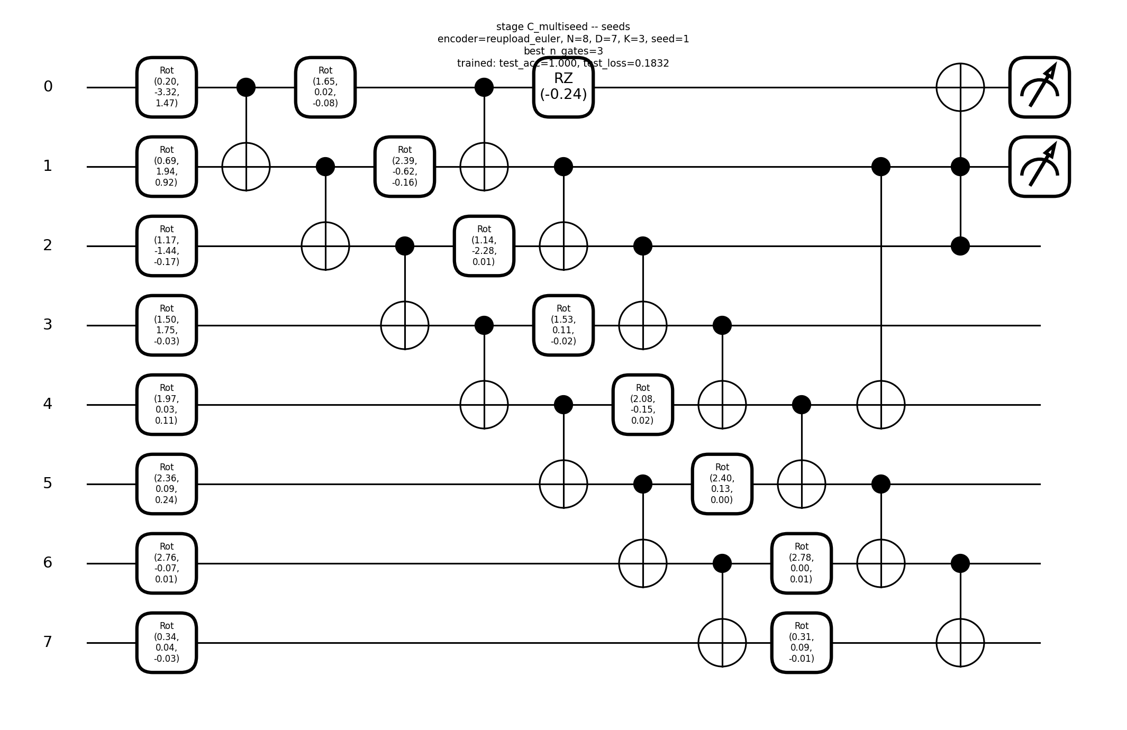
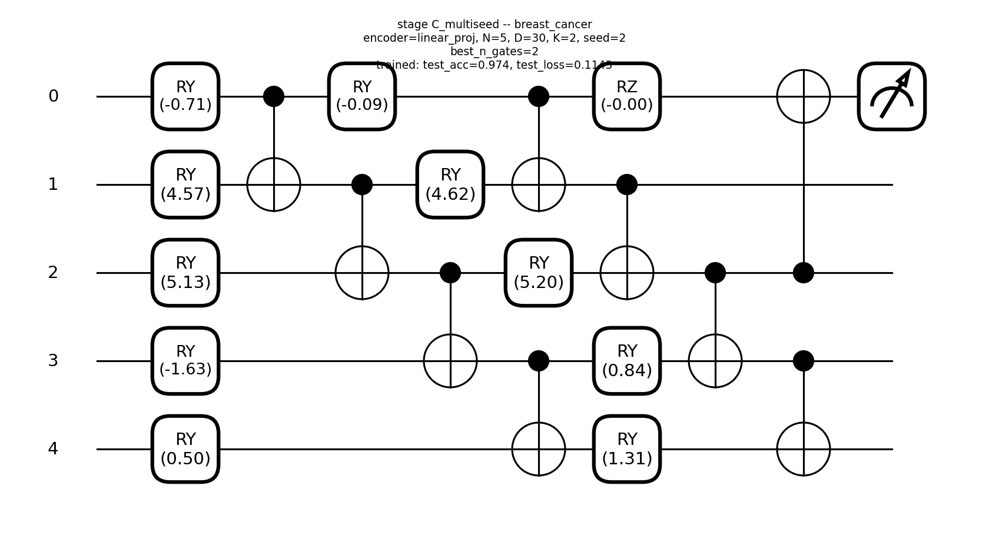
Stage C: 3-seed champion (winners only)
iris N=4 test_acc=1.000 encoder=reupload_euler
wine N=4 test_acc=1.000 encoder=reupload_euler
seeds N=8 test_acc=1.000 encoder=reupload_euler
breast_cancer N=5 test_acc=0.974 encoder=linear_proj

Slide 9
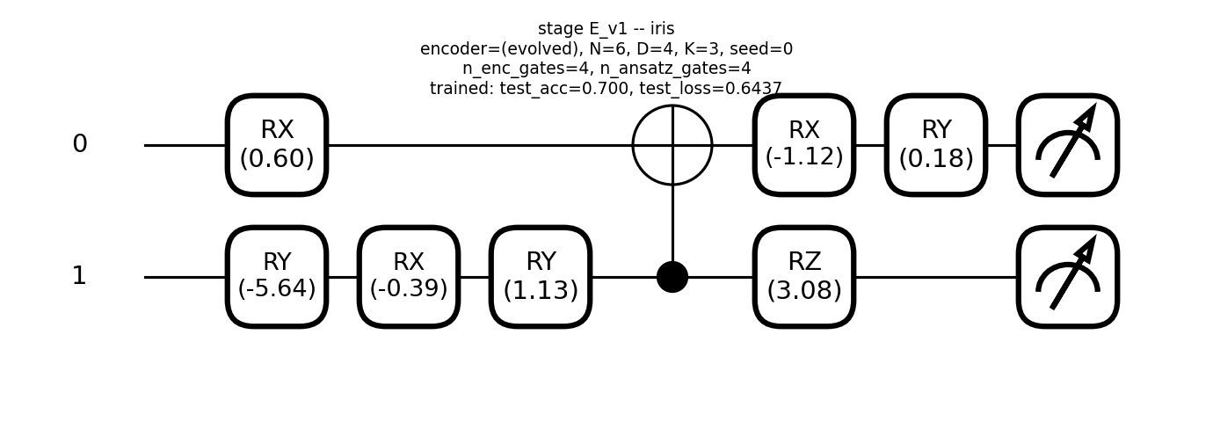
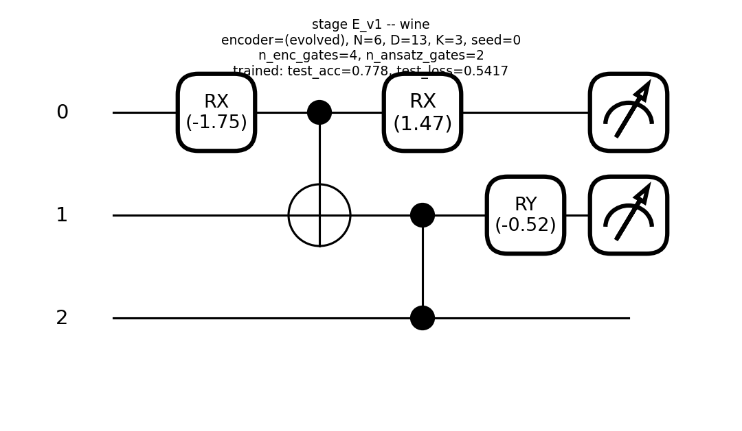
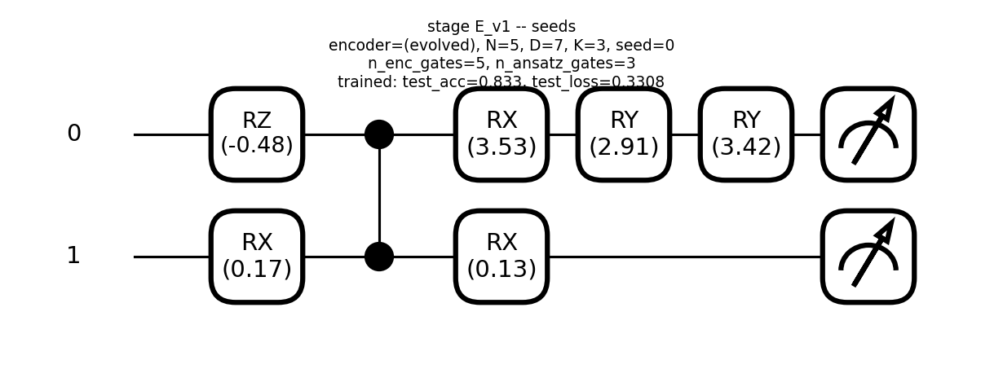
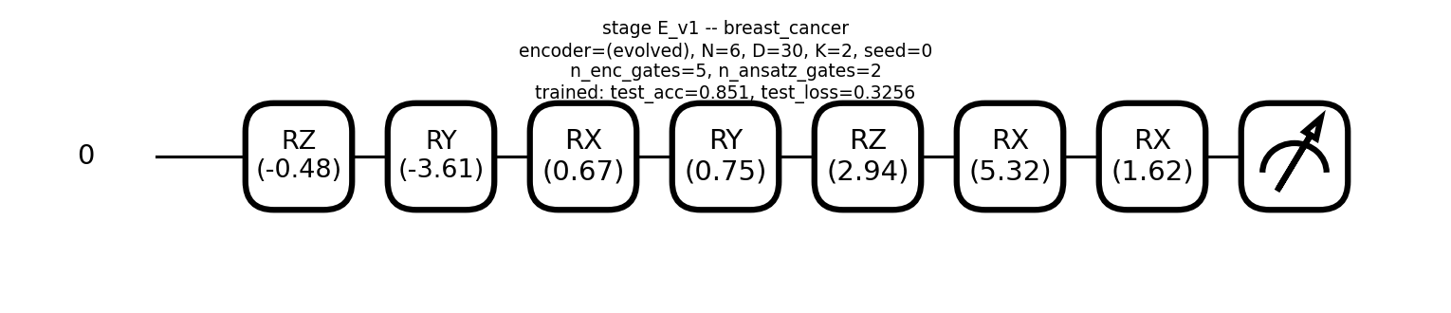
Stage E v1: encoder enc_ry/rx/rz inside genome, depth-interleaved
iris N=6 test_acc=0.700
wine N=6 test_acc=0.778
seeds N=5 test_acc=0.833
breast_cancer N=6 test_acc=0.851

Slide 10
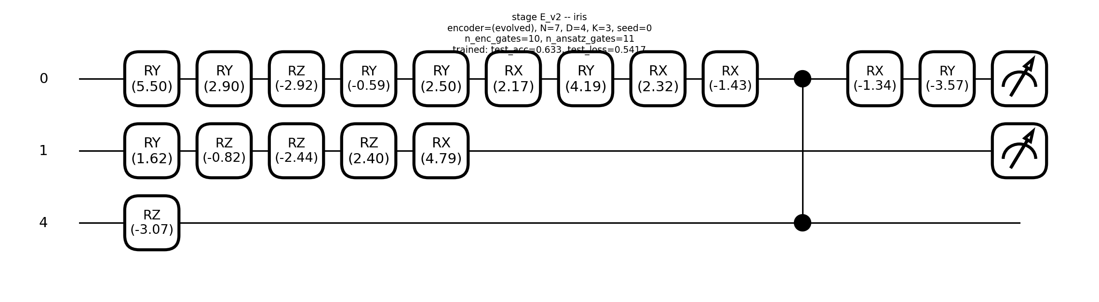
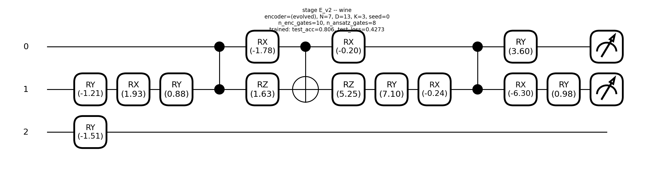
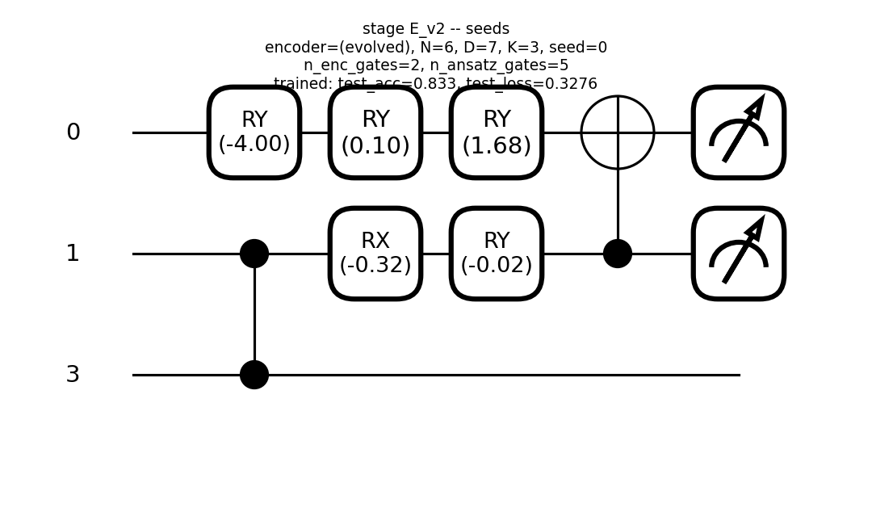
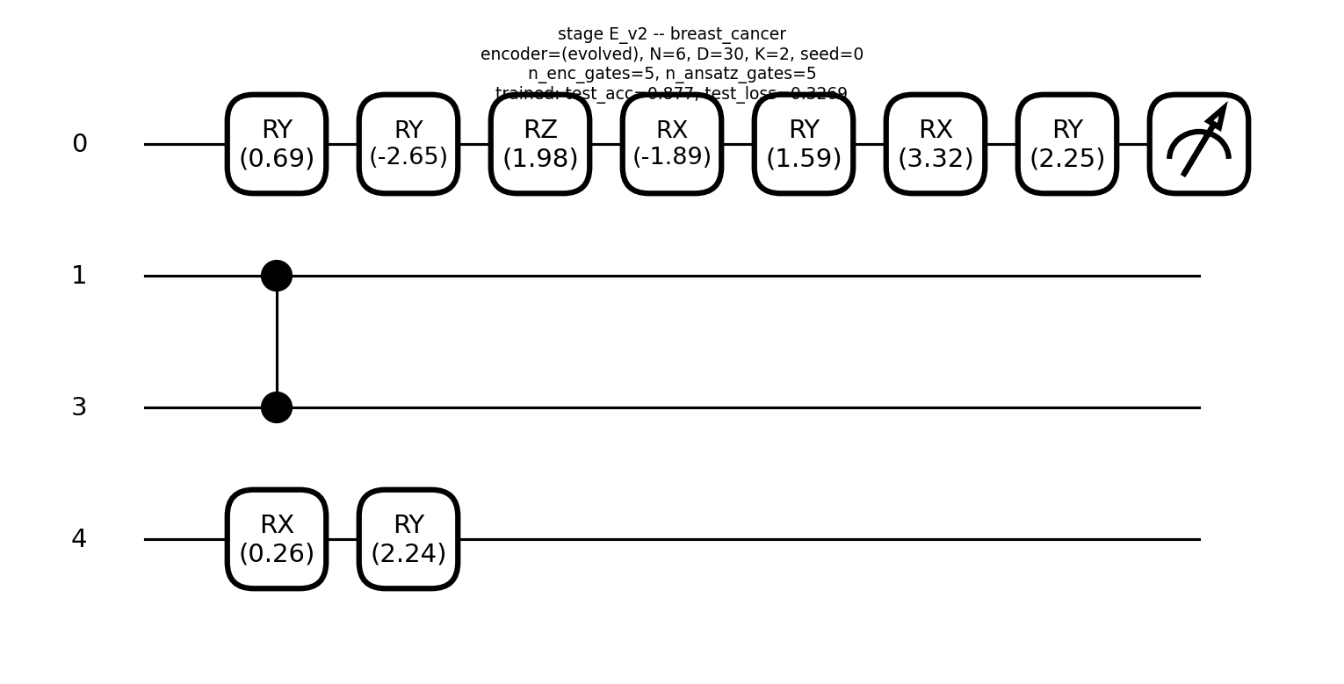
Stage E v2: same as v1, n_genomes 300 (budget bump)
iris N=7 test_acc=0.633
wine N=7 test_acc=0.806
seeds N=6 test_acc=0.833
breast_cancer N=6 test_acc=0.877

Slide 11
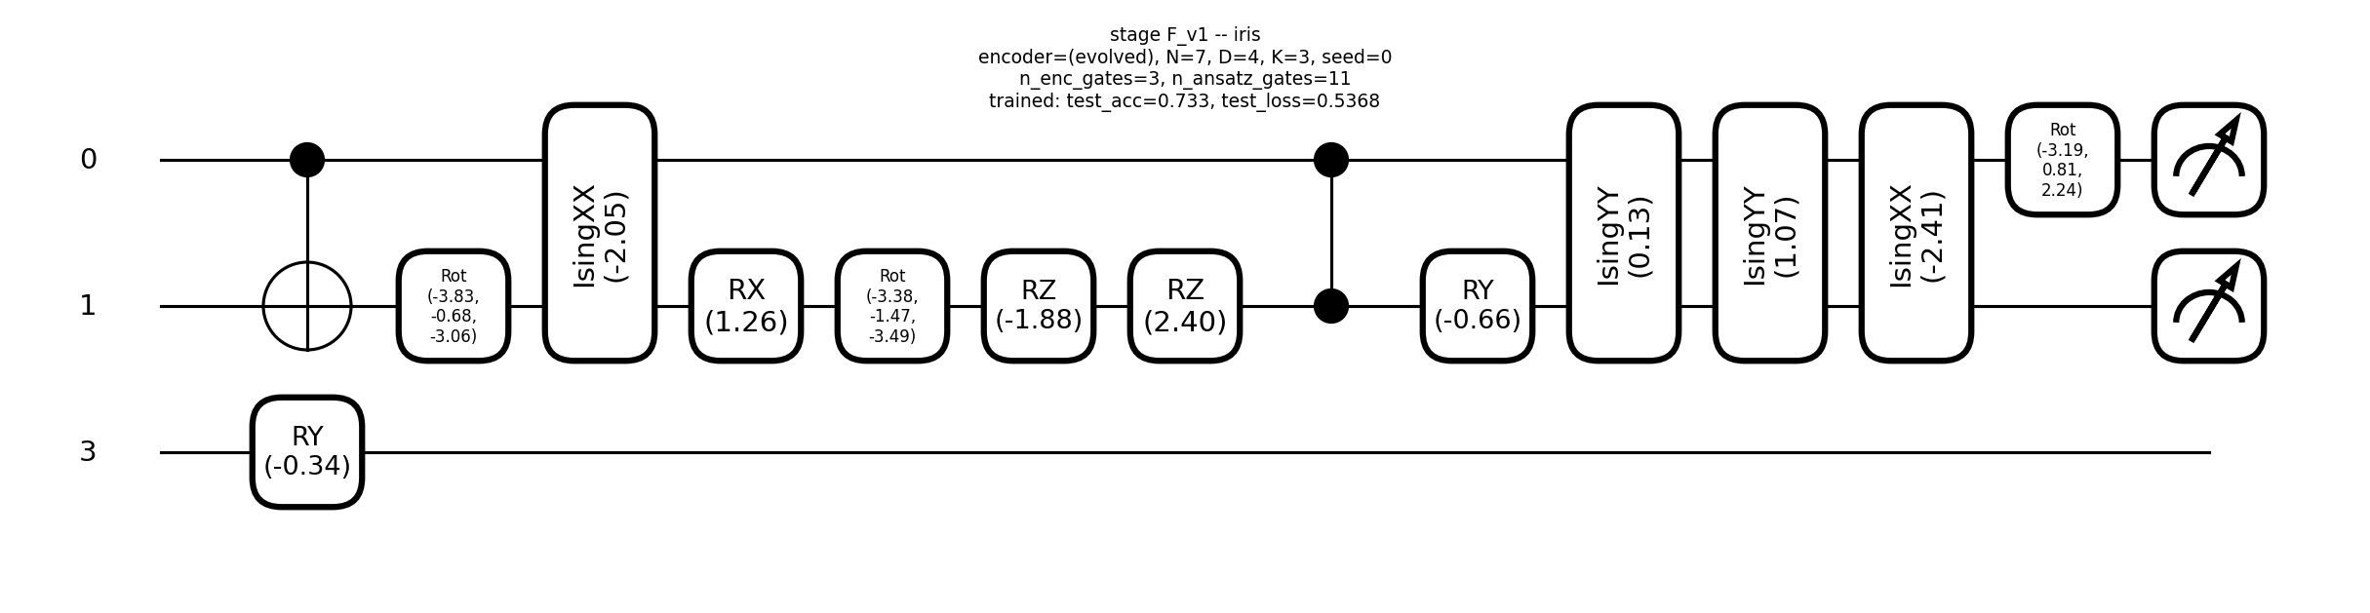
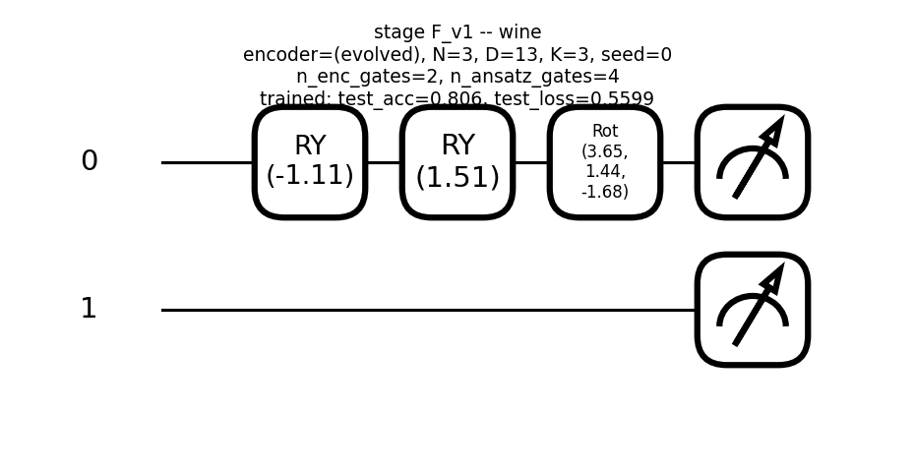
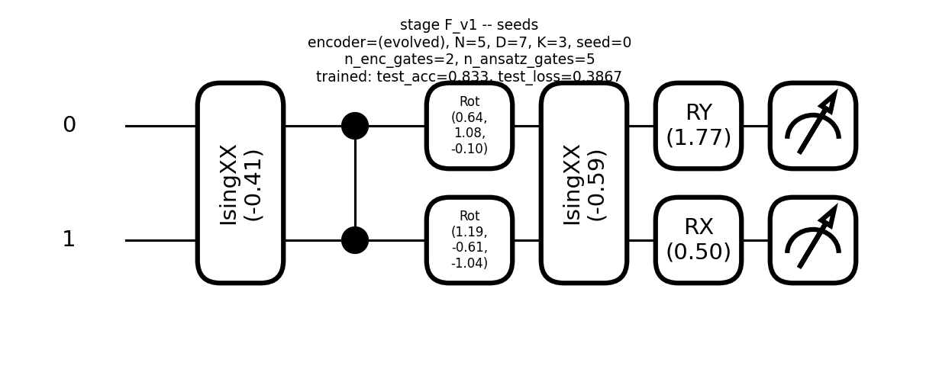
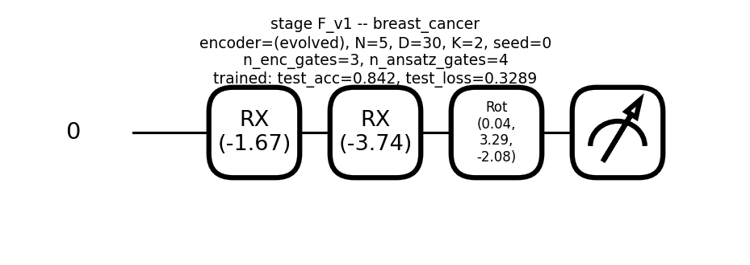
Stage F v1: enc_rot + scalar Ising entanglers, depth-interleaved
iris N=7 test_acc=0.733
wine N=3 test_acc=0.806
seeds N=5 test_acc=0.833
breast_cancer N=5 test_acc=0.842

Slide 12
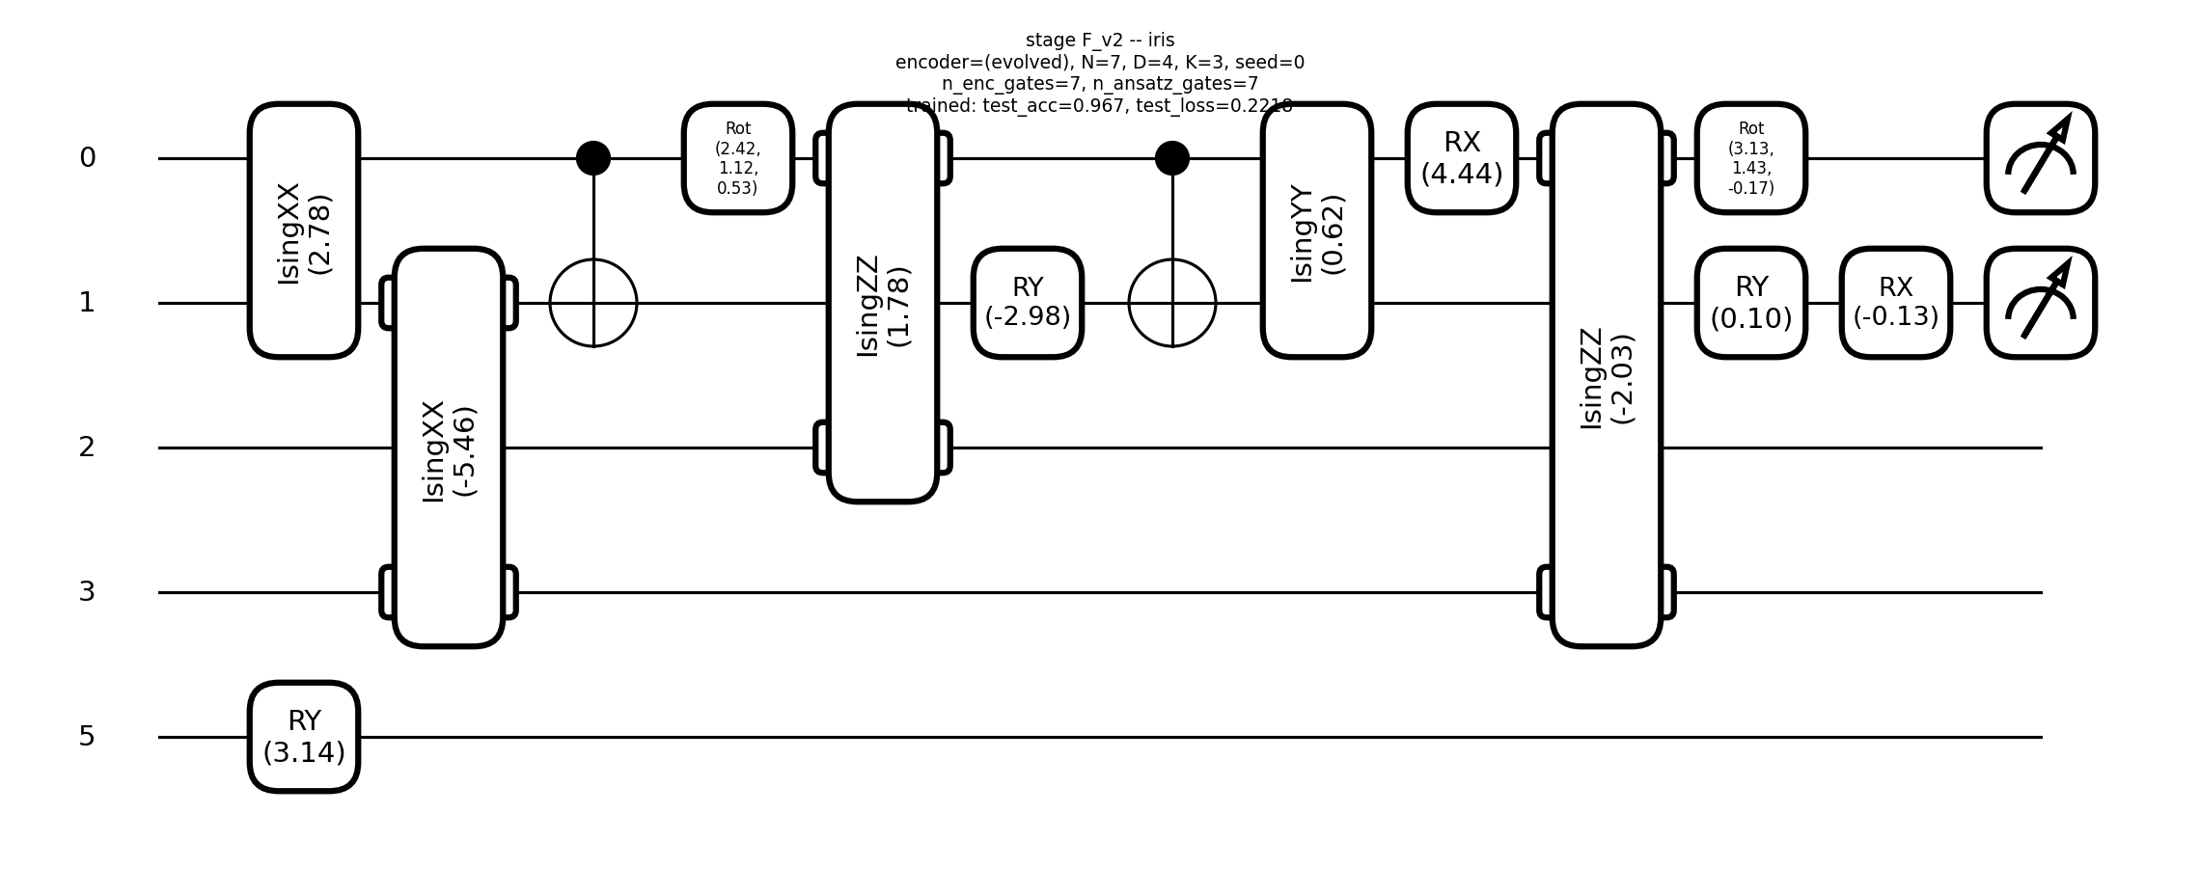
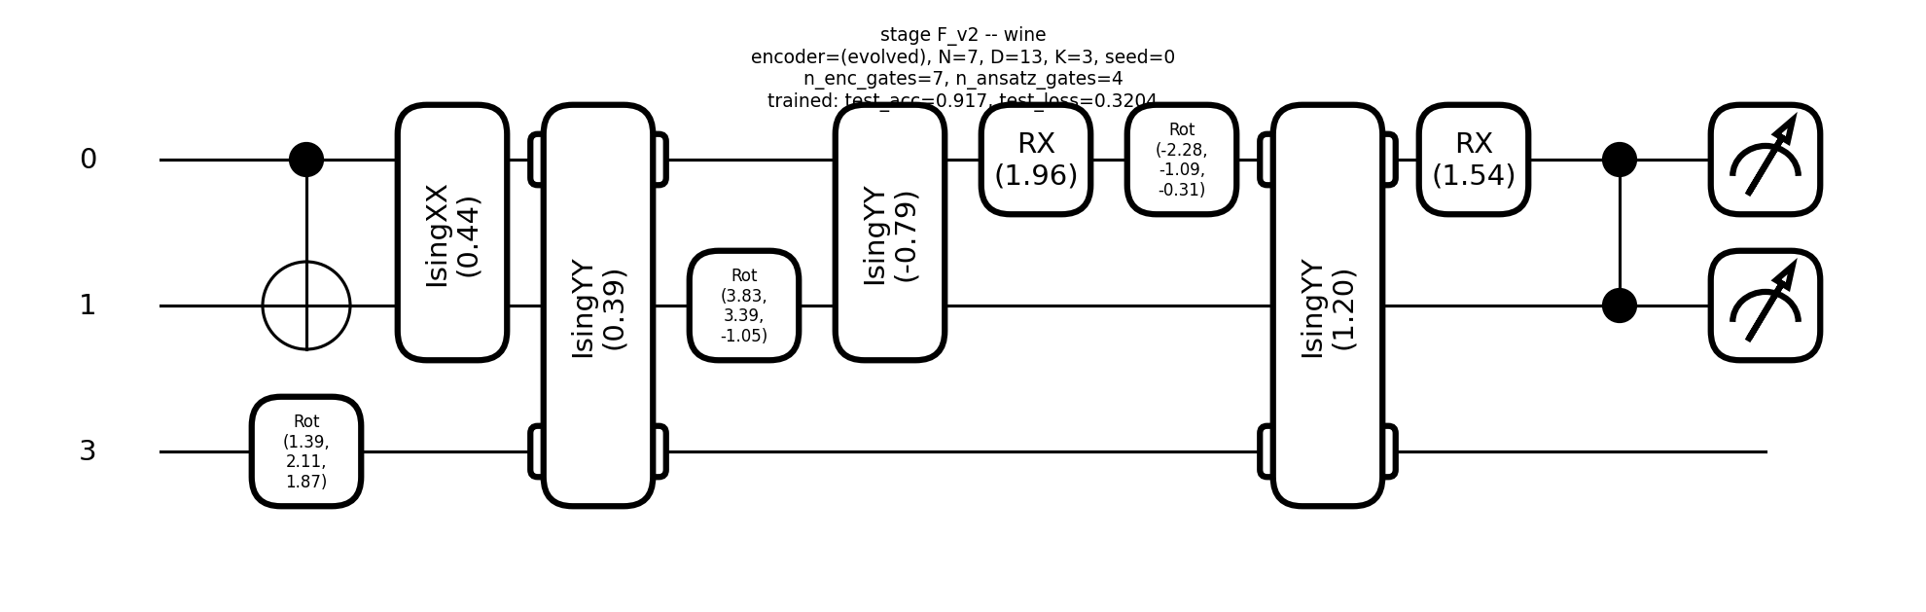
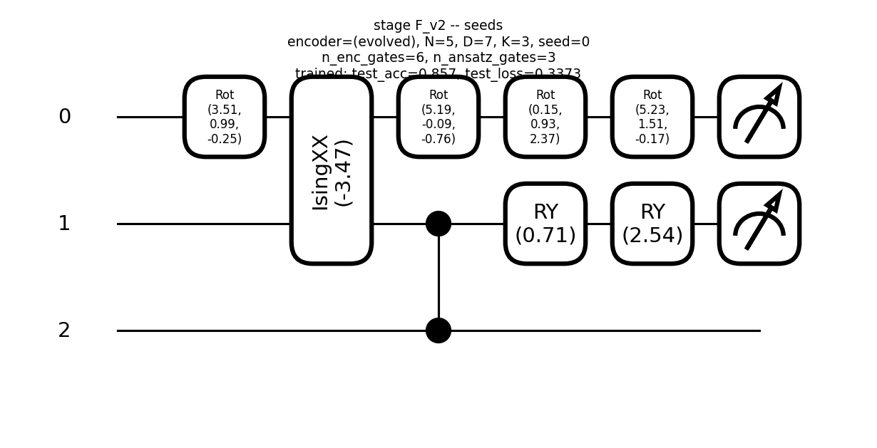
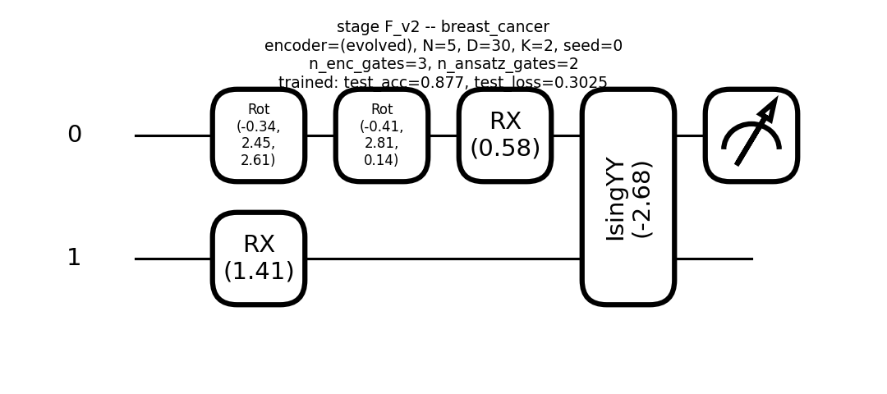
Stage F v2: universal enc_rot + enc_xx/yy/zz, depth-interleaved
iris N=7 test_acc=0.967
wine N=7 test_acc=0.917
seeds N=5 test_acc=0.857
breast_cancer N=5 test_acc=0.877

Slide 13
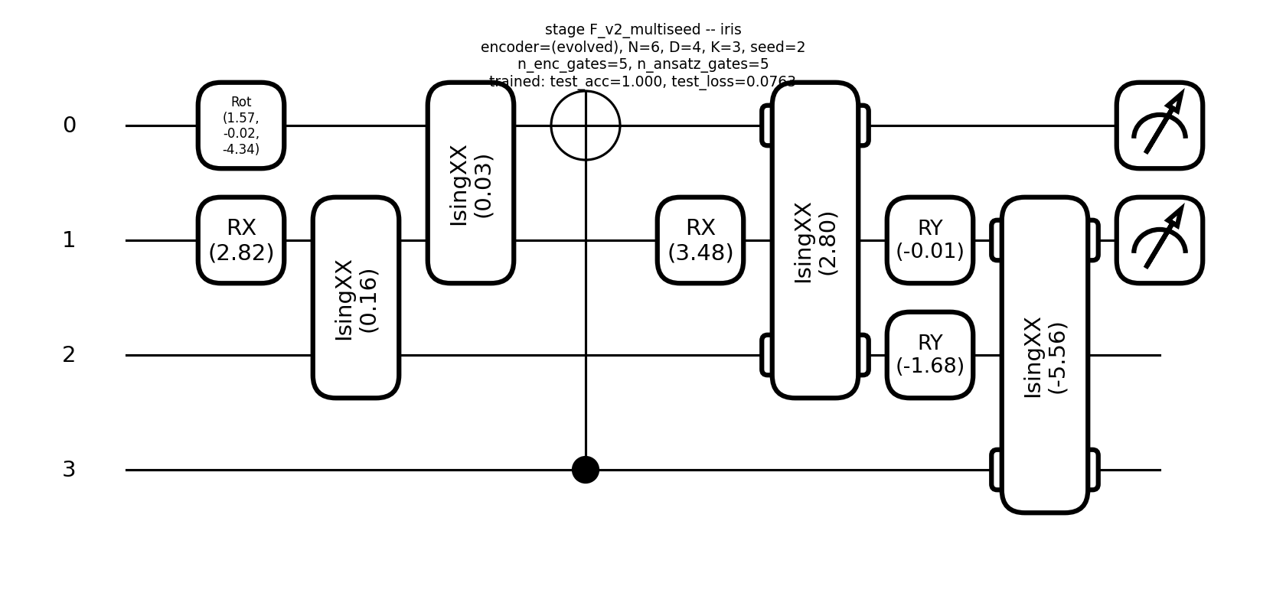
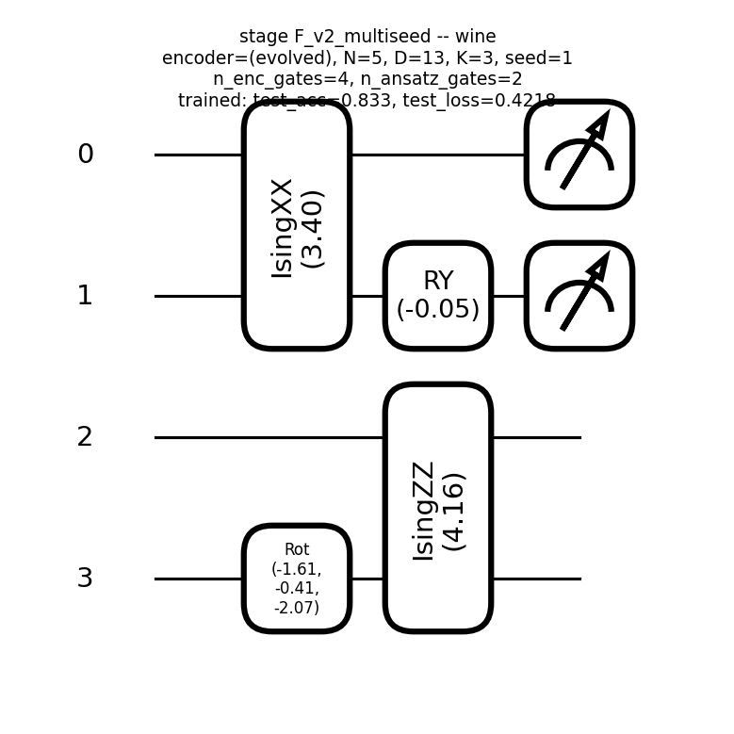
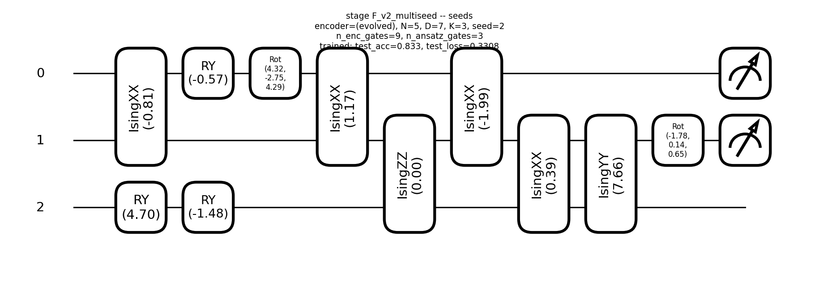
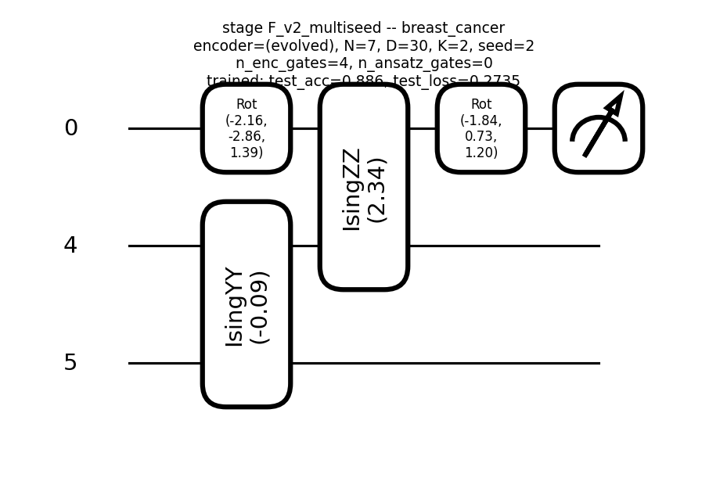
Stage F v2: 3-seed champion
iris N=6 test_acc=1.000
wine N=5 test_acc=0.833
seeds N=5 test_acc=0.833
breast_cancer N=7 test_acc=0.886

Slide 14
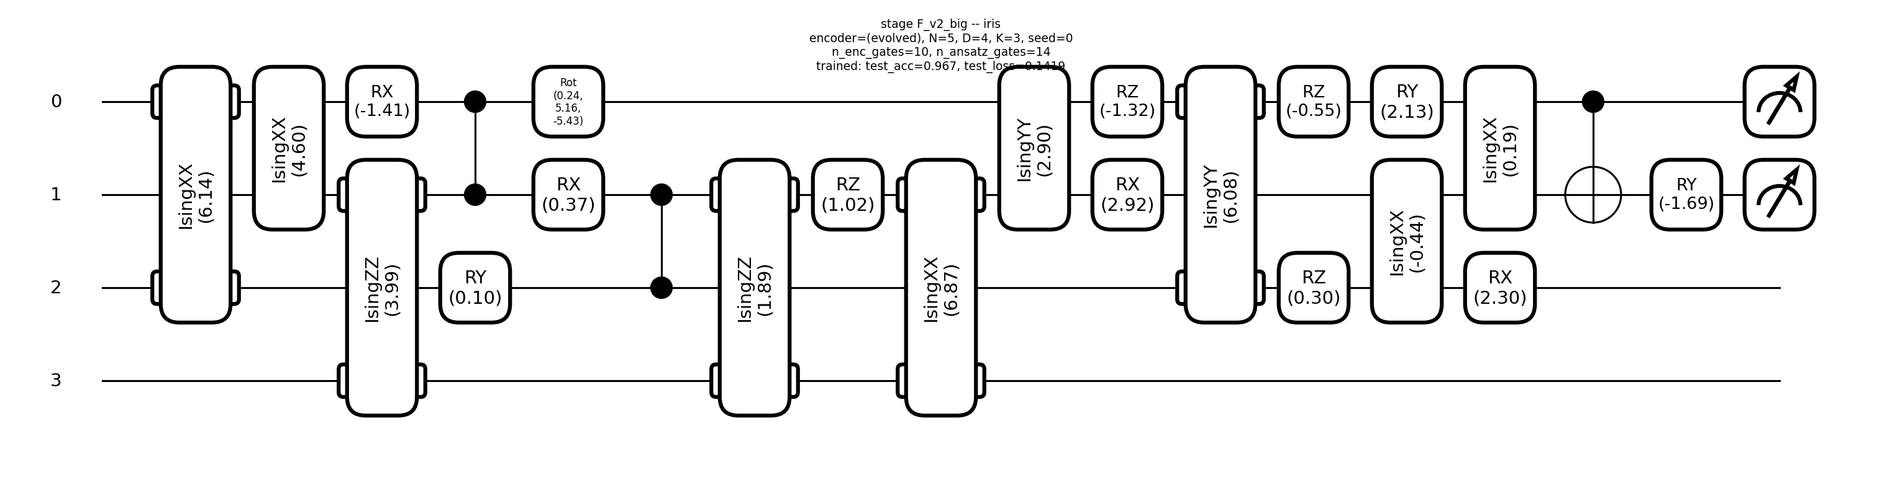
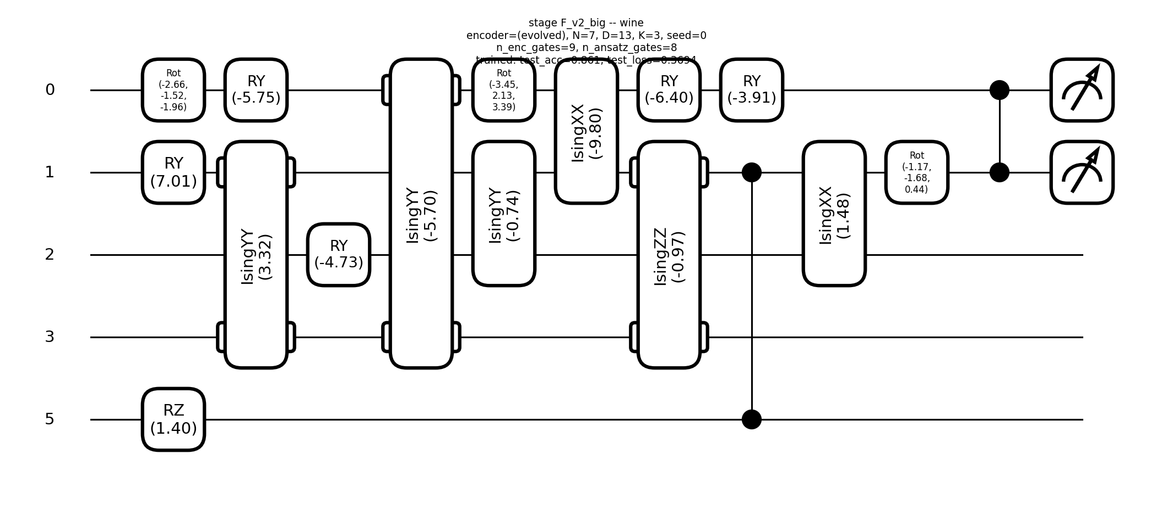
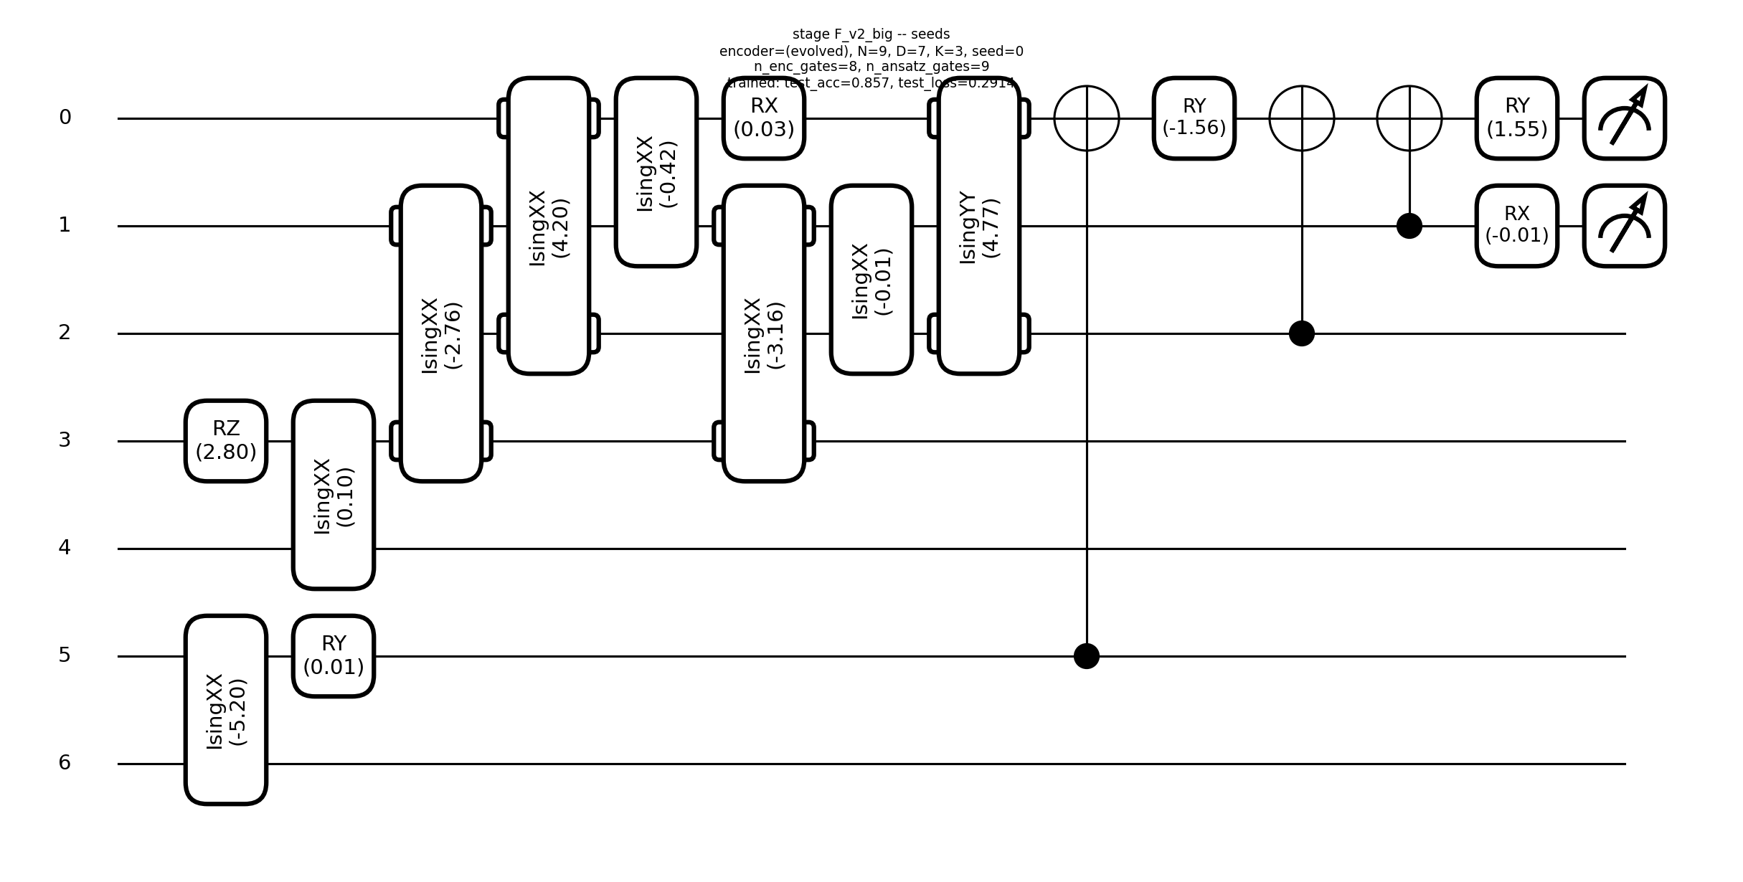
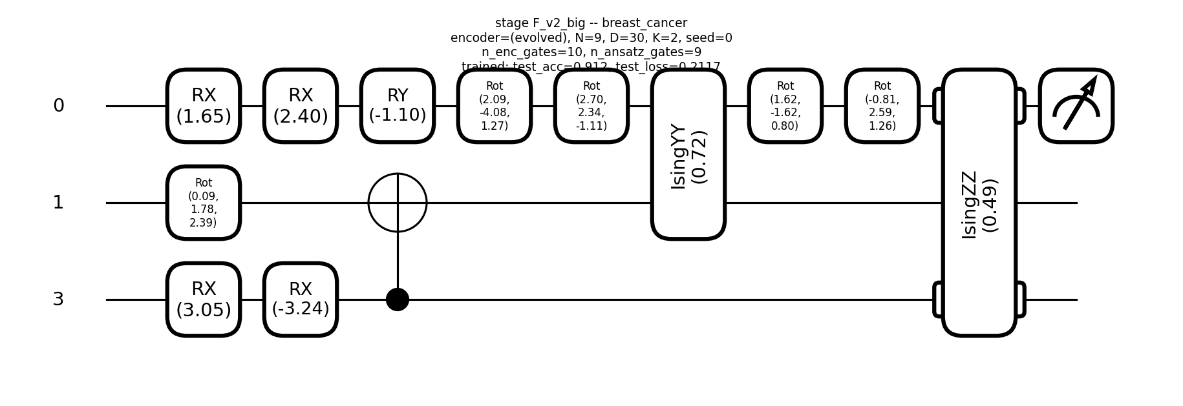
Stage F v2 budget bump (n_genomes 300)
iris N=5 test_acc=0.967
wine N=7 test_acc=0.861
seeds N=9 test_acc=0.857
breast_cancer N=9 test_acc=0.912

Slide 15
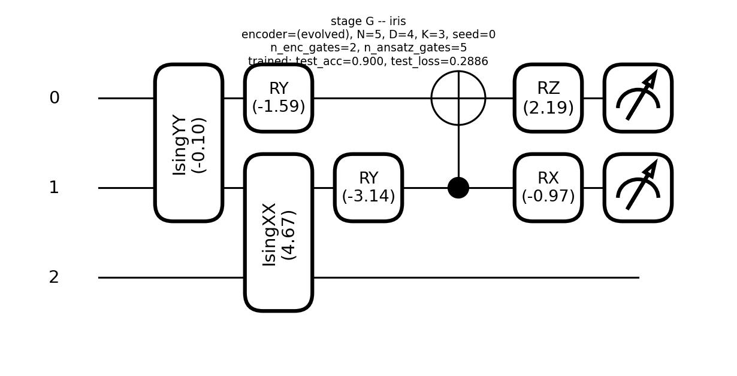
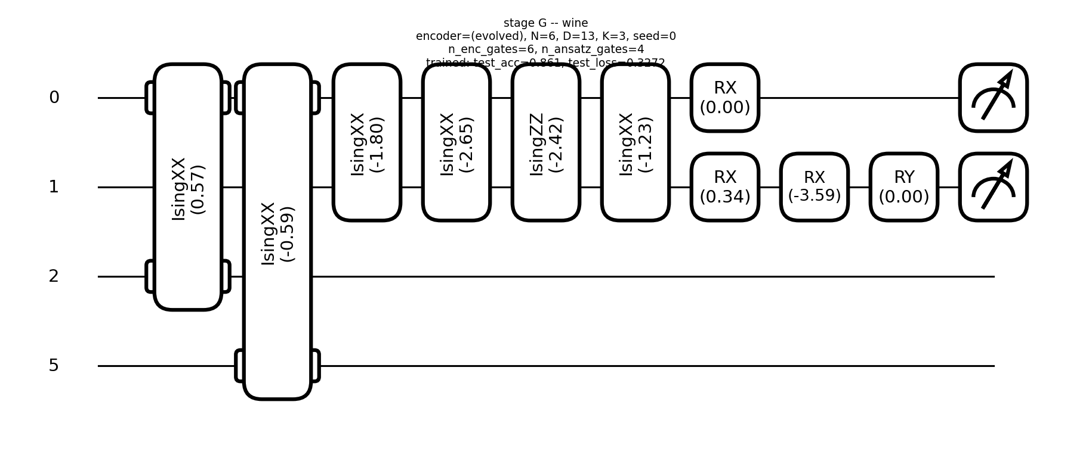
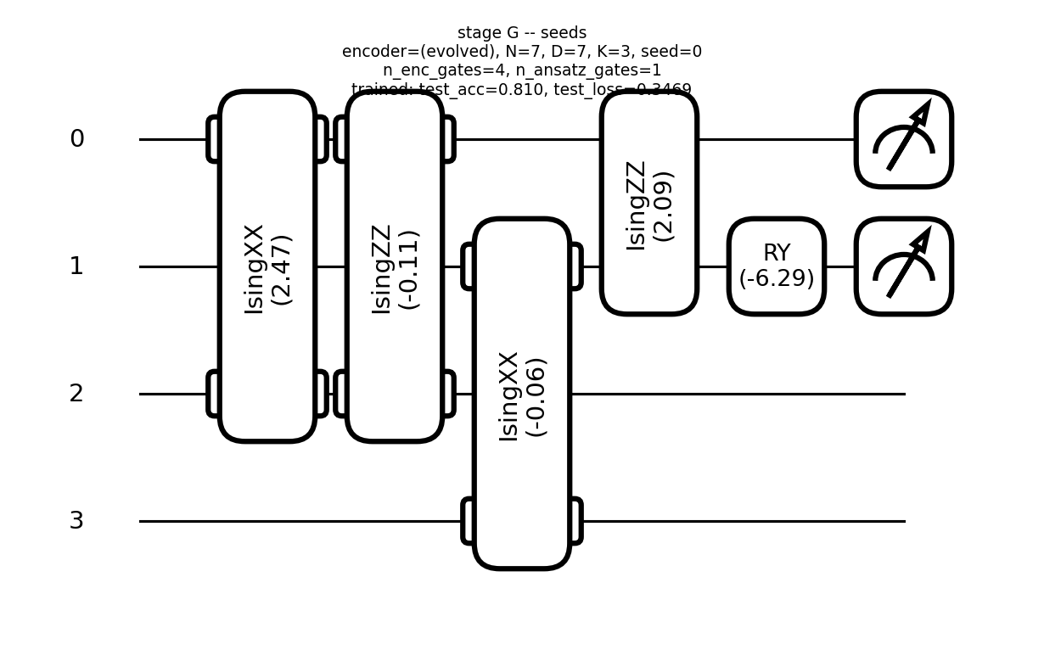
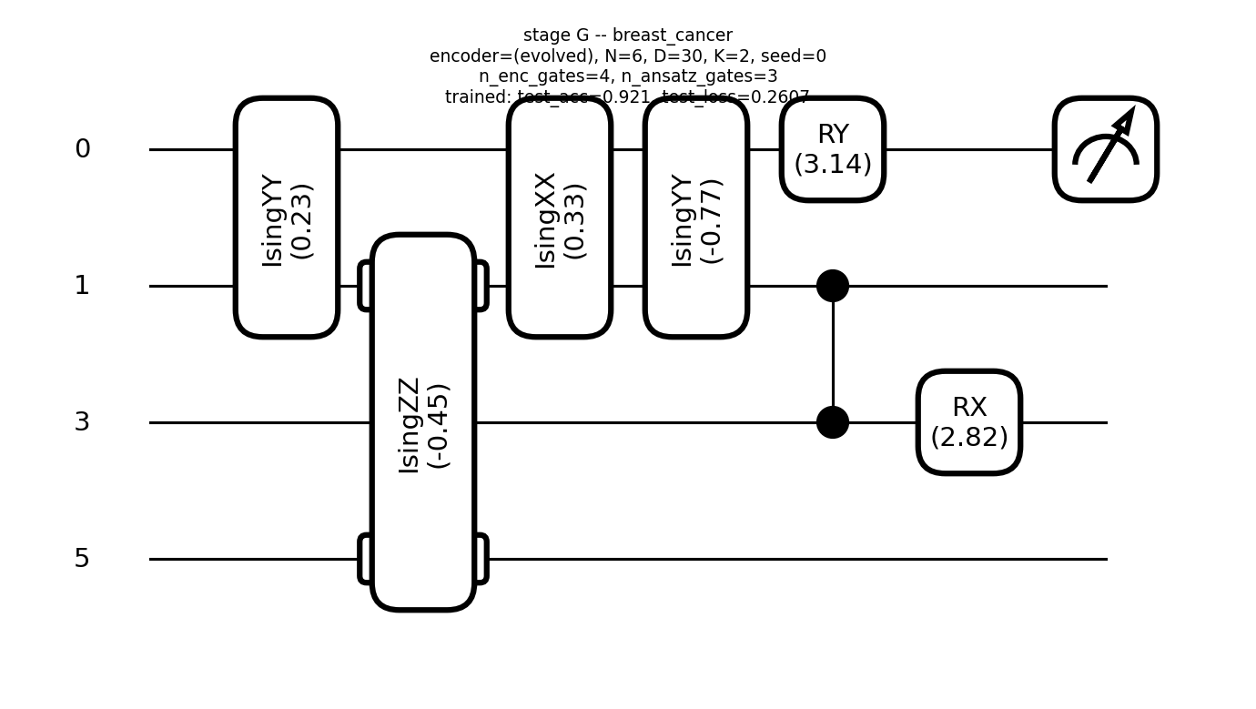
Stage G: ENFORCED encoder block then ansatz block (no interleaving)
iris N=5 test_acc=0.900
wine N=6 test_acc=0.861
seeds N=7 test_acc=0.810
breast_cancer N=6 test_acc=0.921

