Slide 1
Champion circuits: symbolic Quantikz view, Stages A-G
BLUE boxes = encoding gates (angle = a*x_i + b, data-dependent) ORANGE boxes = ansatz / learning gates (trained scalar) control/target idioms (cx, cz) keep their native look Look for interleaved blue/orange in Stages E/F (data re-uploading) and clean block separation in Stage G (block-enforced).

Slide 2
How encoding and learning gates relate per stage
A encoder runs in Python (external block) ; ansatz = fixed RY-CNOT chain
B encoder in Python (block) ; ansatz = evolved genome
C encoder in Python (block) ; ansatz = evolved genome ; evolved N
D encoder classes (linear_proj, reupload_euler), consumed by B/C
E v1/v2 encoder + ansatz gates inside ONE genome, sorted by depth -- INTERLEAVED
F v1 enc_rot universal-1q (blue) + scalar Ising entanglers (orange) -- INTERLEAVED
F v2 enc_rot + enc_xx/yy/zz feat-dep (blue) + ansatz (orange) -- INTERLEAVED (data reuploading)
G same vocab as F v2, but qnode ENFORCES encoder-pass then ansatz-pass
color coding inside the per-stage slides: BLUE = encoding gates (data-dependent) ORANGE = ansatz / learning gates (trained scalar)

Slide 3
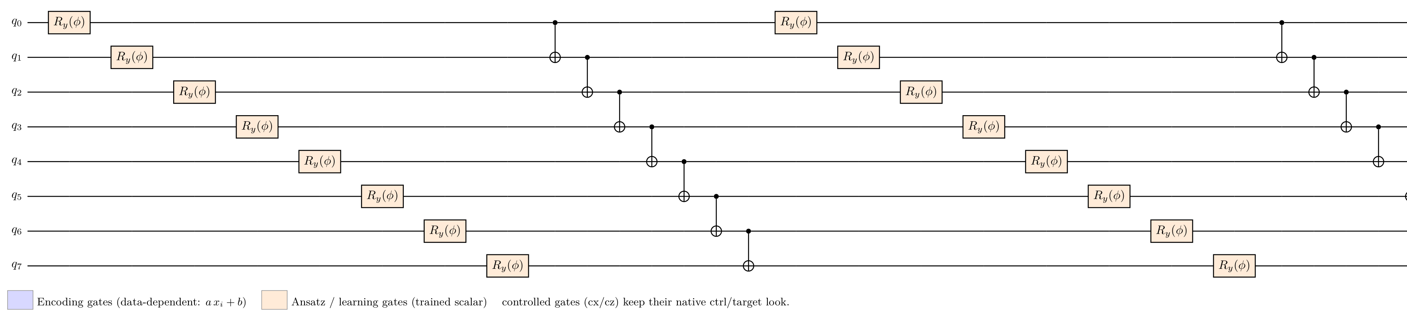
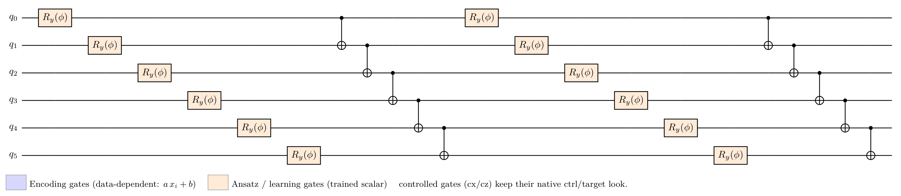
Stage A: Quantikz symbolic (ansatz only; external encoder noted in source .tex)
iris N=8 test_acc=0.967 encoder=learned
wine N=6 test_acc=0.833 encoder=learned
seeds N=8 test_acc=0.881 encoder=learned
breast_cancer N=6 test_acc=0.895 encoder=learned

Slide 4
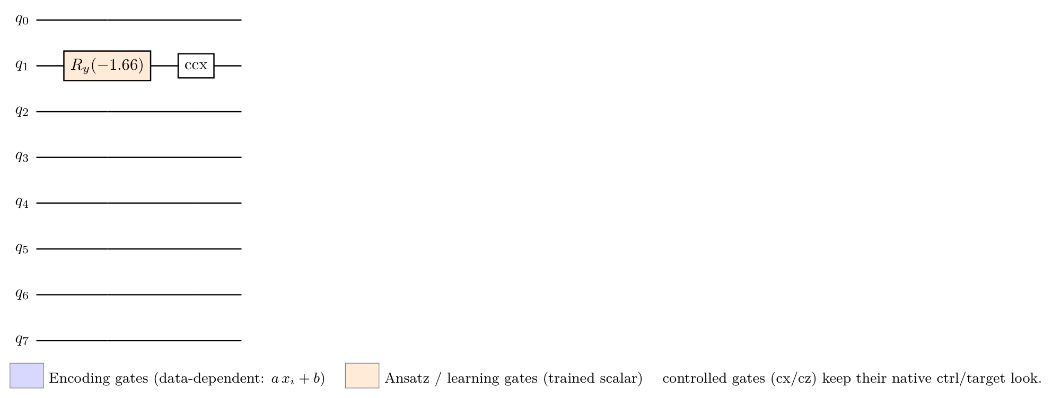
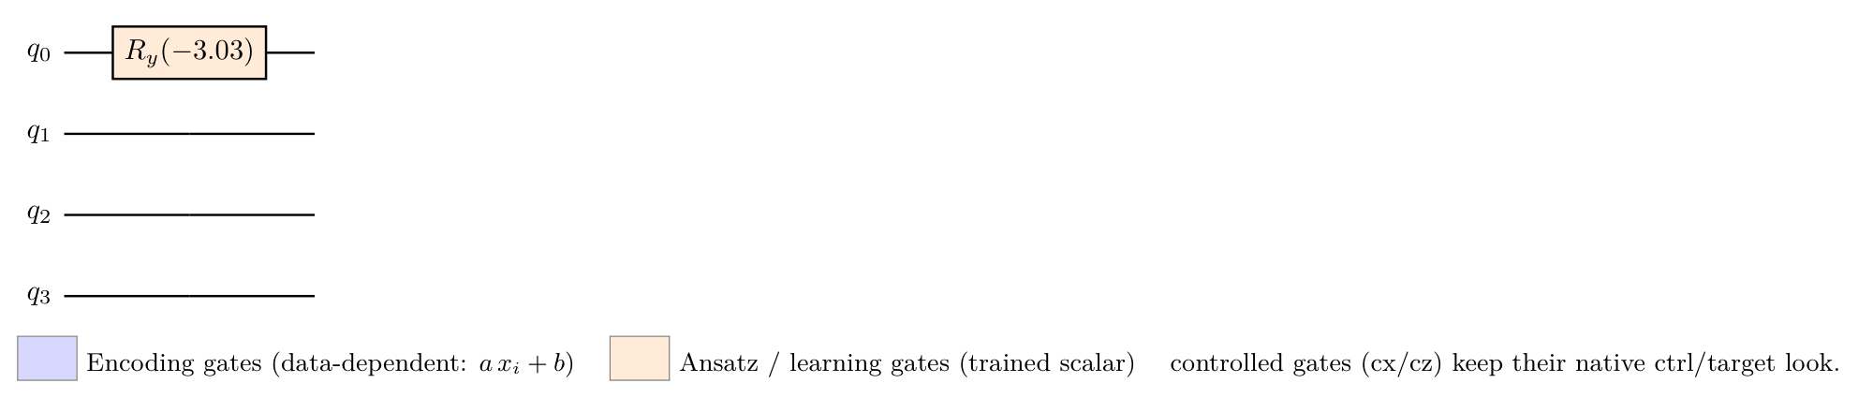
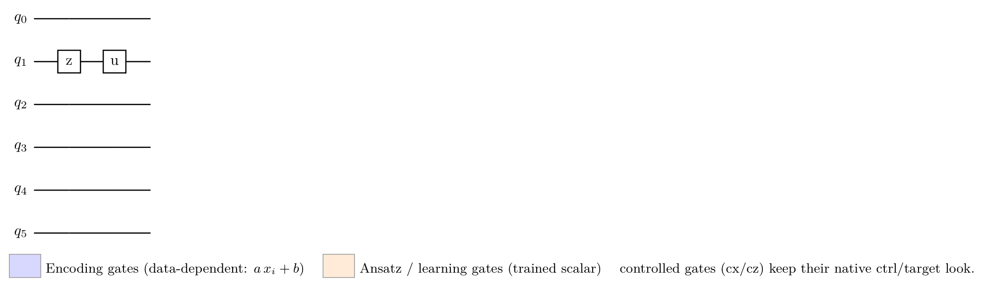
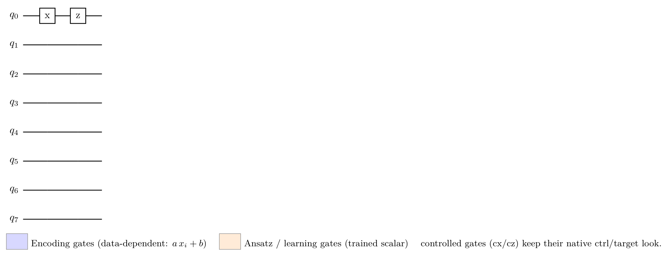
Stage B: Quantikz symbolic (ansatz only; external encoder noted in source .tex)
iris N=8 test_acc=1.000 encoder=reupload_euler
wine N=4 test_acc=1.000 encoder=reupload_euler
seeds N=6 test_acc=1.000 encoder=reupload_euler
breast_cancer N=8 test_acc=0.974 encoder=reupload_euler

Slide 5
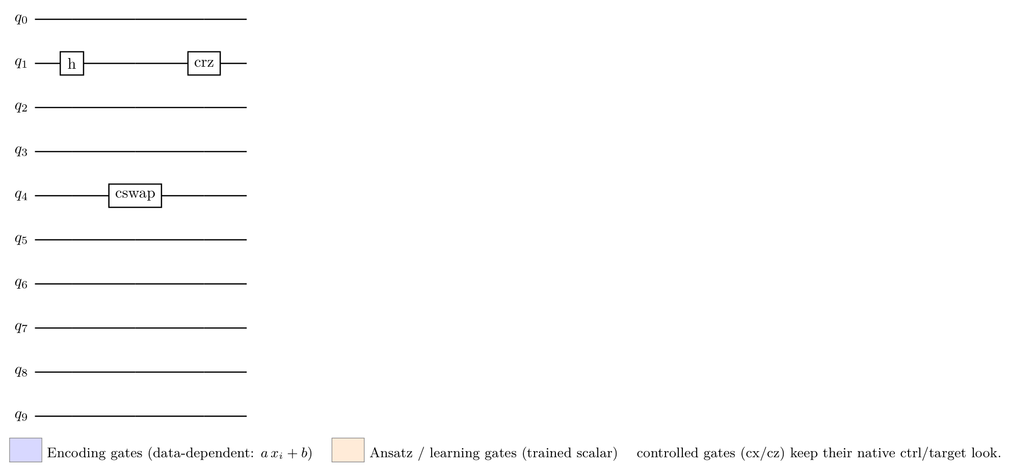
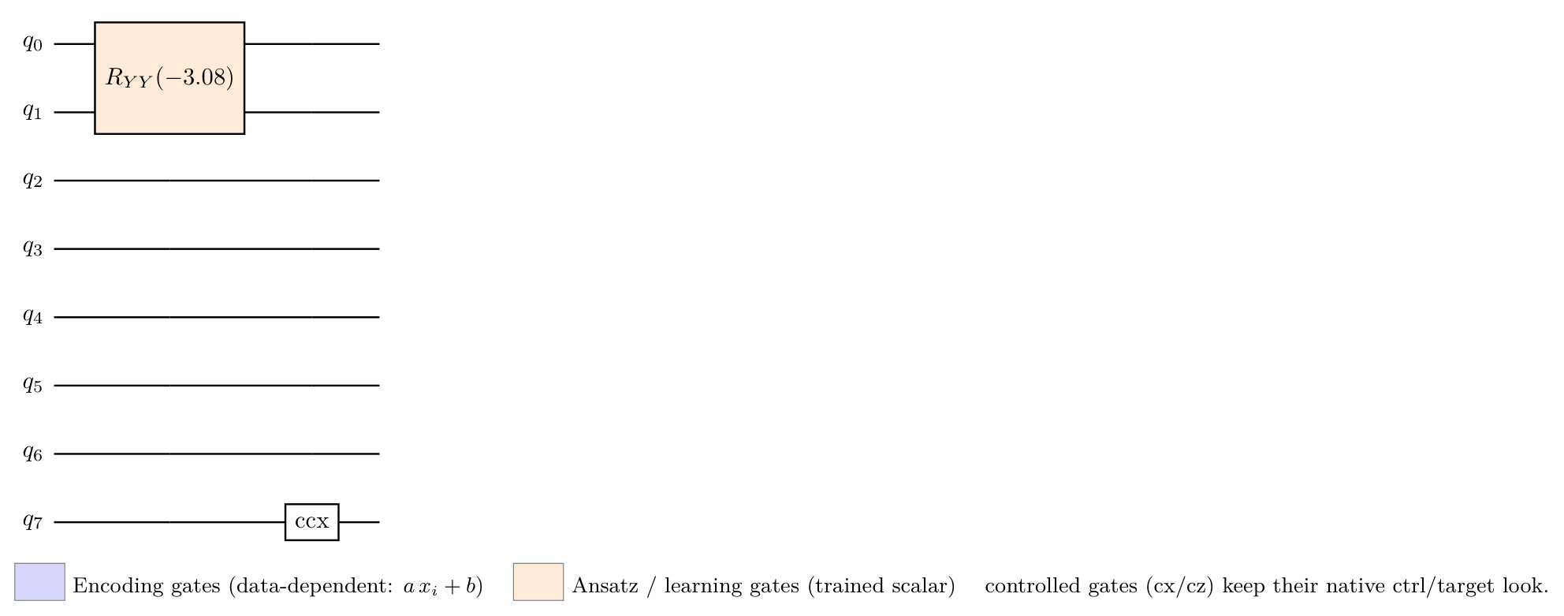
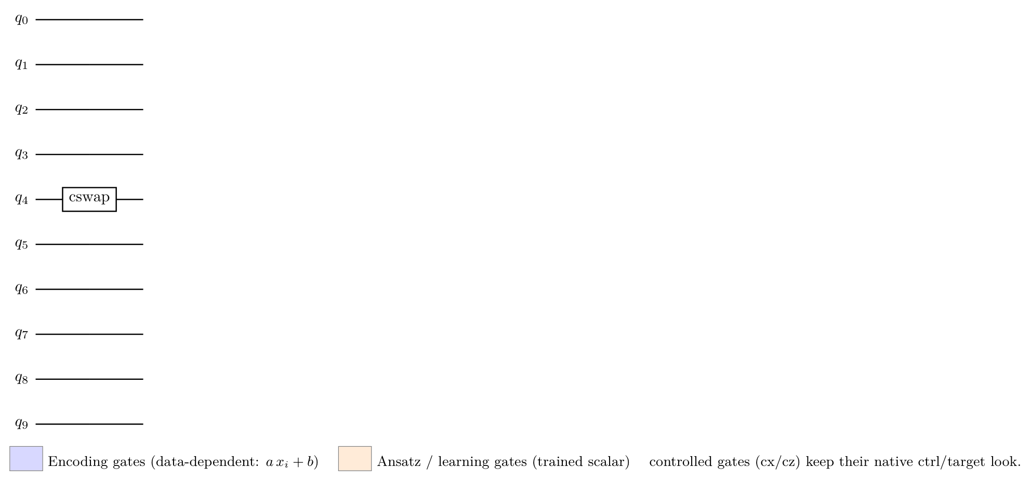
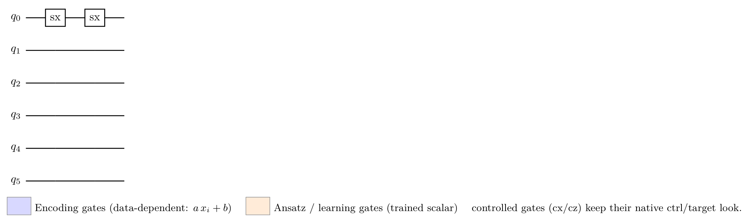
Stage B 3-seed champion (Quantikz)
iris N=10 test_acc=1.000 encoder=reupload_euler
wine N=8 test_acc=1.000 encoder=reupload_euler
seeds N=10 test_acc=1.000 encoder=linear_proj
breast_cancer N=6 test_acc=0.974 encoder=reupload_euler

Slide 6
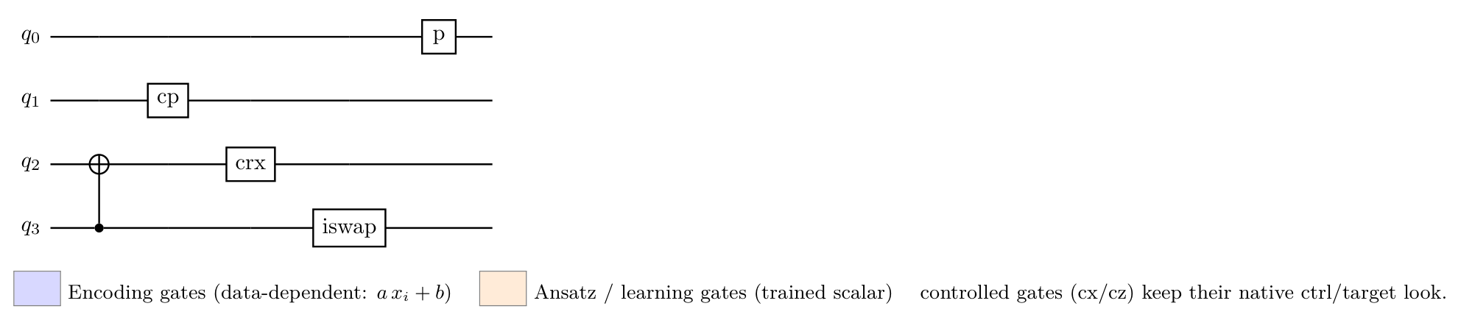
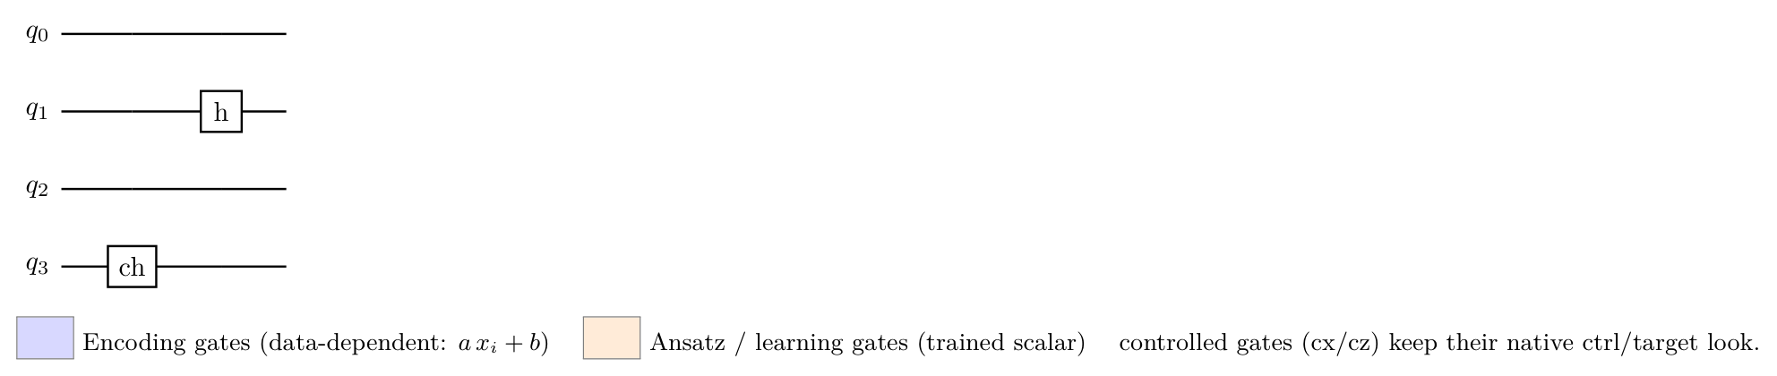
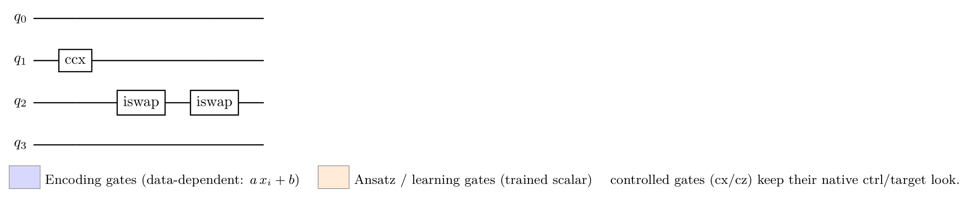
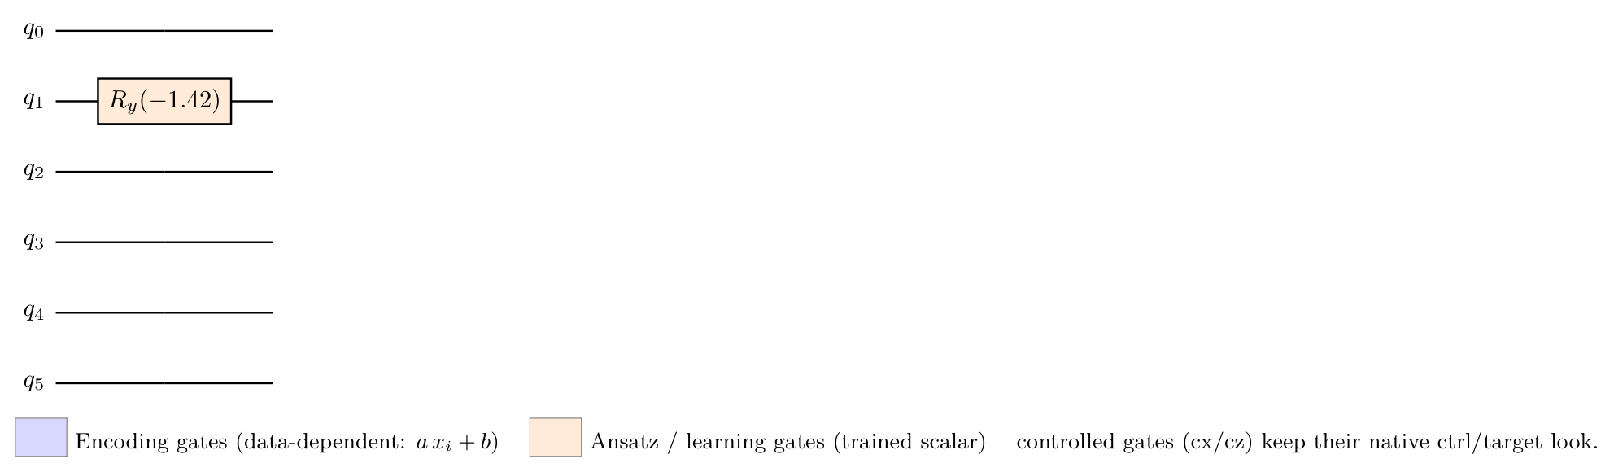
Stage C: Quantikz symbolic (ansatz only; external encoder noted in source .tex)
iris N=4 test_acc=1.000 encoder=reupload_euler
wine N=4 test_acc=1.000 encoder=reupload_euler
seeds N=4 test_acc=1.000 encoder=reupload_euler
breast_cancer N=6 test_acc=0.974 encoder=reupload_euler

Slide 7
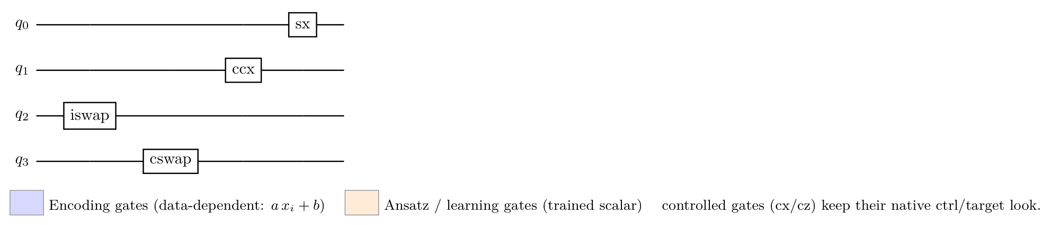
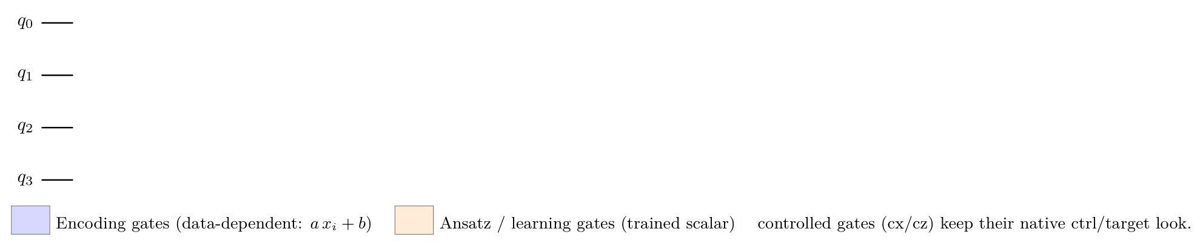
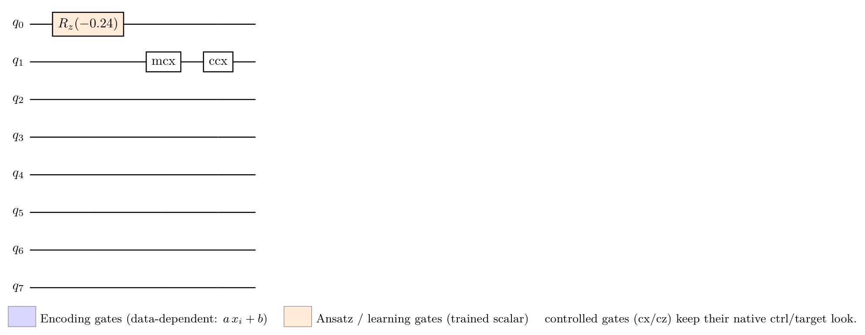
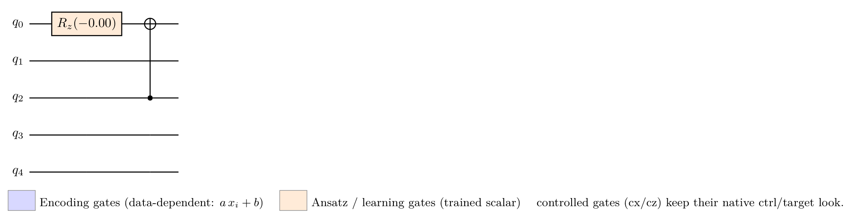
Stage C 3-seed champion (Quantikz)
iris N=4 test_acc=1.000 encoder=reupload_euler
wine N=4 test_acc=1.000 encoder=reupload_euler
seeds N=8 test_acc=1.000 encoder=reupload_euler
breast_cancer N=5 test_acc=0.974 encoder=linear_proj

Slide 8
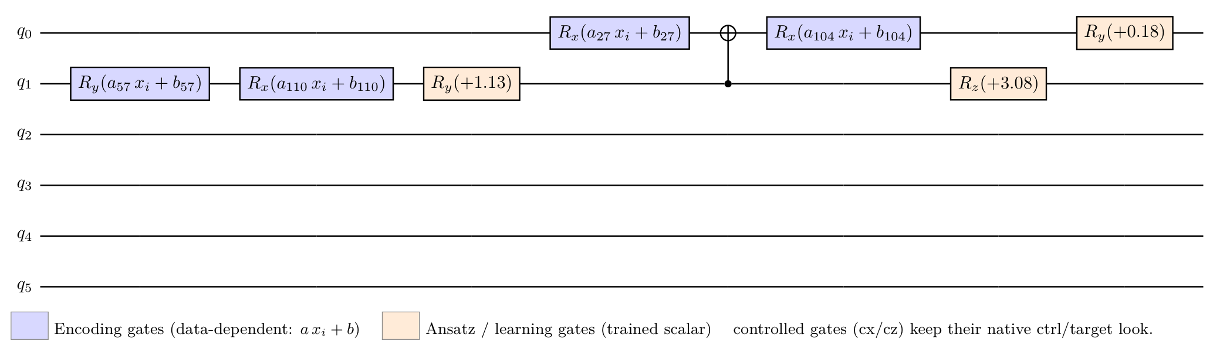
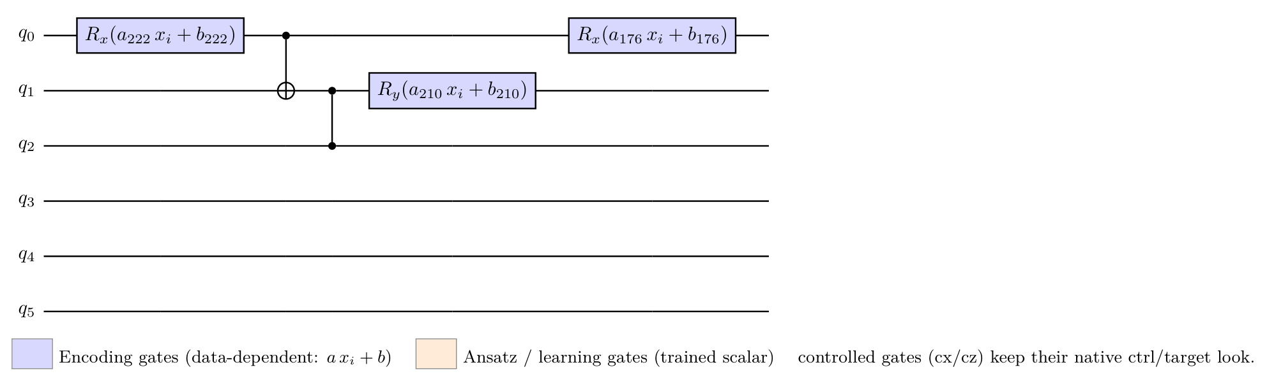
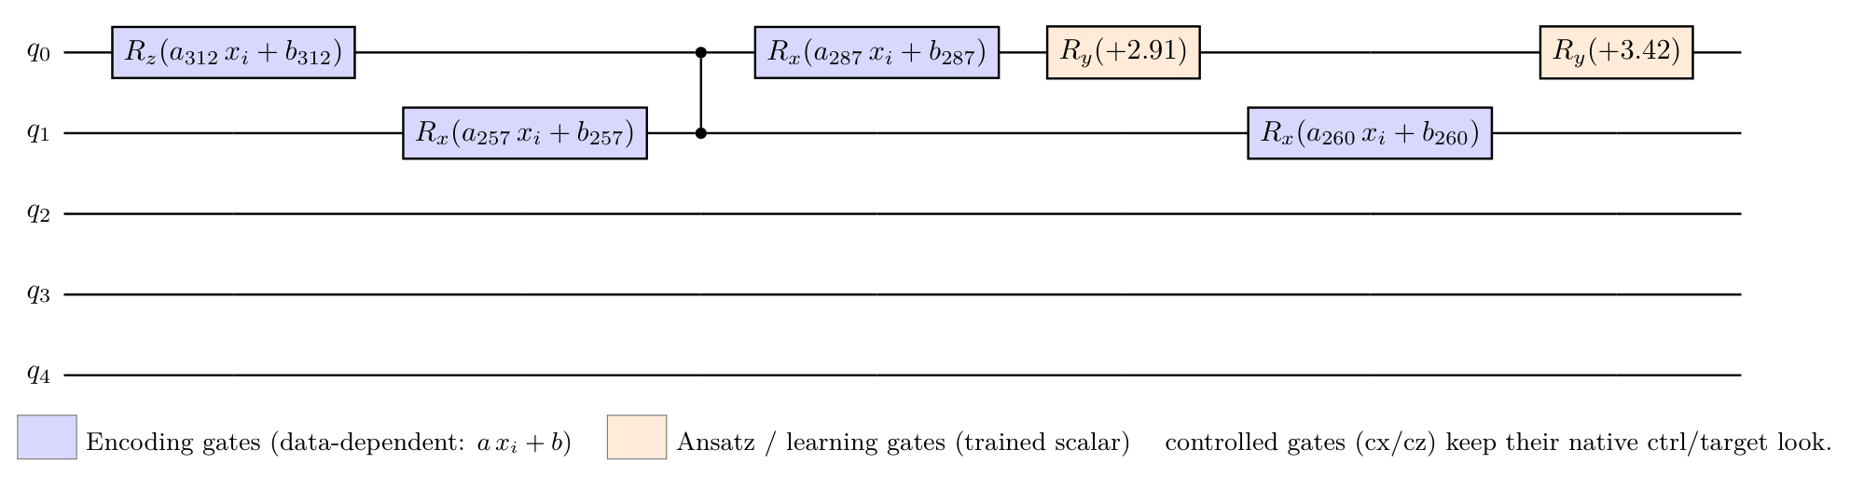
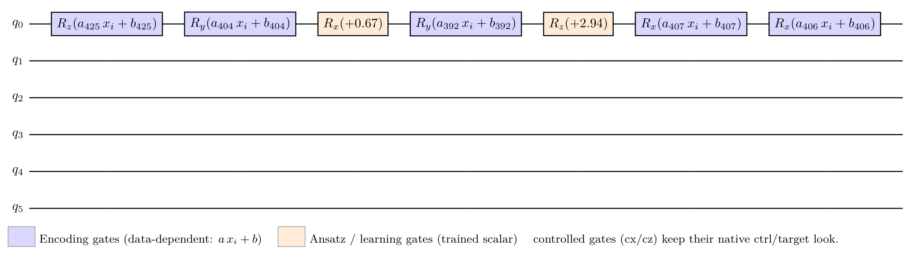
Stage E v1: enc_ry/rx/rz (blue) interleaved with ansatz rotations (orange)
iris N=6 test_acc=0.700
wine N=6 test_acc=0.778
seeds N=5 test_acc=0.833
breast_cancer N=6 test_acc=0.851

Slide 9
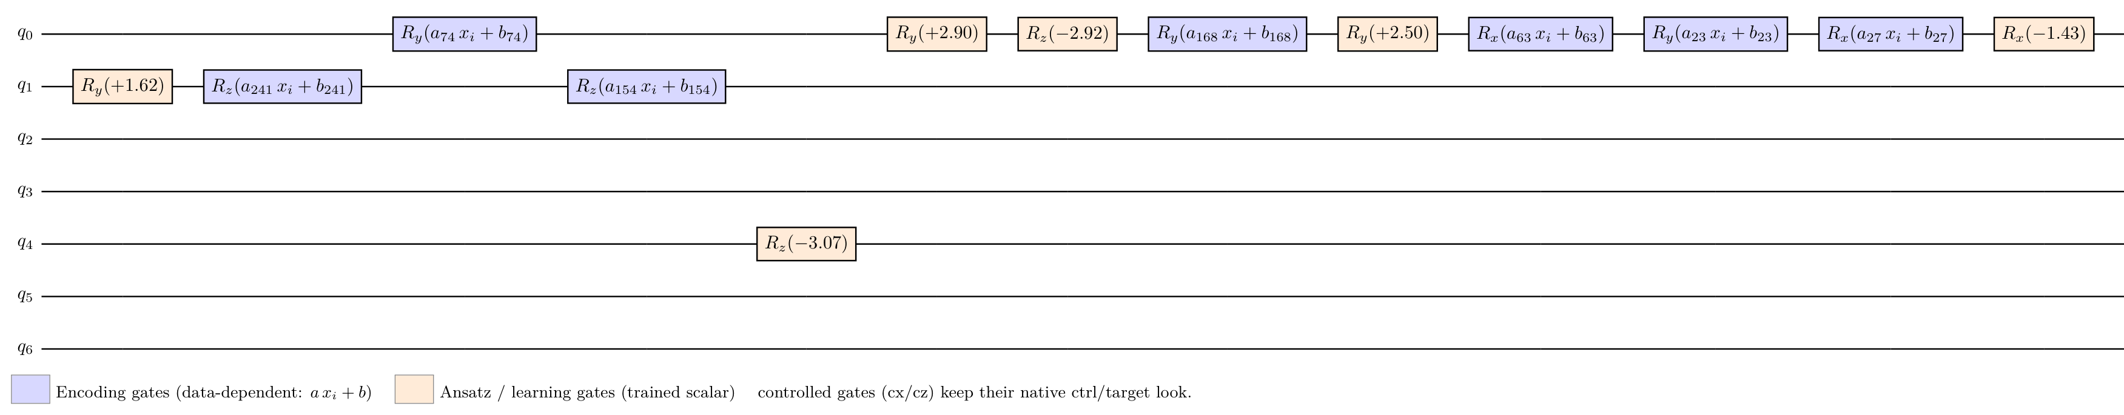
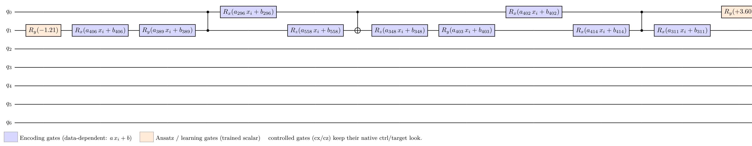
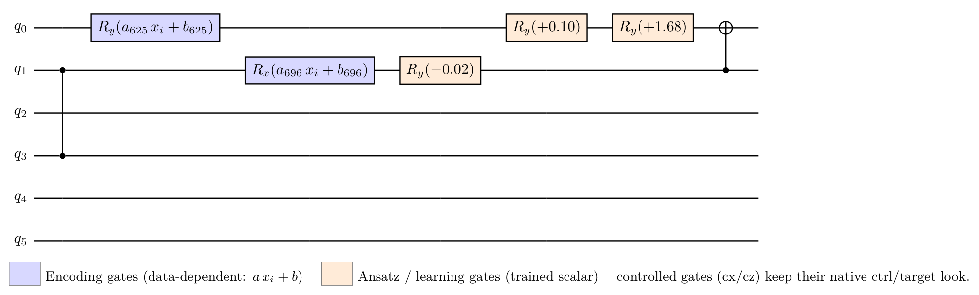
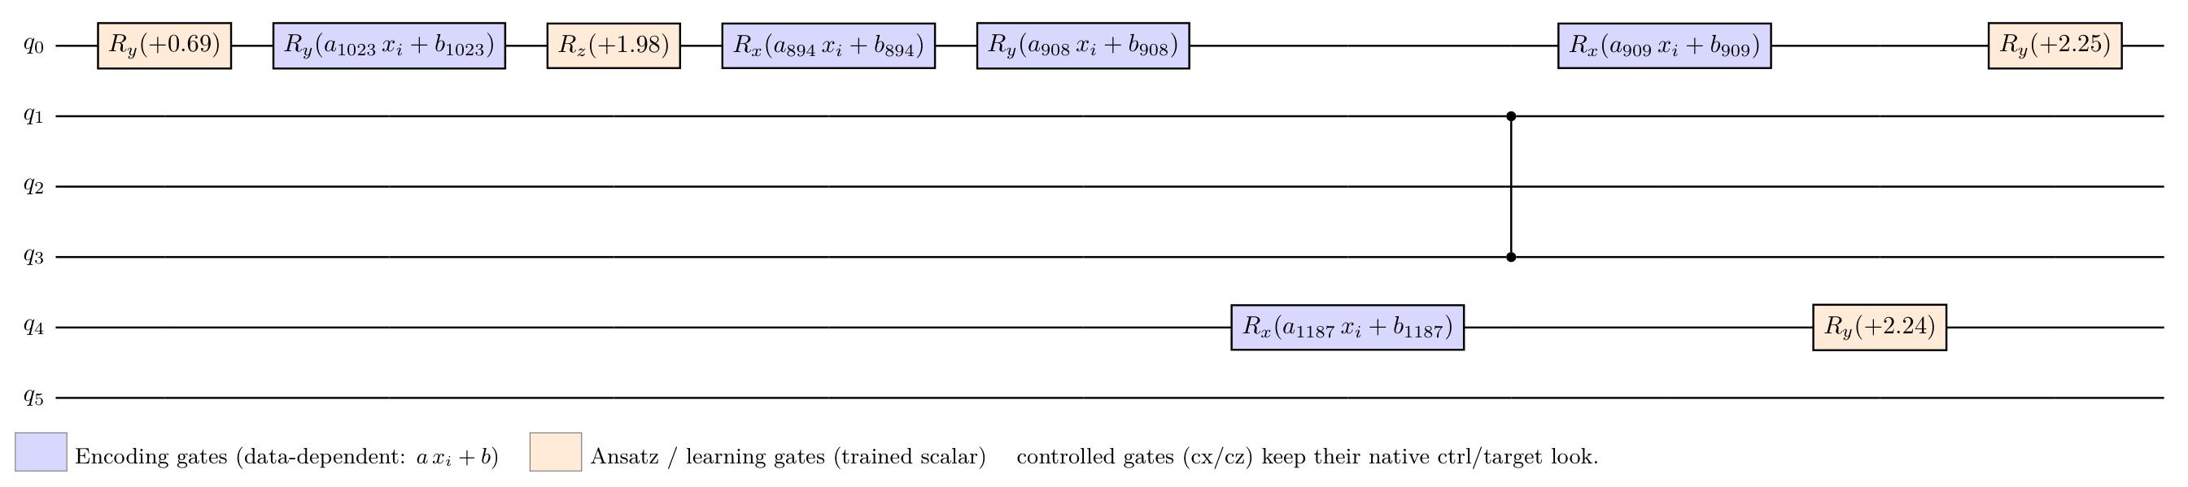
Stage E v2: same as v1 with n_genomes=300
iris N=7 test_acc=0.633
wine N=7 test_acc=0.806
seeds N=6 test_acc=0.833
breast_cancer N=6 test_acc=0.877

Slide 10
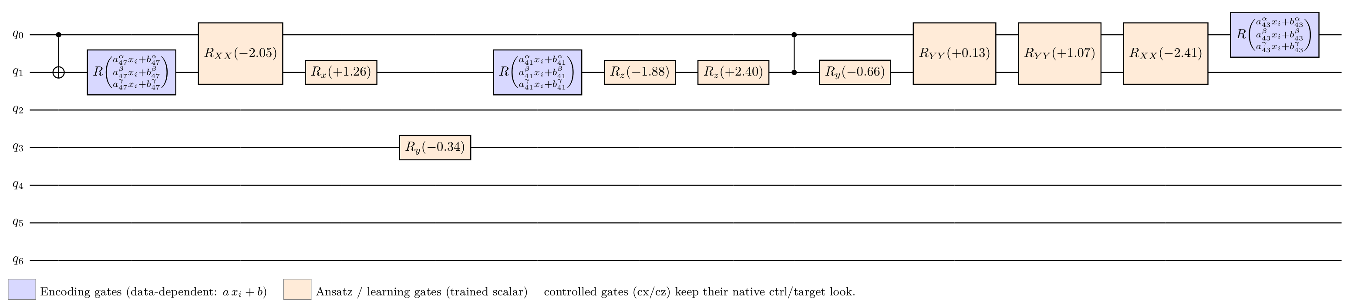
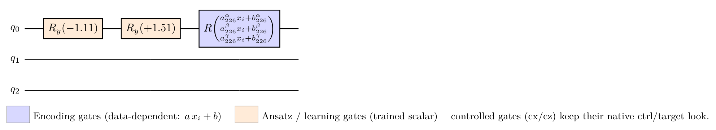
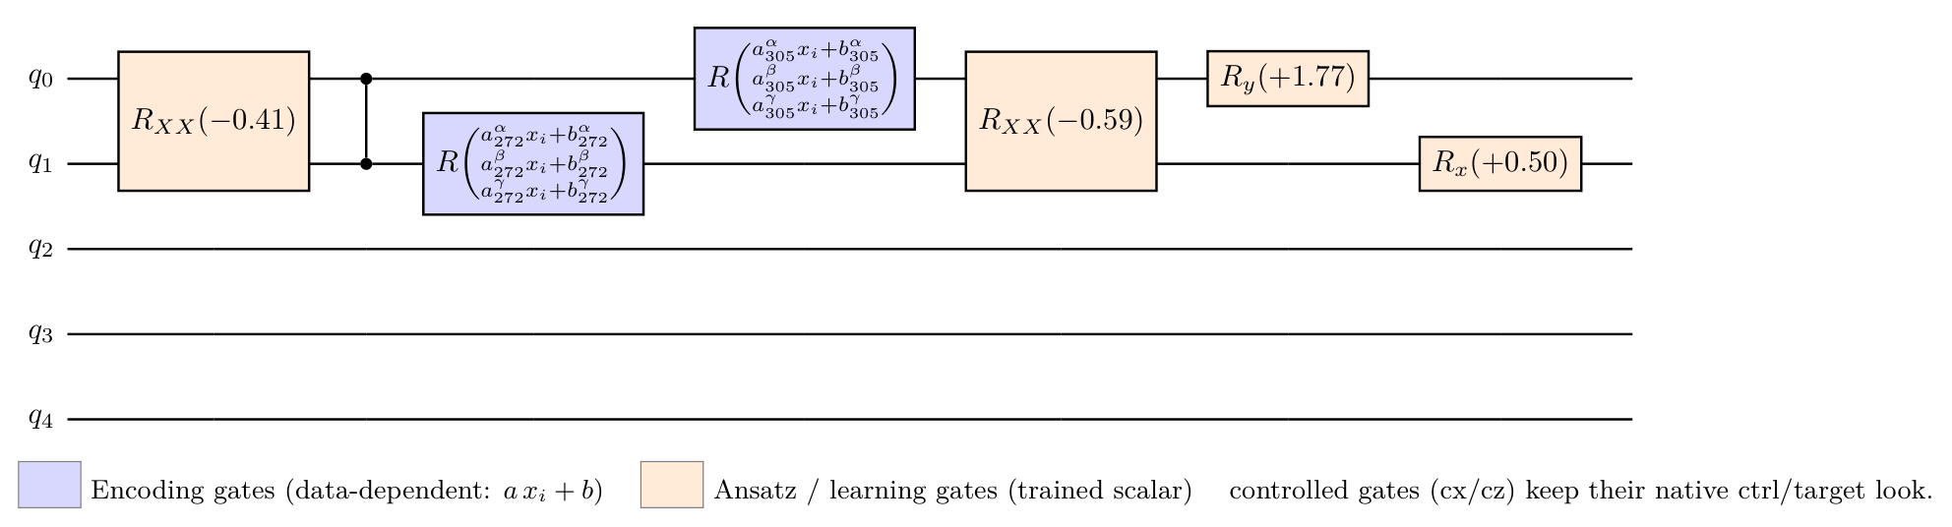
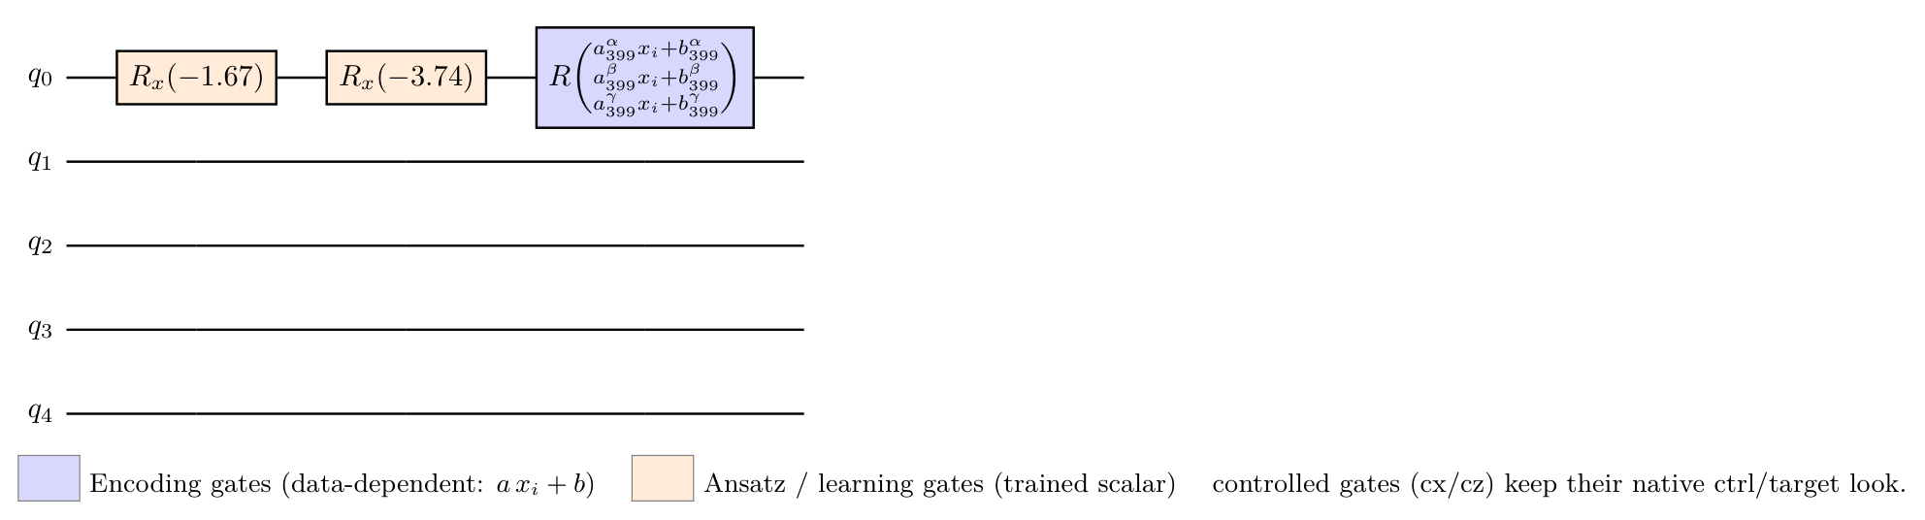
Stage F v1: enc_rot (blue) + scalar Ising entanglers (orange) -- interleaved
iris N=7 test_acc=0.733
wine N=3 test_acc=0.806
seeds N=5 test_acc=0.833
breast_cancer N=5 test_acc=0.842

Slide 11
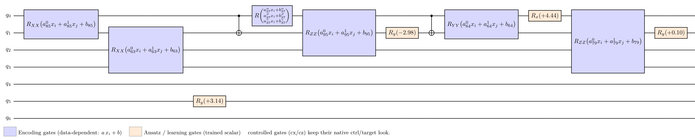
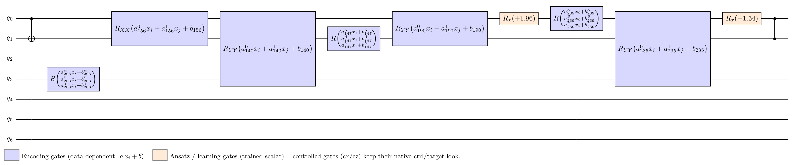
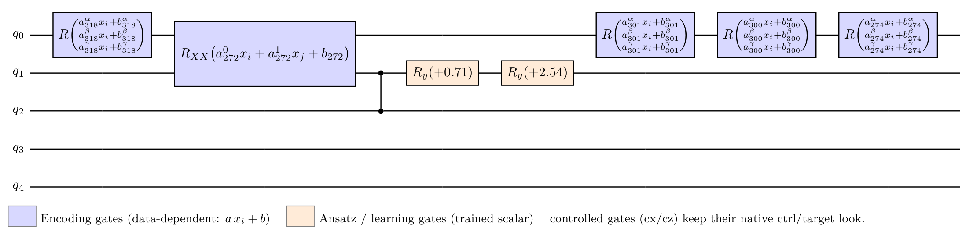
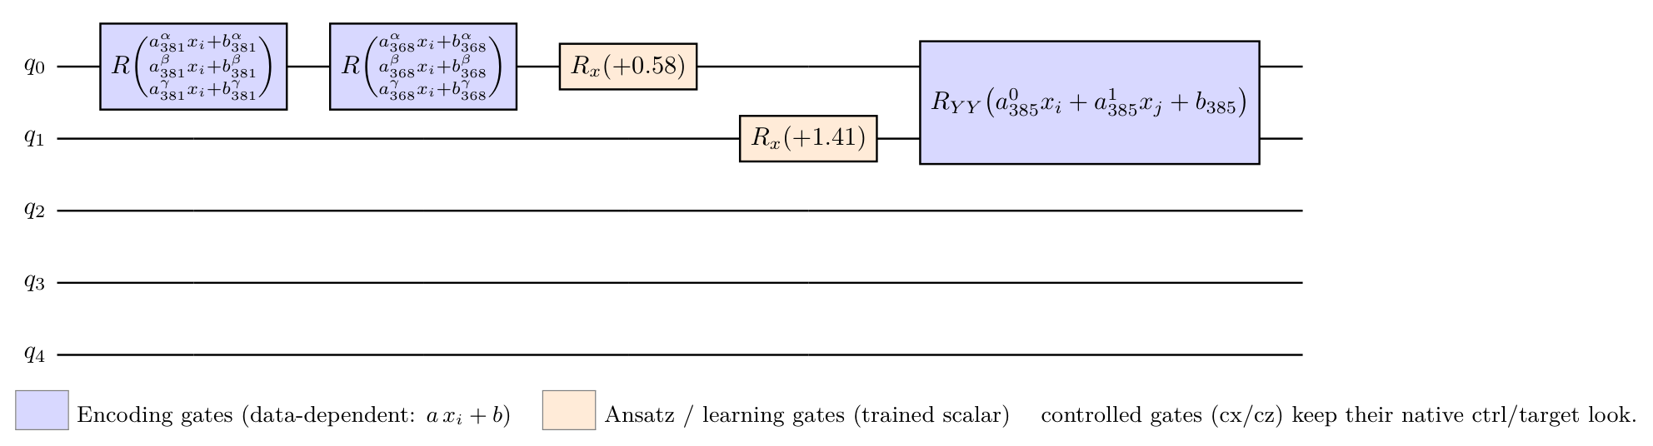
Stage F v2: enc_rot + enc_xx/yy/zz (blue) + ansatz rotations (orange) -- interleaved
iris N=7 test_acc=0.967
wine N=7 test_acc=0.917
seeds N=5 test_acc=0.857
breast_cancer N=5 test_acc=0.877

Slide 12
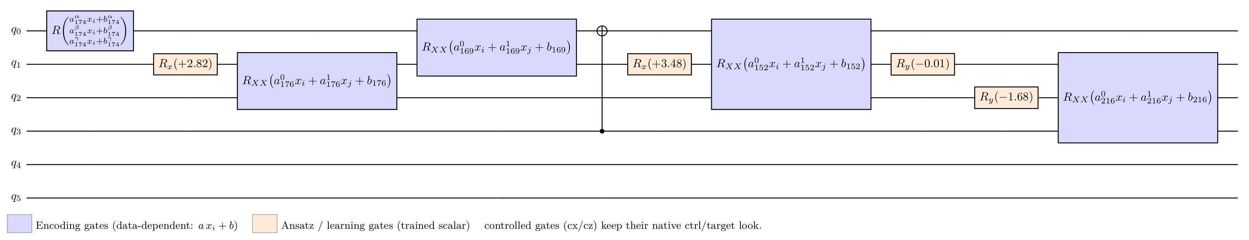
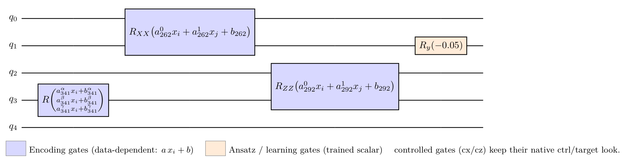
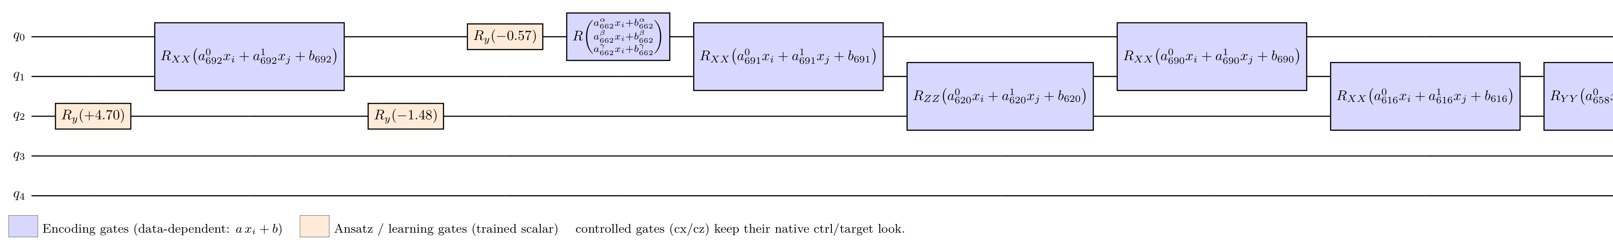
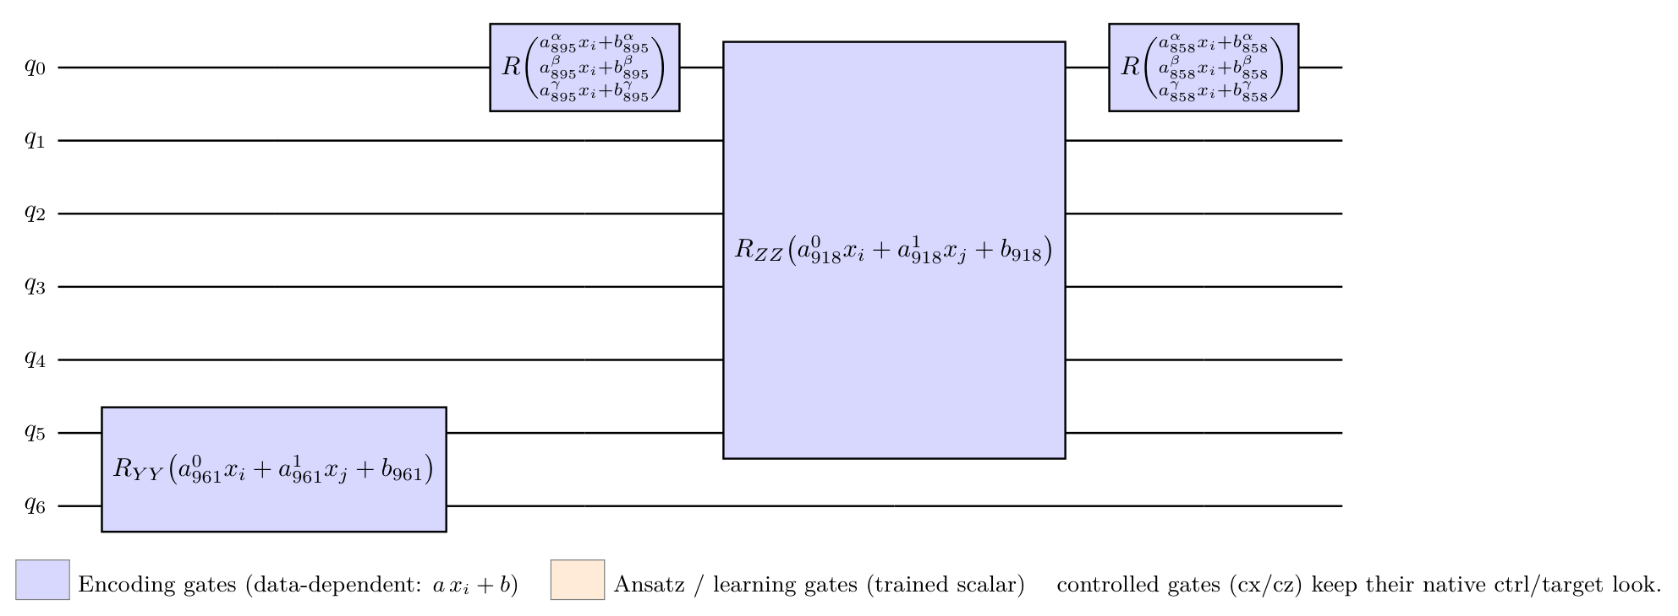
Stage F v2 3-seed champion
iris N=6 test_acc=1.000
wine N=5 test_acc=0.833
seeds N=5 test_acc=0.833
breast_cancer N=7 test_acc=0.886

Slide 13
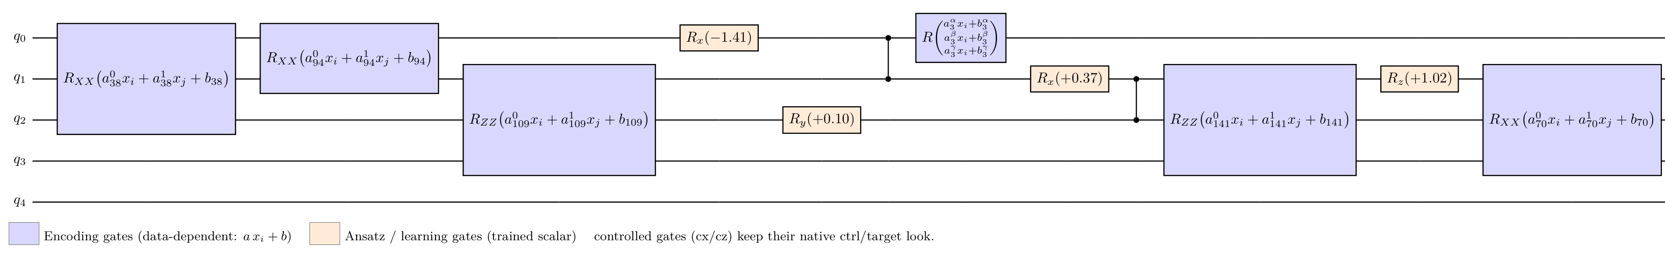
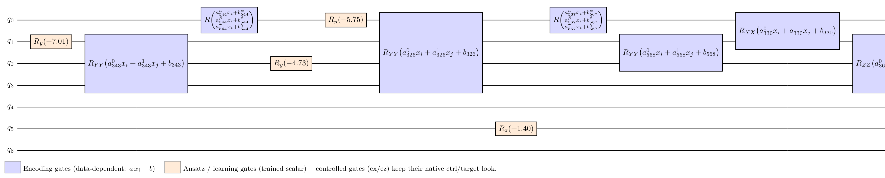
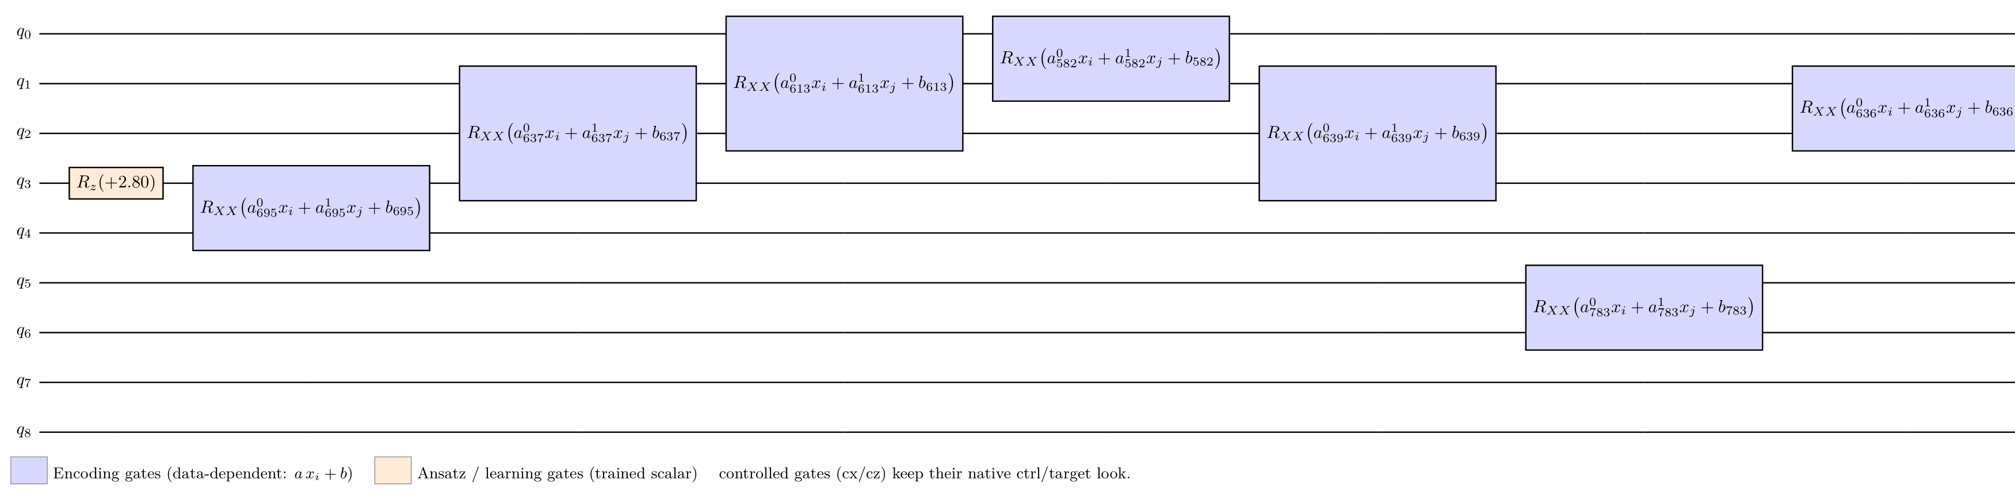
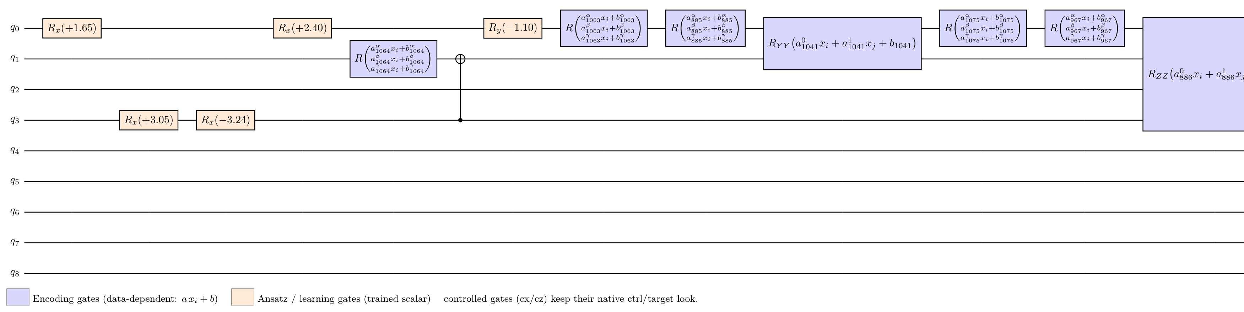
Stage F v2 budget bump (n_genomes=300)
iris N=5 test_acc=0.967
wine N=7 test_acc=0.861
seeds N=9 test_acc=0.857
breast_cancer N=9 test_acc=0.912

Slide 14
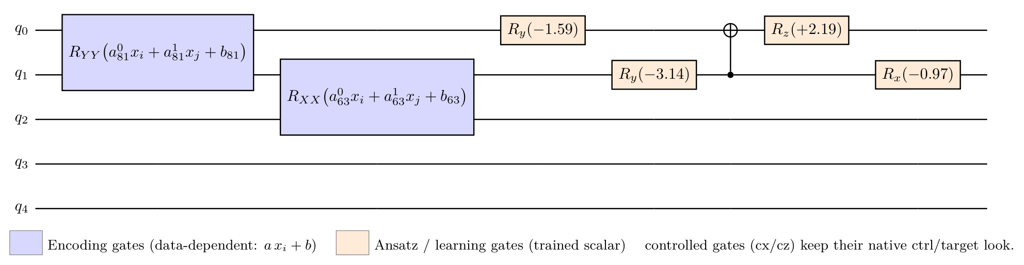
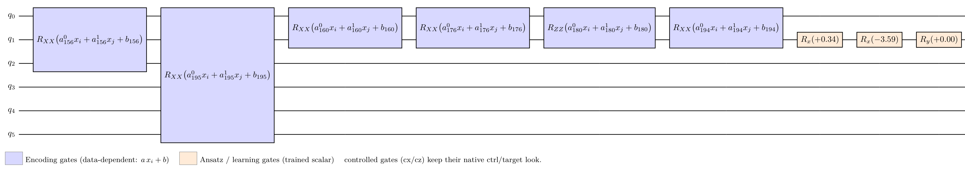
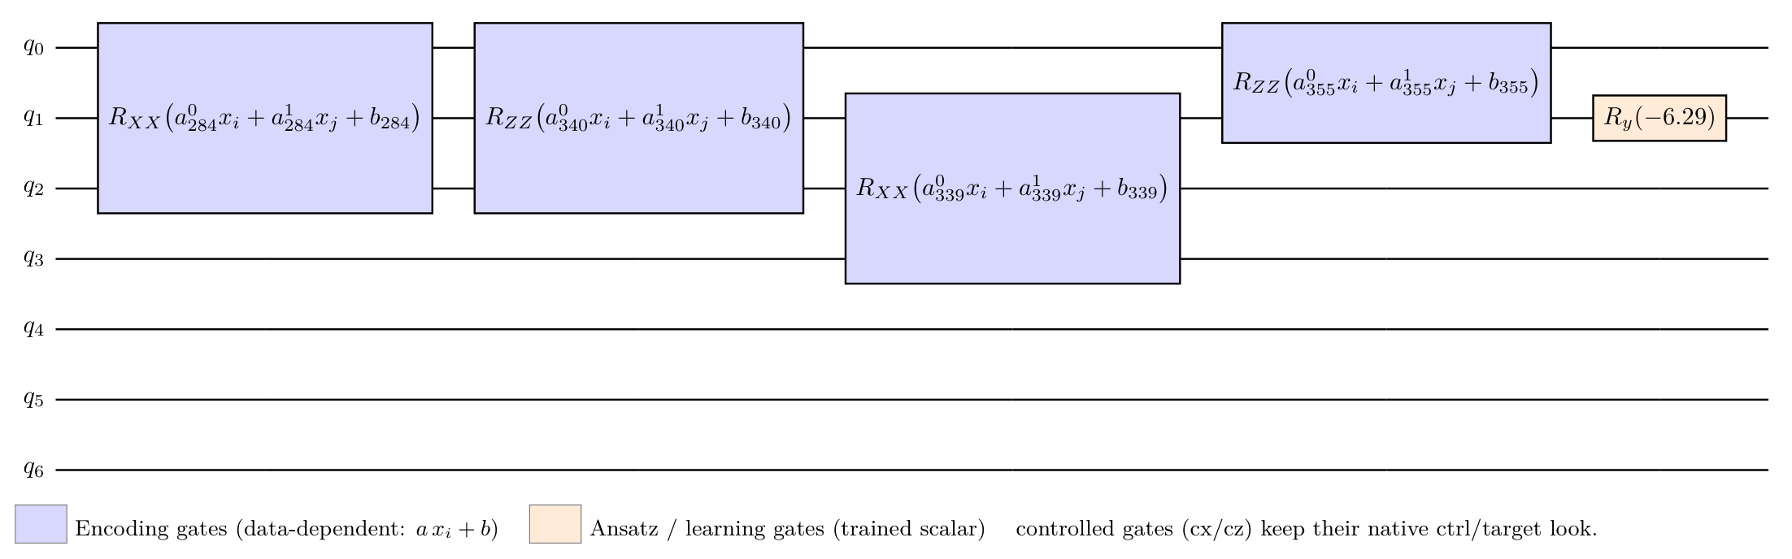
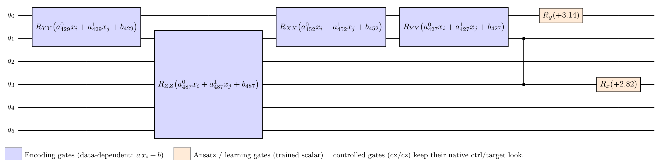
Stage G: encoder block (blue) THEN ansatz block (orange) -- enforced by qnode
iris N=5 test_acc=0.900
wine N=6 test_acc=0.861
seeds N=7 test_acc=0.810
breast_cancer N=6 test_acc=0.921

