Slide 3
UJ
Utah Jazz
Sponsorship Insights Report
July 2025

Slide 4
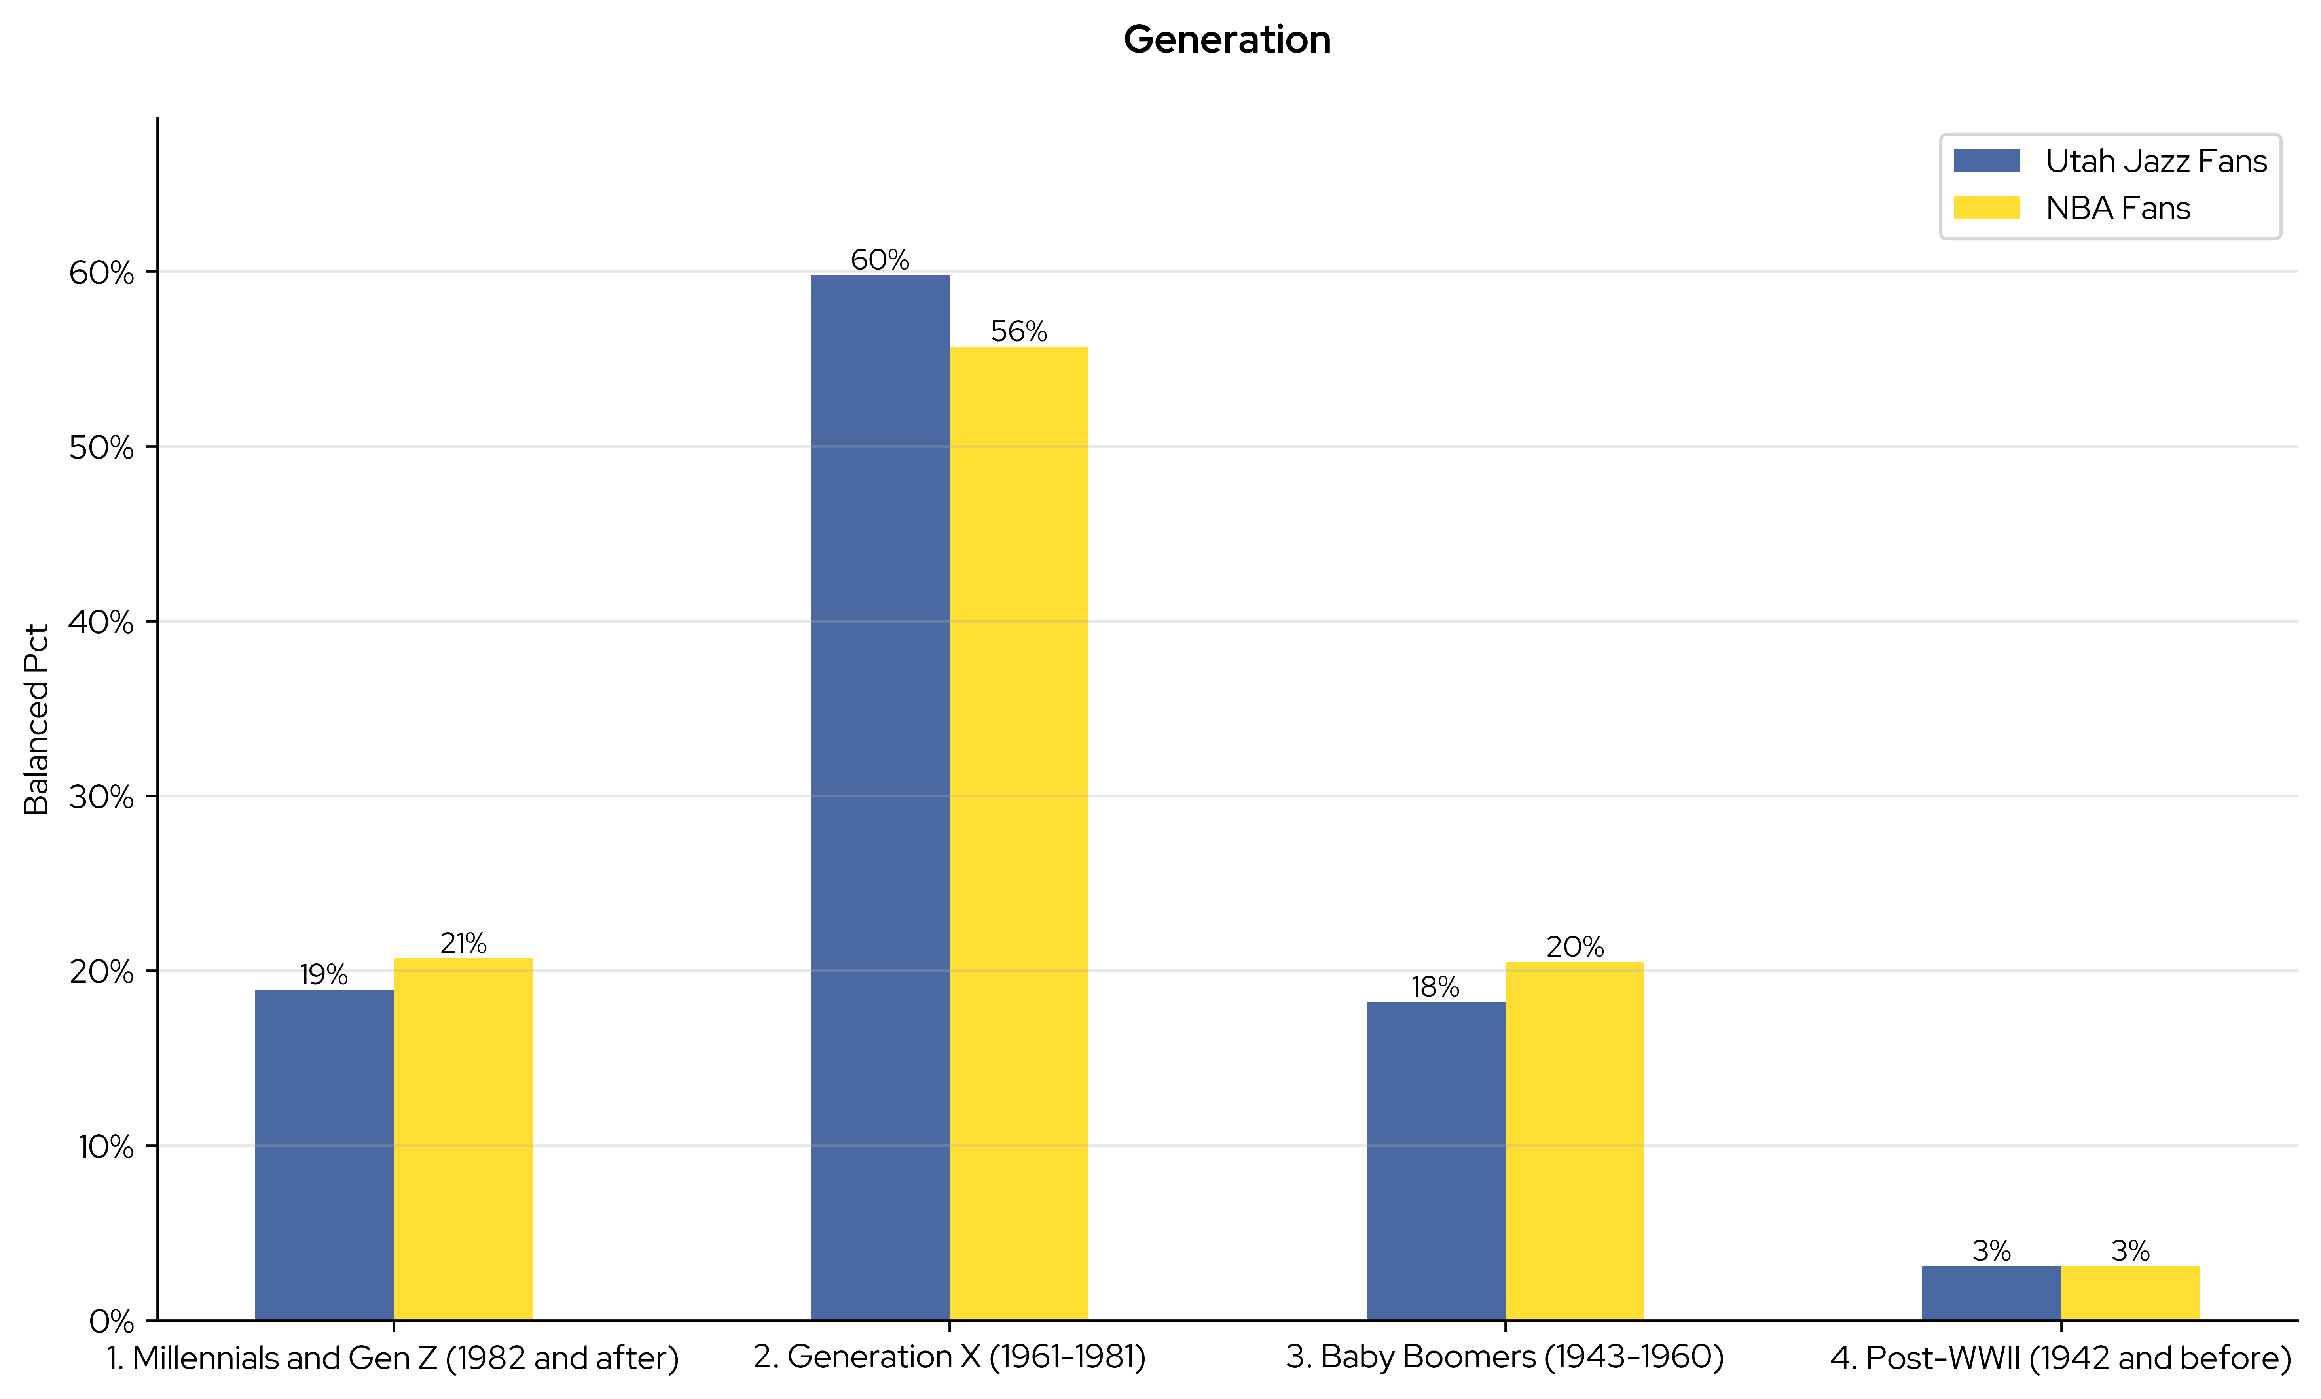
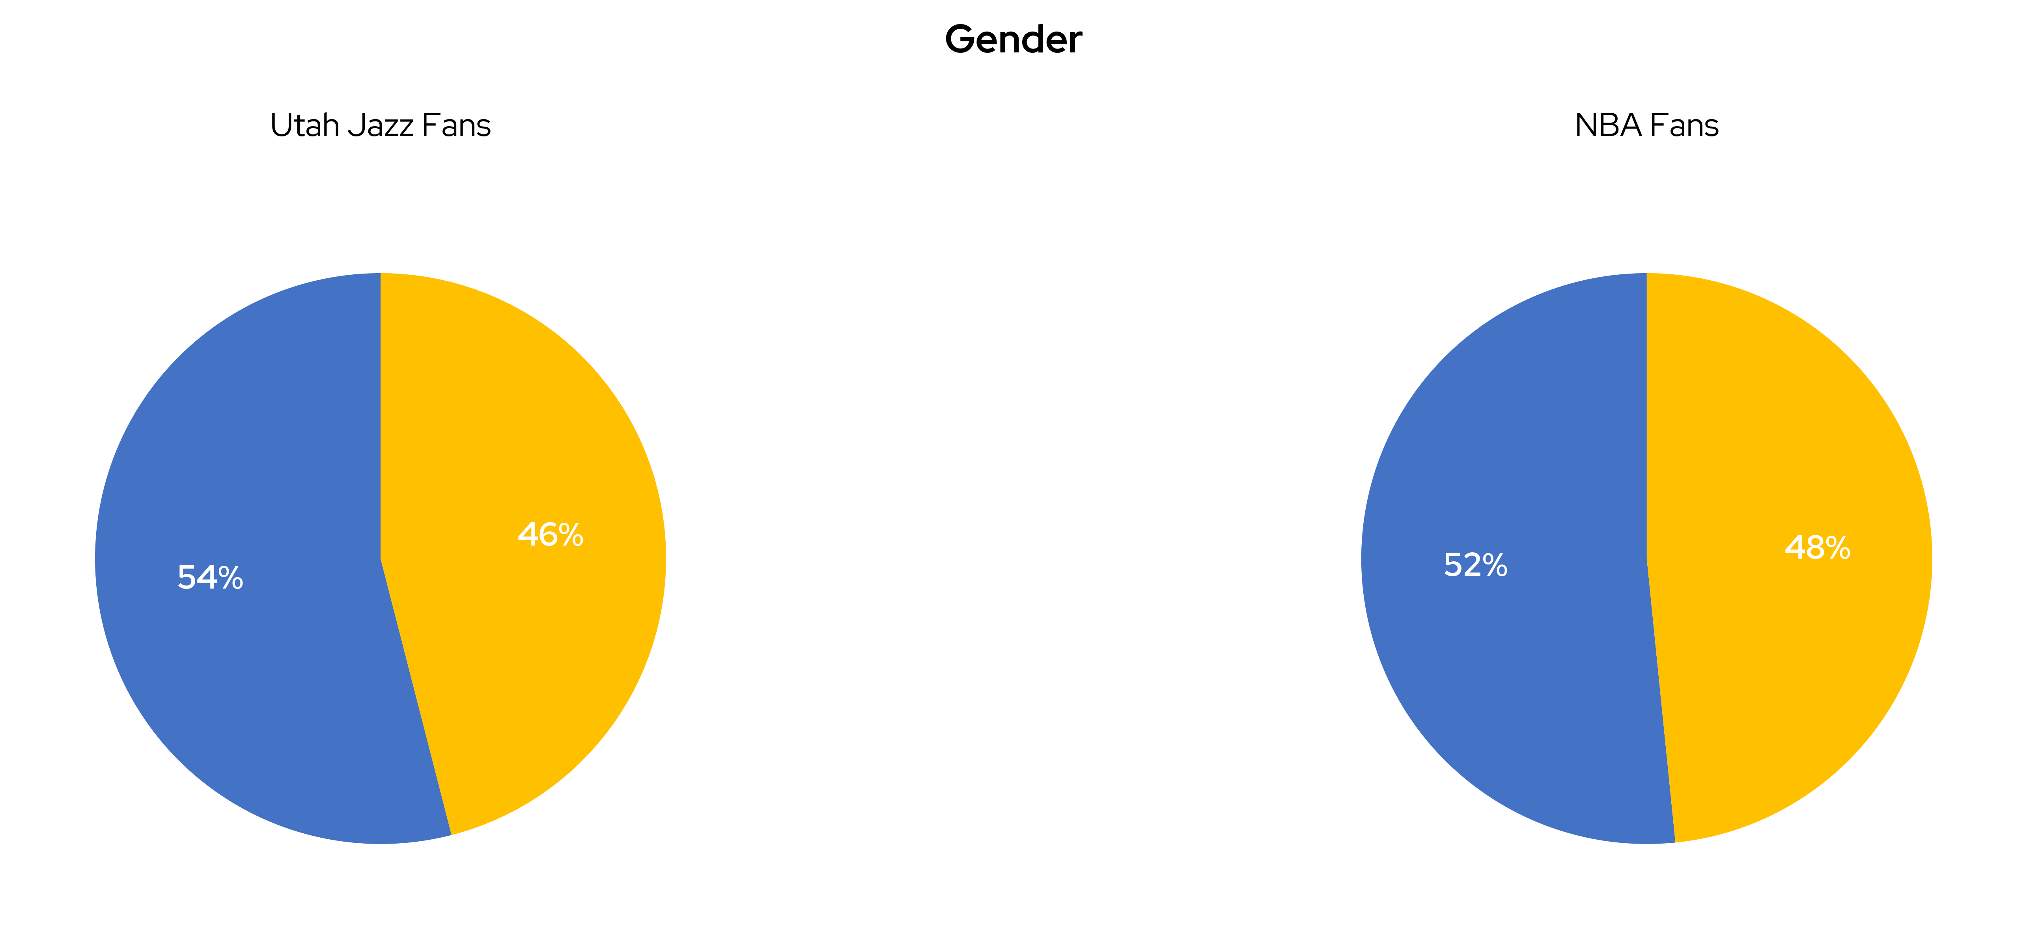
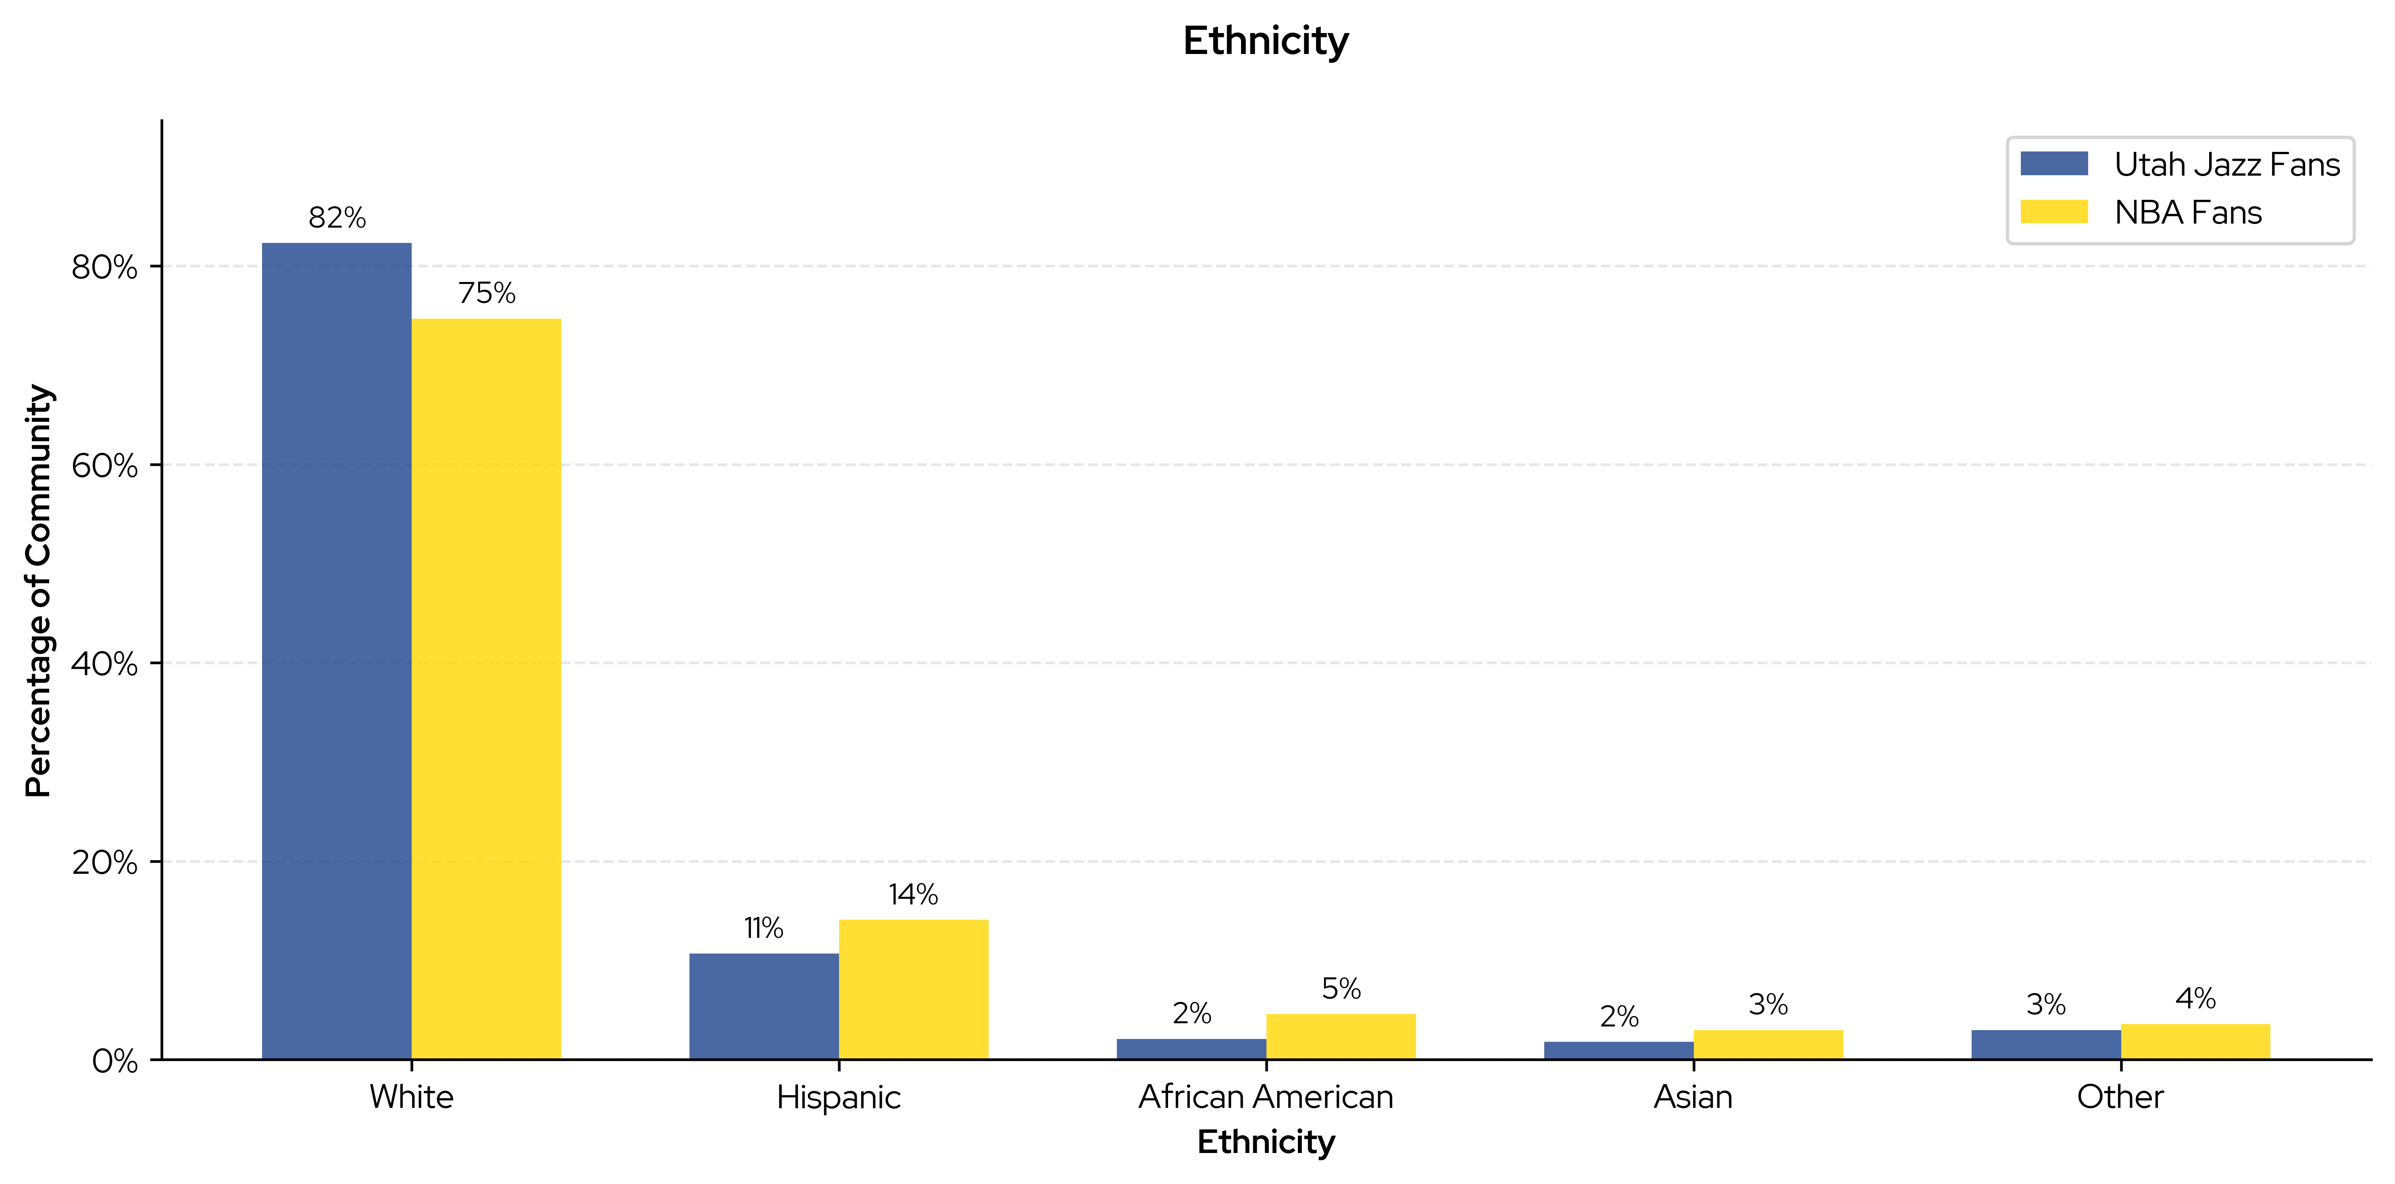
Utah Jazz
Fan Demographics: How Are Utah Jazz Fans Unique
Jazz
"Utah Jazz fans are significantly younger with 79% being Millennials/Gen X, have a higher household income with 76% earning $100K+, are predominantly male at 54%, and are mostly working professionals at 64%, compared to the Utah general population which has 0% in these categories, and they also slightly exceed the NBA average fan percentages."
KEY
- Utah Jazz Fans
- Jazz Gen Pop (state level, excluding Jazz Fans)
- NBA Fans Total (excluding Jazz fans)

Slide 5
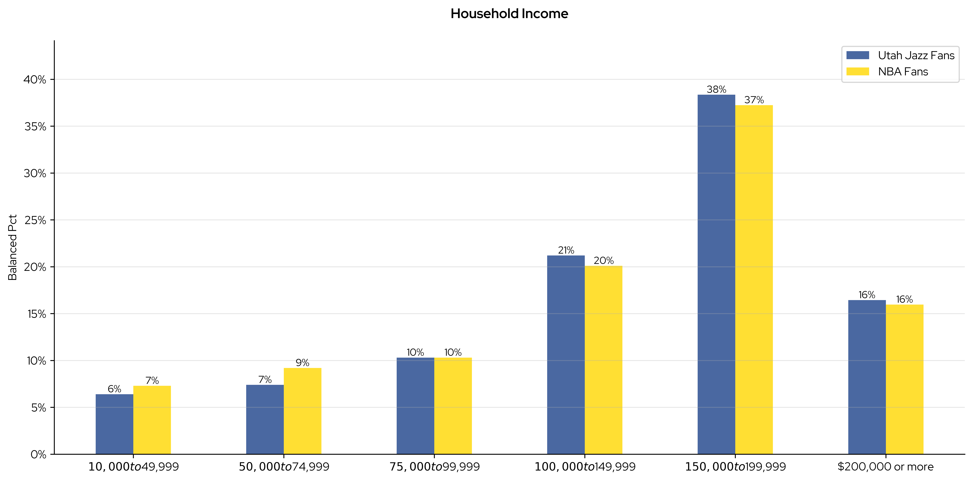
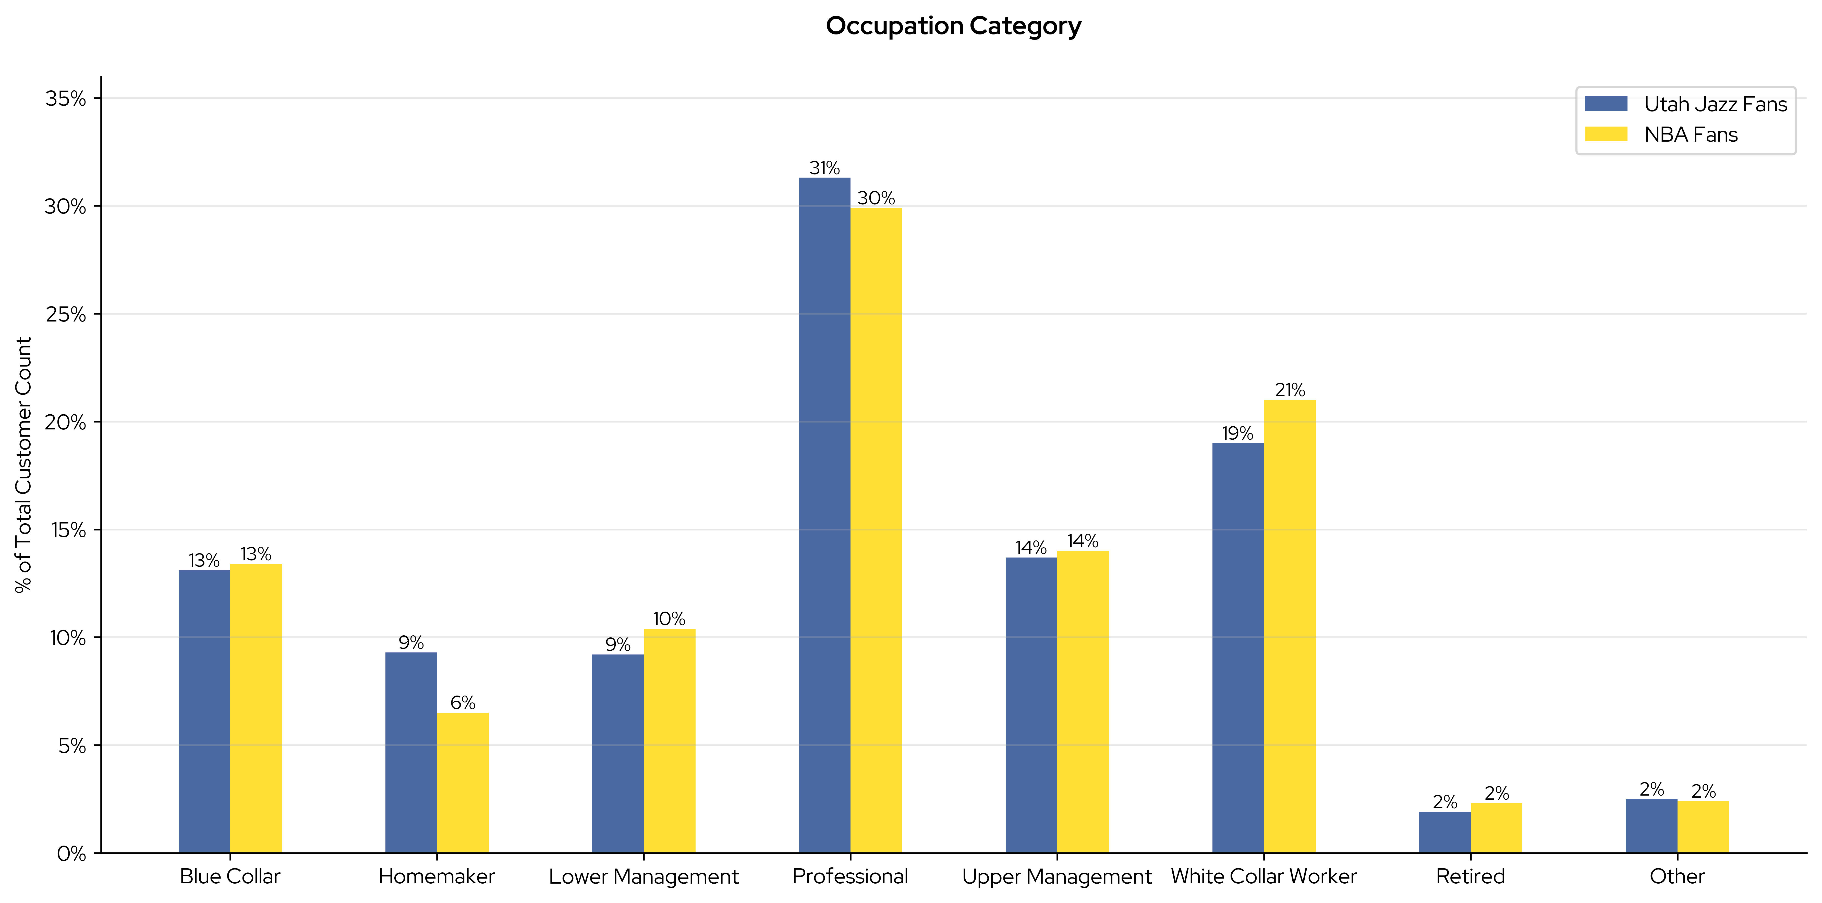
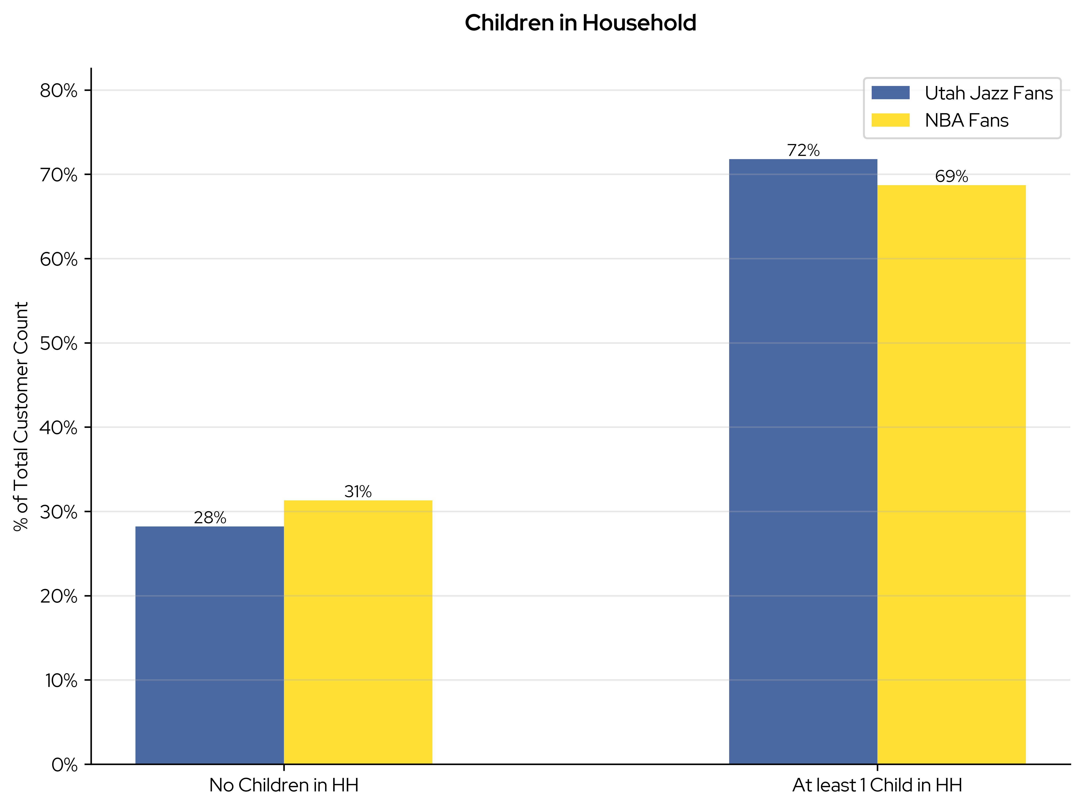
Utah Jazz
Fan Demographics: How Are Utah Jazz Fans Unique (continued)

Slide 6
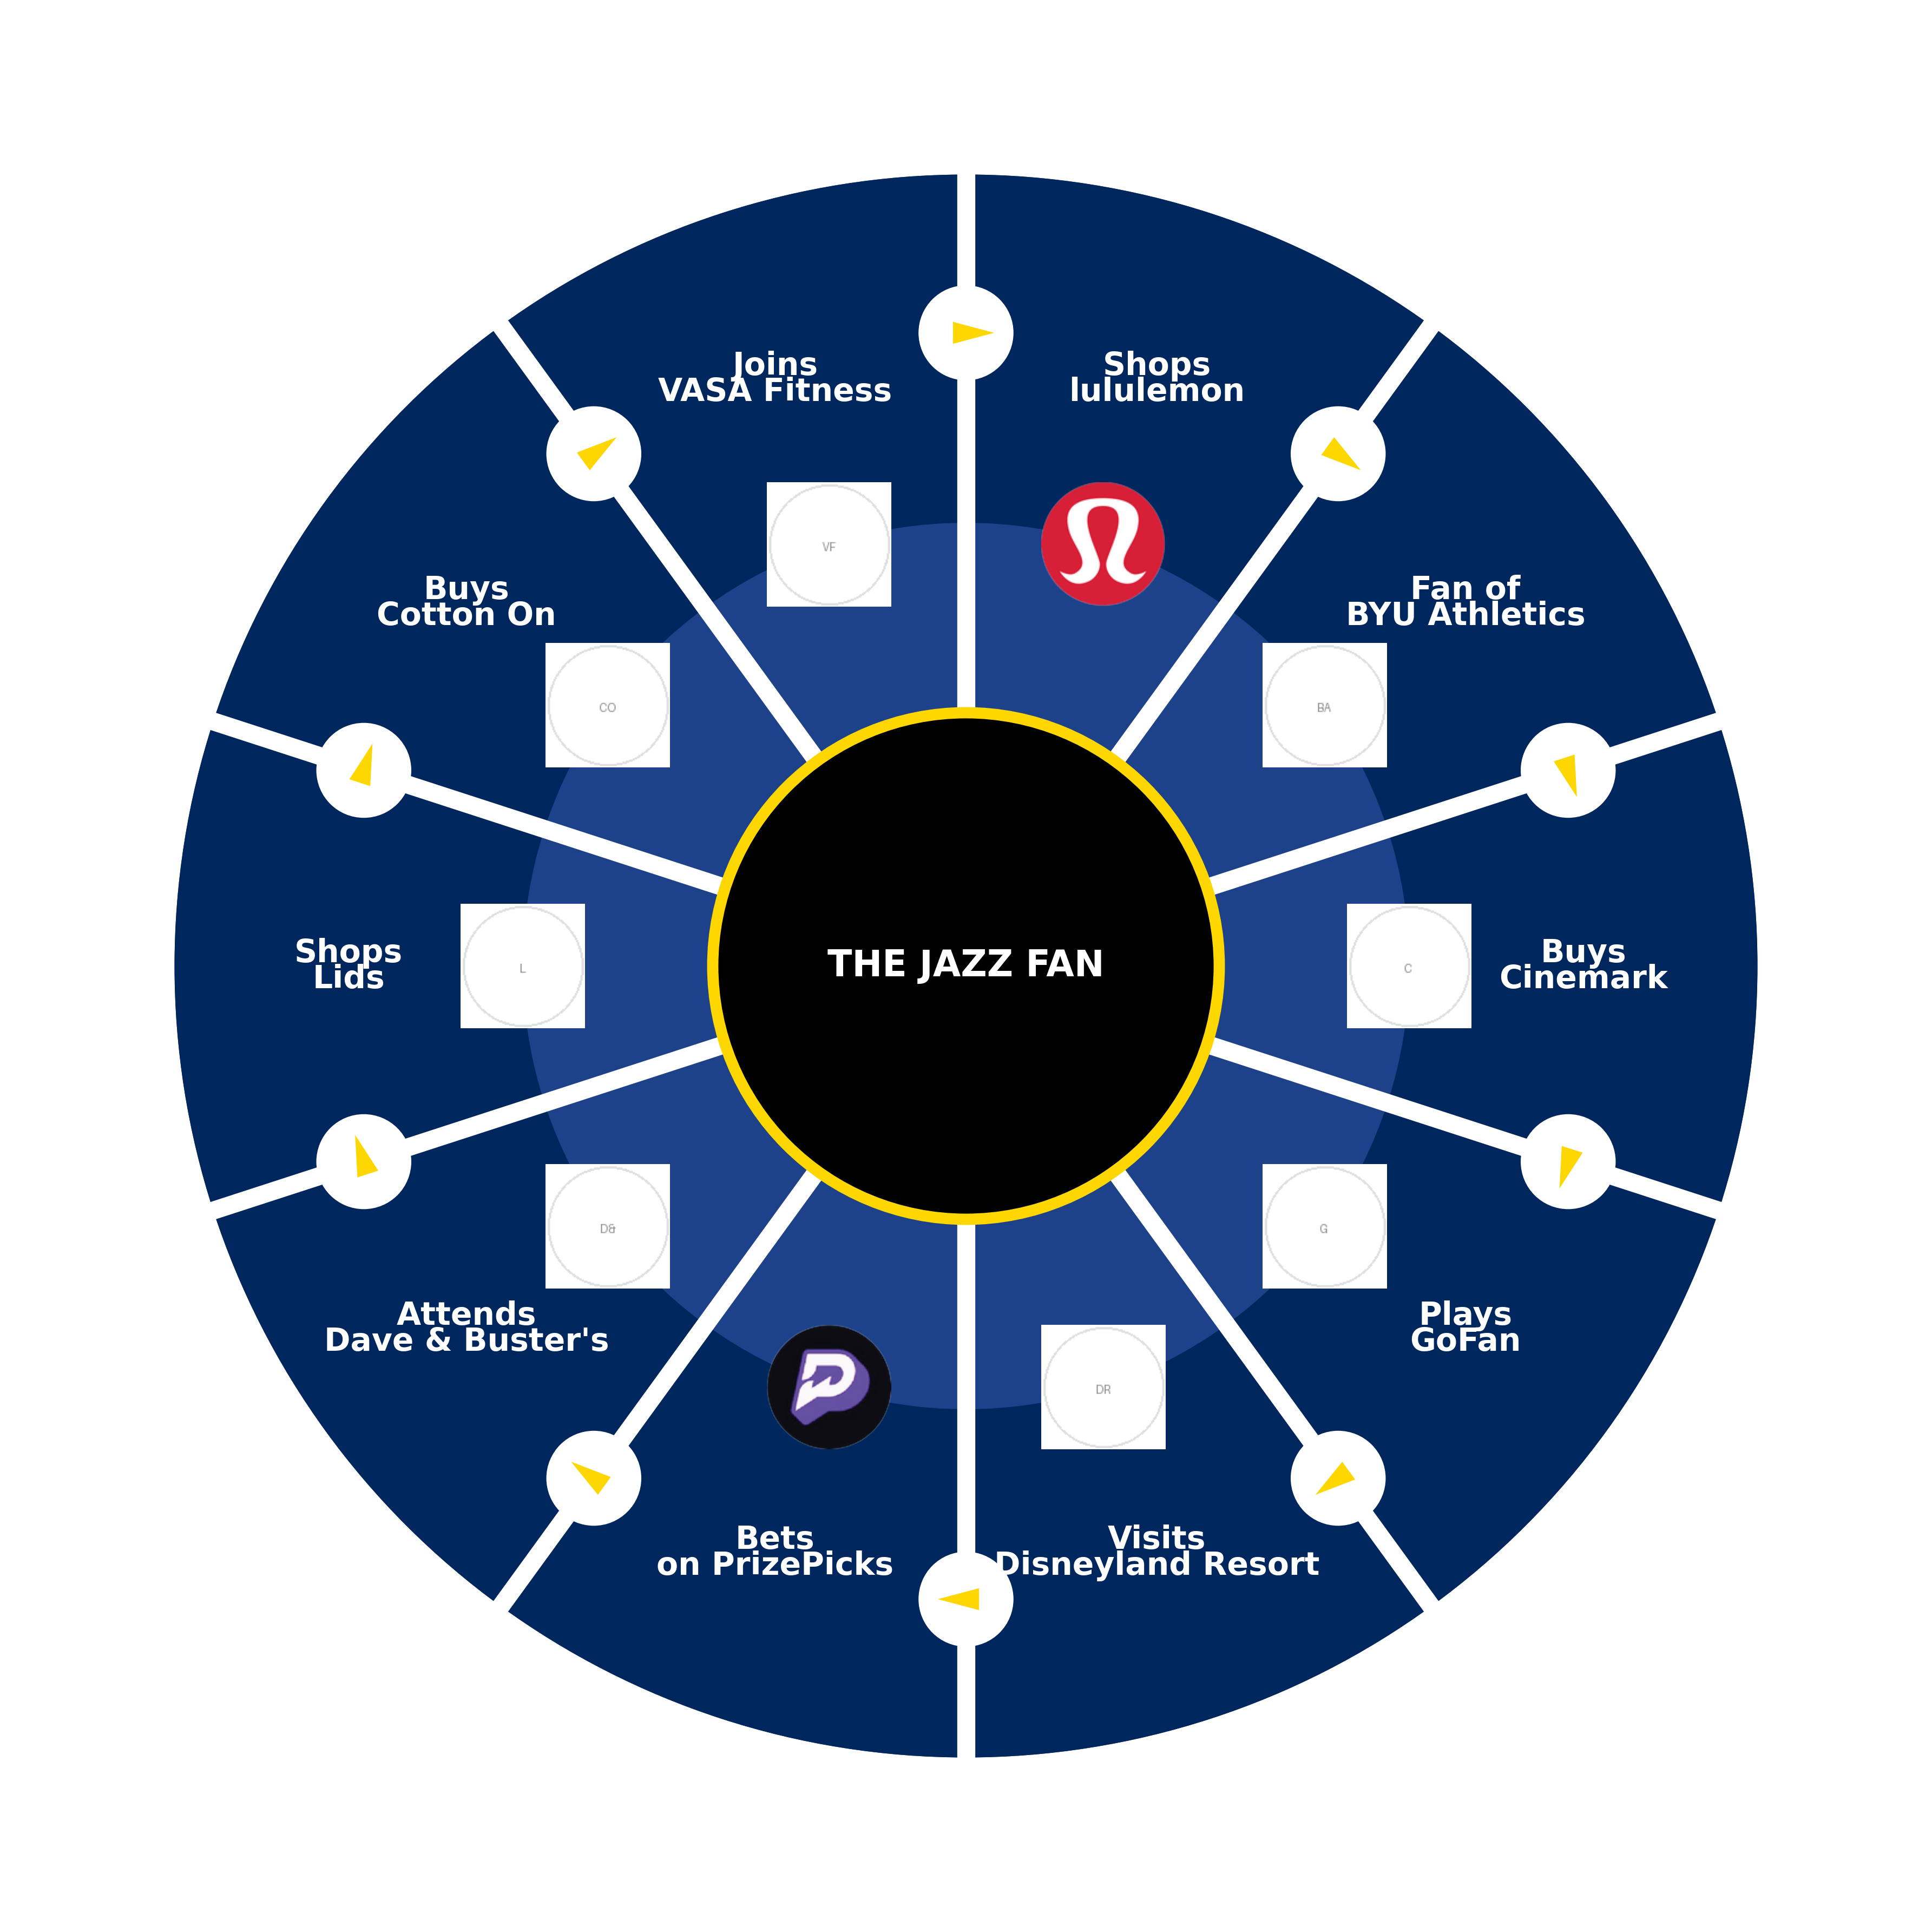
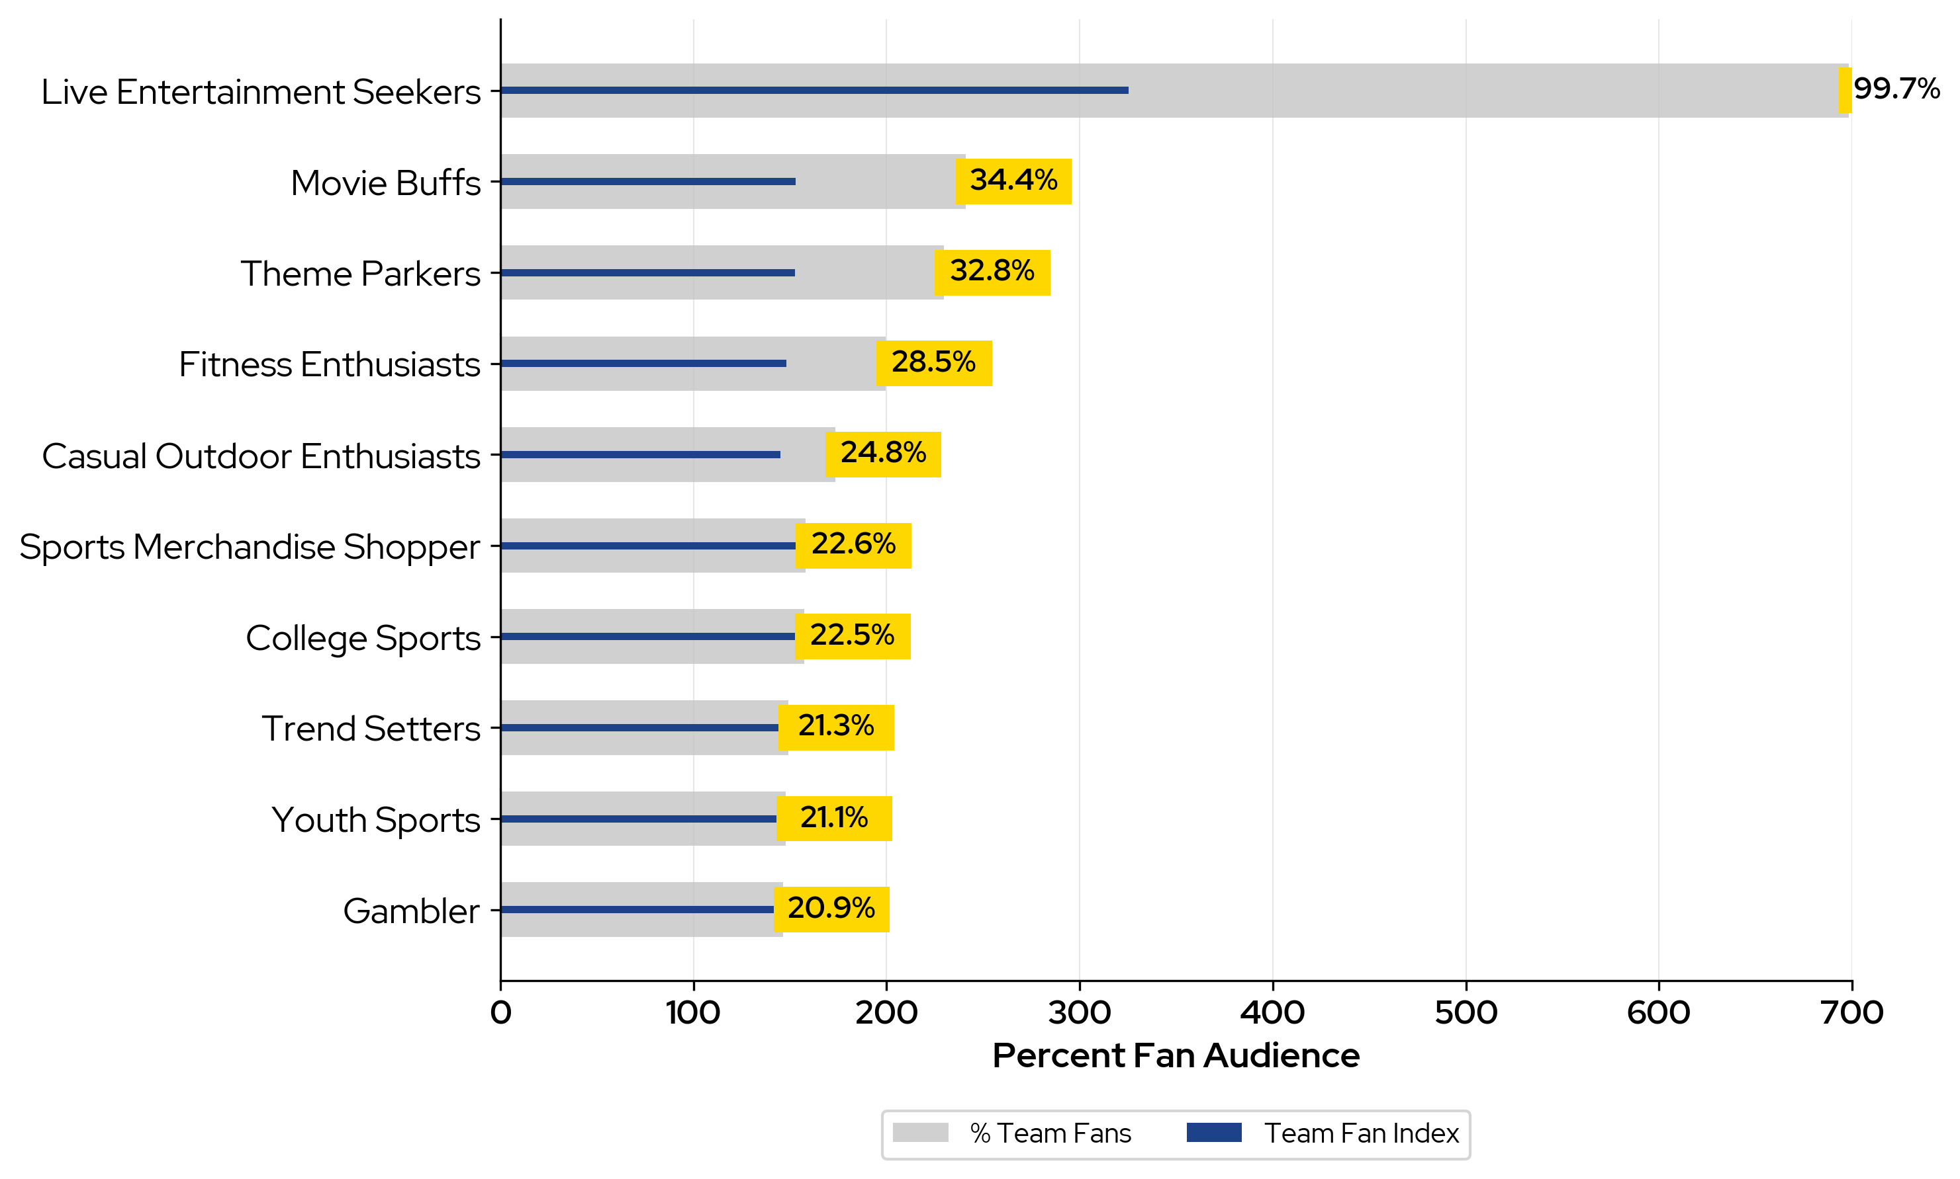
Utah Jazz
Fan Behaviors: How Are Utah Jazz Fans Unique
Jazz
Top Community Fan Purchases
Top Ten Utah Jazz Fan Communities
The top ten fan communities are ranked according to a composite index score of likelihood to purchase, likelihood to make more purchases per fan versus the local general population, and likelihood to spend more per fan.
Jazz fans are values-driven live entertainment seekers who are sports fans and a good movie!

Slide 7
Utah Jazz
Restaurant Sponsor Analysis
Category Analysis: Restaurants
Category Insights:
Category | Percent of Fans Who Spend | How likely fans are to spend vs. local gen pop | How many more purchases per fan vs. local gen pop
Restaurants | 99% | 22% More likely | 152% More
• Jazz Fans are 22% more likely to spend on Restaurants than the local gen pop
• Jazz Fans make an average of 152% more purchases per fan on Restaurants than the local gen pop
• Jazz Fans are more than 4.3X more likely to spend on Fine Dining vs. the local gen pop
• Jazz fans spend an average of $2,536 per fan per year on QSR & Fast Casual
Sub-Category | Percent of Fans Who Spend | How likely fans are to spend vs. local gen pop | How many more purchases per fan vs. local gen pop
Fine Dining | 6% | 328% More | 37% more
QSR & Fast Casual | 99% | 25% More | 145% more
Casual | 76% | 82% More | 68% more
Online Delivery | 45% | 134% More | 14% more
Jazz Fans vs. NBA Fans:
• Utah Jazz fans are 1% more likely to spend on QSR & Fast Casual when compared to the NBA average

Slide 8



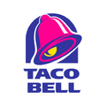
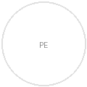
Utah Jazz
Sponsor Spending Analysis: Restaurants Brands
Top Restaurants Brands for Utah Jazz Fans
McDonald's
Chick-fil-A
Wendy's
Taco Bell
Panda Express
Top Brand Insights
Rank (by percent of fans who spend) | Brand | Percent of Fans Who Spend | How likely fans are to spend vs. local gen pop | Purchases Per Fan (vs. Local Gen Pop)
1 | McDonald's | 92% | 35% More | 93% More
2 | Chick-fil-A | 79% | 78% More | 93% More
3 | Wendy's | 77% | 55% More | 49% More
4 | Taco Bell | 68% | 77% More | 60% More
5 | Panda Express | 56% | 64% More | 33% More
• 92% of Utah Jazz fans spent at McDonald's
• Jazz fans make an average of 48 purchases per year at McDonald's—more than any other top Restaurants brand
• Utah Jazz fans spent an average of $546 per fan on McDonald's per year
• Utah Jazz fans are 158% more likely to spend on Panda Express than NBA Fans
Top Brand Target
• The Utah Jazz should target Little Caesars for a sponsorship based on having the highest composite index of 188
• The composite index indicates a brand with significant likelihood for more fans to be spending more frequently, and at a higher spend per fan vs. other brands

Slide 9
Utah Jazz
Athleisure Sponsor Analysis
Category Analysis: Athleisure
Category Insights:
Category | Percent of Fans Who Spend | How likely fans are to spend vs. local gen pop | How many more purchases per fan vs. local gen pop
Athleisure | 41% | 187% More likely | 50% More
• Jazz Fans are 187% more likely to spend on Athleisure than the local gen pop
• Jazz Fans make an average of 50% more purchases per fan on Athleisure than the local gen pop
• Jazz Fans are 193% More likely to spend on Sneakers Plus vs. the local gen pop
• Jazz fans spend an average of $546 per fan per year on Activewear
Sub-Category | Percent of Fans Who Spend | How likely fans are to spend vs. local gen pop | How many more purchases per fan vs. local gen pop
Sneakers Plus | 29% | 193% More | 52% more
Activewear | 26% | 236% More | 24% more
Jazz Fans vs. NBA Fans:
• Utah Jazz fans are 11% more likely to spend on Activewear when compared to the NBA average

Slide 10
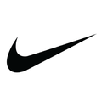



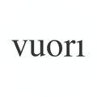
Utah Jazz
Sponsor Spending Analysis: Athleisure Brands
Top Athleisure Brands for Utah Jazz Fans
Nike
lululemon
Under Armour
adidas
Vuori
Top Brand Insights
Rank (by percent of fans who spend) | Brand | Percent of Fans Who Spend | How likely fans are to spend vs. local gen pop | Purchases Per Fan (vs. Local Gen Pop)
1 | Nike | 22% | 181% More | 52% More
2 | lululemon | 12% | 221% More | 20% More
3 | Under Armour | 6% | 191% More | 18% More
4 | adidas | 4% | 166% More | 18% More
5 | Vuori | 3% | 334% More | 13% More
• 22% of Utah Jazz fans spent at Nike
• Jazz fans make an average of 4 purchases per year at Nike—more than any other top Athleisure brand
• Utah Jazz fans spent an average of $567 per fan on lululemon per year
• Utah Jazz fans are 165% more likely to spend on Vuori than NBA Fans
Top Brand Target
• The Utah Jazz should target Quiksilver for a sponsorship based on having the highest composite index of 332
• The composite index indicates a brand with significant likelihood for more fans to be spending more frequently, and at a higher spend per fan vs. other brands

Slide 11
Utah Jazz
Finance Sponsor Analysis
Category Analysis: Finance
Category Insights:
Category | Percent of Fans Who Spend | How likely fans are to spend vs. local gen pop | How many more purchases per fan vs. local gen pop
Finance | 89% | 47% More likely | 84% More
• Jazz Fans are 47% more likely to spend on Finance than the local gen pop
• Jazz Fans make an average of 84% more purchases per fan on Finance than the local gen pop
• Jazz Fans are 151% More likely to spend on Buy Now Pay Later (BNPL) vs. the local gen pop
• Jazz fans spend an average of $2,285 per fan per year on Payment Wallets & Money Transfers
Sub-Category | Percent of Fans Who Spend | How likely fans are to spend vs. local gen pop | How many more purchases per fan vs. local gen pop
Buy Now Pay Later (BNPL) | 13% | 151% More | 33% more
Payment Wallets & Money Transfers | 88% | 49% More | 78% more
Investments | 1% | 67% More | 14% more
Banks | 3% | 33% More | 0% Less
Jazz Fans vs. NBA Fans:
• Utah Jazz fans are 2% more likely to spend on Payment Wallets & Money Transfers when compared to the NBA average

Slide 12





Utah Jazz
Sponsor Spending Analysis: Finance Brands
Top Finance Brands for Utah Jazz Fans
Square
PayPal
Venmo
Klarna
Afterpay
Top Brand Insights
Rank (by percent of fans who spend) | Brand | Percent of Fans Who Spend | How likely fans are to spend vs. local gen pop | Purchases Per Fan (vs. Local Gen Pop)
1 | Square | 81% | 36% More | 100% More
2 | PayPal | 53% | 60% More | 0% Less
3 | Venmo | 12% | 56% More | 110% More
4 | Klarna | 9% | 151% More | 20% More
5 | Afterpay | 7% | 140% More | 30% More
• 81% of Utah Jazz fans spent at Square
• Jazz fans make an average of 28 purchases per year at Venmo—more than any other top Finance brand
• Utah Jazz fans spent an average of $3,183 per fan on Venmo per year
• Utah Jazz fans are 105% more likely to spend on PayPal than NBA Fans
Top Brand Target
• The Utah Jazz should target LevelUp for a sponsorship based on having the highest composite index of 182
• The composite index indicates a brand with significant likelihood for more fans to be spending more frequently, and at a higher spend per fan vs. other brands

Slide 13
Utah Jazz
Gambling Sponsor Analysis
Category Analysis: Gambling
Category Insights:
Category | Percent of Fans Who Spend | How likely fans are to spend vs. local gen pop | How many more purchases per fan vs. local gen pop
Gambling | 11% | 288% More likely | 54% More
• Jazz Fans are 288% more likely to spend on Gambling than the local gen pop
• Jazz Fans make an average of 54% more purchases per fan on Gambling than the local gen pop
• Jazz Fans are more than 6.1X more likely to spend on Online vs. the local gen pop
• Jazz fans spend an average of $1,917 per fan per year on Casinos
Sub-Category | Percent of Fans Who Spend | How likely fans are to spend vs. local gen pop | How many more purchases per fan vs. local gen pop
Online | 9% | 509% More | 23% more
Lottery | 1% | 71% More | 2% Less
Casinos | 2% | 101% More | 40% Less
Jazz Fans vs. NBA Fans:
• Utah Jazz fans are 40% more likely to spend on Casinos when compared to the NBA average

Slide 14


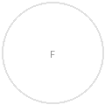


Utah Jazz
Sponsor Spending Analysis: Gambling Brands
Top Gambling Brands for Utah Jazz Fans
PrizePicks
DraftKings
FanDuel
Underdog Sports
BetMGM
Top Brand Insights
Rank (by percent of fans who spend) | Brand | Percent of Fans Who Spend | How likely fans are to spend vs. local gen pop | Purchases Per Fan (vs. Local Gen Pop)
1 | PrizePicks | 4% | 492% More | 24% More
2 | DraftKings | 2% | 476% More | 4% More
3 | FanDuel | 2% | 635% More | 33% More
4 | Underdog Sports | 2% | 547% More | 26% More
5 | BetMGM | 1% | 577% More | 120% More
• 4% of Utah Jazz fans spent at PrizePicks
• Jazz fans make an average of 27 purchases per year at FanDuel—more than any other top Gambling brand
• Utah Jazz fans spent an average of $2,272 per fan on BetMGM per year
• Utah Jazz fans are 79% more likely to spend on Underdog Sports than NBA Fans
Top Brand Target
• The Utah Jazz should target Hard Rock Sportsbook for a sponsorship based on having the highest composite index of 409
• The composite index indicates a brand with significant likelihood for more fans to be spending more frequently, and at a higher spend per fan vs. other brands

Slide 15
Utah Jazz
Travel Sponsor Analysis
Category Analysis: Travel
Category Insights:
Category | Percent of Fans Who Spend | How likely fans are to spend vs. local gen pop | How many more purchases per fan vs. local gen pop
Travel | 53% | 97% More likely | 55% More
• Jazz Fans are 97% more likely to spend on Travel than the local gen pop
• Jazz Fans make an average of 55% more purchases per fan on Travel than the local gen pop
• Jazz Fans are 84% More likely to spend on Airlines vs. the local gen pop
• Jazz fans spend an average of $3,132 per fan per year on Cruises
Sub-Category | Percent of Fans Who Spend | How likely fans are to spend vs. local gen pop | How many more purchases per fan vs. local gen pop
Airlines | 32% | 84% More | 73% more
Travel Agencies | 18% | 82% More | 31% more
Rental Cars | 15% | 104% More | 33% more
Cruises | 4% | 65% More | 4% more
Jazz Fans vs. NBA Fans:
• Utah Jazz fans are 16% more likely to spend on Cruises when compared to the NBA average

Slide 16

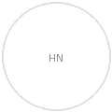

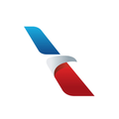
Utah Jazz
Sponsor Spending Analysis: Travel Brands
Top Travel Brands for Utah Jazz Fans
Hudson
Delta
Hudson News
Southwest
American Airlines
Top Brand Insights
Rank (by percent of fans who spend) | Brand | Percent of Fans Who Spend | How likely fans are to spend vs. local gen pop | Purchases Per Fan (vs. Local Gen Pop)
1 | Hudson | 19% | 252% More | 21% More
2 | Delta | 17% | 58% More | 48% More
3 | Hudson News | 15% | 275% More | 24% More
4 | Southwest | 9% | 110% More | 47% More
5 | American Airlines | 8% | 75% More | 58% More
• 19% of Utah Jazz fans spent at Hudson
• Jazz fans make an average of 7 purchases per year at Delta—more than any other top Travel brand
• Utah Jazz fans spent an average of $2,118 per fan on Delta per year
• Utah Jazz fans are 186% more likely to spend on Delta than NBA Fans
Top Brand Target
• The Utah Jazz should target Tripadvisor for a sponsorship based on having the highest composite index of 216
• The composite index indicates a brand with significant likelihood for more fans to be spending more frequently, and at a higher spend per fan vs. other brands

Slide 17
Utah Jazz
Auto Sponsor Analysis
Category Analysis: Auto
Category Insights:
Category | Percent of Fans Who Spend | How likely fans are to spend vs. local gen pop | How many more purchases per fan vs. local gen pop
Auto | 63% | 55% More likely | 33% More
• Jazz Fans are 55% more likely to spend on Auto than the local gen pop
• Jazz Fans make an average of 33% more purchases per fan on Auto than the local gen pop
• Jazz Fans are 127% More likely to spend on Car Washes vs. the local gen pop
• Jazz fans spend an average of $1,515 per fan per year on Car Dealers
Sub-Category | Percent of Fans Who Spend | How likely fans are to spend vs. local gen pop | How many more purchases per fan vs. local gen pop
Car Washes | 21% | 127% More | 16% more
Car Dealers | 28% | 84% More | 17% more
Auto Service | 11% | 62% More | 10% Less
Auto Parts | 28% | 44% More | 12% more
Jazz Fans vs. NBA Fans:
• Utah Jazz fans are 98% more likely to spend on Car Washes when compared to the NBA average

Slide 18

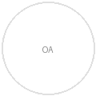



Utah Jazz
Sponsor Spending Analysis: Auto Brands
Top Auto Brands for Utah Jazz Fans
AutoZone
O'Reilly Auto Parts
Jiffy Lube
Quick Quack Car Wash
Mister Car Wash
Top Brand Insights
Rank (by percent of fans who spend) | Brand | Percent of Fans Who Spend | How likely fans are to spend vs. local gen pop | Purchases Per Fan (vs. Local Gen Pop)
1 | AutoZone | 16% | 18% More | 8% More
2 | O'Reilly Auto Parts | 14% | 14% More | 13% More
3 | Jiffy Lube | 13% | 50% More | 13% More
4 | Quick Quack Car Wash | 11% | 62% More | 9% More
5 | Mister Car Wash | 9% | 126% More | 4% More
• 16% of Utah Jazz fans spent at AutoZone
• Jazz fans make an average of 8 purchases per year at Quick Quack Car Wash—more than any other top Auto brand
• Utah Jazz fans spent an average of $279 per fan on O'Reilly Auto Parts per year
• Utah Jazz fans are 1134% more likely to spend on Quick Quack Car Wash than NBA Fans
Top Brand Target
• The Utah Jazz should target Quick Quack Car Wash for a sponsorship based on having the highest composite index of 527
• The composite index indicates a brand with significant likelihood for more fans to be spending more frequently, and at a higher spend per fan vs. other brands

Slide 19
Utah Jazz
Professional Sports Sponsor Analysis
Category Analysis: Professional Sports
Category Insights:
Category | Percent of Fans Who Spend | How likely fans are to spend vs. local gen pop | How many more purchases per fan vs. local gen pop
Professional Sports | 100% | 798% More likely | 110% More
• Jazz Fans are 798% more likely to spend on Professional Sports than the local gen pop
• Jazz Fans make an average of 110% more purchases per fan on Professional Sports than the local gen pop
• Jazz Fans are more than 12.2X more likely to spend on Arenas & Stadiums vs. the local gen pop
• Jazz fans spend an average of $764 per fan per year on Misc Events
Sub-Category | Percent of Fans Who Spend | How likely fans are to spend vs. local gen pop | How many more purchases per fan vs. local gen pop
Arenas & Stadiums | 100% | 1116% More | 93% more
Teams | 100% | 1080% More | 85% more
Misc Events | 1% | 637% More | 10% more
Merchandise | 13% | 484% More | 22% more
Jazz Fans vs. NBA Fans:
• Utah Jazz fans are 12% more likely to spend on Arenas & Stadiums when compared to the NBA average

Slide 20
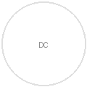
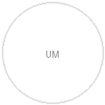

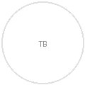
Utah Jazz
Sponsor Spending Analysis: Professional Sports Brands
Top Professional Sports Brands for Utah Jazz Fans
Delta Center
Utah Mammoth
Salt Lake Bees
The Ballpark at America First Square
Top Brand Insights
Rank (by percent of fans who spend) | Brand | Percent of Fans Who Spend | How likely fans are to spend vs. local gen pop | Purchases Per Fan (vs. Local Gen Pop)
1 | Delta Center | 100% | 8942% More | 82% More
2 | Utah Mammoth | 59% | 79566% More | 65% More
3 | Salt Lake Bees | 15% | 420% More | 48% More
4 | The Ballpark at America First Square | 14% | 446% More | 43% More
• 100% of Utah Jazz fans spent at Delta Center
• Jazz fans make an average of 4 purchases per year at Salt Lake Bees—more than any other top Professional Sports brand
• Utah Jazz fans spent an average of $99 per fan on Salt Lake Bees per year
• Utah Jazz fans are 345622% more likely to spend on Delta Center than NBA Fans
Top Brand Target
• The Utah Jazz should target Utah Mammoth for a sponsorship based on having the highest composite index of 159150
• The composite index indicates a brand with significant likelihood for more fans to be spending more frequently, and at a higher spend per fan vs. other brands

Slide 21
Utah Jazz
Colleges & Universities Sponsor Analysis
Category Analysis: Colleges & Universities
Category Insights:
Category | Percent of Fans Who Spend | How likely fans are to spend vs. local gen pop | How many more purchases per fan vs. local gen pop
Colleges & Universities | 27% | 270% More likely | 41% More
• Jazz Fans are 270% more likely to spend on Colleges & Universities than the local gen pop
• Jazz Fans make an average of 41% more purchases per fan on Colleges & Universities than the local gen pop
• Jazz Fans are more than 4.3X more likely to spend on Sports vs. the local gen pop
• Jazz fans spend an average of $222 per fan per year on Sports
Sub-Category | Percent of Fans Who Spend | How likely fans are to spend vs. local gen pop | How many more purchases per fan vs. local gen pop
Sports | 22% | 333% More | 56% more
Bookstores | 11% | 211% More | 11% more
Jazz Fans vs. NBA Fans:
• Utah Jazz fans are 111% more likely to spend on Bookstores when compared to the NBA average

Slide 22
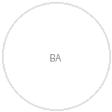
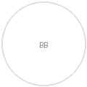
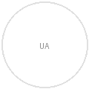

Utah Jazz
Sponsor Spending Analysis: Colleges & Universities Brands
Top Colleges & Universities Brands for Utah Jazz Fans
BYU Athletics
BYU Bookstore
Utah Athletics
Utah Bookstore
UCLA Athletics
Top Brand Insights
Rank (by percent of fans who spend) | Brand | Percent of Fans Who Spend | How likely fans are to spend vs. local gen pop | Purchases Per Fan (vs. Local Gen Pop)
1 | BYU Athletics | 12% | 190% More | 58% More
2 | BYU Bookstore | 7% | 112% More | 21% More
3 | Utah Athletics | 2% | 350% More | 41% More
4 | Utah Bookstore | 2% | 334% More | 3% Less
5 | UCLA Athletics | 2% | 637% More | 18% More
• 12% of Utah Jazz fans spent at BYU Athletics
• Jazz fans make an average of 6 purchases per year at BYU Athletics—more than any other top Colleges & Universities brand
• Utah Jazz fans spent an average of $231 per fan on BYU Athletics per year
• Utah Jazz fans are 25324% more likely to spend on Utah Athletics than NBA Fans
Top Brand Target
• The Utah Jazz should target Utah Athletics for a sponsorship based on having the highest composite index of 6436
• The composite index indicates a brand with significant likelihood for more fans to be spending more frequently, and at a higher spend per fan vs. other brands

Slide 23
Utah Jazz
Professional Sports Sponsor Analysis
Category Analysis: Professional Sports
Category Insights:
Category | Percent of Fans Who Spend | How likely fans are to spend vs. local gen pop | How many more purchases per fan vs. local gen pop
Professional Sports | 100% | 798% More likely | 110% More
• Jazz Fans are 798% more likely to spend on Professional Sports than the local gen pop
• Jazz Fans make an average of 110% more purchases per fan on Professional Sports than the local gen pop
• Jazz Fans are more than 12.2X more likely to spend on Arenas & Stadiums vs. the local gen pop
• Jazz fans spend an average of $764 per fan per year on Misc Events
Sub-Category | Percent of Fans Who Spend | How likely fans are to spend vs. local gen pop | How many more purchases per fan vs. local gen pop
Arenas & Stadiums | 100% | 1116% More | 93% more
Teams | 100% | 1080% More | 85% more
Misc Events | 1% | 637% More | 10% more
Merchandise | 13% | 484% More | 22% more
Jazz Fans vs. NBA Fans:
• Utah Jazz fans are 12% more likely to spend on Arenas & Stadiums when compared to the NBA average

Slide 24
Utah Jazz
Sponsor Spending Analysis: Professional Sports Brands
Top Professional Sports Brands for Utah Jazz Fans
Delta Center
Utah Mammoth
Salt Lake Bees
The Ballpark at America First Square
Top Brand Insights
Rank (by percent of fans who spend) | Brand | Percent of Fans Who Spend | How likely fans are to spend vs. local gen pop | Purchases Per Fan (vs. Local Gen Pop)
1 | Delta Center | 100% | 8942% More | 82% More
2 | Utah Mammoth | 59% | 79566% More | 65% More
3 | Salt Lake Bees | 15% | 420% More | 48% More
4 | The Ballpark at America First Square | 14% | 446% More | 43% More
• 100% of Utah Jazz fans spent at Delta Center
• Jazz fans make an average of 4 purchases per year at Salt Lake Bees—more than any other top Professional Sports brand
• Utah Jazz fans spent an average of $99 per fan on Salt Lake Bees per year
• Utah Jazz fans are 345622% more likely to spend on Delta Center than NBA Fans
Top Brand Target
• The Utah Jazz should target Utah Mammoth for a sponsorship based on having the highest composite index of 159150
• The composite index indicates a brand with significant likelihood for more fans to be spending more frequently, and at a higher spend per fan vs. other brands

Slide 25
Utah Jazz
Ticketing Platforms Sponsor Analysis
Category Analysis: Ticketing Platforms
Category Insights:
Category | Percent of Fans Who Spend | How likely fans are to spend vs. local gen pop | How many more purchases per fan vs. local gen pop
Ticketing Platforms | 50% | 293% More likely | 62% More
• Jazz Fans are 293% more likely to spend on Ticketing Platforms than the local gen pop
• Jazz Fans make an average of 62% more purchases per fan on Ticketing Platforms than the local gen pop
• Jazz Fans are more than 6.2X more likely to spend on Secondary vs. the local gen pop
• Jazz fans spend an average of $737 per fan per year on Secondary
Sub-Category | Percent of Fans Who Spend | How likely fans are to spend vs. local gen pop | How many more purchases per fan vs. local gen pop
Secondary | 22% | 518% More | 45% more
Primary | 42% | 289% More | 50% more

Slide 26




Utah Jazz
Sponsor Spending Analysis: Ticketing Platforms Brands
Top Ticketing Platforms Brands for Utah Jazz Fans
Ticketmaster
GoFan
AXS
SeatGeek
StubHub
Top Brand Insights
Rank (by percent of fans who spend) | Brand | Percent of Fans Who Spend | How likely fans are to spend vs. local gen pop | Purchases Per Fan (vs. Local Gen Pop)
1 | Ticketmaster | 23% | 313% More | 42% More
2 | GoFan | 16% | 189% More | 46% More
3 | AXS | 12% | 342% More | 22% More
4 | SeatGeek | 12% | 542% More | 16% More
5 | StubHub | 7% | 420% More | 25% More
• 23% of Utah Jazz fans spent at Ticketmaster
• Jazz fans make an average of 4 purchases per year at GoFan—more than any other top Ticketing Platforms brand
• Utah Jazz fans spent an average of $739 per fan on Ticketmaster per year
• Utah Jazz fans are 136% more likely to spend on GoFan than NBA Fans
Top Brand Target
• The Utah Jazz should target TickPick for a sponsorship based on having the highest composite index of 336
• The composite index indicates a brand with significant likelihood for more fans to be spending more frequently, and at a higher spend per fan vs. other brands

