Slide 1
UJ
Utah Jazz
Sponsorship Insights Report
July 2025

Slide 2
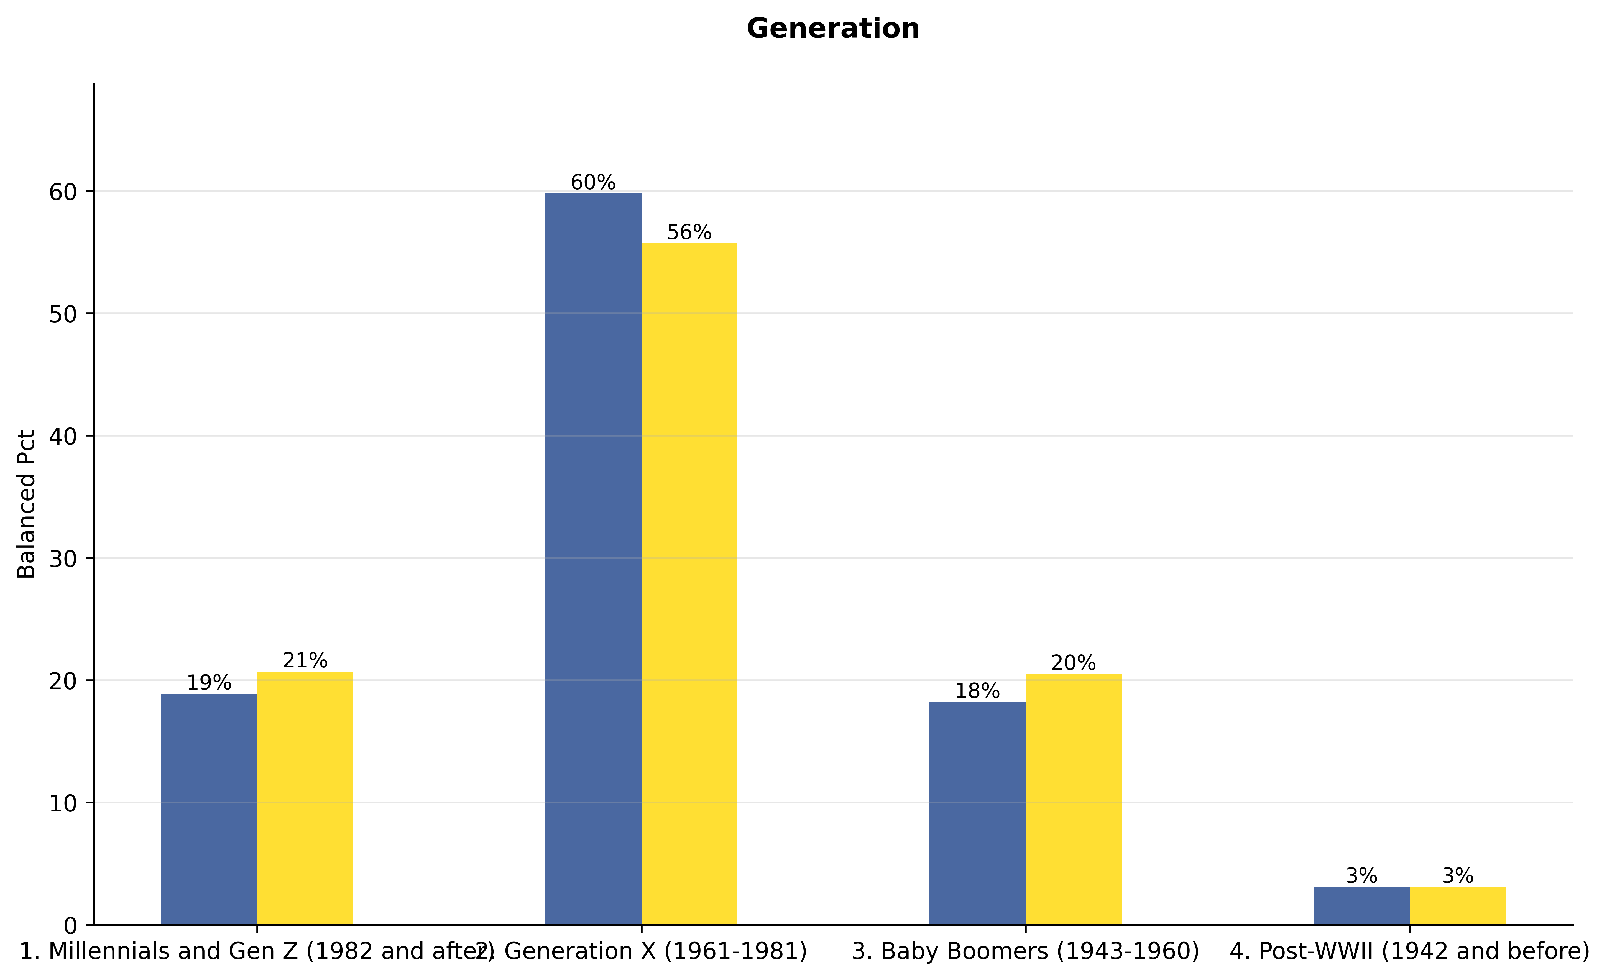
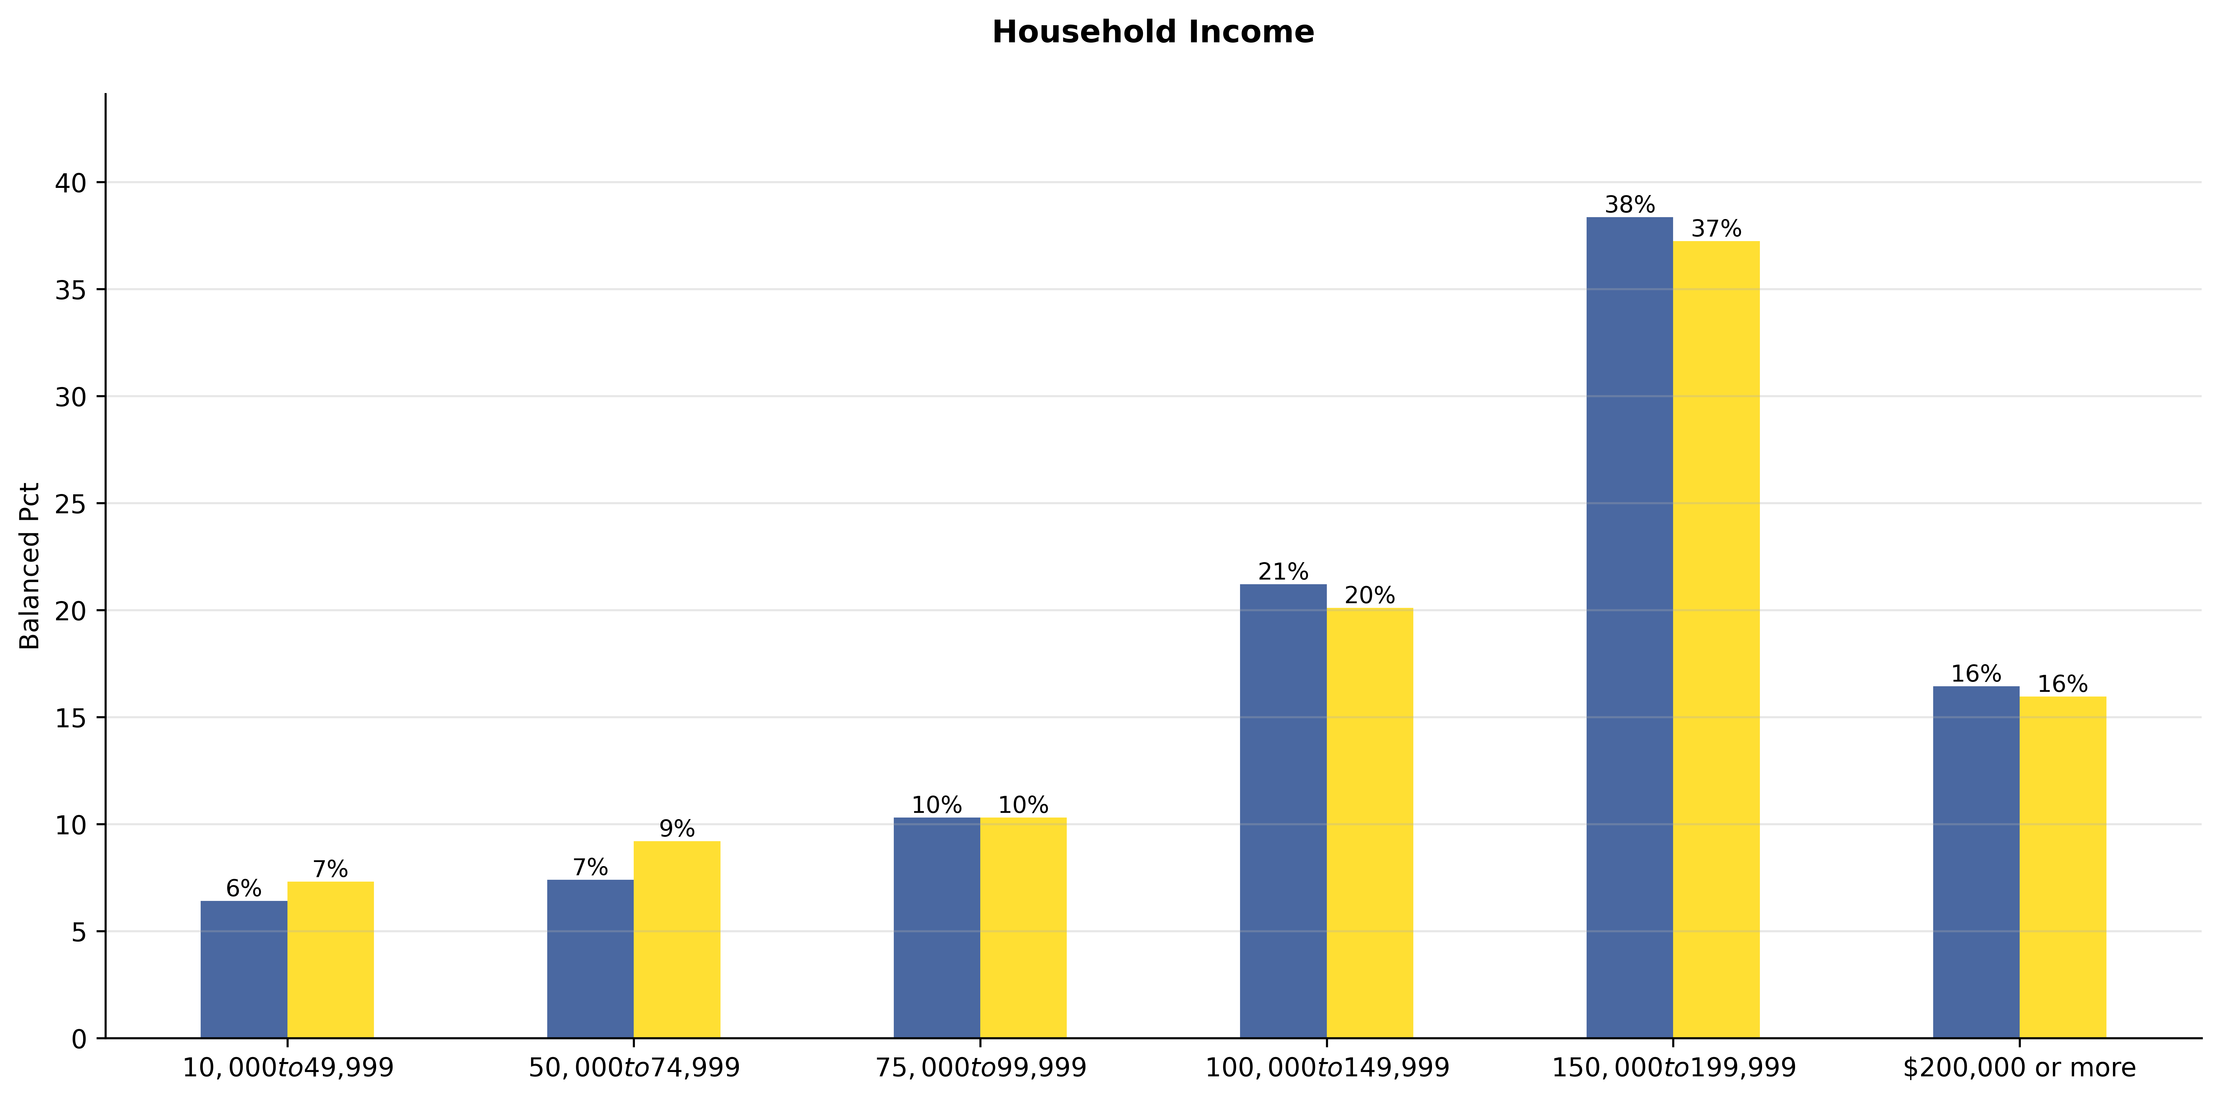
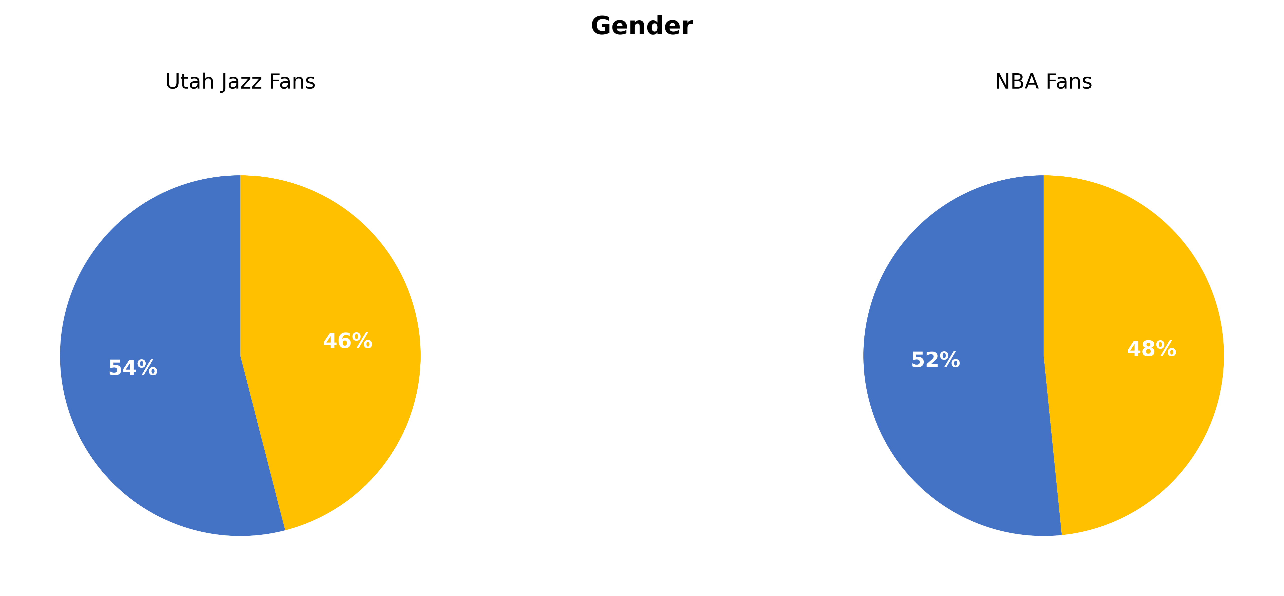
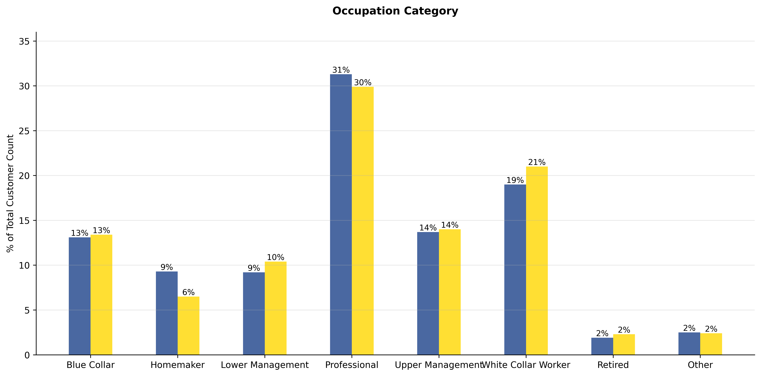
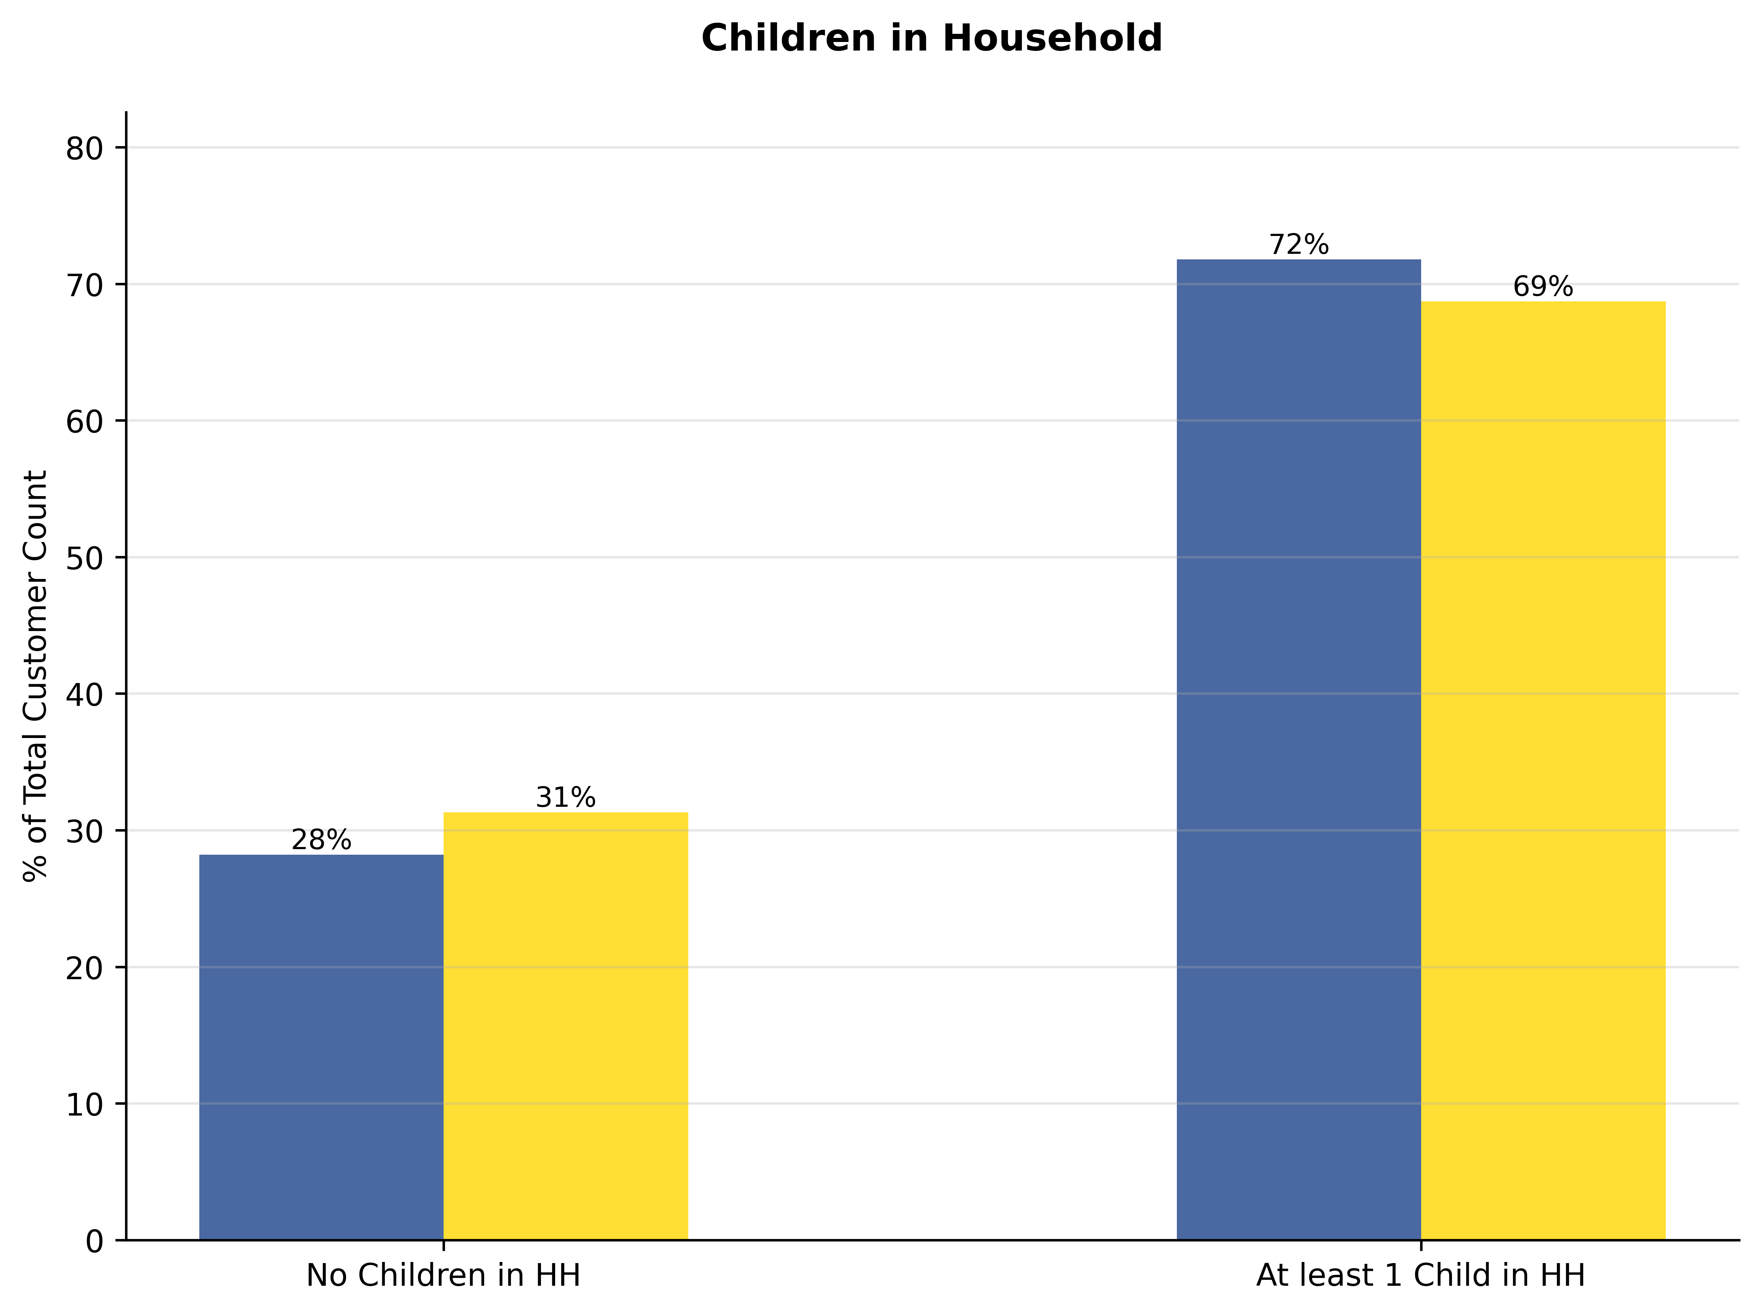
Utah Jazz
Fan Demographics: How Are Utah Jazz Fans Unique
Jazz
"Utah Jazz fans are significantly younger with 79% being Millennials/Gen X, have a higher household income with 76% earning $100K+, are more likely to be male at 54%, and majority are working professionals at 64%, compared to the Utah general population and slightly more so than the NBA average fans."
KEY
-Utah Jazz Fans
- Jazz Gen Pop (state level, excluding Jazz Fans)
- NBA Fans Total (excluding Jazz fans)
Ethnicity

