Slide 1
UJ
Utah Jazz
Sponsorship Insights Report
July 2025

Slide 2
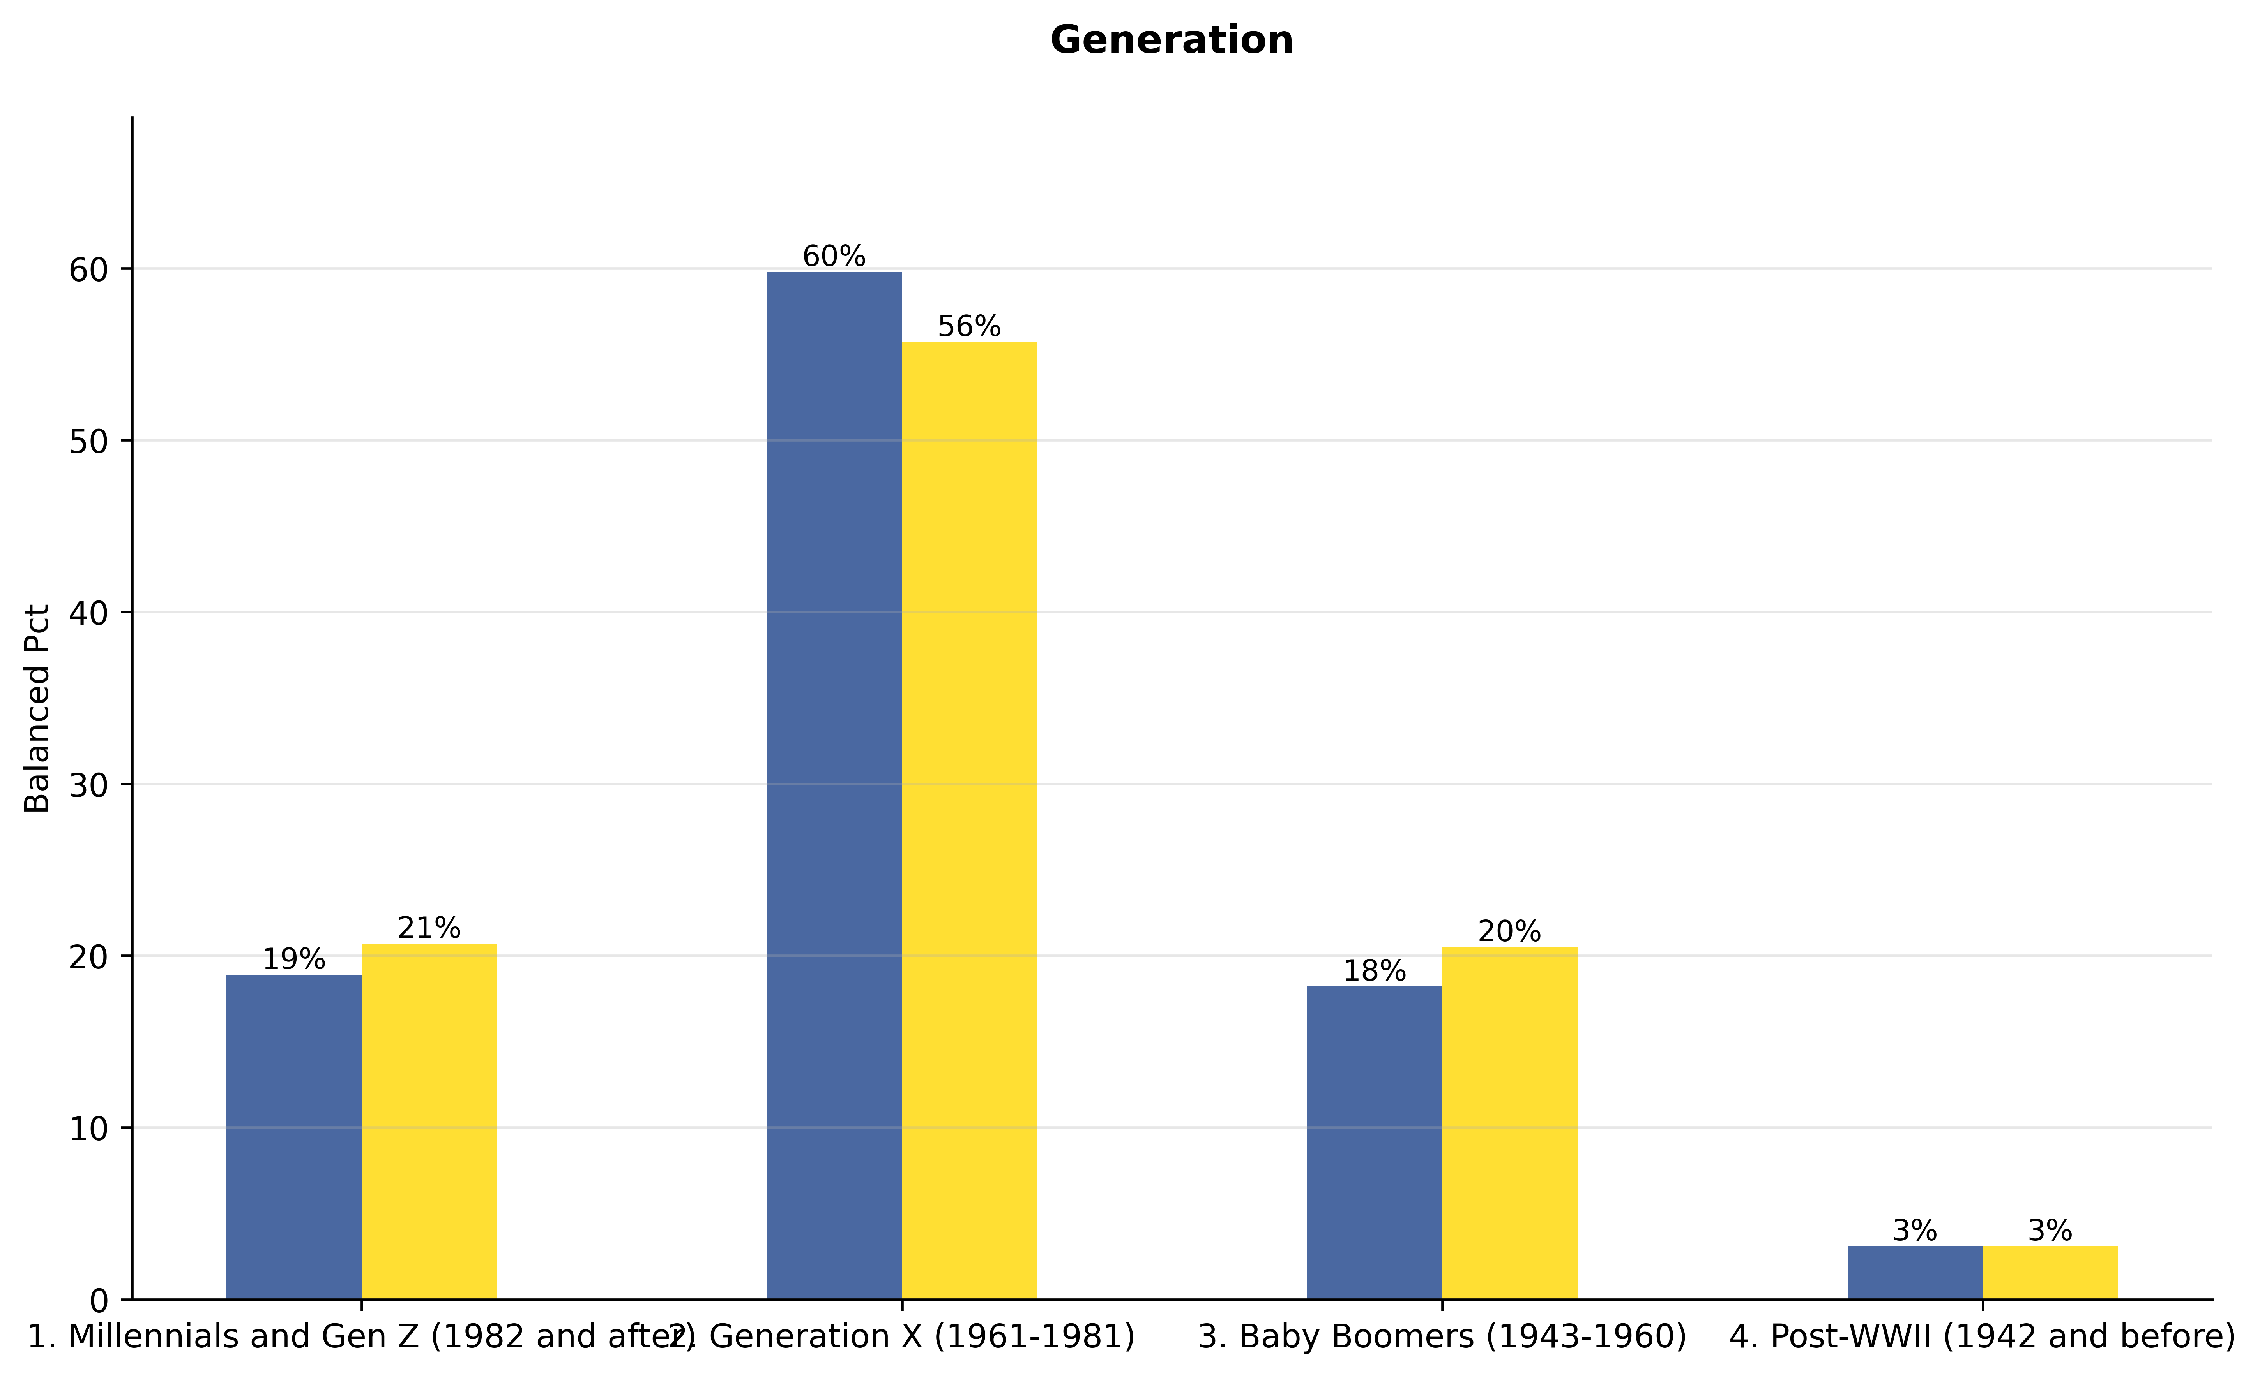
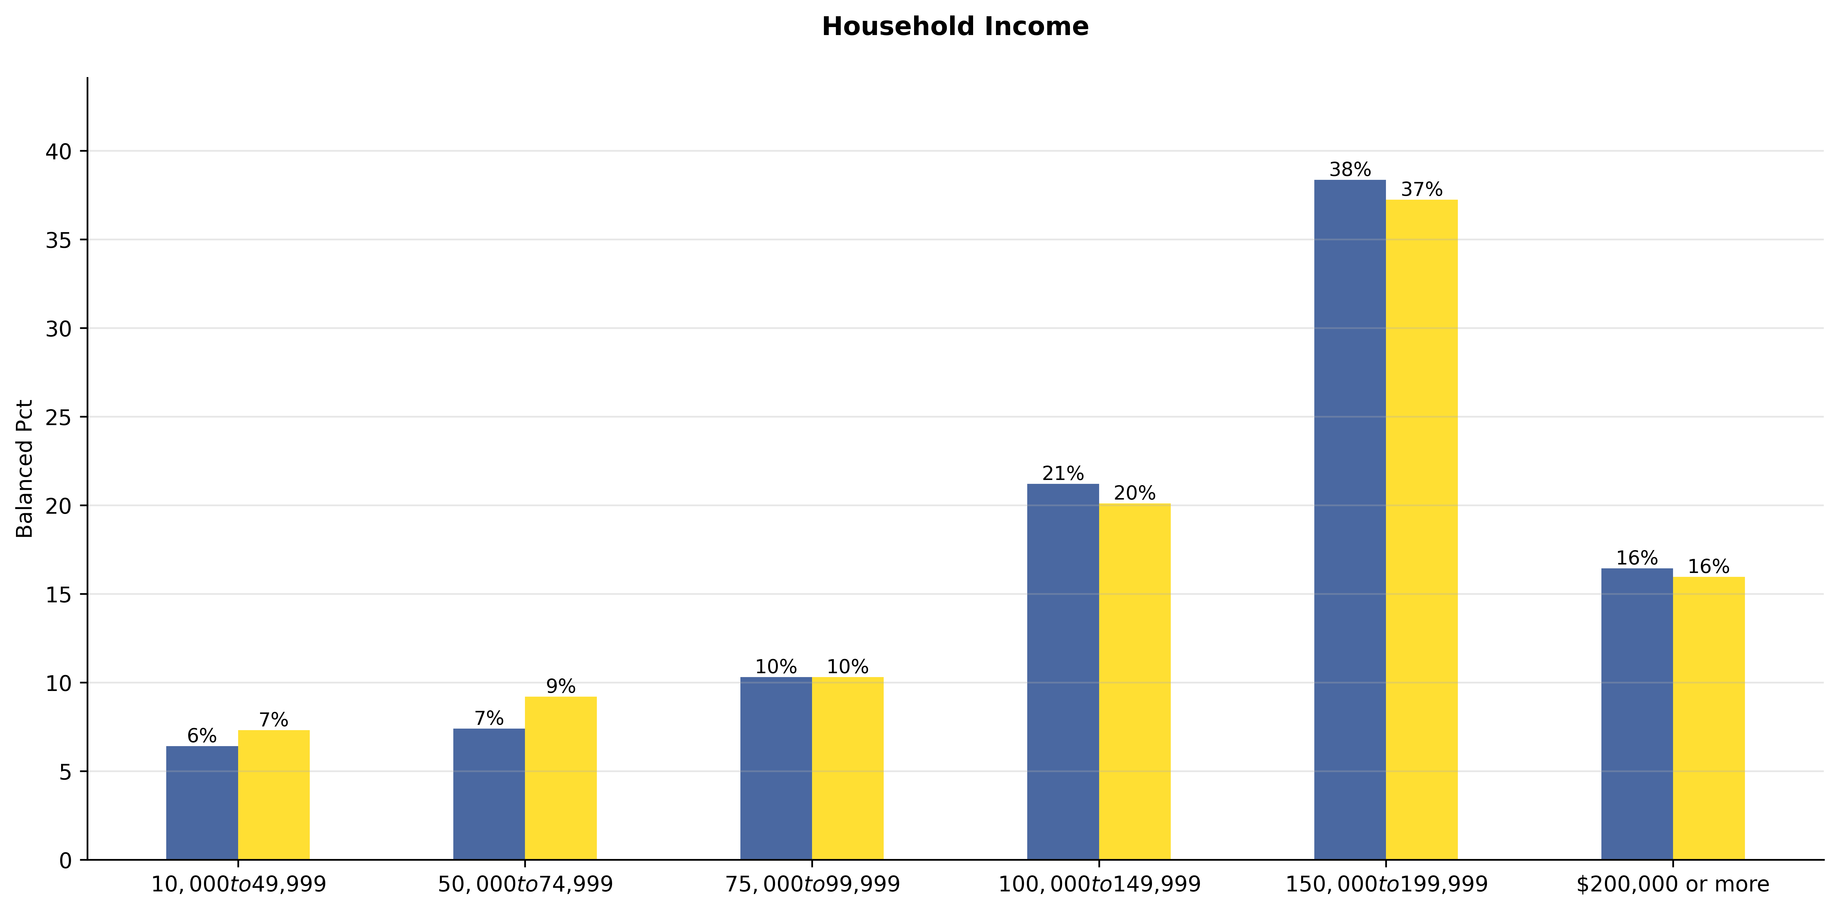
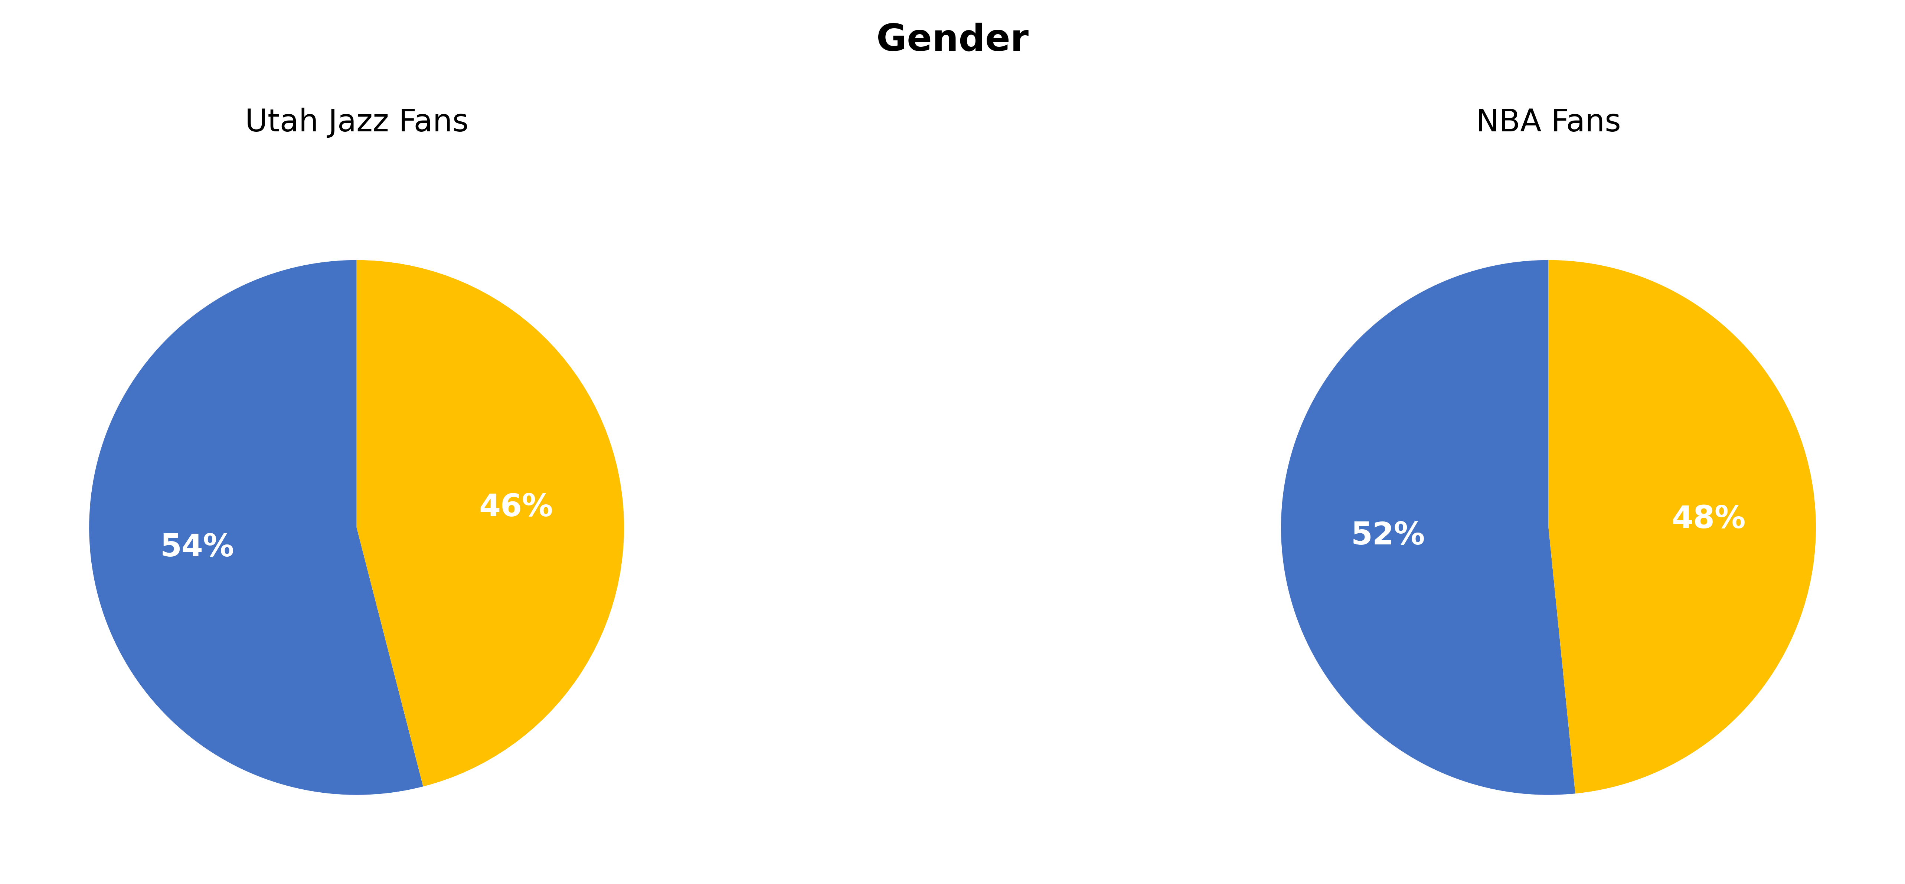
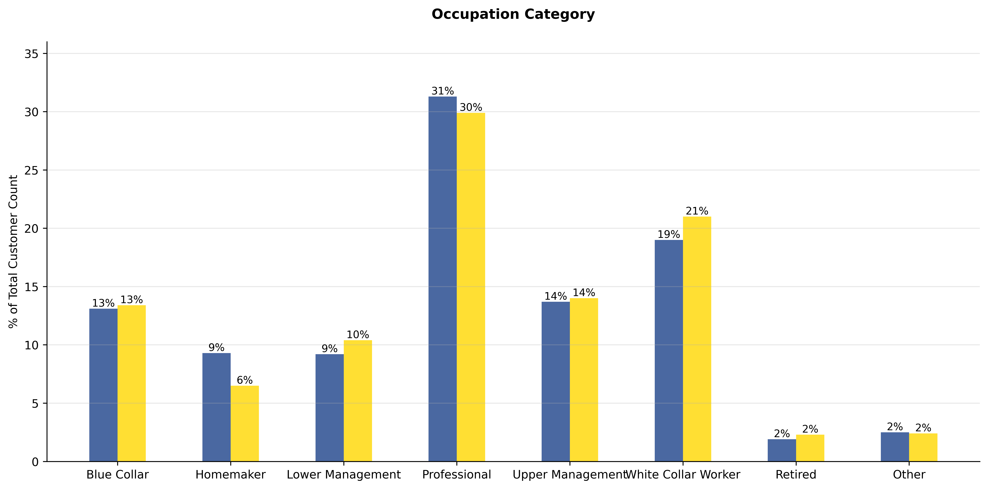
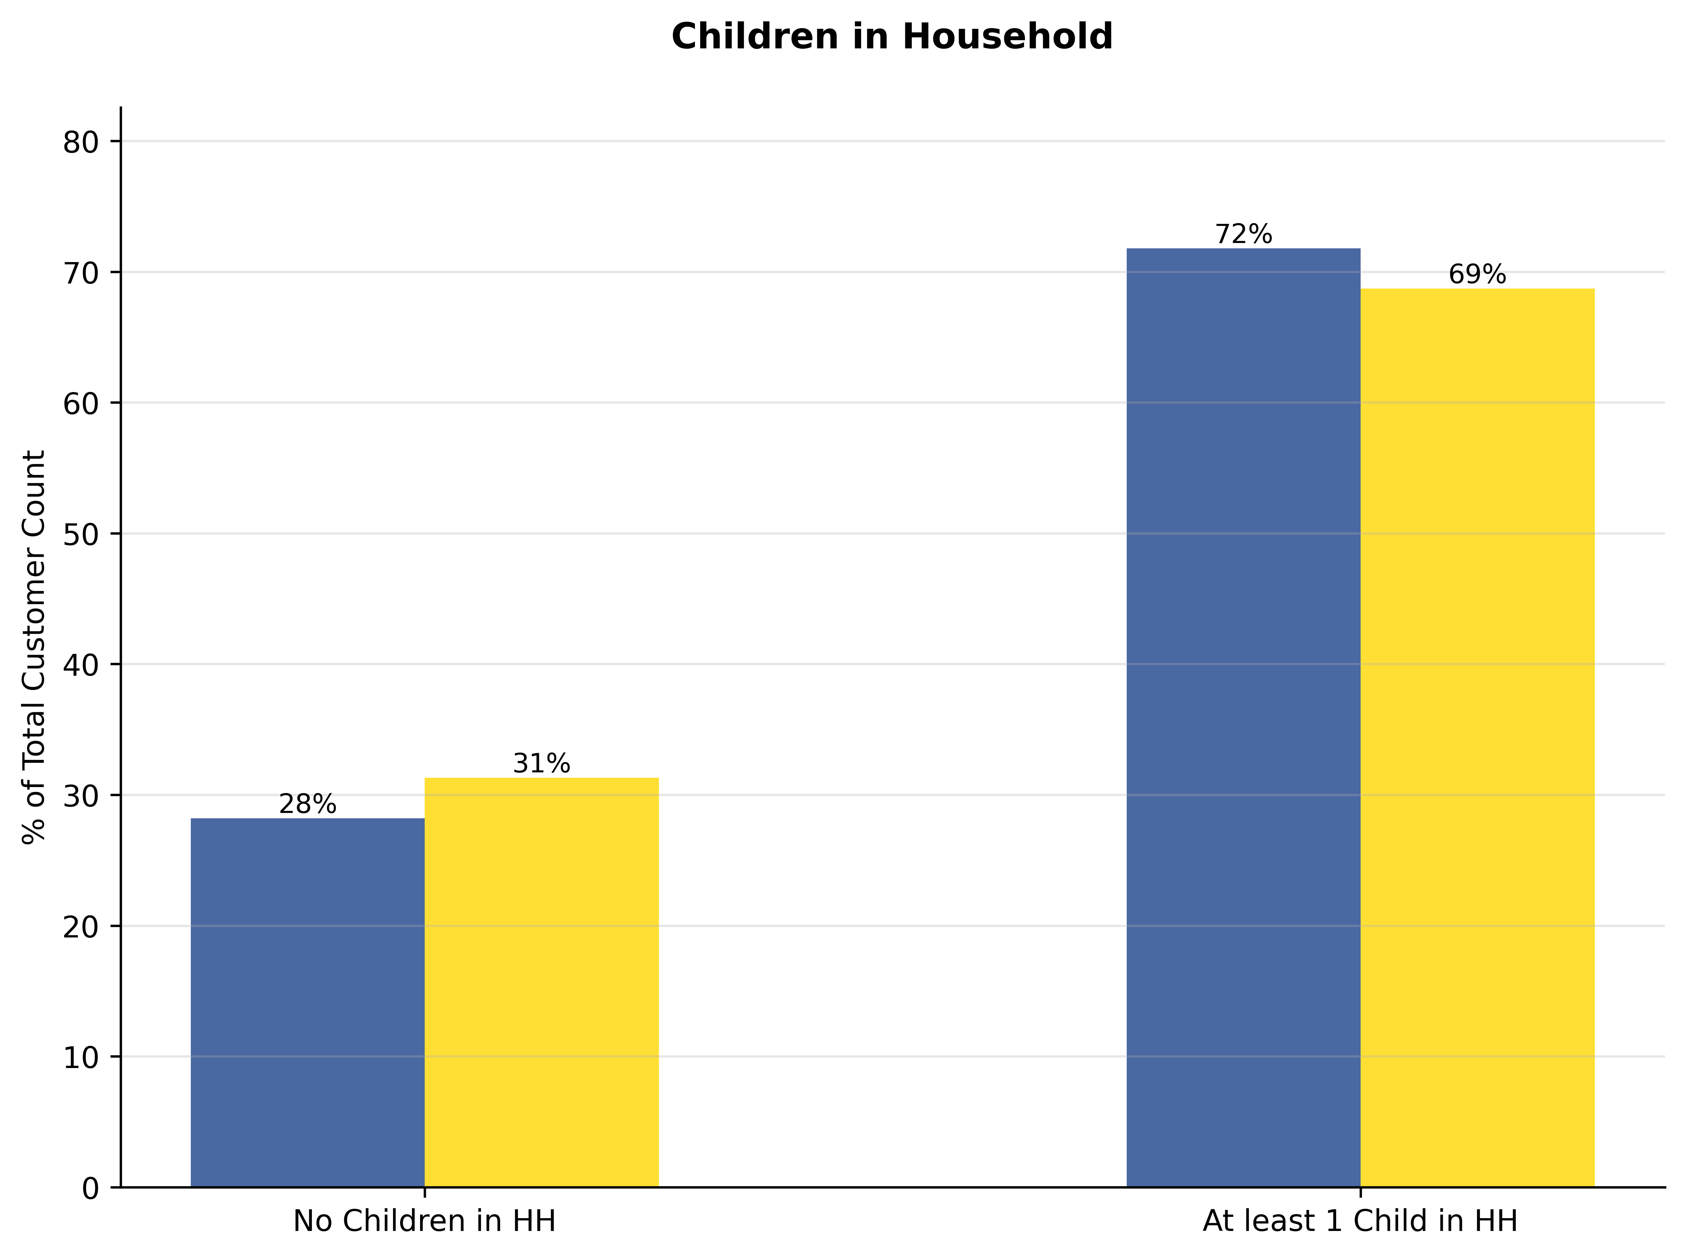
Utah Jazz
Fan Demographics: How Are Utah Jazz Fans Unique
Jazz
"Utah Jazz fans are predominantly younger (79% Millennials/Gen X) with a significantly higher household income (76% earning $100K+), are mostly male (54%), and largely working professionals (64%) compared to both the Utah general population and slightly more so than NBA average fans."
KEY
-Utah Jazz Fans
- Jazz Gen Pop (state level, excluding Jazz Fans)
- NBA Fans Total (excluding Jazz fans)
Ethnicity

