Slide 1


Team 15: Rogue Chess App Bi-Weekly Update 2 Jose Herrera, Travis Head Sponsor: Pranav Dhulipala TA: Eric Robles
Notes:
Michelle

Slide 2
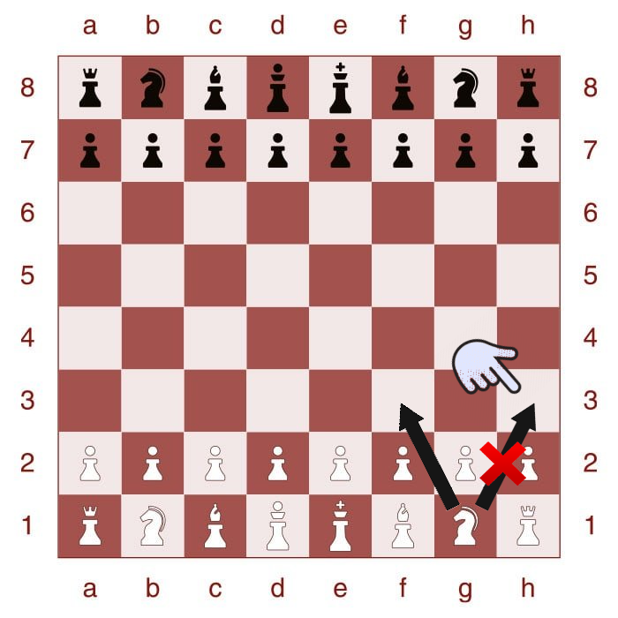
Project Summary
Problem: There are many variations of the game of chess; however, after a while it can be predictable or lack of excitement.
Proposed Solution: Develop an app of a new chess variation with a randomization factor for Android products.
Develop an AI for Single Player Mode
Create a randomization factor
Create a User Interface for the players interaction
Highlighted boxes to assist the player in making the next move legally
Create different difficulty levels
Upload the contents to the cloud
Notes:
Kyle

Slide 3
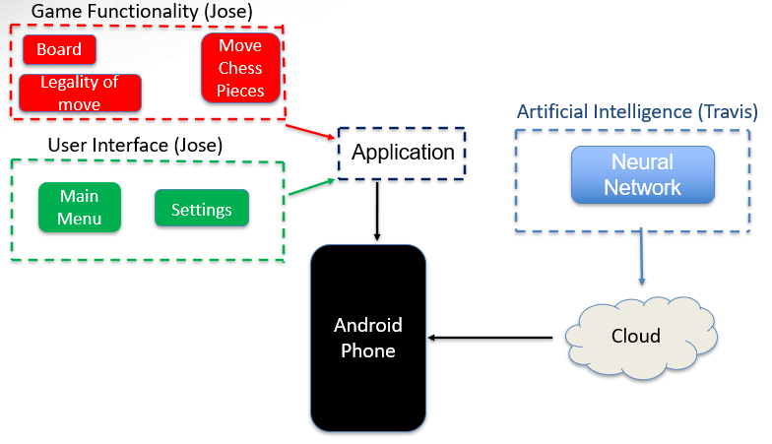
Project Overview
Notes:
Eric

Slide 4
Project Timeline
Subsystem Corrections (to complete by 9/19) | Research for Server Integration (completed 9/12) | Connection of Game App to Server (to complete by 9/20) | Connection of AI & App to Server (to complete by 9/26) | Final Integration (to complete by 10/17) | System Test & Optimization (to complete by 10/31) | Validation (to complete by 11/21) | Demo and Report (to complete by 11/28)
__ - Completed
__ - In Progress
- Not Started
Notes:
Eric

Slide 5
Game Functionality and User Interface
Jose Herrera
Accomplishments since last presentation 12 hrs of effort | Ongoing progress/problems and plans until the next presentation
Changed all the backgrounds/text color and button colors for better user Connected the App to the Firebase Cloud System for the AI and Application Integration Wrote test code in order to test the firebase cloud storage is working | Finish Castling Code Finish Randomization

Slide 6
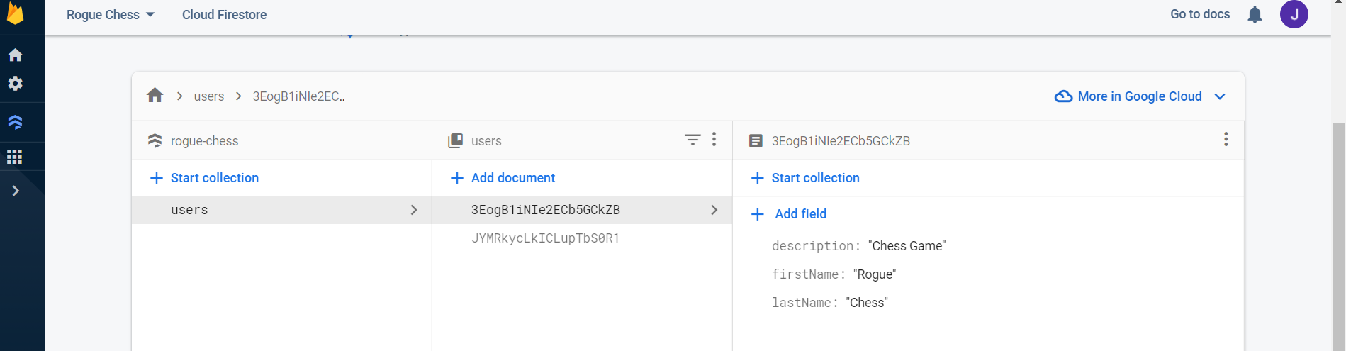
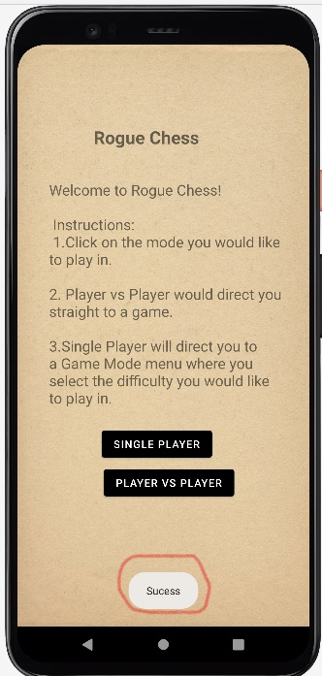
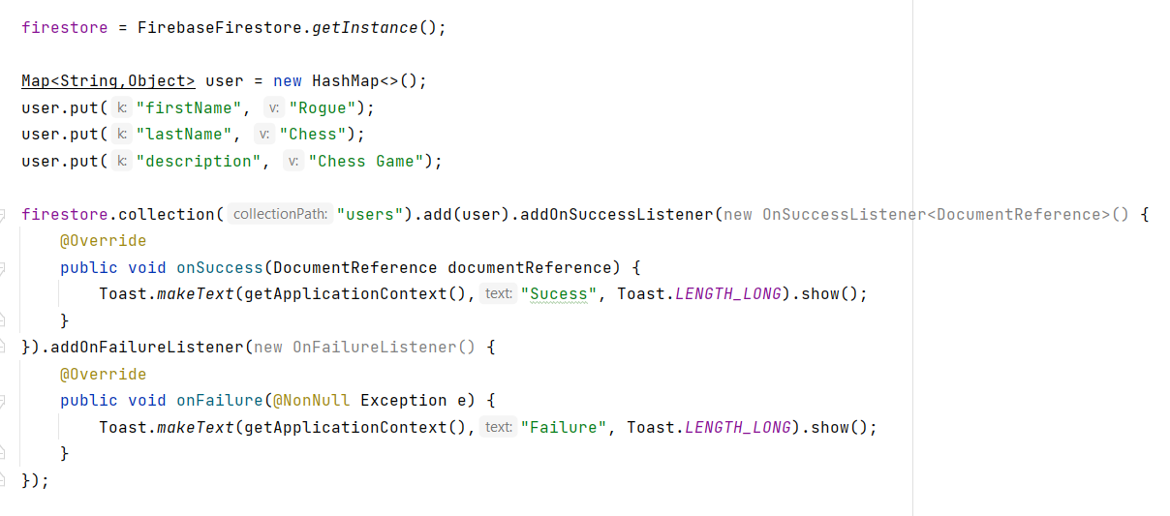
Game Functionality and User Interface
Jose Herrera

Slide 7
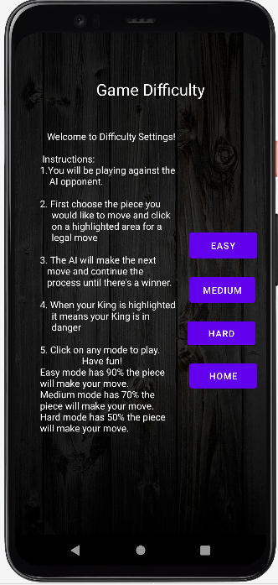
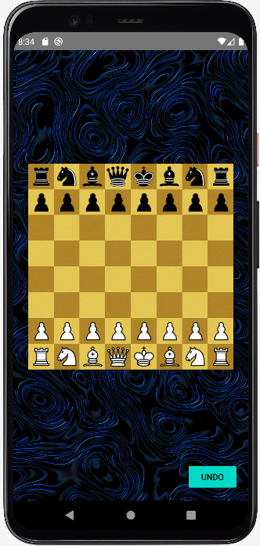
Game Functionality and User Interface Jose Herrera

Slide 8
Artificial Intelligence Travis Head
Accomplishments since last presentation 18 hrs of effort | Ongoing progress/problems and plans until the next presentation
Researched Deploying AI into Firebase Completed Base Code for Integration Redesigned Model of Neural Network | Discussing Server Access Keys Deploying AI to the Server Updated AI Needs Retraining

Slide 9
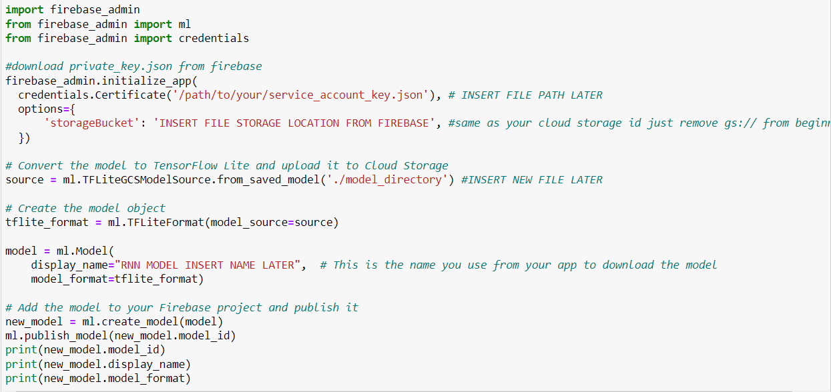
Artificial Intelligence Travis Head

Slide 10
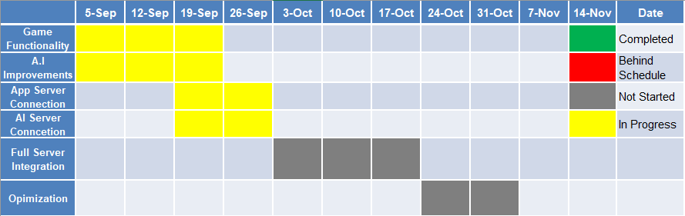
Execution Timeline
Notes:
Michelle

Slide 11
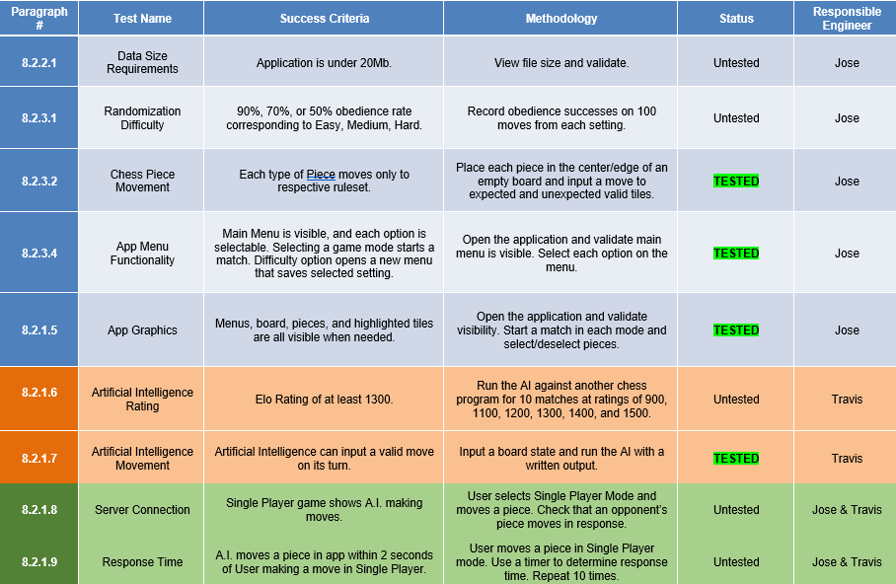
Execution & Plan
Notes:
Michelle

Slide 12
Questions?

