Slide 1

Workshop 2
Labeling Trades
and Forming Teams
Give every agent decision an outcome you can check, then pick a lane and a team.
Travis Sim
NUS · Singapore
Thu 5 Nov 2026 · COM3/COM4
Notes:
[18:00] Welcome, thanks for coming. I'm Travis. Tonight is Workshop 2. Two halves. First half: how to give every agent decision an outcome you can check, which we call a label, and why labels can quietly cheat. Second half: your project. You pick a lane, find a team or decide to go solo, and leave with a one-page brief. If you missed the earlier sessions, you are fine: everything runs on recorded data and nobody needs AI credits or a wallet tonight.

Slide 2
Where we are
Today's question: how do we know if a decision was any good?
DONE
TODAY
NEXT
Build night 2
Workshop 2
Build night 3
Thu 29 Oct
Thu 5 Nov
Thu 12 Nov
Data bars and change alerts
Labeling trades and forming teams
Position sizing and the trade ledger
2
Notes:
[18:03] Quick progress circle, one line each. Build night 2 was last Thursday: data bars and change alerts. Today is Workshop 2. Next Thursday the twelfth is Build night 3, position sizing and the trade ledger, and what your team makes tonight feeds into it. Go round the room: what did you build or try since last week, and is anything stuck? Then the question for tonight: how do we know if a decision was any good? Keep a guess in your head, we come back to it.

Slide 3
Tonight
18:00 to 20:00. The first half is about labels, the second half is about your team.
18:10
40 min
18:50
10 min
19:00
25 min
Teaching
Live demos
Team matching
labels, leaks, the gate, lanes
three demos on real prices
pitch, choose, find, agree
19:25
10 min
19:35
20 min
19:55
5 min
Mini-lab
Open build
Push
label ten decisions by hand
your own project
one line on the next step
3
Notes:
[18:08] Here is the shape. Forty minutes of teaching: labels, leaks, the second-opinion gate, then the three project lanes and the brief. Ten minutes of demos on real prices. Then twenty-five minutes of team matching, which is the part I most want you to enjoy. A ten-minute mini-lab where your new team labels ten decisions by hand. Then open build until eight. If you only remember one thing: by the end you have a lane, a team or a solo plan, and a one-page brief.

Slide 4
A decision needs a checkable outcome
Until you can say "that one worked", you cannot test an agent.
THE AGENT SAYS
WHAT WE NEED
Buy SOL. It rose 6 bps in the last minute.
A label: right, wrong, or nothing happened.
right
wrong
nothing happened
A label turns a decision into a row you can count, chart and test.
Illustrative
4
Notes:
[18:10] Your agent says buy SOL, it rose six basis points in the last minute. Was that a good decision? You cannot tell yet, because there is nothing to check it against. A basis point is one hundredth of a percent. What we need is a label: right, wrong, or nothing happened. A label turns a decision into a row of data you can count, chart and test. Everything tonight is about making labels that are honest. Illustrative example, real numbers come in a few slides.

Slide 5
Fixed-time labels are crude
"Look 2 minutes later" ignores what happened on the way.
PATH A
fixed label: +
PATH B
fixed label: +
Falls 6 bps first, then recovers
Climbs slowly and steadily
stop
A fixed-time label calls both "+". A trader with a stop was already out of A.
Illustrative paths
5
Notes:
[18:13] The simplest label is: look two minutes later and see if the price is higher. Path A falls six basis points first, then recovers. Path B climbs steadily. A fixed-time label calls both of them plus. But a trader with a stop was already out of path A, losing, before it recovered. The fixed label ignores what happened on the way. Both paths here are illustrative. On the real data, a fixed-time label disagrees with the barrier label on 26 percent of decisions, 57 of 219, and we will see that on slide 11.

Slide 6
The triple barrier
Put walls around the decision.
PRICE
STEP 1 OF 3
profit target
A profit target above the entry price. Touch it first and the decision worked.
decision
LABEL RULE
upper barrier -> label +1
Illustrative price path
6
Notes:
[18:15] The fix is the triple barrier, a method inspired by Advances in Financial Machine Learning, chapter 3, written here as plain code. We put walls around each decision. Wall one, above the entry price: a profit target. If the price touches it first, the decision worked and the label is plus one. The dot on the left is the decision, the line is the price afterwards. This diagram stays on screen for the next two slides and I add one thing each time.

Slide 7
The triple barrier
Put walls around the decision.
PRICE
STEP 2 OF 3
profit target
A stop below the entry price. Touch it first and the decision failed.
decision
stop
LABEL RULE
lower barrier -> label -1
Illustrative price path
7
Notes:
[18:16] Wall two, below the entry price: a stop. If the price touches the stop first, the decision failed and the label is minus one. Notice the walls are the same distance above and below. In practice you could make them different, a wider target than stop, but start symmetric: one number to explain. Ask the room: in this picture, which wall does the price hit first? Answer, the upper one. So this decision gets plus one.

Slide 8
The triple barrier
The first wall the price touches is the label.
PRICE
first touched
STEP 3 OF 3
profit target
A time limit on the right. If neither wall is touched, nothing happened.
decision
stop
LABEL RULE
time limit
time limit -> label 0
label +1
label -1
label 0
Illustrative price path
8
Notes:
[18:18] Wall three is a time limit on the right. If the price touches neither wall before then, nothing happened and the label is zero. The rule is: the first wall touched is the label. Plus one, minus one, or zero. That is the whole method. Zero is not a failure, it is information: this decision did not produce a clear move. Later we will see that in our recorded data about one in five decisions times out.

Slide 9
Barrier width follows the noise
A fixed width is too wide on a quiet day and too narrow on a busy one.
QUIET
BUSY
Same width: the walls are never touched
Same width: touched in seconds, by noise
THE RULE WE USE
width = max(floor, 0.8 x noise x sqrt(24 steps))
One real decision: noise 0.92 bps per step, 24 steps, so 0.8 x 0.92 x 4.9 = 3.6 bps.
The floor (2 bps) stops a flat stretch from making the walls touch the price.
Illustrative; the example numbers are from out/labels.json
9
Notes:
[18:20] How far away should the walls be? If you use a fixed width, then on a quiet period the price never reaches them, and on a busy period noise touches them in seconds. The width should follow recent volatility. Our rule: width is the larger of a floor and 0.8 times the recent noise per step times the square root of the number of steps. For one real decision, the noise was 0.92 basis points per step, the time limit is 24 steps of 5 seconds, 0.8 times 0.92 times about 4.9 gives 3.6 basis points. The formula is ours, a simple version; the book uses daily volatility.

Slide 10
A win has to beat the cost
A label of +1 is gross. Fees come off afterwards.
BARRIER WIDTH VERSUS COST (bps)
ROUND TRIP IN POOL FEES
0.04% each way
Average barrier width
3.36
0 of 73
Round trip in pool fees
winning labels had a barrier at least 8 bps wide.
8
A "win" narrower than the cost still loses money. Set the width floor to your costs.
Orca SOL/USDC pool fee 0.04% (recorded/SOURCES.md); widths from out/labels.json and out/agent.json
10
Notes:
[18:23] Important honesty slide. A label of plus one is gross: it ignores fees. Swapping through the Orca pool costs 0.04 percent each way, so about 8 basis points for a round trip, before slippage. Our average barrier is only 3.4 basis points wide. So a win at that width still loses money after fees. In the agent results later, none of the 73 wins had a barrier as wide as the cost. The fix is the width floor: set it to your real costs. This is why we say simulated, gross of fees, not advice.

Slide 11
Real labels on real prices
SOL/USDC, 40 minutes, a decision every 10 seconds.
$108.68
PROFIT TARGET FIRST (+1)
118
54% of 219
STOP FIRST (-1)
56
26% of 219
TIME RAN OUT (0)
45
21% of 219
A fixed-time label disagrees on 57 of 219 (26%).
$107.99
Each dot is one decision, coloured by its label. Orca SOL/USDC pool price, one sample every 5 seconds.
Reads use public mainnet data; every write is devnet only; no real funds. Simulated, on recorded data; not advice.
Source: out/labels.json, recorded Orca SOL/USDC pool price, 21 Oct 2026 17:14 to 17:54 UTC, 481 samples (from build night 1). Gross of fees.
11
Notes:
[18:26] Now real data. This is SOL/USDC from the Orca pool, 40 minutes recorded on 21 October, one price every 5 seconds, 481 samples, reused from build night 1. We make a decision every 10 seconds: 219 labelled decisions. 118 hit the upper barrier first, 56 the lower, 45 timed out. The average barrier is 3.36 basis points and the average decision lasts 13 steps. Note the price drifted up about 0.6 percent in this window, so plus ones outnumber minus ones. One calm night, do not generalise. Reads use public mainnet data, every write is devnet only, no real funds.

Slide 12
Labels depend on the price path
Same agent, same settings, three real price paths.
PRICE PATH
UP
DOWN
TIME
WIDTH
TRADES
HIT RATE
Pyth oracle
86
45
88
7.4 bps
67
14.9%
Jupiter quote
94
58
67
7.2 bps
75
32%
Orca pool price
118
56
45
3.4 bps
143
51%
Pyth updates about every 10 seconds and Jupiter quotes include routing noise, so their paths are choppier than the pool price. Pick the path your agent really sees.
out/sources.json (gross of fees; simulated, on recorded data; not advice)
12
Notes:
[18:29] Same agent, same settings, three real price paths recorded at the same time: the Orca pool price, the Pyth oracle and the Jupiter quote. The labels differ. Pyth only updates about every ten seconds, so its path is stair-steps, and Jupiter's quote includes routing noise. On the Orca path the agent has a 51 percent hit rate with 143 trades, on Jupiter 32 percent with 75 trades, on Pyth 14.9 percent with 67. Labels agree between Orca and Pyth on 61 percent of decisions. Lesson: a label is only as honest as the price path it is made on. Label with the price your agent actually sees.

Slide 13
The labeler in code
demo-repo/code/src/labels.ts
1
Walk forward
const last = i + p.horizon;
if (last > prices.length - 1) return null;
const price = prices[i]!;
const widthBps = barrierWidthBps(v, p);
const up = price * (1 + widthBps / 10_000);
const dn = price * (1 - widthBps / 10_000);
let exitI = last;
let touch: Label["touch"] = "time";
for (let k = i + 1; k <= last; k++) {
const x = prices[k]!;
if (x >= up) { exitI = k; touch = "up"; break; }
if (x <= dn) { exitI = k; touch = "down"; break; }
}
Step by step, up to the time limit.
2
First touch wins
The loop stops at the first barrier.
3
Not known yet
No label if the time limit runs past the data.
Source: demo-repo/code/src/labels.ts, function labelAt (comments and blank lines removed)
13
Notes:
[18:31] This is the real function, from the repo, comments removed. It is short. Walk forward step by step from the decision up to the time limit. At each step check the upper barrier, then the lower. The first touch sets the label and the loop stops. If you get to the end, the label is zero. One more rule: if the time limit runs past the end of your data, return nothing, because the label is not known yet. You can run this on your own strategy's decisions tonight.

Slide 14
Labels overlap
Decide often, look far ahead: the labels share the same future.
Three labels, one price path. The shaded part is future that two or more labels use.
label 1
label 1
label 2
label 2
label 3
label 3
Each label feels like a new fact. Most of it is the same fact.
shared future
0 s
40 s
80 s
120 s
A decision every 20 seconds, each looking 100 seconds ahead (illustrative)
Illustrative
14
Notes:
[18:33] Now the catch. We decide every 10 seconds but each label looks ahead up to 2 minutes. So label one looks at prices from second 0 to 120, label two from 10 to 130, and so on. The shaded part is future that two or more labels use. Each label feels like a new fact, but most of it is the same fact. This overlap is the reason many backtests flatter themselves. The idea of measuring it is inspired by the sample uniqueness material in the book; the counting here is our own.

Slide 15
Overlap leaks into the test
A label decided before the cut can use prices after the cut.
TRAIN
TEST
The crossing label was decided in the train period, but its answer comes from test prices.
decided here, answered here
THE FIX
Purge the labels that cross the cut before you fit anything.
cut
Illustrative
15
Notes:
[18:36] Here is the leak. You split your data: train on the early part, test on the later part. A label decided just before the cut can have its answer decided by prices after the cut. So training already contains a piece of the test period. Your test result is then too good, and you do not know it. The fix is simple: purge, which means drop the training labels that cross the cut before you fit anything. When the test set sits in the middle you also drop a few steps after it; that is called an embargo.

Slide 16
How much is really new?
Real labels from the 40-minute recording.
ALIVE AT ONCE
AVERAGE UNIQUENESS
INDEPENDENT LABELS
CROSS THE CUT
6.9
16%
34
9
on average, at most 13
of a label is not shared
worth of new facts in 219 labels
training labels at step 282 of 481
LABELS VERSUS INDEPENDENT LABELS
219 labels
about 34 independent
out/overlap.json (time limit 24 steps, a decision every 2 steps, cut at 60% of the labels)
16
Notes:
[18:38] Real numbers. At any moment on average 6.9 labels are alive at once, at most 13. The average label is only 16 percent unique, which means 84 percent of its life is shared with others. So 219 labels carry about 34 labels' worth of new information. At the 60 percent cut, step 282, nine training labels cross into the test period. That is why the next part purges them. Demo 2 lets you drag the cut and watch the number change.

Slide 17
A second opinion
The agent picks the side. A second check decides whether to act.
1
AGENT
2
GATE
3
ACT
Buy or sell?
Chance it wins?
Only above the line
TRAIN
early trades: the gate learns
later trades: the gate is scored
purge
The gate is trained on what happened to past trades, and tested on a later period it has not seen.
Illustrative flow
17
Notes:
[18:40] Second idea, meta-labeling, again inspired by the book. The first agent picks the side: buy or sell. A second check, the gate, looks at the situation and estimates the chance this trade wins. Only act above a line. The gate is trained on what happened to past trades and scored on a later period it has not seen. It decides whether to act, and in a bigger system also how much. Ours is a small logistic regression written out in plain code, three features: signal strength, the gap between Orca and Pyth prices, and recent volatility.

Slide 18
The pretend agent writes reasons
No AI credits, no network: a rule that explains itself.
THE CHECKER READS THE FACTS
A WRITTEN REASON
"Buy: SOL fell 9.7 bps in the last 60 s, 2.2x the recent noise, so follow the move. The two venues agree within 4.0 bps."
Direction
says fell
data: rose
WRONG
Size
says 9.7 bps
data: 9.7 bps
TRUE
Noise ratio
says 2.2x
data: 2.2x
TRUE
BUY
one claim in this reason was given a simulated error
Venue gap
within 4.0 bps
data: 4.0 bps
TRUE
The wrong-claim rate is 20%, fixed seed, flagged in out/agent.json.
It checks direction, size and the venue gap. It does not judge the idea.
out/agent.json
18
Notes:
[18:42] We need an agent to label, and we do not want to depend on AI credits. So the pretend agent is a plain momentum rule: if the price moved at least as much as the recent noise, follow the move. It writes a reason for every decision, like an LLM agent would. On the right, the checker reads the facts in that text, direction, size in basis points and the gap between the two venues, and compares them with the data the agent had. It works on plain text, so you can paste reasons from any real agent. To test the checker, one in five reasons is given one wrong claim on purpose. That is simulated, fixed seed, flagged in the file.

Slide 19
Grade the reasons, then the result
Two separate questions, and the answers do not have to agree.
QUESTION 1: WAS THE REASON TRUE?
QUESTION 2: DID THE TRADE WIN?
43 of 43
Reason was true
51.3%
hit rate, 113 trades
simulated wrong claims caught
0 false alarms on 176 true reasons. Easy: we made the errors ourselves.
Reason had a wrong claim
50%
hit rate, 30 trades
A true reason did not make a better trade: 51.3% versus 50%. Grade the facts first, then the label.
out/agent.json (gross of fees; simulated, on recorded data; not advice)
19
Notes:
[18:44] Two questions. One: was the reason true? Two: did the trade win? The checker caught 43 of the 43 wrong claims with no false alarms, which is easy because we made the errors ourselves; a real LLM will be messier. Now the surprise: trades with true reasons won 51.3 percent of the time, 113 trades; trades with a wrong claim won 50 percent, 30 trades. A true reason does not make a good trade. Facts first, then the label. Grade both.

Slide 20
The gate on the test period
Trained on early trades, scored on later ones, with a +/- range.
HIT RATE ON 55 TEST TRADES, WITH A +/- RANGE
BLOCKED BY THE GATE
8 trades
No gate: 55 trades, 45.5% (+/- 13.2)
2 of them would have won
With the gate: 47 trades, 48.9% (+/- 14.3)
Trained on 82 trades; 6 more were purged for crossing the cut.
20%
40%
60%
80%
With this few trades the +/- ranges overlap. This is a method to practise, not a result to trust.
out/meta.json (simulated, on recorded data; not advice)
20
Notes:
[18:46] The gate was trained on the first 82 training trades, with 6 purged for crossing the cut, and scored on the 55 test trades. Without the gate the hit rate is 45.5 percent plus or minus 13.2. With the gate, 47 trades, 48.9 percent plus or minus 14.3. It blocked 8 trades, 2 of which would have won. Those ranges overlap: with this few trades we cannot say the gate helps. I want you to leave with the method, with the plus-minus next to every hit rate, not a result to trust. Simulated, on recorded data, not advice.

Slide 21
An on-chain record
Write each decision to devnet with the Memo program: a record outside your laptop.
MEMO LINE
DEVNET DRY RUN (simulateTransaction)
{"app":"labeler","i":20,"t":1792602939,"side":"sell","label":1,"h":"b77d9610847aaf99"}
Program Memo...GmfcHr invoke [1]
Program log: Memo (len 86): "{...}"
Program Memo...GmfcHr success
HOW IT IS BUILT
3 of 3 accepted, err null, 44,922 to 45,286 compute units of 200,000
step, side, label and a hash of the full record. One signer, one Memo instruction, hand-built, Node ed25519.
Status: dry run on devnet works. Sending needs a funded devnet key: ask a lead.
recorded/devnet-simulation.json (simulateTransaction on devnet, nothing sent)
21
Notes:
[18:48] The Solana part. Each decision can be written to devnet in a Memo transaction, a short line with the step, the side, the label and a hash of the full record, so anyone can recompute it. We built the transaction by hand, no libraries. What is verified: devnet accepted three of them in a dry run, simulateTransaction, and the Memo program logged our exact text. What is not verified: sending. The public faucet refused our throwaway key with a 429, so no key was funded. A lead can fund one for you. We never fake a signature.

Slide 22
Three lanes
Solo or a team of 3 to 4. Pick one lane for the final project.
AGENT
EXCHANGE
TOOLING
A trading agent or strategy with honest validation.
A venue component: order book, matching, deposit or custody flow.
Anything that helps the trading process: data, monitoring, risk, explainability, dashboards.
Judged on utility, tests, devnet evidence and a clear explanation. Never on simulated returns.
22
Notes:
[18:49] Now your project. Solo or a team of 3 to 4, in one of three lanes. Agent: a trading agent or strategy with honest validation, like tonight's labeler. Exchange: a venue component, an order book, matching, a deposit watcher or custody. Tooling: anything that helps the trading process, data collection, monitoring, risk, explainability, dashboards. You are judged on utility, tests, devnet evidence and a clear explanation, never on simulated returns. With about ten of us, aim for two or three teams and do not force all three lanes.

Slide 23
Starters you can run today
Each one has a first test you can measure.
AGENT
EXCHANGE
TOOLING
Label my own strategy
BEG
Deposit watcher
BEG
Data collector for another market
BEG
Build the second-opinion gate
STD
Mini order book
STD
Change and staleness monitor
STD
Explanation checker for an LLM agent
STD
Orca Whirlpool devnet lab
ADV
Label and gate dashboard
STD
Agent with a risk hook and a label log
ADV
Read a real on-chain order book (Phoenix)
ADV
Leak checker for backtests
ADV
Suggestions, not a menu. Bring your own idea if you have one.
demo-repo/code/data/lanes.json (from research/experiments, checked 20-21 Oct 2026)
23
Notes:
[18:51] Starters you can run today, each with a first test you can measure, from our research notes. Agent: label your own strategy, the gate, the explanation checker. Exchange: a deposit watcher that caught a real devnet transfer about a second after it confirmed, a mini order book that gives exactly five trades on the ten-order fixture, an Orca Whirlpool devnet lab, Phoenix source reading. Tooling: a data collector, a change and staleness monitor, a label dashboard, a leak checker. Devnet SOL for any write comes from a lead: the public faucet rate-limits hard, as we saw.

Slide 24
The one-page brief
Nine lines. If you cannot fill one, that is the first task.
1
User
2
Observed failure
3
Smallest useful component
who has this problem
and your evidence
what you will build first
4
Success test
5
Devnet component
6
Limitations
measurable
the on-chain evidence
what it will not do
7
Contributions
8
Learning goals
9
First tasks
what each person brings
what each person wants to learn
three, with names
Plus how you will talk to each other and when you are free.
24
Notes:
[18:54] A brief has nine lines: who has the problem, the failure you observed with your evidence, the smallest useful component, a measurable success test, the devnet component, the limitations, each person's contribution, each person's learning goal, and three first tasks with names. Plus how you will communicate and when you are free. If you cannot fill a line, that is your first task. Beginners get a meaningful task too: tests, reproduction steps, design, documentation, user feedback all count.

Slide 25
Team matching in 25 minutes
About 10 students: aim for two or three teams. Solo is fine.
0-5 min
5-10 min
10-20 min
20-25 min
Pitch
Choose
Find
Agree
one problem each, with evidence you saw
first interest, second choice
share what you bring and want to learn
provisional team, shared problem, first tasks
Interest card: handle | first and second problem | skill I bring | skill I want to learn | availability
Teams can change by agreement. We check fit again on Thu 12 Nov and Thu 21 Jan.
25
Notes:
[19:00] The protocol, 25 minutes. Zero to five: each person pitches one problem with evidence they saw. Five to ten: choose your first interest and note a second choice. Ten to twenty: share what you bring and want to learn, find complementary people. Twenty to twenty-five: agree a provisional team of 3 to 4, a shared problem and first tasks. Fill the interest card: handle, first and second problem, skill I bring, skill I want to learn, availability. Teams can change by agreement, and we re-check on 12 November and 21 January. Leads rotate and help beginners find their contribution.

Slide 26
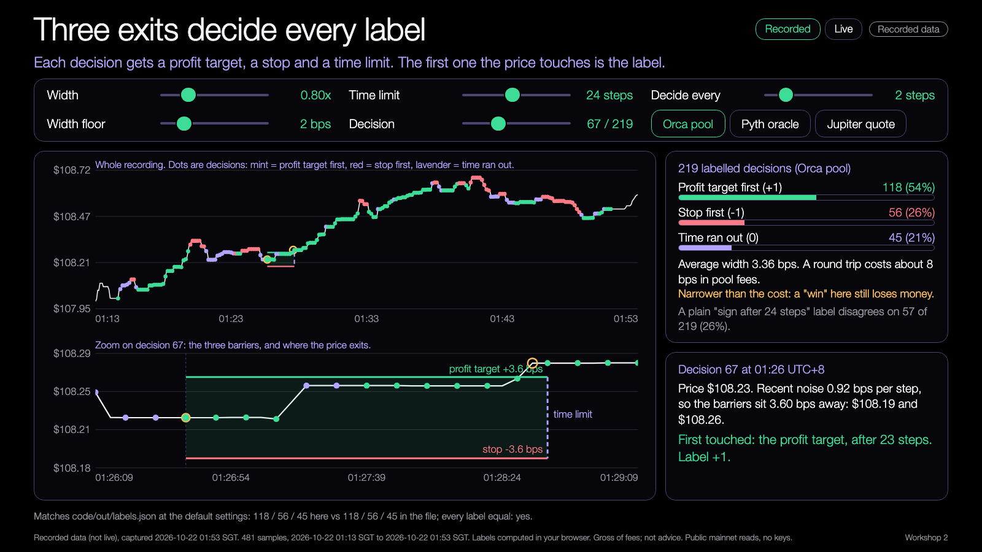
Demo 1
Triple barrier on real prices
PREDICT FIRST
If you double the width, do more labels become +1 or 0?
$ npm run demo -- --recorded --mult 1.6
YOU SHOULD SEE
Fewer touches, more "time ran out"
The average width roughly doubles
Learning Lab demo, runs from disk, recorded data.
Try it: nus-solana-demos.vercel.app/0004/01-triple-barrier.html
Fallback: screenshot below; the lab page works from disk
Live mode: switch it on to watch real Solana data.
Source: demo-repo/lab/screenshots (captured from the Learning Lab demos on recorded data)
26
Notes:
[18:50] Demo 1. Open the triple barrier page. Predict first: if I double the width, do more labels become plus one or zero? Run npm run demo with mult 1.6, then drag the width slider. The room should see fewer touches and more time-outs, and the average width roughly doubles. Click a dot to see its three walls in the zoom panel. Then press Live: your browser reads real Orca and Pyth prices every five seconds and labels them with a shorter horizon. If Live is slow or rate limited, say so and stay on Recorded.

Slide 27
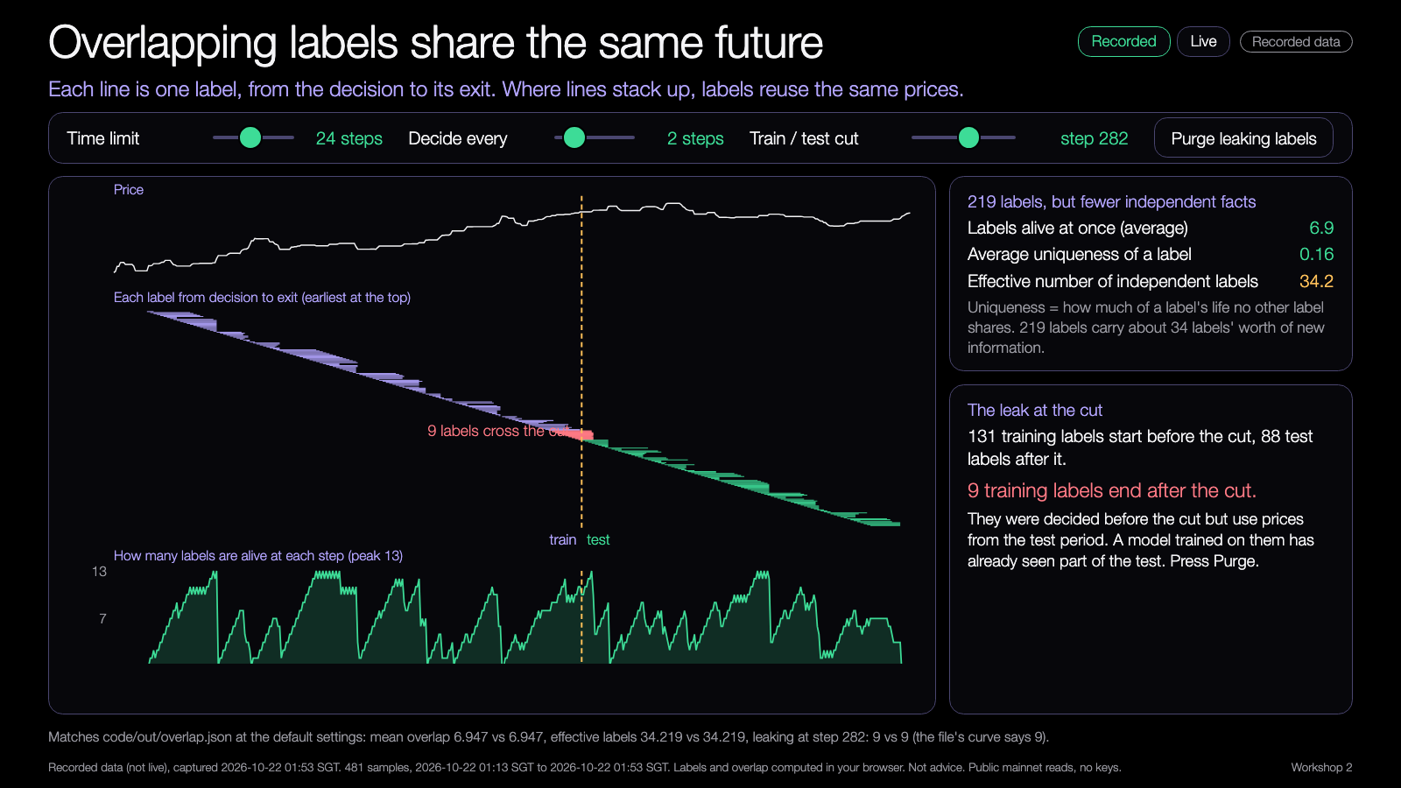
Demo 2
Overlap and leakage
PREDICT FIRST
Where should the cut go so that nothing leaks?
$ open demo-repo/lab/02-overlap-leakage.html
YOU SHOULD SEE
Around 7 labels alive at once
Purge removes the crossing labels
Learning Lab demo, runs from disk, recorded data.
Try it: nus-solana-demos.vercel.app/0004/02-overlap-leakage.html
Fallback: screenshot below; the lab page works from disk
Live mode: switch it on to watch real Solana data.
Source: demo-repo/lab/screenshots (captured from the Learning Lab demos on recorded data)
27
Notes:
[18:55] Demo 2. Each line is one label from decision to exit, the bottom chart is how many are alive at once. Predict where the cut should go so nothing leaks. Drag the cut: the red labels are the ones crossing it. Press Purge and they are dropped. Increase the time limit and watch the overlap and the leak grow. Effective independent labels: 34 out of 219 at the defaults. Live mode runs the same functions on the live path.

Slide 28
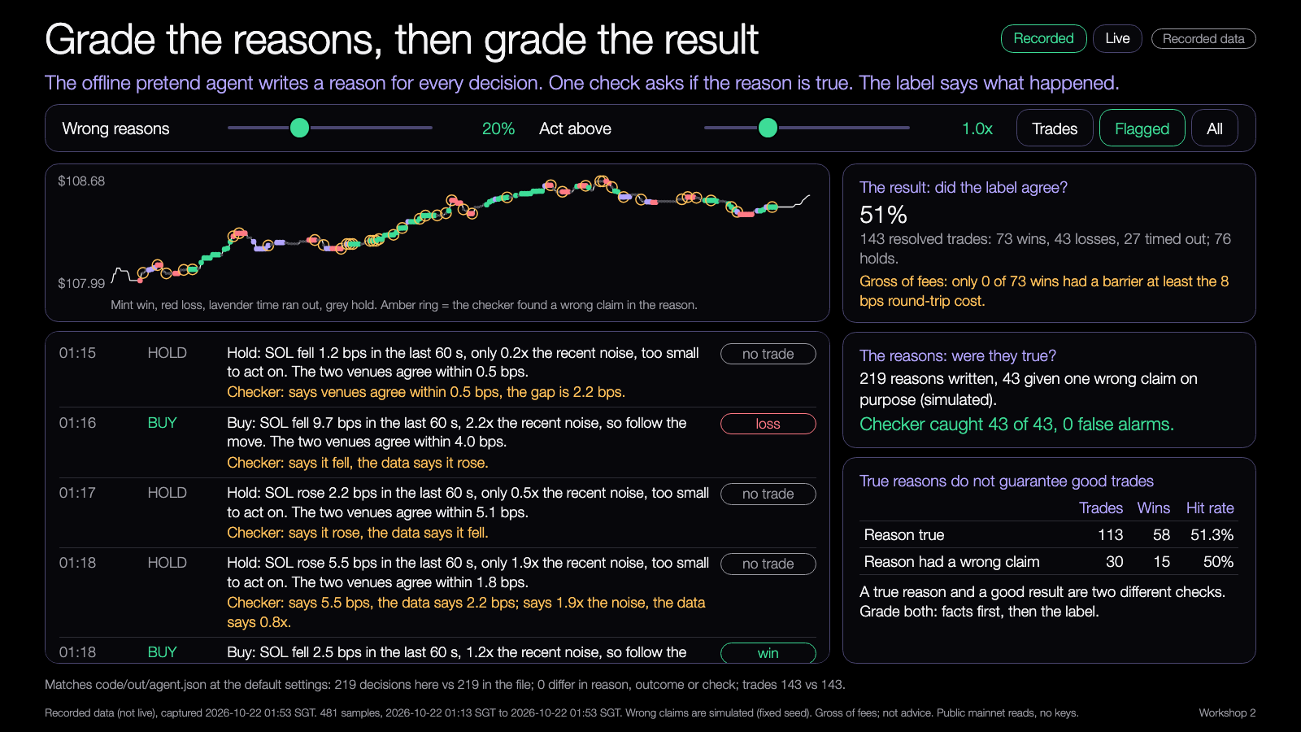
Demo 3
Agent report card
PREDICT FIRST
Do the trades with true reasons win more often?
$ npm run demo -- --recorded --error-rate 40
YOU SHOULD SEE
A flagged reason shows what is wrong
True reasons do not guarantee wins
Learning Lab demo, runs from disk, recorded data.
Try it: nus-solana-demos.vercel.app/0004/03-agent-report-card.html
Fallback: screenshot below; the lab page works from disk
Live mode: switch it on to watch real Solana data.
Source: demo-repo/lab/screenshots (captured from the Learning Lab demos on recorded data)
28
Notes:
[18:57] Demo 3. The pretend agent's reasons, each checked, each with its outcome. Predict: do trades with true reasons win more often? Raise the wrong-reasons slider to 40 percent, filter to Flagged, and read a checker message. Say clearly: the wrong claims are simulated with a fixed seed to test the checker. The point is that reason quality and outcome are two separate checks. In Live mode each new decision is written and checked from real Orca and Pyth reads; its outcome stays pending until a barrier is touched.

Slide 29
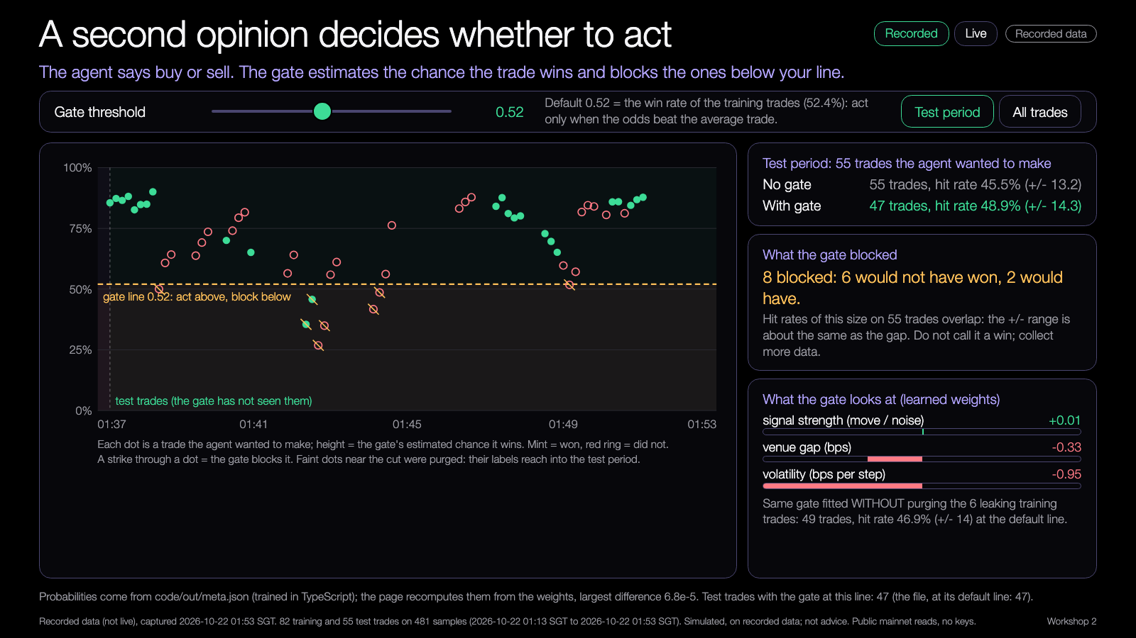
Demo 4
The same agent, with a gate
PREDICT FIRST
Which blocked trades would have won?
$ npm run demo -- --recorded --train-frac 0.5
YOU SHOULD SEE
Blocked trades, some of them winners
A +/- range as wide as the gap
Learning Lab demo, runs from disk, recorded data.
Try it: nus-solana-demos.vercel.app/0004/04-meta-gate.html
Fallback: screenshot below; the lab page works from disk
Live mode: switch it on to watch real Solana data.
Source: demo-repo/lab/screenshots (captured from the Learning Lab demos on recorded data)
29
Notes:
[18:59] Demo 4. Every trade the agent wanted is a dot; height is the gate's estimated chance of winning; the dashed line is your threshold. Drag it. Blocked trades are struck through. Predict which blocked trades would have won: 2 of the 8 at the default. Look at the plus-minus: it is as wide as the gap. Switch to All trades to see the training period, where the gate looks better because it learned from those. Live mode scores new live decisions with the same weights.

Slide 30
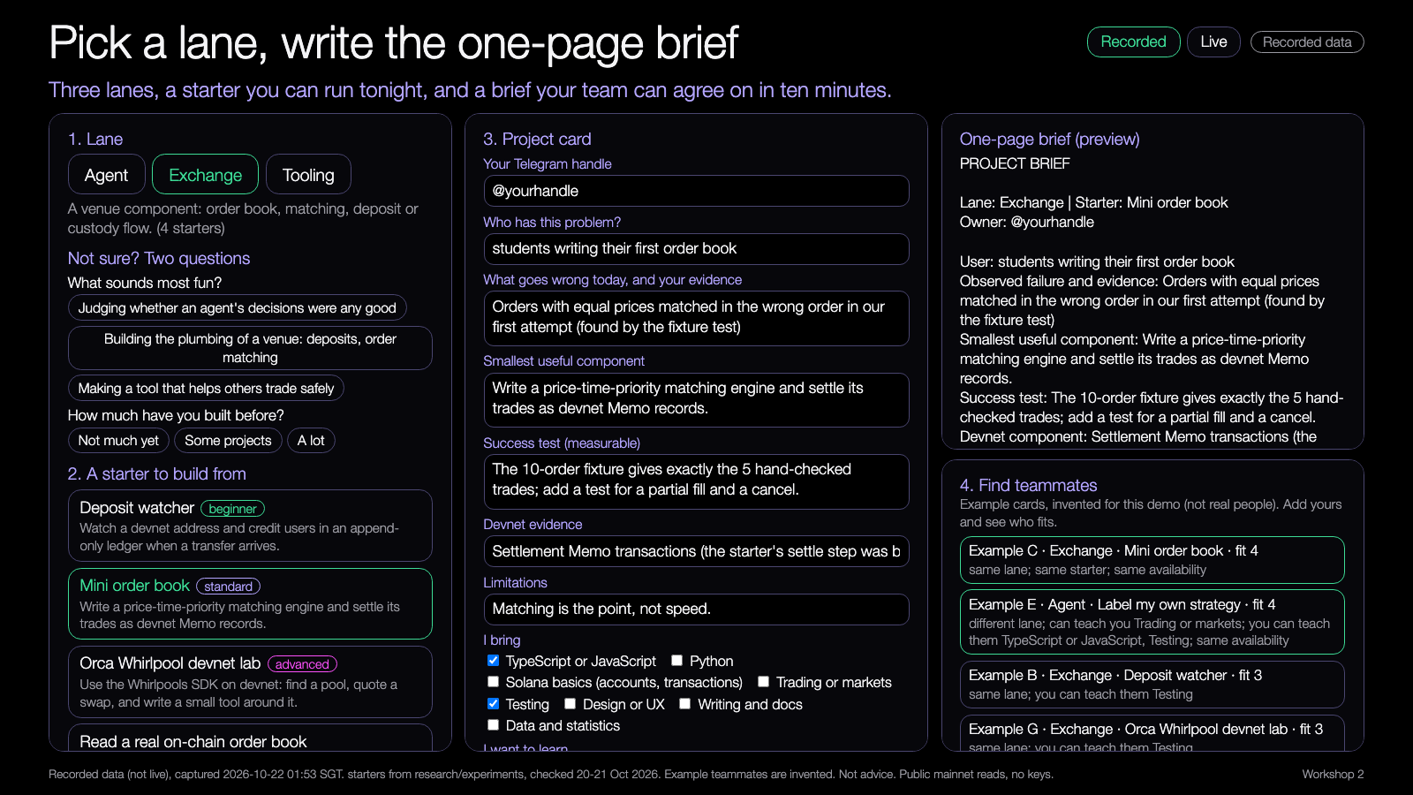
Demo 5
Lane and team picker
PREDICT FIRST
Who fits your card best?
$ open demo-repo/lab/05-lane-team-picker.html
YOU SHOULD SEE
A starter fills in the brief
Example teammates ranked by fit
Learning Lab demo, runs from disk, recorded data.
Try it: nus-solana-demos.vercel.app/0004/05-lane-team-picker.html
Fallback: screenshot below; the lab page works from disk
Live mode: switch it on to watch real Solana data.
Source: demo-repo/lab/screenshots (captured from the Learning Lab demos on recorded data)
30
Notes:
[19:02] Demo 5, used in the team matching. Pick a lane, or answer two questions. Pick a starter and the brief fills in: the smallest component, the success test, the devnet evidence and the limitation come from our research notes. Add your skills, availability and three tasks. The right panel is the one-page brief; copy it or download it as a markdown file. Teammate matches use example cards, invented for the demo, not real people. The live button adds a real market reading to your evidence line.

Slide 31

Try the demos yourself
DEMOS
nus-solana-demos.vercel.app/0004/
Five demos. Open them now.
No install. The same files are in the repo and open from disk. Do not all switch on Live at once: we share one connection.
Scan to open the demos
Source: demo-repo/lab (the five Learning Lab demos, deployed as static pages, recorded data)
31
Notes:
[19:00] Everyone open the demos on your laptop now: scan the code or type the address. No install, they run in the browser from recorded data, and each has a Recorded and Live switch. Do not all switch on Live at once: we share one campus connection, so the public endpoints rate limit. The same files are in the repo and open from disk. The picker is demo five; use it during team matching. Laptops open? Then we start the matching on slide 25.

Slide 32
Mini-lab: label ten decisions by hand
In your new teams. Ten minutes.
1
2
3
4
Open the sheet
Label them
Check the key
Change one thing
out/minilab.md has ten real decisions
+1, -1 or 0 from the price lists
out/minilab-answers.md
npm run demo -- --mult 1.5 and relabel decision 1
Done when your team agrees on all ten and can say why decision 1 changed.
32
Notes:
[19:25] Mini-lab, ten minutes, in your new teams. One: open out/minilab.md, it has ten real decisions with barrier prices and the next 24 prices each. Two: label each one, plus one, minus one or zero. Three: check against out/minilab-answers.md. Four: run the demo with mult 1.5 and relabel decision 1. You are done when your team agrees on all ten and can say why decision 1 changed. Argue about the ones you disagree on, that is the learning.

Slide 33
Build menu
Pick one and make it yours.
Label your own strategy's past decisions
BEGINNER
Build volatility-scaled barriers for another token
BEGINNER
Build the gate with your own features
STANDARD
Build an explanation checker that flags reasons contradicting the data
STANDARD
Label your Session 0 strategy and log it to devnet
ADVANCED
33
Notes:
[19:35] Open build, about twenty minutes, on your own project or your team's first task. The menu: label your own strategy's past decisions; build volatility-scaled barriers for another token; build the gate with your own features; build an explanation checker that flags reasons contradicting the data; label your Session 0 strategy and log it to devnet. Beginner and advanced items are marked. No AI credits needed: every item works with hand edits and npm run demo. Leads rotate; ask early.

Slide 34
Three things to keep
1
A label turns a decision into a checkable outcome.
2
Overlapping labels leak: purge before you test.
3
Your team brief is the first thing you build.
34
Notes:
[19:55] Three things to keep. One: a label turns a decision into a checkable outcome. Two: overlapping labels leak, so purge before you test, and always put a plus-minus next to a hit rate. Three: your team brief is the first thing you build. Before you leave, make sure your brief has your name on it and three first tasks.

Slide 35
Branch out
Take it further after tonight.
BEGINNER
STANDARD
ADVANCED
Change the width, the time limit and the floor. Write down what moves.
Label your own decisions with labelAt, or add a feature to the gate and compare with the +/- range.
Grade the reasons of your own LLM agent, write a purged k-fold split, or log labels to devnet.
35
Notes:
[19:56] Branch out after tonight. Beginner: change the width, time limit and floor and write down what moves. Standard: label your own decisions with labelAt, or add a feature to the gate and compare with the plus-minus range. Advanced: grade the reasons of your own LLM agent, write a purged k-fold split, or log your labels to devnet with the Memo logger.

Slide 36
Share back
Show the room, and the next room.
BY FRI 6 NOV
THU 12 NOV
THU 21 JAN
1
2
3
Post your one-page brief in the group
Bring your first task done to Build night 3
Teams checked again before Workshop 3
36
Notes:
[19:57] Share back: by Friday the sixth, post your one-page brief in the group. On Thursday the twelfth, bring your first task done to Build night 3. On the twenty-first of January we check team fit again before Workshop 3. Fill in the post-workshop feedback form too, and send the 48-hour report details to the leads: GitHub handles, team lanes, blockers.

Slide 37
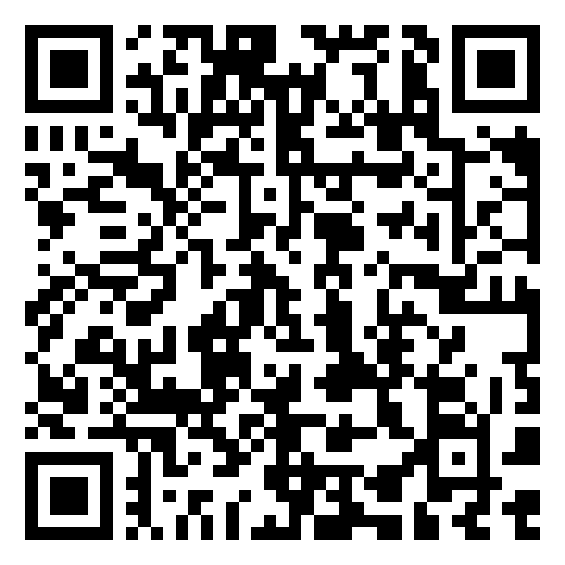
Get the code
REPO
github.com/travisim/solana-agentic-trading-nus
folder: 0004-labeling-trades-forming-teams/demo
1
$ cd demo/code
2
$ npm install
3
$ npm run demo -- --recorded
Scan for the repo folder
Reads use public mainnet data; every write is devnet only; no real funds.
37
Notes:
[19:58] Everything is in one public repo: github.com/travisim/solana-agentic-trading-nus, in the folder for tonight, 0004-labeling-trades-forming-teams. Scan the code. Then cd into demo slash code, npm install, npm run demo with recorded. Node 24 or newer. Reads use public mainnet data, every write is devnet only, no real funds. Never paste a seed phrase or a private key anywhere in this project.

Slide 38


Let's connect
LinkedIn
Telegram
linkedin.com/in/travisim
t.me/travisim
38
Notes:
[19:59] If you want to talk about your project, or you want a code review before the next session, find me on LinkedIn or Telegram. The codes are on screen. Thanks for coming. See you on the twelfth for Build night 3: position sizing and the trade ledger.

Slide 39

Notes:
[20:00] End slide. Leave it on screen while people pack up. Leads: scan the last check-in QR, take photos for the report, note GitHub handles and each team's lane.

