Slide 1

Workshop 3
Deploy a Trading
Venue Component
on Devnet
Read a real order book. Deploy a tiny one. Watch it settle.
Travis Sim
NUS · Singapore
Thu 21 Jan 2027 · COM3/COM4
Notes:
[18:00] Welcome back after the break, thanks for coming. I'm Travis. Tonight is Workshop 3. The first two workshops were about agents and data. Tonight we go to the other side: the venue the agent trades on. You will read a real order book, we will look at a tiny venue component that is deployed on devnet, and then you pick a starter and build. The headline for tonight is simple: leave with a program address and transaction links. If you have not run the setup, do it now while I talk, and wave if you are stuck.

Slide 2
Where we are
Tonight we move from agents to the venue they trade on.
DONE
TONIGHT
NEXT
Build night 3
Workshop 3
Build night 4
Thu 12 Nov 2026
Thu 21 Jan 2027
Thu 28 Jan 2027
Position sizing and the trade ledger
Deploy a venue component on devnet
Backtest validation and failure testing
2
Notes:
[18:02] Quick progress circle. Build night 3 was in November: position sizing and the trade ledger. Then the break. Tonight is Workshop 3, the venue side. Next Thursday the twenty-eighth of January is build night 4, backtest validation and failure testing, so whatever you build tonight can be failure tested next week. Go round the room: one line each, what did you do over the break, and is your project still running? Do not worry if the answer is nothing. Then we start.

Slide 3
Tonight
18:00 to 20:00. The headline is a program address and transaction links.
18:10
40 min
18:50
25 min
19:15
15 min
Slides
Live demos
Mini-lab
order book measures, on-chain or off-chain, sent or confirmed
five demos, you predict first
read one market, spread by hand, then in code
19:30
25 min
19:55
5 min
LEAVE WITH
A program address and transaction links
Open build
Push
pick a starter, extend it, deploy
one line on your next step
3
Notes:
[18:08] Here is the shape of the night. Forty minutes of slides, about twenty-five minutes of live demos where you predict before I run anything, a fifteen minute mini-lab where you read one market and compute a spread by hand, then twenty-five minutes of open build, and a five minute push at the end. The slides are in this order on purpose: first the numbers you can get from an order book, then what belongs on-chain, then why sent is not confirmed, then the thing we deployed.

Slide 4
Goal and rules
Leave with a deployed program address and transaction links.
GOAL
One small venue component, running on devnet, that you can explain.
READS
WRITES
KEYS
Public mainnet data: order books, prices, swaps.
Devnet only. Test tokens, a throwaway key, no real funds.
Never paste a seed phrase. Keep key files out of git.
Reads use public mainnet data; every write is devnet only; no real funds.
4
Notes:
[18:09] The goal is on the slide: leave with a deployed program address and transaction links, and be able to explain one accepted case and one rejected case. The three rules matter more than the goal. Reads use public mainnet data. Every write goes to devnet only. Nobody here needs real funds. And keys: never paste a seed phrase anywhere, and keep key files out of git. Our repo ignores them, but check your own. Devnet SOL is free but the faucet is rate limited, so we have a plan for that on the funding slide.

Slide 5
An order book
Everyone's standing offers, sorted by price.
BIDS: people who want to buy
ASKS: people who want to sell
READ IT LIKE THIS
$99.90
4
$100.10
2
The best bid and the best ask are the top of the book. The gap between them is the spread.
best bid
best ask
$99.80
6
$100.20
5
$99.60
10
$100.50
8
Illustrative book. Price in dollars, size in units.
5
Notes:
[18:10] An order book is everyone's standing offers sorted by price. Bids on the left: people who want to buy, with the highest price at the top. Asks on the right: people who want to sell, lowest price at the top. The best bid and best ask are the top of the book. A trade happens when someone is willing to cross the gap. This book is made up so the maths stays simple: the real ones come in a few slides. Ask the room: if you wanted to buy right now at once, which side of the book do you hit?

Slide 6
Spread and depth
How wide is the gap, and how much can you trade inside a band?
BIDS
ASKS
SPREAD
$0.20
$99.90
4
$100.10
2
20 bps of the mid
spread = best ask - best bid
$99.80
6
$100.20
5
$99.60
10
$100.50
8
DEPTH WITHIN 25 BPS
10 bid / 7 ask
spread $0.20
size inside the dashed rows
depth = size standing within a band of the mid
mid $100.00
A wide spread or thin depth means trading costs more.
Illustrative book, same as the last slide.
6
Notes:
[18:13] Two numbers. Spread: best ask minus best bid. We usually quote it in basis points, a hundredth of a percent, divided by the mid price, so different markets can be compared. Depth: how much size is standing within a band around the mid, for example within fifty basis points. A narrow spread with deep depth is a cheap market to trade. A wide spread or thin depth means you pay to get in and pay again to get out. Both are standard order book measures. They are cheap to compute and an agent can use them as a filter: do not trade when the spread is above a limit.

Slide 7
Imbalance and microprice
Which side is heavier, and where does the fair price lean?
BIDS
ASKS
IMBALANCE
+0.33
$99.90
4
$100.10
2
more size on the bid
imbalance = (bid size - ask size) / (bid size + ask size)
$99.80
6
$100.20
5
$99.60
10
$100.50
8
MICROPRICE
$100.033
top bid size 4 versus top ask size 2
mid is $100.00: it leans up
microprice = size-weighted mid, leaning to the thinner side
Positive imbalance means more buyers waiting than sellers.
Illustrative book, top of book only.
7
Notes:
[18:16] Imbalance compares the size at the top of the book: bid size minus ask size, divided by the total. Between minus one and one. Positive means more buyers waiting than sellers. The microprice is a size-weighted mid: it leans toward the side that is thinner, because that side is about to get consumed. Both are fast signals and both are noisy, so we treat them as features for an agent to consider, not as a trading rule. Nothing here predicts returns on its own. You will see a real test of that later in the order flow demo.

Slide 8
Order flow imbalance
Not how the book looks, but how it changed.
BUY PRESSURE
SELL PRESSURE
NOTHING
bid grows or ask shrinks
bid shrinks or ask grows
the top of the book did not move
before
after
before
after
before
after
Add up the changes between snapshots. A positive sum means buyers were adding.
Illustrative. Needs two snapshots of the book, so it needs a data collection run.
8
Notes:
[18:19] The measures so far look at one snapshot. Order flow imbalance looks at how the top of the book changed between two snapshots. If the best bid grew or moved up, that is buy pressure. If the best ask shrank or moved up, also buy pressure. The mirror cases are sell pressure. Add the changes up over a window and you have a flow measure. It is inspired by the order flow imbalance idea from Cont, Kukanov and Stoikov. The point for tonight is that you need the book at two moments, so you need a data collection run. That is why the demo has snapshots fifteen seconds apart.

Slide 9
You can only compute it if you can see the book
This is why exchange builders matter.
Venue builders who publish their book make every measure here possible.
1
2
3
Spread
Depth
Order flow
needs best bid and best ask
needs the whole ladder
needs the book at two moments
Source: standard order book measures; the demos compute each one from a real book.
9
Notes:
[18:22] Here is the link back to venues. Every measure so far needs the book: spread needs the best bid and ask, depth needs the ladder, order flow needs snapshots. If a venue hides its book you cannot compute any of this. On Solana the book of an on-chain venue is just an account anyone can read. That is a big part of why exchange builders matter: what they choose to publish decides what everyone else can measure. Keep this in mind when you design your own component.

Slide 10
A real Phoenix ladder
SOL/USDC on mainnet, read straight from the market account.
BEST BID
BEST ASK
SPREAD
ORCA, SAME MOMENT
$100.000
$117.999
1,651 bps
$108.22
USDC per SOL
USDC per SOL
ask minus bid, over the mid
reference price
WHAT IS IN THE ACCOUNT
Decoded by our own code, checked against the official SDK output.
1,297 bids and 336 asks on the book
within 10 percent of the mid: 500 SOL bid, 311 SOL ask
Reads use public mainnet data; every write is devnet only; no real funds.
Source: code/out/ladder.json, recorded data captured 2026-10-21 19:49:58 UTC. Phoenix SOL/USDC market 4DoNfFBf..., public mainnet RPC.
10
Notes:
[18:25] This is a real book. Phoenix is an on-chain order book on Solana, and this is the SOL/USDC market on mainnet, read straight from the market account and decoded by our own code, not by an SDK. We checked our decoder against the official SDK output on the same account, and the numbers match. Read the cards: best bid, best ask, spread in basis points, and the Orca price at the same moment for reference. Notice anything odd? The spread is very wide. Hold that thought, it is the next two slides. This is recorded data, captured on the date at the bottom. Reads only, no writes.

Slide 11
Three markets, three spreads
Same decoder, same minute of data collection.
MARKET
CLUSTER
BEST BID
BEST ASK
SPREAD
SOL/USDC
mainnet
100.000
117.999
1,651 bps
JitoSOL/SOL
mainnet
1.2822
1.3100
215 bps
mSOL/SOL
mainnet
1.3878
2.2000
4,527 bps
SOL/USDC
devnet
none
175.705
one-sided
wSOL/USDC
devnet
none
none
empty
A spread of 1,000 bps is 10 percent. These legacy books are thin.
Source: code/out/ladder.json, first of 32 snapshots per market, captured 2026-10-21 19:49:58 UTC. Devnet markets use test tokens.
11
Notes:
[18:28] Same decoder, three mainnet markets in the same minute: SOL/USDC, JitoSOL/SOL and mSOL/SOL, plus the two devnet markets for comparison. The spreads are hundreds or thousands of basis points. A thousand basis points is ten percent. That is not how a healthy market looks. The Phoenix markets we are reading here are the older legacy markets, and they are thin. Devnet is worse: one market has only an ask, the other is empty because its orders had expired. It is honest data, and the lesson is on the next slide.

Slide 12
Thin books are the lesson
What the data collection run actually saw.
SOL/USDC, TOP FIVE LEVELS
LESSON
changed 1 time
A decoder that works is not the same as a market that is busy.
in 32 snapshots over about 8 minutes
A book that never moves carries no new information.
DEVNET MARKETS
TRY THIS
SOL/USDC: no bids, 9 asks, 3 expired
Always check how often the top of the book changes before you trust a feature.
wSOL/USDC: empty, 2 orders expired
Source: code/out/ladder.json, snapshots 15 s apart, captured 2026-10-21 19:49:58 UTC.
12
Notes:
[18:31] A decoder that works is not the same as a market that is busy. In the eight minutes of data collection, the top five levels of the SOL/USDC book changed once. A feature like imbalance computed from a book that never moves is not information. So before you trust any book feature, check how often the top of the book changes, and compare the mid to an independent price such as Orca or Pyth. The right answer when a book is thin is not to hide it, it is to say so. The demo has a Live switch: if you turn it on you will see what the market is doing right now.

Slide 13
Flow without a book
Real Orca swaps, no order book needed.
TICK RULE
ROLL SPREAD
96%
2,633 of 2,750 swaps get the recorded side right
4.3 bps
estimated spread
label each trade by the price move before it
spread estimated from how prices bounce
A DATA ORDER BUG, FOUND BY CHECKING
File order
39%
Execution order
96%
Inside one slot the recorded swaps were reversed. Put back in order, the tick rule works.
Source: code/out/flow.json, 2,900 recorded Orca SOL/USDC swaps.
13
Notes:
[18:33] When you cannot see a book you can still say something from trades. The tick rule labels each trade as a buy if the price went up from the previous trade, and a sell if it went down. The Roll model estimates the spread from how prices bounce back and forth. Both ideas are in the book Advances in Financial Machine Learning, chapter nineteen, section three. The number on the slide is from real Orca swaps. Careful with the story here: when we first ran this the tick rule agreed only thirty-nine percent of the time, which is worse than a coin flip. The cause was the recording: within one slot the swaps were stored in reverse. Once we put them back in order the agreement went to ninety-six percent. Lesson: check your data order before you trust a result.

Slide 14
On-chain or off-chain
Put on-chain only what must be trusted.
ON-CHAIN
OFF-CHAIN
Who owns what
Strategy and signals
The rule that moves funds
Charts and reports
The record of every fill
Retries and monitoring
Our order book component keeps the matching rule and the record on-chain. Everything around it stays off-chain.
14
Notes:
[18:36] The design question for any venue component: what goes on-chain? Put on-chain only what must be trusted by people who do not trust each other: who owns what, the rule that moves funds, and the record of what happened. Keep off-chain everything that is cheap to redo or that changes often: the strategy, charts, retries, monitoring. Our component keeps the matching rule and the record of fills on-chain, and everything that watches it off-chain. On-chain space and compute cost real money, so smaller is better.

Slide 15
Sent is not confirmed
A transaction passes through three commitment levels.
1
2
3
PROCESSED
CONFIRMED
FINALIZED
a node ran it
a supermajority voted on it
it cannot be rolled back
faster, less safe
slower, safer
Each step is slower and safer. Credit money at the level your risk allows.
Illustrative.
15
Notes:
[18:38] A transaction passes through three commitment levels. Processed: a node has run it. Confirmed: a supermajority of validators voted for it. Finalized: it cannot be rolled back. Each step is slower and safer. The mistake to avoid is treating sent as done. Your wallet says sent, your code moves on, and then the transaction fails or is dropped. The rule for money: credit at the level your risk allows, and never before you know the transaction did not fail. For small devnet amounts, confirmed is fine. For large amounts, wait for finalized.

Slide 16
Measured on devnet
Median time from sending to each commitment level, nine real transactions.
DEVNET
PROCESSED
CONFIRMED
FINALIZED
nine transactions, public devnet RPC
319 ms
712 ms
712 ms
LOCAL VALIDATOR
PROCESSED
CONFIRMED
FINALIZED
same program, one machine
300 ms
331 ms
17.0 s
On this devnet, confirmed and finalized arrived together. A local validator waited about 17 seconds for finalized.
Source: code/out/devnet.json (devnet) and the local validator run, same program. Captured 2026-10-21 20:10:50 UTC.
16
Notes:
[18:40] We measured it. Nine real devnet transactions, using websocket subscriptions to see the moment each level arrived. Median: processed in about a third of a second, confirmed in a bit over seven tenths of a second. On this devnet, confirmed and finalized arrived together, so you could not tell them apart. On a local validator, finalized took about seventeen seconds. So the gap can be large or invisible depending on the network. Do not hard-code a wait time. Subscribe, and credit when the level you chose arrives.

Slide 17
The deposit watcher
Credit a deposit only when the transaction succeeded.
Credit at confirmed. Never credit a failed transaction.
deposit 1
0.0010 SOL
confirmed in 932 ms
CREDITED
deposit 2
0.0015 SOL
confirmed in 534 ms
CREDITED
failing deposit
1.0660 SOL (more than held)
confirmed in 654 ms
NOT CREDITED
The failing one never reached the ledger: its transaction carried an error.
Source: code/out/devnet.json, devnet deposits to a fresh vault. Vault ARznxNAn..., captured 2026-10-21 20:01:14 UTC.
17
Notes:
[18:42] Starter number one, and a pattern you will see everywhere. A watcher subscribes to the logs of a vault address, and for each transaction it decides whether to credit. Our rule: credit at confirmed, only if the transaction did not fail. In the real devnet run there were three transfers to a fresh vault. Two succeeded and were credited. The third tried to send more than the sender held, it failed, and it was not credited. A watcher that only looks at the vault balance would miss the failed case entirely, and one that only looks at the log would credit it. Check the error field.

Slide 18
One small component: mini_book
A limit order book in a single account, 272 bytes.
ONE ACCOUNT, 272 BYTES
Header
header: magic, next id, fills, last price
magic, next order id, fills, last price
1
2
3
4
5
6
7
8
16 slots
id, side, price, quantity
9
10
11
12
13
14
15
16
Instructions
2 of 16 slots used after the real devnet session
init, place, cancel
16 bytes header + 16 slots x 16 bytes
Demo only: no balances, no owners, no signer checks. Not a venue.
18
Notes:
[18:44] Now the thing we deployed. mini_book is a limit order book in one account, 272 bytes: a header with a magic number, the next order id, the number of fills and the last price, then sixteen slots, each with an id, a side, a price and a quantity. Three instructions: init, place and cancel. Written in Rust with no libraries so the compiled program is about five and a half kilobytes, which keeps the devnet rent small. The warning on the slide matters: this is a teaching toy. It has no balances, no owners and no signer checks. It is not a venue.

Slide 19
Matching rules
Best price first, then the oldest order. Fill at the resting price.
1
2
REAL DEVNET LOG, STEP 7
Price priority
Time priority
ORDER id=6 ASK px=99 qty=9
FILL taker=6 maker=5 px=101 qty=2
FILL taker=6 maker=3 px=99 qty=6
REST id=6 qty=1
the best price fills first
at one price the lowest order id fills first
3
4
Maker price
Leftovers rest
Example from the real devnet run: ask 9 at 99 meets bid 7 at 101 and bid 6 at 99.
a fill happens at the resting order's price
unfilled quantity joins the book
Source: code/out/matching.json, step 7: ask 9 @ 99 crosses: price priority, then rests 1.
19
Notes:
[18:46] Four rules. Price priority: the best price fills first. Time priority: at the same price the lowest order id, the oldest order, fills first. Maker price: a fill happens at the price of the order that was already resting. Leftovers rest: any quantity not filled joins the book. The example is from the real run: an ask for nine at ninety-nine arrives when bids of seven at one hundred and one and six at ninety-nine are resting. It fills two at one hundred and one first, because that is the better price for a seller, then six at ninety-nine, and the last one rests. Pause here and ask someone to predict before showing the demo later.

Slide 20
The matching loop
program/src/lib.rs (inside place)
1
Find the best
let opp = 3 - side;
let mut left = qty;
while left > 0 {
let m = best(b, opp, side, price);
if m == SLOTS {
break;
}
let o = H + m * 4;
let (mid, mp, mq) = (r(b, o), r(b, o + 2), r(b, o + 3));
let fill = if left < mq { left } else { mq };
let mut l = Line::new();
l.s("FILL taker=").n(id).s(" maker=").n(mid).s(" px=").n(mp).s(" qty=").n(fill);
out.line(&l);
left -= fill;
if fill == mq {
clear(b, o);
} else {
w(b, o + 3, mq - fill);
}
w(b, 2, r(b, 2).wrapping_add(1));
w(b, 3, mp);
}
The best resting order that crosses: price first, then oldest.
2
Fill and log
Fill the smaller side, write a FILL line, clear or reduce.
3
Rest the rest
No libraries, no allocator. Logs are the receipt.
Source: demo-repo/code/program/src/lib.rs (excerpt: indented one level, comments and blank lines removed)
20
Notes:
[18:47] This is the core of the program, with comments stripped. A loop: find the best resting order that crosses, fill the smaller of what is left and what is resting, write a FILL line to the log, clear or reduce the resting order, repeat. When nothing crosses, whatever is left rests. The logs are the receipt: every order and every fill is a text line in the transaction logs, so an explorer shows exactly what happened. The same logic is also written in TypeScript against the same bytes, and a test checks that the two agree with what the chain actually did.

Slide 21
Deployed on devnet
Real addresses. Open them in an explorer.
PROGRAM ID
SLOT
SIZE
UQLHxoX7P4RV4sPV9mS4DFmXD1a6pi1qSkh2vjEWwrL
513,637,896
5,528 bytes
DEPLOY TRANSACTION
3vaz8GiD3DWejpUqorSYe51gBgnWonHdu8WTCFz8fNw44xJNzBoHVqHPemjnWchgd1RdYSE5GaZCH4ZxjBPgCChC
ON-CHAIN = BUILD
CLUSTER
PROGRAM FILE SHA-256
yes, hashes equal
devnet
866aef368c82ff3e47bb74ffa1098b4c3e218fb0f3bf6723922c1b01c131bcb2
UPGRADE AUTHORITY AND PAYER
solana program dump, then compare hashes
2iGcpoF9xx5GFEXDJNpoY2VqB3B5kzimeufvriJCokYV
Funded by a transfer from a leftover devnet wallet, because the faucet returned 429 all day.
Source: code/out/devnet.json (deploy). Explorer: explorer.solana.com/address/<program id>?cluster=devnet
21
Notes:
[18:48] Real addresses, all devnet. The program id, the slot it was deployed in, the size, the hash of the file, and the signature of the deploy transaction. We verified the on-chain bytes equal our built file by dumping the program back from the chain and comparing hashes. Be honest about the caveat on the slide: the faucet returned rate-limit errors all day, so the deployer was funded by a transfer from a leftover devnet test wallet. That is why you may need the same trick for your own keys. Open the explorer link on your laptop and look at the program account.

Slide 22
Nine real transactions
A scripted session against the deployed program.
#
WHAT HAPPENED
SIGNATURE
UNITS
FEE
CONFIRMED
RESULT
1
init: create the book account and initialize it
5rm3EFXH...
266
10,000
678 ms
ok
2
ask 5 @ 101 rests
4WJ3Q2UY...
1,237
5,000
711 ms
ok
3
ask 4 @ 102 rests
4DxXEcyq...
1,244
5,000
712 ms
ok
4
bid 6 @ 99 rests
3FcCzUJo...
1,248
5,000
788 ms
ok
5
bid 3 @ 98 rests
36ed5hpQ...
1,255
5,000
605 ms
ok
6
bid 7 @ 101 crosses, fills 5 @ 101, rests 2
4n8dHBs2...
2,156
5,000
739 ms
ok
7
ask 9 @ 99 crosses, price priority, then rests 1
4Zb1G4nq...
3,018
5,000
898 ms
ok
8
bid with quantity 0 is rejected (fee still paid)
2QFwDfQB...
141
5,000
696 ms
FAILED
9
cancel order 4
3gRwfYsa...
468
5,000
715 ms
ok
Fees in total: 50,000 lamports (0.00005 SOL) for 9 transactions, 1 failed.
Source: code/out/devnet.json. Click through from the demo or the explorer links. Captured 2026-10-21 20:10:50 UTC.
22
Notes:
[18:49] A scripted session against the deployed program: init, two asks, two bids, a bid that crosses, an ask that crosses two orders, a bad order, and a cancel. Nine transactions, each with a real signature and slot. Look at the compute units column: the init is cheap and the crossing orders cost more because they do more work. Total fees were fifty thousand lamports, 0.00005 SOL. Find the one that failed. We come back to it on the next slide.

Slide 23
Rejected, and what this does not do
A failed transaction still costs a fee.
A REJECTED ORDER
WHAT THIS TOY DOES NOT DO
custom error 5
No balances or collateral
Quantity 0 returned custom error 5. The book did not change, the fee was still charged.
No owners or signer checks
16 orders, one book
fee charged: 5,000 lamports units used: 141
Real venues add all three. That is why a venue is a team, not a weekend.
Source: code/out/devnet.json, step 8 of the real session.
23
Notes:
[18:49] Step eight: a bid with quantity zero. The program returned custom error five. The book did not change, because the runtime discards every write of a failed transaction. But the fee was still charged. A rejected transaction is not free. On the right: what this toy does not do. No balances, no owners, no signer checks, and only sixteen orders. Real venues add all three. If a student asks why we did not add them, it is because each one is a lesson on its own, and a venue is a team project, not a workshop.

Slide 24
Pick a starter
Each one reads real data and writes devnet only.
BEGINNER
STANDARD
STANDARD
ADVANCED
Deposit watcher
Mini order book
Phoenix ladder reader
Orca whirlpool lab
ledger, commitment, failed transactions
new order type, more tests
spread, depth, imbalance, a feature for your agent
price from sqrt price, swap reader
$ npm run watch
$ npm run exercise
$ npm run ladder
$ npm run orca
Source: demo-repo/code/package.json scripts (run from demo/code).
24
Notes:
[18:51] Pick one. The deposit watcher is the gentlest: a ledger, commitment levels and failed transactions. The mini order book is for people who want to extend the Rust or the TypeScript mirror: a new order type, more tests. The Phoenix ladder reader is for anyone who wants a book feature for their agent: spread, depth, imbalance. The Orca whirlpool lab turns a sqrt price into a price and reads swaps, and it is the hardest. Every starter reads real data and writes devnet only. If you are not sure, take the one with the tier you are comfortable with.

Slide 25
Three ways to take part
Devnet SOL is the one thing we cannot guarantee.
No SOL
Read-only: Phoenix reader, Orca lab, recorded demos
BEGINNER
About 0.003 SOL
Run the deposit watcher and place orders on our deployed book
STANDARD
About 0.07 SOL
Deploy your own copy of the program
ADVANCED
The faucet is rate limited. Leads will pre-fund throwaway keys. Never send funds from a real wallet.
Measured: the 9 transactions cost 50,000 lamports in fees; the book account needs 2,032,000 lamports of rent; the program file is 5,528 bytes.
25
Notes:
[18:53] Devnet SOL is the one thing we cannot guarantee. Level one: no SOL at all. You run the Phoenix reader and the Orca lab and all the recorded demos, and you can still finish the mini-lab. Level two: about three thousandths of a SOL, enough to run the deposit watcher and place orders on the book we deployed. Level three: about seven hundredths of a SOL, enough to deploy your own copy of the program. The faucet is rate limited. We will pre-fund throwaway keys for people who need them. Never send funds from a real wallet to a devnet key.

Slide 26
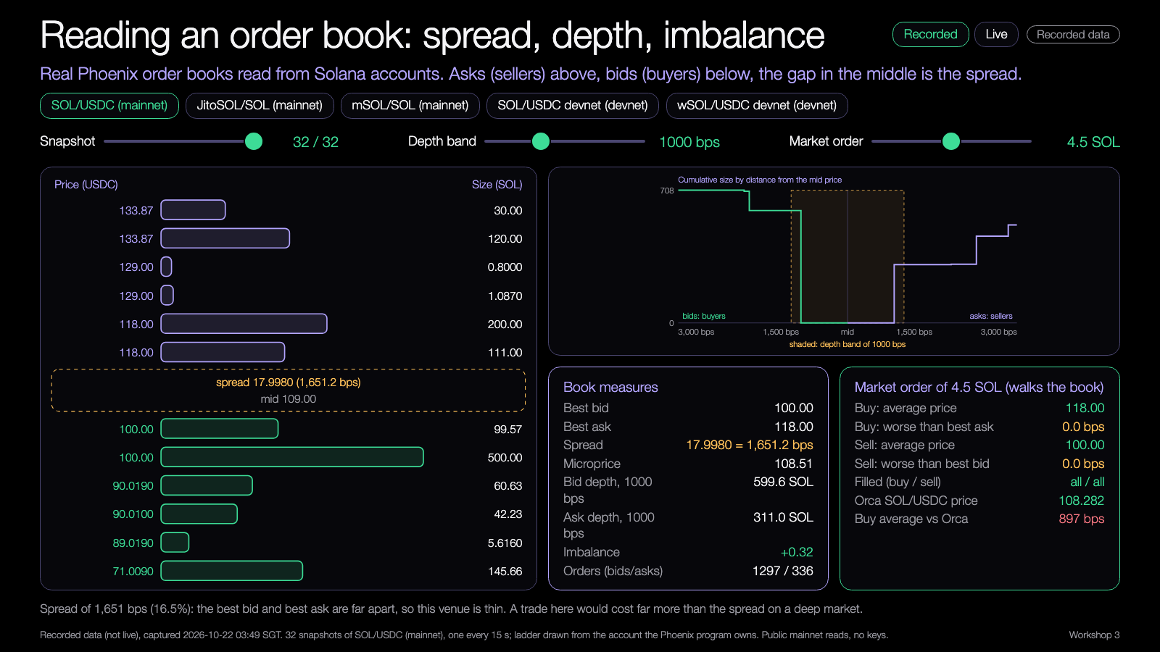
DEMO 1
Demo: order book ladder
PREDICT FIRST
How wide is the SOL/USDC spread on this market, in basis points?
$ npm run ladder
YOU SHOULD SEE
bids and asks as depth bars
spread, depth bands, imbalance
Learning Lab demo, runs from disk, recorded data.
Try it: nus-solana-demos.vercel.app/0006/01-order-book-ladder.html
Fallback: Recorded data is the default. No network needed.
Live mode: switch it on to watch real Solana data.
Source: demo-repo/lab/screenshots (captured from the Learning Lab demos on recorded data)
26
Notes:
[18:55] Demo one. Predict first: how wide is the spread on this market, in basis points? Take guesses from three people. Then open the ladder. You will see bids and asks as depth bars, with spread, depth bands and imbalance beside them. Move the slider to change the band, switch market with the buttons. The Live switch reads the account over the public RPC right now; if it fails three times in a row it falls back to recorded and says so. What to point out: the one-sided devnet market and the expired orders.

Slide 27
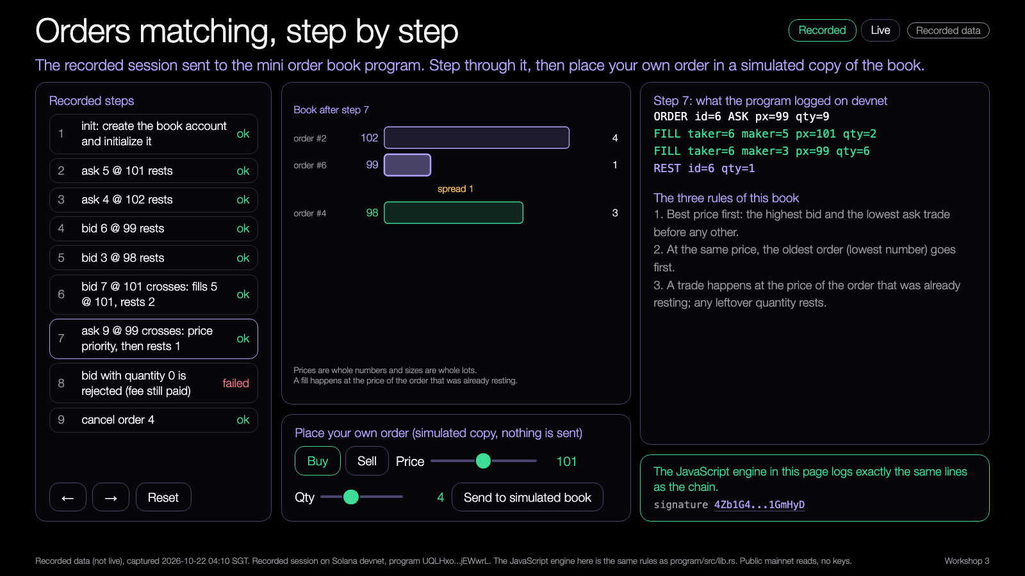
DEMO 2
Demo: matching step by step
PREDICT FIRST
Which resting order fills first when an ask at 99 arrives?
$ npm run demo -- --recorded
YOU SHOULD SEE
the book before and after each order
the log lines the program writes
Learning Lab demo, runs from disk, recorded data.
Try it: nus-solana-demos.vercel.app/0006/02-matching-step-by-step.html
Fallback: Same recorded devnet run. The steps are the same every time.
Live mode: switch it on to watch real Solana data.
Source: demo-repo/lab/screenshots (captured from the Learning Lab demos on recorded data)
27
Notes:
[19:00] Demo two: orders matching one at a time. Predict first: when the ask at ninety-nine arrives, which resting order fills first? Then step through. On the left the book before and after, on the right the log lines the program wrote. Both the TypeScript engine and the on-chain program produced these lines, and they match. Step seven is the one to dwell on: the price priority. Step eight shows the rejected order. If someone asks, the Live mode here reads the real book account on devnet.

Slide 28
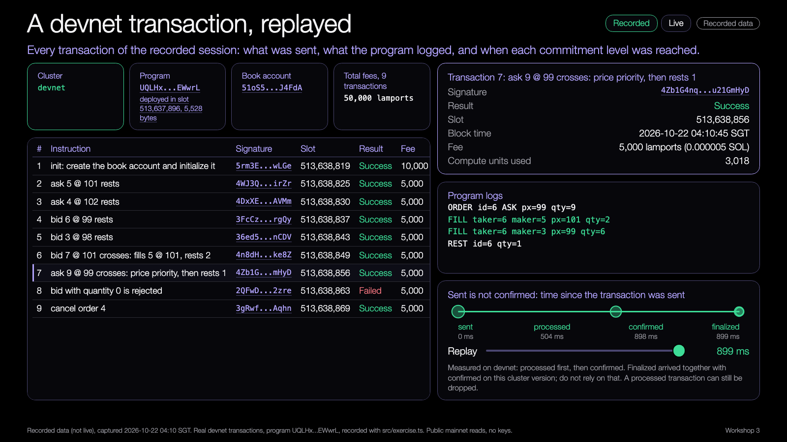
DEMO 3
Demo: devnet replay
PREDICT FIRST
Which of the nine transactions fails, and does it still cost a fee?
$ npm run demo -- --recorded
YOU SHOULD SEE
an explorer-style row per transaction
processed, confirmed and finalized times
Learning Lab demo, runs from disk, recorded data.
Try it: nus-solana-demos.vercel.app/0006/03-devnet-replay.html
Fallback: Recorded devnet signatures. Nothing is sent.
Live mode: switch it on to watch real Solana data.
Source: demo-repo/lab/screenshots (captured from the Learning Lab demos on recorded data)
28
Notes:
[19:04] Demo three is an explorer-style replay of the nine real transactions. Predict first: which one fails and does it still cost a fee? Each row has the signature, the slot, the fee, the compute units and the processed, confirmed and finalized times. Click a row to see the logs. The signatures link to the Solana explorer, so you can open the real thing. Live mode reads the signatures of the deployed program from devnet, so anything people send to our book while we talk shows up.

Slide 29
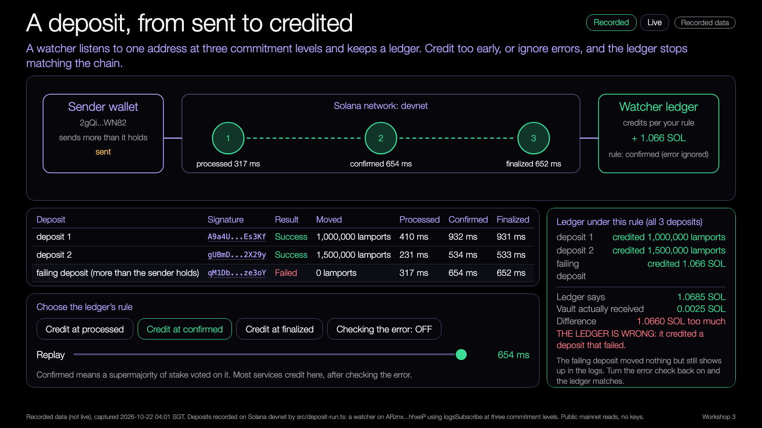
DEMO 4
Demo: deposit flow
PREDICT FIRST
At which stage should a deposit be credited, and what if it failed?
$ npm run demo -- --recorded
YOU SHOULD SEE
a wallet, a vault, a ledger
sent and confirmed as two stages
Learning Lab demo, runs from disk, recorded data.
Try it: nus-solana-demos.vercel.app/0006/04-deposit-flow.html
Fallback: Recorded devnet deposits. Nothing is sent.
Live mode: switch it on to watch real Solana data.
Source: demo-repo/lab/screenshots (captured from the Learning Lab demos on recorded data)
29
Notes:
[19:08] Demo four: a deposit travelling from wallet to vault to ledger, with sent and confirmed as two stages. Predict first: at which stage should the ledger credit, and what happens if the transaction failed? Use the toggle to fail a deposit and see the ledger refuse to credit it. This is the watcher from the starter, drawn out. Live mode watches the vault we used and shows the real devnet slots.

Slide 30
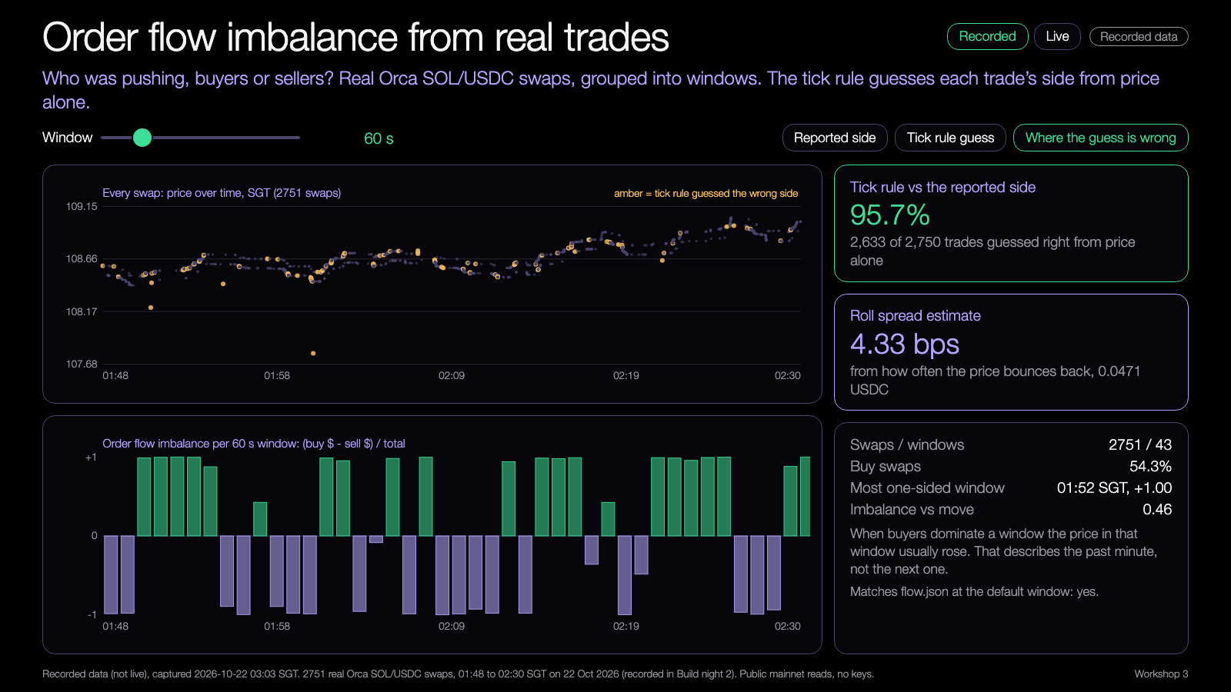
DEMO 5
Demo: order flow imbalance
PREDICT FIRST
Does imbalance in one minute say anything about the next minute?
$ npm run demo -- --recorded
YOU SHOULD SEE
one-minute windows of buys and sells
the correlation with the same and next window
Learning Lab demo, runs from disk, recorded data.
Try it: nus-solana-demos.vercel.app/0006/05-order-flow-imbalance.html
Fallback: Same recorded swaps. The windows are the same every run.
Live mode: switch it on to watch real Solana data.
Source: demo-repo/lab/screenshots (captured from the Learning Lab demos on recorded data)
30
Notes:
[19:11] Demo five goes back to the question from the start. Real Orca swaps, grouped into one-minute windows, each with a buy volume, a sell volume and an imbalance. Predict first: does the imbalance in one minute say anything about the next? The numbers say: it correlates with the return in the same window, but almost not at all with the next one. That is the honest answer. A feature that explains the minute that just happened is not a prediction. This is recorded data, simulated and not advice.

Slide 31
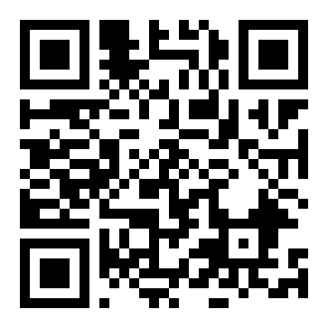
Try the demos yourself
DEMOS
nus-solana-demos.vercel.app/0006/
Five demos. Recorded by default. Switch Live on to read real Solana data.
No install. The same files are in the repo and open from disk.
Scan to open the demos
Source: demo-repo/lab (the five Learning Lab demos, deployed as static pages, recorded data)
31
Notes:
[19:14] Scan the code or type the address. No install: the five demos open in a browser, recorded by default. The same files are in the repo and open from disk if the Wi-Fi is bad. Switch Live on to see real Solana data. If Live fails, the demo falls back to recorded by itself. Take one minute now to open demo one on your laptop. Then we start the mini-lab.

Slide 32
Mini-lab
Read one devnet market and compute the spread by hand, then in code.
1
2
3
4
Read
By hand
In code
Pick
Open the ladder demo, pick a market
Best ask minus best bid, then divide by the mid
npm run ladder, compare your number
Choose a starter and start extending it
Done when your hand number and your code number agree.
32
Notes:
[19:15] Fifteen minutes. Four steps. Read: open the ladder demo and pick a market. By hand: take the best ask minus the best bid, divide by the mid, multiply by ten thousand. In code: run the ladder command and compare. Pick a starter and start extending it. You are done with the lab when your hand number and your code number agree. If they differ, find out why: the usual cause is a rounding or using the wrong price units. Leads rotate and help.

Slide 33
Takeaways
1
Spread, depth and imbalance all come from seeing the book.
2
Put on-chain only what must be trusted.
3
Sent is not confirmed. Credit at the level your risk allows.
DISCUSS
What does the on-chain component add for this user?
Does a successful transaction prove the project did the right thing?
33
Notes:
[19:55] Three things. Spread, depth and imbalance all come from seeing the book. Put on-chain only what must be trusted. Sent is not confirmed: credit at the level your risk allows. Two questions for the discussion, or take them home. What does the on-chain component add for this user? Does a successful transaction prove the project did the right thing? My answer to the second is no: a transaction can succeed and still do the wrong thing, and that is exactly what next week's failure testing is for.

Slide 34
Branch out
Where to take it next.
BEGINNER
STANDARD
ADVANCED
Run the deposit watcher on a second kind of failure.
Add a new order type to mini_book, with a test.
Add an owner and a signer check to the program.
34
Notes:
[19:56] Three ways to go further, by level. Beginner: run the deposit watcher against a second kind of failure, for example a transfer to the wrong address. Standard: add a new order type to mini_book with a test, such as an order that only rests and never fills. Advanced: add an owner and a signer check to the program, so only the owner can cancel an order. Pick one, write it down, and bring it to the next session.

Slide 35
Share back
Tell us what you built.
BY TONIGHT
WITHIN 48 HOURS
NEXT SESSION
1
2
3
Push your code and paste your program address.
Post your transaction links and one lesson.
Bring it to build night 4 for failure testing.
Addresses and signatures are public and safe to share. Never share a key or a seed phrase.
35
Notes:
[19:57] Share back so we can learn from each other and so I can report the session. By tonight: push your code and paste your program address in the group. Within forty-eight hours: post your transaction links and one lesson learned. Next session: bring it to build night 4 for failure testing. Do not paste any key or seed phrase, ever. Addresses and signatures are public and safe to share.

Slide 36
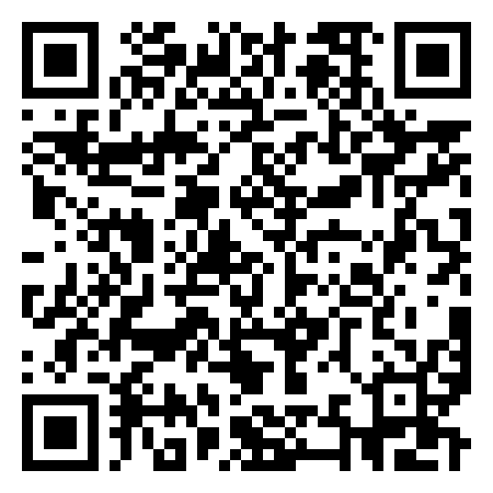
Get the code
REPO
github.com/travisim/solana-agentic-trading-nus
folder: 0006-deploy-venue-component-devnet/demo
1
$ cd demo/code && npm install
2
$ npm test
3
$ npm run demo -- --recorded
Scan for the session folder
Recorded data is the default. Writes are devnet only.
36
Notes:
[19:58] Everything from tonight is in one public repo: the demos, the sample code, the program source and the recorded data. Scan the code or type the address. Then three commands from the code folder: install, test, run the demo with the recorded flag. The recorded flag is the default so it works offline. Writes are devnet only. The folder is the one on the slide, and the program's README explains how to build and deploy your own copy.

Slide 37


Let's connect
LinkedIn
Telegram
linkedin.com/in/travisim
t.me/travisim
37
Notes:
[19:59] If you want to follow up, ask a question, or share what you built, here are LinkedIn and Telegram. Scan either one. Thanks everyone. Push your code before you leave, and I will see you at build night 4 next Thursday.

Slide 38

Notes:
[20:00] End of session. Leave this slide up while people pack up. Remind everyone to submit the post-workshop feedback form and that the report goes out within forty-eight hours, so by Saturday the twenty-third of January.

