Slide 1

Workshop 4
Performance
Scorecard and
Shipping
Honest numbers for your project, and a repo a stranger can run.
Travis Sim
NUS · Singapore
Thu 4 Feb 2027 · COM3/COM4
Notes:
[18:00] Welcome, thanks for coming. I'm Travis. This is Workshop 4, the last workshop before Demo Day on the eighteenth. Two halves today. First half: how to measure your project honestly, with a handful of numbers. Second half: how to ship it so someone else can run it and trust it. We have about forty minutes of talk, twenty-five of demos, a short lab, and then you build on your own project. If you haven't run the setup, put your hand up now and a lead will come to you.

Slide 2
Where we are
Today's question: could a stranger trust your numbers and run your project?
DONE
TODAY
NEXT
Build night 4
Workshop 4
Build night 5
Thu 28 Jan
Thu 4 Feb
Thu 11 Feb
Backtest validation and failure testing
Performance scorecard and shipping
Demo rehearsal
Demo Day: Thu 18 Feb
2
Notes:
[18:02] Quick progress circle. Last Thursday, Build night 4, we broke our own backtests on purpose: leaks, purged splits, failure tests. Today is Workshop 4: the scorecard and shipping. Next Thursday, the eleventh, is Build night 5, a demo rehearsal. Demo Day is Thursday the eighteenth. Go round the room, one line each: where is your project, and what is the one thing that would stop a stranger running it? Today's question is on the slide: could a stranger trust your numbers and run your project? Hold that thought.

Slide 3
Today
18:00 to 20:00. A third talk, a third demos and lab, a third your own build.
18:00
10 min
18:10
40 min
18:50
25 min
Progress circle
Teaching
Live demos
where each project stands
scorecard numbers, then shipping
five demos, you predict first
19:15
15 min
19:30
25 min
19:55
5 min
Mini-lab
Open build
Push and close
score the sample ledger, break a number
your own project, leads rotate
one line on the next step
3
Notes:
[18:07] The shape of the night. Ten minutes of progress circle, which we are in now. Forty minutes of teaching: first the scorecard numbers, then shipping. Then twenty-five minutes of live demos, five of them, and before each one I ask you to predict the result. Then a fifteen minute mini-lab where you score a ledger and break one number on purpose. Then twenty-five minutes of open build on your own project; the leads rotate. At five to eight you push and give one line on your next step.

Slide 4
What you leave with
By 19:55, in your repo.
1
2
3
A tested commit
A README
Devnet evidence
Integrated, and npm test passes.
Run steps that work from a clean checkout.
An explorer link that resolves.
4
5
6
One known limitation
A 3-minute demo script
Peer feedback
Named in the README.
With a recorded backup.
Someone else ran it.
4
Notes:
[18:09] This is what a finished evening looks like. Six things in your repo: a tested commit where npm test passes; a README with run steps that work from a clean checkout; devnet evidence, which is an explorer link that actually resolves; one known limitation written down; a three-minute demo script with a recorded backup; and feedback from a peer who ran it. Not on the list: a big simulated return. We judge utility and engineering evidence, never simulated returns. Keep that sentence in your head for the rest of the night.

Slide 5
A ledger is the input
One row per closed trade. The scorecard does the rest.
id
strategy
side
opened
closed
entry
exit
gross USD
1
One row per closed trade
1
basis
short
+00:10
+00:15
108.05
108.05
+0.000
2
market-maker
short
+00:10
+01:10
108.04
107.96
+0.713
3
market-maker
short
+00:15
+01:15
108.04
107.96
+0.713
2
Gross only: the scorecard applies fees and slippage
4
basis
short
+01:10
+01:40
108.01
108.01
+0.000
5
market-maker
long
+01:05
+02:05
108.01
108.09
+0.686
6
market-maker
short
+01:15
+02:15
108.01
108.08
-0.694
3
Optional on-chain fields: signature, fees, status
7
market-maker
short
+01:20
+02:20
108.01
108.08
-0.721
45 trades in the full ledger
Source: demo-repo/code/out/ledger.json (45 trades from the sample strategies, simulated on recorded data; not advice)
5
Notes:
[18:10] Everything today starts from a trade ledger: one row per closed trade. The table is real: the first rows of our sample ledger, 45 trades from the sample strategies on forty minutes of recorded SOL/USDC data from the 21st of October. Columns: which strategy, long or short, when it opened and closed, entry and exit price, and the gross profit or loss in dollars. Gross means before costs. We keep costs out of the ledger on purpose: the scorecard applies fees and slippage, so you can change them and see what happens. There are optional on-chain fields too, like the signature and the failed status. If your project has no real transactions, leave them out. The scorecard will say not available rather than guess. Simulated, on recorded data; not advice.

Slide 6
Hit rate alone says nothing
Two made-up strategies, ten trades each.
STRATEGY A
STRATEGY B
9 of 10 trades win
4 of 10 trades win
each win pays +1
each win pays +3
the one loss costs -12
each of 6 losses costs -1
net -3 per ten trades
net +6 per ten trades
Hit rate needs the size of wins and losses beside it.
Illustrative numbers, not from our data
6
Notes:
[18:12] The number everyone quotes first is hit rate: how often you win. Look at these two made-up strategies. Left one wins nine trades out of ten. Sounds great. But each win pays one and the one loss costs twelve. Nine minus twelve: it loses three per ten trades. Right one wins only four out of ten, but wins pay three and losses cost one. Four times three is twelve, six losses cost six, so it makes six per ten. These numbers are illustrative, not from our data. The point: a hit rate needs the size of the wins and losses beside it. Ask the room: which would you rather own?

Slide 7
Win size, loss size, break-even
The hit rate you need depends on what a win pays and a loss costs.
break-even hit rate = average loss / (average win + average loss)
NO COSTS (0 + 0 bps per leg)
FEE 5 + SLIPPAGE 2 bps per leg
Hit rate
42%
Hit rate
11%
Average win / loss
+0.69 / -0.44
Average win / loss
+0.45 / -1.40
Break-even hit rate
39.0%
Break-even hit rate
75.8%
Net P&L (USD)
+3.00
Net P&L (USD)
-53.70
Same 45 trades. Only the costs changed.
Source: demo-repo/code/out/cost-scenarios.json (simulated on recorded data; not advice)
7
Notes:
[18:14] So how often do you need to win? That depends on the payoff. Break-even hit rate equals average loss divided by average win plus average loss. If wins and losses are the same size, you need to win half the time. If wins are twice the losses, a third is enough. Now our real ledger. With zero costs, the hit rate is 42 percent, average win 0.69 dollars, average loss 0.44, so break-even is 39.0 percent. We are just above it. Add seven basis points per leg, fee plus slippage, and the same 45 trades give a hit rate of 11 percent, average win 0.45, average loss 1.40, break-even 75.8 percent. Nobody is close. Same trades; only the costs changed. Simulated, on recorded data; not advice. Background for you: this is the same idea as the book's chapter 15, simplified.

Slide 8
Gross is not net
Same 45 trades, three cost settings.
FEE 0 + SLIPPAGE 0 BPS
FEE 5 + SLIPPAGE 2 BPS
FEE 12 + SLIPPAGE 5 BPS
+3.00
-53.70
-134.60
net P&L, USD
net P&L, USD
net P&L, USD
gross +3.00
gross +3.00
gross +3.00
costs 0.00
costs -56.70
costs -137.60
The venue gap in our recorded data was typically 1 to 3 bps (largest 6.3 bps). A round trip here pays 14 bps.
Costs are paid on every leg, win or lose.
Source: demo-repo/code/out/cost-scenarios.json; venue gaps in code/recorded/SOURCES.md. Simulated, on recorded data; not advice.
8
Notes:
[18:16] Three cost settings on the same 45 trades. With no costs the ledger makes 3.00 dollars gross. With 5 plus 2 basis points per leg it loses 53.70. With 12 plus 5, it loses 134.60. Why so brutal? A round trip pays costs on both legs: fourteen basis points at the base setting. In our recorded data the gap between venues was typically one to three basis points and at most 6.3. The edge is smaller than the toll. Costs are paid on every leg, win or lose. Good question to ask your own project: what is my gross edge per trade in basis points, and what does one round trip cost me? If the first is smaller than the second, stop and rethink.

Slide 9
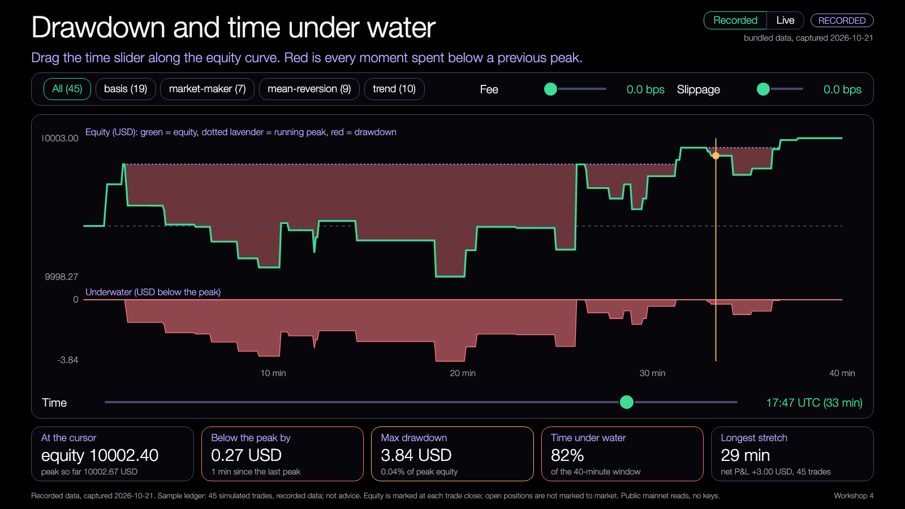
Drawdown and time under water
How far it fell, and how long it stayed down.
MAX DRAWDOWN, ZERO COSTS
3.84 USD
bigger than the 3.00 USD it ends up ahead
UNDER WATER, ZERO COSTS
82%
longest stretch 29 min of 40
WITH 5 + 2 BPS COSTS
99%
under water, max drawdown 53.70 USD
Even with zero costs the equity spent most of the window below a previous peak.
Source: lab demo 2 and code/out/cost-scenarios.json. Simulated, on recorded data; not advice.
9
Notes:
[18:18] Two numbers about pain. Drawdown: how far equity fell from its previous peak. Time under water: how long it stayed below that peak. The picture is from demo 2 with zero costs. Even with zero costs the ledger nets plus 3 dollars, but the max drawdown is 3.84 dollars, bigger than the profit, and equity spent 82 percent of the window below a previous peak, the longest stretch 29 minutes. With the base costs it is under water 99 percent of the time. Why it matters: a strategy that ends up slightly positive can still be unlivable on the way. Ask: how long would you hold something that is red 82 percent of the time? We will play with this in demo 2.

Slide 10
Turnover
How much you traded compared with what you hold.
PER STRATEGY
TURNOVER, ALL 45 TRADES
8.3x
basis
3.8x
19 trades
trend
2.0x
10 trades
83,000 USD traded on 10,000 USD of capital, in 40 minutes
mean-reversion
1.8x
9 trades
market-maker
0.7x
two legs per trade, 1,000 USD each
7 trades
More turnover means more costs. Check it before you celebrate a gross number.
Source: demo-repo/code/out/scorecard.json (capital 10,000 USD, 40 minutes). Simulated, on recorded data; not advice.
10
Notes:
[18:20] Turnover is how much you traded compared with what you hold. We start with 10,000 dollars of capital. The 45 trades, two legs each at 1,000 dollars, traded 83,000 dollars: 8.3 times capital in forty minutes. Per strategy: basis 3.8 times, trend 2.0, mean reversion 1.8, the market maker 0.7. Costs scale with turnover. So when someone shows you a gross number, ask for turnover next. A strategy that needs enormous turnover to produce a small edge will be eaten by costs. Simulated, on recorded data; not advice.

Slide 11
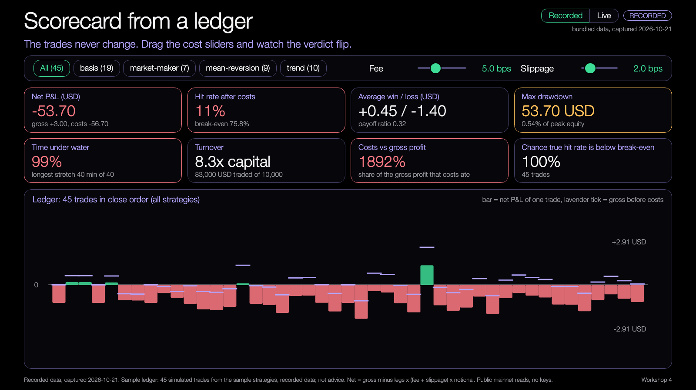
The scorecard on one page
Eight numbers, one ledger.
1
Net, not gross
2
Hit rate against break-even
3
Drawdown and time under water
Source: lab demo 1 (recorded data). Simulated; not advice.
11
Notes:
[18:22] Put the numbers together and you get the scorecard. This is demo 1 at the base costs. Eight cards: net P and L, hit rate against break-even, average win and loss, max drawdown, time under water, turnover, costs against gross profit, and the chance the true hit rate is below break-even, which is the next idea. Below, one bar per trade: green is a win after costs, red a loss, lavender tick is the gross. Notice how many bars the costs push from a small win to a loss. The verdict on this page: net minus 53.70 dollars, hit rate 11 percent against 75.8 needed. That is an honest dashboard saying: do not ship this as a profitable strategy. It might still be a fine project: the scorecard is the feature.

Slide 12
The code behind it
Plain functions, no framework.
src/scorecard.ts
1
Net = gross minus costs on every leg
export function netUsd(t: LedgerTrade, c: CostSettings): number {
const bps = c.feeBps + (t.paysSlippage ? c.slippageBps : 0);
return t.grossUsd - t.legs * (bps / 10_000) * t.notionalUsd;
}
export function breakEvenHitRate(win: number, loss: number): number {
return loss / (win + loss);
}
export function failureProbability(hit: number, breakEven: number, n: number): number {
const se = Math.sqrt((hit * (1 - hit)) / n);
return se === 0 ? (hit < breakEven ? 1 : 0) : normCdf((breakEven - hit) / se);
}
2
Break-even comes from the two average payoffs
3
A normal approximation, with a warning under 30 trades
Source: demo-repo/code/src/scorecard.ts (excerpt)
12
Notes:
[18:24] There is no magic in this. The function net takes a trade and the cost settings: gross minus the number of legs times fee plus slippage times the notional. Break-even hit rate: loss over win plus loss. And failureProbability: from the hit rate you saw, how many trades, and break-even, it returns the chance the real hit rate is below break-even, using a normal approximation. About fifteen lines. Read the whole file src/scorecard.ts tonight, it is short. In the mini-lab you will change an input and watch these functions react.

Slide 13
Run it
One command, recorded data, no network.
$ npm run demo -- --recorded
Strategy Trades Hit AvgWin AvgLoss Payoff NetUSD MaxDD Under% Turn x PFail
basis 19 0% n/a -1.33 n/a -25.29 25.29 99% 3.8 n/a
market-maker 7 43% +0.20 -1.02 0.20 -3.45 4.06 94% 0.7 98%
mean-reversion 9 0% n/a -1.29 n/a -11.57 11.57 80% 1.8 n/a
trend 10 20% +0.81 -1.88 0.43 -13.39 13.50 73% 2.0 100%
--------------------------------------------------------------------------------------------------------
ALL (one ledger) 45 11% +0.45 -1.40 0.32 -53.70 53.70 99% 8.3 100%
One ledger, in words
45 trades; 11.1% won after costs; the break-even hit rate for these payoffs is 75.8%.
Gross +3.00 USD, costs -56.70, net -53.70. Costs ate 1892% of the gross profit.
What this cannot say: 40 minutes of one quiet night is one path, not a distribution. A good number here is a reason to test more, never a result.
1
Table per strategy, then the whole ledger
2
Names the limit: 40 minutes, one path
Source: terminal output of the sample code (assets/terminal-demo.txt), recorded data of 21 Oct 2026
13
Notes:
[18:26] This is the real terminal output from npm run demo with recorded data. First a table per strategy, then the whole ledger in words, then what this cannot say. Point at the line "What this cannot say": forty minutes of one quiet night is one path, not a distribution. The program says this itself. You can copy that habit: have your code print its own limits. Everything is recorded data bundled in the repo, no network, no keys. If someone's machine fails here, they run --recorded and nothing else; a lead helps.

Slide 14
Probability of failure
Is the hit rate you saw the real one?
THE IDEA
HIT RATE 45%, BREAK-EVEN 50%
You saw a hit rate over N trades. The real one is unknown. Break-even says how low it can go before you lose. The chance it is below break-even shrinks as N grows.
chance the real hit rate is below break-even
10 trades
62%
30 trades
71%
100 trades
84%
200 trades
92%
500 trades
99%
Same hit rate, more trades, surer answer.
Our own ledger has 45 trades.
Source: demo-repo/code/out/failure-table.json (hit rate 45%, wins pay 1x losses, break-even 50%). Normal approximation; illustrative.
14
Notes:
[18:28] Second idea from the book, in our words. You saw a hit rate over N trades. The real hit rate is unknown. Break-even tells you how low the real one can be before you lose money. So: what is the chance the real hit rate is below break-even? Example on the right, made up: 45 percent hit rate, wins pay the same as losses, so break-even is 50. After 10 trades, the chance is 62 percent. After 30, 71. After 100, 84. After 200, 92. After 500, 99 percent. Same hit rate, more trades, surer answer: the more you watch, the surer you are that 45 is below 50. Our real ledger has 45 trades, and the code warns below 30 trades. It is a normal approximation, a rough guide, not a guarantee. If they push: it ignores that trades may not be independent.

Slide 15
What simulated numbers can and cannot say
Say it on the dashboard, not in the Q&A.
THEY CAN SAY
THEY CANNOT SAY
Whether an idea is worth testing more
What happens next
Which costs matter most
A return you could earn
How deep and how long a drawdown looked on this data
Busy markets, or your own order's impact
Our sample: 40 minutes on one quiet night (21 Oct 2026, 17:14 to 17:54 UTC). Simulated, on recorded data; not advice.
15
Notes:
[18:30] Be honest on the dashboard itself. Simulated numbers can say: whether an idea is worth testing more, which costs matter most, and how deep and how long a drawdown looked on this data. They cannot say: what happens next, a return you could earn, how busy markets behave, or what your own order does to the price. Our sample is forty minutes on one quiet night, 21 October, 17:14 to 17:54 UTC. Put a sentence like this next to your chart. Judges trust projects that name their limits. Simulated, on recorded data; not advice.

Slide 16
What Solana itself costs
Real capture: 2,680 transactions in five finalized blocks.
BASE FEE
MEDIAN FEE PAID
PAID A PRIORITY FEE
FAILED
5,000
5,222
66%
35.3%
lamports per signature, fixed by the protocol
lamports = 0.0006 USD = 0.006 bps of a 1,000 USD trade
of transactions; the 90th percentile paid 10,000 lamports in total priority
of 2,680 transactions; 28% to 44% per block
Put fees, priority fees, Jito tips and the failed rate in your dashboard when you have real transactions. Jito tips: not captured.
Source: demo-repo/code/recorded/solana-costs.json, public mainnet RPC, 21 Oct 2026 19:53 UTC. Five blocks, one evening: a sample, not a measurement of Solana.
16
Notes:
[18:32] Solana's own costs, from a real capture: five finalized blocks on the 21st of October, 2,680 transactions. The protocol base fee is 5,000 lamports per signature. The median fee paid was 5,222 lamports: about 0.0006 dollars, or 0.006 basis points of a 1,000 dollar trade. About 65 percent of transactions paid some priority fee. And 35 percent of the transactions in those blocks failed, between 28 and 44 percent per block. That failure rate is mostly bot traffic that fails by design, so it says little about your own failure rate, and five blocks on one evening is a sample, not a measurement of Solana. Not captured: Jito tips. Lesson: on-chain fees are tiny next to venue fees and slippage here, but failed transactions still pay the base fee. If your project sends real transactions, put fees, priority fees, tips, the failed rate and explorer links in your dashboard.

Slide 17
What judges look at
Utility, tests, devnet evidence.
1
2
3
Utility
Tests
Devnet evidence
Does it solve a real problem for someone?
Can a stranger run npm test and see it pass?
An explorer link that resolves.
Never simulated returns.
17
Notes:
[18:34] Switch to shipping. On Demo Day judges look at three things: utility, tests, devnet evidence. Utility: does it solve a real problem for someone, and can they say who. Tests: can a stranger run npm test and see it pass. Devnet evidence: an explorer link that resolves, for a transaction you made. Never simulated returns. A project with a beautiful equity curve and no tests loses to a plain one that runs. No prizes or funding to talk about here; we are judging engineering evidence.

Slide 18
README anatomy
Six blocks. A first-time reader sees the benefit and the limit.
1
What it is
One sentence, one reader.
templates/README.template.md
# <project name>
<One sentence: what it does and for whom.>
**Status:** <works on devnet / prototype / simulation only>. R
## Run it (from a fresh checkout)
```
npm install
npm test
npm run demo -- --recorded
```
Expected output: <paste the first 5 lines you actually see>. T
## What you will see
<A screenshot or a 3-line description. Name the one number or
## Devnet evidence
<Explorer link with ?cluster=devnet for at least one real tran
## Known limitation
2
Run it
Exact commands from a clean checkout.
3
What you will see
One picture or three lines.
4
Devnet evidence
An explorer link, or "none".
5
Known limitation
One honest sentence.
6
Safety
Devnet only, no keys, simulated is labelled.
Source: demo-repo/code/templates/README.template.md (excerpt)
18
Notes:
[18:36] A README has six blocks. What it is: one sentence, one reader. Run it: exact commands from a clean checkout, and what output to expect. What you will see: one picture or three lines. Devnet evidence: an explorer link, or the word none. Known limitation: one honest sentence. Safety: devnet only, no keys, simulated results are labelled. The code card is from the template in templates/README.template.md. Copy it today. A first-time reader should see both the benefit and the limit within thirty seconds.

Slide 19
Tests and devnet evidence
Show it, do not describe it.
TESTS
DEVNET EVIDENCE
$ npm test
https://explorer.solana.com/tx/<signature>?cluster=devnet
One command runs them. They pass from a clean checkout. One test per number you print.
A link is not evidence until it resolves. Never paste a key.
Evidence is a transaction you made on devnet. Not a screenshot of a chart.
19
Notes:
[18:38] Tests: one command runs them, they pass from a clean checkout, and ideally there is a test for each number you print. Devnet evidence: the link format is explorer.solana.com slash tx slash the signature, question mark cluster equals devnet. Two rules. A link is not evidence until it resolves; demo 5 can check that live against devnet. And never paste a key or a keypair into a doc. Evidence means a transaction you made, not a screenshot of a chart. Writes are devnet only, no real funds; if you need devnet SOL, use a throwaway keypair that is gitignored and ask a lead about airdrop limits.

Slide 20
Secrets and repo hygiene
Scan before you push. Run it on your own project.
$ npm run ship-check -- ../my-project
$ npm run ship-check -- .
Ship check: .
PASS README at the top of the project
PASS README says how to install and run
PASS README names one known limitation
PASS README says devnet only, no real funds
PASS Tests exist
PASS One command runs the tests
PASS No .env or keypair files in the project
PASS No keys or secrets inside files
PASS .gitignore covers .env and node_modules
PASS Licence file
PASS Demo script or pitch notes
WARN Devnet evidence (explorer link or signature)
no devnet explorer link (.../tx/<signature>?cluster=devnet)
PASS Recorded backup for the demo
PASS No junk or oversized files
NEARLY READY: 13/14 checks pass, 0 fail, 1 warn
Secrets
.env, keypair files, key-shaped text
.gitignore
.env and node_modules listed
Licence
MIT is a fine default
Junk
.DS_Store, logs, big files
If a real key ever reached git, rotate it. Deleting the file is not enough.
Source: terminal output of the ship check on the sample code itself (assets/terminal-shipcheck.txt)
20
Notes:
[18:40] Before you push, scan. The ship check looks for secret files like .env, id.json, keypair files and pem files, and for key-shaped text: a list of 64 numbers, or PRIVATE_KEY equals a long string. It checks your .gitignore covers .env and node_modules, that there is a licence, and that there is no junk like DS_Store or big files. The terminal card is the real output of the ship check run on this sample project itself: 13 of 14 pass; the one warning is devnet evidence, because this project makes no devnet writes. If a real key ever reached git, rotate it: deleting the file does not remove it from history. It prints where the problem is, never the secret.

Slide 21
Demo script
Three minutes. Say it twice with a timer.
0:20
1:00
0:40
0:30
0:20
Problem
Run
Evidence
Limit
Next
Who loses what, with one example.
The exact command. Say what to look at first.
A passing test run or an explorer link.
One thing it does not do.
One concrete next step.
Template: templates/DEMO-SCRIPT.template.md
21
Notes:
[18:42] Now the Demo Day prep. Your demo script, three minutes. Twenty seconds on the problem: who loses what, with one example. A minute on the run: the exact command, and say what to look at before you press enter. Forty seconds on evidence: a passing test run or an explorer link. Thirty seconds on the limit: one thing it does not do. Twenty seconds on what is next. Rehearse it twice with a timer. Template in templates/DEMO-SCRIPT.template.md.

Slide 22
The 2-minute pitch
Five parts. Write one sentence for each.
20 s
30 s
30 s
25 s
15 s
1
2
3
4
5
Problem
What it does
Evidence
Limit
Ask
0 to 20 s
20 to 50 s
50 to 80 s
80 to 105 s
105 to 120 s
Who loses what, and why.
One thing. Show it.
Tests pass. Devnet link. One output.
It does not X, so Y.
Run it. Next I will Z.
Template: templates/PITCH-2MIN.md
22
Notes:
[18:44] Shorter version, two minutes, five parts. Problem, zero to twenty seconds. What it does, twenty to fifty, show it. Evidence, fifty to eighty: tests pass, devnet link, one output. Limit, eighty to a hundred and five: it does not X, so Y. Ask, last fifteen seconds: run it, here is the repo, next I will Z. Write one sentence for each part tonight. You will refine them at Build night 5.

Slide 23
Cold-start test
The README has to work for someone who is not you.
1
2
3
4
Copy
Follow
Watch
Fix
A clean folder: no node_modules, no out.
Only the README. Nothing from memory.
The peer types. You stay silent.
Change the README, not the peer.
$ npm run smoke
npm install, npm test and the demo, in a temp copy
Smoke test first, then a peer. Feedback sheet: templates/PEER-FEEDBACK.md
23
Notes:
[18:46] The best README test is someone who is not you. Four steps. Copy the project to a clean folder with no node_modules and no out folder. Follow only the README, nothing from memory. The peer types; you stay silent and watch where they stall. Then fix the README, not the peer. There is a command, npm run smoke, that does the mechanical part: it copies the project to a temp folder and runs only the README commands: install, test, demo. Run it first, then ask a peer. Feedback sheet is in templates/PEER-FEEDBACK.md.

Slide 24
Recorded backup
Decide before you walk up. The network will fail at the worst moment.
Network fails
Run with --recorded. The data is in the repo.
Laptop fails
Screenshots and a PDF in the repo.
A command is slow
Know what you will say while it runs.
Test the backup, not just the live path.
24
Notes:
[18:48] Decide before you walk up: what happens when the network fails, the laptop fails, or a command is slow. Network fails: run with --recorded; the data is in the repo. Laptop fails: screenshots and a PDF, also in the repo. A command is slow: know what you will say while it runs. And test the backup, not just the live path. In a classroom everyone shares one campus network address, and public APIs rate limit: in our tests Jupiter's free quote API answered 429 after about one call. Do not depend on the network for your demo. That is why every demo we show today has a recorded mode.

Slide 25
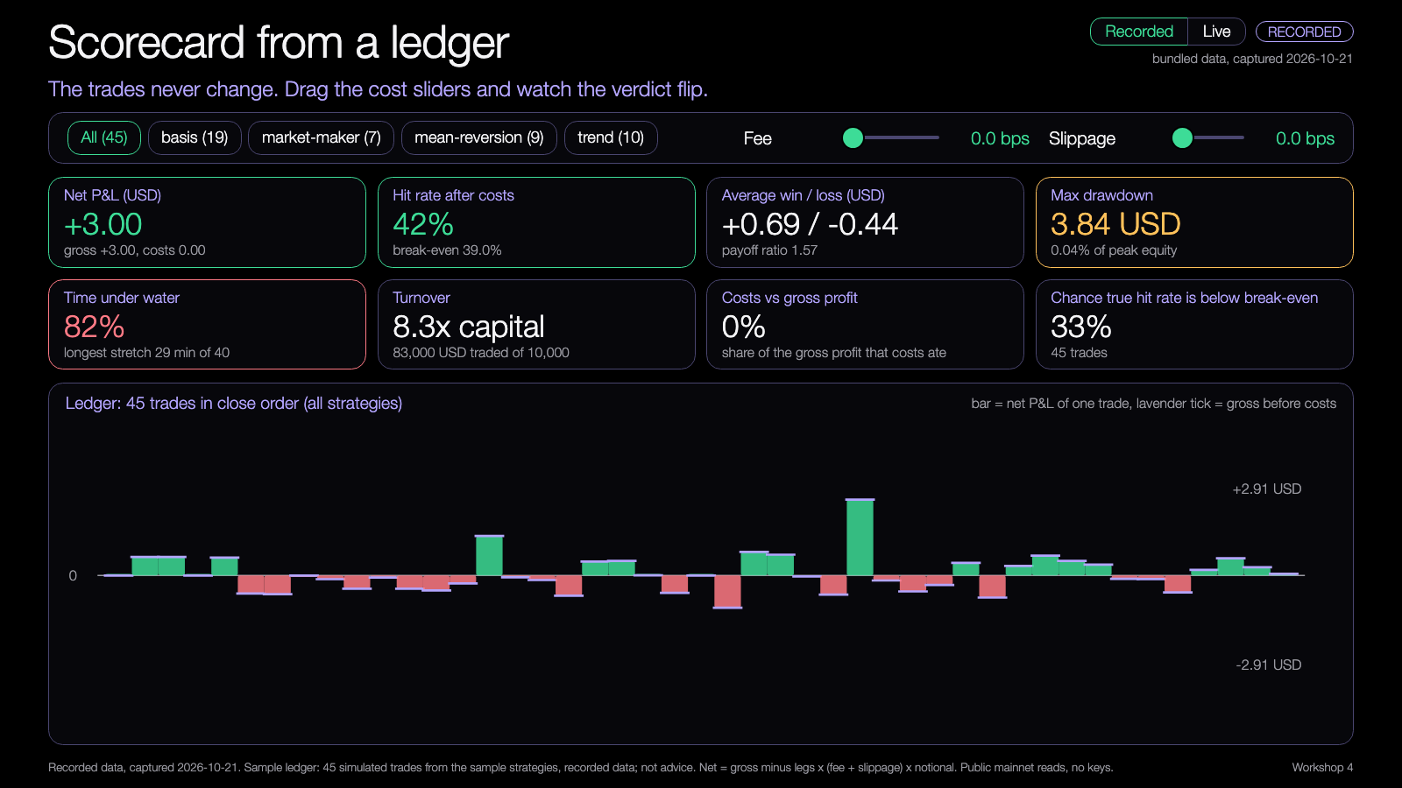
DEMO 1
Demo 1: scorecard from a ledger
PREDICT FIRST
At zero costs, does this ledger make money? What about at 7 bps per leg?
$ npm run demo -- --fee-bps 0 --slippage-bps 0
YOU SHOULD SEE
net and hit rate, with costs at 0 and at 7 bps
break-even hit rate against the hit rate
Try it: nus-solana-demos.vercel.app/0008/01-scorecard.html
the verdict flips as the sliders move
Live mode: switch it on to watch real Solana data.
Recorded data. Runs in your browser.
Fallback: Recorded data is bundled. Open lab/01-scorecard.html offline.
Source: demo-repo/lab/screenshots (captured from the lab demos on recorded data). Simulated; not advice.
25
Notes:
[18:50] Demo time, five demos. Before each one: predict. Demo 1: the scorecard. Question: at zero costs, does this ledger make money? And at seven basis points per leg? Let people answer. Run the command with zero costs in the terminal, or open lab 01 in the browser. Drag the fee and slippage sliders: net goes from plus 3.00 to minus 53.70 at 5 plus 2 and minus 134.60 at 12 plus 5. Pick a strategy button: trend, 10 trades, 20 percent hit rate. Switch on Live: it shows the live Jupiter versus Orca gap against your cost line and counts how many live ticks cleared it; usually none. What this does not show: a future return; it is 45 trades on 40 minutes. If Live fails, the pill says rate limited and it falls back to recorded.

Slide 26
DEMO 2
Demo 2: drawdown and time under water
PREDICT FIRST
With zero costs, how much of the 40 minutes is spent below a previous peak?
$ open lab/02-underwater.html
YOU SHOULD SEE
red is every moment below the running peak
max drawdown, time under water, longest stretch
Try it: nus-solana-demos.vercel.app/0008/02-underwater.html
drag the cursor: minutes since the last peak
Live mode: switch it on to watch real Solana data.
Recorded data. Runs in your browser.
Fallback: Same recorded ledger every time.
Source: demo-repo/lab/screenshots (captured from the lab demos on recorded data). Simulated; not advice.
26
Notes:
[18:55] Demo 2. Predict: with zero costs, how much of the forty minutes does the equity spend below a previous peak? Collect guesses, then open the demo with costs at zero: 82 percent, longest stretch 29 minutes, max drawdown 3.84 dollars, final plus 3.00. Drag the time cursor: it tells you how many minutes since the last peak. Then set the sliders back to 5 and 2: 99 percent, max drawdown 53.70. Live mode adds a paper long of 1,000 dollars from the moment you switch Live on, marked to the live Orca price, so you see an underwater chart being drawn. What it does not show: open positions are not marked to market in the recorded ledger.

Slide 27
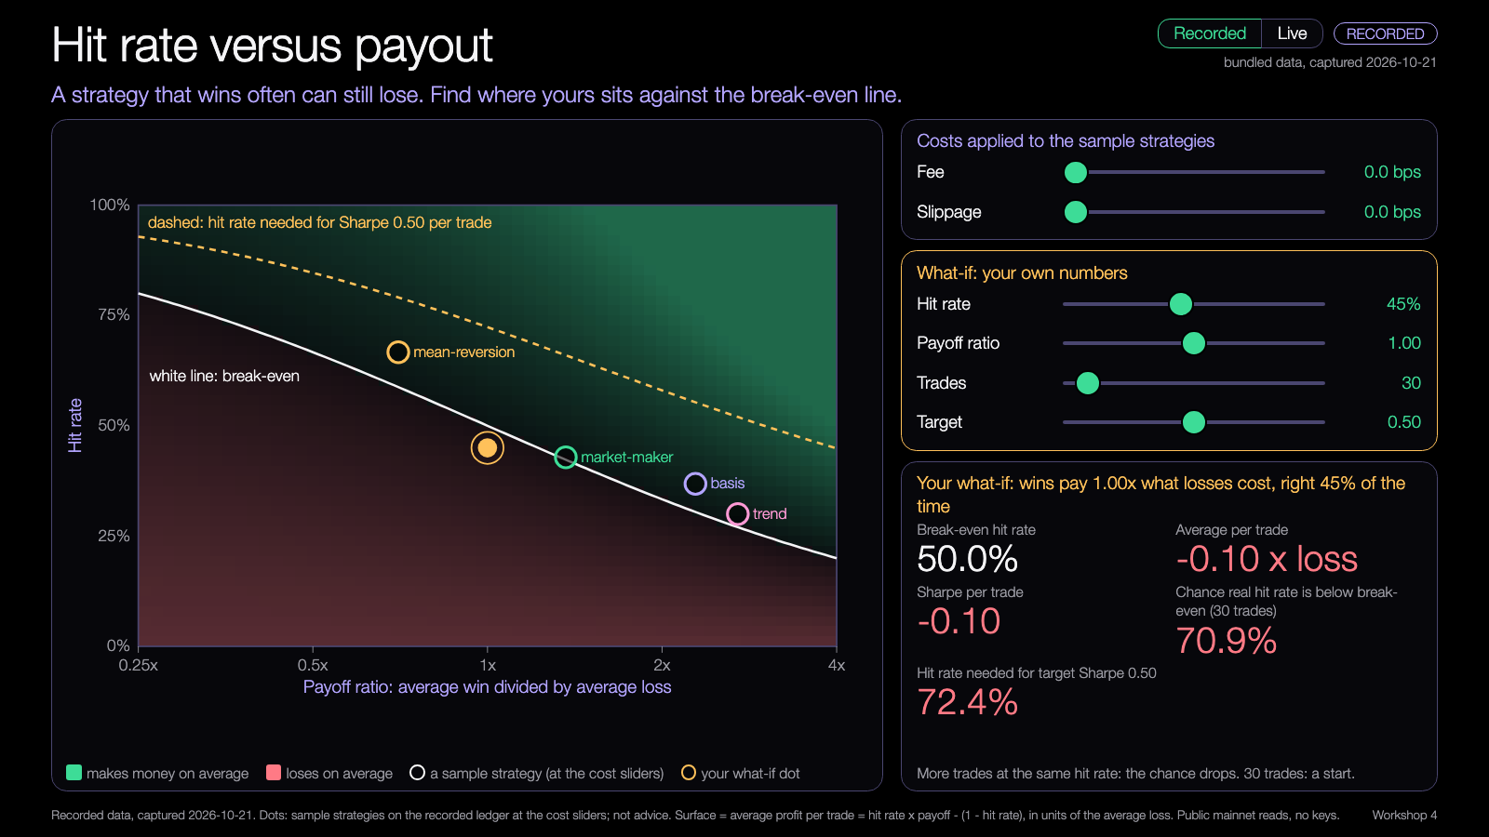
DEMO 3
Demo 3: hit rate versus payout
PREDICT FIRST
Where does a 45% hit rate with equal wins and losses land? How many trades until you trust it?
$ open lab/03-hit-rate-payoff.html
YOU SHOULD SEE
the white line is break-even
your what-if dot, and the chance it is below the line
Try it: nus-solana-demos.vercel.app/0008/03-hit-rate-payoff.html
the sample strategies move with the cost sliders
Live mode: switch it on to watch real Solana data.
Recorded data. Runs in your browser.
Fallback: All maths runs in the page; no network needed.
Source: demo-repo/lab/screenshots (captured from the lab demos on recorded data). Simulated; not advice.
27
Notes:
[19:00] Demo 3. Predict: a 45 percent hit rate with equal wins and losses; where is it, and how many trades before you would trust it? The surface: green is profitable on average, red loses. The white line is break-even. The dots are the sample strategies at the cost sliders. The yellow dot is your what-if. Set hit rate 45, payoff 1.0, trades 30: chance the real hit rate is below break-even 71 percent. Move trades to 200: 92 percent. The target slider adds a dashed line: the hit rate needed for a given per-trade Sharpe ratio. Live mode treats each live tick as a one-tick trade; costs push the dot left and down, so you see why a five second move cannot pay a fourteen basis point round trip. What it does not show: independence of trades.

Slide 28
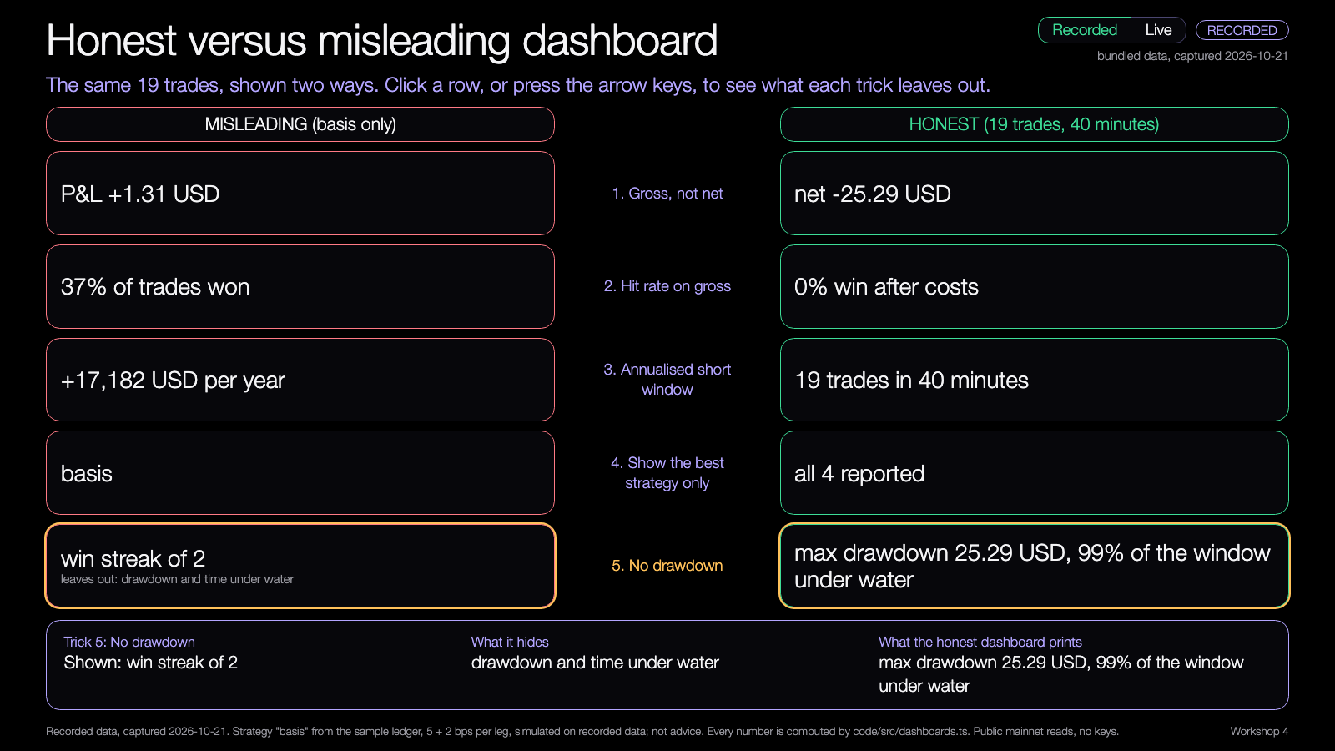
DEMO 4
Demo 4: honest versus misleading dashboard
PREDICT FIRST
Which of the five tricks would have fooled you first?
$ open lab/04-honest-dashboard.html
YOU SHOULD SEE
left: gross, annualised, best strategy only
right: net, drawdown, all strategies
Try it: nus-solana-demos.vercel.app/0008/04-honest-dashboard.html
click a row: what it hides
Live mode: switch it on to watch real Solana data.
Recorded data. Runs in your browser.
Fallback: Same ledger, computed by the code, no network.
Source: demo-repo/lab/screenshots (captured from the lab demos on recorded data). Simulated; not advice.
28
Notes:
[19:05] Demo 4. Same 19 trades of the basis strategy, shown two ways. Left: misleading. Right: honest. Click through the five tricks. One, gross not net: plus 1.31 gross, minus 25.29 net. Two, hit rate on gross: 37 percent won, but zero percent win after costs. Three, annualised short window: 17,182 dollars a year, from 40 minutes of data. Four, best strategy only: the other three together lost 28.41 net. Five, no drawdown: a win streak of two, hiding 99 percent of the window under water. Ask the room which one would have fooled them. Live mode does the same with a live paper position. What it does not show: every trick that exists.

Slide 29
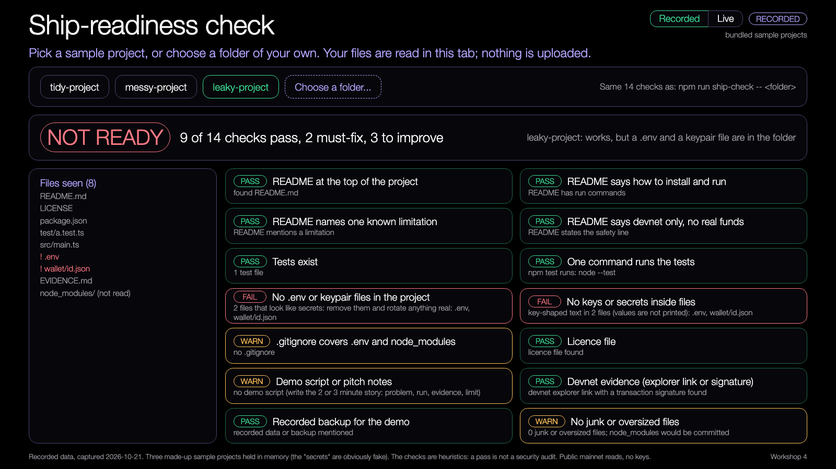
DEMO 5
Demo 5: ship-readiness check
PREDICT FIRST
Which of the three sample projects would you ship? What stops the other two?
$ npm run ship-check -- ../my-project
YOU SHOULD SEE
14 checks: pass, warn or fail
leaky-project: .env and a keypair file caught
Try it: nus-solana-demos.vercel.app/0008/05-ship-check.html
Live: does the devnet link resolve?
Live mode: switch it on to watch real Solana data.
Recorded data. Runs in your browser.
Fallback: The page has three sample projects built in.
Source: demo-repo/lab/screenshots (captured from the lab demos on recorded data). Simulated; not advice.
29
Notes:
[19:09] Demo 5. Three sample projects built into the page. Predict: which would you ship, and what stops the other two? Tidy passes 14 of 14. Messy passes 3: no tests, a thin README, no licence, junk files. Leaky passes 9 and fails two: a .env and a wallet file id.json, caught by name and by content, and it never prints the secret. Click Choose a folder to run the same 14 checks on your own project; files are read in your browser tab and nothing is uploaded. Live mode asks the devnet RPC whether signatures in your docs exist. The same checks run from the terminal with npm run ship-check. What it does not show: it is a set of heuristics, a pass is not a security audit.

Slide 30
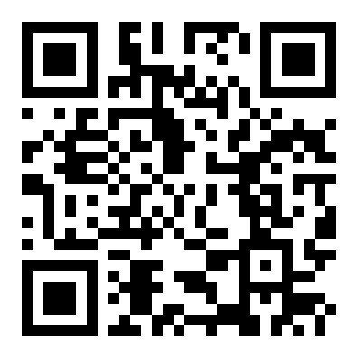
Try the demos yourself
OPEN ON YOUR LAPTOP
nus-solana-demos.vercel.app/0008
Open it on your laptop and move the sliders.
Five demos: scorecard, drawdown, hit rate versus payout, honest versus misleading dashboard, ship check. Recorded data; nothing to install.
Scan to open the demos
30
Notes:
[19:13] The demos are all deployed at nus-solana-demos.vercel.app slash 0008. Scan the QR code, open it on your laptop, and move the sliders. They work from recorded data with nothing to install. Everything in the repo also opens from disk. Leave this up while people scan. Then we go straight into the mini-lab.

Slide 31
Mini-lab
19:15 to 19:30. Fifteen minutes.
1
2
3
4
Run
Read
Break
Explain
Score the sample ledger on recorded data
Find hit rate, break-even, drawdown
Break one number on purpose
Which scorecard line caught it?
Finish line: one number broken, and the scorecard line that showed it.
31
Notes:
[19:15] Fifteen minutes. Four steps. Run: score the sample ledger on recorded data, npm run demo. Read: find the hit rate, the break-even hit rate and the max drawdown. Break: break one number on purpose. Change the costs, delete the five winning trades, double the loss on one trade, shorten the window. Explain: which scorecard line caught it, and why. Finish line: one number broken, and the scorecard line that showed it. Leads, walk the room. Beginners: just do the cost sliders in the browser. Advanced: edit the ledger JSON and rerun with --ledger.

Slide 32
Build menu
19:30 to 19:55. Pick one, or bring your own project.
Run the scorecard and put three numbers in your README
BEGINNER
Finish your README from the template
BEGINNER
Dashboard on your own ledger (--ledger)
STANDARD
Clean-checkout run by a peer
STANDARD
Statistics that fit your lane, integrated
ADVANCED
A recorded-demo backup
ADVANCED
32
Notes:
[19:30] Open build until five to eight. Pick one or bring your own. Beginners: run the scorecard and put three numbers in your README, or finish your README from the template. Standard: a dashboard on your own ledger with --ledger, or a clean-checkout run by a peer. Advanced: a statistic that fits your lane, integrated into your project and tested, or a recorded-demo backup. Leads rotate. At 19:50 start pushing; we need a tested commit, a README, and one known limitation in the repo.

Slide 33
Three takeaways
❑
Hit rate means nothing without payoffs, costs and drawdown.
❑
Say what simulated numbers cannot say, on the dashboard.
❑
Ship what a stranger can run: README, tests, devnet evidence, one limitation.
33
Notes:
[19:55] Three takeaways. One: hit rate means nothing without payoffs, costs and drawdown. Two: say what simulated numbers cannot say, on the dashboard itself. Three: ship what a stranger can run: README, tests, devnet evidence, one limitation. And remember what judges look at: utility, tests, devnet evidence, never simulated returns.

Slide 34
Branch out
After today, in your own time.
BEGINNER
STANDARD
ADVANCED
Run ship-check on your project and fix every FAIL.
Score your own ledger with --ledger and add a drawdown chart to your README.
Add a statistic that fits your lane (failed-transaction rate, fee share) and test it.
34
Notes:
[19:56] After today, in your own time. Beginner: run ship-check on your project and fix every FAIL. Standard: score your own ledger with --ledger and add the drawdown chart to your README. Advanced: add a statistic that fits your lane, like failed-transaction rate or fee share, and test it. These feed straight into Build night 5 and Demo Day.

Slide 35
Share back
Before you leave, and by Thu 11 Feb.
TODAY
THU 11 FEB
ANY TIME
1
2
3
Push your commit, README and one known limitation.
Bring your 3-minute demo script and your peer feedback.
Send your repo link to the leads.
35
Notes:
[19:57] Before you leave: push your commit, your README and your one known limitation. Thursday the eleventh: bring your three-minute demo script and your peer feedback, we rehearse. Any time: send your repo link to the leads. Reports to the program team are due within 48 hours, so we will collect links tonight.

Slide 36
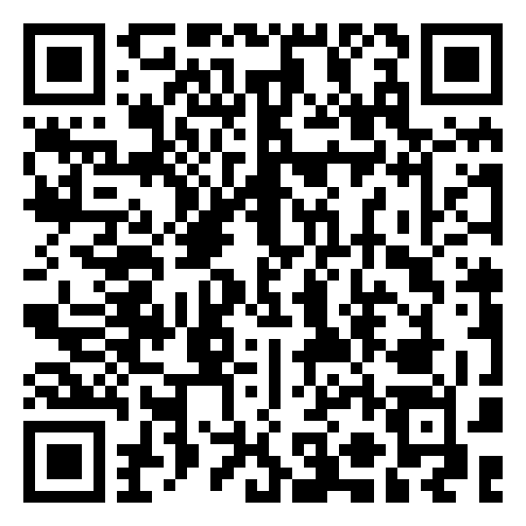
Get the code
REPO
github.com/travisim/solana-agentic-trading-nus
folder: 0008-performance-scorecard-shipping/demo
1
$ npm install
2
$ npm run demo -- --recorded
Run both from the demo/code folder. Node 24. No keys, no AI credits. Recorded data is bundled.
Scan for today's demos and code
36
Notes:
[19:58] Everything from tonight is in the repo: github.com slash travisim slash solana-agentic-trading-nus, folder 0008 performance scorecard shipping, then demo. Two commands from demo slash code: npm install, then npm run demo with --recorded. Node 24. No keys, no AI credits, recorded data is bundled. Reads use public mainnet data; every write is devnet only; no real funds, no seed phrases. Scan the QR code.

Slide 37


Let's connect
LinkedIn
Telegram
linkedin.com/in/travisim
t.me/travisim
37
Notes:
[19:59] If you want to stay in touch: my LinkedIn and Telegram, two QR codes. Send me your repo link or ask questions about the project. Thanks everyone. See you next Thursday for the rehearsal.

Slide 38

Notes:
[20:00] Closing slide: the plain black slide with the official Solana logo. Leave it up while people pack up, scan the QR codes from the previous slides if they missed them, and hand their repo links to the leads. Remember the 48-hour report: event link, attendee counts, project links, blockers, next session date (Thu 11 Feb), GitHub handles.

