Slide 1

Build night 5
Demo
Rehearsal
Three minutes, four parts, a plan for when the live call fails, and the evidence a judge opens.
Travis Sim
NUS · Singapore
Thu 11 Feb 2027 · COM3/COM4
Notes:
[18:00] Welcome to the last build night. Next Thursday is Demo Day, so tonight is not about new features. It is about making what you already have easy to understand in three minutes, and honest about what it does not do. We run two timed rehearsals, with a fix block in between, and at the end you freeze your commit and send your demo pack to the leads. If you came to this one first, you have not missed anything you need: everything you need tonight is in the repo and the demos.

Slide 2
Where we are
One week to Demo Day. Tonight we make the pitch reviewable.
DONE
TONIGHT
NEXT
Workshop 4
Build night 5
Demo Day
Thu 4 Feb
Thu 11 Feb
Thu 18 Feb
Performance scorecard and shipping
Demo rehearsal and freeze
Working projects, agent, exchange or tooling
2
Notes:
[18:02] Quick orientation. Workshop 4 last week was the scorecard and shipping, so your projects should be close to a working state. Tonight is rehearsal and freeze. Next Thursday, the eighteenth, is Demo Day. After tonight there are no speculative features: whatever works at the freeze is what you show. Readiness circle now, one line each: who is presenting, is your repo link ready, and what evidence is still missing. If you are missing a devnet link, say so now; that is the most common gap and we can fix it tonight.

Slide 3
Tonight
18:00 to 20:00. Two timed runs, one fix block, one freeze.
18:00
15 min
18:15
20 min
18:35
30 min
Readiness circle
Demo structure
Rehearsal 1
presenters, links, missing evidence
four parts and the failure plan
3 minutes plus 2 of questions each
19:05
30 min
19:35
20 min
19:55
5 min
Fix the weakest claim
Rehearsal 2
Freeze and send
rerun the core test
new listeners, recorded backup
commit, demo pack to the leads
3
Notes:
[18:10] The shape of the night. Fifteen minutes to get ready, twenty minutes of me talking about structure, then rehearsal one: three minutes each, then two minutes of questions from peers. After that thirty minutes to fix the weakest claim and rerun the core test. Rehearsal two, with different listeners, and test your recorded backup. Last five minutes: freeze the commit and send the pack. I will keep my part short. The time is yours.

Slide 4
Three minutes, four parts
A budget for each part, then two minutes of questions.
Problem
What it does
Live proof
Limit and next
THEN
0:30
0:35
1:15
0:40
2:00
Who has the problem, in one sentence
The idea and the parts, no jargon
Live fix, failure test, devnet evidence
One limitation, what is untested, what comes next
Peer questions. A good answer points to a test or admits a limit.
0:00
0:30
1:05
2:20
3:00
Run over by more than 10 seconds in any part and the check list fails. Rushed under half and you are skipping something.
Source: demo-repo/code/out/pitch.json (budgets from code/src/timer.ts).
4
Notes:
[18:15] Three minutes is short. Here is the budget. Problem, thirty seconds. What it does, thirty-five. Live proof, seventy-five: this is the longest part on purpose, because it is the part nobody can argue with. Limit and next, forty seconds. Then two minutes of questions. The numbers on this slide are exactly what the timer in demo one uses. The rule: if any part runs more than ten seconds over, the check list fails. If a part is under half its budget, you are probably skipping something. You do not have to hit the budget to the second. You have to know where your time goes.

Slide 5
Part 1 and 2: problem, then what it does
About a minute together. No jargon, one sentence each.
PART 1: PROBLEM
PART 2: WHAT IT DOES
“An agent that can place orders will sooner or later send a bad one: too big, based on a stale price, or in the wrong unit. Anyone building an agent on Solana needs a plain check between the idea and the action. Without it, one wrong number moves real money.”
“This is a small agent. It reads recorded Orca SOL/USDC swaps, cuts them into 20,000 dollar bars, wakes on an 8 basis point change alert and proposes one order per alert. A risk hook checks each order against the Pyth oracle and answers yes or no, with the rule that decided. Accepted orders go into a ledger.”
50 words, about 23 s of 30 s
57 words, about 26 s of 35 s
Read from the sample script for the risk-hooked agent. Yours will differ; the shape should not.
Source: demo-repo/code/out/pitch.json (sample script, written from out/walkthrough.json).
5
Notes:
[18:20] Parts one and two. Problem: who has it, in one sentence. Not a market, a person. My sample says: an agent that places orders will sooner or later send a bad one, too big, from a stale price, or in the wrong unit. What it does: the idea and the parts, no jargon. My sample says it reads recorded Orca swaps, cuts them into dollar bars, wakes on a change alert, proposes an order, and a risk hook says yes or no with the rule that decided. Read both aloud at normal speed and they take about fifty seconds, which fits. Your wording will differ. The shape should not: a person, a problem, the parts.

Slide 6
Part 3: live proof
Seventy-five seconds. Show it working, show it refused, show where it lives.
LIVE FIX
FAILURE TEST
DEVNET EVIDENCE
One real decision
Bad orders, refused
A link, or why none
9 / 1
5,000 USD order
Signed memo tx
REJECT max-notional
devnet node: AccountNotFound (no SOL), signature accepted
oracle 300 s old
Flipped one bit
accepted / refused of 10 change alerts (1 max-notional)
REJECT max-oracle-age
devnet node: SignatureFailure
price in cents
Alert 8: sell 1,064 USD
REJECT unit-sanity
Funded tx link
100 bps off the oracle
none: faucet answered HTTP 429
[max-notional] limit 1,000 USD
REJECT max-oracle-gap
Devnet slot 513,629,831, read 2026-10-21. Say so; do not hide it.
Injected on purpose; all four refused.
Source: demo-repo/code/out/walkthrough.json and recorded/devnet-reads.json.
6
Notes:
[18:24] Part three is where the pitch is won. Three things, in this order. One: a live fix, which means show one real decision end to end. In my sample the run has ten change alerts, nine orders accepted and one refused by the max-notional rule. Two: the failure test. I feed it four bad orders on purpose, a five thousand dollar order, an oracle that is three hundred seconds old, a price in cents, and a price a hundred basis points off. All four are refused, each with its own reason. Say the reasons out loud. Three: devnet evidence. Open a link, or say there is none and why. In my sample the devnet node verified my signed transaction, but the faucet was rate limited, so I have no funded transaction link. I say that plainly. That is better than a link I cannot open.

Slide 7
Part 4: limit and next
Forty seconds. Say what you have not proved.
SAY OUT LOUD
DO NOT SAY
One limitation, in your own words.
A return, a profit or a win rate as the headline.
What is untested.
A capability the tests do not cover.
The next step, one sentence.
A transaction link you have not opened tonight.
SAMPLE, PART 4
“Limits: this is simulated on recorded data, about seventeen minutes of one afternoon. The order sizes and the fee are assumptions, and no order was sent anywhere. The ledger is not evidence of returns. Next: write one funded devnet memo for every accepted order, and run the same hook on the live feed.”
Judges score utility, tests and devnet evidence, never simulated returns.
7
Notes:
[18:28] Part four is where you earn trust. Say one limitation in your own words. Say what is untested. Say the next step in one sentence. In my sample: it is simulated on recorded data, about seventeen minutes of one afternoon; order sizes and the fee are assumptions; nothing was sent anywhere. On the right, three things not to say. No return or win rate as the headline. No capability the tests do not cover. No link you have not opened tonight. If someone asks a question you cannot answer, point to a test or admit the limit. Do not invent a capability.

Slide 8
What the judge sees
Three questions, four checks each. Twelve in all.
UTILITY
4 / 4
TESTS
3 / 4
DEVNET EVIDENCE
2 / 4
Names a user and a problem in one sentence
npm test passes and the report is attached
Shows a devnet address, or says there is none and why
Runs from a clean checkout using only the README
A test covers the failure case (a bad input is refused)
At least one devnet transaction link opens
Shows one decision end to end: input, rule, result
Tests run offline on recorded data
What the slide claims matches what the link shows
States what it does not do
The test report is from the frozen commit
Reads labelled public mainnet; writes labelled devnet only
Not scored: any simulated return. The score is the evidence.
Source: demo-repo/code/src/rubric.ts; sample pack scored in out/rubric.json.
Filled mint dot: the sample pack passes the check. Sample pack: 9 of 12.
8
Notes:
[18:30] Here is how Demo Day is judged: three questions, four checks each. Utility: a named user and problem, runs from a clean checkout using only the README, one decision shown end to end, and what it does not do. Tests: npm test passes with the report attached, a test for the failure case, tests run offline on recorded data, and the report is from the frozen commit. Devnet evidence: an address or a stated reason, a transaction link that opens, a claim that matches the link, and reads labelled mainnet and writes labelled devnet. Twelve checks. Simulated returns are not on the list. If your pitch leads with a simulated profit, it scores nothing and takes time away from the part that scores.

Slide 9
One set of evidence
The same claim must be true in the pitch, the repo and the running demo.
ONE CLAIM, THREE PLACES
10 change alerts: 9 accepted, 1 refused (max-notional)
PITCH
REPO
RUNNING DEMO
Says what works, what failed, what is untested.
A frozen commit, a README that runs, a test report.
Live, or the recorded copy of the same output.
WHERE THIS CLAIM LIVES
WHERE THIS CLAIM LIVES
WHERE THIS CLAIM LIVES
Part 3 says: 9 accepted, 1 refused.
out/walkthrough.json: rejectedByRule max-notional: 1. A test checks it.
Demo 4, alert 8: REJECT [max-notional].
Source: demo-repo/code/out/walkthrough.json.
9
Notes:
[18:32] The single most useful rule for tonight: the same claim must be true in three places. In the pitch, in the repo, and in the running demo. Take one claim from my sample: nine of ten alerts were accepted and one was refused by max-notional. The pitch says it. The test and the out file in the repo contain it. The demo shows it, live or from the recorded copy. If any of those three disagree, a listener will find it in the questions. Tonight, for your weakest claim, find all three places and make them match.

Slide 10
The sample project
Built from earlier sessions, run on recorded data. Rehearse on it before your own.
REAL SWAPS
DOLLAR BARS
CHANGE ALERTS
ORDERS
LEDGER
1,114
51
10
9 / 1
9
Orca SOL/USDC, recorded
$20,000 each
8 bps threshold
accepted / refused by the risk hook
fills, next swap price
WINDOW
SCORECARD (NOT SCORED BY JUDGES)
18:13:46 to 18:30:20 UTC, 21 Oct 2026
+3.00 USD net, hit rate 67%, drawdown 8.03 USD
2,900 swaps recorded; 1,114 used after cleaning and the Pyth window
Simulated, on recorded data; not advice. Tests: 51 passing, 0 failing.
Reads use public mainnet data; every write is devnet only; no real funds.
Source: demo-repo/code/out/walkthrough.json; recorded data from recorded/SOURCES.md. Simulated; not advice.
10
Notes:
[18:34] A sample project for the walk-through, built only from pieces you already have. Recorded Orca swaps from build night two, cleaned and cut into dollar bars; a CUSUM change alert; one order per alert; the risk hook from build night one; accepted orders go into a ledger. On the slide: one thousand one hundred and fourteen real swaps inside the Pyth window, fifty-one dollar bars, ten alerts, nine accepted and one refused, nine ledger rows. The scorecard says plus three dollars net, simulated, on recorded data, not advice. It is there to show the idea of a ledger. It is not evidence of anything and judges do not score it. Reads are public mainnet data; every write is devnet only; no real funds.

Slide 11
The decision in code
demo-repo/code/src/agent.ts
1
The alert proposes an order.
const side: Side = ev.direction === "up" ? "buy" : "sell";
const sizeUsd = Math.round(bucketBps * params.usdPerBps);
const order: Order = { side, sizeUsd, price: ev.price };
const oracleAgeSec = Math.max(0, ev.t - read.publishTime);
const context: RiskContext = { oraclePrice: read.price, oracleAgeSec };
const decision = checkOrder(order, context, params.limits);
if (!decision.ok) return;
2
The oracle gives the context.
3
The risk hook says yes or no, with the rule.
Source: demo-repo/code/src/agent.ts (excerpt: comments, blank lines and two bookkeeping lines removed)
11
Notes:
[18:36] The core of the sample is these few lines. The alert proposes an order, with a side and a size from how far the bucket filled. The oracle gives the context: the Pyth price and how old it is. The risk hook checks the order against the context and says yes or no with the rule that decided. Notice what makes this demo-able: the input is recorded, the rule is plain code, the output is a decision with a reason. If your project has that shape, your live proof is easy. If it does not, ask what your input, your rule and your decision are.

Slide 12
When a live call fails
One retry, then recorded data, then the recording.
LIVE CALL
RETRY
THIRD FAILURE
RECORDED DATA
BACKUP RECORDING
fails once
once more
in a row
same code, same screen
if the screen fails
THE RULE
WHAT YOU SAY, THEN CARRY ON
A failed call is tried again. The third failure in a row switches to recorded data.
“The live call is not answering, so I am switching to recorded data from 2026-10-21. It is the same logic on data I captured earlier.”
Back on track within 30 seconds.
“Same input shape, same rule, same refusal. Here is the decision.”
Source: demo-repo/code/src/drill.ts and out/drill.json.
12
Notes:
[18:38] Live calls fail. Wi-Fi in the room is shared and public endpoints get rate limited. Plan for it. The rule, same as every demo you have used: a failed call is tried again; the third failure in a row switches to recorded data. Then you say one sentence, carry on from the same step, and do not restart. Aim to be back on track within thirty seconds of the first failure. If the whole screen fails, you narrate your backup recording. The recording is not a cheat, it is real output from your repo that you captured earlier. The drill in demo three practises exactly this.

Slide 13
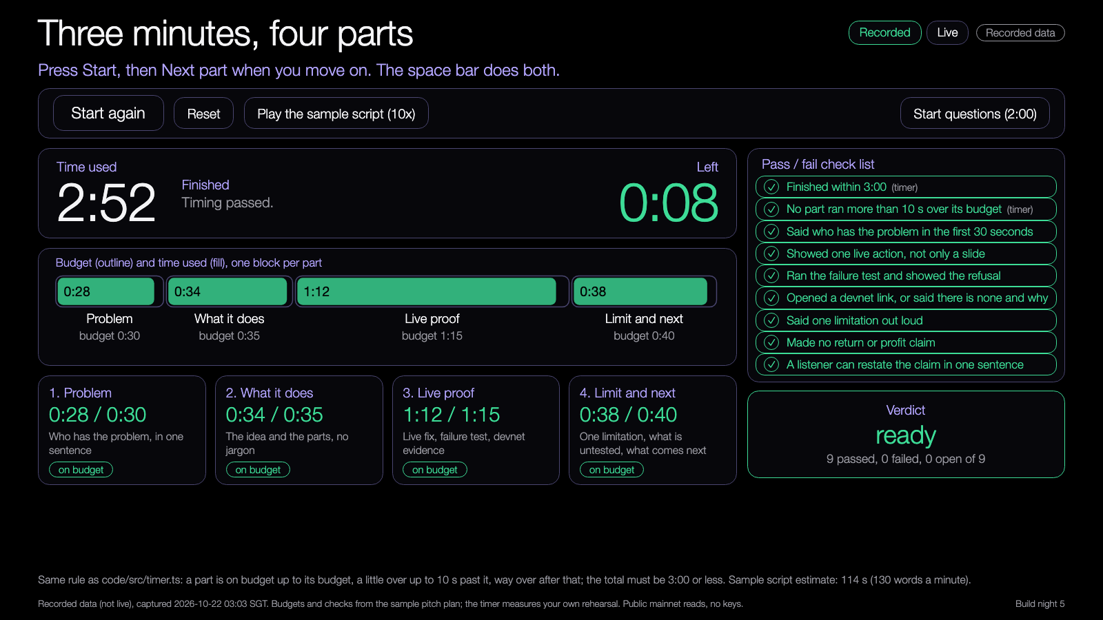
DEMO 1
Demo: rehearsal timer
PREDICT FIRST
With the budgets on the slide, which part do you usually run over?
$ npm run demo -- --recorded
YOU SHOULD SEE
four parts with a budget and a status each
a verdict from the nine-item check list
Lab demo, runs from disk, recorded data.
Try it: https://nus-solana-demos.vercel.app/0009/01-rehearsal-timer.html
Fallback: The timer needs no network. Use the space bar.
Live mode: switch it on to watch real Solana data.
Source: demo-repo/lab/screenshots (captured from the lab demos on recorded data)
13
Notes:
[18:40] Demo one, the rehearsal timer. Predict first: which part do you usually run over? Open it, press the space bar to start, and the space bar again to move to the next part. The bar shows budget against time used, and each part gets a status: on budget, a little over, or way over. When you finish, the check list gives a verdict: ready, not finished, or fix and rerun. Two of the nine checks come from the timer, seven from your listeners. There is a button that plays the sample script at ten times speed so you can see a passing run. Live mode adds a strip with the current Pyth price and slot, which is a number that changes while you talk. It is not part of the timer. Try it on your laptop.

Slide 14
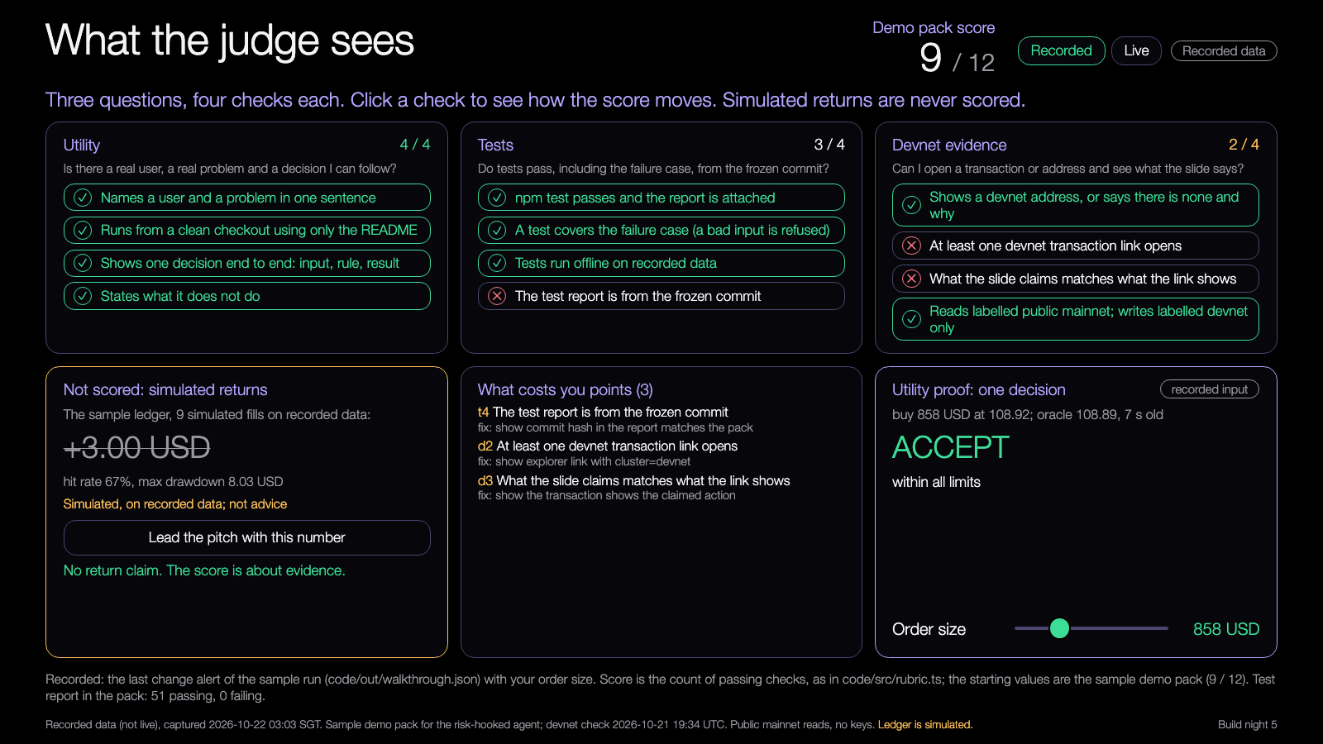
DEMO 2
Demo: what the judge sees
PREDICT FIRST
Which two checks does the sample pack miss, and why?
$ npm run report && npm run demo -- --recorded
YOU SHOULD SEE
12 checks, a score and a fix list
a simulated return that never changes the score
Lab demo, runs from disk, recorded data.
Try it: https://nus-solana-demos.vercel.app/0009/02-judge-view.html
Fallback: Recorded data is the default. The rubric needs no network.
Live mode: switch it on to watch real Solana data.
Source: demo-repo/lab/screenshots (captured from the lab demos on recorded data)
14
Notes:
[18:43] Demo two, the judge view. Predict first: which two checks does the sample pack miss? Open it. The sample scores nine of twelve. It misses the test report from the frozen commit, because we have not frozen, and the two devnet checks that need a funded transaction. Click a check to see the score move. Press lead the pitch with a simulated number and watch: the score does not change, and the page tells you to cut it. The box on the right sends one order through the risk hook; drag the size past one thousand dollars and watch max-notional fire. Live mode uses the live Orca price and the live Pyth price in that box.

Slide 15
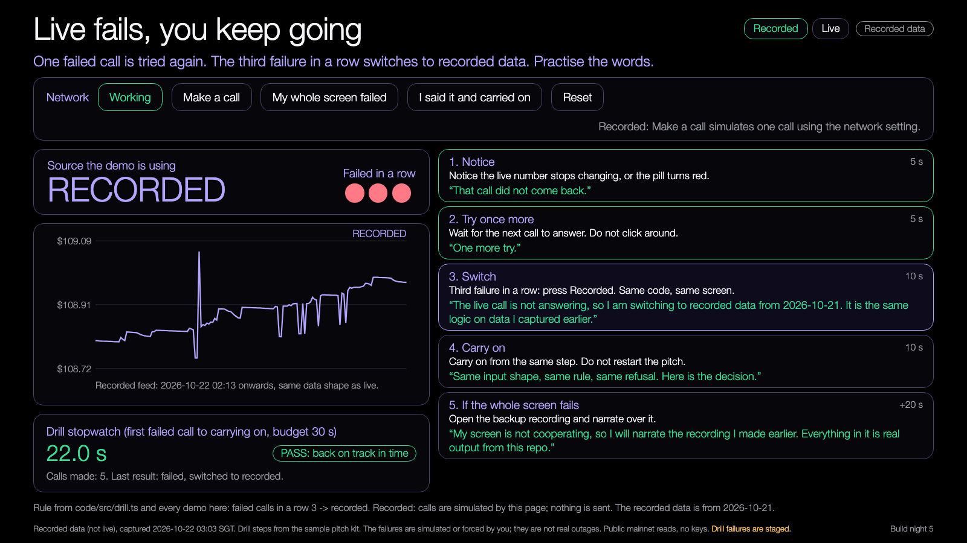
DEMO 3
Demo: live to recorded switch
PREDICT FIRST
How many seconds from the first failed call to carrying on?
$ npm run demo -- --recorded
YOU SHOULD SEE
three failed calls in a row, then the switch
a stopwatch against the 30 second budget
Lab demo, runs from disk, recorded data.
Try it: https://nus-solana-demos.vercel.app/0009/03-switch-drill.html
Fallback: Recorded mode simulates the failures. Nothing is sent.
Live mode: switch it on to watch real Solana data.
Source: demo-repo/lab/screenshots (captured from the lab demos on recorded data)
15
Notes:
[18:46] Demo three, the switch drill. Predict first: how many seconds from the first failed call to carrying on? In recorded mode you press make a call with the network set to broken; after three failures the source flips to recorded. The right side shows what to do and what to say at each step. The stopwatch starts at the first failure and stops when you press I said it and carried on. Budget is thirty seconds. In live mode the broken switch points your browser at a dead address, so the failures are real and the same rule fires. Practise saying the switch sentence out loud once. It is fine to read it.

Slide 16
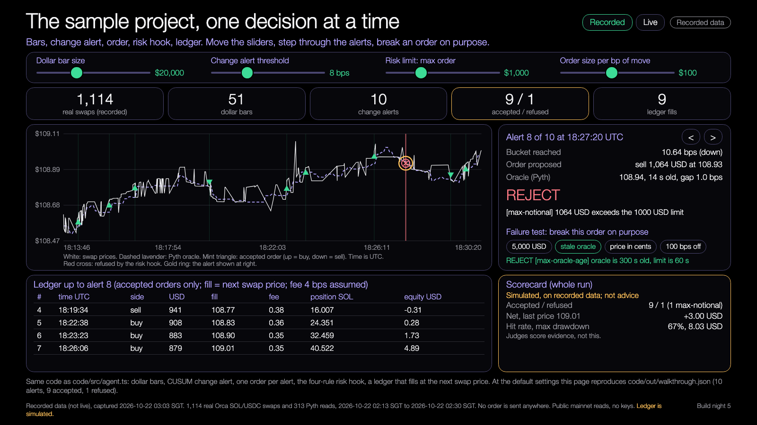
DEMO 4
Demo: sample project walk-through
PREDICT FIRST
Which alert will the risk hook refuse, and which rule fires?
$ npm run demo -- --recorded --max-notional 800
YOU SHOULD SEE
one decision at a time: order, oracle, rule
the failure test refusing four bad orders
Lab demo, runs from disk, recorded data.
Try it: https://nus-solana-demos.vercel.app/0009/04-sample-walkthrough.html
Fallback: Same recorded data. The decisions are the same every run.
Live mode: switch it on to watch real Solana data.
Source: demo-repo/lab/screenshots (captured from the lab demos on recorded data)
16
Notes:
[18:49] Demo four, the sample project walk-through, one decision at a time. Predict first: which alert will the risk hook refuse, and which rule fires? Step through the ten alerts with the arrows. Alert eight is the refusal: a sell of one thousand and sixty-four dollars against a one thousand dollar limit. Move the max order slider and watch the decisions change. Then press one of the four failure buttons: five thousand dollars, stale oracle, price in cents, a hundred basis points off. Each is refused with a reason. Live mode feeds live price ticks through the same change alert and the same risk hook against the live Pyth price.

Slide 17
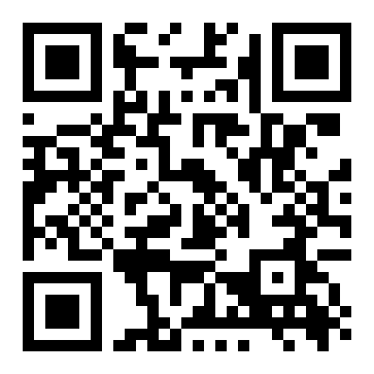
Try the demos yourself
DEMOS
nus-solana-demos.vercel.app/0009/
Open on your laptop. Run your own pitch against the timer.
No install. The same files are in the repo and open from disk.
Scan to open the demos
Source: demo-repo/lab (the four lab demos, deployed as static pages, recorded data)
17
Notes:
[18:52] The four demos are online and in the repo. Scan the code, open them on your laptop, and use the timer for your own pitch in rehearsal one. No install is needed, they open from disk too. If the hosted copy is slow on the shared Wi-Fi, open them from the cloned repo, the lab folder. Everything defaults to recorded data so nothing breaks offline.

Slide 18
Your mission
Rehearsal 1 and the fix block, 18:35 to 19:35.
1
2
3
4
Time
Listen
Fix
Backup
Run your 3 minutes on the timer
Peers note one unclear claim
The weakest claim, then rerun the core test
Play your recording with Wi-Fi off
Finish line: one claim that a listener can restate.
18
Notes:
[18:35] This is the rehearsal block. Time: run your three minutes against the timer, with listeners. Listen: peers each note one unclear claim, only one, so the feedback is usable. Fix: take the weakest claim, find where it is true in the pitch, the repo and the demo, and fix the disagreement, then rerun the core test. Backup: play your recording with Wi-Fi off and check that you can narrate it in the time. Finish line for the block: one claim a listener can restate in a sentence. Rehearsal two, at 19:35, has different listeners.

Slide 19
Build menu
Between rehearsals. Pick one, or fix your own weakest claim.
Tighten the script to the budget
BEGINNER
Add the missing evidence to the pack
STANDARD
Rehearse offline from the recording
STANDARD
Add a test for the failure you demo
ADVANCED
19
Notes:
[19:05] Between the rehearsals. Beginner: tighten the script to the budget. Cut a sentence, do not talk faster. Standard: add the missing evidence to the pack, or rehearse offline from the recording. Advanced: add a test for the failure you demo, so the refusal in your pitch is also a line in your test report. If you are not sure what to fix, open the judge view demo, fill your own checks honestly, and fix the first red one. No new features. After the freeze, nothing speculative.

Slide 20
Three takeaways
1
Use the same evidence in the pitch, the repo and the running demo.
2
Say what works, what failed and what is untested.
3
A good answer points to a test or admits a limitation.
20
Notes:
[19:55] Three things to take away. One: use the same evidence in the pitch, the repo and the running demo. Two: say what works, what failed and what is untested. Three: a good answer to a question points to a test or admits a limitation; it does not invent a capability. If you remember only one, make it the first: it is what makes a three-minute demo believable.

Slide 21
Branch out
Before Demo Day, in your own time.
BEGINNER
STANDARD
ADVANCED
Time your pitch three times and trim the part that always runs long.
Fill your own demo pack in the rubric and fix the first missing check.
Write one funded devnet transaction per decision and open the link in your pitch.
21
Notes:
[19:56] After tonight, in your own time, before Demo Day. Beginner: time your pitch three times and trim the part that always runs long. Standard: fill your own demo pack in the rubric and fix the first missing check. Advanced: write one funded devnet transaction per decision and open the link in your pitch; use the faucet early in the week, because it rate limits. Remember the freeze: tonight's commit is what you show, so branch out on a branch, not on the frozen one.

Slide 22
Share back
Before you leave, and by Demo Day.
TONIGHT
THU 18 FEB
ANY TIME
1
2
3
Freeze the commit and send the demo pack.
Present at Demo Day, same evidence, same script.
Send your repo link to the leads.
22
Notes:
[19:57] Before you leave: freeze the commit and send the demo pack to the leads. The pack is the repo and frozen commit, your three-minute script, the recorded backup, the test report, deployment addresses, transaction links and stated limitations. Next Thursday is Demo Day: same evidence, same script. Any time: send your repo link to the leads, and tell us what is blocking you early rather than on the day.

Slide 23
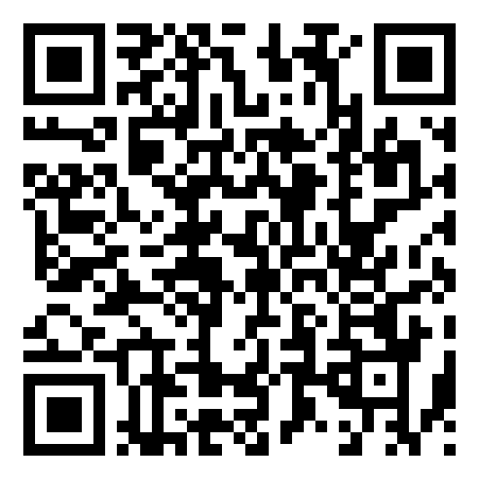
Get the code
REPO
github.com/travisim/solana-agentic-trading-nus
folder: 0009-demo-rehearsal/demo
1
$ npm install
2
$ npm run demo -- --recorded
Run both from the demo/code folder. Node 24. No keys, no AI credits. Recorded data is bundled.
Scan for this session's code
23
Notes:
[19:58] The code for tonight is in the shared repo, folder zero zero zero nine demo rehearsal, under demo. Scan the code or use the address. npm install, then npm run demo with recorded. Node 24. No keys, no AI credits, the recorded data is bundled. The folder holds the timer and check list logic, the rubric, the drill, and the sample project, plus the four demos. The sample project is a pattern to copy: input, rule, decision with a reason.

Slide 24


Let's connect
LinkedIn
Telegram
linkedin.com/in/travisim
t.me/travisim
24
Notes:
[19:59] If you want to talk about your project, your pitch or what to build next, find me on LinkedIn or Telegram. The codes are on the slide. Thank you for working hard tonight. See you at Demo Day on the eighteenth.

Slide 25

Notes:
[20:00] Thank you. Photos, last check-in scan, and pack up. Leads: confirm every team has sent its demo pack before they leave.

