Slide 1

Demo Day
Student projects,
shown with evidence
Agent, exchange and tooling projects, shown with tests and devnet evidence.
Hosted by Travis Sim
NUS · Singapore
Thu 18 Feb 2027 · COM3/COM4
Notes:
[18:00] Welcome to Demo Day. Doors are open, the gallery is on the second screen, and check-in is at the door. Please find the photo-choice sheet and tell a lead what you are comfortable with: photos, recordings, neither. While people settle in, I am going to leave this slide up. Presenters: if you have not told a lead your slot yet, do it now, and open your recorded backup in a spare tab. Everything tonight runs on devnet or recorded data: no real funds, no seed phrases on any screen.

Slide 2
Ten weeks, three lanes
Tonight every project shows evidence, not just a pitch.
AGENT
EXCHANGE
TOOLING
A trading agent or strategy with honest validation.
A venue part: order book, matching, deposit or custody flow.
Data collection, backtesting, monitors, risk guards, dashboards.
LANE 1 OF 3
LANE 2 OF 3
LANE 3 OF 3
2
Notes:
[18:10] Ten weeks ago this program started with a question: could a group of students build real agentic trading projects on Solana in one semester? Tonight you answer it. There were three lanes. Agent: a trading agent or strategy with honest validation. Exchange: a venue part, such as an order book, matching, or a deposit and custody flow. Tooling: anything that helps the trading process, like data collection, a backtester, a monitor, a risk guard or a dashboard. Whatever your lane, tonight is the same test: show it working, show how you know, and tell us what is still weak.

Slide 3
Tonight
18:00 to 20:00. Most of it is you showing and trying work.
18:00
10 min
18:10
10 min
18:20
35 min
18:55
15 min
Doors
Welcome
Demos
Peer gallery
check-in, gallery open
the format and how projects are judged
3 minutes, then 2 for questions
try demos, leave one question
19:10
10 min
19:20
25 min
19:45
15 min
Feedback
Community build
Retrospective
feedback and next steps
reproduce, file an issue, plan
what changed, what continues
3
Notes:
[18:12] Here is the shape of the evening. We are in the welcome now. At 18:20 the demos start: three minutes to show, two for questions, up to seven slots, back to back until 18:55. Then the peer gallery until 19:10, where you try each other's work. Then feedback, then community build time, then a short retrospective. If you are here to watch, you are in the right place: every project has a gallery card you can open on your own laptop. Food is only provided if the budget is approved, so do not count on it.

Slide 4
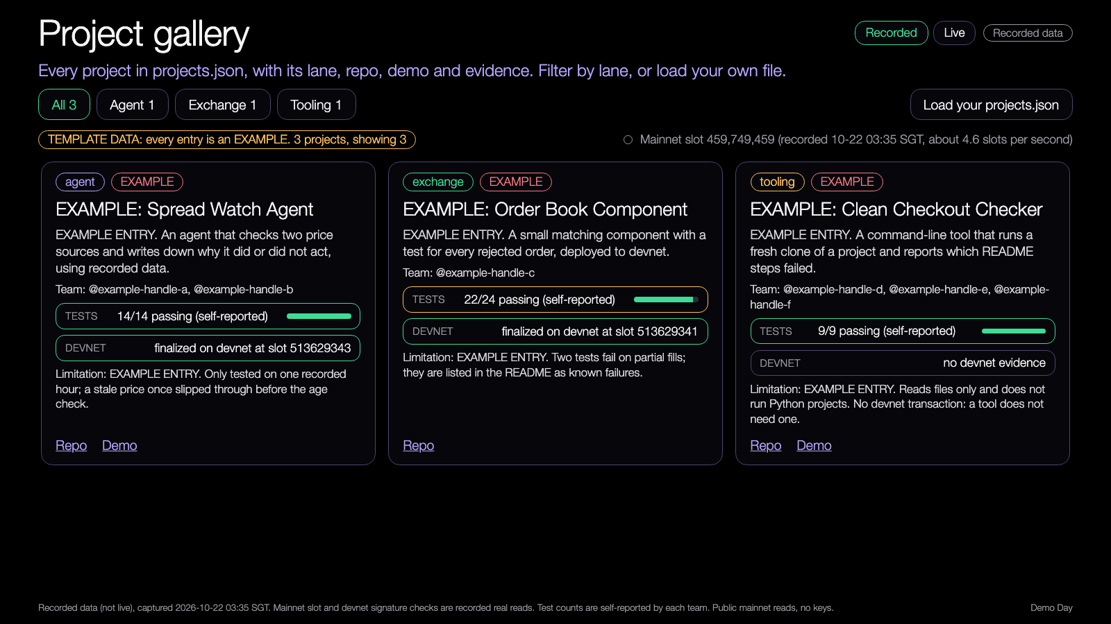
DEMO 1 · ON SCREEN DURING DOORS
Demo: project gallery
PREDICT FIRST
Which project would you open first, and what evidence would you look for?
$ npm run demo -- --recorded
YOU SHOULD SEE
one card per project, with its lane
tests and devnet evidence on each card
Demo Day demo, runs from disk, recorded data.
Try it: https://nus-solana-demos.vercel.app/0010/01-project-gallery.html
Fallback: Recorded data is the default. No network needed.
Live mode: switch it on to watch real Solana data.
Source: demo-repo/lab/screenshots (captured from the Demo Day demos on recorded data; the three projects are EXAMPLE entries)
4
Notes:
[18:00 on the second screen, 18:13 if you want to talk through it] This is the project gallery. It is built from one file, projects.json. Each card shows the lane, the team, the repo and demo links, test results and devnet evidence. Use the lane buttons to filter. The three cards you see in the template are labelled EXAMPLE: they are not real projects, they show what a good entry looks like. On the day the leads replace them with the real file. Try it yourself at the link on the slide, and switch Live on to see the real Solana slot move and to have your browser check a transaction signature on devnet, read only. If Live is slow, stay on Recorded: it is the same page with captured data. Test counts on the cards are what each team reports; the judges re-run them.

Slide 5
Rules of the room
Four rules, so every project gets a fair five minutes.
1
Devnet only
2
The timer decides
Everything shown runs on devnet or recorded data. No real funds, no seed phrases on screen.
Three minutes to demo, two for questions. When it ends we thank the presenter and move on.
3
Ask for evidence
4
Photos by choice
Good questions start with: which command, which test, where can I see it.
Photo and recording choices are made at the door. Nobody is filmed without saying yes.
5
Notes:
[18:14] Four rules. One: devnet only. Everything you run tonight is devnet or recorded data, and no seed phrase or key should be on a screen. Two: the timer decides. Three minutes to demo, two for questions, and when it ends I will thank you and we move on, so the next team gets their full time. Three: ask for evidence. The best questions start with which command, which test, where can I see it. Four: photos by choice. You told a lead at the door, and we will respect it. Questions about the rules? Good. Presenters, this is the last time I talk for a while.

Slide 6
Three minutes, then two
Seven slots, 18:20 to 18:55, back to back.
DEMO · 3 minutes
QUESTIONS · 2 minutes
0:00
2:30
3:00
5:00
Demo starts
30 seconds left
Demo ends
Slot ends
the first sentence says what it does
a signal from the host, no surprise
questions start
the next presenter is already at the laptop
Have the recorded backup open in another tab before you start.
6
Notes:
[18:15] The clock. You start at 0:00 and your first sentence says what it does. At 2:30 I give you a signal, so there are no surprises, and at 3:00 the demo ends and questions start. At 5:00 the slot ends and the next presenter is already at the laptop. There is no changeover buffer, because seven slots fit exactly between 18:20 and 18:55, so please hand over the laptop quickly. Keep your recorded backup open in another tab: if the network or the demo fails, switch to it and keep talking. A calm switch to the backup is a good demo.

Slide 7
What three minutes holds
An evidence-based story: problem, failed attempt, useful change, test, limitation.
1
30 s
2
30 s
3
60 s
4
40 s
5
20 s
Problem
Failed attempt
Useful change
Test
Limitation
What hurt, in one sentence.
What did not work, shown or told.
What you changed and what it does now.
The command, and its result.
What is still weak.
A clear negative result is valuable. Say it.
7
Notes:
[18:16] A structure you can borrow. Problem, in one sentence: what hurt. Failed attempt: what did not work, and show it if you can. Useful change: what you changed and what it does now. Test: the exact command and its result. Limitation: what is still weak. The times on the slide are a suggestion: about 30 seconds, 30 seconds, a minute, 40 seconds, 20 seconds. A clear negative result is valuable. If your agent failed on stale prices and you caught it, that is a good story, tell it. We do not score returns, so you do not need a profit chart.

Slide 8
PLACEHOLDER: leads fill this on the day
Order of presenters
Filled in by the leads on the day, from the final project list.
SLOT 1
SLOT 2
SLOT 3
SLOT 4
18:20
to 18:25
18:25
to 18:30
18:30
to 18:35
18:35
to 18:40
Project and team to be added
Project and team to be added
Project and team to be added
Project and team to be added
SLOT 5
SLOT 6
SLOT 7
Seven slots of 3 + 2 minutes. More than seven projects: the rest go to a lightning slot or the peer gallery.
18:40
to 18:45
18:45
to 18:50
18:50
to 18:55
Project and team to be added
Project and team to be added
Project and team to be added
Run-of-show timer: https://nus-solana-demos.vercel.app/0010/03-run-of-show-timer.html
Live mode: switch it on to watch real Solana data.
Source: demo-repo/code/out/schedule.json (18:20 to 18:55, 3 + 2 minutes per slot). No project names: filled in by the leads.
8
Notes:
[18:17, then stays on screen] This slide is a placeholder for the order. The seven slot times are real: 18:20, 18:25, 18:30, 18:35, 18:40, 18:45 and 18:50, each with 3 minutes to demo and 2 for questions. The leads fill in the project and team for each slot from the final list before the doors open, and read it out. If there are more than seven projects, the extra ones take a lightning slot or go to the peer gallery. The run-of-show timer on the second display uses these same slots: Space starts and pauses it. The link is on the slide, and the timer has a Live switch that shows the real Solana slot; that strip is not part of the timer.

Slide 9
How projects are judged
Five criteria, 100 points, published before tonight.
30
25
25
10
10
points
points
points
points
points
Utility
Reproducible tests
Devnet evidence
Clear explanation
Sustained contribution
Would someone else use this, or learn from it?
Can a stranger run the tests from a clean clone and get the same result?
Is there a devnet transaction or program anyone can check?
Problem, failed attempt, useful change, test, limitation: was the story clear?
Did the work grow over the semester, with commits from the whole team?
Weights add up to 100. Utility, tests and devnet evidence carry 80.
Never scored: simulated returns, profit claims, backtest return charts.
Source: demo-repo/code/out/rubric.json. Weights are a proposal for the leads to confirm.
9
Notes:
[18:18] This is the published review criteria. Five things, 100 points. Utility, 30: would someone else use this or learn from it. Reproducible tests, 25: can a stranger run the tests from a clean clone and get the same result. Devnet evidence, 25: is there a devnet transaction or program anyone can check. Clear explanation, 10: was the story clear. Sustained contribution, 10: did the work grow over the semester, with commits from the whole team. The weights are a proposal that the leads confirm before tonight. And the line at the bottom: simulated returns, profit claims and backtest return charts are never scored. We are not announcing prizes or funding tonight; if that changes, the leads will say so.

Slide 10
Devnet evidence you can check
A signature on a slide is a claim. A signature devnet confirms is evidence.
1
Show it
2
We ask devnet
3
Read the answer
The transaction signature, in the README or on screen.
A read-only check. Nothing is sent.
Status and slot, or not found.
SAMPLE CHECK (REAL, 22 OCT 2026, NOT A STUDENT TRANSACTION)
HEADS UP
signature 2eGnTvKi...krTXY6
Devnet keeps recent history, so freeze a transaction you can still show on the day.
status finalized
devnet slot 513,629,343
read only: getSignatureStatuses
Source: demo-repo/code/recorded/signature-checks.json (devnet getSignatureStatuses, captured 22 Oct 2026 03:35 SGT).
10
Notes:
[18:19] What counts as devnet evidence. A signature on a slide is a claim. A signature that devnet confirms is evidence. So: show the transaction signature in your README or on screen; we ask devnet, which is a read-only call that sends nothing; and we read the answer, a status such as finalized and a slot, or not found. The sample on this slide is a real check we made on 22 October 2026 on a devnet transaction that does not belong to any student. One caution: devnet keeps recent history only, so a very old signature can come back not found. Freeze a transaction you can still show on the day, and note it in your demo pack.

Slide 11
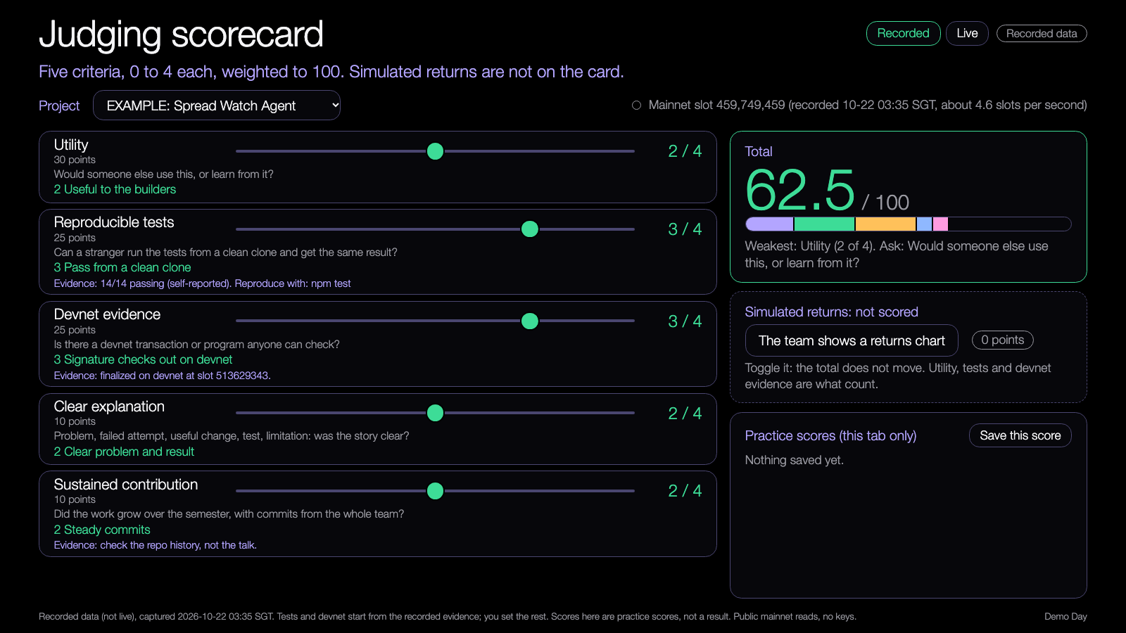
DEMO 2
Demo: judging scorecard
PREDICT FIRST
Which criterion will cost most teams the most points?
$ npm run demo -- --recorded
YOU SHOULD SEE
five sliders, weighted to 100
a returns chart that adds zero points
Demo Day demo, runs from disk, recorded data.
Try it: https://nus-solana-demos.vercel.app/0010/02-judging-scorecard.html
Fallback: Same recorded data. The scores are practice scores.
Live mode: switch it on to watch real Solana data.
Source: demo-repo/lab/screenshots (captured from the Demo Day demos on recorded data; the three projects are EXAMPLE entries)
11
Notes:
[Before 18:20, for the judges] This is the scorecard the judges use. Pick a project, and five sliders from 0 to 4 give a total out of 100. Tests and devnet start from the evidence on the card; the judge sets the rest. Watch the bottom right: there is a toggle for a team showing a returns chart, and when you press it the total does not move, because returns are not scored. Practice scores stay in this browser tab. The scorecard also names the weakest criterion with a question to ask: that is the feedback, not a ranking. Live mode shows the Solana slot and re-checks the signature on devnet. If it is slow, Recorded is identical.

Slide 12
Peer gallery
18:55 to 19:10. Try a demo and leave one question.
1
Open
QUESTIONS THAT EVIDENCE CAN ANSWER
A project from the gallery that is not yours.
Which command did you run, and what did you see?
2
Try
Where is the test for the failure case?
Follow its README, run its demo or its tests.
3
Ask
Can I check that transaction on devnet?
Leave one question that evidence can answer.
Everyone should reproduce at least one thing before 19:10.
12
Notes:
[18:55] Demos are done, thank you all. Now the peer gallery until 19:10. Everyone: open a project that is not yours from the gallery, follow its README, run its demo or its tests, and leave one question that evidence can answer. Three examples on the slide: which command did you run and what did you see; where is the test for the failure case; can I check that transaction on devnet. The goal is that everyone reproduces at least one thing before 19:10. If many laptops hit the same public endpoint at once it can rate limit, so use the recorded data first and go live one at a time.

Slide 13
What happens next
19:10 to 20:00. Voluntary, and yours to shape.
19:10
19:20
19:45
Feedback and next steps
Community build time
Retrospective
Tell us what you would use or contribute to, and what to test first.
Reproduce a demo, open an issue, or agree a small next experiment.
What changed after a failed attempt, and who wants to keep building.
13
Notes:
[19:10] The rest of the evening is voluntary. At 19:10, feedback and next steps: tell us what you would use or contribute to, and what you would test before relying on it. At 19:20, community build time: reproduce a demo, open an issue on a project, or agree a small next experiment with the team. At 19:45, a short retrospective: what changed after a failed attempt, and who wants to keep building. If anyone is interested in helping mentor the next cohort, tell a lead. Any mention of referrals, guests or opportunities after tonight: only say what the leads have confirmed with the Solana Foundation. Nothing else.

Slide 14
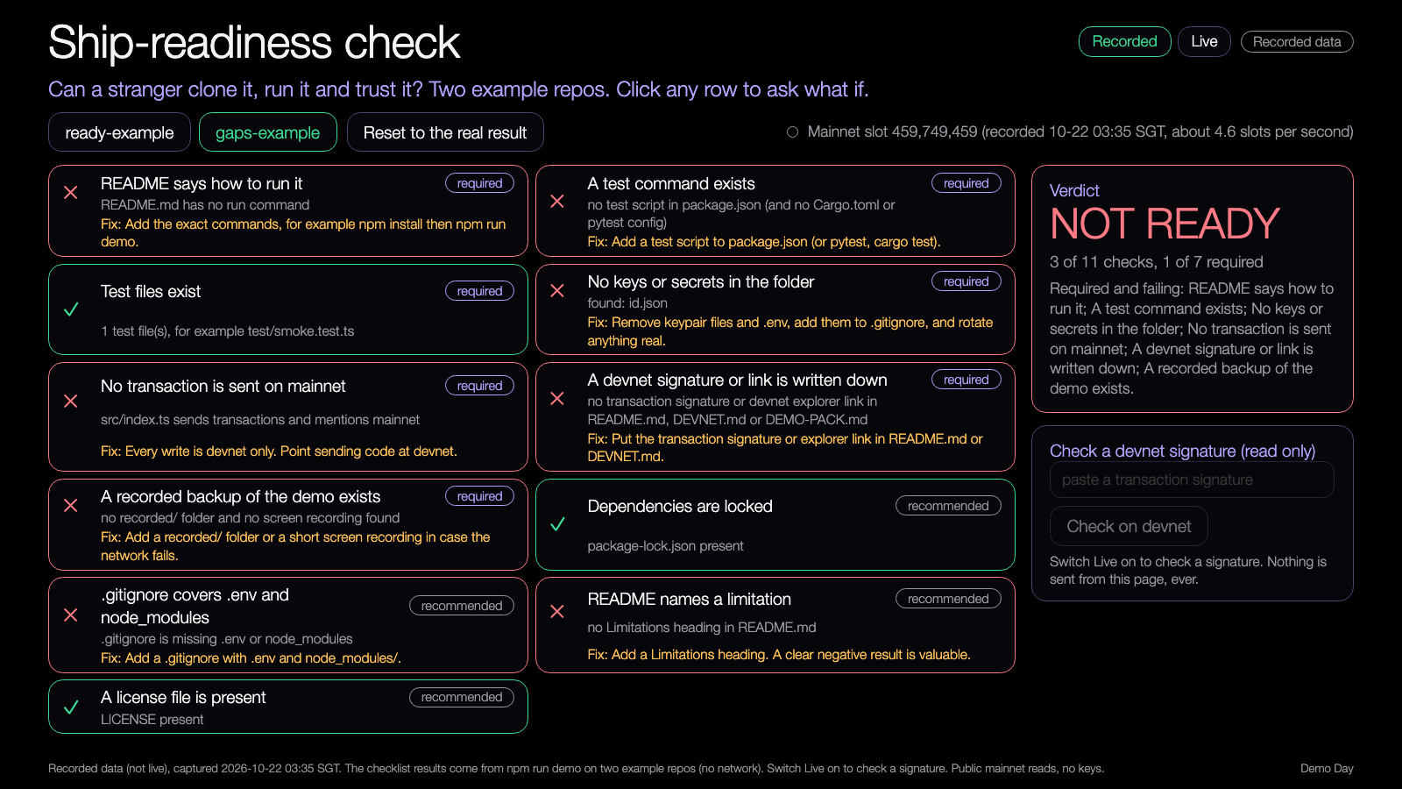
DEMO 3 · COMMUNITY BUILD TIME
Demo: ship-readiness check
PREDICT FIRST
Which required check do most repos fail first?
$ npm run ship -- --dir ../my-project
YOU SHOULD SEE
eleven checks, seven required
a clear fix for every failure
Demo Day demo, runs from disk, recorded data.
Try it: https://nus-solana-demos.vercel.app/0010/04-ship-readiness.html
Fallback: Recorded results for two example repos. No network needed.
Live mode: switch it on to watch real Solana data.
Source: demo-repo/lab/screenshots (captured from the Demo Day demos on recorded data; the three projects are EXAMPLE entries)
14
Notes:
[19:20, community build time] A practical tool for the build time. It reads a project folder and tells you if a stranger can clone it, run it and trust it. Eleven checks, seven required: a run command in the README, a test command, test files, no keys or secrets, no transaction sent on mainnet, a devnet signature or link written down, and a recorded backup. The demo runs it on two example repos: one ready, one with gaps. Click any row to ask what if. Run it on your own repo with the command on the slide, fix every required gap, and rerun. It only reads files and never runs your code. It is a set of heuristics, so it can miss things.

Slide 15
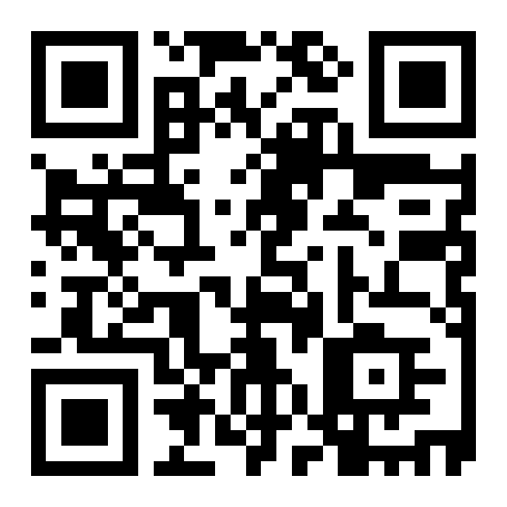
Try the demos yourself
DEMOS
nus-solana-demos.vercel.app/0010/
Open the gallery and the scorecard on your laptop.
No install. The same files are in the repo and open from disk.
Scan to open the demos
Source: demo-repo/lab (the four Demo Day demos, deployed as static pages, recorded data by default)
15
Notes:
[19:45] Everything you saw tonight is public: the gallery, the scorecard, the timer and the ship-readiness check. Scan the code or open the link on your laptop. No install. The same files are in the repo and open from disk. Each one has a Live switch that reads real Solana data from your own browser, read only, and falls back to recorded data if an endpoint is slow.

Slide 16
Branch out
After tonight, in your own time.
BEGINNER
STANDARD
ADVANCED
Run a peer's project from its README and write down every step that failed.
Open an issue on that repo with the command, the output and what you expected.
Add a test or a fix for it, or run the ship-readiness check on your own repo and close every required gap.
16
Notes:
[19:46] After tonight, in your own time. Beginner: run a peer's project from its README and write down every step that failed. Standard: open an issue on that repo with the command, the output and what you expected. Advanced: add a test or a fix for it, or run the ship-readiness check on your own repo and close every required gap. The point of the semester was a project a stranger can use. Reproducing someone else's work is the quickest way to learn what makes that possible.

Slide 17
Share back
Before you leave, and this week.
TONIGHT
THIS WEEK
ANY TIME
1
2
3
Leave one evidence-based question for a peer.
Send your repo link and demo pack to the leads.
Keep the repo public, and tell the group when you ship a fix.
17
Notes:
[19:48] Three things. Tonight, before you leave: leave one evidence-based question for a peer, on the card or in the group chat. This week: send your repo link and demo pack to the leads, they need it for the 48-hour report. Any time: keep your repo public and tell the group when you ship a fix. The shared GitHub organisation and the group chat stay open after tonight.

Slide 18
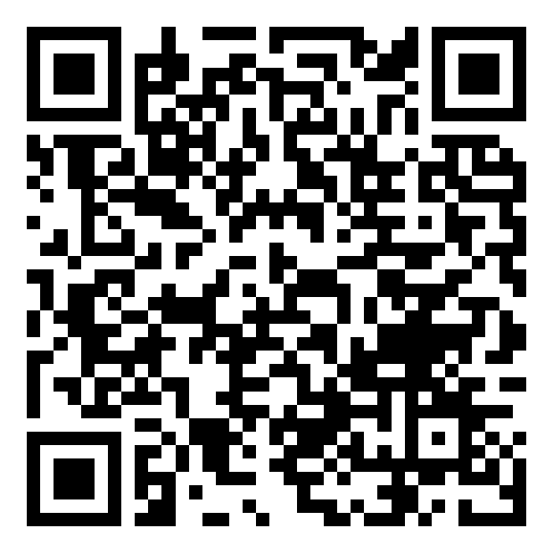
Get the code
REPO
github.com/travisim/solana-agentic-trading-nus
folder: 0010-demo-day/demo
1
$ npm install
2
$ npm run demo -- --recorded
Run both from the demo/code folder. Node 24. No keys, no AI credits. Recorded data is bundled.
Scan for this session's code
18
Notes:
[19:50] The code behind the tools is in the public repo, in the folder on the slide. Two commands from the demo slash code folder: npm install, then npm run demo with the recorded flag. You get a validator for projects.json, the gallery, the schedule and the ship-readiness check. Node 24, no keys, no AI credits, recorded data bundled. Reads use public mainnet data, and every write is devnet only, with no real funds. Scan the code to open the folder.

Slide 19


Let's connect
LinkedIn
Telegram
linkedin.com/in/travisim
t.me/travisim
19
Notes:
[19:52] If you want to keep in touch, scan the QR codes. LinkedIn on the left, Telegram on the right: linkedin.com/in/travisim and t.me/travisim. For program questions, Aaron Solanki is the Solana University contact on Telegram. Thank you for ten weeks of work.

Slide 20

Notes:
[19:55] Thank you, everyone. That is Demo Day. Leave this slide up while people leave and the leads collect repo links, photos and the last check-in scan.

