Slide 1

Build night 4
Backtest Validation
and Failure Testing
Try to break your own backtest before the market does.
Travis Sim
NUS · Singapore
Thu 28 Jan 2027 · COM3/COM4
Notes:
[18:00] Welcome back, thanks for coming. I'm Travis. Tonight is build night 4, and the topic is not fooling yourself. The plan is the usual one: a short talk, three demos where you guess first, a guided mission, and then most of the night is you building. Tonight we try to break our own backtest, and then we break our own agent on purpose. If something we break tonight is something you have already shipped in your project, good. That is the point.

Slide 2
Where we are
Tonight we try to break our own backtest, then break our own agent.
DONE
TONIGHT
NEXT
Workshop 3
Build night 4
Workshop 4
Thu 21 Jan
Thu 28 Jan
Thu 4 Feb
Deploy a venue component on devnet
Backtest validation and failure testing
Performance scorecard and shipping
2
Notes:
[18:02] Quick progress circle. Workshop 3 was on the twenty-first of January, deploying a venue component on devnet. Tonight is build night 4. Next Thursday the fourth of February is Workshop 4, performance scorecard and shipping, so what you validate tonight is what you will put a number on next week. Go round the room, one line each: what was your last result, and what do you suspect about it? Then the question for tonight: how do you break your own backtest before the market does? Keep a guess in your head.

Slide 3
Tonight
18:00 to 20:00, mostly hands on.
18:00
10 min
18:10
10 min
18:20
20 min
Progress circle
Mini-talk
Demo tour
last result and tonight's question
leakage and the best-of-many-tries trap
you predict, then we run it
18:40
20 min
19:00
50 min
19:50
10 min
Guided mission
Free build
Show and tell
find the planted leak, fix it
your own project
push, one line on next step
3
Notes:
[18:10] Shape of the night. Ten minutes of talk, twenty of demos, twenty of guided mission where we all hunt the same planted bug, then fifty minutes of free build on your own project. Last ten: show and tell and push. In the demos I will ask you to predict before I run anything. Be wrong out loud. If you did not set up yet, do it during the mission, I will help.

Slide 4
Three ways to fool yourself
A backtest can look great and mean nothing.
1 LEAKAGE
2 BEST OF MANY TRIES
3 A BROKEN FEED
60.4% to 53.9%
1.00 to 0.17
95 s
Balanced accuracy of the same memoriser: shuffled folds, then time folds plus purge and embargo (label horizon 24). A coin flip is 50%.
Score of the best of 50 random strategies: on the data it was picked on, then on data it never saw.
Time for the alarm to catch a simulated oracle freeze. No false alarm on the healthy 40 minutes.
Numbers from demo-repo/code/out (splits.json, overfit.json, breaks.json). Simulated, on recorded data; not advice.
4
Notes:
[18:11] Three traps, one card each. One, leakage: when test and training data sit next to each other, the model has already seen the answer. In our demo the same memoriser scores 60.4 percent balanced accuracy with shuffled folds and 53.9 percent when we cut by time and purge; a coin flip is 50. Two, best of many tries: try 50 random strategies and the best one looks brilliant, 1.00 in-sample here, and 0.17 on data it never saw. Three, a broken feed: an oracle that freezes still shows a normal looking number, but our alarm caught the simulated freeze 95 seconds after it started. Everything tonight is simulated on recorded data, not advice. For you only: leakage is inspired by chapter 7 of the book, tries by chapters 11 and 12, the alarm by chapter 17.

Slide 5
Overlapping labels leak
A label looks ahead, so neighbours share answers.
Every moment is labelled by what happens in the next h samples. Two moments next to each other share most of that future.
MOMENTS, IN TIME ORDER
train
test
label of moment 8 looks 6 ahead: no overlap
label of moment 14 reaches into the test block
A training moment right before the test block already knows part of the test answer.
Illustrative; h = 6 here. The real data uses h from 6 to 48 samples of 5 seconds.
5
Notes:
[18:12] A label is what we are trying to predict, for example: does the price go up over the next h samples? So the label of moment i covers moments i to i plus h. The bracket under each moment shows that. Now look at the test block in lavender. The training moment just before it, the one with the red bracket, has a label that reaches into the test block. So the model trains on a piece of the test answer. Neighbours share futures. If you shuffle your folds, almost every test moment has such a neighbour. That is the leak. Illustrative picture, h of 6.

Slide 6
Purge and embargo
Remove the neighbours that know too much.
Purge: drop training moments whose label overlaps a test label. Embargo: drop a few more after the test block.
MOMENTS, IN TIME ORDER
train
test
purged
embargo
label of moment 8 looks 6 ahead: no overlap
label of moment 14 reaches into the test block
Fewer training moments, an honest score.
Illustrative; h = 6, embargo = 3 here.
6
Notes:
[18:13] Same picture, two fixes. Purge: drop every training moment whose label overlaps a test label. Those are the red ones, crossed out. Embargo: drop a few more moments right after the test block, in yellow, because markets stay correlated for a while after the test window. The price is fewer training moments: on the real data with h of 24 and an embargo of 12, about 48 of roughly 346 training moments go in each fold. The reward is a score you can believe. Note shuffled folds cannot be purged at all: every training moment sits next to a test moment, nothing is left. So: cut folds by time first.

Slide 7
The planted leak
One off-by-one, and today's decision sees tomorrow's price.
src/leaky.ts
PROFIT, BEFORE COSTS
export function trendSignal(px: number[], i: number, o: TrendOpts = {}): 1 | -1 | 0 {
const fast = o.fast ?? 2, slow = o.slow ?? 10;
+18.84 USD
-1.76 USD
const shift = o.leak ? 1 : 0;
<- the planted bug
if (i - slow + 1 < 0) return 0;
leaky
fixed
const end = i + 1 + shift; // slice end is exclusive
const f = mean(px.slice(end - fast, end));
const s = mean(px.slice(end - slow, end));
return f > s ? 1 : -1;
}
CAUSALITY TEST: MOMENTS THAT CHANGE
THE CAUSALITY TEST
37 of 440
0 of 440
if (signal(px, i) !== signal(px.slice(0, i + 1), i)) { leaking++; flagged.push(i); if (first === null) first = i; }
leaky
fixed
61 trades each. Simulated, on recorded data; not advice.
Source: demo-repo/code/src/leaky.ts (excerpt: comments and blank lines removed). Simulated, on recorded data; not advice.
7
Notes:
[18:14] A second kind of leak is in the strategy itself. Look at the red line: shift equals one if leak. The windows end one step too late, so the decision at moment i quietly uses the price at i plus one. It looks harmless, and on the data the leaky version makes 18.84 dollars before costs against minus 1.76 for the fixed one, same 61 trades. A time split would not catch this because the future is peeked everywhere. The causality test does: cut the series off at i, recompute the signal, compare. 37 of 440 moments change for the leaky version, 0 of 440 for the fixed one. That is tonight's mission: find it, fix it. Simulated, on recorded data, not advice.

Slide 8
Best of many tries
50 random strategies, one winner in-sample.
score on fresh data
WINNER IN-SAMPLE
2
1.00
1
if the score held up
coin-flip #704396 hold18, 8 trades
0
what it scored on fresh data
SAME STRATEGY ON FRESH DATA
0.17
-1
5 trades; rank 30 of 48
-2
-2
-1
0
1
2
score in-sample (where we picked)
The winner is picked on the left axis. The fresh data is the bottom axis.
48 of 50 plotted; the rest had fewer than 4 trades on one side.
Source: code/out/overfit.json, draw 1, before costs. Simulated, on recorded data; not advice.
8
Notes:
[18:15] Now the second trap. We drew 50 random strategies: moving-average trends, mean reversion, oracle basis from build night 1 with random settings, plus a coin flip that has no skill by construction. Each dot is one strategy. Across is the score in-sample, up is the score on data it never saw. The winner in-sample is the highlighted dot, a coin flip called 704396, with a score of 1.00. On fresh data it scores 0.17. We picked the best, so of course it looked good. The score is mean over standard deviation of per-trade profit, before costs, with at least four trades. Illustrative of how selection works, from the recorded data.

Slide 9
The luck benchmark
The more you try, the better the best looks, by luck alone.
1.5
20 DRAWS OF 50, BEFORE COSTS
0.51 to 0.12
best so far 1.00
average best score in-sample, then the same strategies on fresh data
1.0
WINNER BEATS ITS BENCHMARK
luck benchmark 0.76
4 of 20
0.5
draws; a score only counts if it clears the luck line
fresh data 0.17
WITH 5 + 2 BPS COSTS PER LEG
0.0
-1.39
1
10
20
30
40
50
number of strategies tried
average best score in-sample; positive on fresh data in 0 of 20
Simulated, on recorded data; not advice.
Source: code/out/overfit.json (curveSeed1 and summary), before costs. Simulated, on recorded data; not advice.
9
Notes:
[18:16] How good should the best of N look by pure luck? There is a formula for the expected best of N zero-skill tries; it is the idea behind the deflated Sharpe ratio. The lavender line is that luck benchmark, it climbs as the number of tries grows. The mint line is the best score so far. Once the mint line is not clearly above the lavender one, you cannot tell your strategy from luck. At 50 tries the benchmark is 0.76 and the winner is 1.00. Over 20 draws the best in-sample averaged 0.51 and the same strategies averaged 0.12 on fresh data, and the best beat its benchmark in only 4 of 20 draws. With costs of 5 plus 2 bps per leg nothing wins at all in this calm window. Keep a count of your own tries.

Slide 10
Real numbers
40 minutes of real SOL/USDC prices from Jupiter, Pyth and Orca.
SAMPLES
WINDOW
TEST MOMENTS
STRATEGIES
481
40 min
433
20 x 50
one every 5 seconds
01:13 to 01:53 Singapore time, 21 Oct 2026 (UTC evening)
5 folds; one standard error is about 2.4 points
20 draws of 50 random strategies
MEMORISER BALANCED ACCURACY (coin flip = 50%)
Balanced accuracy: guessing one side every time scores 50%. This window drifted up, so plain accuracy of always guessing up would be 63.5% at h = 24. Read the gap between fold schemes, not the level.
60.4
shuffled
time folds
time + purge + embargo 12
54.1
53.9
56.8
50%
44.1
35.3
h = 24
h = 48
Reads use public mainnet data; every write is devnet only; no real funds.
Source: code/out/splits.json, overfit.json and recorded/SOURCES.md; recorded data from earlier build nights, last sample 2026-10-21 17:53:59 UTC. Public mainnet reads. Simulated, on recorded data; not advice.
10
Notes:
[18:17] Where the numbers come from. 481 samples, one every 5 seconds, 40 minutes of real Jupiter, Pyth and Orca prices recorded on the 21st of October, from earlier build nights. The leak table uses balanced accuracy, the average of the hit rate on rising and on falling moments, so always guessing one side scores 50. With h of 24: shuffled folds 60.4 percent, contiguous with purge and embargo 53.9; at h of 48, 56.8 versus 35.3. We use balanced accuracy because this window drifted up: plain accuracy for guessing up every time would be 63.5 percent at h of 24. Values under 50, like 35.3, are noise and regime change, not a trading signal. The lesson is the gap between fold schemes. With 433 test moments, one standard error is about 2.4 points. Reads use public mainnet data; every write is devnet only; no real funds.

Slide 11
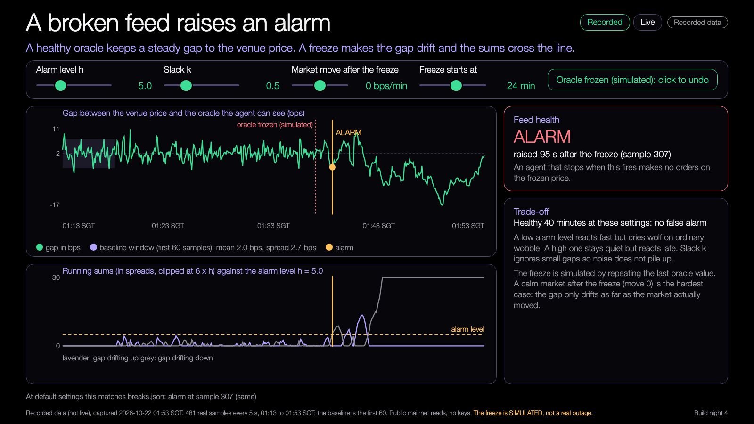
A broken feed raises an alarm
Watch the gap between the venue price and the oracle.
GAP: VENUE MINUS ORACLE (bps)
simulated freeze
alarm
CUSUM SUM (alarm level 5)
Try it: https://nus-solana-demos.vercel.app/0007/04-feed-break.html
Live mode: switch it on to watch real Solana data.
01:13
01:53 SGT
BASELINE GAP
HEALTHY FEED
SIMULATED FREEZE
2.0 bps
sd 2.7 bps
no alarm
across all 40 minutes
95 s
from freeze to alarm
Source: code/out/breaks.json. The freeze is SIMULATED; the venue price and the gap before it are real.
11
Notes:
[18:18] Third trap. Take the gap between the venue price and the oracle price in basis points. When the feed is healthy it wobbles around 2 bps, standard deviation about 2.7. If the oracle freezes, the gap drifts away as the market moves. A CUSUM adds up the standardised gap minus a small slack and rings when the total passes a level. On the healthy 40 minutes: no alarm. On the simulated freeze: alarm 95 seconds after it started. Same idea as the CUSUM change filter from build night 2, pointed at feed health. The freeze is simulated, the prices are real. Try it yourself on the link, drag the alarm level. Book note: inspired by CUSUM structural break tests, chapter 17.

Slide 12
Five Solana failures
We inject each one on top of real prices. Nothing live is attacked.
1
2
3
4
5
Stale oracle
RPC outage
Slippage shock
Fee change
Duplicate submission
The oracle stops updating while the market moves 80 bps.
HTTP 429 for 5 minutes. The agent keeps its last prices.
Every fill is 40 bps worse than expected.
Fee per leg jumps from 5 to 30 bps.
A timeout makes the agent send every order twice.
A paper agent sends one 250 USD order every 30 seconds through the build night 1 risk hook (limits 1000 USD, 50 bps from the oracle, oracle no older than 60 s). The fault lasts 5 minutes from 01:37 Singapore time.
Source: code/src/faults.ts. Simulated, on recorded data; not advice.
12
Notes:
[18:19] Our failure injector. Five faults, all simulated on top of real prices, nothing live is attacked. Stale oracle: the oracle stops updating and the market moves 80 bps. RPC outage: HTTP 429 for five minutes, the agent keeps its last prices; with a one second retry that is 300 calls, with back-off 14. Slippage shock: every fill 40 bps worse. Fee change: from 5 to 30 bps per leg. Duplicate submission: a timeout makes the agent send each order twice. A paper agent sends one 250 dollar order every 30 seconds through the build night 1 risk hook. Before the next slide, predict: which does the hook stop?

Slide 13
What the hook caught and missed
The build night 1 risk hook, unchanged, against each fault.
FAULT
ORDERS
THE HOOK
LOSS, HOOK
LOSS, NO HOOK
WITH EXTRA GUARD
Stale oracle
10
$2.02
$10.04
no extra guard needed
CAUGHT 8 of 10
RPC outage (429)
10
$2.05
$10.17
no extra guard needed
CAUGHT 8 of 10
Slippage shock
10
$10.00
$10.00
breaker: 3 accepted, $3.00
MISSED ALL
Fee change
10
$6.25
$6.25
none yet: $6.25 extra fees
MISSED ALL
Duplicate submission
20
$5,000 exposed
$5,000 exposed
idempotency key: 10 accepted
MISSED ALL
Re-priced strategies (net, whole 40 min): trend -89.4 USD at 40 bps slippage and -63.4 USD at a 30 bps fee; basis -169.7 and -120.3. HTTP 429 for 300 s: 300 calls with a 1 s retry, 14 with back-off.
Source: code/out/faults.json. 10 orders of 250 USD in the 5-minute fault window (20 for duplicates). Simulated, on recorded data; not advice.
13
Notes:
[18:20] The hook is unchanged from build night 1. Stale oracle: it rejects 8 of 10 orders by oracle age and lets 2 through in the first minute, so the loss is 2.02 dollars instead of 10.04. RPC outage: same, 8 rejected, 2.05 instead of 10.17. Then the three it cannot see: slippage shock, all 10 accepted, 10 dollars lost; fee change, all accepted, 6.25 dollars of extra fees; duplicates, 20 accepted, 5000 dollars of exposure. Two tiny guards fix some of this: an idempotency key leaves 10 orders, a circuit breaker stops after 3 bad fills and the loss falls to 3 dollars. The lesson: every failure you can name should become a test. Simulated, on recorded data, not advice.

Slide 14
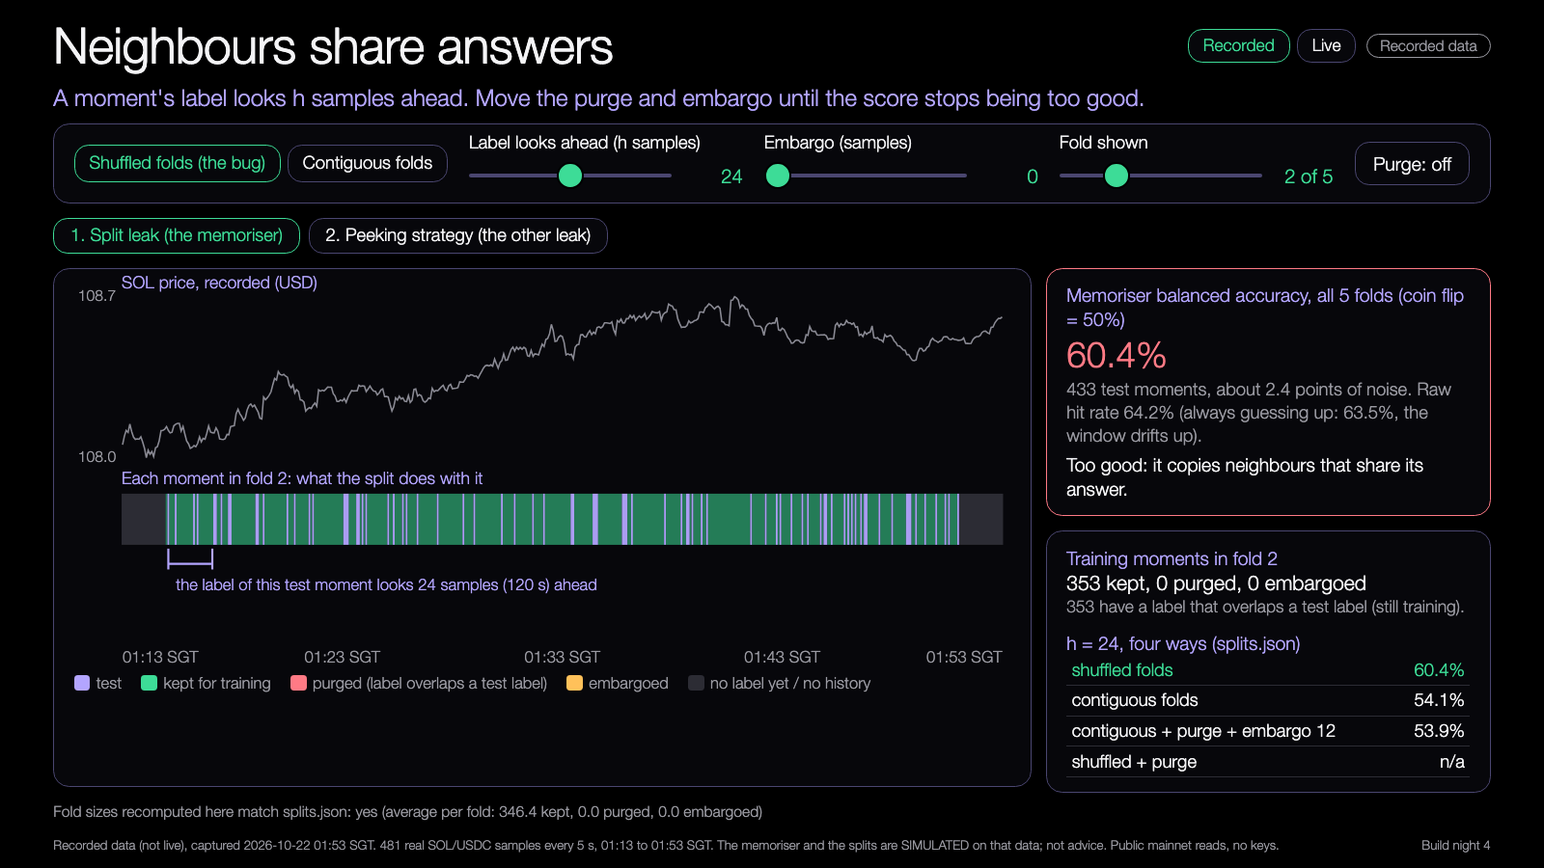
DEMO 1
Demo: split leakage
PREDICT FIRST
Does a memoriser score higher with shuffled folds or with a purge, and by how many points?
$ npm run demo -- --recorded
YOU SHOULD SEE
accuracy for shuffled and contiguous folds
training moments purged and embargoed
Learning Lab demo, runs from disk, recorded data.
Try it: https://nus-solana-demos.vercel.app/0007/01-split-leakage.html
Fallback: Recorded data is the default. No network needed.
Live mode: switch it on to watch real Solana data.
Source: demo-repo/lab/screenshots (captured from the Learning Lab demos on recorded data). Simulated, on recorded data; not advice.
14
Notes:
[18:20] Demo 1. Predict first: does the memoriser score higher with shuffled folds or with a purge, and by how many points? Run it, or open the demo: pick shuffled folds, then contiguous, switch purge on and drag the embargo slider. Watch the purged cells turn red, the training count drop, and the balanced accuracy fall (50 percent is a coin flip). Fallback: recorded data is default, no network. Live mode is a strip that shows the live Pyth age and pool price; it is not part of the simulation. If someone asks why accuracy goes below 50 percent: small sample, regime changes, a few points of noise.

Slide 15
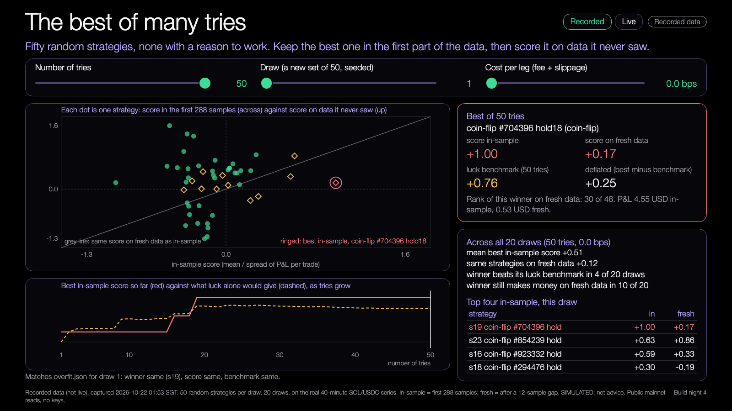
DEMO 2
Demo: many strategies
PREDICT FIRST
How much of the winner's score survives on data it never saw?
$ npm run demo -- --recorded --seeds 20
YOU SHOULD SEE
the best in-sample dot, and where it lands out-of-sample
the luck benchmark rising with the number of tries
Learning Lab demo, runs from disk, recorded data.
Try it: https://nus-solana-demos.vercel.app/0007/02-many-strategies.html
Fallback: Same recorded data. The 50 strategies come from a seed.
Live mode: switch it on to watch real Solana data.
Source: demo-repo/lab/screenshots (captured from the Learning Lab demos on recorded data). Simulated, on recorded data; not advice.
15
Notes:
[18:27] Demo 2. Predict: how much of the winner's score survives on data it never saw? Slide the number of tries from 1 up to 50 and watch the best dot move up while the luck benchmark rises with it. Change the draw: another seed gives another 50 strategies and a different winner. Then raise the cost slider to a few bps and see the cloud sink below zero. Honest caveat: in draw 1 the winner is a coin flip that still clears its benchmark by 0.25, which tells you the benchmark itself is a rough guide with only about 48 noisy scores behind it.

Slide 16
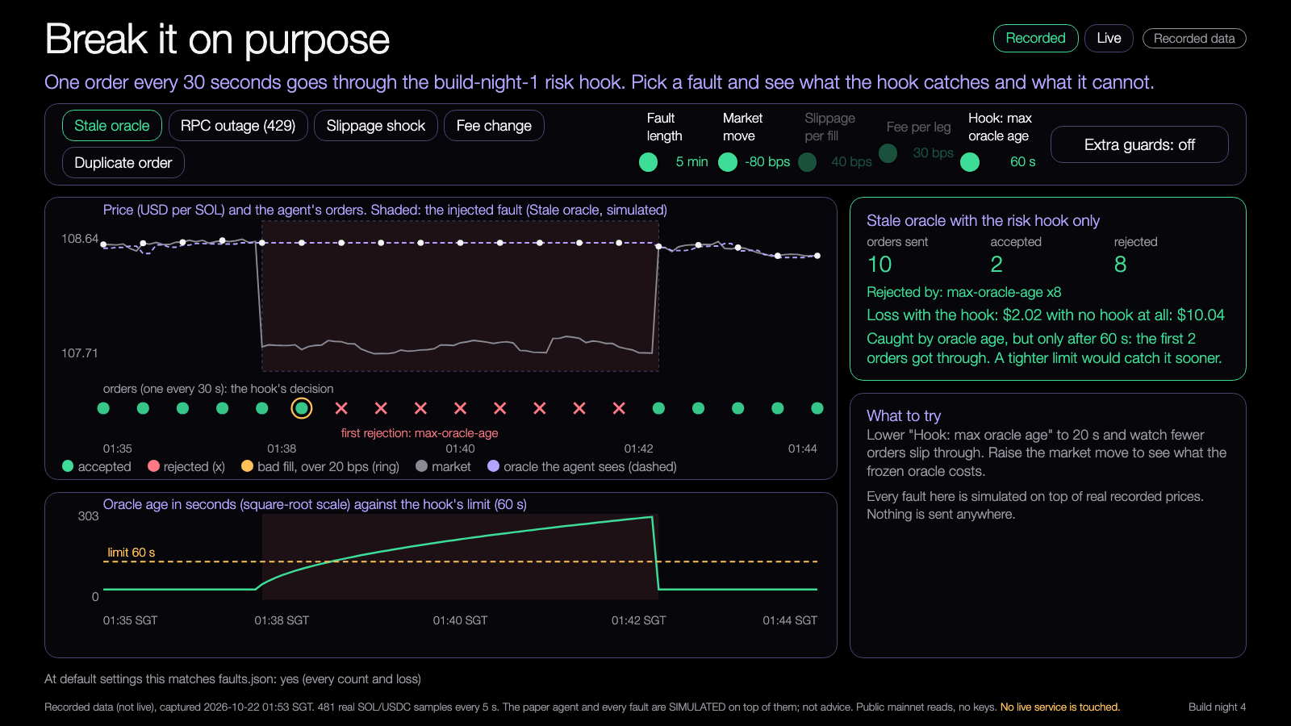
DEMO 3
Demo: failure injector
PREDICT FIRST
Which of the five faults does the risk hook stop?
$ npm run demo -- --recorded
YOU SHOULD SEE
each order accepted or rejected, with the rule
loss with the hook and with no hook
Learning Lab demo, runs from disk, recorded data.
Try it: https://nus-solana-demos.vercel.app/0007/03-failure-injector.html
Fallback: Same recorded data. The faults are simulated on top of it.
Live mode: switch it on to watch real Solana data.
Source: demo-repo/lab/screenshots (captured from the Learning Lab demos on recorded data). Simulated, on recorded data; not advice.
16
Notes:
[18:34] Demo 3. Predict: which of the five faults does the risk hook stop? Pick a fault, set its length and size, then watch each order on the timeline: accepted, rejected with the rule, or bad fill. Tighten the max oracle age slider from 60 to 20 seconds and watch the first-minute leak shrink. Toggle the extra guards and see duplicates and slippage get handled. In live mode a real Pyth read goes through the same hook every five seconds and the fault buttons simulate staleness on top. Everything injected is simulated.

Slide 17
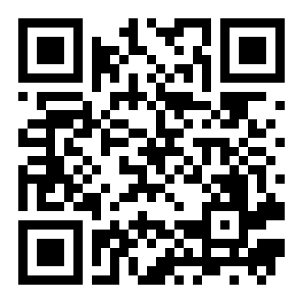
Try the demos yourself
DEMOS
nus-solana-demos.vercel.app/0007/
Open on your laptop. Move the sliders.
No install. The same files are in the repo and open from disk.
Scan to open the demos
Source: demo-repo/lab (the four Learning Lab demos, deployed as static pages, recorded data)
17
Notes:
[18:40] All four demos are static pages, no install, they work on your phone or laptop. Scan the code or type the address. The same files are in the repo and open from disk, so if the campus Wi-Fi misbehaves you still have them. Recorded is the default; Live is opt-in and falls back to recorded by itself if an endpoint is rate limited. Take two minutes now, then we move to the mission.

Slide 18
Your mission
18:40 to 19:00. Twenty minutes.
1
2
3
4
Run
Find
Fix
Chart
The sample leaky strategy
The planted leak with the causality test
The leak, and score with a purged split
The result, before and after
Finish line: one chart with a before and an after.
18
Notes:
[18:42] Twenty minutes, all of us on the same small thing. Step one, run the sample leaky strategy and note its profit. Step two, find the planted leak: run the causality test and see which moments change when the future is cut off. Step three, fix it, change the shift to zero, and score with a purged split instead of a plain one. Step four, chart before and after. Finish line: one chart with a before and an after. If you finish early, run the causality test on a signal from your own project.

Slide 19
Build menu
19:00 to 19:50. Pick one, or bring your own project.
Audit your own project for a leak
BEGINNER
Purged split on your strategy
STANDARD
A feed-health alert
STANDARD
A regression test for a failure you injected
ADVANCED
19
Notes:
[19:00] Fifty minutes of free build. Pick one. Beginner: audit your own project for a leak, look for any place that uses a future value, a full-sample mean, or shuffled folds. Standard: put a purged split on your strategy. Or a feed-health alert that rings when your oracle gap drifts. Advanced: write a regression test for a failure you injected, one that fails first and then passes after your fix. Or bring your own project and tell me what you want to break. I will walk around.

Slide 20
Three takeaways
1
Neighbouring moments leak: cut folds by time, then purge and embargo.
2
The best of many tries is mostly luck: deflate it and test on fresh data.
3
Inject failures: the hook stopped the stale data but not slippage, fees or duplicates.
20
Notes:
[19:50] Three things. One: neighbouring moments leak, so cut folds by time, then purge and embargo. Two: the best of many tries is mostly luck, so deflate it against a luck benchmark and test on fresh data. Three: inject failures; our hook stopped stale data but not slippage, fees or duplicates, and every failure you name should become a test. Ask the room: which assumption failed in your project tonight? Could a user tell something went wrong? What test stops it coming back?

Slide 21
Branch out
After tonight, in your own time.
BEGINNER
STANDARD
ADVANCED
Run the causality test on a signal from your own project.
Raise the number of tries from 10 to 100 and chart the best score against the luck benchmark.
Add a guard for a fault the hook missed, with a regression test that fails first.
21
Notes:
[19:53] After tonight, in your own time. Beginner: run the causality test on a signal from your own project. Standard: raise the number of tries from 10 to 100 and chart the best score against the luck benchmark. Advanced: add a guard for a fault the hook missed, with a regression test that fails first. Everything is in the repo, and you need no AI credits and no keys for any of it: you can hand-edit one parameter and rerun.

Slide 22
Share back
Before you leave, and by next Thursday.
TONIGHT
THU 4 FEB
ANY TIME
1
2
3
Push your branch to your own repo.
Bring one honest number to Workshop 4.
Send your repo link to the leads.
22
Notes:
[19:55] Before you leave, push your branch to your own repo. By Thursday the fourth of February, bring one honest number to Workshop 4, with its limitations next to it. And any time, send your repo link to the leads. Show and tell now: one line each, what did you break, and what did you fix?

Slide 23
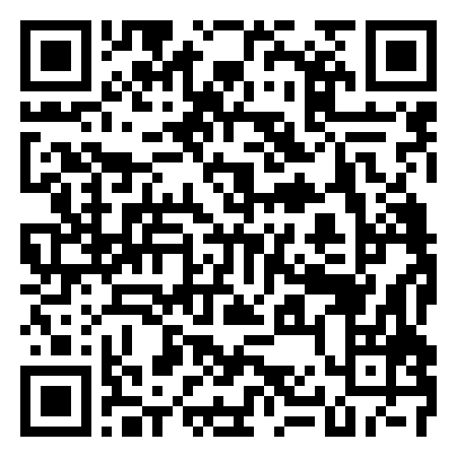
Get the code
REPO
github.com/travisim/solana-agentic-trading-nus
folder: 0007-backtest-validation-failure-testing/demo
1
$ npm install
2
$ npm run demo -- --recorded
Run both from the demo/code folder. Node 24. No keys, no AI credits. Recorded data is bundled.
Scan for this session's code
23
Notes:
[19:57] Everything from tonight is in the shared repo, in the folder for session 0007. Scan the code. From the demo code folder run npm install, then npm run demo with the recorded flag. Node 24. No keys, no AI credits, recorded data is bundled. Reads use public mainnet data and every write is devnet only, no real funds.

Slide 24


Let's connect
LinkedIn
Telegram
linkedin.com/in/travisim
t.me/travisim
24
Notes:
[19:58] If you want to keep going, find me on LinkedIn or Telegram. Send me what you broke and what you fixed, I like reading those. Thank you, see you next Thursday for Workshop 4.

Slide 25

Notes:
[20:00] End of the session. Leave this slide up while people pack up and take photos. Remind everyone the 48-hour report is the leads' job, but the feedback form after every workshop is theirs. Thank you.

