Slide 1
CSCI-1620
Decomposition

Slide 2
Decomposition
Decomposition is the process of subdividing a complex design into smaller, more manageable units
Often times, programs are solving large and/or complex problems
As in other situations, it is helpful to break down these complex problems into smaller, more “bite sized” pieces
This helps us in Computer Science in many ways
  Easier to write/debug/test code
  Reusability
Notes:
Set of characteristics that define a piece of data

Slide 3
Decomposition
Given a complex problem, it is possible to solve the entire thing in a single method, however, it cannot be tested until the entire thing is done
Additionally, the smaller parts of a complex problem may also be parts of other problems, and therefore reused in other solutions

Slide 4
Decomposition
In Object-Oriented languages, such as Java, Decomposition can occur at two levels
  Create multiple Classes to solve the problem
  Create small, easily testable methods that each solve a portion of the problem
The Classes created should be types that are focused and general, such that they may be reused for similar problems
Methods should also be small and focused on perform a single, well defined task

Slide 5
Decomposition Example
The easiest way to look at this is through an example
Let’s say we are writing a program that completes a Caesar Cipher
  A Caesar Cipher is a simple encryption that shifts all letters in the original message to the left or right by an interger shift value
We could create a program, with a single main method that performs this entire task, but do we have something to gain by decomposing the problem?

Slide 6
Caesar Cipher Decomposition
While the problem seems simple, it may be a little more complex than we think and involves many restrictions and steps
Things to think about:
  An inputted message will be a String, what characters are allowed?
  How should invalid characters be handled? What about spaces?
  What are valid shift values?
  How should invalid shift values be handled?
  How can a shift be performed on a single letter?

Slide 7
Caesar Cipher Decomposition
Overall Steps
Read in message
Read in desired shift
  Validate shift value (between -25 and 25, but not 0)
  If valid set in range of 1 – 25 (ex. Shift of -1 is the same as Shift of 25)
  If invalid generate random valid shift value
Generate cipher
  Cleanse message of invalid characters, convert all characters to upper case
  For each letter in cleansed message find shifted letter
  Append shifted letter to cipher message

Slide 8
Caesar Cipher Decomposition
Each of these steps is a small, well defined task which can be a method of its own
Additionally, all of the Caesar Cipher “stuff” can be encapsulated in a class of its own
  There may be multiple programs that could utilize the ability to construct a Caesar Cipher
  By creating a stand alone class, it can be used in many applications

Slide 9
CaesarCipherMessage UML
CaesarCipherMessage
String originalMessage String cleanMessage String cipher int shift
<<constructor>> CaesarCipherMessage(originalMessage : String, shift : int) - checkShiftValid(shift : int) : boolean setShift(shift : int) randomShift( ) + generateCipher() cleanseMessage() shiftChar(c : char) : char + getOriginalMessage() + getCleanMessage() + getCipher()

Slide 10
Decomposition
The CaesarCipherMessage class has been designed such that the individual steps are each done by a single method
With the design done, the Class itself can be written, but where to start?
It may help to notice that some methods depend upon others in order to function

Slide 11
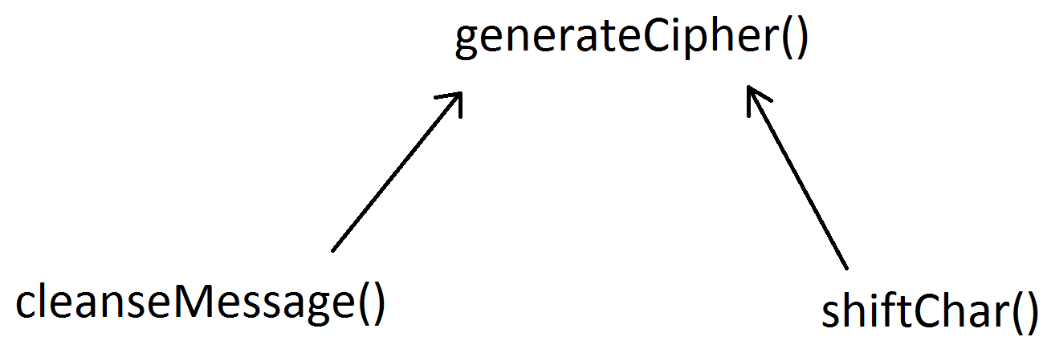
Dependencies
For example, the generateCipher() method will call upon cleanseMessage() and shiftChar()
Which method should we write first?
  Approach Top-Down or Bottom-Up?

Slide 12
Dependencies
With a Top-Down approach we would write the generateCipher() method first, assuming what it depends on, cleanseMessage() and shiftChar(), working
  This is a more linear, perhaps seemingly natural approach, since we will be starting with the entry point of the problem
  HOWEVER, since we are making the assumption that its dependencies WILL work (they are not yet written), the generateCipher() method cannot be tested until those dependencies are actually written
  If we do this, and the generateCipher() method does not produce the correct results, there are THREE candidates for where an error may be
  It could be in the generateCipher() method itself, or there could be an error in cleanseMessage() or shiftChar()

Slide 13
Dependencies
With a Bottom-Up approach, we start writing methods that have no dependencies
This way we can test the methods for accuracy as they are written
Once cleanseMessage() and shiftChar() have been written and individually tested to the point we are sure they independently perform correctly, the generateCipher() method can be written
If an error occurs when testing generateCipher() we can be somewhat certain that the error lies in the generateCipher() method alone since we have already vetted its dependencies!

Slide 14
Unit Testing
Unit Testing is the idea of testing small, individual pieces of code for correctness
With a Bottom-Up approach, each method that is written can be tested on its own to ensure it is working correctly after it is written
  If it is not working correctly, find and fix the issue before moving on to the next method
This makes finding logical errors much easier since you are only debugging small units of code at a time

Slide 15
Unit Testing
How can a method in a Class be tested?
Any Class can be given a main method
  If a main method is placed in a class it can create an instance of that class and access all its data members and methods, even the private ones!

Slide 16
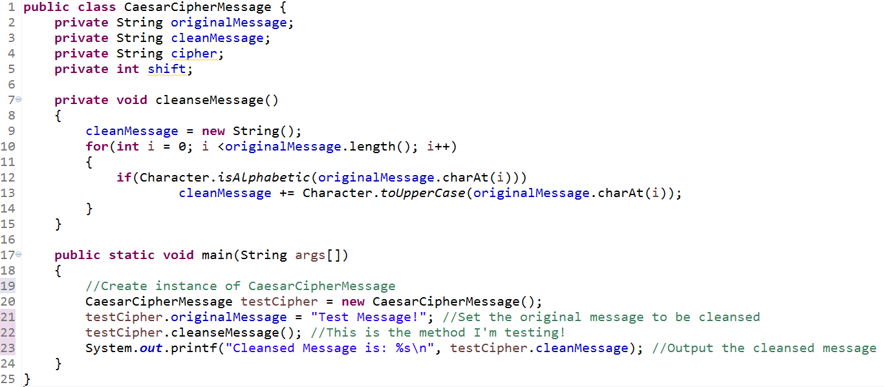
Unit Testing

Slide 17
Unit Testing
First I write the cleanseMessage() method since it has no dependencies
After writing the method, a small main method that serves as a unit test for that method alone is written
I can create a number of test cases to be certain the method works correctly for all possible cases
Be sure to test for “fringe” cases, those that are on the border between valid and invalid
  For example, if a method tests if a value is greater than 0, be sure to test cases that are on the “fringe” of the restriction, such as -1, 0, and 1
In the case of cleanseMessage() I want to be sure to test what happens with lower case letters and non-alpha characters

Slide 18
Unit Testing
After reasonably testing the cleanseMessage() method I would move on to the shiftChar() method, and likewise test it
After this, I can more confidently write the generateCipher() method, knowing that its dependencies are written and working

Slide 19
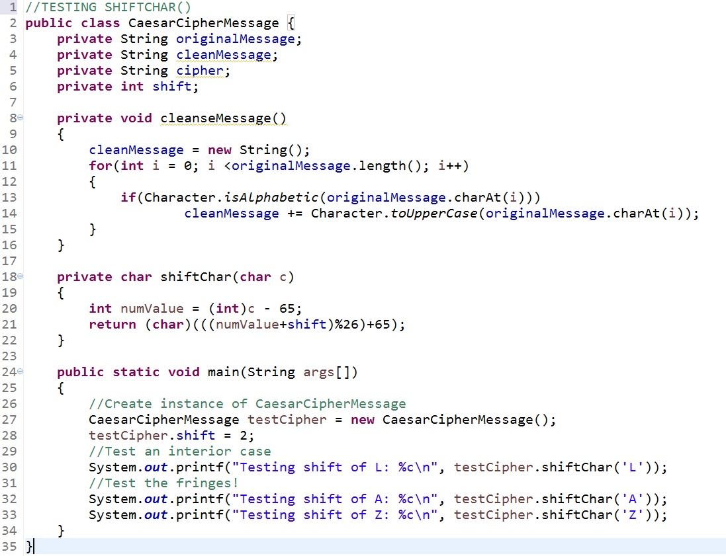

Slide 20
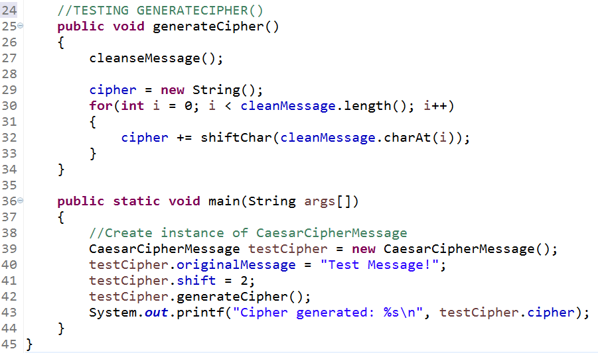

Slide 21
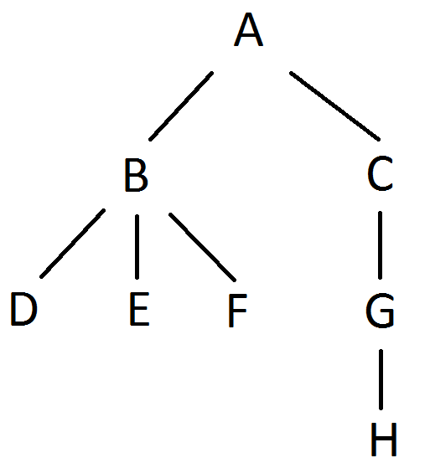
Dependencies
The dependencies in the previous, small example are very shallow, but often are much deeper
If this were our dependency structure, where each letter is a method, the advantage gained from a Bottom-Up approach with unit testing becomes more clear
If you were to start with A, it couldn’t be tested until all others were written; if it didn’t work then the logical error could potentially be in any of the methods! Very had to debug!

Slide 22
Decomposition Approach
Given a problem:
Dissect the problem into small steps
Design Classes that can encapsulate the larger, yet focused, reusable units
For each class, design a method for the small actions that are used to solve the larger problem
Create dependency charts
Write methods with no, or completed dependencies
Test each method written individually

Slide 23
Decomposition
Decomposition is a bit of an art form and it may be difficult to see how Classes and methods should be dissected
In this course, this is done for you, but pay attention to how the larger problems are broken down in order to help learn how decomposition is done
You should perform unit testing on individual methods as discussed here
  It may seem like it is an extra step, but it is an easy extra step that will save you hours in debugging!

