Slide 1
CSCI-1620
Utilizing IDEs

Slide 2
IDE
IDE – Integrated Development Environment
Software application that serves as a programming environment
Contains tools to make programming easier
Integrated documentation
Auto-complete
Highlighting of syntax and logic errors
Debugger
Etc.

Slide 3
IDE
Many IDEs are language independent, some are designed for specific languages
Some IDEs that are used for Java are:
Eclipse – www.eclipse.org
NetBeans – www.netbeans.org
BlueJ – www.bluej.org
All of the above are free to use

Slide 4
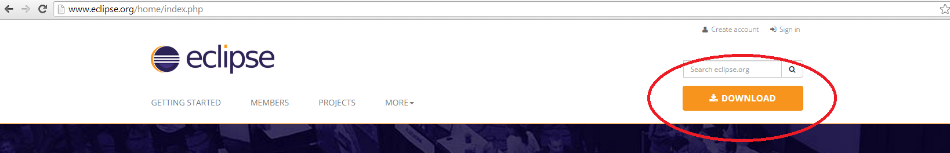
Eclipse
One of the most popular IDEs is Eclipse, and for the sake of consistency this is the one you will use for the last assignment
This is available for both Windows and OSX

Slide 5
Installing
The Eclipse download will be a compressed folder, unzip this and place the eclipse folder where ever you want it installed
A good place for this is in Program Files
You may want to create a short cut to the Eclipse application on your desktop for quicker access
First time starting up it will ask you to create a workspace folder for you projects to go, create this folder where ever you would like

Slide 6
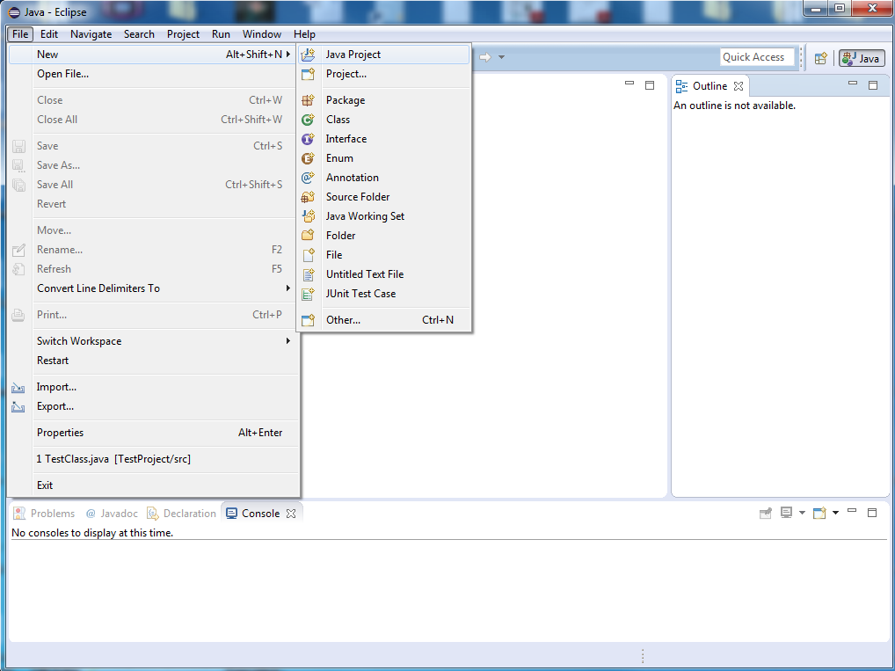
Creating a Project

Slide 7
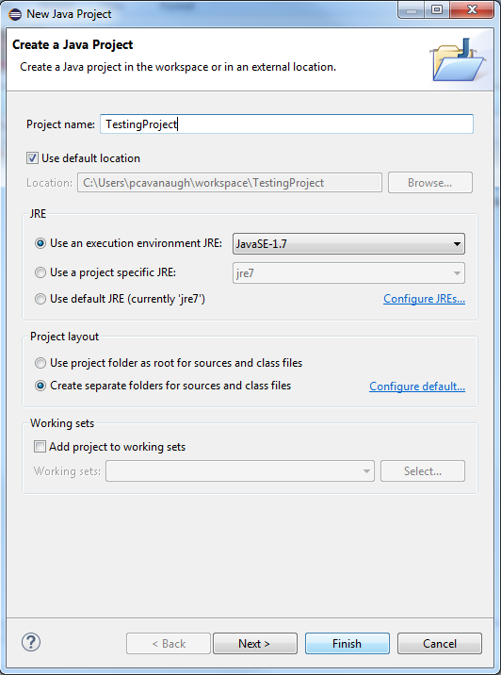
Creating a Project
Name your Project
Give project its own folders

Slide 8
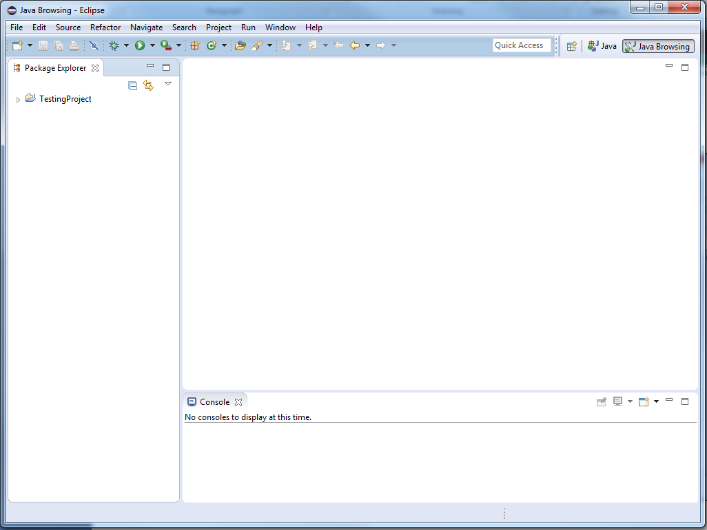
Creating a Project
Empty Project
No Classes

Slide 9
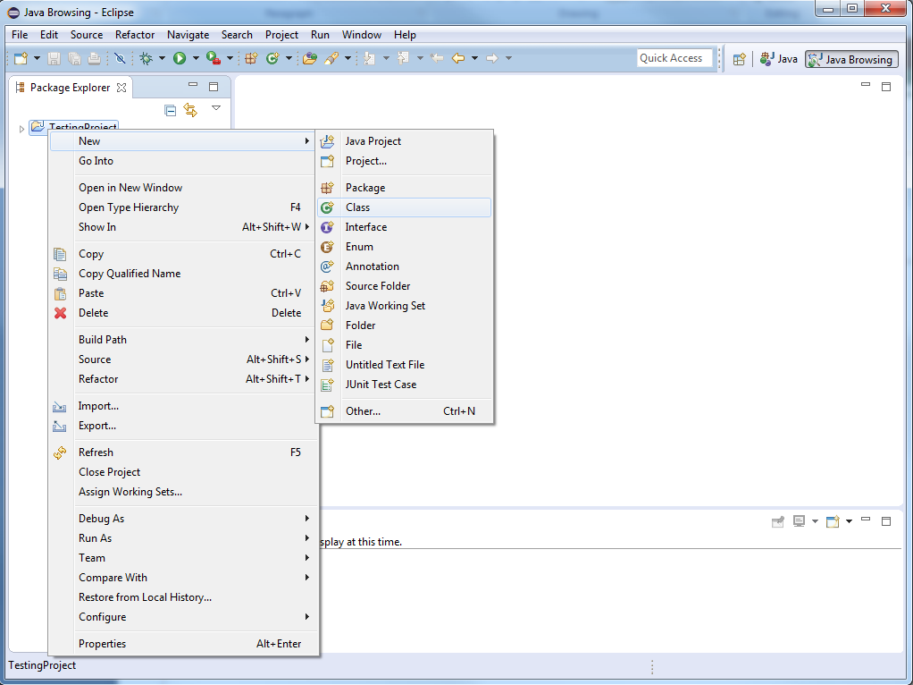
Creating a Project
Right click the
Project Folder
New -> Class

Slide 10
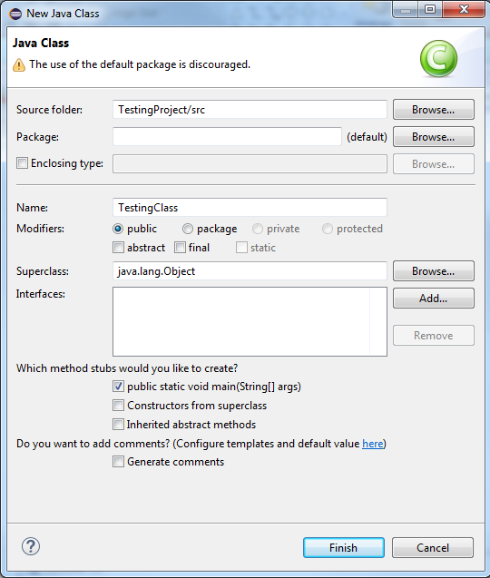
Creating a Project
Name your Class
Other options include:
Access Level
Declaring superclass
Does this class have main?
Provide inherited abstract
methods
Choosing these options will automatically generate the code required for these options

Slide 11
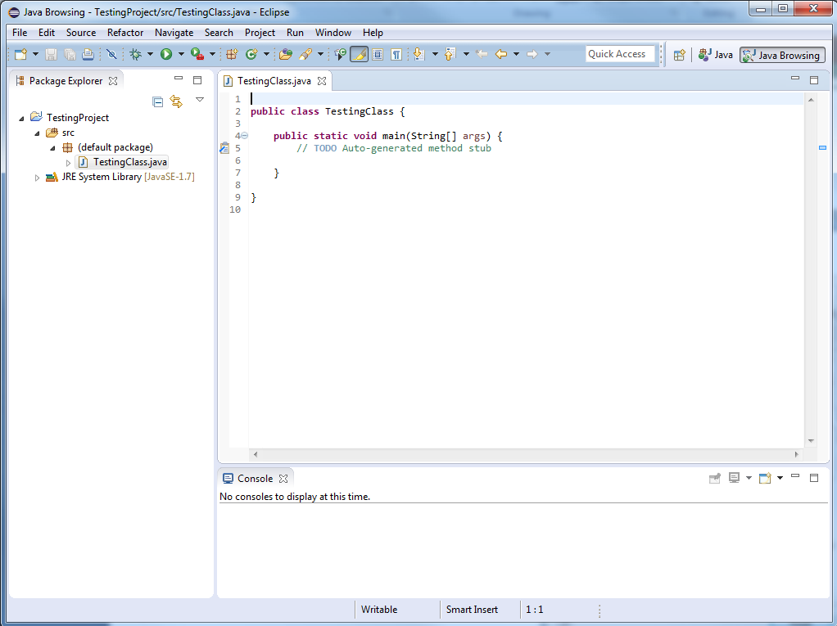
Creating a Project
This is what was automatically generated

Slide 12
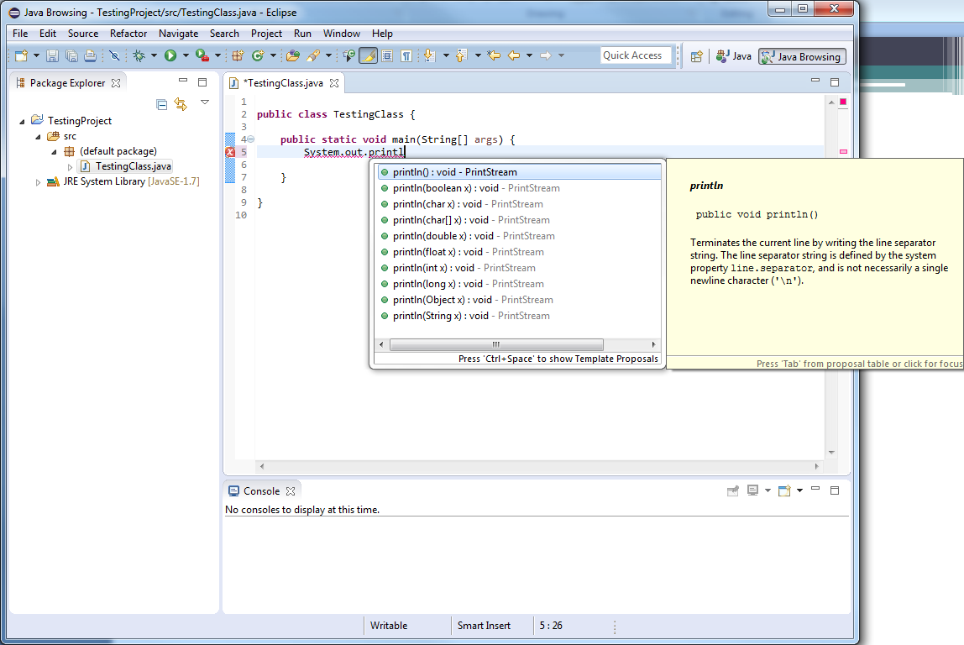
Editing/Compiling
Auto-fill with
Tool tips

Slide 13
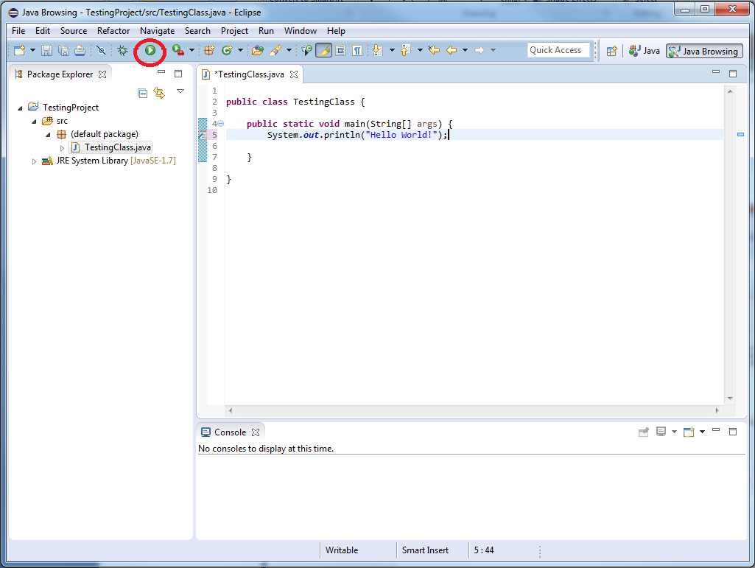
Editing/Compiling
To compile and run the project hit the “play” button
This will then ask you what files you wish to save before compiling

Slide 14
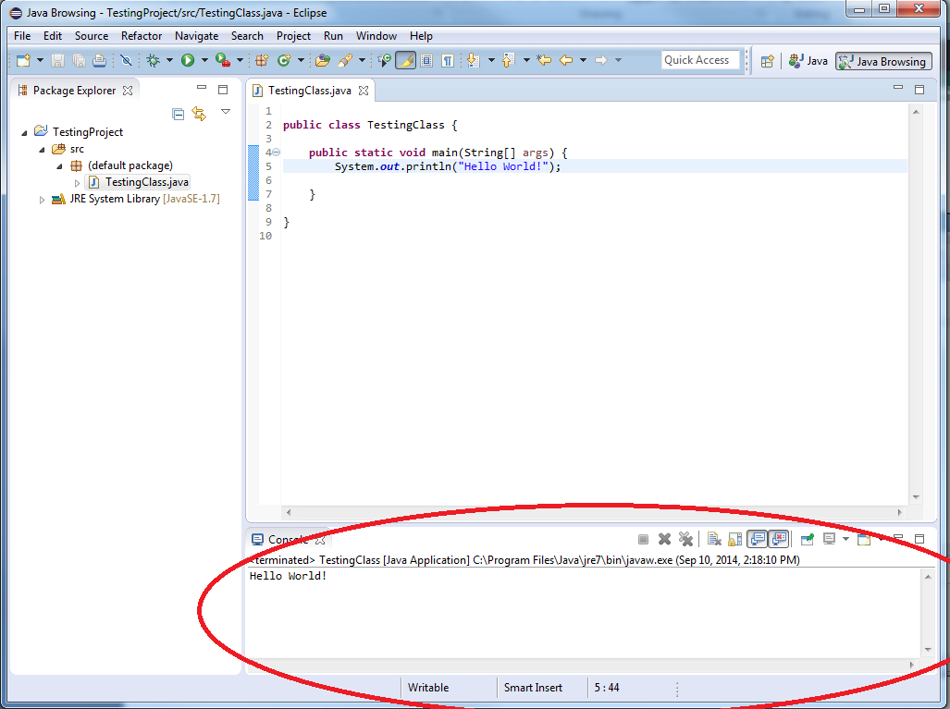
Console Output
Outputting to System.out will appear in the console window
If this window isn’t present you can view it by selecting it in the Window menu
Input will also be taken in this console window

Slide 15
Features
The editor will let you know where Warnings and Syntax errors are before you compile
These will be identified with underlining the problem
Underlined in yellow for possible issues
Underlined in red for things that would cause compiling to fail

Slide 16
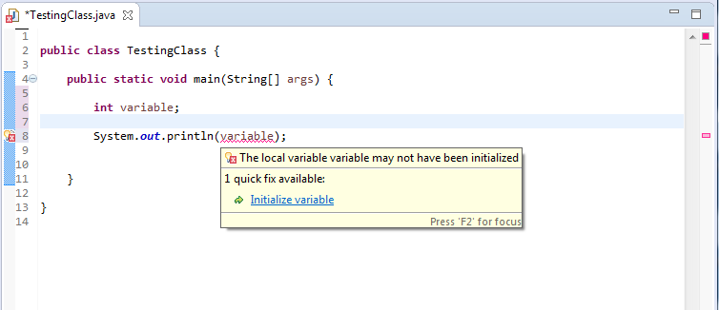
Features
Using uninitialized variables would cause a compiler error, but the editor catches it
Hover over to see details
Locations of errors and warnings can be seen next to scroll bar

Slide 17
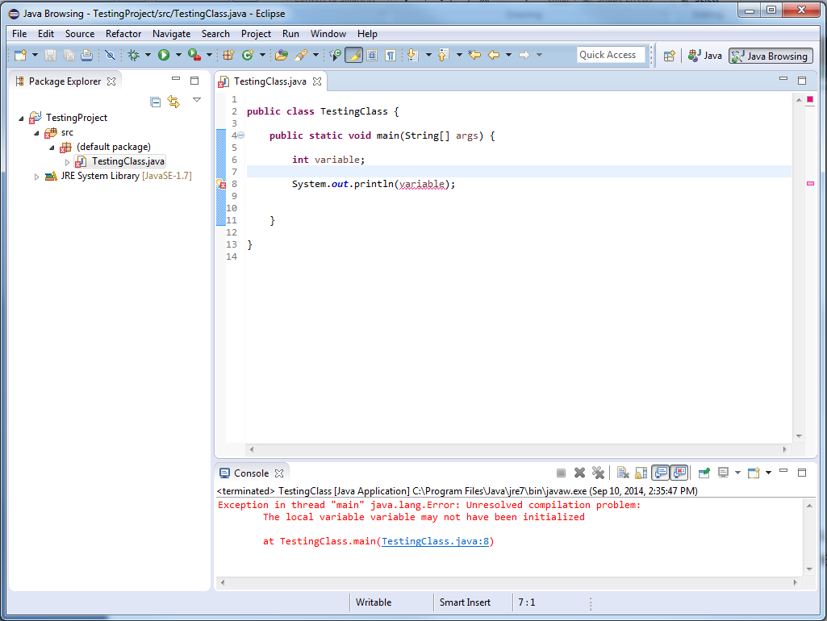
Features
If you do compile and there are errors and/or warnings they will appear in the console

Slide 18
Packages in Ecplipse
New Packages can be created by selecting File->New->Package
Name the package, recall a package also creates a directory structure
A dot in the package name denotes a subdirectory

Slide 19
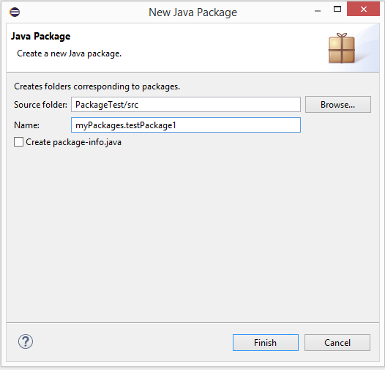
Packages in Eclipse
This will create a logical package
Also creates the required directories
Within the src folder it will create a directory called myPackages, within that directory will be another called testPackage1

Slide 20
Packages in Eclipse
Create the package a class is going to be declared to belong before creating the class
The source code (.java file) must be placed in the package directory
However, if the source file is not in the correct location determined by a package declaration (and will therefore not compile), you will have the option to place it there through a quick fix
If the packages is not yet created it will be done with the quick fix

Slide 21
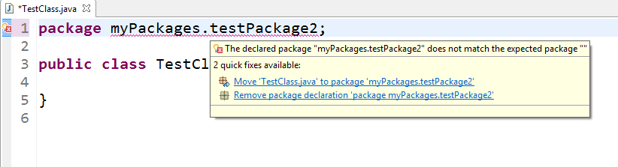
Packages in Eclipse
Any class that is not declared to be in a package will be placed in the “default package”, the source will appear directly in the src directory
The above class has been placed in the default package but declares it is a part of a package
The tool tip shows this as an error, using the first quick fix will create the declared package if necessary and move the source to it

Slide 22
Debugging
With debugging you can run a program while at the same time watch the source code and variables during execution
This can be done by setting up breakpoints and watchpoints
Breakpoint – stop running code at a certain point
Watchpoint – stop execution if a field is being read or modified

Slide 23
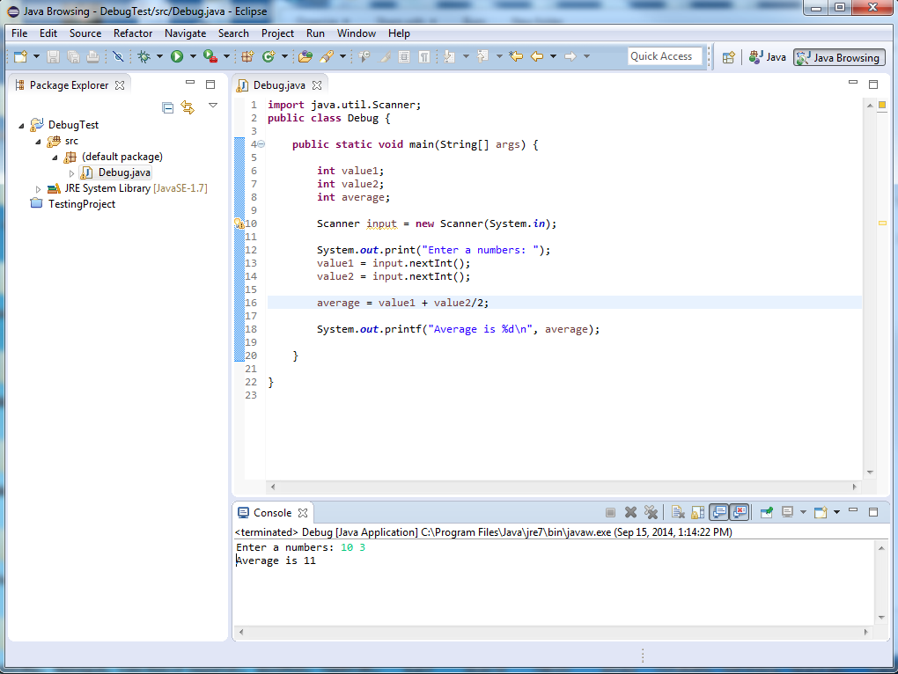
Debugging
Oh no! Where is this going wrong?

Slide 24
Breakpoints
To add a breakpoint you can right click on the blue bar to the left of your code and select Toggle Breakpoint
Or you can simply double click on the bar where you want the breakpoint to be
When running the code as Debug (F11) the execution will stop at those points
From here you can inspect the values of variables

Slide 25
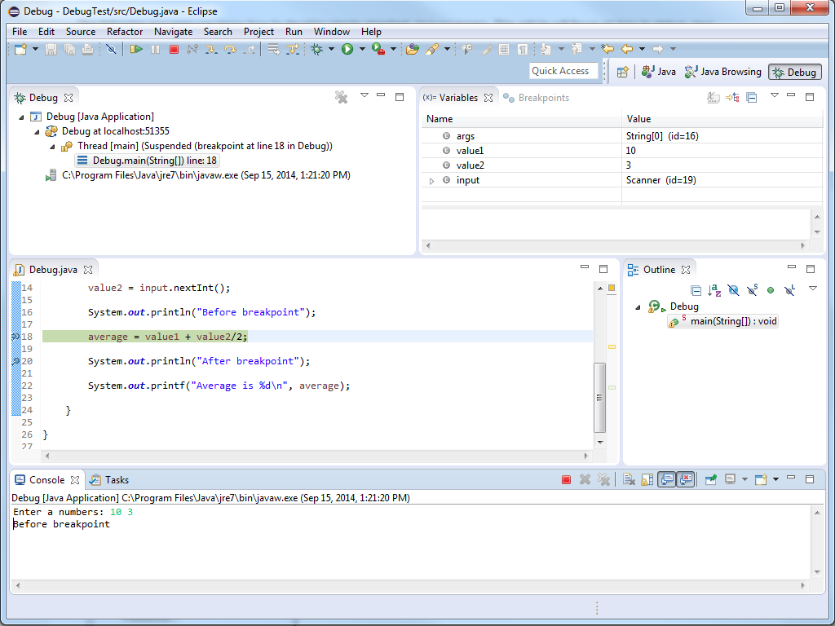
Breakpoints
2. Hit “Play” to continue
1. Stops before this line is executed

Slide 26
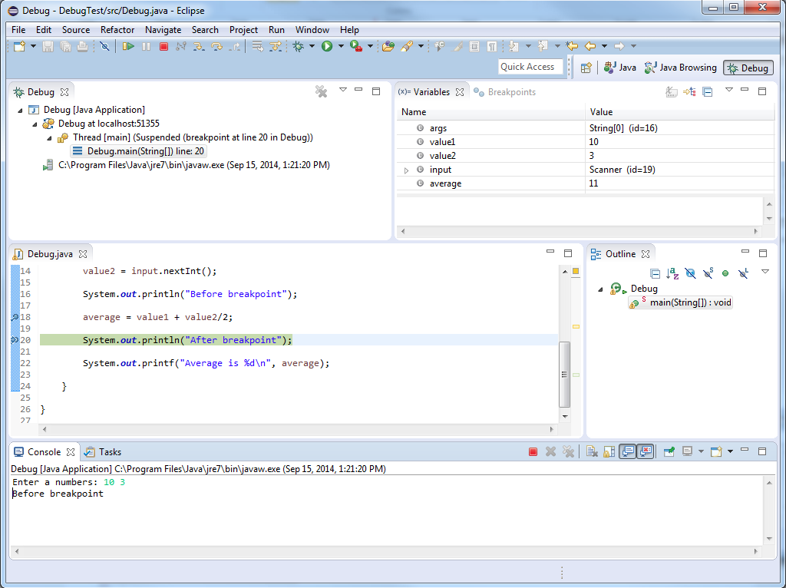
Breakpoints
Looks like this is where my value went wrong!
Sure enough, my arithmetic is wrong!

Slide 27
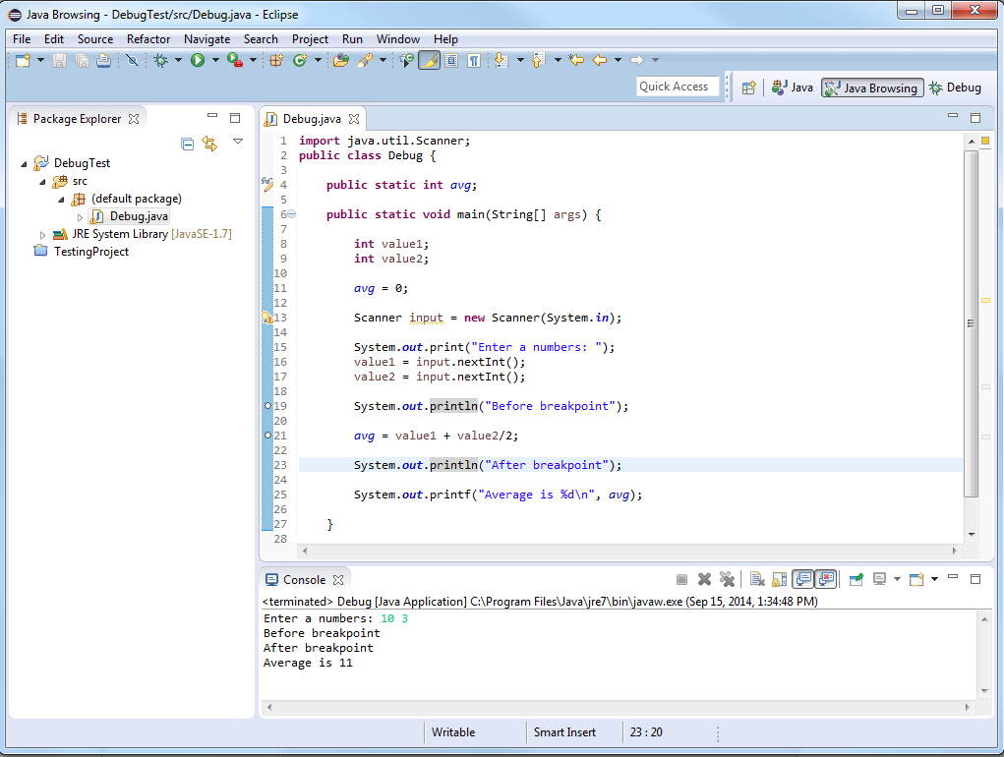
Watchpoints
Fields (Class level variables) can be set as watch points.
This is done in the same way as setting breakpoints, but next to where a field is declared. Whenever this field is accessed debugging will halt as if a breakpoint were reached.

Slide 28
Debugging
There are a lot more debugging features available, these are the simplest features that are extremely useful
Feel free to look up more of the debugging tools!

