Slide 1
CSCI-1620
Queue

Slide 2
Queues
Queues, very similar to the Stack, is a Restricted Data Structure
Queues are used to process data in the order that they are received
Much like a check out line at a super market
The item that has been in the Queue the longest is the next to be removed
Queues are First-in, First-out (FIFO)

Slide 3
Queues
Much like Stacks, there are two required methods to make a Queue, and these are the only methods that are allowed to alter the structure
enqueue()
  Add the item to the end of the Queue
dequeue()
  Remove the item from the front of the Queue, and return the data

Slide 4
Queues
Queue uses
A computer with only a single processor is only capable of giving processor time to one application at a time, even though many applications may be running, a Queue structure is used to manage the application requests
A printer connected to a network will process requests using a Queue structure, requests are added to the end, but those jobs at the front are printed first

Slide 5
Queue
The Queue class can also be based upon the Linked List structure
Once again, to retain the integrity of the Logical concept of a Queue, the composition format should be used
Queue will not have access to those methods in Linked List that allow for arbitrary element access

Slide 6
Queue
Queue methods
enqueue()
dequeue()
isEmpty()
lengthIs()
search()
peek()

Slide 7
Queues
There are a few variations of the basic Queue
Priority Queue
Double Ended Queue
Circular Queue

Slide 8
Priority Queue
Instead of the standard First-in, First-out access, all elements in the Queue have a priority to them
This would require the Node class to have an added data member
The element removed is the one with the highest priority
The standard Queue can be thought of as a Priority Queue where the priority is time

Slide 9
Priority Queue
Unsorted Priority Queue
Elements are added to the end
Linear Search used to find the element to remove
Sorted Priority Queue
Elements added into ordered Queue
Elements removed from front

Slide 10
Double-Ended Queue (Deque)
The Double-Ended Queue is a very loose interpretation of the Queue
It allows for data to be added and removed from both the front and end of the Queue
Access from the middle is still restricted

Slide 11
Circular Queue
The Circular Queue is a different logical interpretation of the Queue
This version of the Queue is used for very specific situations, although the general use may seem the same
This is typically implemented with an array, and not as a Dynamic Data Structure

Slide 12
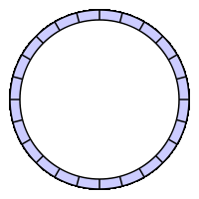
Circular Queue
Elements are still only added to the end and removed from the front
The number of data elements allowed in the ring are limited, based on the size of the array used to implement the Circular Queue
As elements are added, older elements that have not yet been removed will be over written

Slide 13
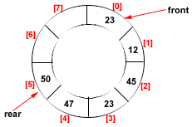
Circular Queue
The “start point” and “end point” of the Circular Queue is always changing with enqueues and dequeues

