Slide 1
K-mer Prefilter for Homology Search
Zhong Ziyue

Slide 2
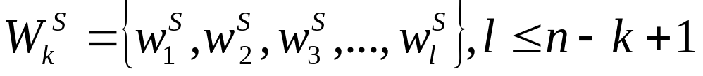
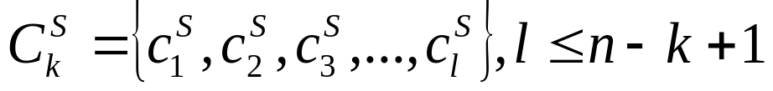
Step1 Count K-mers
Words
Counts

Slide 3
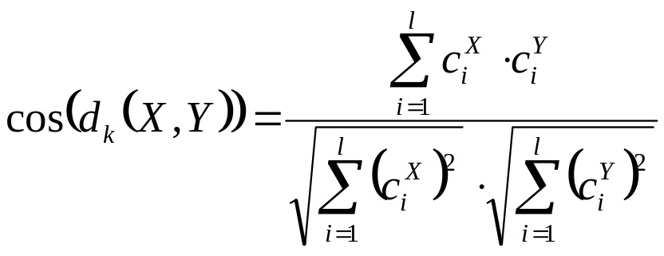
Step2 Distance Measurement
Cosine Angle (by Stuart G.W)

Slide 4
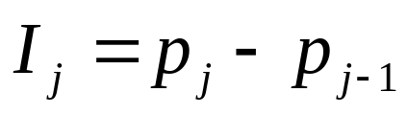
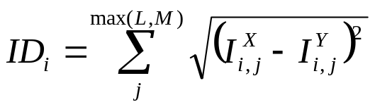
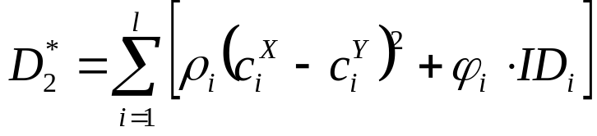
Step2 Distance Measurement
D2Star

Slide 5
Questions?

