Slide 1


Call Volume Forecast: A Comprehensive Guide to Data Analysis and Modelling

Slide 2


Before we Begin
Objectives
Questions
Assumptions
Data Collection and Cleaning
Data Exploration
Forecasting Methods
Data Modelling and Visualization

Slide 3

Objective
The objective is to forecast the call volume for 6 months for a customer service team using historical data, with a forecast variance of not more than 4%

Slide 4
Questions
What are the forecast assumptions
What algorithm/methodology used?
How accurate is it
When does this work and when it does not work

Slide 5

Assumptions
Reliable datasets and the information is applicable to the current situation an can be considered a good data for analysis.
Call centre is not using any tool or following any practices different from the other call centre
Performance of the call centre has never been low or under improvement for all the previous year
Seasonality is monthly

Slide 6

Data Collection and Cleaning
This step involves cleaning the data set of formatting errors and incorrect data to obtain good quality data, then looking for abnormally low or high call volumes and missing information, determining the reason for abnormality, categorizing the data to observe patterns, and evaluating seasonality and trend analysis for 3 years call volume forecast report

Slide 7
IDENTIFY THE DATA NEEDED FOR ANALYSIS AND CLEAN THE DATA
Call
Call volume forecast report for the last 3 years
Correct
Correct the formatting errors and inappropriate data from the data set for us to get the good quality data
Look
Look for abnormally low or abnormally high call volume and missing information
Determine
Determine the reason for abnormality if any
Categorize
Categorize the data to obtain the graphical interpretation of trend and performance to observe any unusual patterns
Evaluate
Evaluate the seasonality and trend analysis

Slide 8
DATA EVALUAION AND EXPLORING THE POSSIBILITIES
Prepare the line chart and understand if the data is stationary or trending
Explore the data: You should explore the historical call volume data to identify patterns and trends

Slide 9

Forecasting Methods
Methods used are
Time series analysis: Plotting the call volume over time to identify any seasonal or trend patterns.
Correlation analysis: Examining the relationship between call volume and external factors such as holidays or marketing campaigns.
Excel Inbuilt Forecast Function
Exponential Smoothing Method

Slide 10

Data Modelling and Visualization
Execute the data models that can generate the output which is matching with the test data.
- Demonstrate the data with the test data and the training data to show the reliability of the output
- Graphical interpretation of the historic call volume and predicted call volume

Slide 11
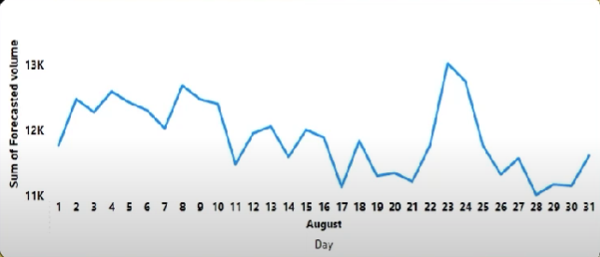
Report Insight
Final Output of forecasted call volume for Q3 and Q4 of 2020
When does this work
- This works when the data is stationary with no lag or lead trends.
- Works when Business is still using the same call type and the same process flow.
- Market’s fluctuation has no influence on the call flow patterns.

