Slide 1

Power BI Dashboard On Telangana Tourism Insight

Slide 2


Insights
To provide insight on total number of Domestic and Foreign visitors year wise
Top 10 Districts with highest number of Domestic Visitors
Top 3 Districts and Bottom 3 districts based on Compounded Annual Growth Ratio (CAGR) of visitors between 2016-2019
Peak and Low season months for Hyderabad based on data from 2016-2019
Top 5 and Bottom 5 districts based on total population to Footfall ratio
Projected Domestic and Foreign visitors for 2025
Projected Domestic and Foreign revenue for 2025

Slide 3


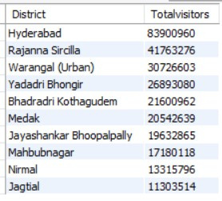
HIGHEST DOMESTIC TOURISM DISTRICTS
Using the domestic visitors data from 2016 - 2019, here are the Top-10 districts that have highest number of domestic visitors.
Results using SQL
Hyderabad
Rajanna Sircilla
Warangal (Urban)
Yadadri Bhongir
Bhadradri Kothagudem
DOMESTIC VISITORS REPORT
Jayashankar Bhoopalpally
Nirmal
Jagtial
0
25,000,000
50,000,000
75,000,000
100,000,000
Top-10 Districts - Domestic Visitors (2016 - 2019)

Slide 4

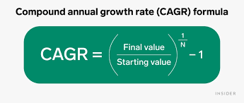
4. CAGR Ratio Calculation
Mathematically speaking, the CAGR formula is given by the following equation

Slide 5



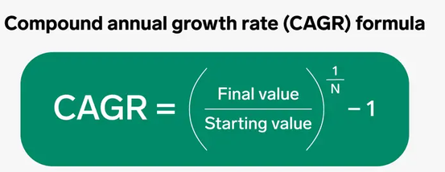


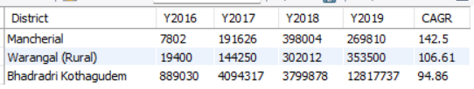

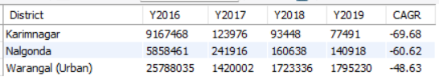
What is CAGR
TOP 3 DISTRICTS WITH HIGH & LOW CAGR RATIO
Districts with CAGR % - Domestic & Foreign Visitors
Top 3 CARG % Districts
Bottom 3 CARG % Districts

Slide 6
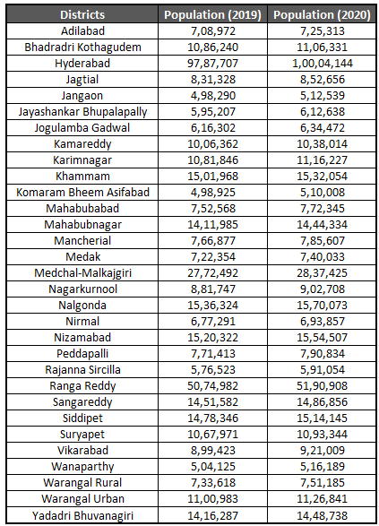

Projected population
Data from Chat GPT

Slide 7
5. Foot Fall Ratio
One of the main basic KPIs, that help us to know other results of our business, is the Footfall
This shows the districts where the tourists are more than the residents

Slide 8
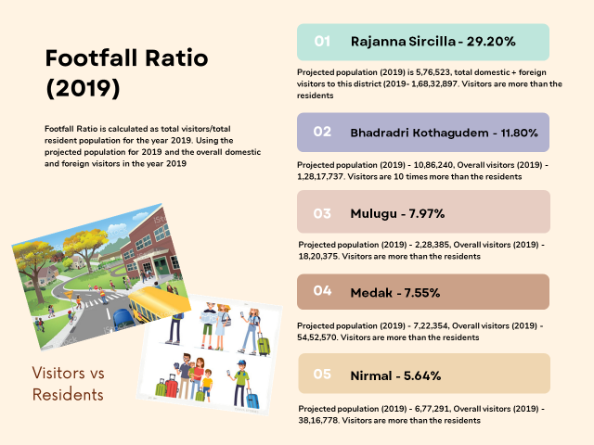



01
Rajanna Sircilla - 29.20%
Footfall Ratio
(2019)
Projected population (2019) is 5,76,523, total domestic + foreign visitors to this district (2019- 1,68,32,897. Visitors are more than the residents
Footfall Ratio is calculated as total visitors/total resident population for the year 2019. Using the projected population for 2019 and the overall domestic and foreign visitors in the year 2019
02
Bhadradri Kothagudem - 11.80%
Projected population (2019) - 10,86,240, Overall visitors (2019) - 1,28,17,737. Visitors are 10 times more than the residents
03
Mulugu - 7.97%
Projected population (2019) - 2,28,385, Overall visitors (2019) - 18,20,375. Visitors are more than the residents
04
Medak - 7.55%
Projected population (2019) - 7,22,354, Overall visitors (2019) - 54,52,570. Visitors are more than the residents
Visitors vs Residents
05
Nirmal - 5.64%
Projected population (2019) - 6,77,291, Overall visitors (2019) - 38,16,778. Visitors are more than the residents

Slide 9
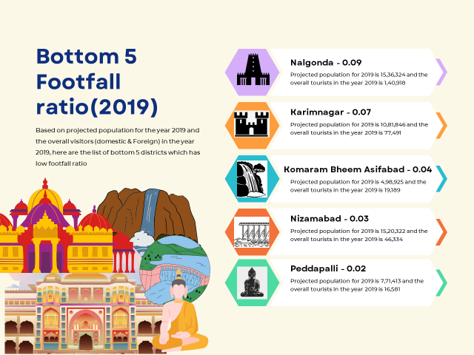

Slide 10

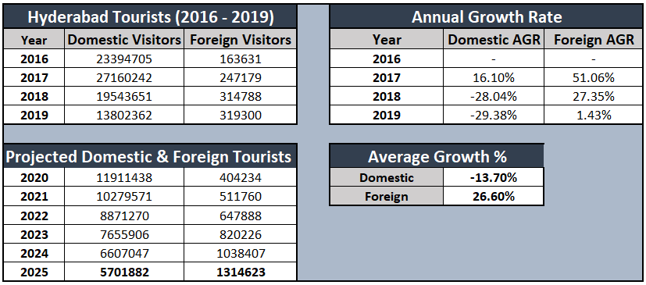
7. Projected Revenue (2025)

Slide 11

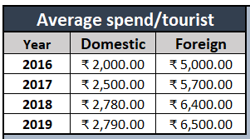

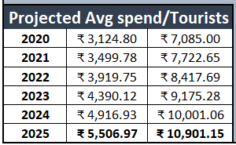
Projected Revenue for Hyderabad based on average spend per tourist for the year
2025
Assuming that the average spend per tourist for the year 2016, 2017, 2018 and 2019 is as per the list below
Projected Average spend per tourist is as below
These figures are based on approximate estimates and can vary depending on a number of factors, such as the type of traveller, the purpose of the trip, and the duration of the stay.

Slide 12

PROJECTED
REVENUE
Based on the approximate average spend per tourist and using the projected visitors for the years starting from 2020 to 2025, below charts shows that Domestic revenue is higher than the revenue from foreign tourists
₹ 40,000,000,000
Domestic
3212 Crores
Foreign
₹ 30,000,000,000
2772 Crores
2392 Crores
2064 Crores
₹ 20,000,000,000
1781 Crores
931 Crores
₹ 10,000,000,000
735 Crores
362 Crores
460 Crores
581 Crores
₹ 0
2021
2022
2023
2024
2025

Slide 13
