Slide 1

Tools in your AI's Toolbox: An Introduction to MCP Servers
Understanding key technologies powering AI systems
Notes:
AI-generated content may be incorrect. ---

Slide 2

Tim Rayburn
11-time Microsoft MVP (2007-2018)
Open Source Maintainer for Highway Framework
BBQ Fanatic – Feed over 200 people every July 4th at the Improving Dallas office
Soccer Fan – Season ticket holder for FC Dallas, Followed the USWNT through the World Cup playoff rounds in France (2019)
Former Game Store Owner
Avid Magic the Gathering player (Commander)
Former D&D Podcaster (Radio Free Hommlet)
Drone Pilot
Firearms Instructor
Specialization is for Insects.

Slide 3
Introduction to MCP Servers
Notes:
Empowering AI with Tool Access

Slide 4

Empowering AI with Tool Access
Generative AI Capabilities
Generative AI produces fluent text, images, and content, marking a revolution in AI capabilities.
Need for AI Agency
Next AI frontier is agency, enabling models to interact with and act upon the world actively.
Integration Challenges
Custom integrations cause the N x M problem, limiting scalability and real-world AI adoption.
Standardized Framework Solutions
Standard frameworks like Model Context Protocol enable secure, reusable AI tool access.
Notes:
The generative AI revolution has ushered in a new era of capabilities, enabling models to produce text, images, and other content with remarkable fluency. However, the next frontier in AI development is agency—the ability for models to interact with, query, and act upon the world around them. This shift from passive generation to active engagement requires a new approach to tool integration. Traditionally, each AI model needed a custom, often brittle integration for every external tool or data source, leading to the 'N x M integration problem.' This method is not scalable and hinders the broader adoption of AI in real-world applications. To address this, developers are exploring standardized frameworks that allow AI models to access tools like sales leads, code repositories, and IoT devices in a secure and reusable manner. This presentation introduces Anthropic’s Model Context Protocol (MCP), an open-source solution designed to solve these challenges and empower AI agents with robust tool access.

Slide 5
Challenges in AI Integration
Notes:
The N x M Integration Problem

Slide 6

The N x M Integration Problem
Integration Complexity
Each AI model requires unique integration with multiple tools, increasing complexity exponentially.
Maintenance Challenges
Bespoke integrations are fragile, hard to update, and limit scalability across environments.
Need for Standardization
A universal framework is needed to standardize AI model-tool interactions and reduce redundancy.
MCP as Solution
MCP aims to streamline integration and enable AI models to operate effectively in tool-rich environments.
Notes:
One of the most significant challenges in AI development today is the 'N x M integration problem.' This issue arises when each AI model (N) requires a unique integration for every external tool or data source (M). As the number of models and tools grows, the complexity and maintenance burden increase exponentially. These bespoke integrations are often fragile, difficult to update, and lack interoperability, making it hard for AI systems to scale across diverse environments. Developers spend considerable time and resources building and maintaining these connectors, which detracts from innovation and slows down deployment. The lack of standardization also poses security risks and limits the reusability of integrations. Addressing this problem requires a paradigm shift toward a universal framework that can standardize how AI models discover and interact with tools, reducing redundancy and fostering a more collaborative ecosystem. MCP aims to be this universal connector, streamlining integration and enabling AI models to operate more effectively in dynamic, tool-rich environments.

Slide 7
Introducing the Model Context Protocol (MCP)
Notes:
Overview and Architecture

Slide 8
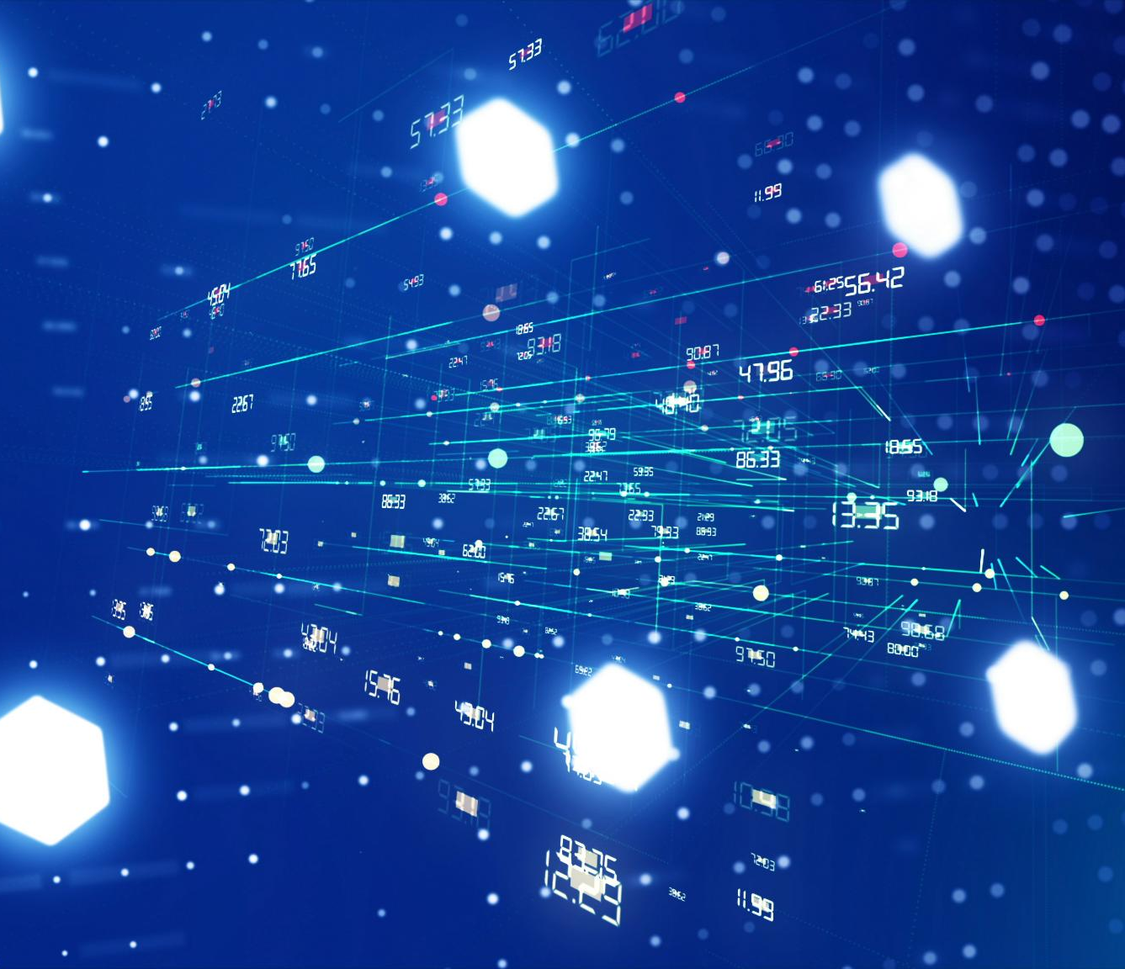
Overview and Architecture
Universal AI Connector
MCP acts as a universal connector, standardizing how AI models discover and use external tools.
Client-Server Architecture
MCP uses a robust client-server model to enable secure and scalable interaction between AI agents and tools.
Standardized Tool Interface
The protocol defines consistent interfaces for tool discovery, invocation, and context management.
Enhanced Interoperability
Adopting MCP reduces integration overhead, improving interoperability and accelerating AI development.
Notes:
The Model Context Protocol (MCP) is an open-source framework developed by Anthropic to address the integration challenges faced by AI models. MCP serves as a universal connector, akin to a USB-C port, that standardizes how AI models discover and use external tools. Unlike simple function-calling mechanisms, MCP introduces a robust client-server architecture that facilitates secure and scalable interactions between AI agents and tools. The protocol defines a consistent interface for tool discovery, invocation, and context management, allowing models to access a wide range of resources without bespoke integrations. MCP supports both pre-built and custom servers, enabling developers to expose proprietary data and APIs in a compliant and secure manner. By adopting MCP, organizations can reduce integration overhead, improve interoperability, and accelerate the development of intelligent, context-aware AI agents. This architecture lays the foundation for a new ecosystem where tools and models can interact seamlessly, fostering innovation and collaboration across the AI community.

Slide 9

The Protocol for Direct AI Connections
Does not solve Tool or Agent Discovery
You need some sort of registry to find MCP servers either that you can run, or that are hosted online.
Does not let one tool directly call another
This does not handle eventing between agents.
Protocol Adoption is In Progress
The protocol has become the clear front-runner in the space, but few tools fully support it today.

Slide 10
GitHub Remote Server
Demonstration

Slide 11
Practical Applications of MCP
Notes:
Using Pre-built MCP Servers

Slide 12
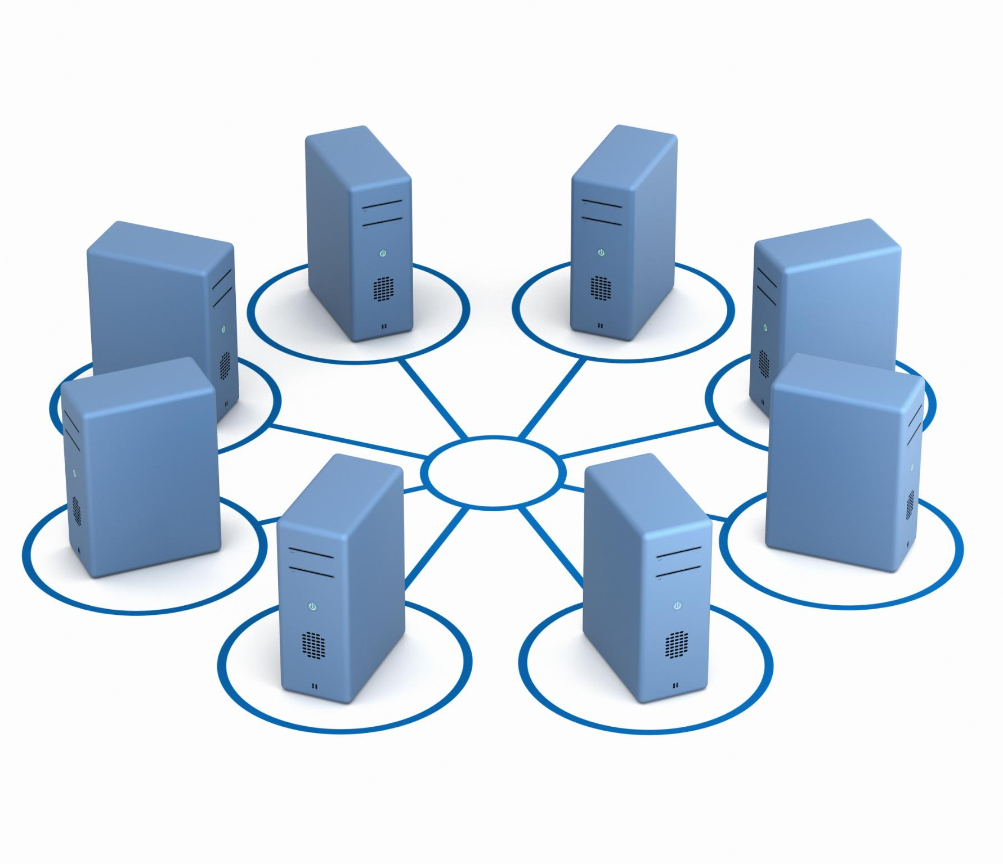
Using Pre-built MCP Servers
Instant Tool Integration
Pre-built MCP servers enable instant connection of AI models to popular tools like Git, Slack, and databases.
Standardized Interfaces and Security
These servers provide standardized interfaces and robust security features for safe and reliable interactions.
Accelerated Development
Leverages ready-made integrations to speed up prototyping and deployment of AI agents without custom coding.
Encourages Experimentation and Learning
Availability of open-source servers lowers barriers, fostering exploration and contribution in the MCP ecosystem.
Notes:
One of the key advantages of the Model Context Protocol is its support for pre-built, open-source MCP servers. These servers allow developers to instantly connect AI models to commonly used tools such as Git, Slack, and various databases. By leveraging these ready-made integrations, teams can rapidly prototype and deploy AI agents without the need for extensive custom development. Pre-built MCP servers come with standardized interfaces and security features, ensuring reliable and safe interactions between models and tools. This approach not only accelerates development but also promotes best practices in tool integration. Developers can focus on building intelligent behaviors and user experiences rather than spending time on low-level connectivity issues. The availability of these servers also encourages experimentation and learning, making it easier for newcomers to explore the capabilities of MCP and contribute to the growing ecosystem. Overall, pre-built MCP servers provide a practical and efficient pathway to empower AI models with real-world tool access.

Slide 13
Custom MCP Server Development
Notes:
Building and Securing Custom Integrations

Slide 14

Building and Securing Custom Integrations
Custom Integration Development
Developers create custom MCP servers to expose proprietary data and APIs with secure, compliant interfaces.
Security and Compliance
Robust authentication and authorization ensure data control while enabling AI model access to tools.
Tailored Use Cases
Custom servers support diverse applications like sales databases, IoT monitoring, and legacy system interaction.
Scalable and Future-proof
Following MCP guidelines ensures interoperability and scalable, maintainable AI infrastructure integration.
Notes:
While pre-built MCP servers offer convenience, many organizations require custom integrations to expose proprietary data and APIs. MCP supports the development of custom servers that adhere to its protocol specifications, allowing developers to create secure and compliant interfaces for their unique tools. Building a custom MCP server involves defining the tool's capabilities, implementing the protocol's communication standards, and ensuring robust authentication and authorization mechanisms. This process enables organizations to maintain control over their data while providing AI models with structured and meaningful access. Custom servers can be tailored to specific use cases, such as accessing internal sales databases, monitoring IoT devices, or interacting with legacy systems. By following MCP guidelines, developers can ensure interoperability and future-proof their integrations. This capability empowers teams to move beyond ad-hoc solutions and build scalable, maintainable infrastructures for AI tool access. Ultimately, custom MCP servers unlock the full potential of AI agency by bridging the gap between models and proprietary resources.

Slide 15
Scryfall MCP Server
Demonstration

Slide 16
Benefits of Standardized AI Integration
Notes:
Creating a Collaborative Ecosystem

Slide 17
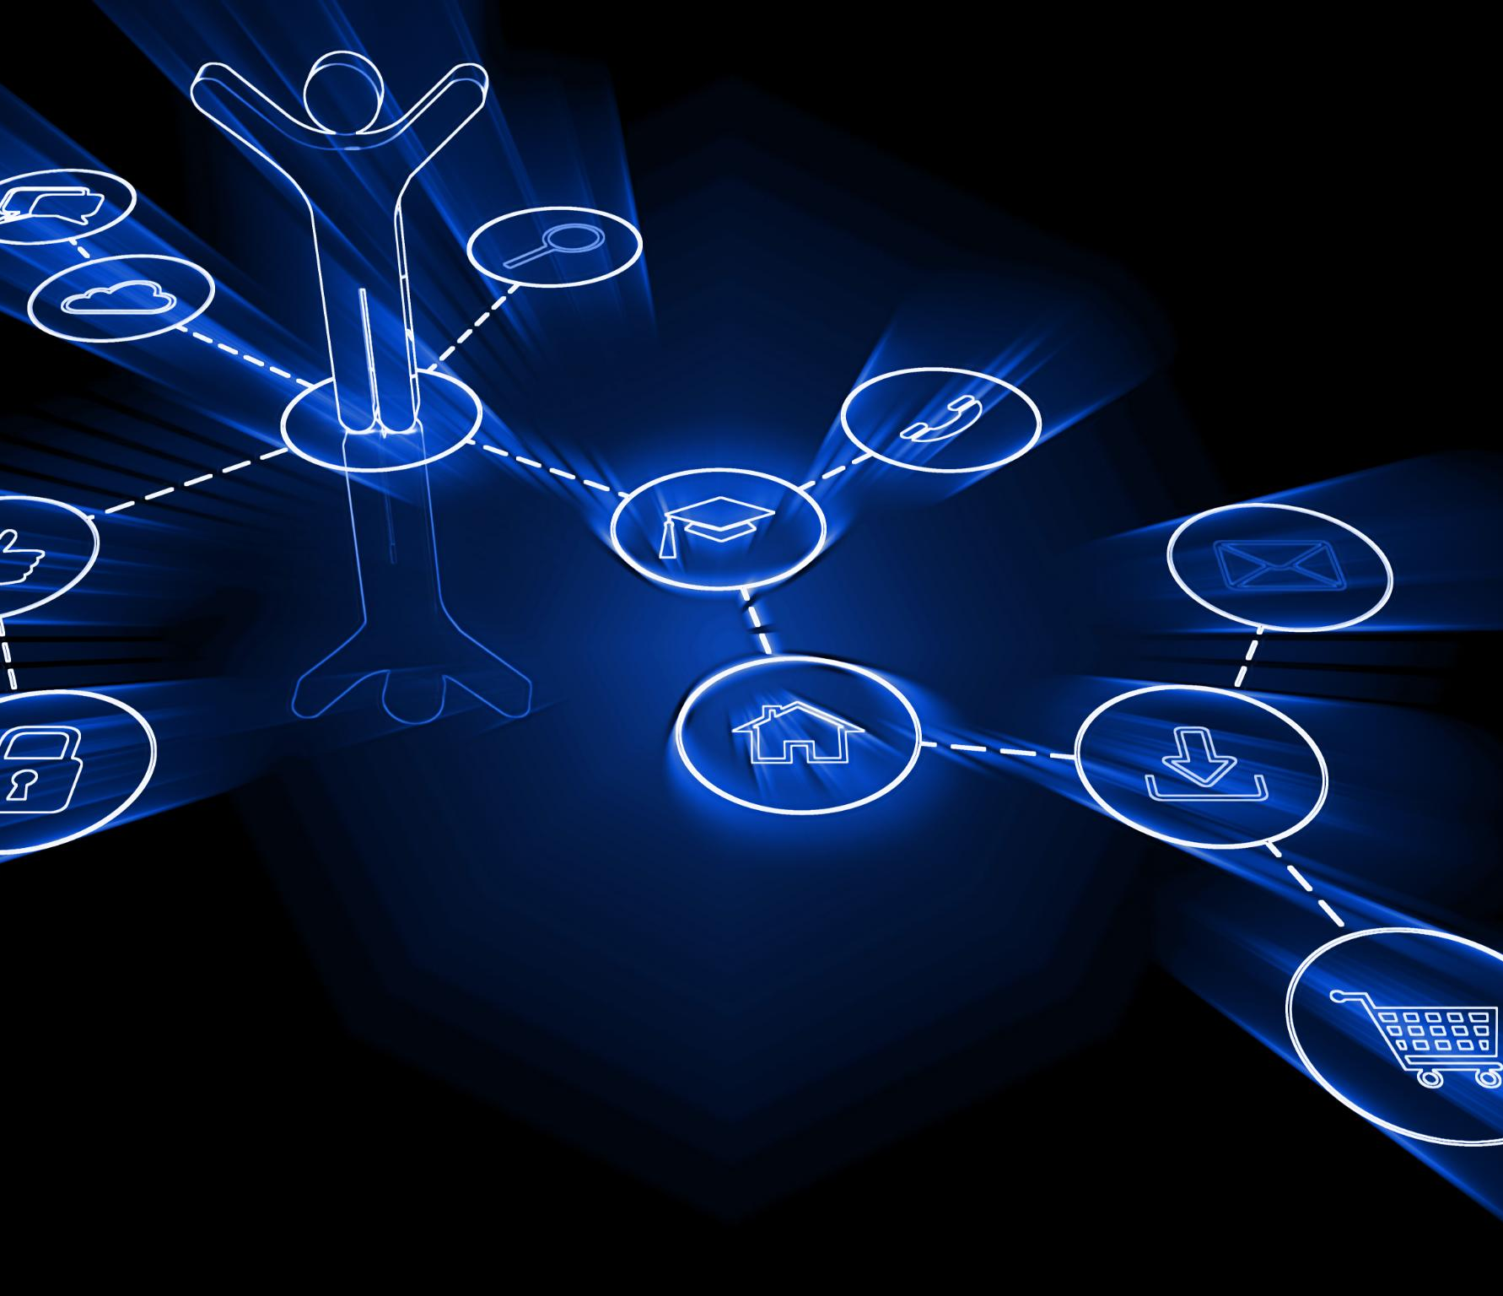
Creating a Collaborative Ecosystem
Efficiency Through Standardization
Standard protocols reduce reliance on bespoke connectors, saving time and improving reliability in AI tool integration.
Collaborative Developer Community
Sharing tools and best practices fosters innovation and accelerates progress across the AI community.
Enhanced Security and Compliance
Consistent authentication and data access mechanisms improve security and regulatory compliance.
Intelligent, Actionable Agents
Standardization enables AI agents to understand context, generate content, and take meaningful actions.
Notes:
Standardizing AI tool integration through protocols like MCP offers numerous benefits that extend beyond individual projects. First, it reduces the need for bespoke connectors, saving time and resources while improving reliability. Second, it fosters a collaborative ecosystem where developers can share tools, servers, and best practices, accelerating innovation across the AI community. Third, it enhances security and compliance by providing consistent mechanisms for authentication and data access. MCP’s open-source nature encourages transparency and community contributions, leading to continuous improvement and broader adoption. By aligning on a common protocol, organizations can ensure that their AI models are compatible with a wide range of tools and environments, facilitating interoperability and scalability. This standardization also supports the development of intelligent agents that are not only capable of understanding and generating content but also of taking meaningful actions. In essence, MCP transforms AI from a passive technology into an active participant in digital ecosystems, paving the way for the next generation of context-aware, tool-enabled agents.

Slide 18
Playwright MCP Server
Demonstration

Slide 19
Conclusion and Call to Action
Notes:
Building the Next Generation of AI Agents

Slide 20

Building the Next Generation of AI Agents
Evolution from Generative to Agentic AI
Transitioning from generative AI to agentic AI allows systems to interact meaningfully with the environment.
Role of Model Context Protocol
MCP provides secure and efficient standards for integrating AI with external resources and systems.
Empowering Developers with MCP
Developers use MCP tools and ecosystem to build AI agents that understand context and act autonomously.
Future of Autonomous AI Agents
AI agents capable of decision-making and task performance represent the future of intelligent technology.
Notes:
The journey from generative AI to agentic AI represents a significant evolution in the field. By adopting the Model Context Protocol, developers can move beyond building one-off connectors and start creating intelligent agents that interact with the world in meaningful ways. MCP provides the tools and standards necessary to integrate AI models with external resources securely and efficiently. This session has introduced the core concepts of MCP, demonstrated its practical applications through pre-built and custom servers, and highlighted the benefits of standardized integration. Developers are encouraged to explore MCP, contribute to its ecosystem, and leverage its capabilities to build AI agents that don’t just talk, but act. The future of AI lies in its ability to understand context, make decisions, and perform tasks autonomously. MCP is a foundational step toward realizing this vision, and by embracing it, developers can play a pivotal role in shaping the next generation of AI technology.

