Slide 1


POWERED BY
PANDAS
Feedback: goo.gl/forms/zkQd3CENt6ibL0lD2

Slide 2
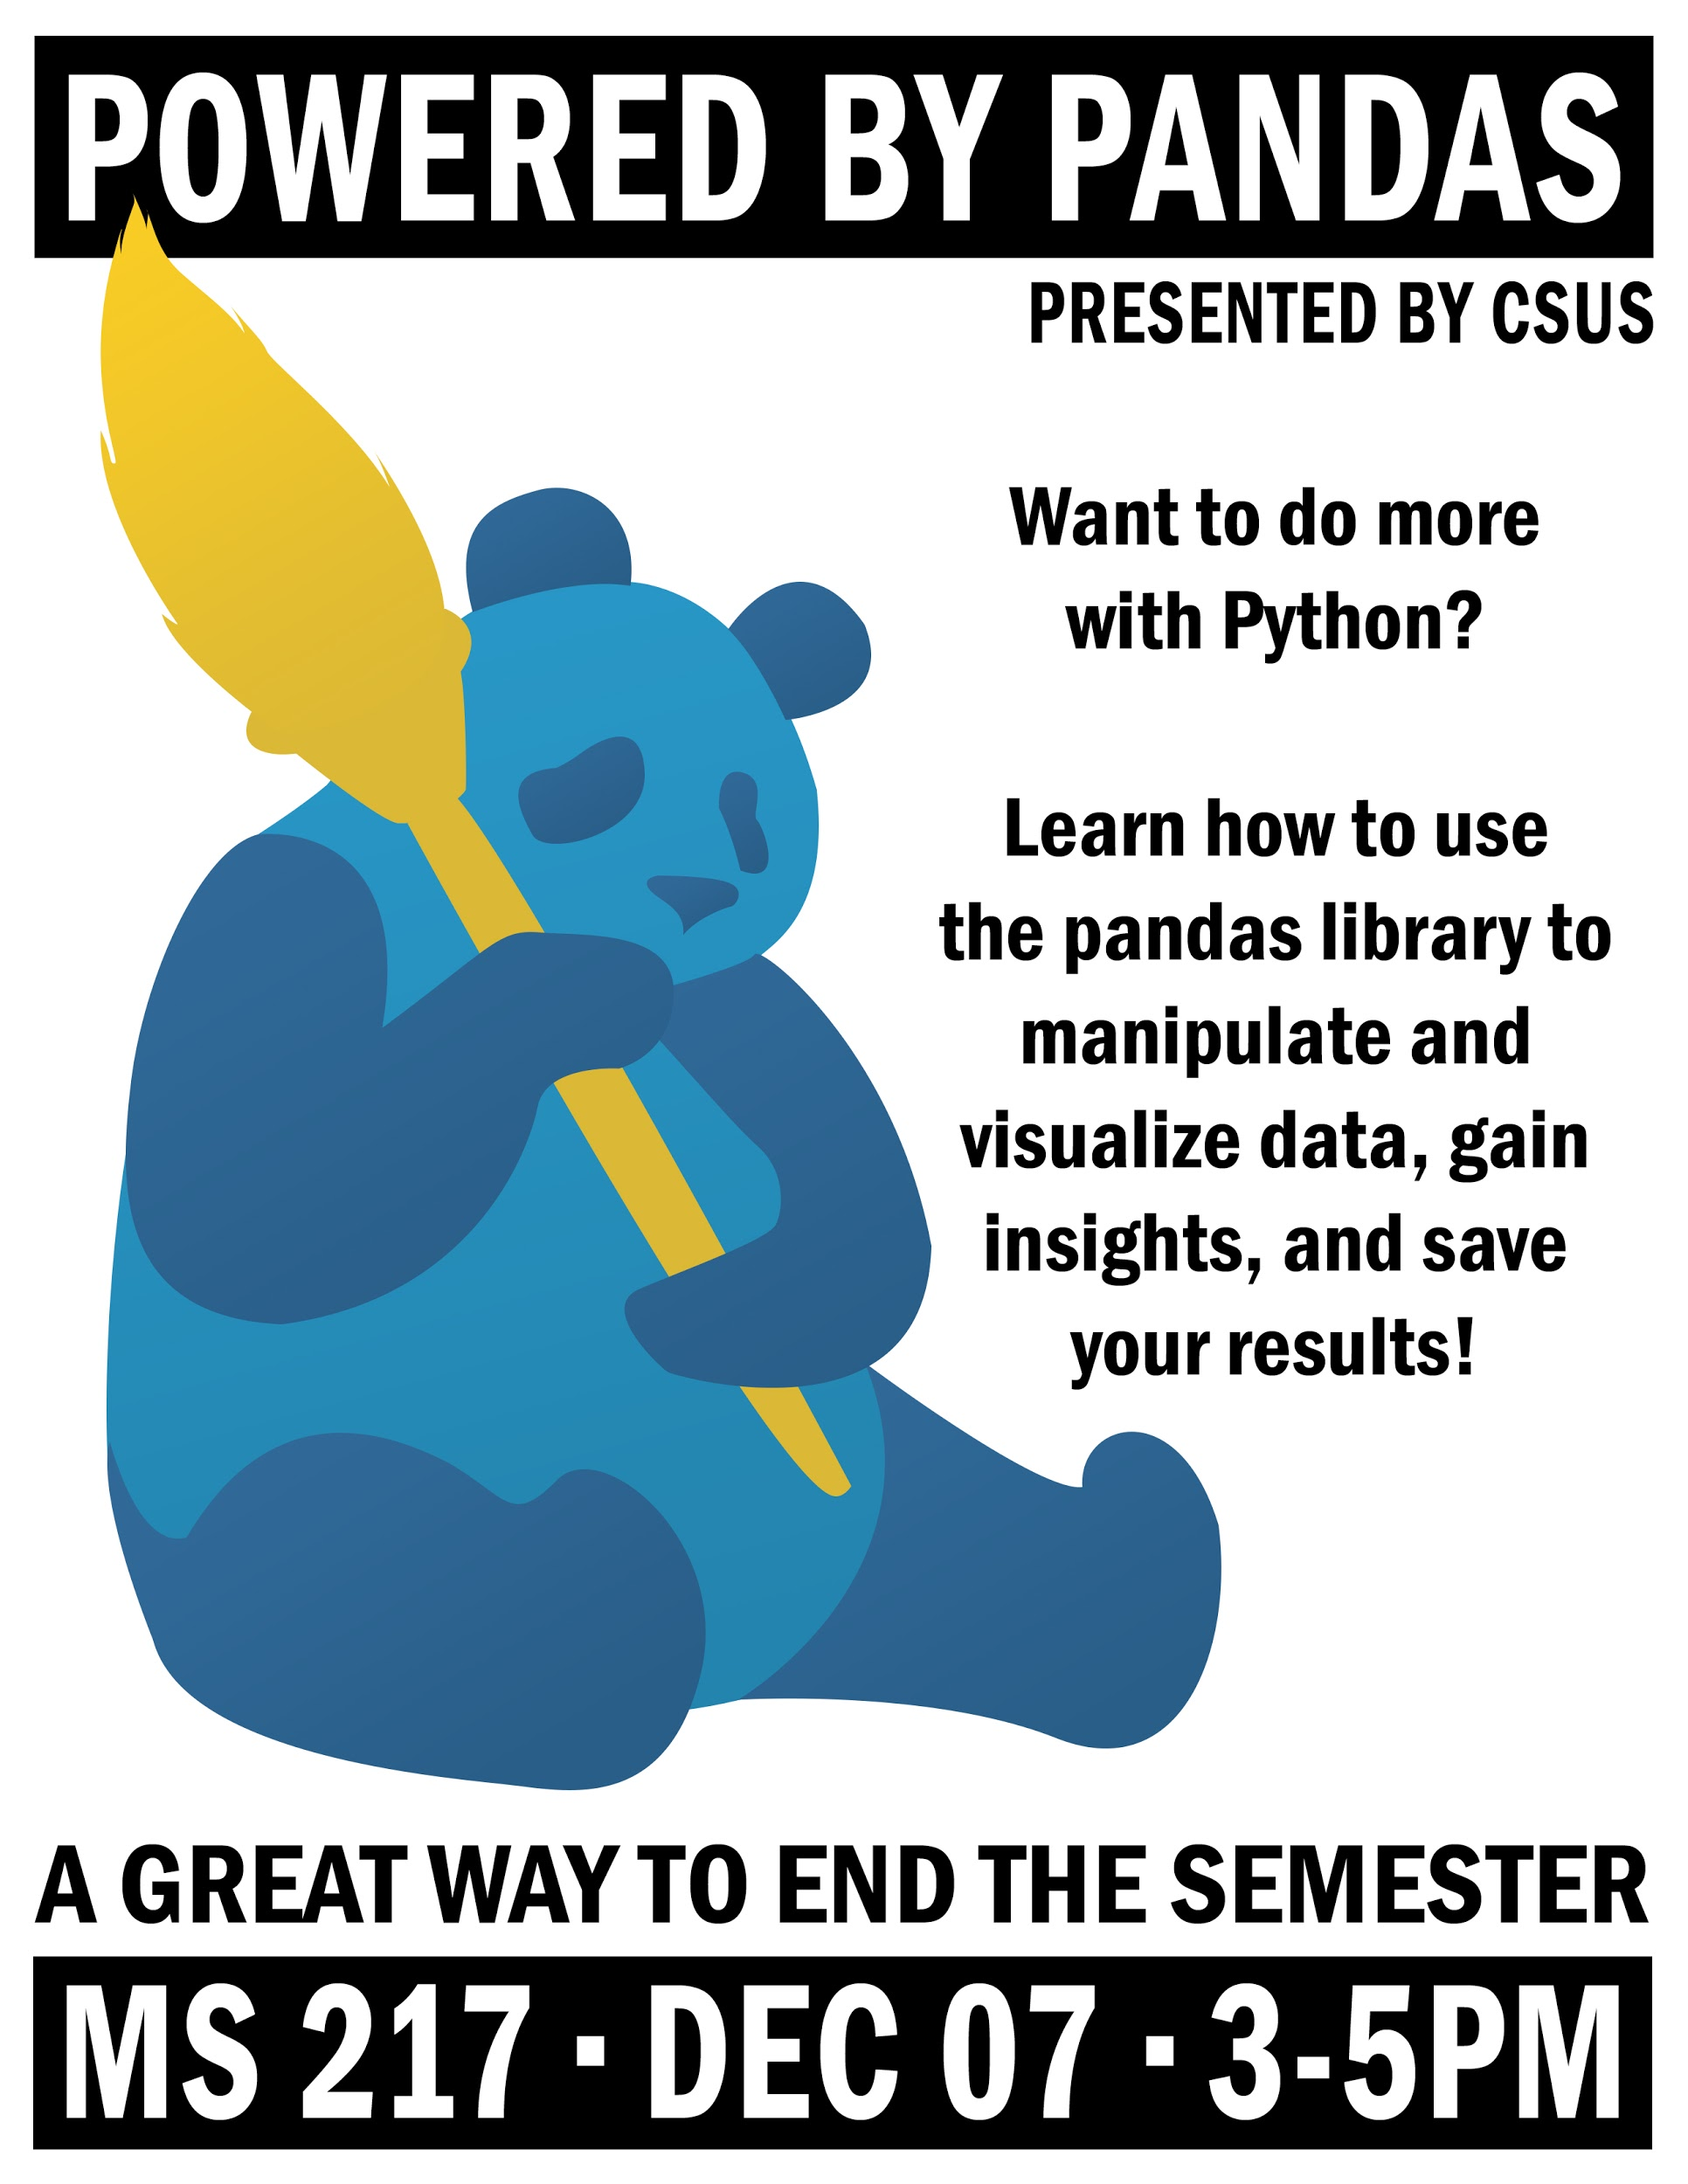
Agenda
Getting Started
File IO, DataFrames, and You!
Data Manipulation
Visualizing Data
Saving Your Work
Resources

Slide 3
Getting Started
What is Pandas, Matplotlib, Anaconda/Jupyter?

Slide 4

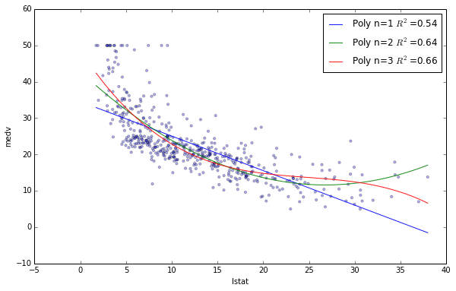
Key Points - Pandas
An open-source data-analysis library.
Easy to use.
Great for playing with data from a CompSci perspective.
Works well with Matplotlib library API to visualize data.
Also works well with the Jupyter interface for interactive programming.

Slide 5


Key Points - Jupyter & Anaconda
Open-source data-analysis interface.
Best installed through with Anaconda Navigator.
Allows chunks of code to be executed separately.
Allows ‘chunks’ that contain formatted HTML.
A simple and powerful toolbox.

Slide 6
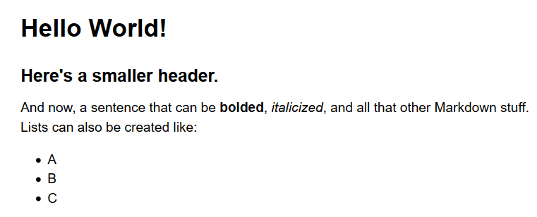
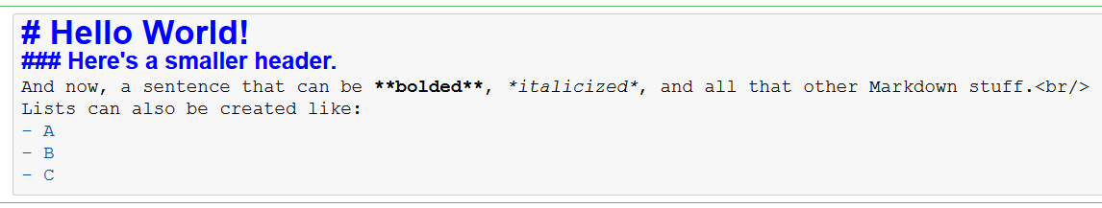
Jupyter Notebooks
Two cell types
Markdown
A super-set to HTML.
Allows for fancy formatting mixed in with code.
Supports cool stuff like LateX equations.
Code
Writing chunks of code.
Can be independently executed. (Out-of-order too!)

Slide 7
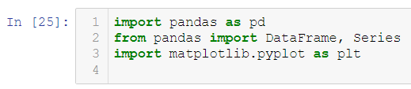
Importing Essential Modules
# Line 1
# Import the pandas module,
# but refer to it as ‘pd’
# Line 2
# And don’t bother prefixing
# DataFrames and Series with
# ‘pd’ when referring to them
# Line 3
# Also bring matplotlib along
# but only the ‘pyplot’ part of it.

Slide 8
File IO, DataFrames, and You!
Importing Data, Working with DataFrames.

Slide 9
Importing/Loading Files
# Excel Files
excelDataFrame = pd.read_excel(<filename>)
# CSV Files
csvDataFrame = pd.read_csv(<filename>)
# From Clipboard
# Tries to format what you copied as a dataframe.
cpDataFrame = pd.read_clipboard()

Slide 10
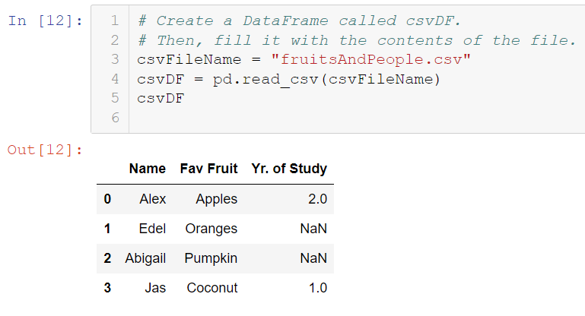
Example
# Line 3
# Save a string of filename.
# Line 4
# Read and fill a dataframe
# with the contents.
# Line 5
# Tell Jupyter to display the
# contents of the dataframe.

Slide 11
Rows & Columns
DataFrames are made up of a bunch of ‘Series’
DataFrames/Series can be concatenated or dropped.
Adding Rows/Cols
dataFrame.append(row)
dataFrame.loc[:, “col”] = X
Deleting Rows/Cols
dataFrame.drop([‘rowName’])
dataFrame.drop(columns=[“col1”, “col2”])

Slide 12
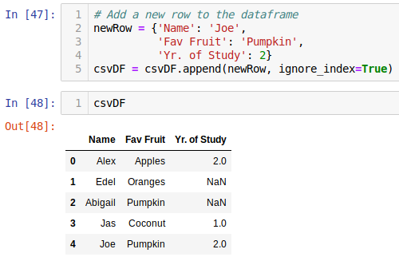
Example
# Line 2
# Create a dictionary with the new information.
# Line 5
# Append the new row.
# Line 5
# Tell Jupyter to display the
# contents of the dataframe.

Slide 13
Data Manipulation
Sampling Data, Clean-Up, Data Generation

Slide 14
Large Datasets
Large datasets can be hard to view on a screen.
Instead, we can view small chunks at a time using pandas!
Head (First X Entries)
dataFrame.head(X) # Default w/o X is 5 entries.
Tail (Last X Entries)
dataFrame.tail(X) # Default w/o X is 5 entries.
Sample (X Random Entries)
dataFrame.sample(X) # Default w/o X is 1 entry.

Slide 15
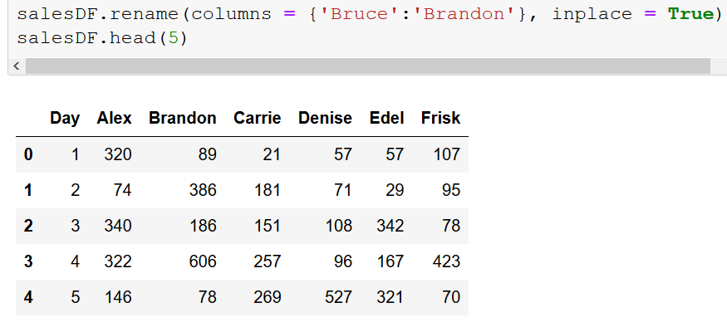
Renaming Rows/Cols
There are many ways to rename something in pandas.
Most notably, using the dataFrame.rename() function.
index/columns for rows and columns respectively.
Done by mapping the old value in a dictionary as a key, with the value being the new value.

Slide 16
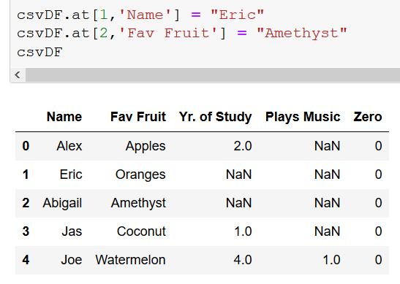
Changing Entries
At a basic level, a cell of data can be modified with the dataFrame.at() function.
csvDF.at[1,1] = “example” will create a new column called “1” and set its 1st row as “example”
Depends on whether the row/cols are named, or actual integer indices.

Slide 17
Visualizing Data
Building Up Bigger

Slide 18
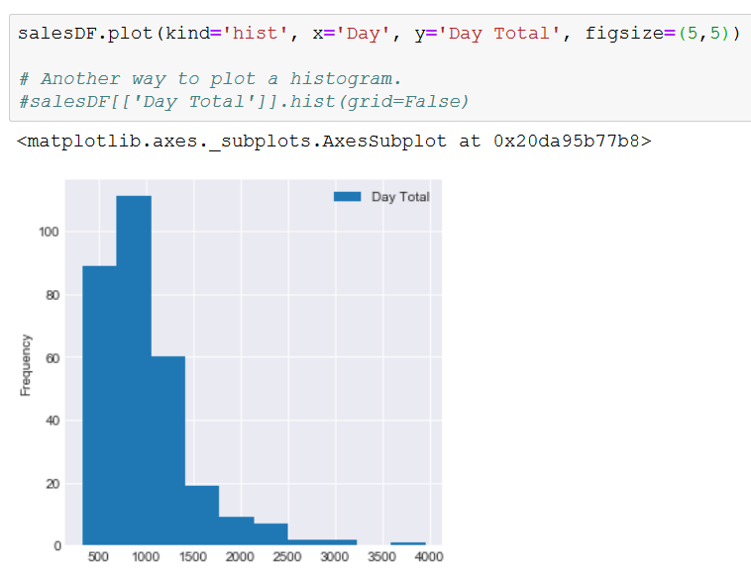
Data Visualization
Data visualization is done through the matplotlib API.
If you import the matplotlib.pyplot itself, you can also use matplotlib functions and styling.
Generally, use pandas’ visualization for basics, and matplotlib for advanced stuff.

Slide 19
Saving Your Work
Getting Files, Images, Python Files, Presentations, and More!

Slide 20
Saving/Exporting Files
# Excel Files
excelDataFrame = pd.to_excel(<filename>)
# CSV Files
csvDataFrame = pd.to_csv(<filename>)

Slide 21
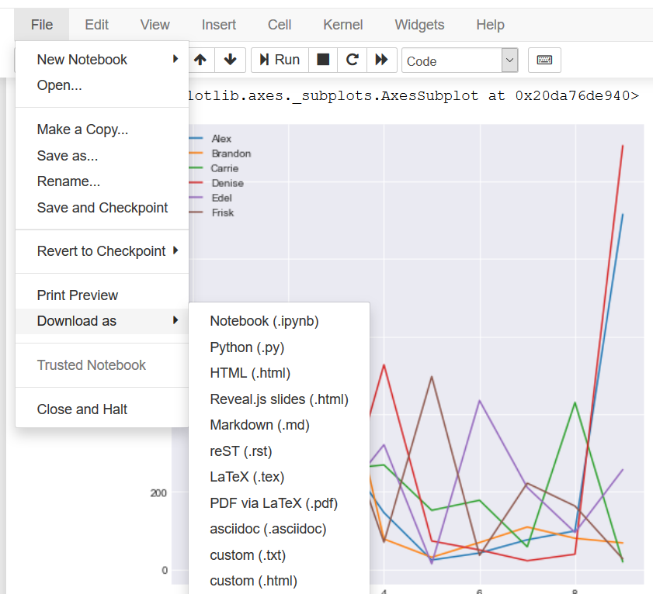
Saving/Exporting Files
Jupyter supports many different times of exporting.
.py will create a Python file with all markdown cells converted to comments.
.html creates a non-interactive copy of your notebook for presentations.

Slide 22
Resources
Documentation, Galleries, and Courses

Slide 23
Resources
Pandas Documentation
https://pandas.pydata.org/pandas-docs/stable/genindex.html
Matplotlib Documentation
https://matplotlib.org/index.html
Anaconda Navigator Downloads
http://docs.continuum.io/anaconda/install/

Slide 24
Thank You!
Feedback: goo.gl/forms/zkQd3CENt6ibL0lD2
GitHub: github.com/traymondbiz/PoweredByPandas

