Slide 1
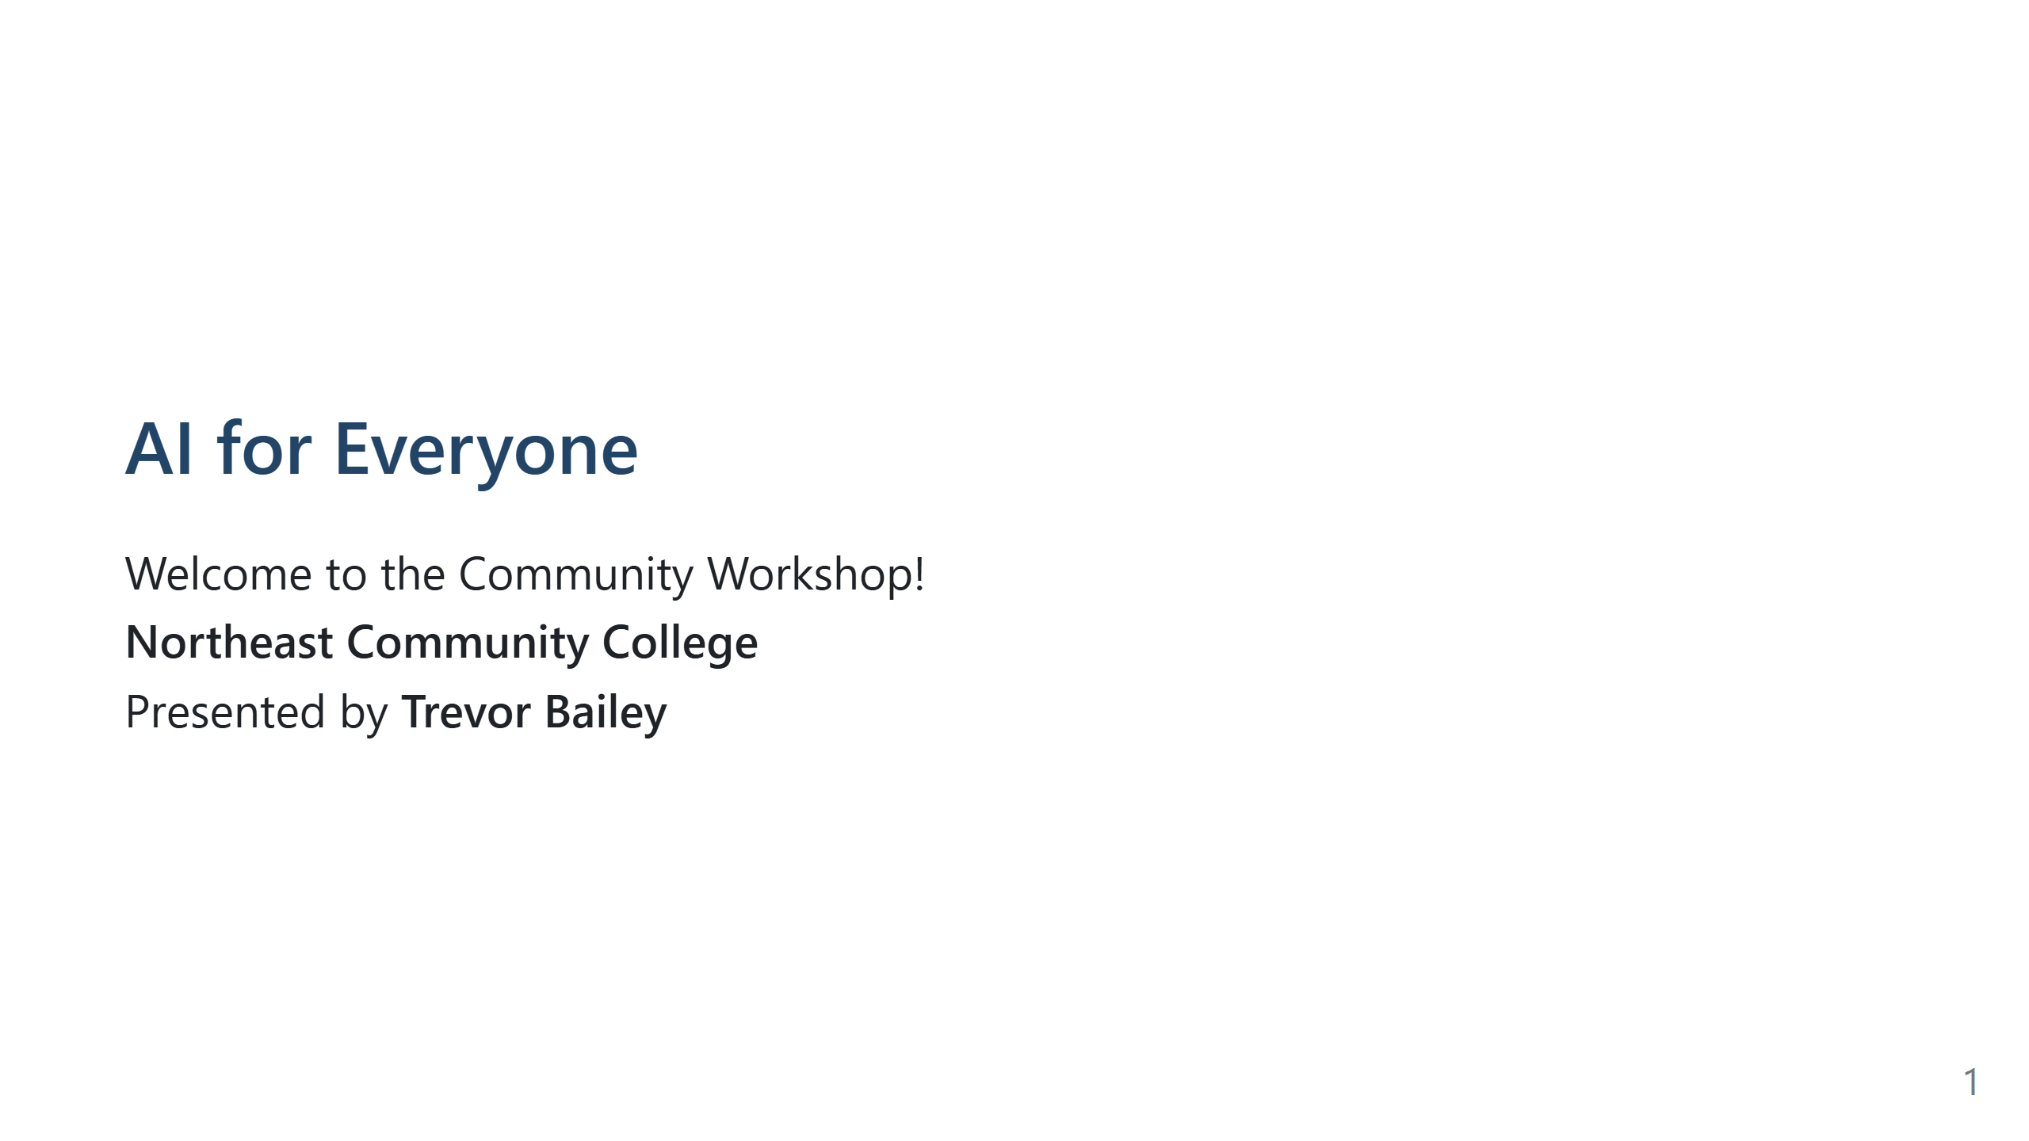
Notes:
Open warmly. Let people know the session is meant to be interactive, simple, and beginner-friendly.
Emphasize that AI is already in everyday life, and this workshop is hands-on.

Slide 2
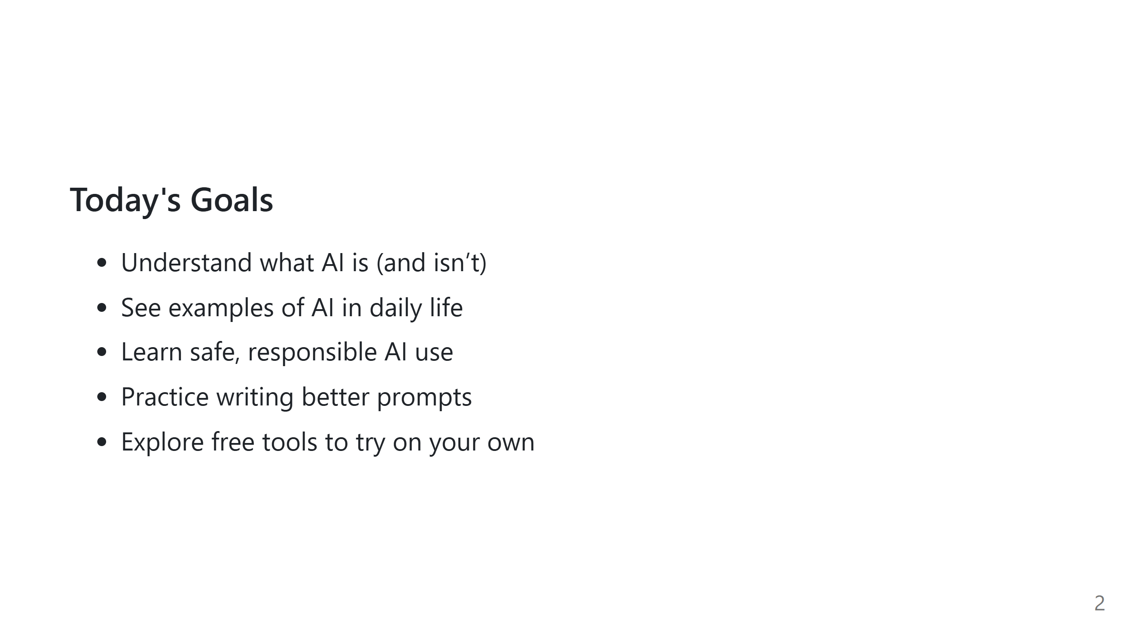
Notes:
Reassure them the workshop isn't technical or intimidating.
Stress that the goal is empowerment, not complexity.

Slide 3
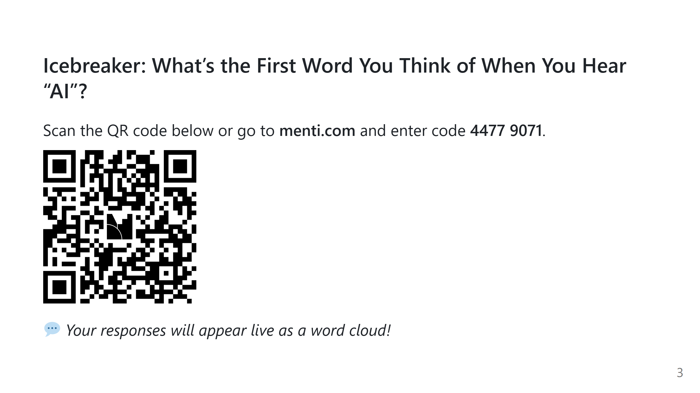
Notes:
Encourage quick participation.
Use the word cloud as a springboard: note common themes like excitement, fear, curiosity.

Slide 4

Notes:
Briefly introduce the idea that AI developed slowly over decades.
Mention that progress depended on computing power, data, and new ideas.

Slide 5
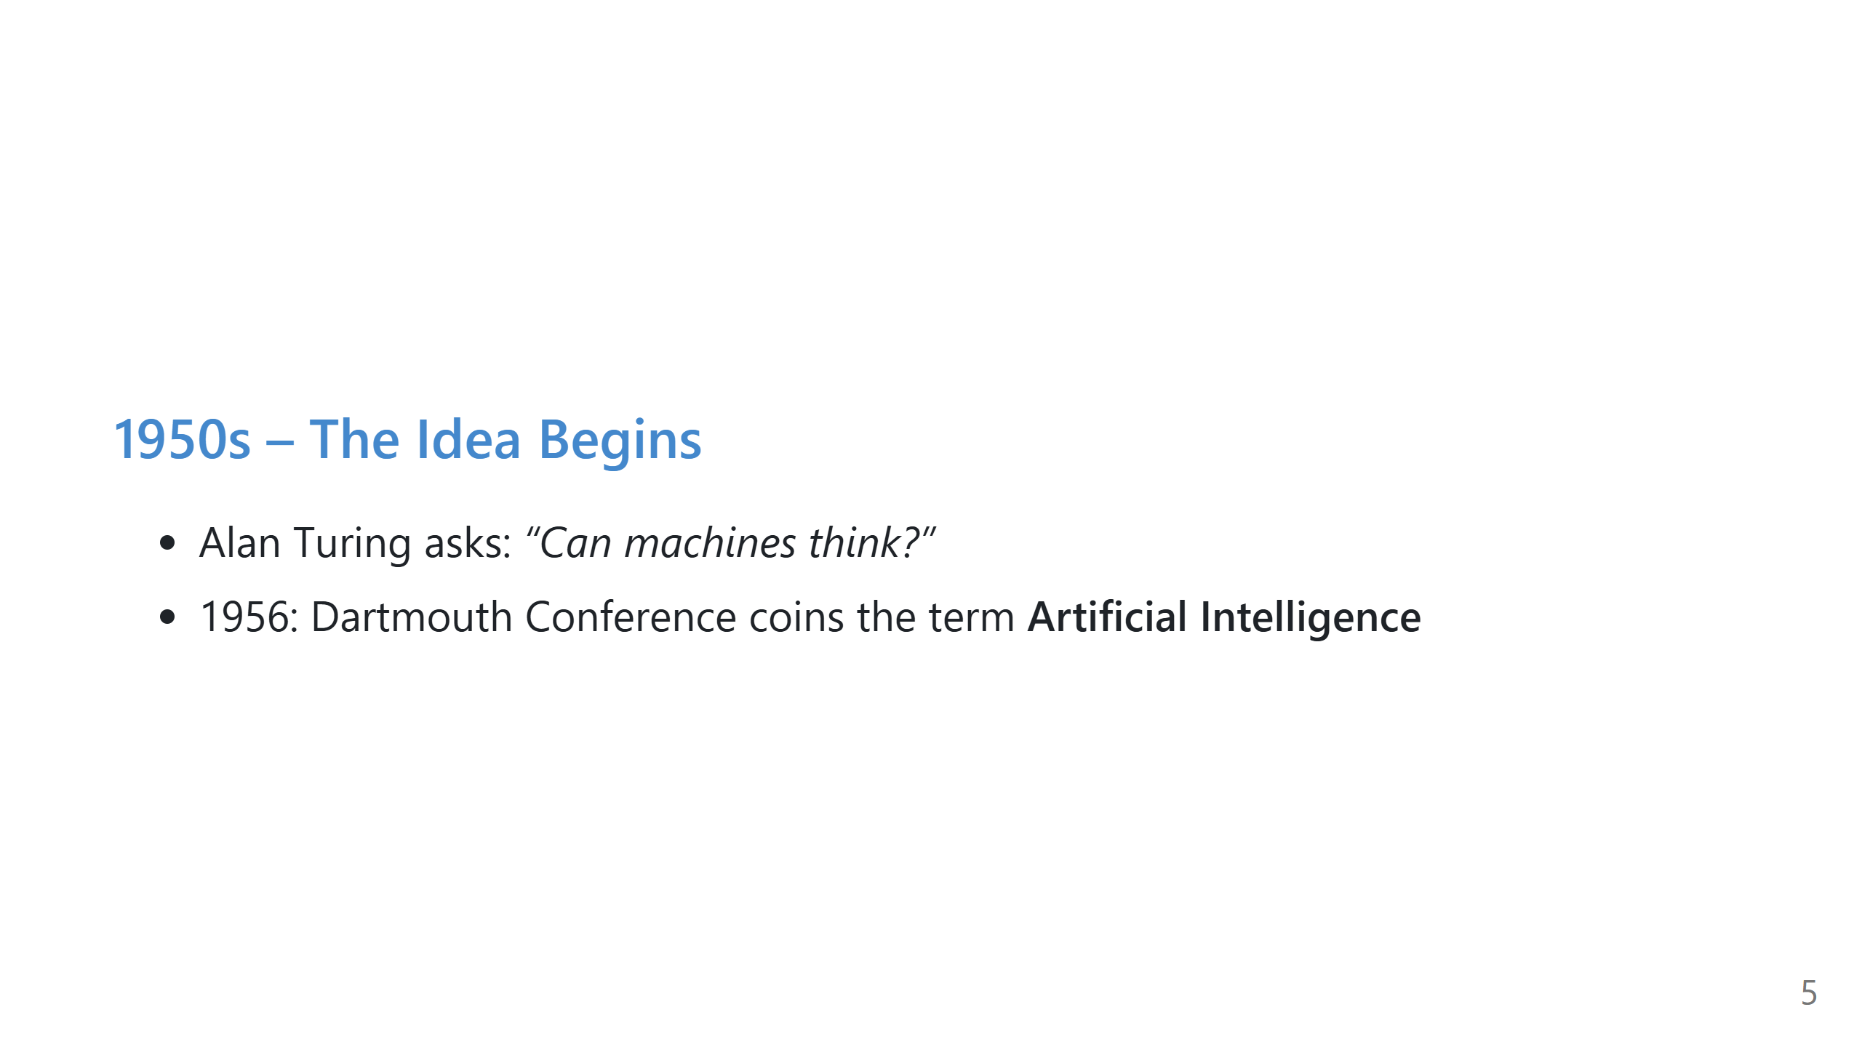
Notes:
Note that early AI researchers were extremely optimistic.
AI began as a philosophical question before it became practical.

Slide 6
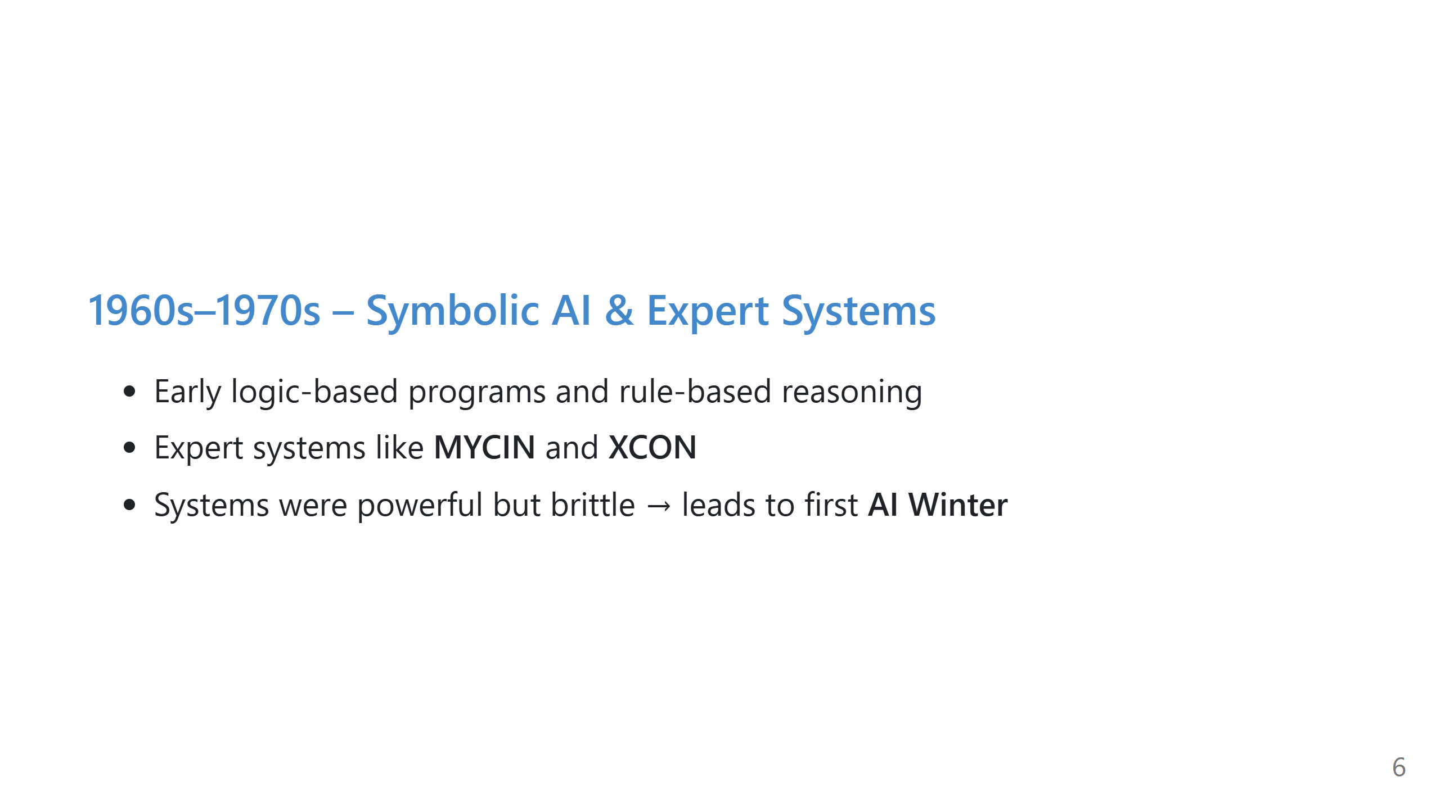
Notes:
Explain that expert systems were basically giant rule trees.
Point out the maintenance problem: the real world is messier than fixed rules.

Slide 7
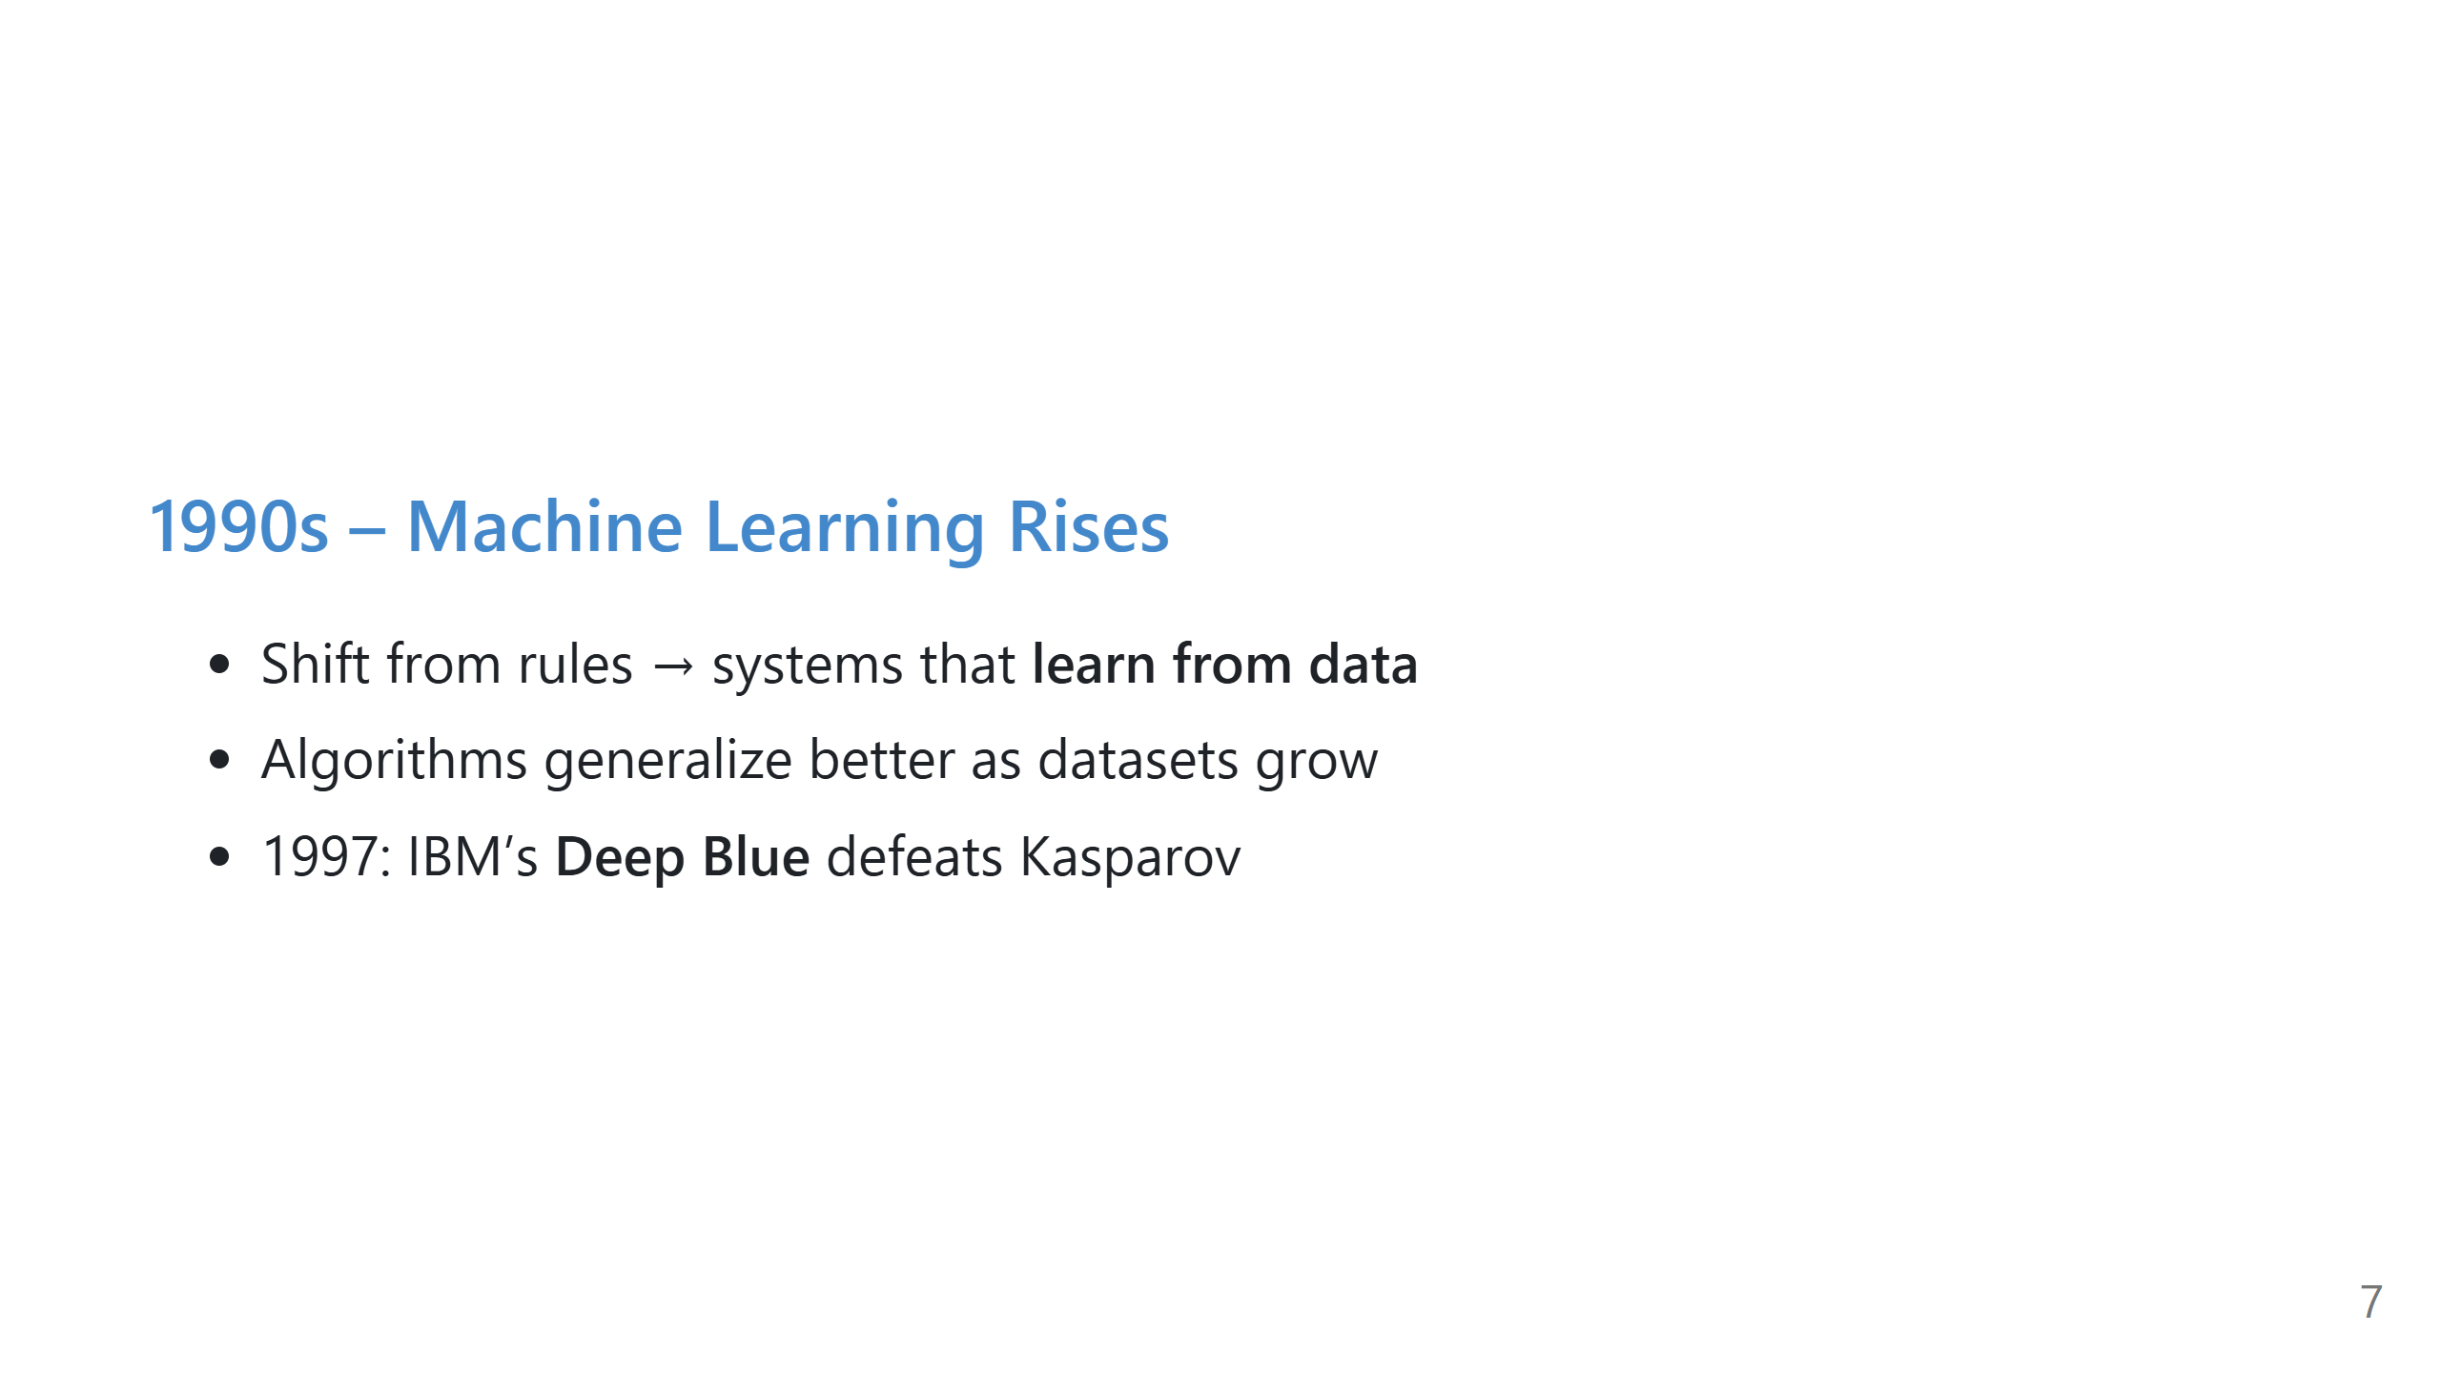
Notes:
Use Deep Blue as an example of narrow but extremely strong AI.
Mention Kasparov accusing the machine of “creativity.”
Clarify it's not general intelligence—just powerful pattern evaluation.

Slide 8
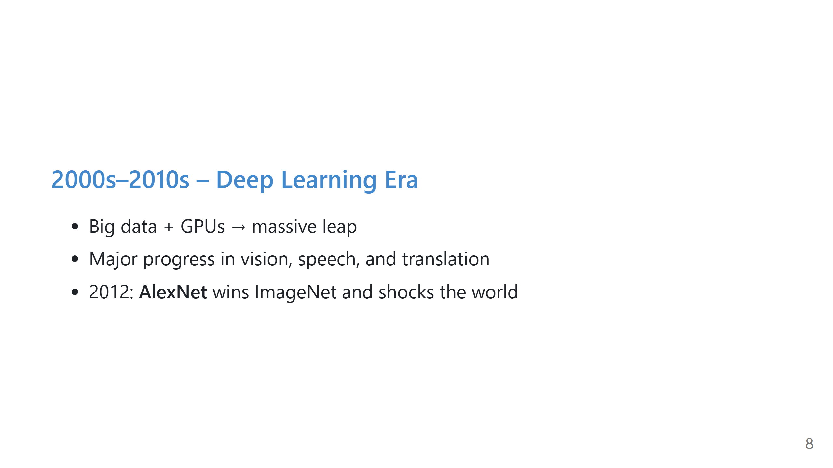
Notes:
Explain that GPUs (made for video games) accidentally became perfect for AI math.
AlexNet cut error rates dramatically and started the modern boom.

Slide 9
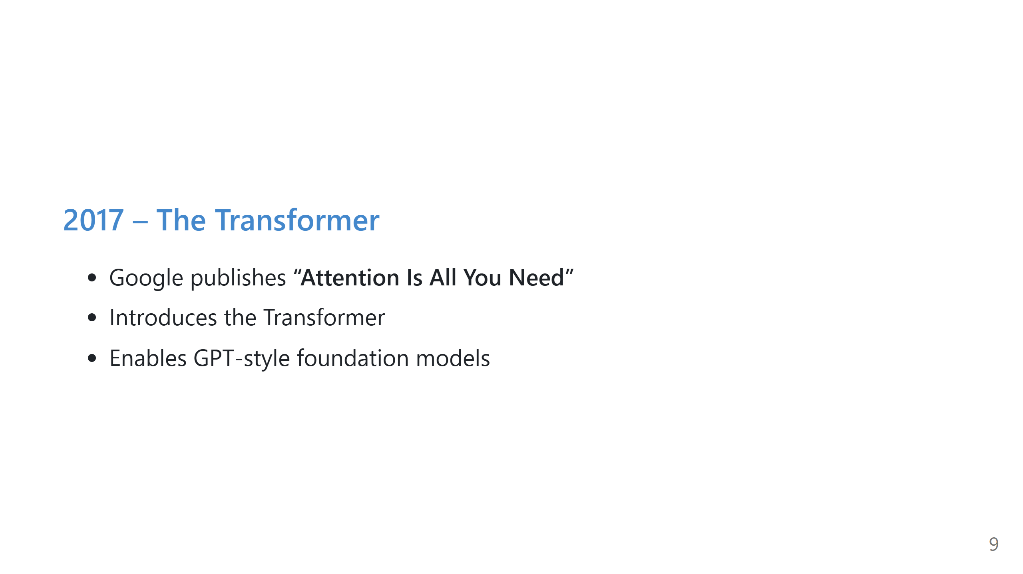
Notes:
Emphasize that this architecture changed everything.
Transformers understand long sequences and context far better.

Slide 10
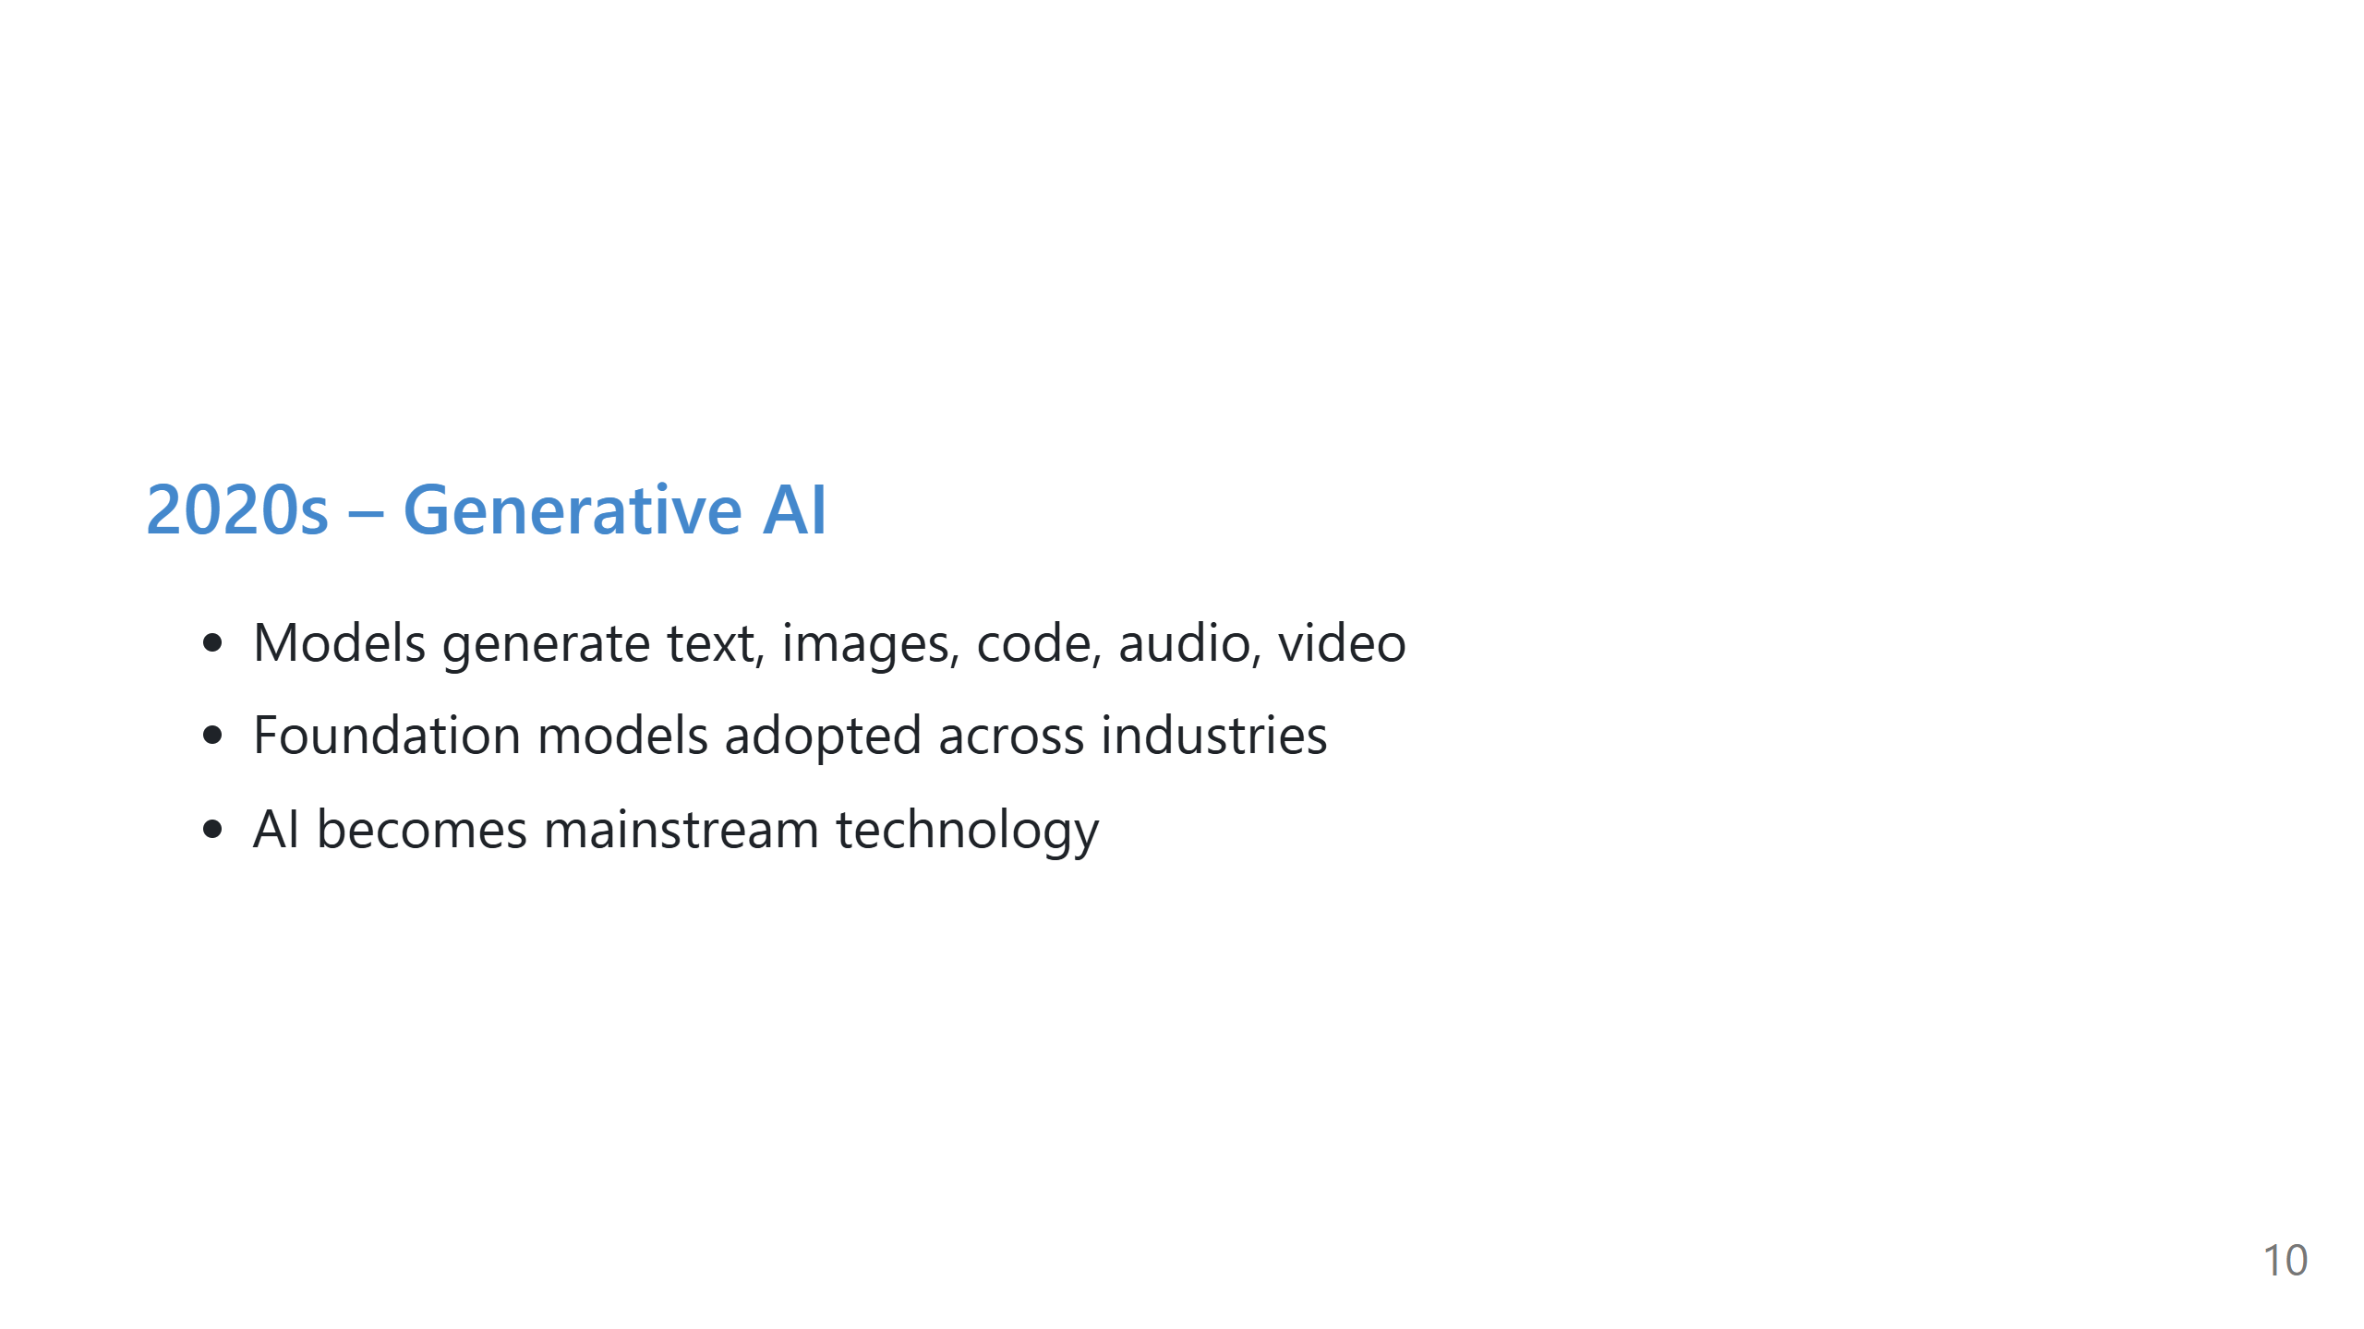
Notes:
Mention that ChatGPT hit 100M users in two months.
Generative AI moved AI from background tech to something everyone interacts with.

Slide 11
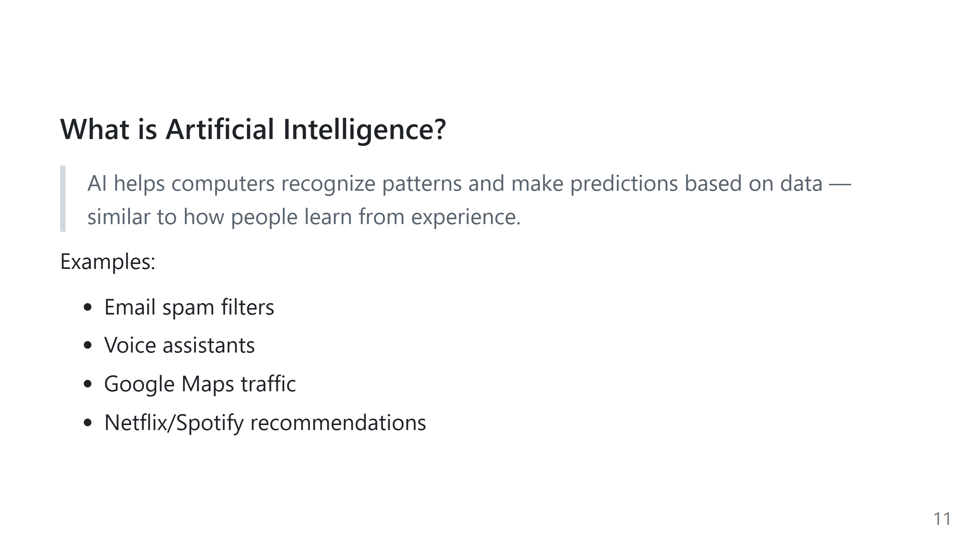
Notes:
This is the “grounding” slide.
Make AI feel less mysterious and more like simple pattern recognition.

Slide 12
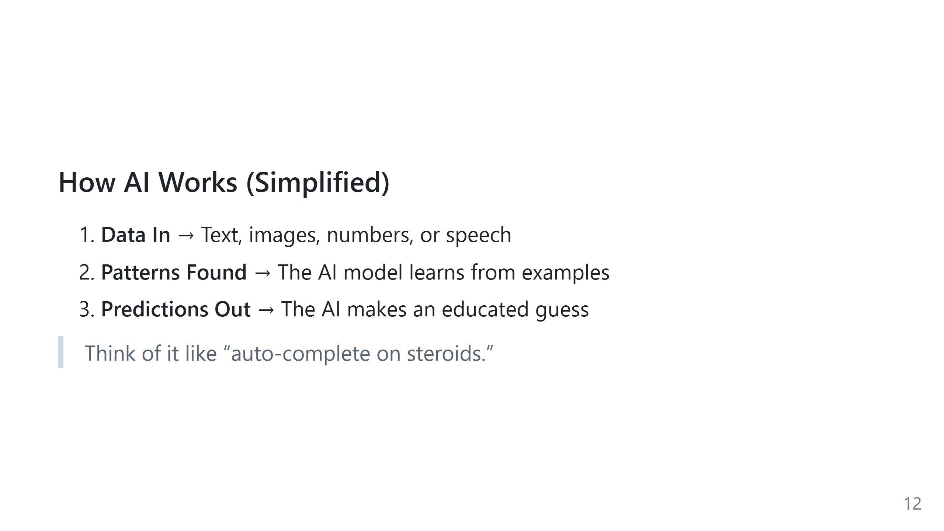
Notes:
Keep this friendly and simple. No math.
Reinforce that AI doesn't "understand" — it predicts.

Slide 13
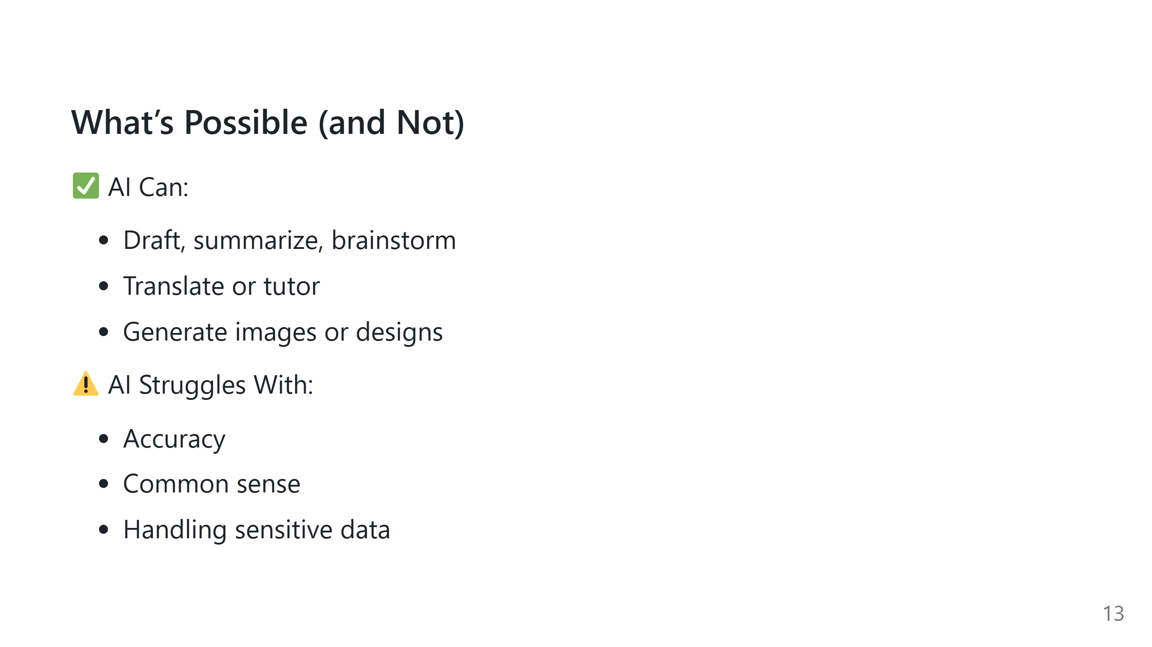
Notes:
Use examples. Point out hallucinations as a real risk.
Explain that AI is confident even when wrong.

Slide 14
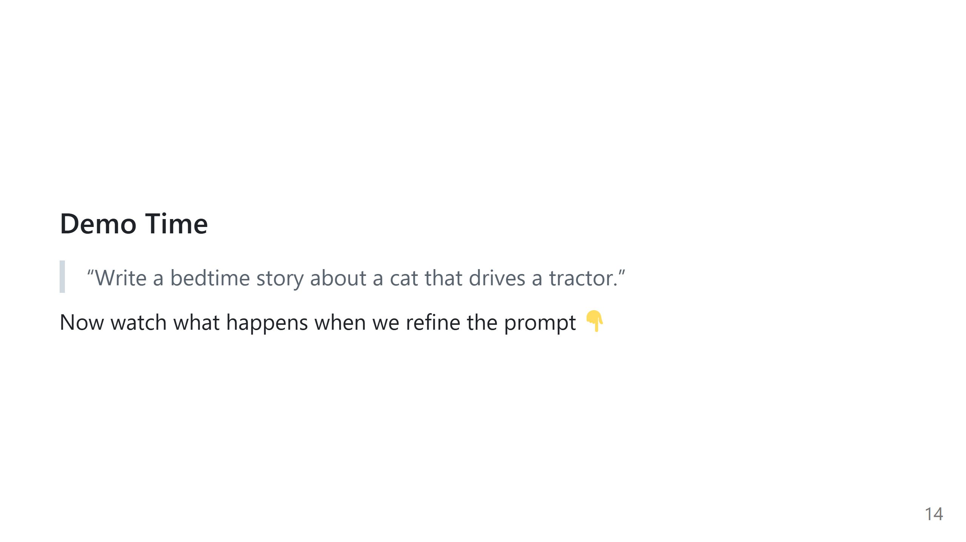
Notes:
Use humor. Show how refinement improves output quality.
Encourage attendees to experiment without fear.

Slide 15
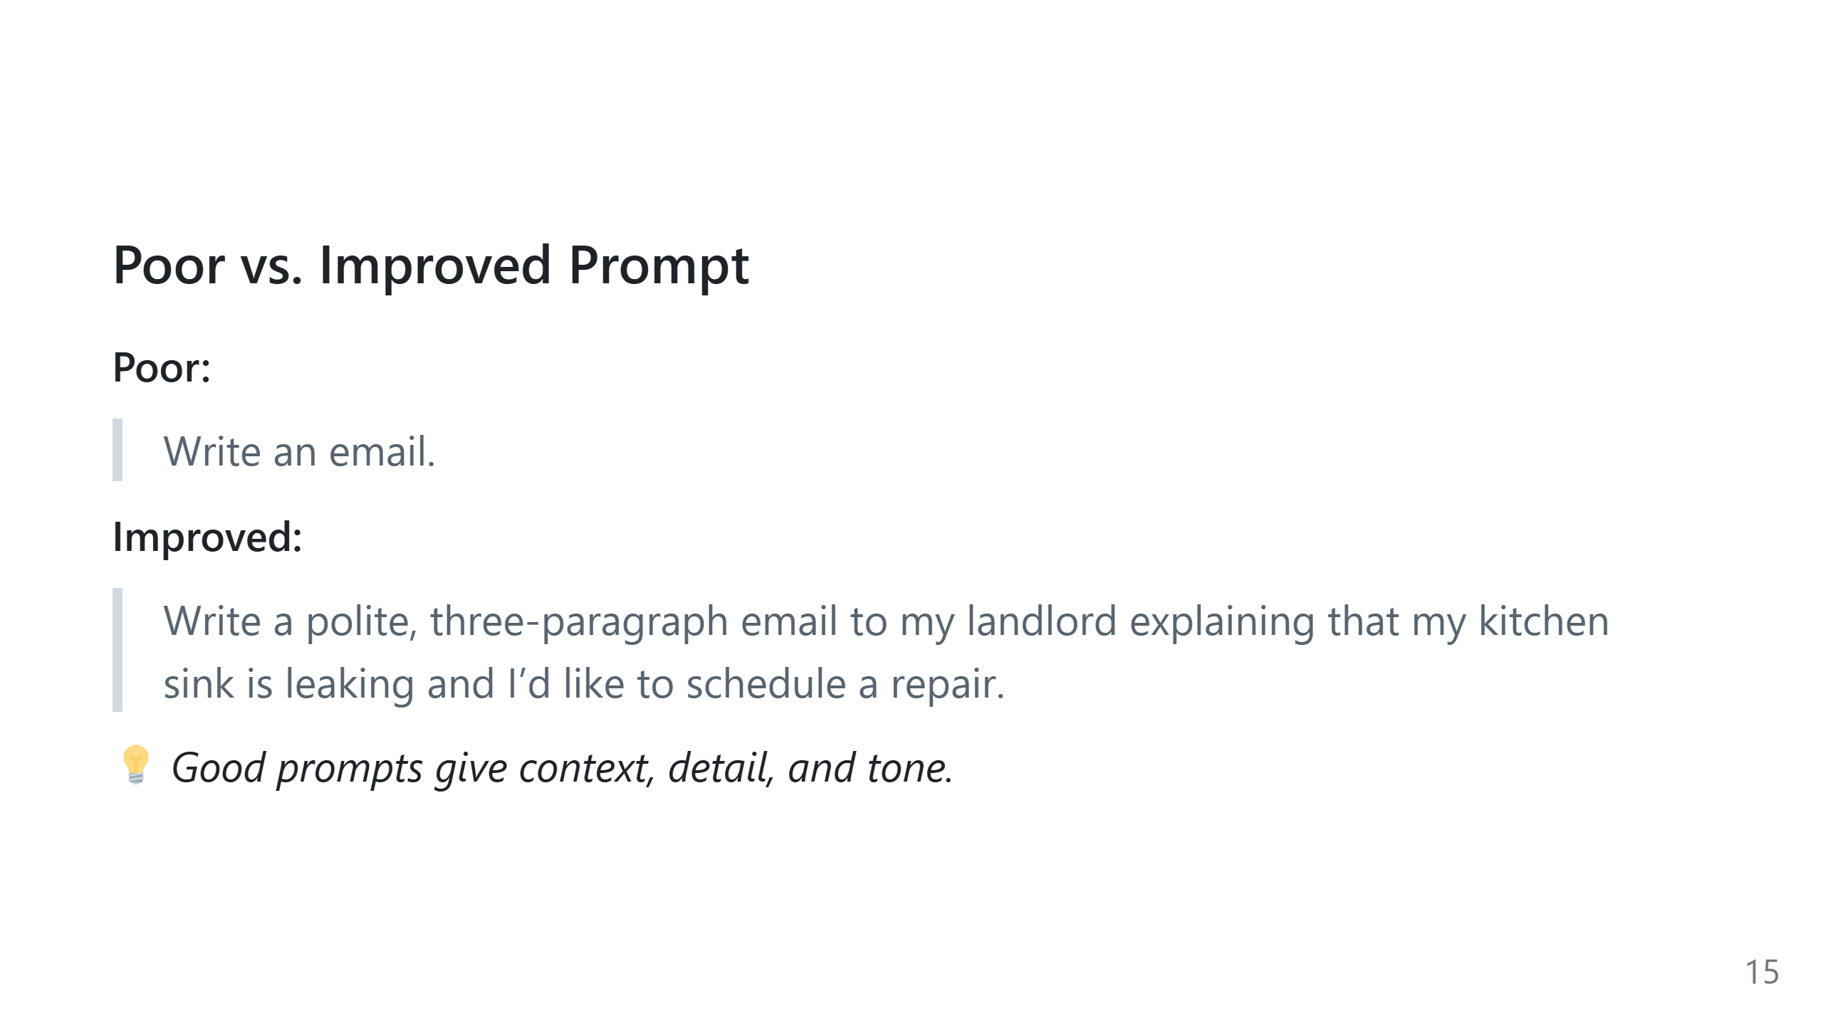
Notes:
Explain why the second works: context, who, purpose, tone, details.
Mention that students often under-specify what they want.

Slide 16
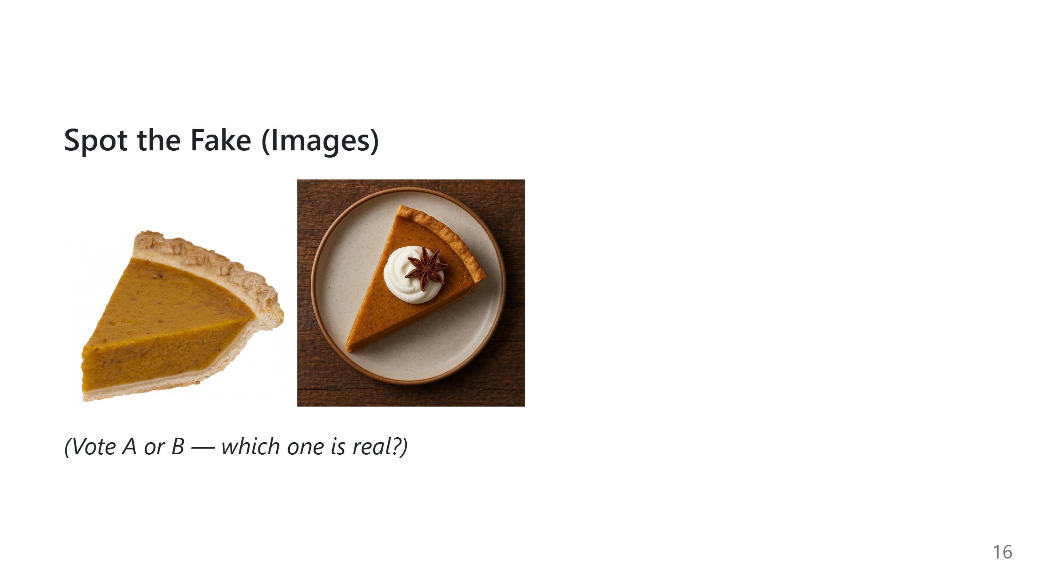
Notes:
Get quick hands-up votes.
Ask what visual cues they used: lighting, texture, odd details.

Slide 17
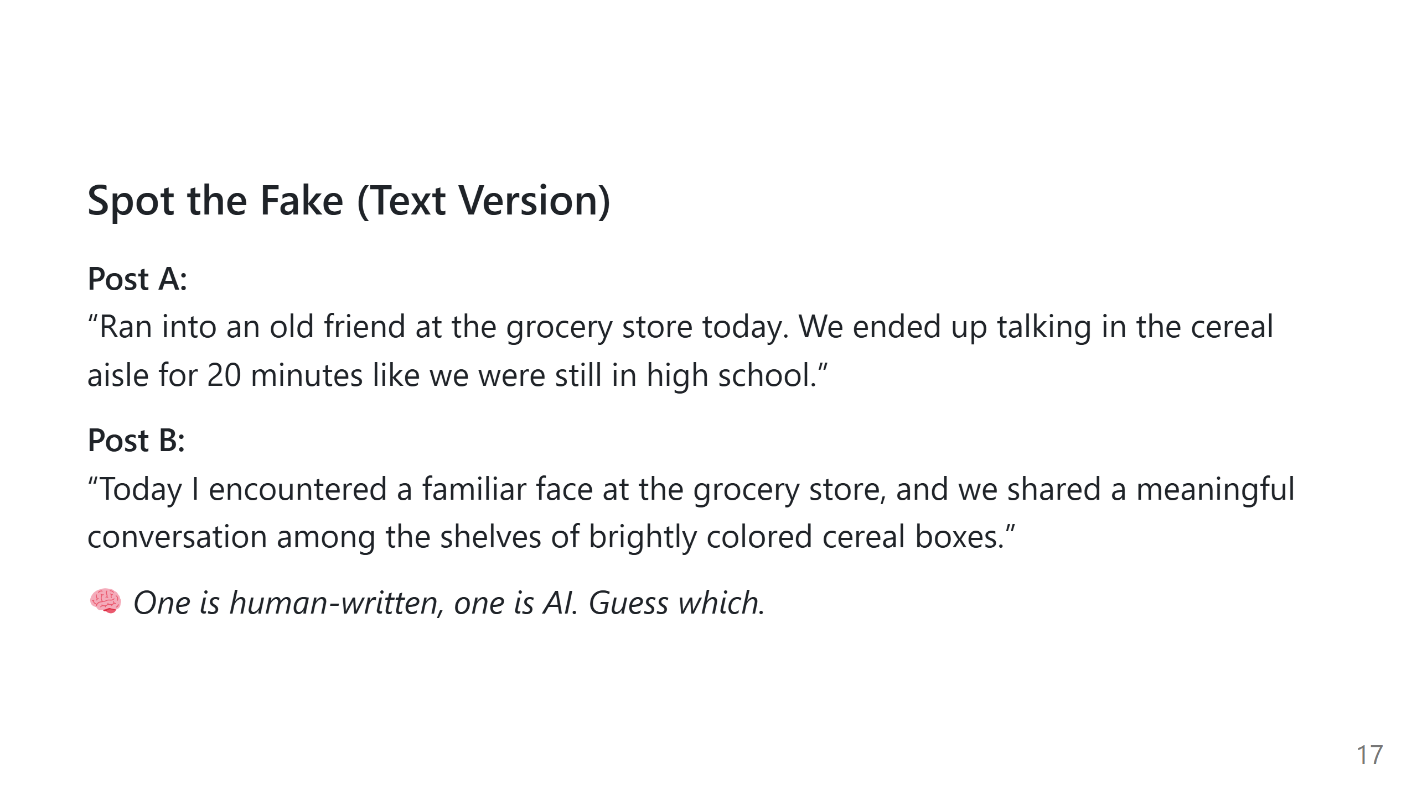
Notes:
AI = Post B
Why it works: B sounds slightly too formal and polished for a casual social post.
Point out that AI tends to sound overly poetic, generic, or abstract.
Explain that detecting fakes is getting harder.

Slide 18
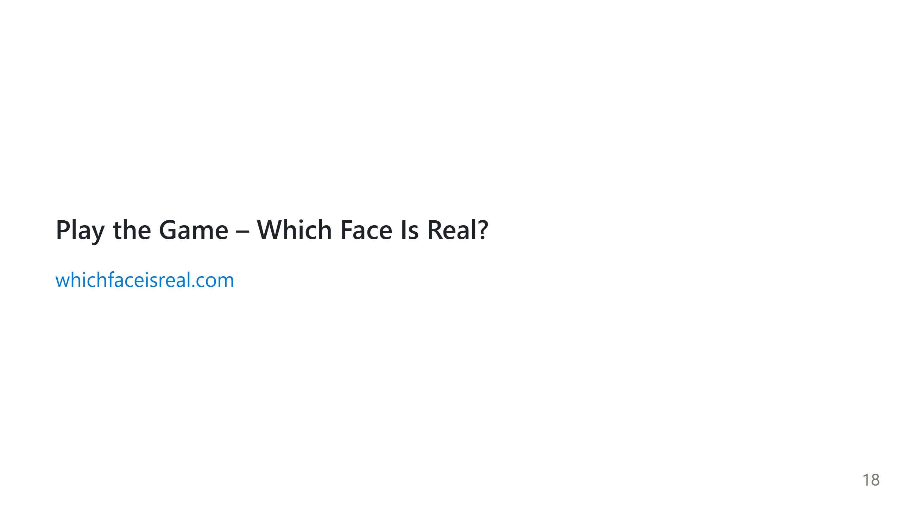
Notes:
Encourage them to guess and discuss.
Explain how trained models can produce ultra-realistic faces.

Slide 19
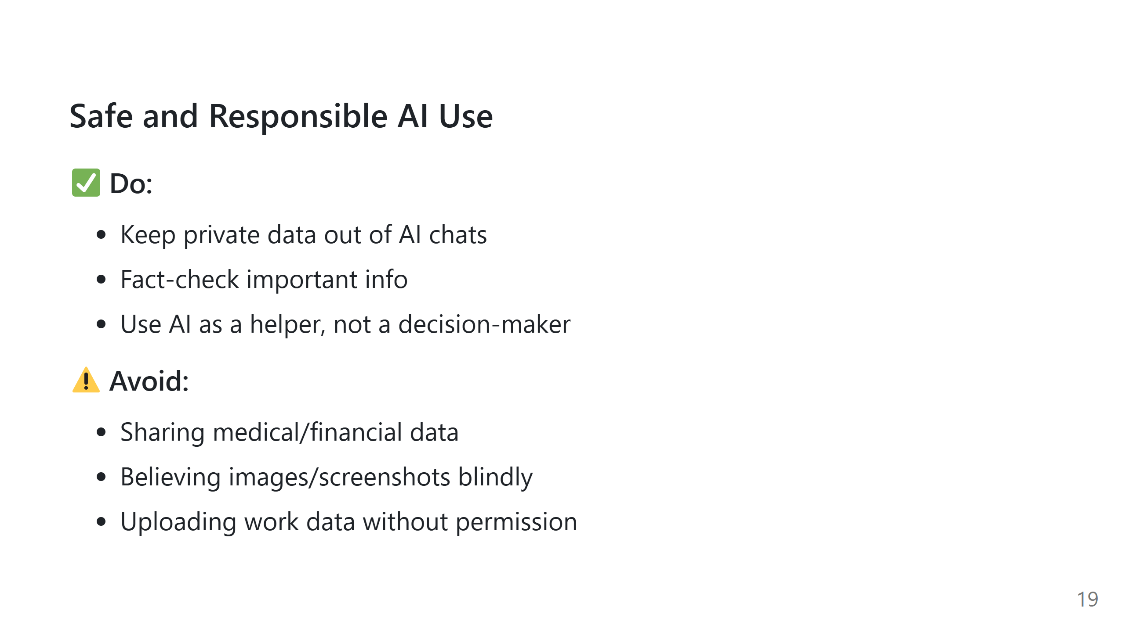
Notes:
Reinforce this slide more seriously.
Mention that AI tools store prompts, depending on the platform.

Slide 20
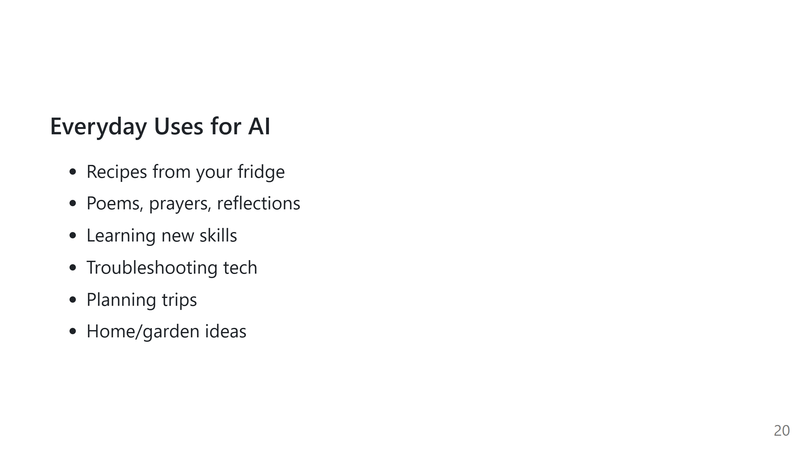
Notes:
Relate to everyday life so AI feels approachable.
Mention how it can save time or spark creativity.

Slide 21
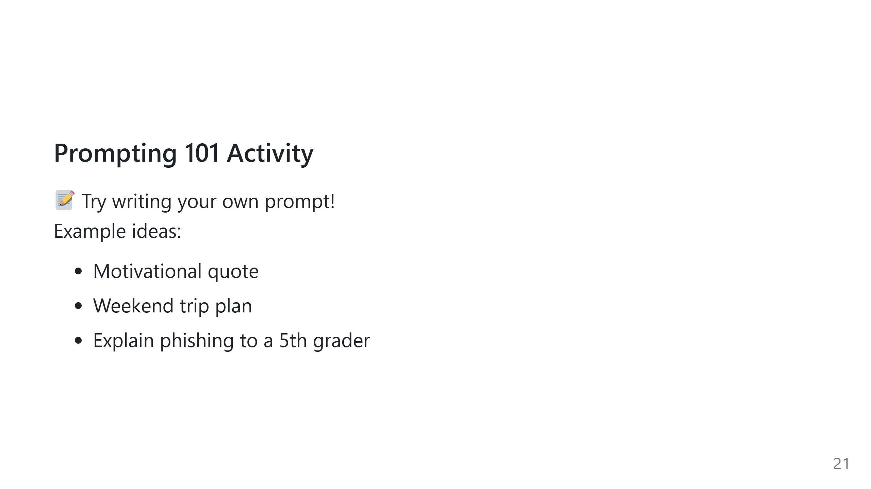
Notes:
Walk around and assist.
Encourage specificity and tone-setting in prompts.

Slide 22
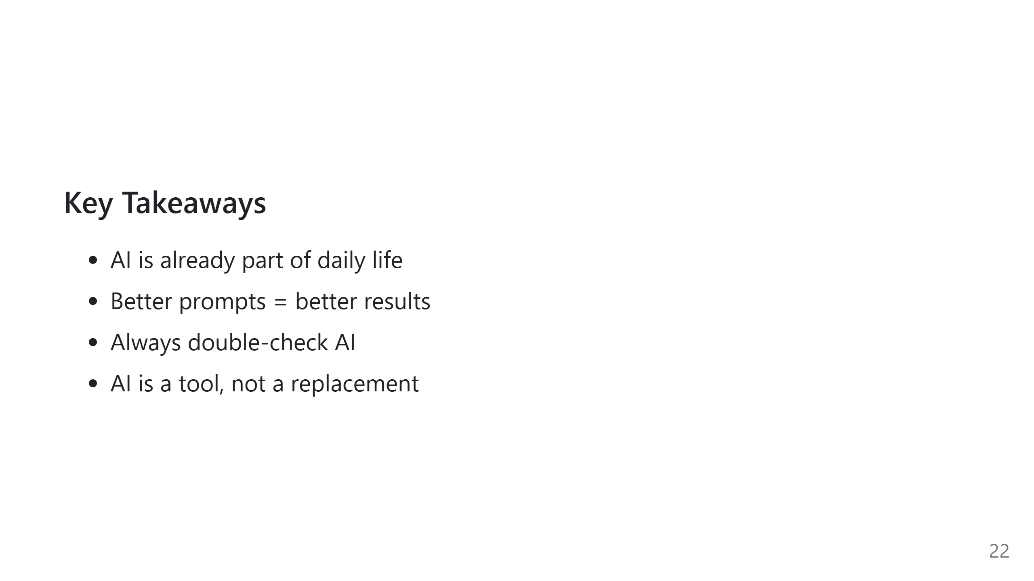
Notes:
Wrap up the concepts clearly.
Encourage curiosity and ongoing experimentation.

Slide 23
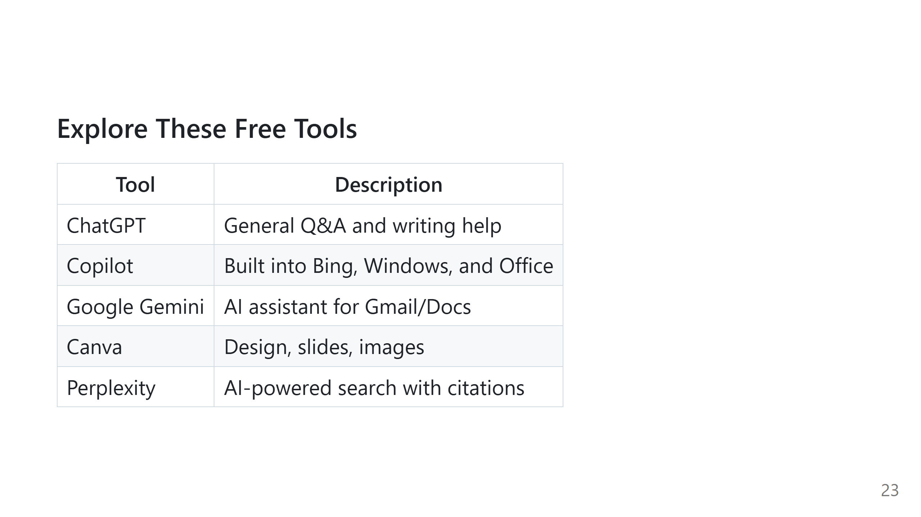
Notes:
Briefly describe when someone might choose each tool.

Slide 24
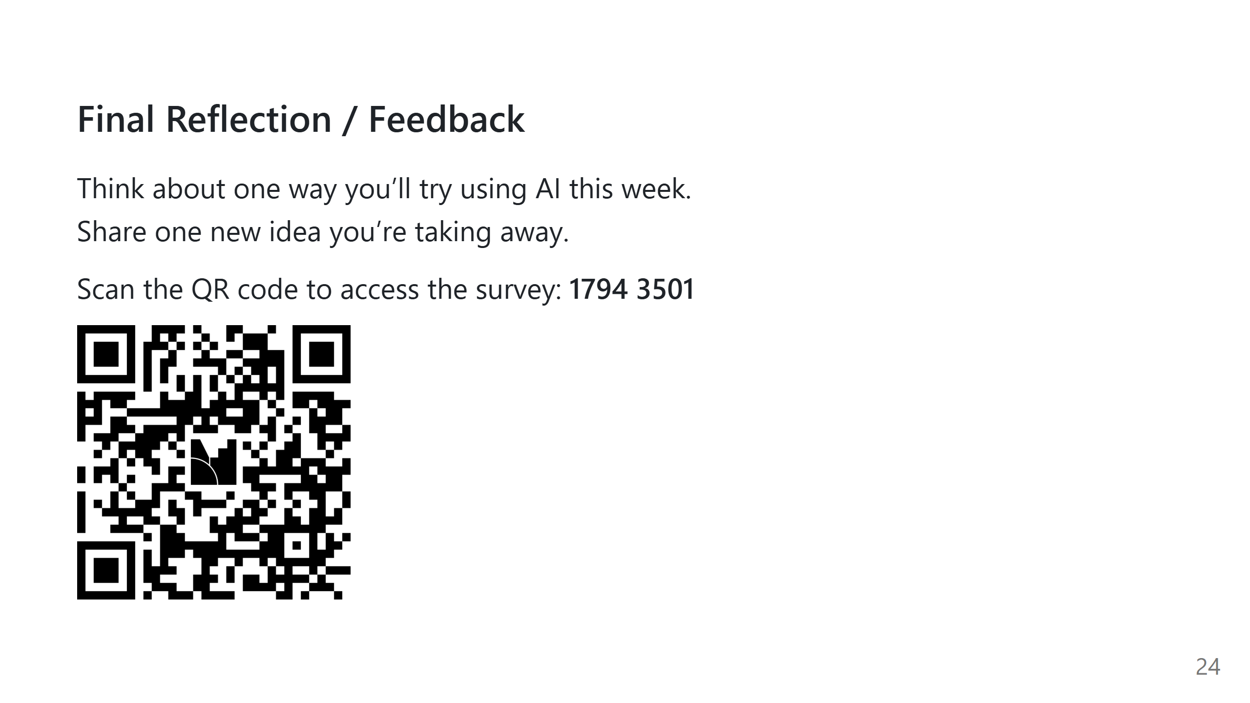
Notes:
Invite final questions.
Encourage honest feedback so future workshops improve.

Slide 25
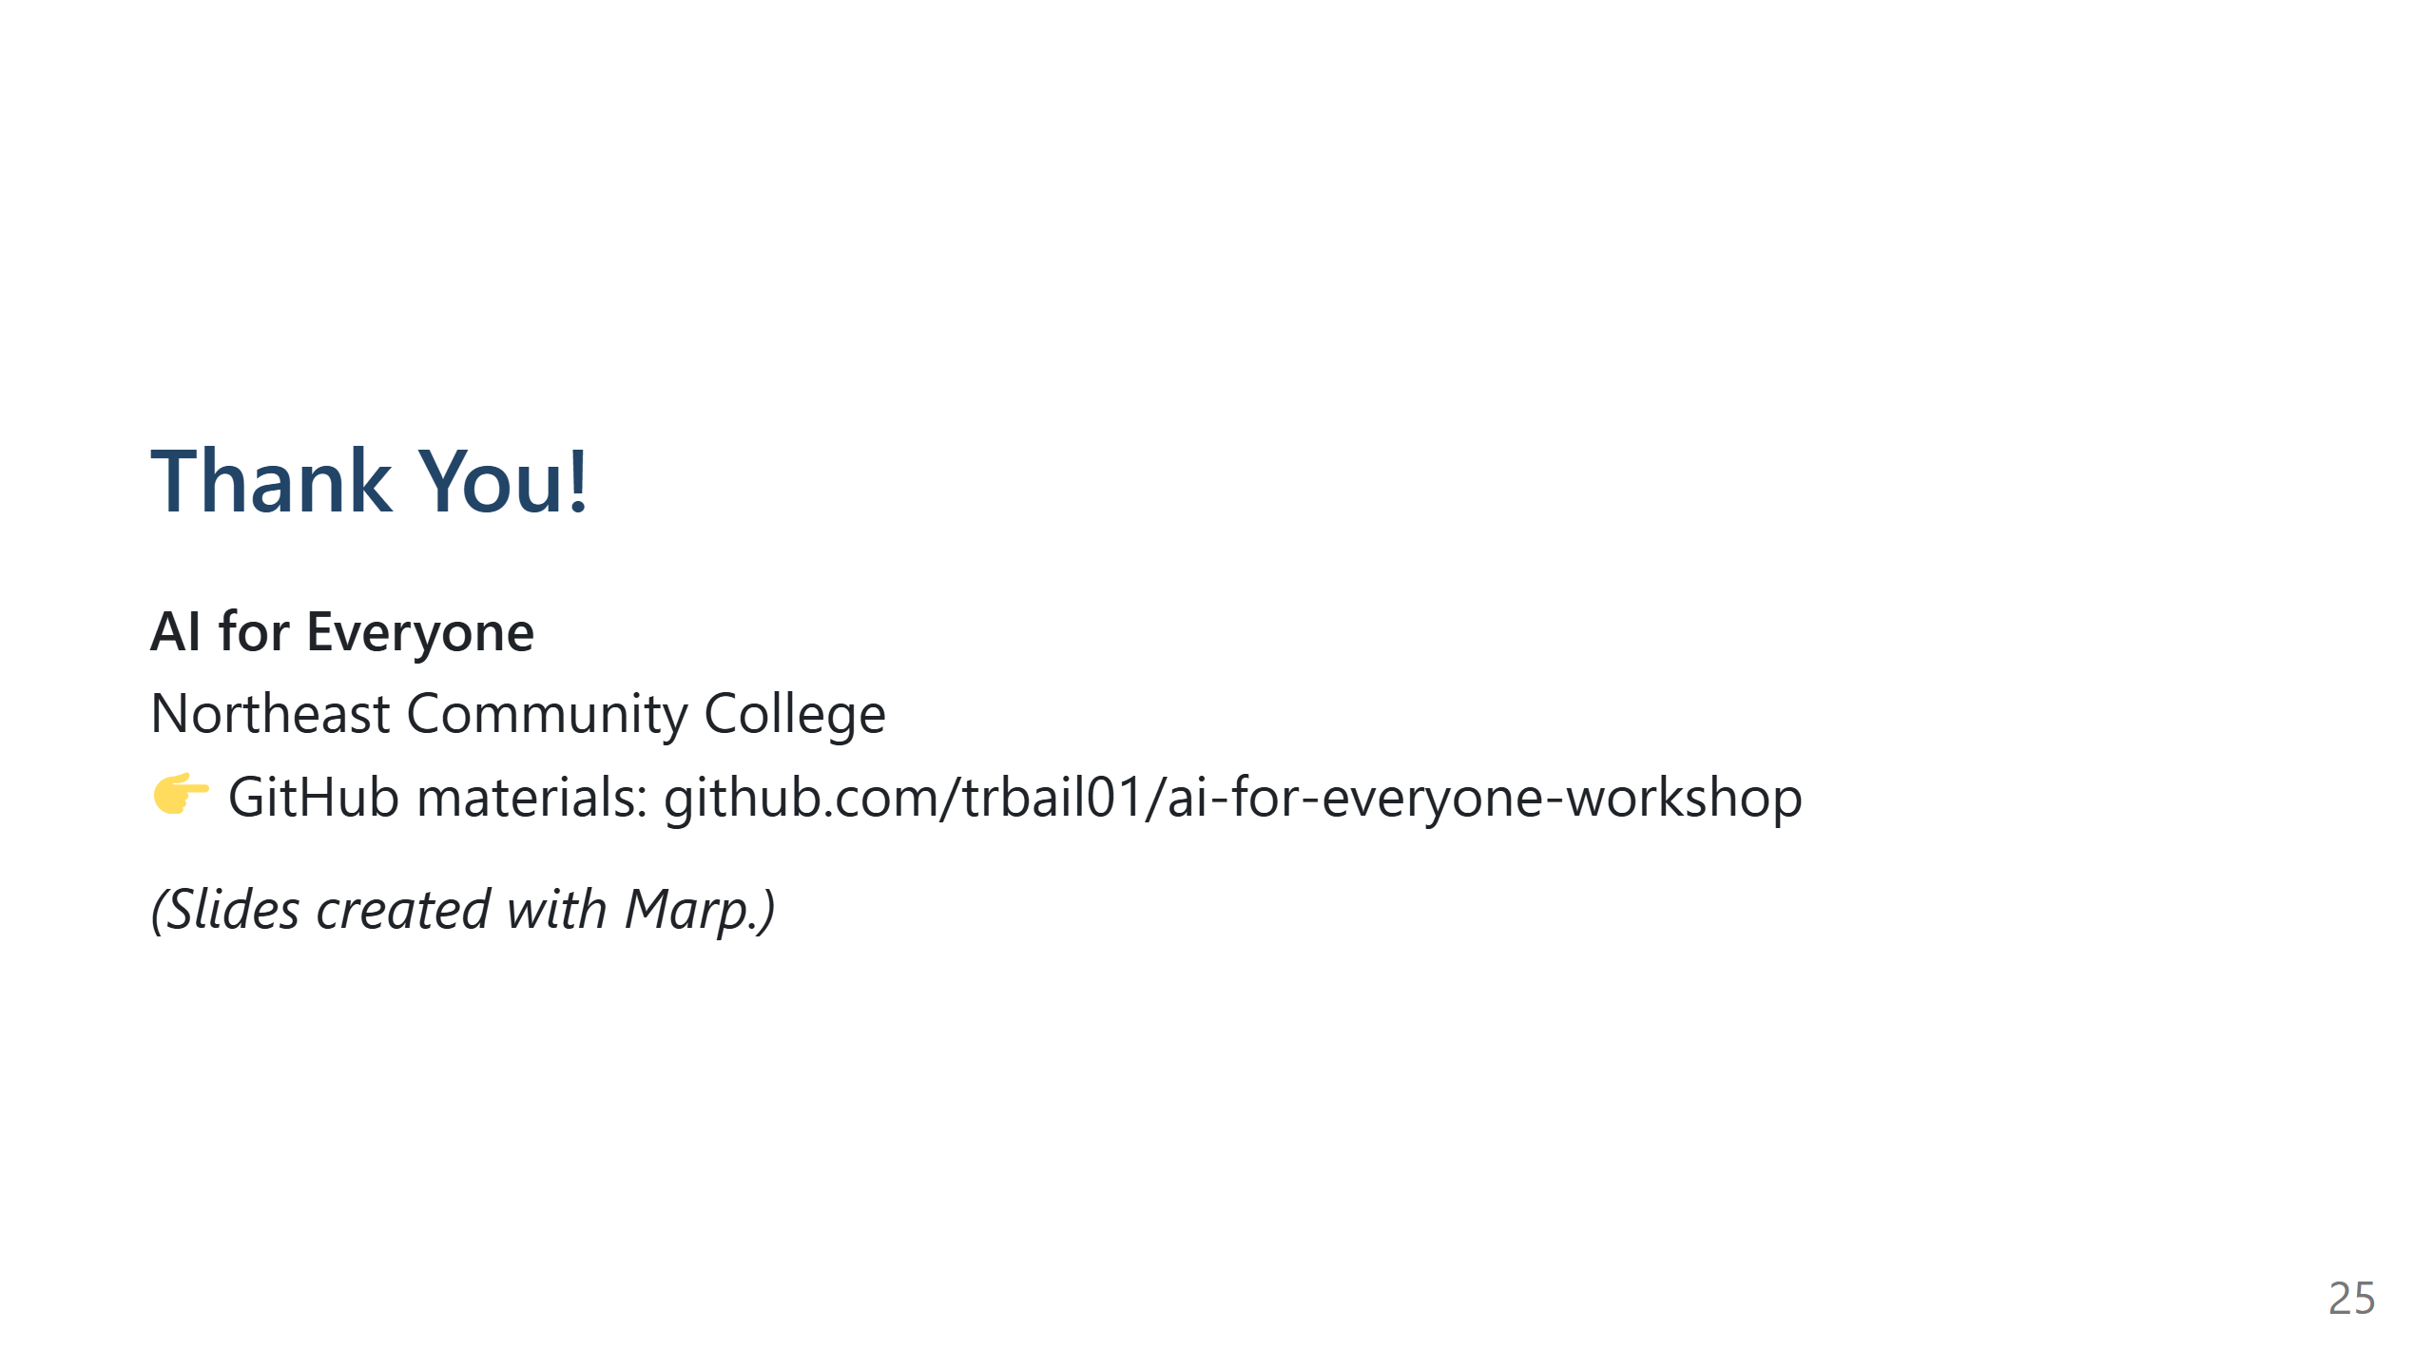
Notes:
End warmly.
Mention how to contact you or where materials live.

