Slide 1
Enhancing Student Field Studies with BYOD Technology
Tom Baker, University of Kansas
tbaker@ku.edu - @trbaker
Create a user account at: Google.com
KU Summer Workshop * http://edgis.org/TEFSworkshop

Slide 2
Teacher Workflow: Setup
Create a Google Drive Form for centralized data collection
“GPS-enable” the form at http://edgis.org
Use ArcGIS Online to map & visualize data
Create Google Form
Convert to EdGIS GeoForm
Map in ArcGIS Online

Slide 3
Learner Workflow
In classroom, verify smartphone Location Services.
Apple IOS 6: Settings -> Privacy -> Location Services
Apple IOS 4.x: Settings -> Location Services
Android: Menu -> Settings -> Location & Security
Android 4.1.1: Menu -> Settings -> Personal -> Location Services
Students enter project URL
In field, learners report data
In lab, use ArcGIS Online to map & analyze data
Enable Smartphone GPS
Submit data to “GPS-enabled” form
Analyze data in ArcGIS Online
Share URL

Slide 4
Be the Learner
Enable Smartphone GPS
Submit data to GeoForm
Find “Texas Soda” Map in ArcGIS Online

Slide 5
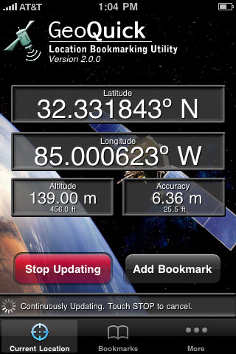
Step 1: Enable Smartphone GPS
Apps
Apps: Motion X, My Tracks, etc
GPS-enabled Web pages
Smartphones may use many methods to get location.
GPS chip
Cell tower triangulation
Wi-Fi Geo-location
Accuracy will vary

Slide 6
Step 2: Open Web Browser
Carbonated Beverage Survey
http://edgis.org/geoforms/49515.html
Field studies can be scientific or social – ranging from an inventory of species or geological features to graffiti or neighborhood monitoring.

Slide 7
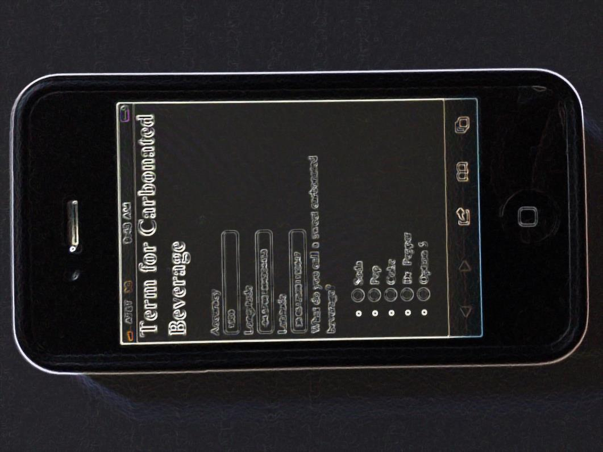
Step 3: Report Data
Webinar example: Report your favorite beverage
Click to add GPS
Click to send data
Use the back browser button to submit more data

Slide 8
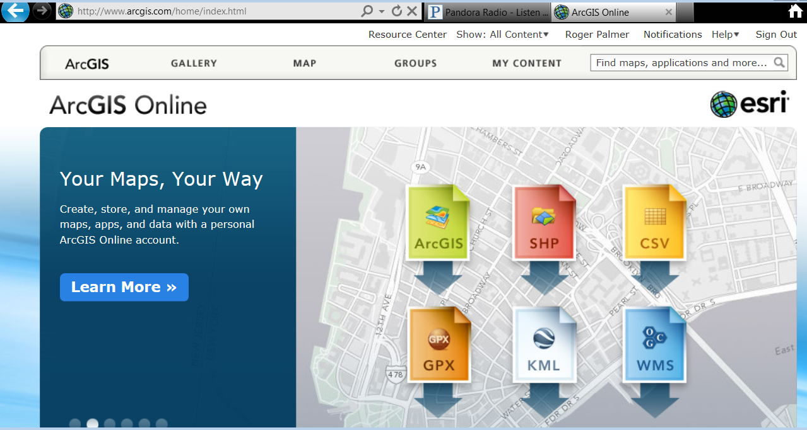
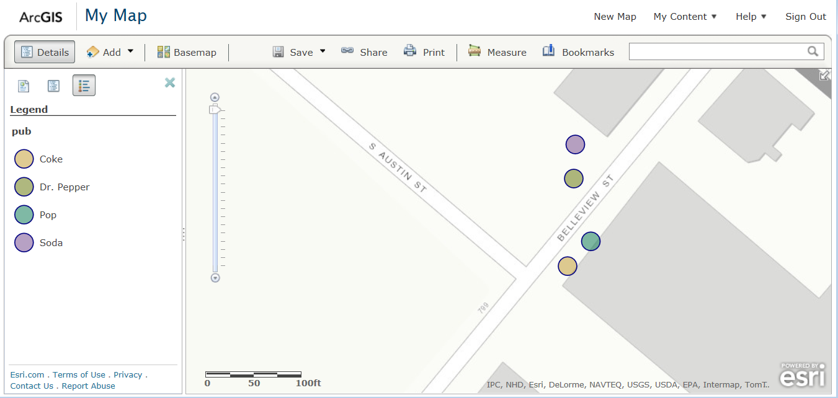
Step 4: Review data with a Map

Slide 9
Be the Teacher
Create Google Form
Convert to GeoForm
Map in ArcGIS Online
Field research begins with a question and a
design for the data to be collected.

Slide 10
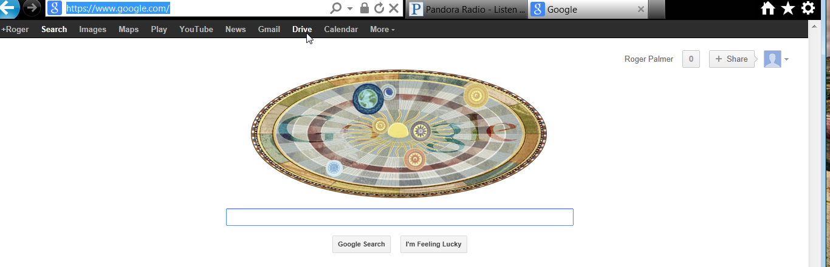
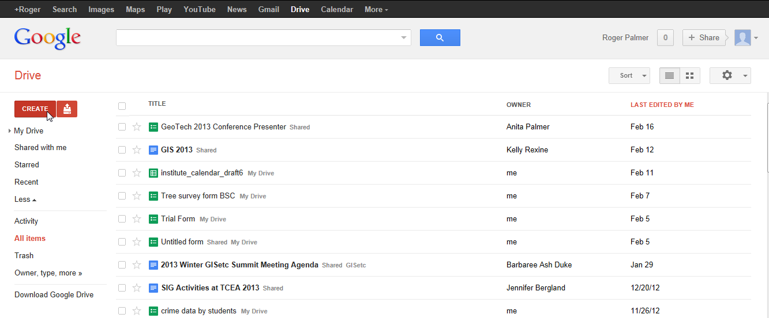
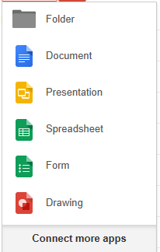
Step 1a: Create a Google Drive Form

Slide 11
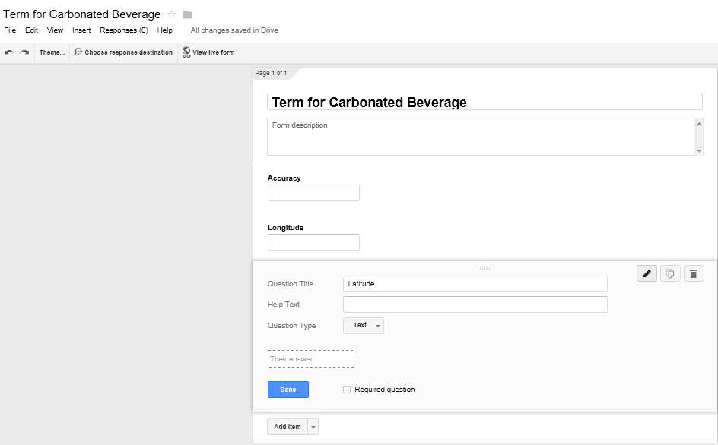
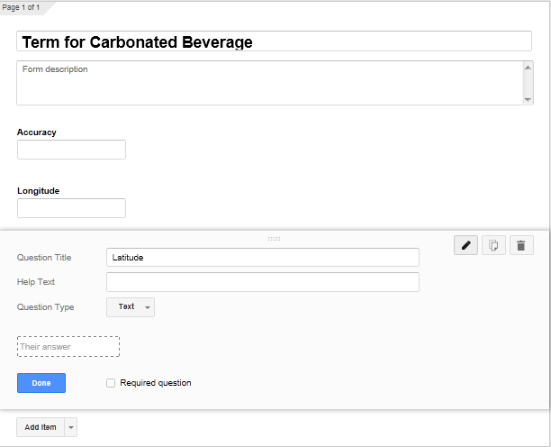
Step 1b: Build Form Fields

Slide 12
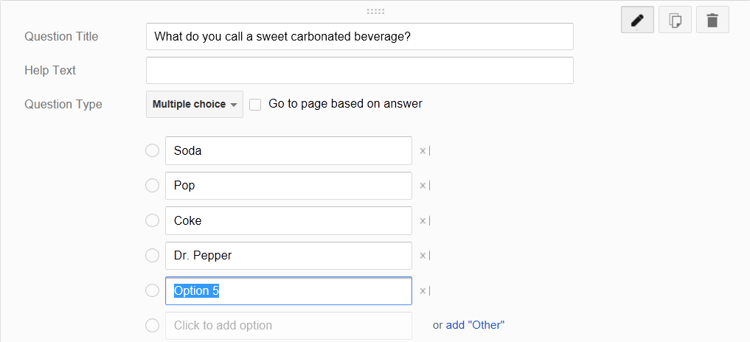
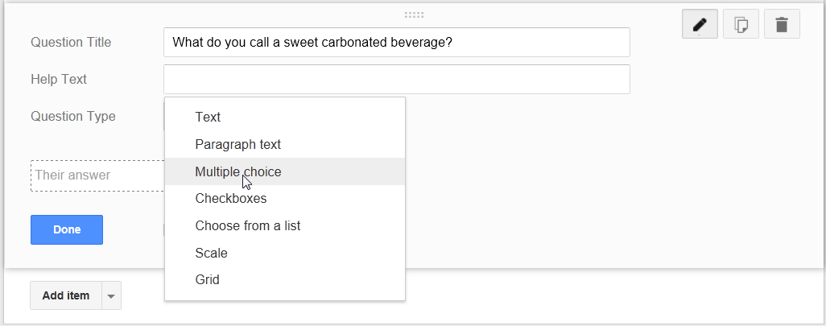
Step 1c: Set Question Types for Pre-set Answers

Slide 13
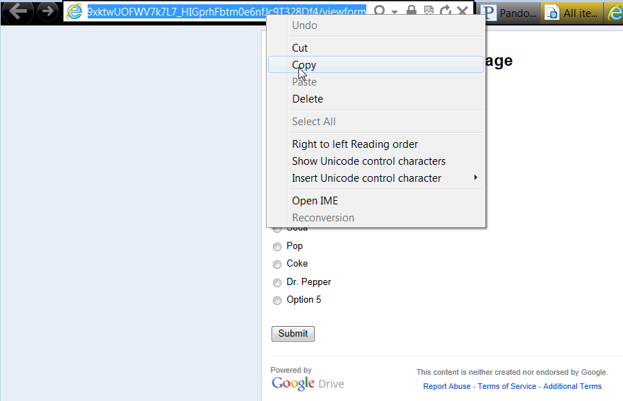
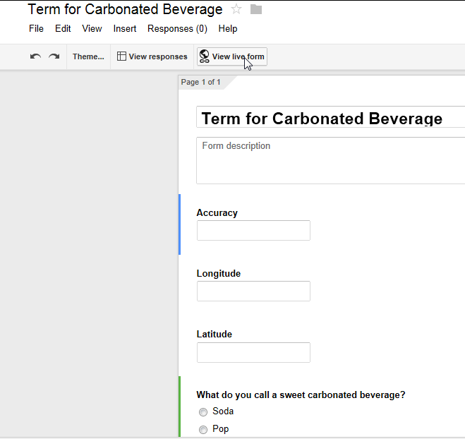
Step 1d: Go to Live Form, Copy URL

Slide 14
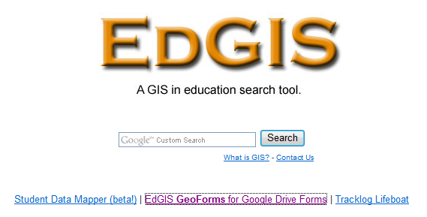
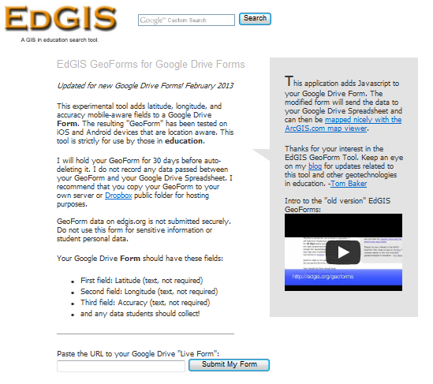
Step 2a: Submit your Google “Live Form” URL to EdGIS.org

Slide 15
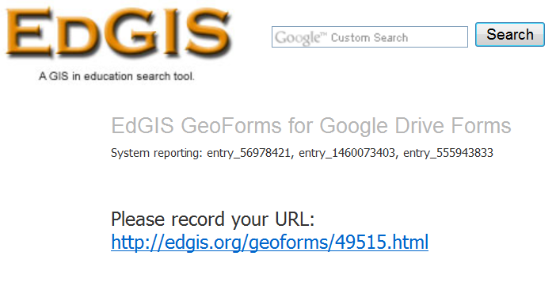
Step 2b: EdGIS Copies your Form & Adds a GPS Button
Go collect data to enter into your Google spreadsheet

Slide 16
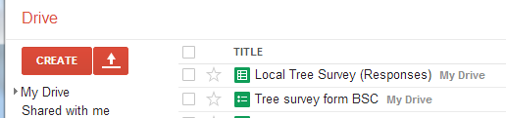
After Entering a Few Data, Open the spreadsheet
Spreadsheet
Forum

Slide 17
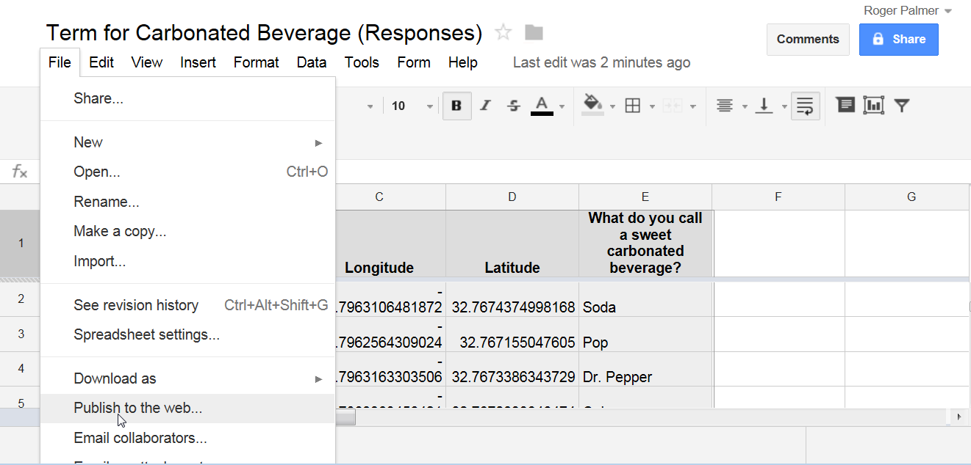
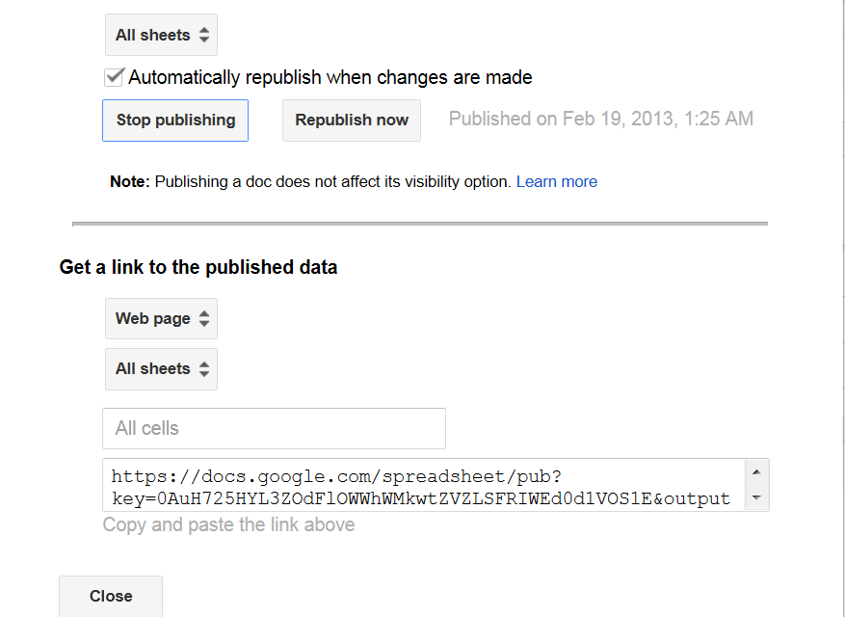
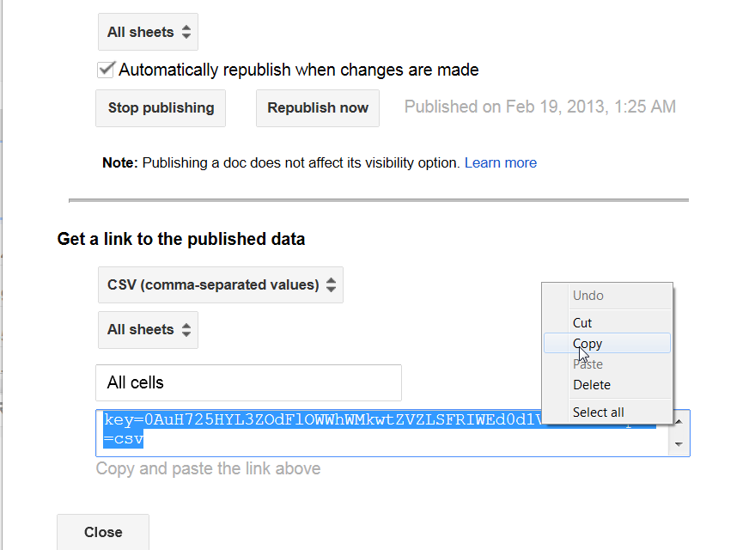
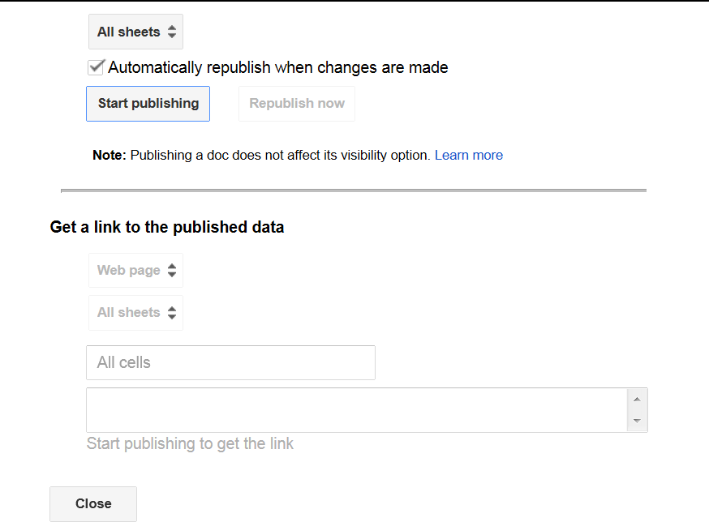
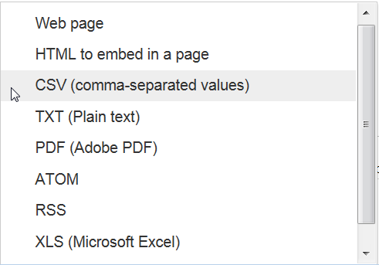
Step 3a: Publish the Collected data from your Google Drive

Slide 18
Step 3b: Map Data at ArcGIS.com

Slide 19
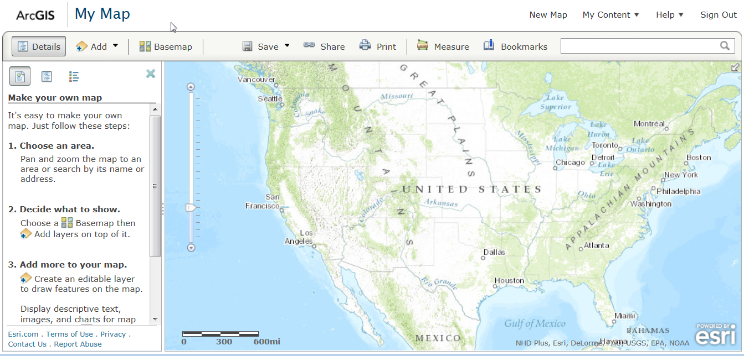
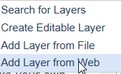
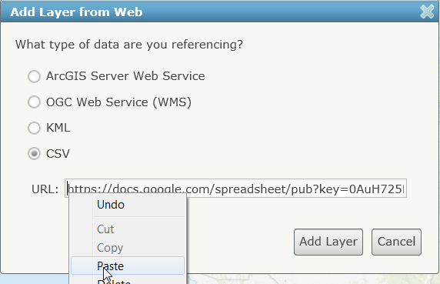
Step 3c: Add your Data

Slide 20
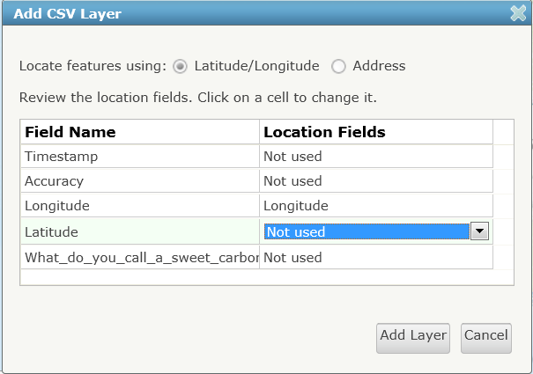
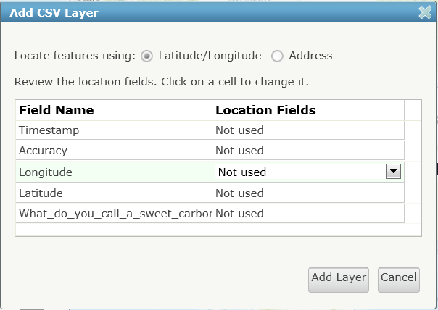


Step 3d: Set Location Fields

Slide 21
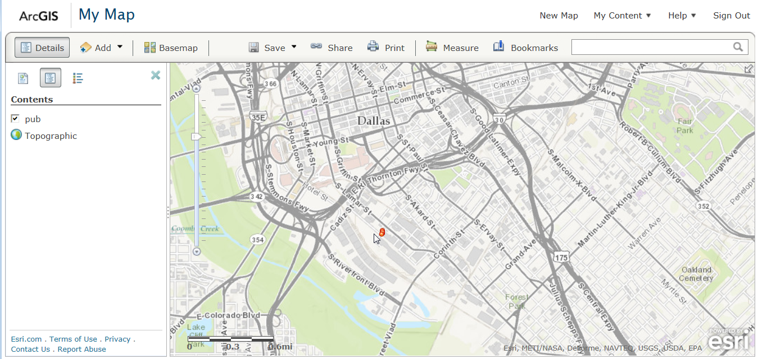
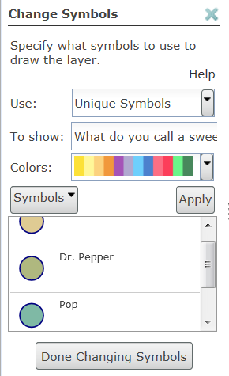
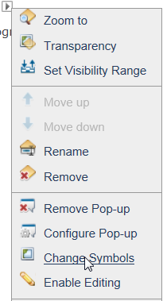
Step 3e: Analyze Patterns in Data Symbols

