Slide 1

Khumbudzo Mufamadi Consulting
Business Analysis • Strategy • Customer Experience • Digital Transformation • AI Strategy
Johannesburg, South Africa | 060 569 3798 | khumbudzo.mufamadi@gmail.com
Notes:
[Sources]
- Background image: https://pngtree.com/freebackground/smart-city-and-abstract-line-dot-connect-network-big-data-connection-technology-digital-transformation_2500219.html
[/Sources]

Slide 2
Company Profile
Business Analysis • Strategy • CX • Digital Transformation • AI Strategy
About
Specialised consulting to help organisations modernise operations, improve customer experience, and execute digital transformation.
We bridge business needs and technology delivery through structured requirements, process optimisation, governance alignment, and data-driven decision making.
What you can expect
Senior-level analysis and facilitation
Clear documentation (BRS/FRD, user stories, traceability)
Practical delivery support (UAT, change impacts, sign-off packs)
Customer-centric design and measurable KPIs
AI readiness, prioritised use cases, and responsible AI guardrails
Experience snapshot
11+ years in business & systems analysis
Public sector, finance, and transformation programmes
ERP/CRM/SAP and web-based systems
Governance & compliance awareness (POPIA, PFMA, King IV)
Khumbudzo Mufamadi Consulting
Indicative packages • Pricing excludes VAT
Notes:
[Sources]
- Provided CV: Khumbudzo_Mufamadi_Senior_Business_Analyst_CV.docx
[/Sources]

Slide 3


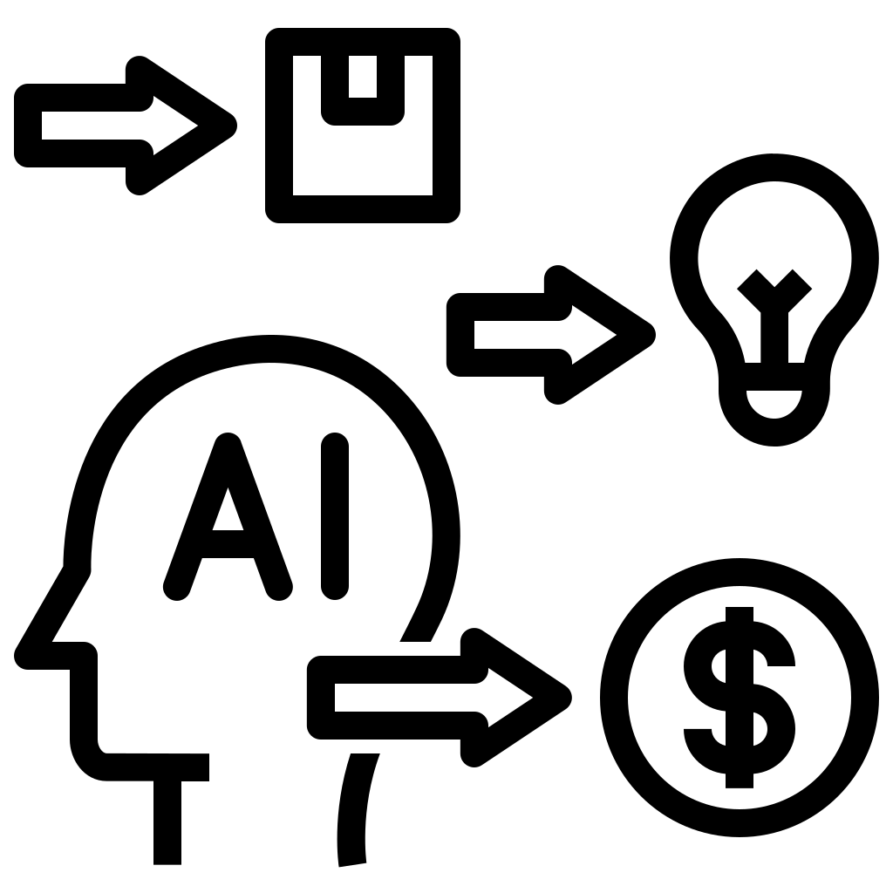
Capabilities
From strategy to implementation
Core capabilities
Business Analysis
Transformation Strategy
Customer Experience
Requirements, traceability, UAT, solution validation
Roadmaps, gap analysis, operating model support
Journey mapping, service design, CX metrics
Process Optimisation
Data & Reporting
AI Strategy
As-is/to-be mapping and automation opportunities
KPI frameworks and Power BI dashboard requirements
Readiness, use cases, governance, roadmap & adoption
Khumbudzo Mufamadi Consulting
Indicative packages • Pricing excludes VAT
Notes:
[Sources]
- Business analysis illustration icon (iconfinder): https://www.iconfinder.com/icons/13029448/business_analysis_analyst_swot_requirements_gathering_process_improvement_icon
- Customer journey mapping icon (pngtree): https://pngtree.com/freepng/customer-journey-mapping-rgb-color-icon-management-flat-line-vector_11015479.html
- AI strategy icon (iconfinder): https://www.iconfinder.com/icons/11055698/ai_process_ideas_strategy_artificial_intelligence_business_planning_icon
[/Sources]

Slide 4
Services
What we offer
Service lines
Business Analysis
Transformation & Strategy
BRS/FRD, user stories & acceptance criteria
Traceability, scope control, change impacts
UAT planning, execution support, sign-off packs
Solution validation & stakeholder workshops
Digital transformation roadmaps
Process optimisation & automation opportunities
Operating model and capability assessments
Governance-aligned delivery assurance
Customer Experience (CX)
AI Strategy Consulting
Customer journey mapping & service blueprints
Digital channel experience improvements
VoC, CX KPIs and measurement frameworks
Prioritised backlog for delivery
AI readiness (data, process, skills, risk)
Use case pipeline and prioritisation
Responsible AI governance (privacy, bias, controls)
AI roadmap and adoption/change plan
Khumbudzo Mufamadi Consulting
Indicative packages • Pricing excludes VAT
Notes:
[Sources]
- Business analysis illustration icon (iconfinder): https://www.iconfinder.com/icons/13029448/business_analysis_analyst_swot_requirements_gathering_process_improvement_icon
- Customer journey mapping icon (pngtree): https://pngtree.com/freepng/customer-journey-mapping-rgb-color-icon-management-flat-line-vector_11015479.html
- AI strategy icon (iconfinder): https://www.iconfinder.com/icons/11055698/ai_process_ideas_strategy_artificial_intelligence_business_planning_icon
[/Sources]

Slide 5
Approach
Discover → Optimise
A structured delivery approach
1
2
3
4
5
Discover
Analyse
Design
Deliver
Optimise
Goals, pain points, stakeholders, users
Requirements, gaps, processes & journeys
Future state, solution options, KPIs
Implementation support, UAT, adoption
Measure outcomes, continuous improvement
Typical deliverables
As-is/to-be processes and customer journeys
BRS/FRD, user stories, acceptance criteria
Traceability matrix and scope baseline
UAT plan, scripts, defect logs and sign-off pack
Roadmaps, KPIs and dashboard requirements
AI readiness and AI roadmap
Khumbudzo Mufamadi Consulting
Indicative packages • Pricing excludes VAT
Notes:
[Sources]
- Provided CV: Khumbudzo_Mufamadi_Senior_Business_Analyst_CV.docx
[/Sources]

Slide 6
Service Packages
Quick-start options
Indicative packages (excl. VAT)
Discovery Workshop
Requirements Sprint
Transformation Roadmap
1 day
2–4 weeks
4–6 weeks
R18k–R45k
R45k–R120k
R75k–R160k
CX Improvement Package
AI Strategy Starter
UAT Management
3–6 weeks
4–6 weeks
2–6 weeks
R60k–R180k
R150k–R350k
R40k–R95k
Monthly retainers (advisory partnership)
Advisor Lite
8 hrs/mo • R18k–R25k
Transformation Partner
16 hrs/mo • R35k–R55k
Strategic Advisor
32 hrs/mo • R65k–R95k
Khumbudzo Mufamadi Consulting
Indicative packages • Pricing excludes VAT
Notes:
[Sources]
- Pricing is indicative and based on packaged consulting structure (not a quoted market rate).
[/Sources]

Slide 7
Engagement Models
How clients work with us
Flexible engagement options
Workshop (fast start)
Project-based delivery
Monthly retainer
1-day discovery / alignment
Clear problem statement & priorities
Next-step plan and proposal
Defined scope, deliverables and timeline
End-to-end BA and implementation support
Testing and sign-off
Ongoing advisory and governance support
Backlog shaping and decision support
Continuous improvement + AI adoption
Khumbudzo Mufamadi Consulting
Indicative packages • Pricing excludes VAT
Notes:
[Sources]
- Provided CV: Khumbudzo_Mufamadi_Senior_Business_Analyst_CV.docx
[/Sources]

Slide 8
Capability & Delivery Fit
Where we add value
Industries and delivery methods
Industries served
Why clients choose us
Public sector & government
Financial services
Corporate & enterprise services
Technology & digital platforms
Shared services & operations
Senior facilitation: clear alignment and fast decisions
Structured documentation that accelerates delivery
Practical implementation support (not just analysis)
Customer-centric outcomes and measurable KPIs
AI-ready approach with governance and adoption built in
Tools & ways of working
Agile, Waterfall & Hybrid delivery
Process mapping (as-is/to-be)
ERP/CRM/SAP and web-based systems
Power BI reporting and KPI dashboards
UAT planning & execution
Remote delivery available
Workshops, requirements, and advisory delivered on-site or remotely.
Khumbudzo Mufamadi Consulting
Indicative packages • Pricing excludes VAT
Notes:
[Sources]
- Provided CV: Khumbudzo_Mufamadi_Senior_Business_Analyst_CV.docx
[/Sources]

Slide 9
Let’s talk
Book a discovery session to confirm scope, outcomes and the best package.
Contact
Phone: 060 569 3798
Email: khumbudzo.mufamadi@gmail.com
Location: Johannesburg, South Africa
Next step
Send a short email with:
• your goal
• timeframe
• key stakeholders
Notes:
[Sources]
- Background image: https://pngtree.com/freebackground/smart-city-and-abstract-line-dot-connect-network-big-data-connection-technology-digital-transformation_2500219.html
[/Sources]

