Slide 1
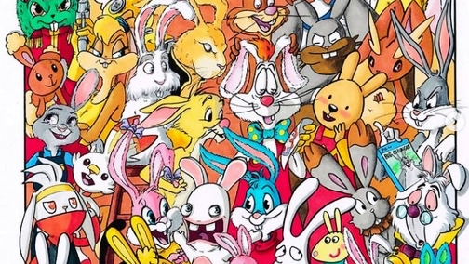
Eternal Rabbit Project
Secure ERP

Slide 2
First impressions

Slide 3
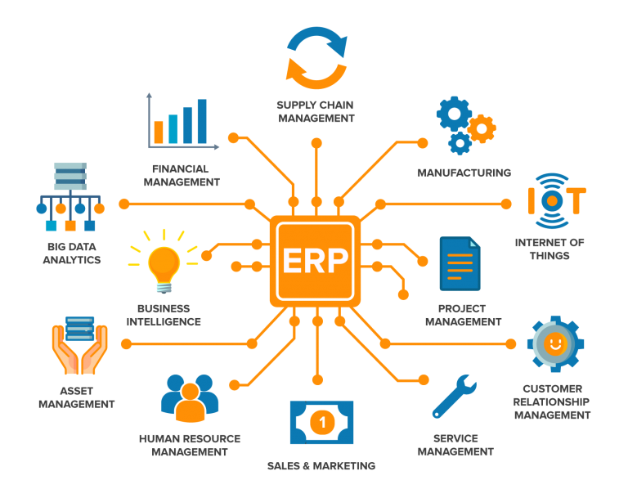
What is ERP?
Enterprise resource planning (ERP) refers to a type of software that organizations use to manage day-to-day business activities such as accounting, procurement, project management, risk management and compliance, and supply chain operations.

Slide 4
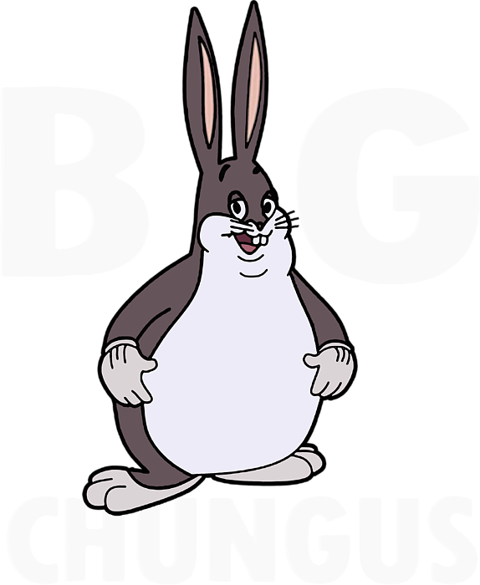
Workflow
Monday | Tuesday | Wednesday | Thursday
Created team(s) Collected popular rabbits Tried to split the project Tried to understand MVC structure (Deeply analized the concept of Big Chungus) | Understood MVC structure Split the project | Growth Mindset WS Worked on the project | Prestentation Finalized the product

Slide 5
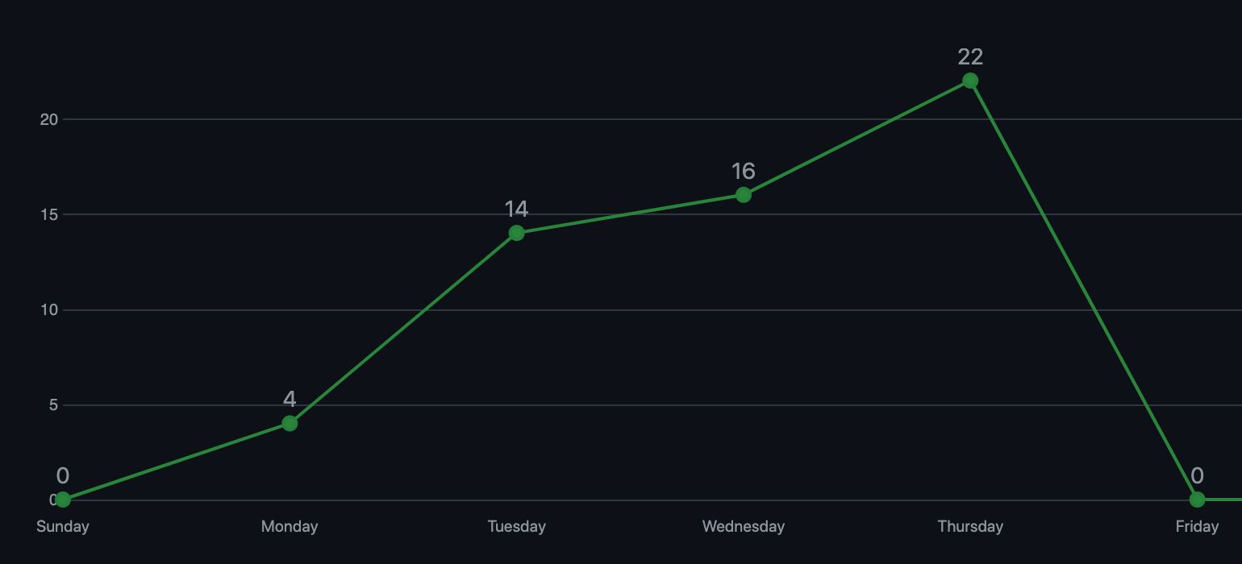
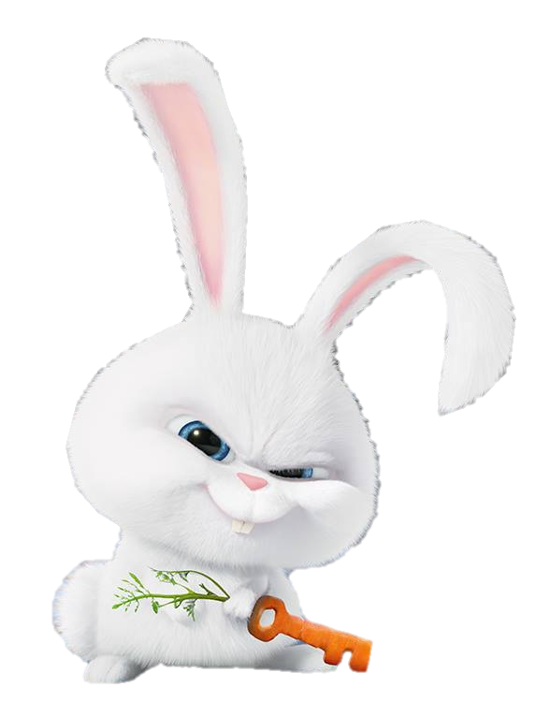
Commit history

Slide 6
Let’s see the program!

