Slide 1

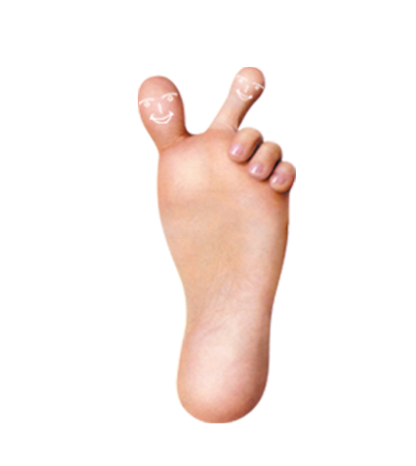
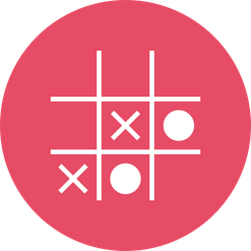
Thicc Toes
Tic Tac Toe

Slide 2
Tic Tac Toe
Two players: X and O
Different game modes:
Human vs. human
Human vs. AI
AI vs. human
AI vs. AI
Unbeatable AI

Slide 3
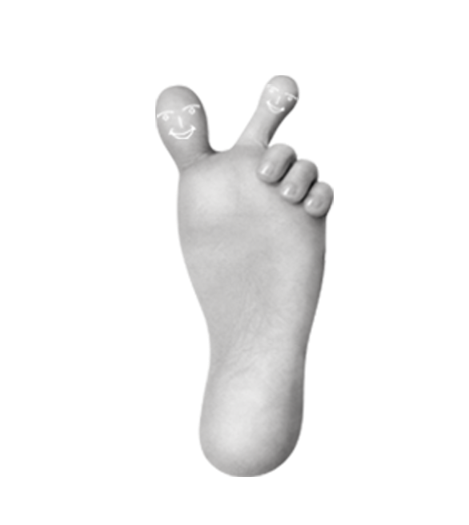
Teamwork
Monday | Tuesday | Wednesday
Created teams Assigned the tasks Started the work function by function | Teamwork started to fail Different pace of work | Teamwork totally fell apart

Slide 4
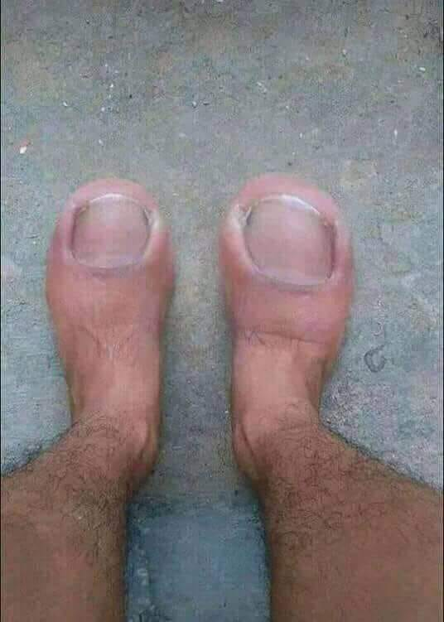

Slide 5
Workflow
Monday | Tuesday | Wednesday
Started the work function by function Almost finished the main game | Finished mandatory features Started to work on AI Refactoring | AI Refactoring

Slide 6
Let’s play!

Slide 7
Thank you for yor attention!

