Slide 1
Kérdezz Komám
Basics of a crowdsourced Q&A site

Slide 2
Challanges
+
Relatively easy task
Fluctuating human resourses (online & offline)
-
?

Slide 3
Workflow
Monday | Tuesday | Wednesday | Thursday | Friday
Basics of the project | Most effective day, almost done with the work | Refactoring Prettifying | Refactoring | Presentation

Slide 4
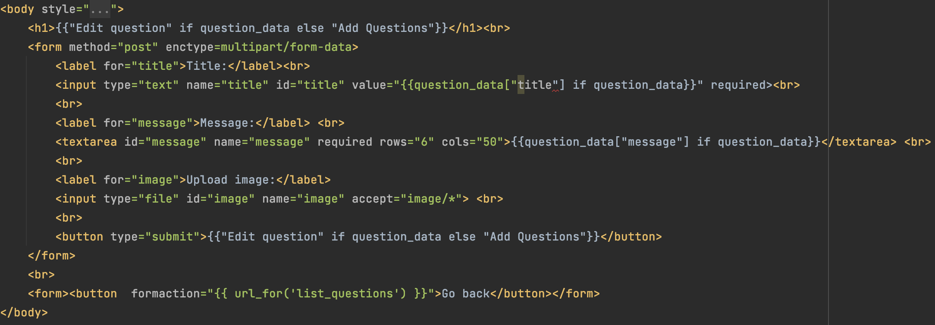
Add/Edit questions

Slide 5
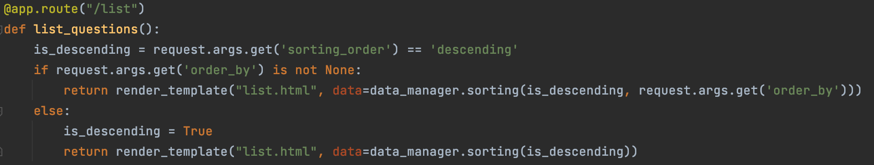
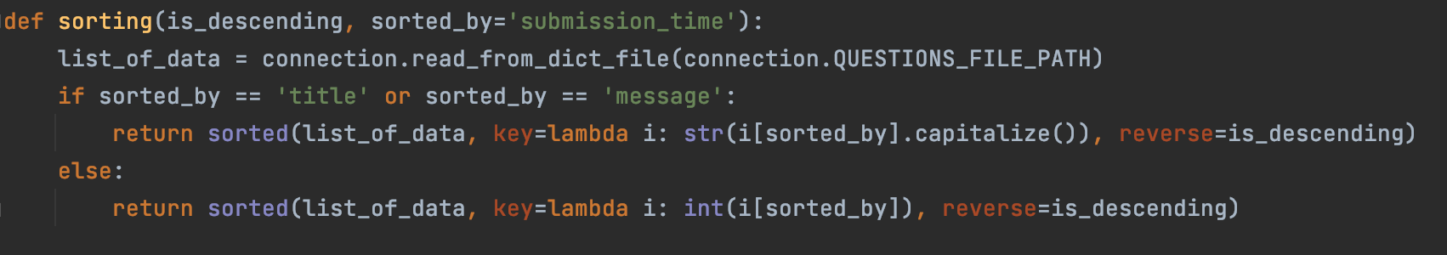
Sort Questions

Slide 6


