Slide 1
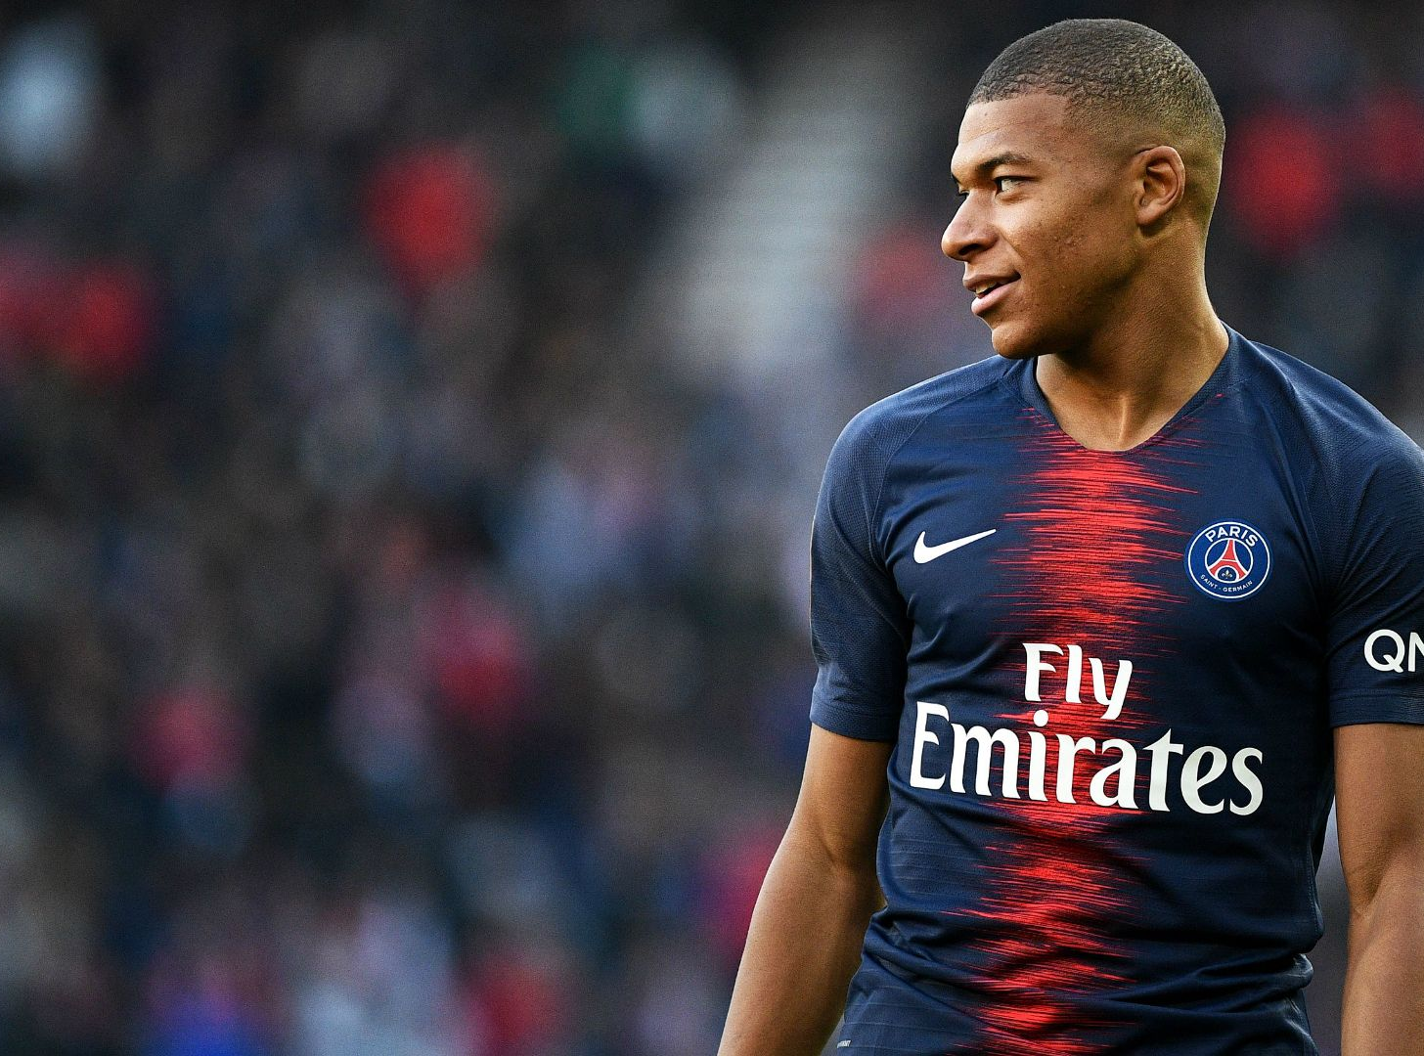
WHO CAN REPLACE MBAPPÉ?
Tobías Rodríguez Brindicci
St. Thomas University
CIS541 Final Project

Slide 2
ABOUT THE PROJECT
01
DATA SOURCE
02
TABLE OF CONTENTS
KNN ANALYSIS
03
FINDINGS
04
SHINY APP
05

Slide 3
ABOUT THIS PROJECT
Over the next slides I will present my research project on finding a suitable replacement for Kylian Mbappé if he leaves Paris Saint-Germain.
Implementation of a nearest-neighbors based recommendation system working on football data from the 2020-21 season, in order to find similar players to the selected football player.
1

Slide 4
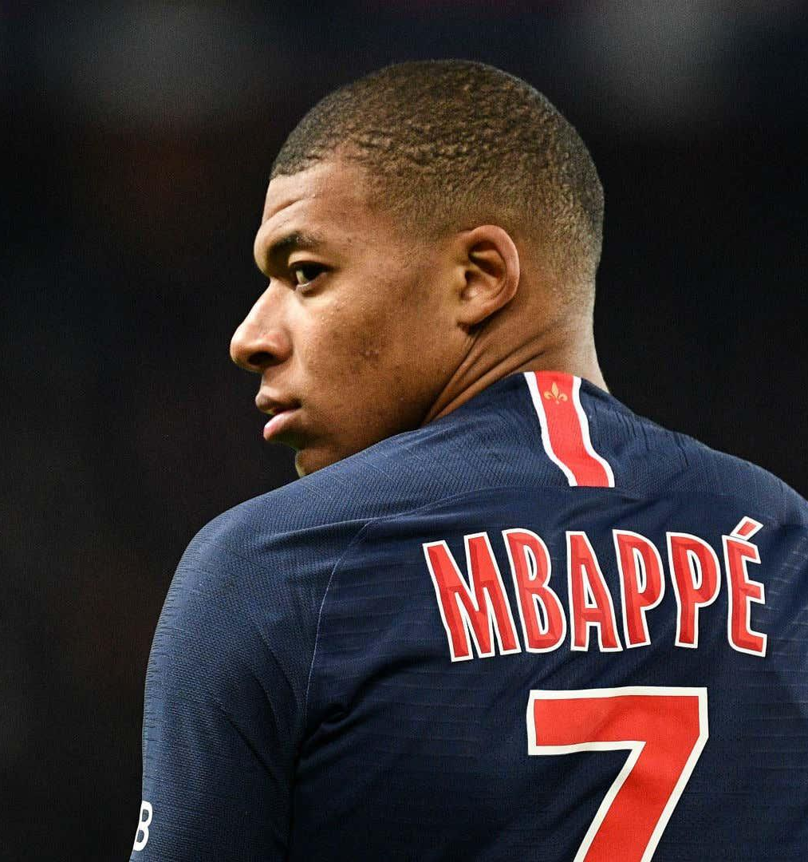

DATA SOURCE
All data has been obtained from FBRef.com.
FBRef is an online free database with data on over 178,000 players.
For this project, I have looked at 2820 players from the top 5 Leagues in Europe
2

Slide 5
K-NEAREST NEIGHBOR ANALYSIS
Whats is a KNN Analysis?
The KNN is an algorithm that assumes that similar things exists in close proximity. Similar things are near to each other.
The concept of similarity refers to the distance between two given points.
There are other ways to calculate similarity, distance, proximity, or closeness:
Euclidean Distance
Cosine Similarity
2

Slide 6
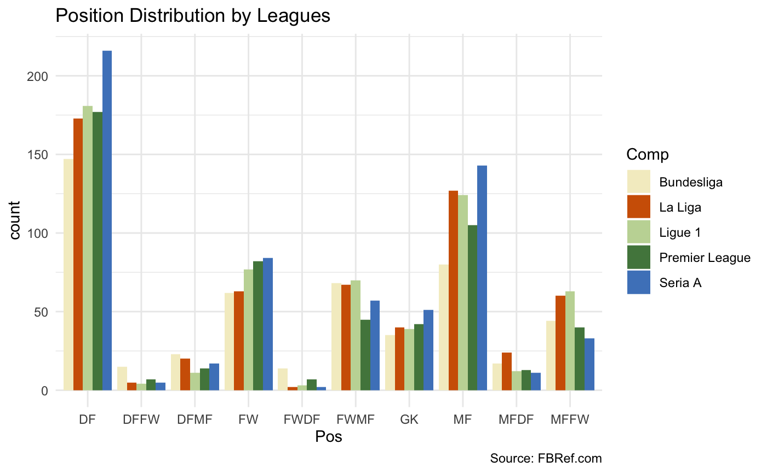
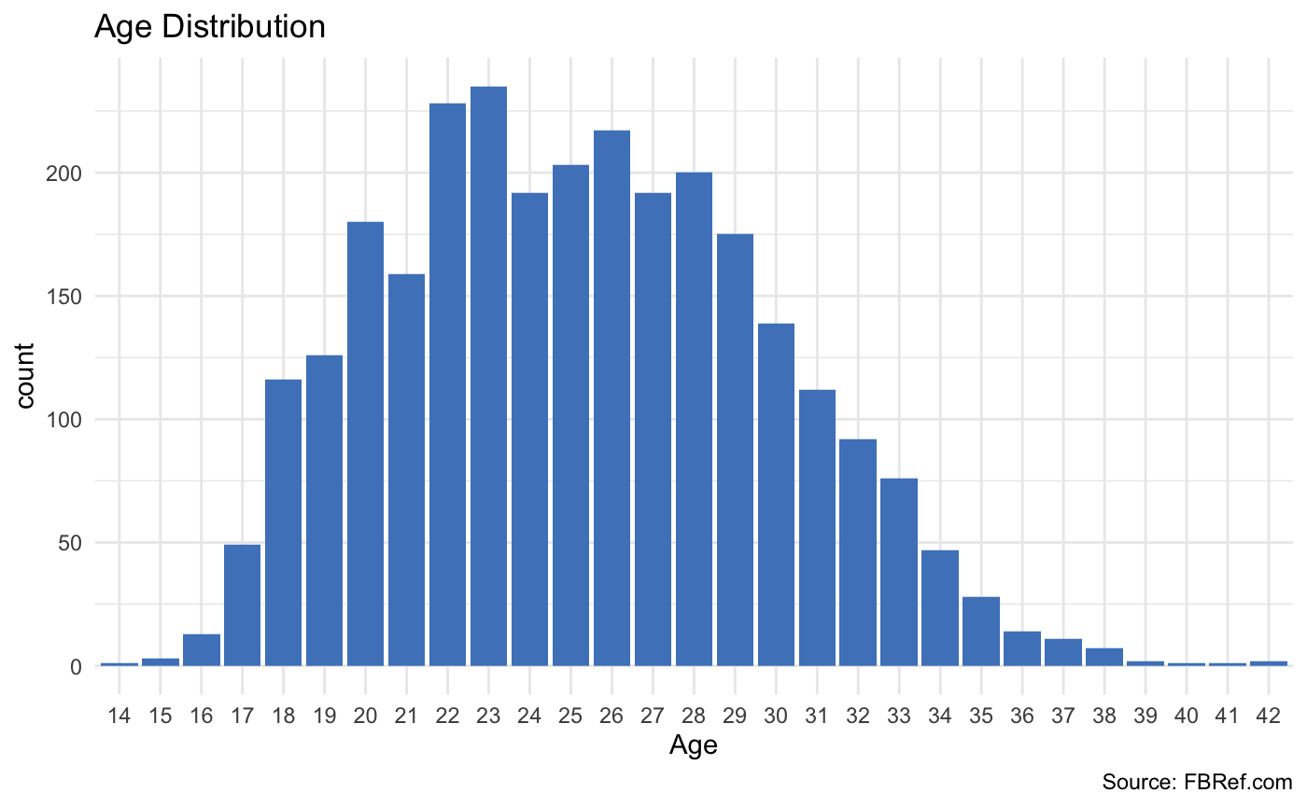
FINDINGS
Position Distribution Among Leagues
Age Distribution
Nearest Neighbor Analysis with Similarity Score
Age:
Mean: 25.24
Mode: 23
Median: 25
3

Slide 7
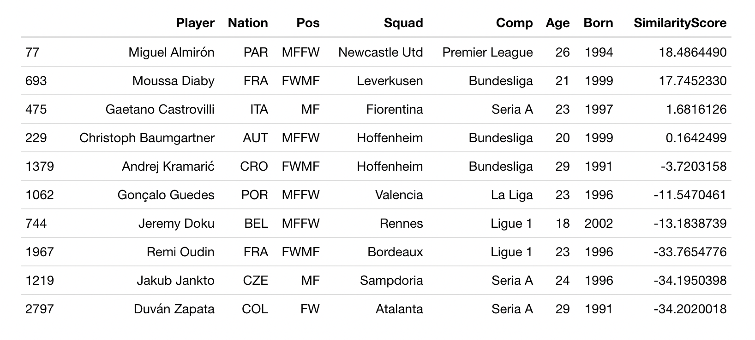
FINDINGS
3

Slide 8
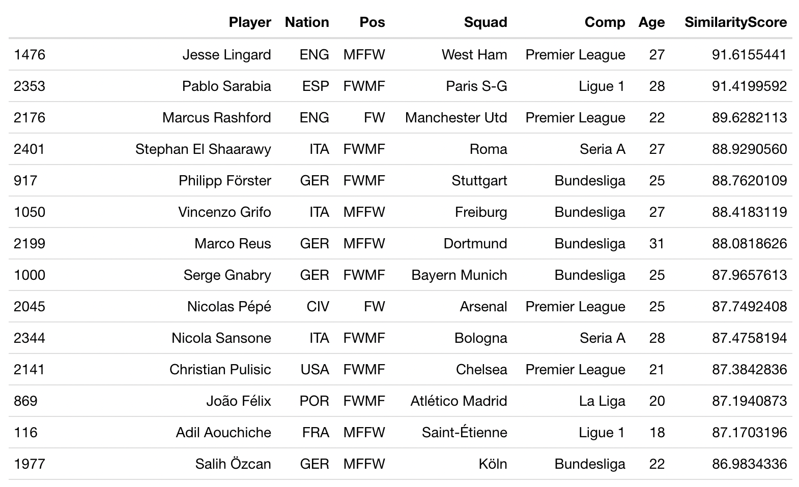
FINDINGS
Position Specific KPIs (all per 90 min)
Goals
Assists
Expected Goals (xG)
Expected Assists (xA)
Shots
SoT
SoT%
CMP (Passes Completed)
CMP%
PPA (CMP into 18-yard box
Progressive Passes
Touches
Successful Dribbles
SuccDrib%
Carries
Carries To Box
SCA
GCA
GCDrib
GCShot
3

Slide 9
SHINY APP
Please type the following link on your computer:
https://bqcq0v-tobias-rodriguez.shinyapps.io/ShinyProject/
5

Slide 10
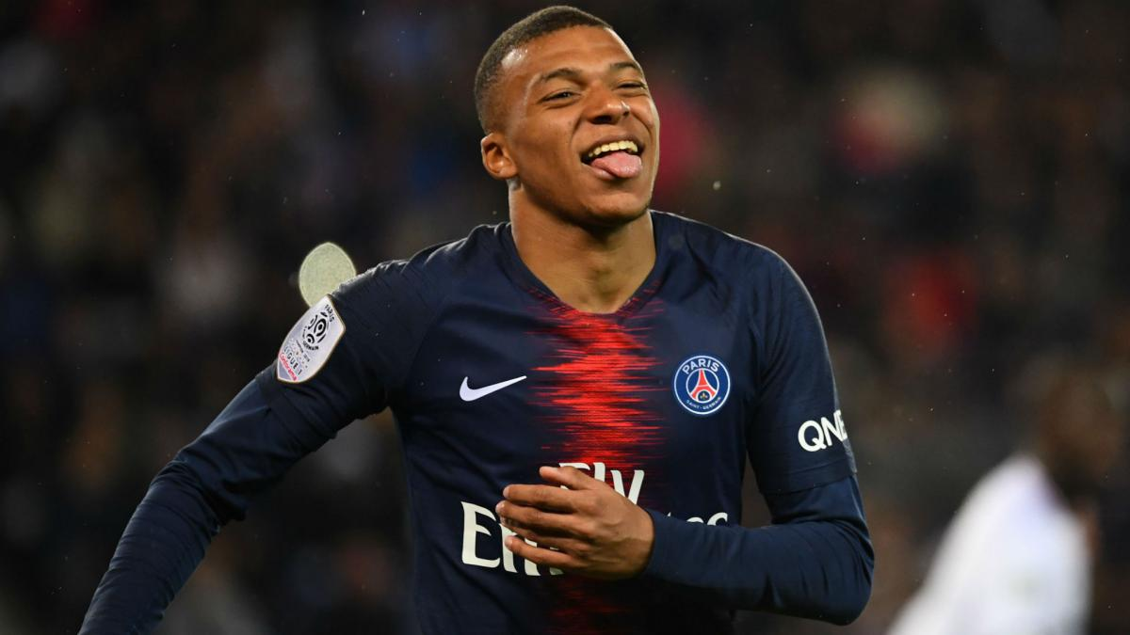
THANKS
Does anyone have any questions?
Tobias Rodriguez Brindicci
St. Thomas University
CIS541 Final Project

