Slide 1

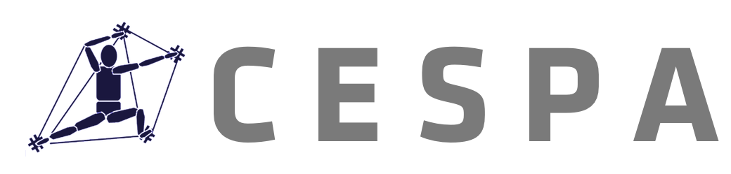
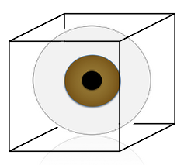
Compatibility Effects in Bistable Perception of the Necker Cube
T. R. Brooks | Till Frank | James Dixon
T. R. Brooks
ICPA 19 | Seoul, Korea

Slide 2
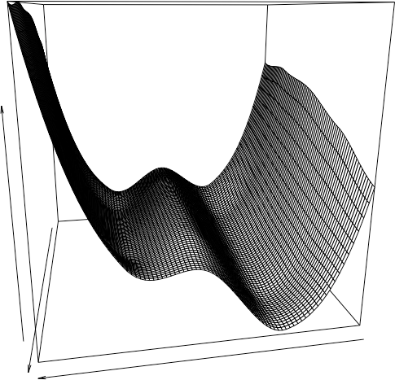
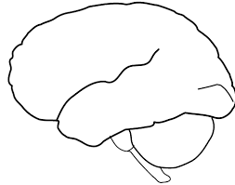
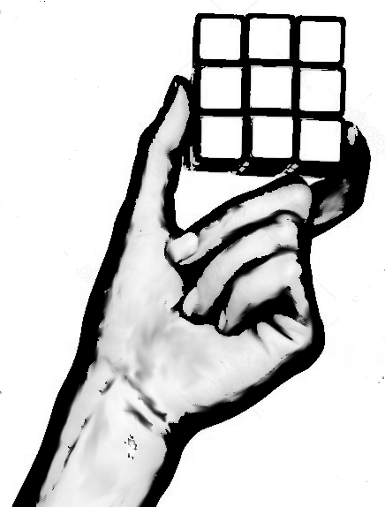
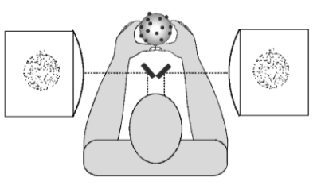
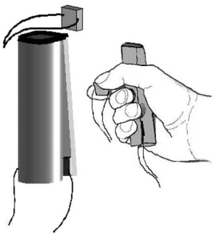
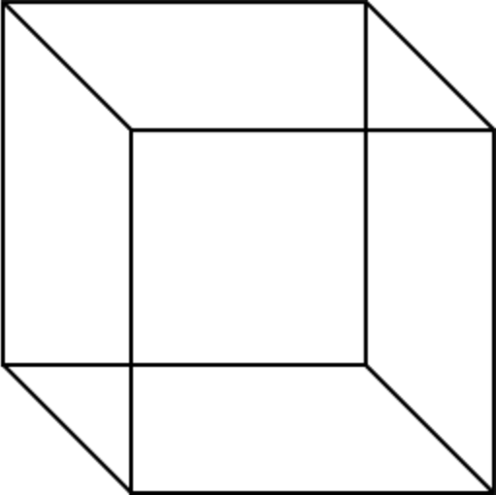
DORSAL
“Multisensory Integration”
Rules for combining
Information “boosts a signal”¹
Ecological (lazy) approach
Combined elements detected directly.
A “landscape” of perception/action space²
Visual
VENTRAL
→ What would an ecological version of these experiments look like?
Don’t try to separate perception from action. The report is the task. The action is the stimulus
Should track development over time (perceptual learning).
Haptic
Bistable Perception
“Micro-affordance³”
Report
State
Time
T. R. Brooks
ICPA 19 | Seoul, Korea
³Ellis et al., 2007.
¹Tong, Meng, & Blake, 2006.
²Stoffregen & Bardy, 1997.
Notes:
Add in part/whole image?

Slide 3
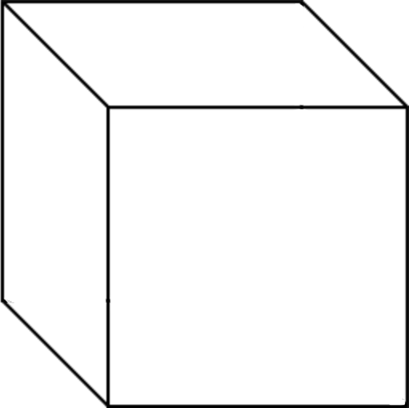
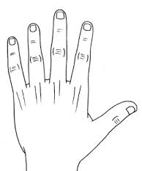
The Experiment
Compatible Condition
Participants viewed a bistable image and reported its orientation.
Cube-shaped lever used for report
An additional exterior figure was provided to show the participant what was being reported.
Compatibility of lever with exterior cube was manipulated
Outer figure controlled using lever
Inner figure (Necker cube) appears to change orientations spontaneously
Task: “Match the orientation of the outer figure to the perceived orientation of the inner figure using the controller”
T. R. Brooks
ICPA 19 | Seoul, Korea
Notes:
Mention ellis & tucker?

Slide 4
The Experiment
Incompatible Condition
Participants viewed a bistable image and reported its orientation.
Cube-shaped lever used for report
An additional exterior figure was provided to show the participant what was being reported.
Compatibility of lever with exterior cube was manipulated
Outer figure controlled using lever
Inner figure (Necker cube) appears to change orientations spontaneously
Disadvantage: Task no longer differentiates, stimulus from response.
Advantage: Task no longer differentiates stimulus from response.
Task: “Match the orientation of the outer figure to the perceived orientation of the inner figure using the controller”
T. R. Brooks
ICPA 19 | Seoul, Korea

Slide 5
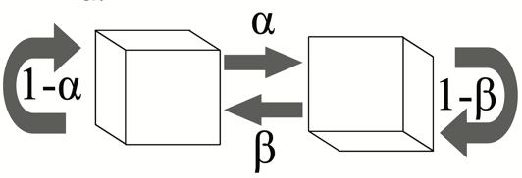
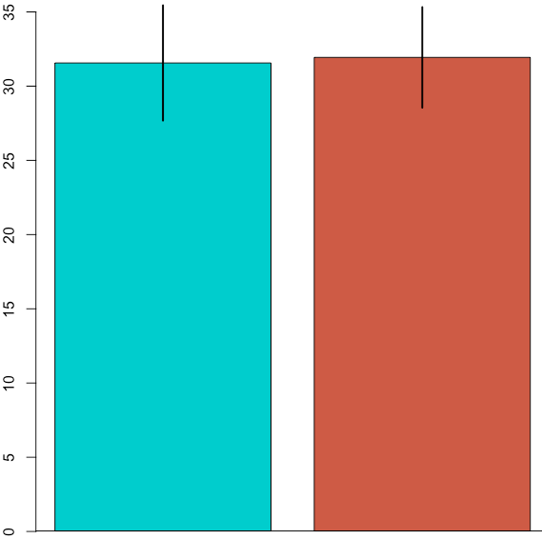
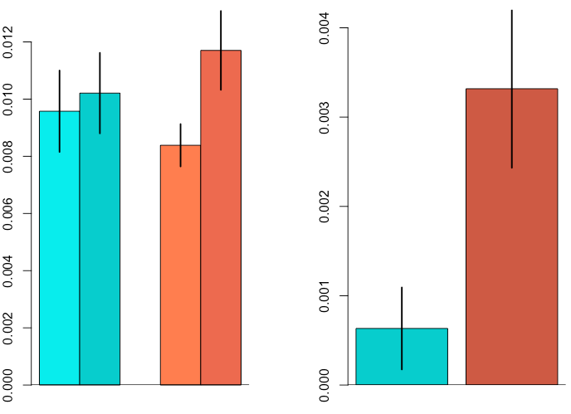
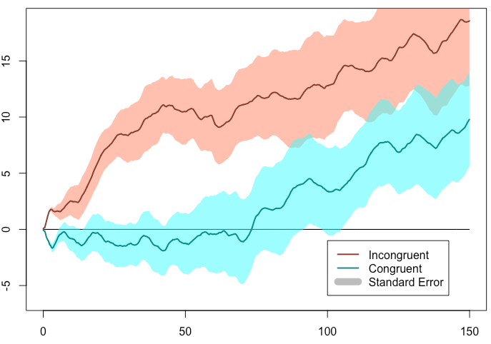
Results
Did the signals “boost” each other?
Are preferences affected?
𝝰 = p (down-to-up)
𝝱 = p (up-to-down)
What should we expect according to MI?
Visual and haptic signals “boost” each other
H1: Fewer switches in the compatible condition
Also: Greater preference for one position over the other in the compatible condition (due to stabilizing influence.)
What should we expect according to EP / GA (lazy) theory?
Visual and haptic information “warps” landscape of perception/action states
H1: Same as above, but evolves over time
H2: Some (non-obvious) effect that is different from above, which evolves over time
𝝱 - 𝝰
Number of Switches
𝝰
𝝱
𝝰
𝝱
Compatible
Incompatible
Compatible
Incompatible
Compatible
Incompatible
Preference for down position
Participants preferred the “down” orientation
Preference emerged sooner in incompatible condition
↑
+1
-1
↓
Time
ICPA 19 | Seoul, Korea
Notes:
Add in experiment schematic at bottom?

Slide 6
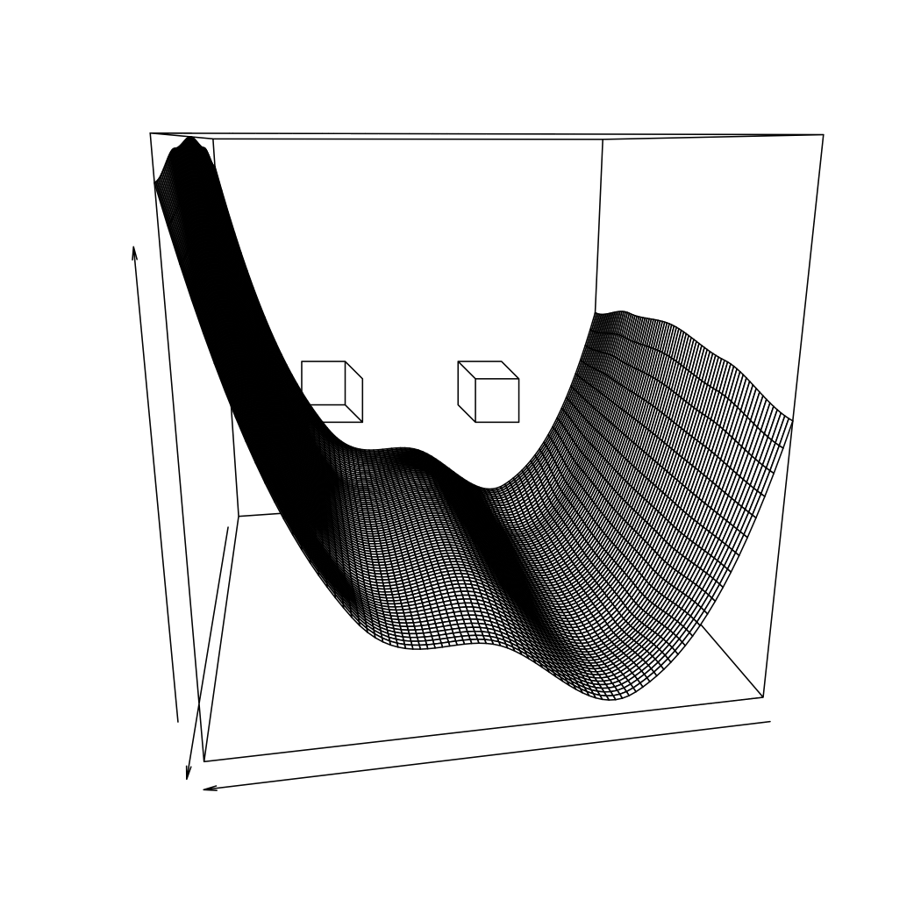
Conclusions (Final Slide!)
Perception across modalities is more (or different) than “boosting a signal”.
The landscape model’s advantage is what it does not assume:
perception - action, stimulus – response separate processes
Influence constant over time (stationary)
Lazy Approach to the rescue?
Greater noise in system
ICPA 19 | Seoul, Korea
Notes:
Bring it back home to big picture
Make better plots (colors, fewer, etc.

Slide 7
Conclusions (Final Slide!)
Perception across modalities is more (or different) than “boosting a signal”.
The landscape model’s advantage is what it does not assume:
perception - action, stimulus – response separate processes
Influence constant over time (stationary)
Lazy Approach to the rescue?
Greater noise in system
Change in attractor strength over time
Compatibility as an initial condition
Perceptual learning as end-directed development
“Hard work might pay off in the future, but laziness pays off right now.”
ICPA 19 | Seoul, Korea
Notes:
Bring it back home to big picture
Make better plots (colors, fewer, etc.

Slide 8
This presentation file can be downloaded at:
github.com/trbrooks/ICPA19
ICPA 19 | Seoul, Korea

Slide 9
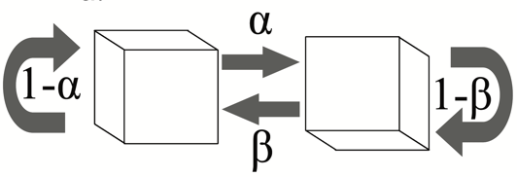
ICPA 19 | Seoul, Korea

Slide 10
Training Phase (Compatible)
Order:
Compatible Training
Compatible Test
Incompatible Training
Incompatible Test
Outer figure controlled using lever
Inner figure (Necker cube) appears to change orientations spontaneously
Task: “Keep the outer figure matched to the inner figure using the lever”
T. R. Brooks
ICPA 2017 | Seoul, Korea

Slide 11
Training Phase (Incompatible)
Order:
Compatible Training
Compatible Test
Incompatible Training
Incompatible Test
Outer figure controlled using lever
Inner figure (disambiguatedcube) changes orientation at random intervals
Task: “Keep the outer figure matched to the inner figure using the lever”
T. R. Brooks
ICPA 2017 | Seoul, Korea

Slide 12
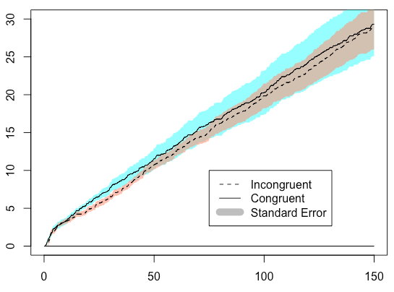
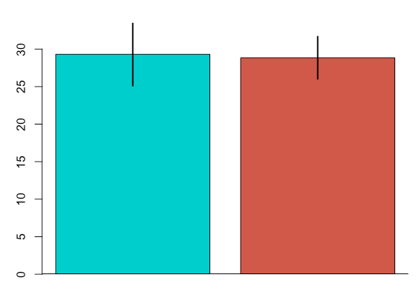
Mean of running total of number of switches
Time (Seconds)
ICPA 19 | Seoul, Korea

