Slide 1
Advanced Robotics Programming Class Lesson 3: Creating a Robot Base with TeleOp Control
Titan Robotics Club FRC492
Michael Tsang (Programming Mentor)

Slide 2
Agenda
In this lesson, you will learn:
Simple Motor
Game Controller and Button Panel
Control a Motor With Analog Joystick
Student Exercise: Create a simple drive base and control it with analog joystick
Student exercise: Create a mecanum drive base and control it with analog joystick

Slide 3
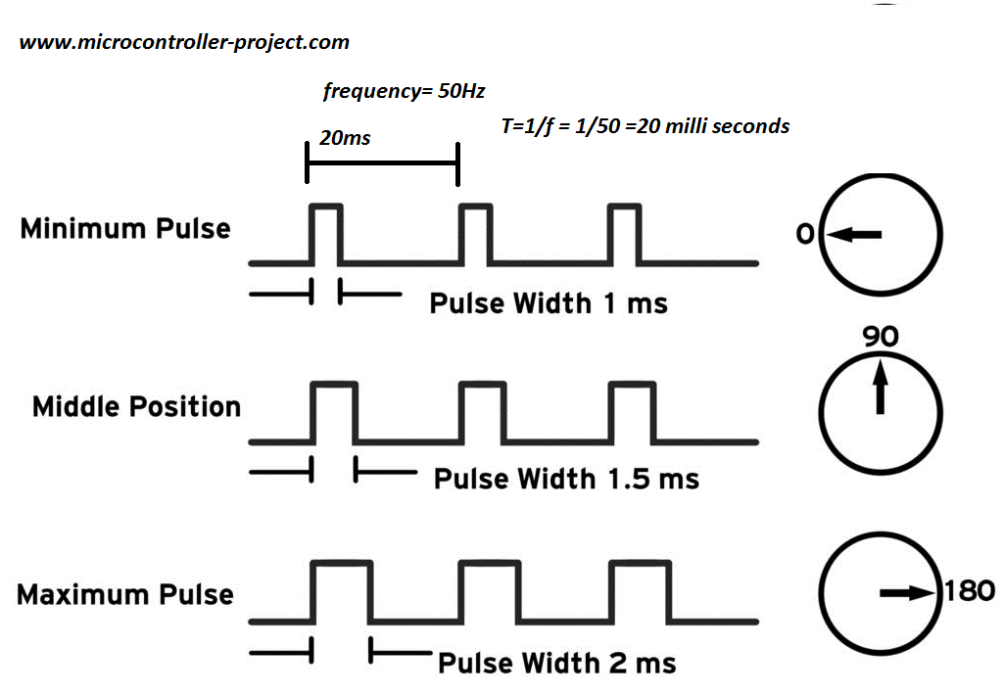
Simple Motor
Two types of motor controllers: simple motor controllers, smart motor controllers (PWM vs. communication protocol).
Create an instance of a motor controller object.
Example: FrcCANTalon – Constructor needs instance name and CAN ID.
Motor controller object properties:
Motor direction.
Encoder direction.
Encoder and odometry.
Limit switches.
Reset odometry on digital trigger.
Zero calibration.
Brake mode.
Power mode vs velocity mode.
Built-in PID control.

Slide 4
Game Controller and Button Panel
Create an instance of a game controller object.
Example: FrcJoystick, FrcXboxController – Constructor needs instance name and port number.
Typical game controller consists of:
A number of analog sticks (can have multiple axes).
A number of analog throttles/twists.
A number of buttons.
Button panel consists of an array of buttons.
Game controller/Button panel object properties:
Y axis direction.
Analog control deadband.
Analog control response curve.
Button event handler.

Slide 5
Control a Motor with Analog Joystick
Understanding analog joystick input to power output curve.
Create and configure a game controller.
Create and configure a motor.
Enable motor odometry.
Add code to read joystick value and set motor power with it.
Add code to display motor odometry.

Slide 6
Exercise: Simple Drive Base
Control a simple drive base with analog joysticks.
Create and configure game controller(s).
Create and configure 2 motors.
Create and configure a simple drive base with the 2 motors.
Add TeleOp code to run the simple drive base with the joysticks using tank drive.
Enable motor and drive base odometries.
Add code to display drive base odometry.

Slide 7
Exercise: Mecanum Drive Base
Control a mecanum drive base with analog joysticks.
Create and configure game controller(s).
Create and configure 4 motors.
Create and configure a mecanum drive base with the 4 motors.
Add TeleOp code to run the mecanum drive base with the joysticks.
Enable motor and drive base odometries.
Add code to display drive base odometry.

