Slide 1
Advanced Robotics Programming Class Lesson 4: Simple Actuators
Titan Robotics Club FRC492
Michael Tsang (Programming Mentor)

Slide 2
Agenda
In this lesson, you will learn:
Simple Servo
Game Controller Buttons
Student Exercise: Control a servo using game controller button
Enhanced Servo
Student Exercise: Control a grabber using game controller button
Pneumatic
Student Exercise: Control pneumatic using buttons on a button panel

Slide 3
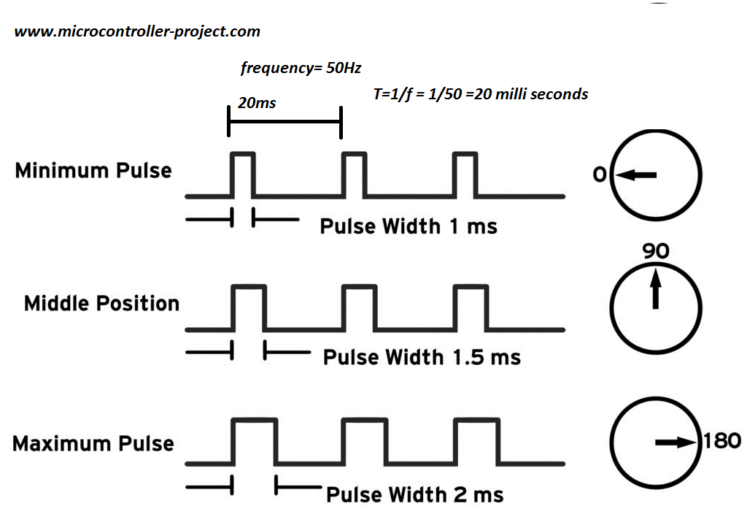
Simple Servo
Two types of servos: positional servo, continuous servo.
Servos are controlled by PWM.
Create an instance of a servo object.
FrcServo: Constructor needs instance name and a PWM channel number.
Servo object properties:
Servo direction.
Servo position.
Logical position vs Physical position.

Slide 4
Game Controller Buttons
Create an instance of a game controller object.
Create a button event handler and hook it up to the game controller object.
Button event handler gets called when a button is pressed and when a button is released.
Three different ways to control action using buttons, for example:
One button to close the grabber, another button to open the grabber.
Press the button to close the grabber, release the button to open the grabber.
Press the button once to close the grabber, press it again to open the grabber (i.e. Toggle button)

Slide 5
Exercise: Simple Servo
Control a simple servo using buttons on a button panel.
Create and configure a game controller.
Create and configure a servo.
Create a button event handler and hook it up to the game controller object.
Add code to the button event handler to set servo positions responding to button events.
Add code to display servo status.
Extra credit: control the servo with 2 buttons, 1 button and toggle button.

Slide 6
Enhanced Servo
Create an instance of an enhanced servo object.
TrcEnhancedServo – Constructor needs instance name, one or two physical servos, optional lower/upper limit switches.
Enhanced servo object properties:
Dual servo support.
Regular servo vs continuous servo.
Limit switches support.
Encoder support.
Range calibration.
Speed control and step mode.

Slide 7
Exercise: 2-servo Grabber
Control a 2-servo grabber using buttons on a game controller.
Create and configure a game controller.
Create and configure two servos.
Create and configure an Enhanced Servo with the 2 servos.
Create a button event handler and hook it up to the game controller object.
Add code to the button event handler to set servo positions responding to button events.
Add code to display servo status.
Extra credit: use an analog control on the game controller to control the position of the grabber opening or closing.

Slide 8
Pneumatic
Create an instance of a pneumatic object.
FrcPneumatic – Constructor needs PCM number and one or more channel numbers.
Pneumatic object properties:
Set pneumatic channels ON or OFF.
Set pneumatic channels ON only for the specified period.
Set pneumatic channel pattern 1 for set period 1 and then pattern 2 for set period 2 and optionally repeat.
Set action list that specifies what channel pattern to set for the specified period and optionally repeat.
Extend, Retract, Timed Extend.
isExtended – Check the state of the pneumatic cylinder.

Slide 9
Exercise: 2-channel Pneumatic Cylinder
Control a 2-channel pneumatic cylinder to extend and retract using game controller buttons.
Create and configure a game controller.
Create and configure a 2-channel pneumatic object.
Create a button event handler and hook it up to the game controller object.
Add code to the button event handler to extend or retract the cylinder.
Add code to display pneumatic status.
Extra credit: make the button to do a timed actuation of the pneumatic cylinder.

