Slide 1
Advanced Robotics Programming Class Lesson 5: PID Control
Titan Robotics Club FRC492
Michael Tsang (Programming Mentor)

Slide 2
Agenda
In this lesson, you will learn:
What is PID Control?
Tuning PID
PID Limitations
Feed Forward (PIDF)
Power Compensation
PID Controller
PID Controlled Actuators (e.g. Elevator)
Student Exercise: Control an elevator using a joystick

Slide 3
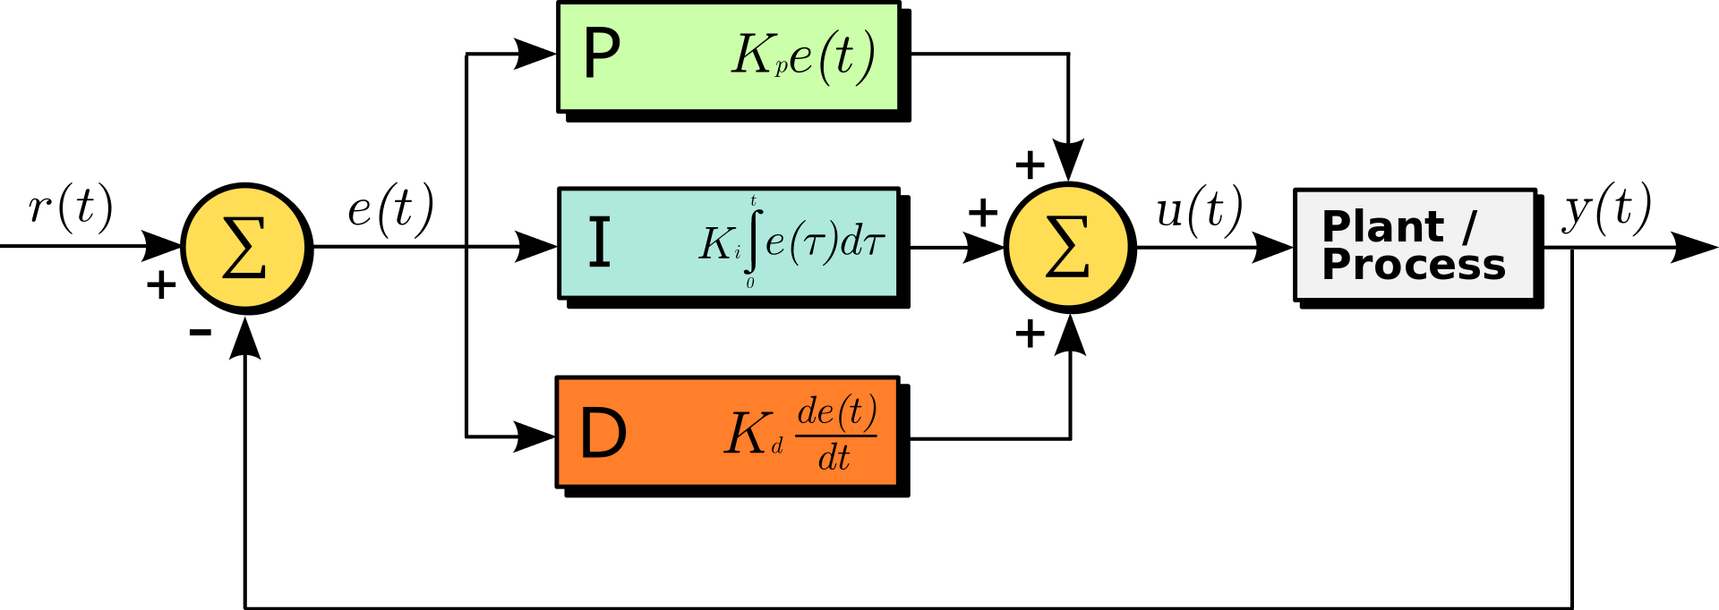
What is PID Control?
PID is a popular control mechanism utilizing sensor feedback.
PID stands for Proportional, Integral and Derivative. PID control is the sum of these 3 weighted terms. Poutput = Kp*e(t) + Ki *∫e(t)dt + Kd*de(t)/dt
Proportion Term: power output is proportional to how far we are from target (error).
Integral Term: power output is proportional to cumulative error.
Derivative Term: power output is proportional the error change rate.
Read more about it here: PID controller – Wikipedia

Slide 4
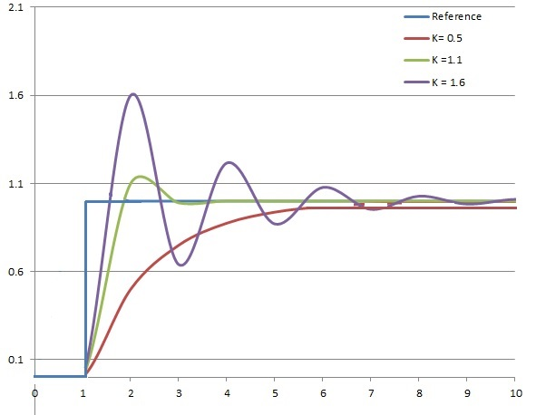
Proportional Term
Power output is proportional to the error (i.e. distance to target). The larger the distance to target, the larger the error, the larger the output power. Poutput = Kp*e(t)
In English: Power output is largest when we are far away from target. As we get closer, the error becomes smaller and so is the power output (i.e. we slow down when we get close).
Problem with P-only controller (Ki and Kd set to zero): when error becomes too small, output power becomes so small that it cannot overcome friction (i.e. it will never reach target – steady state error).
This graph shows the response curve varying Kp while keeping Ki and Kd constant.

Slide 5
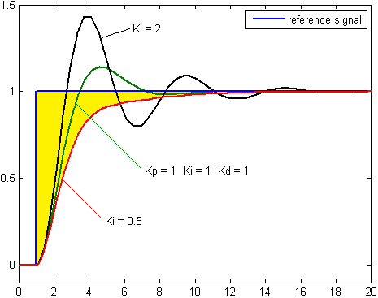
Integral Term
Power output is proportional to the cumulative error (i.e. time integral of the error – yellow area under the curve). The longer we have an error, the larger the yellow area, the larger the corrective output. Poutput = Ki *∫e(t)dt
In English: In P-only controller, we have a steady state error that will go on forever. The I term in a PI-controller will cause power output to increase (winding up) as time goes on integrating steady state error giving it more power to overcome friction and eventually achieve target.
Problem with I-term: the winding up of power will eventually overcome friction causing it to spring forward. This causes instability (i.e. oscillation).
This graph shows the response curve varying Ki while keeping Kp and Kd constant.

Slide 6
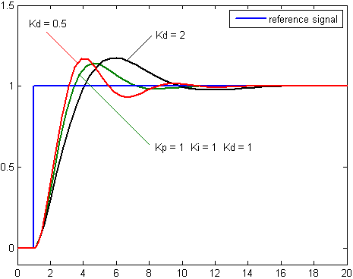
Derivative Term
Power output is proportional to the error change rate (i.e. the faster the error changes, the steeper the slope, the larger the corrective output). Poutput = Kd*de(t)/dt
In English: In the PI-only controller, the I-term causes oscillation. The spring forward means we have a high error change rate (i.e. the error decreases rapidly – a large negative number). This creates a “braking” effect. The stronger the spring forward force, the stronger the braking. This suppresses oscillation created by the I-term. In general, the D-term decreases the slope of the curve making the response curve gentler.
This graph shows the response curve varying Kd while keeping Ki and Kd constant.

Slide 7
Putting It All Together
In PID control, by tuning the three PID constants (Kp, Ki and Kd), we control the weight of each term. When tuned perfectly, we will reach target the fastest and yet stable (with minimal oscillation – oscillates once or twice is acceptable).
To make an analogy to a vehicle: Kp is like the gas pedal, Kd is like the brake pedal.
A note on “reaching target”: In computer control, target must be “fuzzy”. It is impossible to reach exact target. Therefore, we must have “tolerance” in the concept of target. For example, going forward 5 feet with a tolerance of 2 inches means we consider target reached if we reached a distance between 58 to 62 inches (i.e. close enough).

Slide 8
Tuning PID
Tuning PID means determining the values of the three constants: Kp, Ki and Kd.
Estimate initial Kp by asking yourself the question: what “distance to target” should we slow down to 50% power? For example, if we drive the robot forward 10 feet, we may want to slow down to 50% power when we are 24 inches away. Poutput = Kp*e(t) => 0.5 = Kp*24 => Kp = 0.5/24 => Kp = 0.02
Set both Ki and Kd to zero. Tune Kp up or down from the initial value until it starts to oscillate. If it doesn’t oscillate or even reach target, increase Kp. If it oscillates too much, decrease Kp.
Once it oscillates a little too much, set Kd to an initial value of Kp/10. Then tune Kd up or down until it just overshoots a little bit and settles fairly quickly.
Generally, we want a stronger Kp so it has enough power to reach target quicker and be able to overcome friction even with smaller target distance. To do this, we increase Kp more until it oscillates a little too much. Then tune Kd up until it settles quickly. Keep repeating this process of increasing Kp and Kd until it reaches the desired behavior that it reaches target quickly and settling fairly quickly. It’s a balance of pressing more on the gas pedal but also pressing more on the brake until we have satisfactory result.
In most scenarios, we don’t like to deal with the I-term and set Ki to zero because it is very sensitive and causes instability so we essentially have a PD-only controller. However, if you require very tight tolerance, you may want to try tuning the I-term but Ki should be much smaller than Kp and Kd and a bigger Kd to suppress oscillation.

Slide 9
PID Limitations
PID control is a feedback control system that reacts to error changes.
There are scenarios that PID controller performs poorly:
Speed control: when a spinning motor is at target RPM, error becomes zero. PID controller output will also become zero that cuts power to the motor. Motor will slow down until the error is big enough to maintain a certain power level that spins the motor at a speed lower than the target speed (i.e. steady state error).
Controlling mechanisms that are against gravity (e.g. elevator): Similar to speed control, when the elevator is at target height, error becomes zero that cuts power. The elevator will drop to a height until the resulting error generates a certain power level maintaining a height that’s lower than target height. In addition, it takes more effort for the elevator to go up than coming down. In the elevator scenario, at least the effect of gravity is constant.
Controlling non-linear mechanisms (e.g. swing arm): Similar to an elevator, a swing arm is working against gravity but it is not linear. The effect of gravity on the swing arm is proportional to the sine of the arm angle. The arm is heaviest when it is completely horizontal and lightest when it is vertical.
Do not react to changing process behavior (e.g. battery running down, static vs dynamic friction): Even PID is perfectly tuned, as the battery is running down, the mechanism may no longer reach target (i.e. increased steady state error). When PID is perfectly tuned for a larger SetPoint, one may notice a larger steady state error when the SetPoint is small.

Slide 10
Feed Forward (PIDF)
Introduce Feed Forward to PID to make it PIDF: Poutput = Kp*e(t) + Ki *∫e(t)dt + Kd*de(t)/dt + Kf*SetPoint
Speed control: When a motor is at target RPM, all error related terms become zero (i.e. P-term, I-term and D-term), but the F-term will generate power proportional to the target speed (i.e. SetPoint). Therefore, the faster the target speed, the higher the power level to maintain that speed.
To determine Kf, plot the “Poutput vs motor speed“ curve. Set motor power from 0.1 to 1.0 with a step of 0.1, record the motor speed at each motor power step. The curve should be fairly linear. Kf is the slope of the line. Since you know it’s linear, a quicker way is to set the motor power to any level (e.g. 0.5) and just record the speed. Then Kf = Poutput/SetPoint where Poutput was 0.5 and SetPoint was the recorded motor speed.

Slide 11
Power Compensation
In scenarios where the mechanism is against gravity, non-linear or the process behavior is changing dynamically, even PIDF controller is not able to perform satisfactorily. In these scenarios, we need to add Power Compensation to the PIDF controller. Poutput = Kp*e(t) + Ki *∫e(t)dt + Kd*de(t)/dt + Kf*SetPoint + PowerComp
Elevator: In this scenario, PowerComp is constant and is proportional to the weight of the elevator. PowerComp can be tuned by increasing motor power until elevator will hold its position and not dropping.
Swing Arm: In this scenario, PowerComp is proportional to the torque on the pivot point which is proportional to the sine of the arm angle. Exercise: figure out how to determine PowerComp.
Power Fluctuation (e.g. battery running low): In this scenario, PowerComp is inversely proportional to the battery voltage.
Since PowerComp changes with different scenarios and may even be dynamic (i.e. changes with time), it is a callback handler. Whenever, we need to calculate Poutput, we call the callback handle to determine the amount of power compensation.

Slide 12
PID Controller
TrcPidController Constructor: instance name, PID coefficients, tolerance, settling time, feedback data source, power compensation source.
PID controller object properties:
setInverted – controls the feedback sensor direction.
setAbsoluteSetPoint – controls if the setpoint is absolute or relative to current position.
setNoOscillation – prevents the PID controller to oscillate back and forth.
setRampRate – limits the acceleration or deceleration of the PID controlled mechanism.
setOutputLimit – limits the top speed of the PID controlled mechanism.
setTarget – sets the target setpoint.
isOnTarget – check if the mechanism has reached target.
getOutput – applies PID control algorithm to calculate output power.

Slide 13
PID Controlled Actuator
TrcPidActuator Constructor: instance name, 1 or 2 physical motors, a lower limit switch, a PID controller, movement range and other optional parameters.
PID Actuator object properties:
setPositionScale – make actuator works with real world units.
getPosition – inquire the actuator position.
setTarget – set and hold the actuator position using PID control.
setPower – move the actuator at the specified power and optionally hold position.
setPowerWithinPosRange – move actuator at specified power but applying PID control when it is close to lower or upper position limits.
setManualOverride – overriding PID control.
zeroCalibrate – perform Zero Calibration.
getCompensation – calculate power compensation to account for gravity, for example.

Slide 14
Exercise: Elevator
Control an elevator using an analog joystick.
Create and configure a game controller and hook a button event handler to it.
Create and configure a motor.
Create and configure a lower limit switch.
Create and configure a PID controller.
Create and configure a PID controlled actuator object.
Add TeleOp code for zero calibration and manual override.
Add TeleOp code to run the elevator up and down.
Add code to display elevator status.
Extra credit: hook up a power compensation handler to compensate for gravity.

Slide 15
PID Controlled Drive
TrcPidDrive Constructor: instance name, drive base, 3 PID controllers (X, Y and turn).
PID Drive object properties:
Absolute Target mode – Can minimize cumulative error
WarpSpace mode – Mainly for robot heading
Absolute Pose – Absolute field position of the robot
Absolute Target Pose – Absolute intended position of the robot
Stuck wheel detection – Detect if any of the wheels are stuck
Turn mode – in-place, pivot, curve
Set Relative Target – Target is relative to current position of the robot
Set Absolute Target – Target is absolute field position
Set Sensor Target – Target is determined by sensors
Constant Heading Drive - Manual Drive but maintain constant heading

Slide 16
Exercise: PID Controlled Mecanum Drive
Press a button to have the robot drive forward 10 feet, another button to strafe left 5 feet, another button to drive backward 7 feet, another button to turn left 90 degrees.
Create a game controller object and hook a button event handler to it.
Create and configure 4 motors for a mecanum drive base.
Create and configure an IMU (i.e. gyro among other things).
Create and configure a mecanum drive base.
Create and configure 3 PID controllers.
Create and configure a PID Drive object with the drive base and 3 PID controllers.
Add code in TeleOp to the button event handler to do the driving.
Add code to display the robot position on the field.
Extra credit: Enable Absolute Target mode for the drive.

