Slide 1
Advanced Robotics Programming Class Lesson 2: Basic Robot Components
Titan Robotics Club FRC492
Michael Tsang (Programming Mentor)

Slide 2
Agenda
In this lesson, you will learn:
Information Displays
Java Console
Dashboard: Shuffleboard
Input: Game Controller and Button Panel
Output: Motor Controllers
Output: Servo Motors
Output: Pneumatics

Slide 3
Information Display
For operating the robot and for debugging, we need mechanisms to display information from your code to the Driver Station Laptop. There are two main display mechanisms:
Java Console: mainly for outputting information as strings and will scroll away as more information is printed to the console.
Dashboard: can be bidirectional, outputting as well as inputting information. Information can be of different data types (Boolean, Number, String, Raw date bytes).
Output: Can select how the info is displayed. If displayed as text/number fields, they are displayed at fixed locations on the screen, will not scroll away but will keep changing as the information is updated. If desire to see history of the changing values, one can display the info as a time graph.
Input: Allows user to input information (Boolean, Number, String, SendableChooser) so that robot code can read them. Example uses include picking autonomous strategies and competition parameters.

Slide 4
Java Console
Standard console associated with the Java VM. Can be written to by calling System.out methods such as println(), print() and printf() to output strings. Java Console can be hosted by Visual Studio Code or Driver Station app. This tends to be quite chatty because all code components write to it, including our code, WPILib, 3rd-party Vendor Libraries and other systems. Outputs are also captured into the RoboRIO log file for post examination.
Pros:
Captures everything in chronological order (i.e. what happens before what).
Keeps history of the values if data is printed periodically so you can examine the data trend.
Cons:
Captures everything and thus quite chatty. Information could be hard to spot especially if information are printed periodically at a fast rate.
If information is printed periodically, it could overwhelm the console (hundreds of lines per second). Console usually has a limited buffer capacity which means you will start losing info at the beginning when the buffer gets full.

Slide 5
Console Output: TrcDbgTrace
Provided by our framework and is built on top of console output.
Features additional to conventional console output:
Allows specifying different message level of the output information thus allowing verbosity filtering (traceFatal, traceErr, traceWarn, traceInfo, traceVerbose).
Allows logging to our own log file asynchronously thus filtering out information from other parties (reducing chatters).
Provides methods to print the thread stack (printThreadStack) giving you the ability to “catch the culprit” during debugging (i.e. who did this?).
Provides methods to log events. Unlike messages that are unstructured, events are structured output that can be parsed by analytic tools such as TrcTraceLogAnalyzer that can visually replay events occurred in autonomous, for example.
Get an instance of TrcDbgTrace: TrcDbgTrace.getGlobalTracer() or simply robot.globalTracer.
Popular methods: void traceInfo(String funcName, String format, Object... args) void printThreadStack()
Format String: most commonly used substitutions are %d (for integers), %f (for floats and doubles) and %s (for strings). For %f, you can even specify decimal places (e.g. %6.3f).

Slide 6
Exercise: Console Output
In FrcTeleOp.java, add code to print to the console the square root values of 1 to 100 without using any loops (hint: use the periodic method). Use the following methods:
robot.globalTracer.traceInfo
Math.sqrt

Slide 7
Dashboard: FrcDashboard
Dashboard is a plug-in to the Driver Station app. FIRST provided a few Dashboard apps but we will focus on the Shuffleboard app which is what we use. Information is written by calling SmartDashboard methods which communicates with the Shuffleboard app via Network Table. Information written can be of different data types: Boolean, Number, String and Raw data bytes.
Pros:
Information is updated in a field on the SmartDashboard that won’t scroll away.
Information can be displayed in different UI: number, text, switch state, or even a time graph or other widgets.
Dashboard is bidirectional so it can be used to get user input (e.g. making choices for autonomous, or getting input for tuning PID).
Cons:
Information is always updated to the current value which means you don’t see the value history unless it is displayed in a time graph.
Will not show time relationship between different data values (e.g. what changed before what?).
Periodic values will keep changing and will not freeze so you can’t look for a particular value in time.
FrcDashboard is provided by our framework and is built on top of WPILib SmartDashboard.
Features additional to WPILib SmartDashboard:
Simulates a 16-line LCD display where code can put information in a specified line on the simulated display.
Get an instance of the Dashboard: FrcDashboard.getInstance(), or simply robot.dashboard.
Popular methods: void displayPrintf(int lineNum, String format, Object... args)

Slide 8
Exercise: Dashboard Output
In FrcTeleOp.java, add code to print the TeleOp running match time to line 1 of the dashboard (hint: use the periodic method). Use the following methods:
robot.dashboard.displayPrintf
TrcTimer.getModeElapsedTime or use elapsedTime parameter in periodic

Slide 9
Input: Game Controllers
Our framework supports the following game controllers
FrcJoystick: Generic joystick and generic button/switch panels.
FrcXboxController: Xbox game controller and generic gamepad.
Typical game controller consists of:
A number of analog sticks (can have multiple axes X/Y).
A number of analog throttles/twists.
A number of buttons.
Button/Switch panel consists of an array of buttons/switches. It is presented as a joystick but with only buttons or switches, no analog control.

Slide 10
Game Controller: Analog Control
Multi-axes stick: typically X and Y but some support twist.
An axis gives a range of -1.0 to 1.0 with the center at zero, perfect for controlling motors.
Analog stick returns to center position when released but not necessarily give you zero value causing the robot to drift slowly.
Deadband: a small range of movement near the center of the analog stick is still considered center and thus returns zero value.
Analog control response curve: squared input gives you precise control at the low-end and accelerated control at the high-end.
Y inversion: Joystick was designed for airplane, push away from you is down, giving negative values. But for driving robot, push away from you is forward and need to be positive and therefore must be inverted.
Constructors: FrcJoystick(String instanceName, int controllerNum) FrcXboxController(String instanceName, int controllerNum)
Popular methods: void setYInverted(boolean inverted) double getXWithDeadband(boolean squared) double getTwistWithDeadband(boolean squared)

Slide 11
Exercise: Analog Control
In FrcTeleOp.java, add code to print the X and Y values of the joystick to line 2 of the dashboard (hint: use the periodic method). Use the following methods:
robot.dashboard.displayPrintf
robot.driveController.getXWithDeadband
Extra credits: what other analog controls are there? Print those values to the dashboard too.

Slide 12
Game Controller: Digital Control
Digital controls are buttons and switches that give you two states: ON or OFF (pressed or released).
Our framework library detects edge events of these buttons and switches. It does callbacks on the events. It means it will call your eventHandler method when a press or release event is detected.
Registering a Callback Event Handler for a game controller: robot.driverController.setButtonHandler(this::driverControllerButtonEvent)
Unregistering a Callback Event Handler for a game controller: robot.driverController.setButtonHandler(null)
Callback Event Handler: void driverControllerButtonEvent(int button, boolean pressed)
Three strategies using digital controls:
Action on pressed.
Action on toggle.
Action on pressed and hold, different action on released.

Slide 13
Exercise: Digital Control
In FrcTeleOp.java, add code to print a message when a button on the game controller is pressed or released to line 3 of the dashboard (hint: use the periodic method). Use the following methods:
robot.dashboard.displayPrintf
robot.driveController.setButtonHandler
Extra credits: create a boolean variable and use the three different digital control strategies to set its state. Print a message to the dashboard showing the state of the variable.

Slide 14
Output: Motor Controllers/Servos
Two types of motor controllers:
Simple motor controllers: controls brushed DC motors, no built-in microcontrollers, communicate with RoboRIO via PWM (Pulse Width Modulation).
Smart motor controllers: controls brushed or brushless DC motors, built-in microcontrollers, communicate with RoboRIO via CAN bus.
Three types of servo motors:
Position servos: have limited range of motion usually 90-degree or 180-degree.
Continuous servos: similar to DC motors on PWM motor controllers but with smaller form factor and weaker strength.
Digital servos: smart servo that can be programmed as position servo or continuous servo.

Slide 15
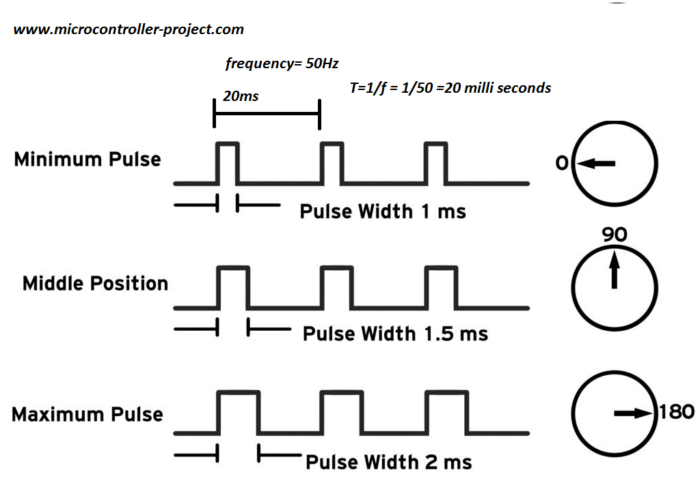
Simple Motor Controllers
Simple motor controllers are dumb controllers without built-in processors.
Communicates with the RoboRIO via PWM (Pulse Width Modulation: 1 ms full speed reverse, 1.5 ms stop, 2 ms full speed forward).
Our framework supports: FrcPWMSparkMax, FrcPWMTalonFX, FrcPWMTalonSRX, FrcPWMVictorSPX and generic FrcPWMMotorController.
Constructors: FrcPWMVictorSPX(String instanceName, int pwmChannel, Encoder encoder, FrcDigitalInput revLimitSw, FrcDigitalInput fwdLimitSw)
Popular Methods: void setInverted(boolean inverted) void stopMotor() void set(double delay, double value, double duration) void set(double value)

Slide 16
Exercise: Simple Motor Controllers
In Robot.java, create a PWM motor controller.
In FrcTeleOp.java, add code to control a motor connected to the motor controller by a game controller and print a message showing the motor power to line 4 of the dashboard (hint: use the periodic method). Use the following methods:
robot.dashboard.displayPrintf
robot.driveController.getYWithDeadband
robot.pwmMotor.set

Slide 17
Smart Motor Controllers
Smart motor controllers have built-in processors.
Communicates with the RoboRIO via CAN bus.
RoboRIO can issue CAN command to control the direction as well as the speed of the motor.
Supports position sensors (e.g. encoder or analog potentiometer) to perform close-loop control (e.g. position control or speed control).
Supports hardware limit switches to limit motor movement within a range of physical positions.
Our framework supports: FrcCANFalcon, FrcCANTalon, FrcCANSparkMax.
Constructors: FrcCANFalcon(String instanceName, int canID) FrcCANTalon(String instanceName, int canID) FrcCANSparkMax(String instanceName, int canID, boolean brushless)
Popular Methods: void setInverted(boolean inverted) void stopMotor() void set(double delay, double value, double duration) void set(double value)

Slide 18
TrcMotor
All motor controller classes extend TrcMotor. Different motor controllers have different capabilities. TrcMotor simulates features that the motor controller does not have native support, using software wherever possible. Examples:
Simulates close-loop control for simple motor controllers with software PID and external position sensor.
Simulates limit switch protection for simple motor controllers with external limit switches.
TrcMotor features with software simulation:
Motor direction.
Motor followers.
Position sensor direction.
Motor odometry (position, velocity, current).
Limit switches.
Close-loop control (position control, velocity control).
Motor stall detection/protection.
Motor zero position calibration.

Slide 19
Exercise: Smart Motor Controllers
In Robot.java, create a Talon SRX motor controller.
In FrcTeleOp.java, add code to control a motor connected to the motor controller by a game controller and print a message showing the motor power to line 4 of the dashboard (hint: use the periodic method). Use the following methods:
robot.dashboard.displayPrintf
robot.driveController.getYWithDeadband
robot.talonMotor.set

Slide 20
Servo Motors
Position servos: communicates via PWM signal between 1 ms to 2 ms. Pulse width sets the position of the servo. For example, for 180-degree servo, 1 ms sets it to 0-degree, 1.5 ms sets it to 90-degree and 2 ms sets it to 180-degree.
Continuous servos: communicates via PWM signal between 1 ms to 2 ms. Pulse width sets the direction and speed the servo will spin. 1 ms sets it to spin full speed in reverse, 1.5 ms sets it to stop and 2 ms sets it to spin full speed forward.
Digital servos: smart servo with built-in processor. Can be programmed to be position servo or continuous servo. Can change servo parameters such as the position range, deadband in continuous mode etc.
Create a servo: new FrcServo(instanceName, pwmChannel)
Constructors: FrcServo(String instanceName, int pwmChannel)
Popular Methods: void setInverted(boolean inverted) void setPosition(double position) //for position servo void setPower(double power) //for continuous servo

Slide 21
Exercise: Position Servo
In Robot.java, create a servo motor.
In FrcTeleOp.java, add code to control a servo by buttons on a game controller. For example:
Button X: 0-degree
Button Y: 90-degree
Button B: 180-degree
Print a message to the dashboard when the servo changes its position.

Slide 22
Output: Pneumatics
Pneumatics are devices actuated by air. They have a piston that extends and retracts when compressed air is pumped into one side or the other side of the cylinder.
Two types of pneumatics cylinders: one valve or two valves. 2-valve allows air to pump into one side or the other side to extend or retract. 1-valve allows air to pump into the cylinder to extend. Retraction is by spring.
Components of a pneumatic system: compressor, air tanks, pressure regulators, pressure sensor switch and valves. Compressor turns on to fill air tanks up to the maximum pressure of 120 psi which trips the pressure sensor switch to stop the compressor. Pneumatic Control Hub (PCH) is a CAN bus device that receives commands from RoboRIO to turn valves ON or OFF. PCH supports 16 channels. 2-valve pneumatic cylinder requires 2 channels (extend and retract).
Constructors: FrcPneumatic(String instanceName, int pchCANId, PneumaticsModuleType moduleType, int channel) //for 1-valve FrcPneumatic(String instanceName, int pchCANId, PneumaticsModuleType moduleType, int channel1, int channel2) //for 2-valve
Popular Methods: void extend() void retract()

Slide 23
Exercise: Pneumatics
In Robot.java, create a 2-valve pneumatic object.
In FrcTeleOp.java, add code to control the pneumatic valves connected to the PCH channels by a game controller button and print a message showing the pneumatic valve state to line 5 of the dashboard (hint: use the periodic method). Use the following methods:
robot.dashboard.displayPrintf
robot.pneumatic.extend
robot.pneumatic.retract

