Slide 1
Advanced Robotics Programming Class Lesson 2: Basic Robot Components
Titan Robotics Club FTC3543
Michael Tsang (Programming Mentor)

Slide 2
Agenda
In this lesson, you will learn:
Information Displays
Java Console
Dashboard: Shuffleboard
Game Controller
Motor Controllers
Servo Motors
Sensors
Indicators

Slide 3
Information Display
For operating the robot and for debugging, we need mechanisms to display information from your code. There are two main display mechanisms:
Java Console: mainly for outputting information as strings and will scroll away as more information is printed to the console.
Dashboard: display information as name/value pairs on the Driver Station. Our framework library also simulates a 16-line dashboard display where you can display info in one of the 16 lines. The information are displayed at fixed locations on the screen, will not scroll away but will keep changing as the information is updated.

Slide 4
Java Console
Standard console associated with the Java VM. Can be written to by calling System.out methods such as println(), print() and printf() to output strings. Java Console is hosted by Android Studio via ADB. This tends to be quite chatty because all code components write to it, including our code, FTC SDK and Android OS. Outputs are also captured in the ADB logcat file for post examination.
Pros:
Captures everything in chronological order (i.e. what happens before what).
Keeps history of the values if data is printed periodically so you can examine the data trend.
Cons:
Captures everything and thus quite chatty. Information could be hard to spot especially if information are printed periodically at a fast rate.
If information is printed periodically, it could overwhelm the console (hundreds of lines per second). Console usually has a limited buffer capacity which means you will start losing info at the beginning when the buffer gets full.

Slide 5
Console Output: TrcDbgTrace
Provided by our framework and is built on top of ADB log.
Features additional to conventional console output:
Allows specifying different message level of the output information thus allowing verbosity filtering (traceFatal, traceErr, traceWarn, traceInfo, traceVerbose).
Allows logging to our own log file asynchronously thus filtering out information from other parties (reducing chatters).
Provides methods to print the thread stack (printThreadStack) giving you the ability to “catch the culprit” during debugging (i.e. who did this?).
Provides methods to log events. Unlike messages that are unstructured, events are structured output that can be parsed by analytic tools such as TrcTraceLogAnalyzer that can visually replay events occurred in autonomous, for example.
Get an instance of TrcDbgTrace: TrcDbgTrace.getGlobalTracer() or simply robot.globalTracer.
Useful methods: void traceInfo(String funcName, String format, Object... args) void printThreadStack()
Format String: most commonly used substitutions are %d (for decimal integers), %x (for hexadecimal integers), %f (for floats and doubles) and %s (for strings). For %f, you can even specify decimal places (e.g. %6.3f). For more info about format string, read documentation here.

Slide 6
Exercise: Console Output
In FtcTeleOp.java, add code in the periodic method to print to the console the square root values of 1 to 100. Useful methods are:
robot.globalTracer.traceInfo
Math.sqrt

Slide 7
Dashboard: FtcDashboard
Pros:
Information is updated in a named field on the Driver Station that won’t scroll away.
In conjunction with FtcChoiceMenu and FtcValueMenu, it can be used to get user input using the game controller as the input device (e.g. making choices for autonomous, or getting input for tuning PID).
Cons:
Information is always updated to the current value which means you don’t see the value history.
Will not show time relationship between different data values (e.g. what changed before what?).
Periodic values will keep changing and will not freeze so you can’t look for a particular value in time.
FtcDashboard is provided by our framework and is built on top of FTC SDK Telemetry.
Features additional to FTC SDK Telemetry:
Simulates a 16-line dashboard display where code can put information in a specified line on the simulated dashboard.
Get an instance of the Dashboard: FtcDashboard.getInstance(), or simply robot.dashboard.
Useful methods: void displayPrintf(int lineNum, String format, Object... args)

Slide 8
Exercise: Dashboard Output
In FtcTeleOp.java, add code in the periodic method to print the TeleOp running match time to 3 decimal places on the dashboard (up to milliseconds). Useful methods are:
robot.dashboard.displayPrintf
TrcTimer.getModeElapsedTime or use elapsedTime parameter in the periodic method.

Slide 9
Game Controllers
Our framework supports generic USB game controllers via the FtcGamepad class.
Typical game controller consists of:
Left and right analog sticks (have 2 axes: X/Y).
Left and right analog triggers.
A number of buttons and Dpad that report digital values (true or false).
FTC supports two game controllers: Driver and Operator gamepads.

Slide 10
Game Controller: Analog Control
Multi-axes stick: typically X and Y.
An axis gives a range of -1.0 to 1.0 with the center at zero, perfect for controlling motors (i.e. axis value can be used to set motor power).
Analog stick returns to center position when released but not necessarily give you zero value causing the robot to drift slowly.
Deadband: a small range of movement near the center of the analog stick is still considered center and thus returns zero value.
Analog control response curve: squared input gives you precise control at the low-end and accelerated control at the high-end.
Y inversion: Joystick was designed for airplane, push away from you is down, giving negative values. But for driving robot, push away from you is forward and need to be positive and therefore must be inverted.
Constructors: FtcGamepad(String instanceName, Gamepad gamepad, TrcGameController.ButtonHandler buttonHandler) Useful methods: void setYInverted(boolean inverted) double getLeftStickX(boolean squared) double getTrigger(boolean squared)

Slide 11
Exercise: Analog Control
In FtcTeleOp.java, add code in the periodic method to print the X and Y values of the left controller stick to the dashboard. Useful methods are:
robot.dashboard.displayPrintf
driverGamepad.getLeftStickX
driverGamepad.getRightStickY
driverGamepad.getLeftTrigger
Extra credits: get the values of both the left and right triggers, combine them to give you a value range of -1.0 to 1.0 (i.e. pressing left trigger all the way gives you a value of -1 and pressing right trigger all the way gives you a value of 1). Print the combined value on the dashboard.

Slide 12
Game Controller: Digital Control
Digital controls are buttons that give you two states: ON or OFF (pressed or released).
Our framework library detects edge events of these buttons. It does callbacks on the events. It means it will call your buttonHandler method when a press or release event is detected.
Registering a Callback Event Handler for a game controller when calling its constructor: new FtcGamepad(“DriverGamepad”, gamepad1, this::driverButtonEvent)
Callback Event Handler: void driverButtonEvent(TrcGameController gamepad, int button, boolean pressed)
Three strategies using digital controls:
Action on pressed.
Action on toggle.
Action on pressed and hold, different action on released.

Slide 13
Exercise: Digital Control
In FtcTeleOp.java, add code to the buttonEvent handler of the game controller (driverButtonEvent) to print a message when a button on the game controller is pressed or released on the dashboard. Useful methods are:
robot.dashboard.displayPrintf
driverButtonEvent
Extra credits: create a boolean variable and use the three different digital control strategies to set its state. Print a message to the dashboard showing the state of the variable.

Slide 14
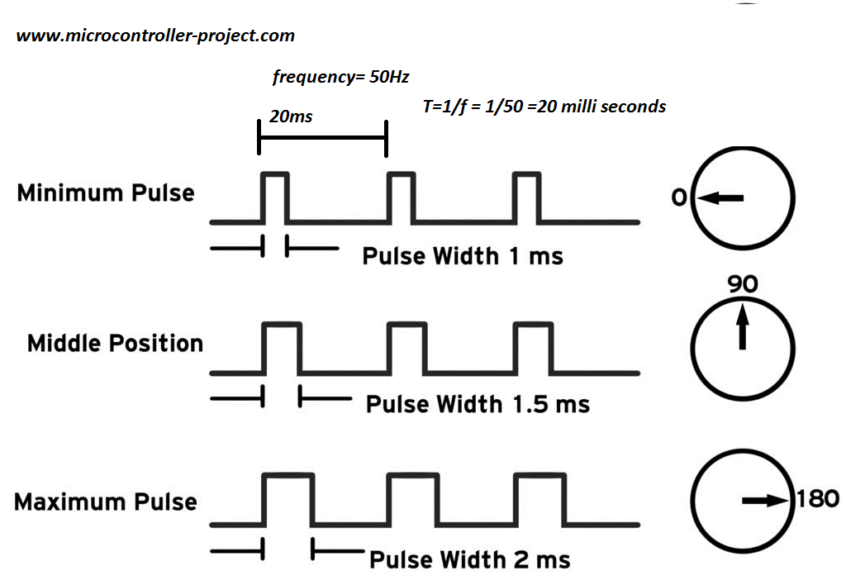
Simple Motor Controllers
FTC supports simple motor controllers such as RevSPARKMini via servo ports.
Simple motor controllers do not support position sensors.
Robot controller controls the motor controller via PWM (Pulse Width Modulation: 1 ms full speed reverse, 1.5 ms stop, 2 ms full speed forward).
Our framework currently does not support RevSPARKMini but they can be accessed directly using FTC SDK. We don’t really use it but we will support this in the near future.

Slide 15
Smart Motor Controllers
Smart motor controllers supports DC motors with encoders.
Motor controllers on the Rev Robot Control Hub and Extension Hub are all smart motor controllers.
Our framework support smart motor controllers via the FtcDcMotor class that extends TrcMotor. It supports close-loop control modes either natively or via software PID control.
Constructor: FtcDcMotor(String instanceName) Useful Methods: void setInverted(boolean inverted) void stop () void setPower(double delay, double power, double duration) void setVelocity(double velocity) void setPosition(double position, boolean holdTarget, double powerLimit)

Slide 16
Exercise: Smart Motor Controllers
In Robot.java, create an FtcDcMotor.
Create a class variable (motor) to hold the created smart motor controller object.
In robotInit method, create the motor controller object specifying a name corresponding to the hardware name in robot config.
In FtcTeleOp.java, add code to control a motor connected to the motor controller by a game controller and print a message showing the motor power on the dashboard.
Read the gamepad left stick for the Y-axis (driverGamepad.getLeftStickY).
Set the motor power with the joystick value (robot.motor.setPower).
Display the motor power value to the dashboard (robot.dashboard.displayPrintf).

Slide 17
TrcMotor
FtcDcMotor class extends TrcMotor. Different motor controllers have different capabilities. TrcMotor simulates features that the motor controller does not have native support, using software wherever possible. Examples:
Simulates close-loop control for simple motor controllers with software PID and external position sensor.
Simulates limit switch protection for motor controllers with external limit switches.
TrcMotor features with software simulation:
Motor direction.
Motor followers.
Position sensor direction.
Motor odometry (position, velocity).
Limit switches.
Close-loop control (position control, velocity control).
Motor stall detection/protection.
Motor zero position calibration.

Slide 18
Servo Motors
Three types of servo motors:
Position servos: have limited range of motion usually 90-degree or 180-degree, communicate via PWM signal between 1 ms to 2 ms. Pulse width sets the position of the servo. For example, for 180-degree servo, 1 ms sets it to 0-degree, 1.5 ms sets it to 90-degree and 2 ms sets it to 180-degree.
Continuous servos: similar to DC motors on PWM motor controllers but with smaller form factor and weaker strength, communicate via PWM signal between 1 ms to 2 ms. Pulse width sets the direction and speed the servo will spin. 1 ms sets it to spin full speed in reverse, 1.5 ms sets it to stop and 2 ms sets it to spin full speed forward.
Digital servos: programmable servo that can be programmed as position servo or continuous servo, can change servo parameters such as the position range, deadband in continuous mode etc.
Constructors: FtcServo(String instanceName) FtcCRServo(String instanceName, TrcDigitalInput lowerLimitSw, TrcDigitalInput upperLimitSw, TrcEncoder encoder)
Useful Methods: void setInverted(boolean inverted) void setPosition(double position) //for position servo void setPower(double power) //for continuous servo

Slide 19
Exercise: Position Servo
In Robot.java, create a servo motor.
Create a class variable (servo) to hold the created servo motor object (e.g. FtcServo).
In robotInit method, create the servo motor object specifying a name corresponding to the hardware name in robot config.
In FtcTeleOp.java, add code in the periodic method to control a servo by using the left trigger of the game controller. (i.e. releasing it to go to 0-degree position and pressing it fully to go to 180-degree) and print a message on the dashboard to show the servo position.
Read the gamepad left trigger (driverGamepad.getLeftTrigger).
Set the servo position with the trigger value (robot.servo.setPosition).
Display the servo position to the dashboard (robot.dashboard.displayPrintf).

Slide 20
Sensors
Two types of sensors: Digital sensors and Analog sensors.
Digital Sensors have two states: active, inactive (e.g. limit switches, touch sensors).
Analog sensors provide analog values (e.g. ultrasonic, LIDAR, pressure sensor, color sensor, gyro, accelerometer etc).
FtcDigitalInput constructors: FtcDigitalInput(String instanceName)
FtcDigitalInput useful methods: void setInverted(boolean inverted) boolean isActive()
FtcAnalogInput constructors: FtcAnalogInput(String instanceName)
FtcAnalogInput useful methods: void calibrate() SensorData<Double> getRawData(int index, DataType dataType)

Slide 21
Exercise: Digital Sensor
In Robot.java, create a limit switch.
Create a class variable (limitSwitch) to hold the created digital input object (e.g. FtcDigitalInput).
In robotInit method, create the limit switch object specifying a name corresponding to the hardware name in robot config.
In FtcTeleOp.java, add code to the periodic method to print a message showing the state of the limit switch on the dashboard.

Slide 22
Exercise: Analog Sensor
In Robot.java, create a REV color sensor.
Create a class variable (colorSensor) to hold the created analog sensor object (e.g. FtcColorSensor).
In robotInit method, create the color sensor specifying a name corresponding to the hardware name in robot config.
In FtcTeleOp.java, add code to the periodic method to print a message showing the color sensor values on the dashboard.
Display the color sensor values on the dashboard (robot.dashboard.displayPrintf, robot.colorSensor.getRawData).

Slide 23
Digital Sensor Trigger
Digital trigger provides an asynchronous mechanism to detect digital sensor state changes. It monitors the digital sensor and will do a callback when state change occurs. By default, the digital trigger is created disabled so you need to explicitly enable the monitoring and disable it when it’s no longer needed.
TrcDigitalInputTrigger constructors: TrcDigitalInputTrigger(String instanceName, TrcDigitalInput sensor, TrcEvent.Callback triggerCallback)
TrcDigitalInputTrigger useful methods: void setEnabled(boolean enabled) boolean isEnabled() boolean getSensorState()
Digital Trigger callback method: void digitalTriggerCallback(Object context)
Digital Trigger callback context is an AtomicBoolean. It gives you the digital sensor state that caused the trigger: ((AtomicBoolean) context).get()

Slide 24
Exercise: Digital Sensor Trigger
In Robot.java, create a limit switch and a digital trigger.
Create a class variable (limitSwitch) to hold the created digital input object (FtcDigitalInput).
Create a class variable (limitSwitchTrigger) to hold the created digital trigger (TrcDigitalInputTrigger).
In robotInit method, create the limit switch object specifying a name corresponding to the hardware name in robot config.
In robotInit method, create the digital trigger specifying a name, the limitSwitch object as the sensor and the callback method to call when the trigger occurs.
Create the trigger callback method: private void limitSwitchTriggerCallback(Object context)
In the callback method, print a message showing the state of the limit switch on the dashboard. Hint: ((AtomicBoolean) context).get() returns the state of the limit switch

Slide 25
Analog Sensor Trigger
Analog trigger provides an asynchronous mechanism to detect sensor value crosses preset thresholds. It monitors the analog sensor and will do a callback when a threshold has been crossed.
TrcAnalogSensorTrigger constructors: TrcAnalogSensorTrigger(String instanceName, TrcSensor<D> sensor, int index, D dataType, double[] dataPoints, boolean dataIsTrigger, TrcEvent.Callback triggerCallback)
TrcAnalogSensorTrigger useful methods: void setEnabled(boolean enabled) boolean isEnabled() double getSensorValue()
Analog Trigger callback method: void analogTriggerCallback(Object context)
Analog Trigger callback context is a TrcAnalogSensorTrigger.CallbackContext object. It gives you the state of the analog trigger at the time of the trigger: ((TrcAnalogSensorTrigger.CallbackContext) context).sensorValue ((TrcAnalogSensorTrigger.CallbackContext) context).prevZone ((TrcAnalogSensorTrigger.CallbackContext) context).currZone

Slide 26
Exercise: Analog Sensor Trigger
In Robot.java, create a REV color sensor and an analog trigger that monitors it.
Create a class variable (colorSensor) to hold the created REV color sensor (FtcColorSensor).
Create a class variable (colorSensorTrigger) to hold the created analog trigger (TrcAnalogSensorTrigger).
In robotInit method, create the REV color sensor object specifying a name corresponding to the hardware name in robot config.
Create an array of doubles containing the trigger threshold values.
Create the analog trigger specifying a name, the created analog sensor, zero as the index, TrcAnalogInput.DataType.INPUT_DATA as the data type, the threshold array, false as dataIsTrigger and the method to call when the trigger occurs.
Create the getColorSensorValue method that returns the proximity value of the REV color sensor (revColorSensor.getProximity).
Create the trigger callback method: private void colorSensorTriggerCallback(Object context)
In the callback method, print a message showing the state of the color sensor on the dashboard. Hint: TrcAnalogSensorTrigger.CallbackContext colorSensorContext = (TrcAnalogSensorTrigger.CallbackContext) context; colorSensorContext.sensorValue returns the color sensor value colorSensorContext.prevZone returns the previous threshold zone colorSensorContext.prevZone returns the current threshold zone

Slide 27
Indicators
Indicators are used to give feedback to the human operators. Our framework supports the following categories:
Single LED: (FtcDigitalOutput)
LED strip: single color, RGB (FtcRevBlinkin)
Addressable LED strip: each pixel on the strip can be programmed to a different color (FtcRevBlinkin)
Speech: robot.speak
TrcTone, TrcSong: supports generating sound and play songs.

Slide 28
Priority Indicators
Using LEDs as an indicator device allows subsystems to display their status.
Problem: Multiple subsystems trying to send their status to the LED causing contention.
Solution: Priority Indicator (TrcPriorityIndicator).
Each subsystem creates different indicator patterns. TrcPriorityIndicator keeps a table with these patterns stored in priority order (highest priority first).
Subsystem turns on an indicator pattern. TrcPriorityIndicator has a task going through the table periodically to find the highest priority pattern that is ON and display it. When the highest priority pattern is turned off, the next highest priority pattern will be displayed.
Useful methods: void setPatternState(T pattern, boolean enabled, double expiredTime) setPatternState not only allows you to turn a pattern ON or OFF, you can also specify an expiredTime so it will turn itself off after the specified period. This is good for indicating an edge event or creating a blinking pattern.

Slide 29
Exercise: Priority Indicators
In subsystems/LEDIndicators.java, add a new TrcRevBlinkin.RevLedPatterns named buttonXPattern to the top of the priority list (ledPatternPriorities) and set it to solid green color.
Add another pattern named buttonYPattern to the second of the priority list and set it to solid yellow color.
Add two methods that enables or disables the buttonXPattern and buttonYPattern states according to the pressed parameter (Hint: led.setPatternState). void setXButtonState(boolean pressed) void setYButtonState(boolean pressed)
In FtcTeleOp.java, add code to the driversControllerButtonEvent method to call setXButtonState enabling the LED pattern when button X is pressed, disabling it when button X is released.
Similarly, add code to call setYButtonState enabling the LED pattern when button Y is pressed, disabling it when button Y is released.

