Slide 1
Advanced Robotics Programming Class Lesson 5: Robot Drive Strategies
Titan Robotics Club FtC3543
Michael Tsang (Programming Mentor)

Slide 2
Agenda
In this lesson, you will learn about different robot drives.
PID Controlled Drive.
Sensor Drive.
Path following.
Pure Pursuit Drive.

Slide 3
PID Controlled Drive
Applying PID control algorithm to drive the robot base.
Consists of up to three PID controllers (X, Y and rotation), monitoring each degree of freedom to make sure they all reach target.
Requires feedback sensors to keep track of the robot odometry (X and Y location of the robot on the field as well as its heading), usually encoders for X/Y and gyro for the heading.
TrcPidDrive Constructor: TrcPidDrive(String instanceName, TrcDriveBase driveBase, TrcPidController xPidCtrl, TrcPidController yPidCtrl, TrcPidController turnPidCtrl)
PID Drive features:
Absolute Target mode – Can minimize cumulative error
WarpSpace mode – Mainly for robot heading
Absolute Pose – Absolute field position of the robot
Absolute Target Pose – Absolute intended position of the robot
Stuck wheel detection – Detect if any of the wheels are stuck
Turn mode – in-place, pivot, curve
Set Relative Target – Target is relative to current position of the robot
Set Absolute Target – Target is absolute field position
Set Sensor Target – Target is determined by sensors
Constant Heading Drive - Manual Drive but maintain constant heading

Slide 4
Exercise: PID Controlled Mecanum Drive
Press button Y to have the robot drive forward 10 feet, button X to strafe left 5 feet, button A to drive backward 7 feet, button B to turn right 90 degrees.
In the previous exercise, you already created 4 drive motors, a gyro and a mecanum drive base.
In Robot.java, add code to robotInit to create 3 PID controllers: X, Y and rotation (TrcPidController), specifying their names, their PID parameters and methods to get the robot’s X, Y and heading (Hint: mecanumDriveBase::getXPosition/getYPosition/getHeading).
Set the rotation PID controller to use absolute setpoint (Hint: rotPidCtrl.setAbsoluteSetPoint).
Create a PID drive object pidDrive (TrcPidDrive), specifying a name, the mecanum drive base and the 3 PID controllers and enable absolute target mode (Hint: pidDrive.setAbsoluteTargetModeEnabled).
In FrcTeleOp, add code to the driverControllerButtonEvent method to perform the corresponding PID drive when button X, Y, A, B are pressed and print a message on the dashboard to report the button event (Hint: robot.pidDrive.setRelativeTarget).
In FrcTeleOp, add code to the periodic method to print the robot position on the dashboard (Hint: robot.mecanumDriveBase.getXPosition/getYPosition/getHeading).

Slide 5
Sensor Drive
A drive base has a number of degrees of freedom. A tank drive base has 2: Y-axis and rotation. A mecanum or swerve drive base has 3: X-axis, Y-axis and rotation.
In order to navigate a drive base, there must be a number of controllers equal to the number of degrees of freedom. TRC Library provided a generic PID controlled drive class (TrcPidDrive.java) that can PID controlled drive up to 3 degrees of freedom. Therefore, it takes up to 3 PID controllers, one for each degree of freedom: X-PID controller, Y-PID controller and Turn-PID controller.
Each PID controller must be able to get feedback on the movement along its degree of freedom. Typically, for X and Y axes, we use encoders to tell us how far the robot has moved in the corresponding axes. For rotation, we use gyro to tell us the robot’s heading. These are feedback sensors.
One could be creative on using different sensors to achieve different PID controlled drive scenarios. For example, using ultrasonic sensor as the Y-axis feedback sensor allows the robot to drive up to a given distance from an obstacle. Using a pair of distance sensors on the side of the robot as turn feedback sensors allows the robot to follow the wall. Using one or more light sensors pointing to the ground as rotation feedback sensors allows the robot to follow a line on the ground. Camera and vision processing can detect the distance and angle of your target. Using distance info as the Y-axis feedback sensor and angle info as rotation feedback sensor allows the robot to navigate and align to the target.

Slide 6
PID Control Drive Using Sensors
TrcPidDrive provides different drive options:
setRelativeTarget – Typically uses encoders as X/Y feedback sensors and gyro as heading sensor. Targets are set as relative distance from current position.
setAbsoluteTarget – Typically uses encoders as X/Y feedback sensors and gyro as heading sensor. Targets are absolute field position.
setSensorTarget – All three degrees of freedom can use any type of sensors. The target values are generally absolute sensor values. For example, using ultrasonic sensor to drive the robot to N inches in front of an obstacle, the Y target will be set as absolute N inches. Using light sensor to follow a line on the floor will set the turn target value as the absolute light value average between the white line and the dark floor. Sometimes it is useful for a PID controller to use multiple sensors to control a degree of freedom. For example, using a pair of distance sensors to control the turn target can be used to follow the wall. Just set the absolute turn target to zero and report the heading to the PID controller by subtracting the back distance sensor from the front distance sensor. Note that AbsoluteTargetMode cannot be used in setSensorTarget.

Slide 7
Exercise: Wall Following Drive
Assuming the robot is 12 inches from the wall on the right side. Use two distance sensors to drive the robot following the wall for 10 feet.
In previous exercises, you have already created a mecanum drive base.
In Robot.java, add code to robotInit to create two distance sensor objects such as the FrcLaserShark.
Create three PID controllers:
X PID controller averages the two distance sensors to control the X distance from the wall.
Y PID controller uses the drive base encoders to control the Y distance to travel.
Turn PID controller uses the difference of the distance sensors to control the heading of the robot.
Create a PID drive using the three PID controllers.
In FrcTeleOp.java, add code to driverControllerButtonEvent to follow the wall 12 inches away for 10 feet by pressing button A.
In FrcTeleOp.java, add code to periodic to print the robot location as well as the two distance sensor readings on the dashboard.

Slide 8
Path Following
In autonomous, it is not uncommon to have the robot follow a path getting to the target. PID controlled drive breaks down the path into segments and runs each segment in sequence. Problem: very slow. When transition between segments, PID drive must stop at each waypoint precisely before starting next segment.
A better path following strategy is to combine all the segments into a smooth curved path and have a path following algorithm running this path as one operation.
WPILib provides PathFinder.
Our library provides PurePursuitDrive.

Slide 9
What Is Pure Pursuit Drive?
In autonomous, we usually program the robot to drive to a location using PID controlled drive doing multiple segments, one degree of freedom at a time. Each segment of PID drive involves the robot accelerating at the beginning and decelerating at the end. Sometimes going back and forth to achieve target within tolerance before moving on to the next segment. This wastes a lot of precious autonomous time.
Pure Pursuit Drive solves this problem by navigating the robot following a given path smoothly. Since it is a single path, there is no intermediate segment for which the robot would stop at the end of each segment.
Pure Pursuit path is defined by a set of waypoints. Pure Pursuit will interpolate a smooth curve passing through each waypoint in the path and will try to follow the path to the final destination in one smooth movement.
Abhay did a good job implementing Pure Pursuit Drive in our library. He also created a great document explaining Pure Pursuit Drive and among other things in robotics: FRC Guidebook.docx - Microsoft Word Online (live.com).

Slide 10
Using Pure Pursuit Drive
TrcPurePursuitDrive Constructor: TrcPurePursuitDrive(String instanceName, TrcDriveBase driveBase, double proximityRadius, double posTolerance, double turnTolerance, TrcPidController.PidCoefficients xPosPidCoeff, TrcPidController.PidCoefficients yPosPidCoeff, TrcPidController.PidCoefficients turnPidCoeff, TrcPidController.PidCoefficients velPidCoeff)
Methods:
Some setter methods to set various parameters of Pure Pursuit Drive: e.g. following distance, tolerances, PID coefficients, interpolation types etc.
isActive – check if Pure Pursuit Drive is in progress.
cancel – cancel the Pure Pursuit Drive that is in progress.
start – start the pure pursuit drive with the specified path. void start(TrcPath path, TrcEvent event, double timeout)

Slide 11
TrcPath
TrcPath defines a path for the robot to follow and whether waypoint headings are in degrees or radians. A path is an array of waypoints.
A waypoint defines a point on the path and contains info such as:
timestep – a timestamp relative to the starting time of the path. This is optional and is only required for a certain motion drive strategies (not needed by Pure Pursuit).
pose – location of the waypoint: X, Y and heading. This is always required for any motion drive strategies.
encoderPosition – specifies the encoder position at this waypoint (not needed by Pure Pursuit).
velocity – specifies the tangential velocity of the robot at this waypoint (not needed by Pure Pursuit).
acceleration – specifies the tangential acceleration of the robot at this waypoint (not needed by Pure Pursuit).
jerk – specifies the jerk (derivative of acceleration) of the robot at this waypoint (not needed by Pure Pursuit).
There are two types of path:
Absolute path: the location of each waypoint is an absolute position in a reference frame (usually the competition field).
Incremental path: the location of each waypoint is a relative position from the previous waypoint on the path.

Slide 12
TrcPathBuilder
TrcPathBuilder is a utility class that makes it easier to build paths for Pure Pursuit Drive.
Pure Pursuit Drive requires all waypoints relative to the first waypoint in the path.
TrcPathBuilder can build such a path for Pure Pursuit from a field absolute path or an incremental path.
TrcPathBuilder Constructor: TrcPathBuilder(TrcPose2D startingPose, boolean incrementalPath, boolean inDegrees)
startingPose – absolution position of the robot at the start of the path (i.e. absolute field position of the robot).
incrementalPath – specifies whether the path is given as incremental path or absolute path.
inDegrees – specifies whether the waypoint headings are in degrees or radians.
Methods:
append – append a point to the path (the point can be a waypoint or a pose).
toPath – returns a path that contains absolute waypoints in the reference frame.
toRelativeStartPath – returns a path that contains waypoints relative to the first waypoint of the path (this is the type of path Pure Pursuit needs).

Slide 13
Exercise: Drive Robot Through a Slalom Path
Navigate the robot through a slalom path using Pure Pursuit Drive.
In previous exercises, you have already created a mecanum drive base.
In Robot.java, add code to the robotInit method to create the purePursuitDrive (TrcPurePursuitDrive), specifying a name, the mecanum drive base, proximityRadius set to 12.0, posTolerance set to 2.0, turnTolerance set to 2.0 and the PID coefficients for the four PID controllers (XPos, YPos, Rotation and Velocity).
Enable fast mode by calling purePursuitDrive.setFastModeEnabled(true).
In FrcTeleOp, add code to the startMode method to set the initial robot position to the field position of (x=72.0, y=9.0, angle=0.0). (Hint: driveBase.setFieldPosition).
Add code to driverControllerButtonEvent method to perform the pure pursuit drive (purePursuitDrive.start) when button A is pressed and print a message on the dashboard to report the button event. The slalom path has 9 relative waypoints: (0, 27, -90), (0, 24, 90), (0, 24, 90), (0, 48, -90), (0, 24, -90), (0, 48, 90), (0, 24, 90), (0, 24, -90), (0, 24, 0)

Slide 14
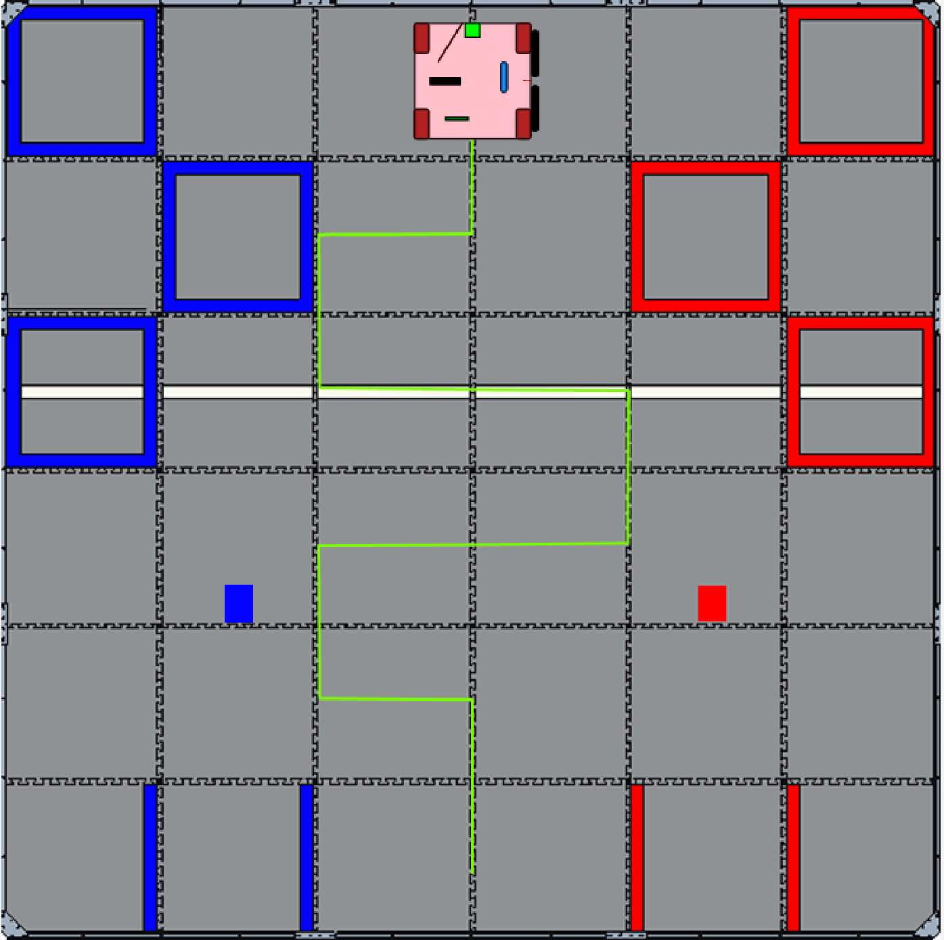
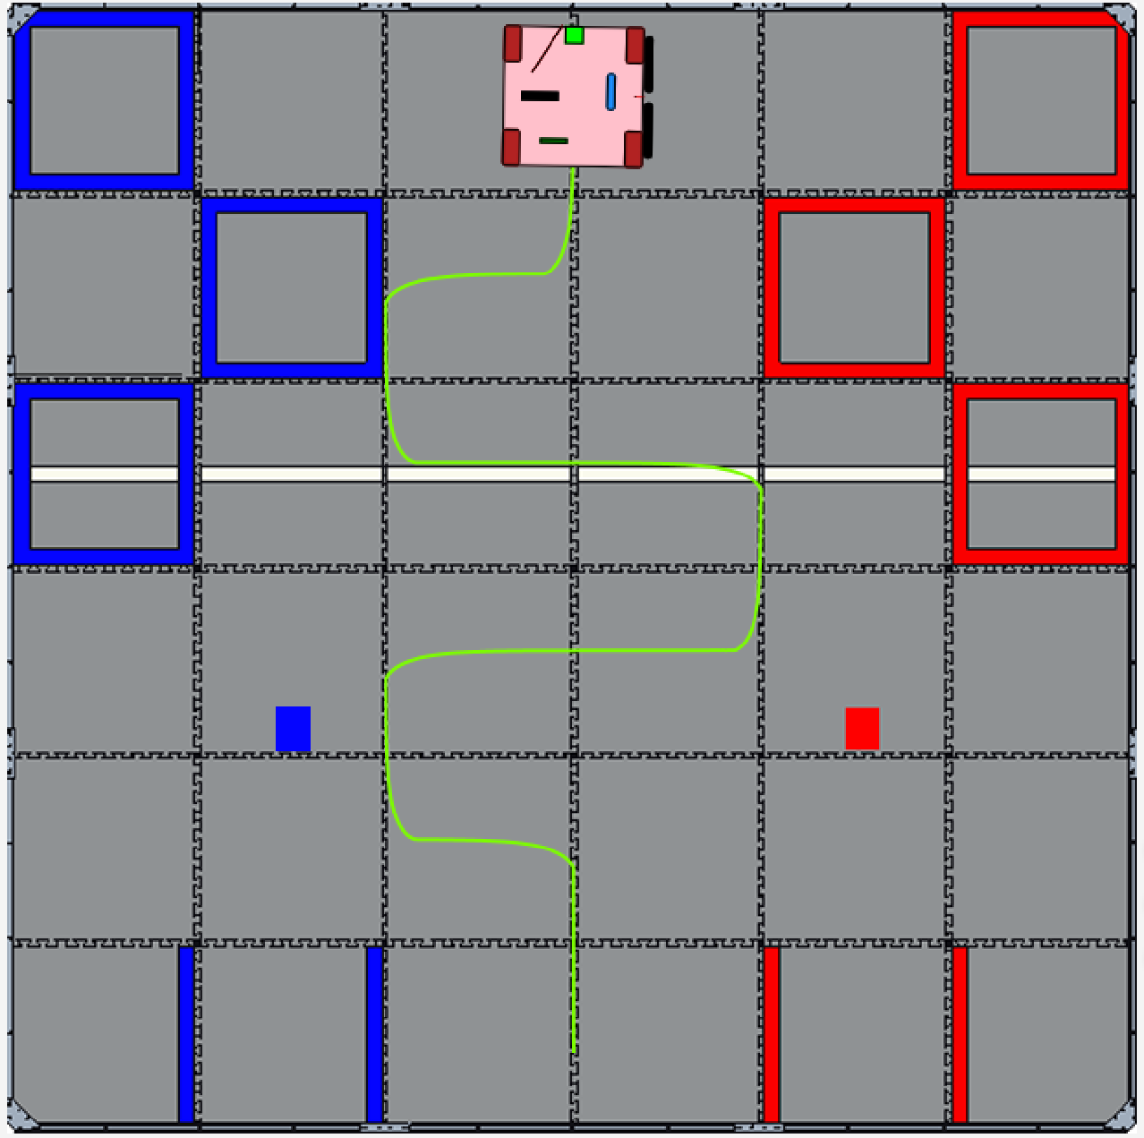
Slalom Path
PID Drive Path Pure Pursuit Drive Path

