Slide 1


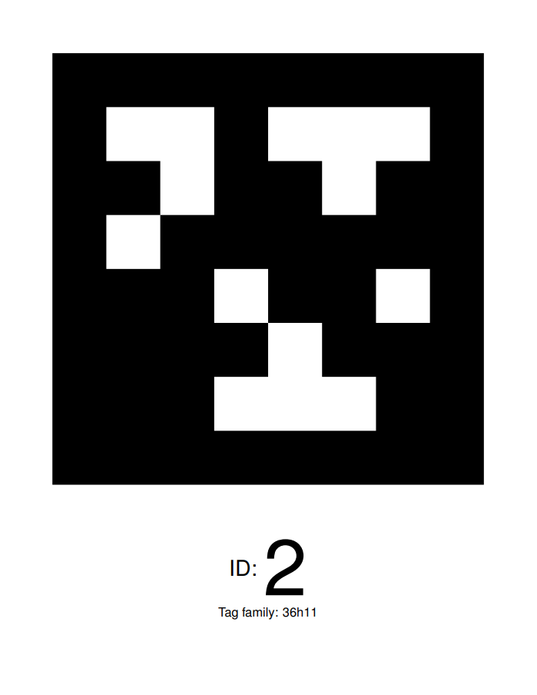
3543
3543
3543

