Slide 1
Big Hole Watershed Data Slides Trevor Heath, Earth 450, 20 July 2026

Slide 2
Annual Water Temperature – Melrose, MT
Plot 1. Annual mean water temperature (°C) for the Big Hole River near Melrose, MT, 1995-2025. No 1981-2010 climate normal is shown, as this is a water-temperature rather than air-temperature record. Data obtained from USGS gage 06025500, https://waterdata.usgs.gov/monitoring-location/USGS-06025500/statistics/#selectedDataTypes=daily-80154-0. Data file: Heath_BigHole_ClimateData.xlsx, tab Plot1_WaterTemp.

Slide 3
Annual Discharge – Melrose, MT
Mean: 979.6 ± 372.0 cfs (1981-2010)
2000-2001: One of several low-flow years amid Western megadrought
Plot 2. Annual mean discharge (cfs) for the Big Hole River near Melrose, MT, 1923-2025. The horizontal line marks the 1981-2010 climate normal (mean = 979.6 cfs, SD = 372.0 cfs). Data obtained from USGS gage 06025500, https://waterdata.usgs.gov/monitoring-location/USGS-06025500/statistics/#selectedDataTypes=daily-00060-0. Data file: Heath_BigHole_ClimateData.xlsx, tab Plot2_AnnualQ.

Slide 4
August Discharge – Melrose, MT
Plot 3. Mean August discharge (cfs) for the Big Hole River near Melrose, MT, 1924-2024 (1923 and 2025 excluded due to incomplete data). The horizontal line marks the 1981-2010 climate normal (mean = 389.2 cfs, SD = 221.9 cfs). Data obtained from USGS gage 06025500, https://waterdata.usgs.gov/monitoring-location/USGS-06025500/statistics/#selectedDataTypes=daily-00060-0. Data file: Heath_BigHole_ClimateData.xlsx, tab Plot3_AugQ.

Slide 5
Mean Annual Precipitation – Glen, MT
Plot 4. Mean annual precipitation (mm) at Glen, MT, 1895-2025. The horizontal line marks the 1981-2010 climate normal (mean = 234.6 mm, SD = 52.7 mm). Data obtained from the PRISM Climate Group gridded dataset (4 km resolution, AN91m), https://prism.oregonstate.edu/, for the coordinates 45.4686°N, 112.6561°W. Data file: Heath_BigHole_ClimateData.xlsx, tab Plot4_AnnualPrecip.

Slide 6
Mean Annual Temperature – Glen, MT
Plot 5. Mean annual air temperature (°C) at Glen, MT, 1895-2025. The horizontal line marks the 1981-2010 climate normal (mean = 5.98°C, SD = 0.83°C). Data obtained from the PRISM Climate Group gridded dataset (4 km resolution, AN91m), https://prism.oregonstate.edu/, for the coordinates 45.4686°N, 112.6561°W. Data file: Heath_BigHole_ClimateData.xlsx, tab Plot5_AnnualTemp.

Slide 7
Mean July Temperature – Glen, MT
Plot 6. Mean July air temperature (°C) at Glen, MT, 1895-2025. The horizontal line marks the 1981-2010 climate normal (mean = 18.21°C, SD = 1.77°C). Data obtained from the PRISM Climate Group gridded dataset (4 km resolution, AN91m), https://prism.oregonstate.edu/, for the coordinates 45.4686°N, 112.6561°W. Data file: Heath_BigHole_ClimateData.xlsx, tab Plot6_JulyMeanTemp.

Slide 8
Maximum July Temperature – Glen, MT
2007: Hottest July max on record
Plot 7. Mean of daily maximum July air temperature (°C) at Glen, MT, 1895-2025. The horizontal line marks the 1981-2010 climate normal (mean = 28.53°C, SD = 2.61°C). Data obtained from the PRISM Climate Group gridded dataset (4 km resolution, AN91m), https://prism.oregonstate.edu/, for the coordinates 45.4686°N, 112.6561°W. Data file: Heath_BigHole_ClimateData.xlsx, tab Plot7_JulyMaxTemp.

Slide 9
April 1 Snow Water Equivalent – Dark Horse Lake, MT
2001: Lowest snowpack on record
Plot 8. April 1 snow water equivalent (inches) at Dark Horse Lake SNOTEL station (Big Hole River headwaters), water years 1981–2026. Selected as most relevant to Arctic Grayling habitat since headwaters snowpack drives baseflow to the mainstem during critical low-flow summer months. Data: USDA NRCS National Water and Climate Center, https://wcc.sc.egov.usda.gov/nwcc/rgrpt?report=snowcourse&state=MT. File: Heath_BigHole_ClimateData.xlsx, tab Plot8_SWE.

Slide 10
Significant Events: Big Hole Watershed
1864–1902: Gold strike at French Gulch triggers decades of placer mining that severely contaminated/degraded the stream (channel straightened, disconnected from floodplain, provided minimal fish and wildlife habitat)
1970s-1980s: Grayling population suffers severe decline, partly driven by major drought; August discharge reaches lowest value in the 103-year record [see Plot 3]; 1974 was the driest year on record [see Plot 4]
1991–1997: Arctic Grayling designated as an ESA candidate species (1991); Big Hole Watershed Committee founded (1995); Drought Management Plan adopted, creating hoot-owl restrictions (1997)
2000–2001: Onset of Western megadrought; low annual discharge, lowest snowpack on record [see Plots 2, 8]
2006–2007: Peak drought/heat stretch: low August discharge coincides with hottest July temperatures on record [see Plots 6, 7]
2009: Upper Big Hole CCAA (Candidate Conservation Agreement with Assurances) established, a 20-year voluntary habitat/flow agreement (2009–2029)
2012, 2021: Hottest water temperature on record (2012) [see Plot 1]; among the hottest July temperatures on record (2021) [see Plot 7]
2014–2024: USFWS rules Grayling "not warranted" for listing (2014, 2020); BHWC completes the French Gulch & Moose Creek Restoration Project, addressing this legacy mining damage (2017); lawsuits follow; federal judge orders USFWS to redo the decision (2024)
Sources: Big Hole Watershed Committee, "Drought Management Plan & Grayling Recovery," https://bhwc.org/project/dmp-grayling/; Big Hole Watershed Committee, "French Gulch and Moose Creek Restoration," https://bhwc.org/project/french-gulch-and-moose-creek/.

Slide 11
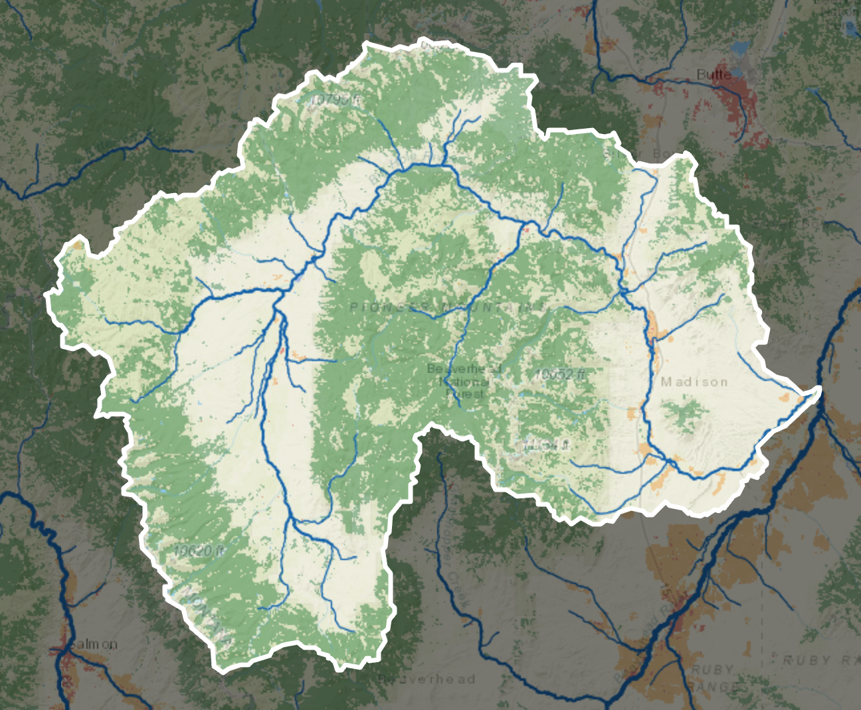
Big Hole Watershed Map
Figure A. Big Hole watershed boundary with EARTH 450 field-trip stops (July 17, 2026), marked in the order visited: red (Gold Creek/Wise River), orange (Wise River @ Grand Vista), yellow (Eric's Ranch), green (Browns Bridge), light blue (Fish Trap Creek), dark blue (Big Hole River below Fish Trap confluence), purple (Fishtrap @ BHR confluence).

Slide 12
Conceptual Diagram
Restoration
Shading
Riparian Vegetation
Mine Disturbance
Water Temperature
Sedimentation
Acid Mine Drainage
Fish Stress
Water Quality
Positive Relationship
Negative Relationship
Figure B. Conceptual diagram showing how BHWC's Elkhorn Mine restoration project (reducing mine disturbance, acid drainage, and sedimentation while restoring riparian vegetation and shading) is expected to lower water temperature and reduce stress on Arctic Grayling. Source: Big Hole Watershed Committee, "Elkhorn Creek, Mine, and Mill," https://bhwc.org/project/elkhorn-mine/.

