Slide 1
Analysis of Housing Exemptions in NYC
By Kimberly Grauer

Slide 2
Context and Hypothesis
Rent-affordability is a frequently discussed issue for New Yorkers
Lots of ambiguity on who receives exemptions
Media trends suggest there have been sharp declines of exemptions in NYC
Hypothesis
Analysis from the Housing and Vacancy Survey could show which types of exemptions and for which people are declining and/or increasing. From there we can predict in the following years who will lose and exemption and where.
Modified Hypothesis
Decided to focus on one year sample (problems with cleaning)
Are there any predictors of who will receive an exemption, and possibly where are those exemption.

Slide 3
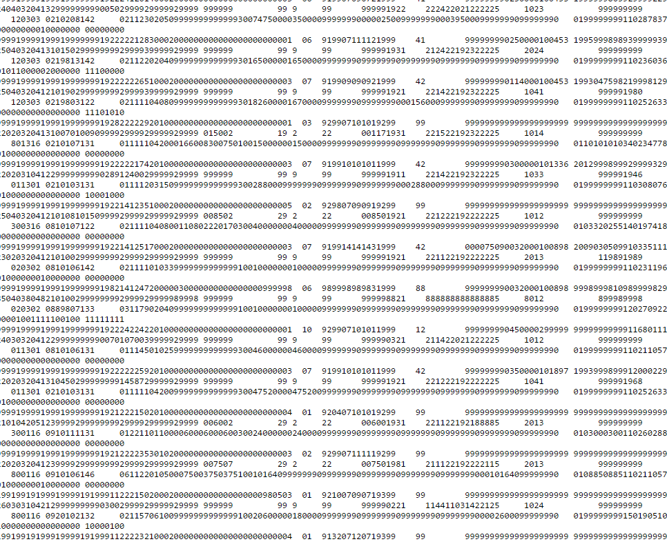
The Data
Data from the Housing and Vacancy Survey, 2014.
The data is very messy and needs to be parsed through an SAS program to get to a CSV.
There were 15,343 observations, which all have weights applied to them to represent properly the NYC population.
I did not use the weights as I was only concerned with trends and relationships, not absolute numbers.
Started with hundreds of variables and
Reduced it to around 40 including:
Household income - Coop/Condo status
Gender - Units in building
Race - Age
Ethnicity
Removed data: quality of house and other demographic information

Slide 4
Feature selection
Target 1 – Exemption/ non-market rate home
Target 2 – Public Housing versus HUD
Always:
Wages
Age
Gender
Sometimes:
Race
Ethnicity
Place of Birth
Units in building(?)
Toilets in building
Data cleaning
dummy transformations
Outliers
Creating sub data sets

Slide 5
Other Variables considered
Record Type | Heating equipment breakdown | Occupancy status before acquisition | Salary
Borough | Number of heating breakdowns | Condo/Coop before acquisition | Salary flag
External Walls--Missing brick | Functioning Air Conditioning | Down payment(1) | Business income
External Walls--Sloping walls | Carbon Monoxide Detector | Down payment(2) | Business income flag
External Walls--Major cracks in walls | Additional sources of heat | Value | Interest income
External Walls--Loose or hanging cornice | Presence of mice and rates | Mortgage status | Interest income flag
External Walls--No problems | Number of Cockroaches | Monthly mortgage | Retirement income (1)
External Walls--Unable to observe | Exterminator service | When Did Most Recent Mortgage Originate | Retirement income (1) flag
Condition of Windows--Broken/missing | Cracks/holes in interior walls | Current Interest Rate | Government income
Condition of Windows--Rotten/loose | Holes in floors | Condo/Maintenance fees | Government income flag
Condition of Windows--Boarded-up | Broken plaster/peeling paint | Senior Citizen Carrying Charge Increase Exemption | Retirement income (2)
Condition of Windows--No problems | Plaster/paint> 8.5 x 11 | Fire and liability insurance paid separately | Retirement income (2) flag
Condition of Floors--Unable to observe | Year moved to NYC | Complete plumbing facilities | Hispanic Origin
Condition of building | DHCR status input flag | Exclusive use of plumbing facilities | Race of householder
Broken/Boarded Windows--observation | New control status recode | Toilet breakdown | Year moved--renters
Wheelchair accessibility--Street entry | Structure class recode | Complete kitchen facilities | Year moved--owners/renters
Wheelchair accessibility--Elevator | Type of schedule code | Exclusive use of kitchen facilities | Value
Wheelchair accessibility--Unit entrance | Year built recode | Kitchen facilities functioning | Stories in building
Sex of householder | Condition of unit recode | Type of heating fuel | Rooms/Bedrooms
uf43 | Respondent line number | Electricity-paid separately | Plumbing facilities
Hispanic origin | Household composition recode | Monthly electricity cost | Kitchen facilities
Race of householder | Presence of nonrelatives | Gas-paid separately | Type of heating fuel
Temporary Residence-Affordability | Race and Ethnicity of householder | Monthly gas cost | Electricity cost
Temporary Residence-Other | Race Recode 1 | Combined gas/electricity | Gas cost
Most recent place lived | Race Recode 2 | Water and sewer-paid separately | Combined gas/electricity cost
sc52 | Presence of plumbing facilities recode | Yearly water and sewer cost | Water and sewer cost
On or after July 1, 1971 | Presence of kitchen facilities recode | Other fuels-paid separately | Other fuels cost
First occupants of unit | Number of 1987 maintenance deficiencies | Yearly cost for other fuels | Contract rent
Reason for moving | Number of 2014 maintenance deficiencies | Home Energy Assistance | Rental assistance
Place of birth-householder | Total persons recode | Yearly assistance amount | Household income
Place of birth-father | rec28 | Contract rent | Salary income
Place of birth-mother | Monthly gross rent | Length of lease | Business income

Slide 6
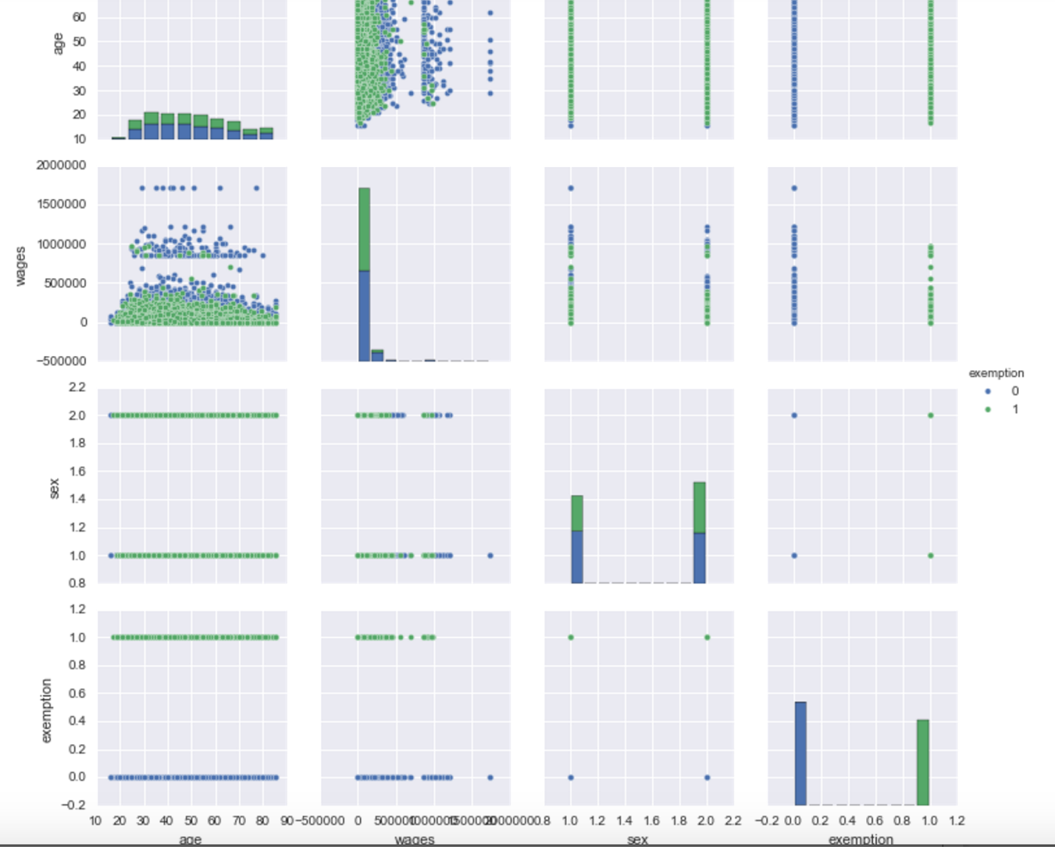
Pre-work and visualization
Chose a few important variables to explore:
Target: Exemption
Features: gender, age, income
Observations:
Somewhat even distribution across age, with slightly more concentration younger
A few rich men getting exemptions. Fewer poor women not getting them.

Slide 7
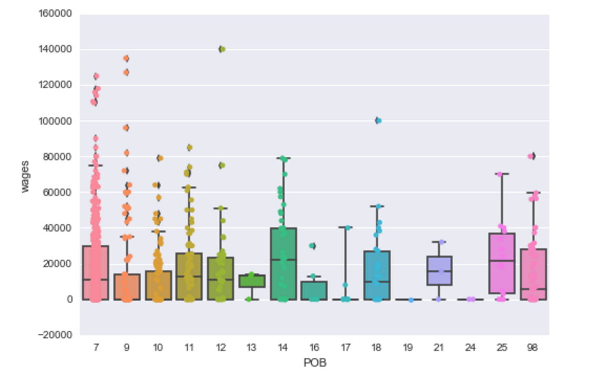
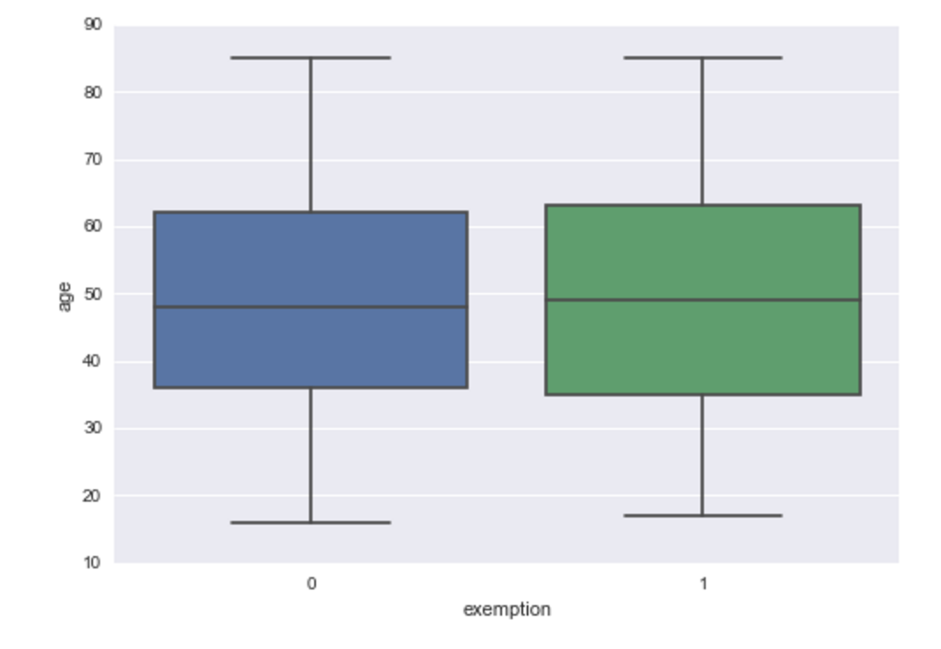
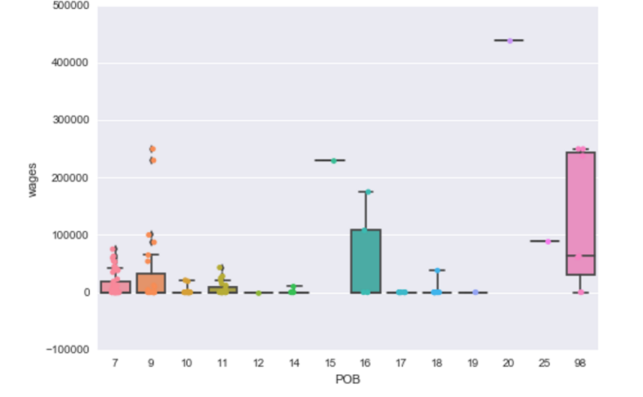
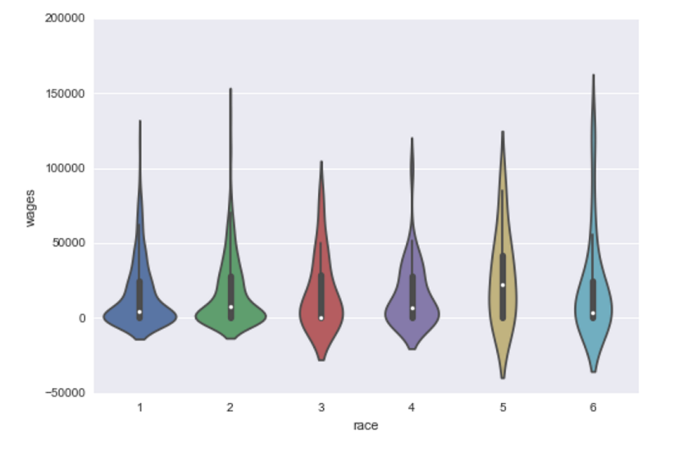
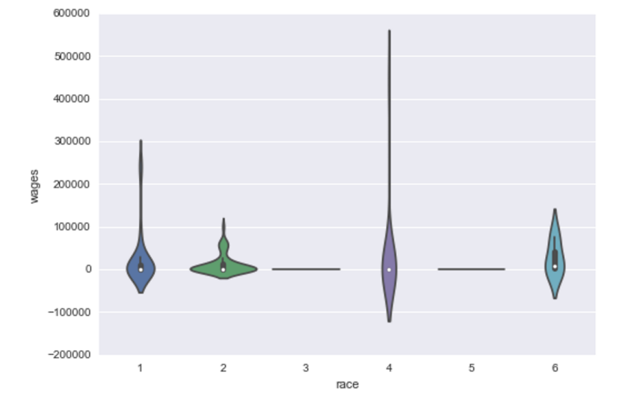
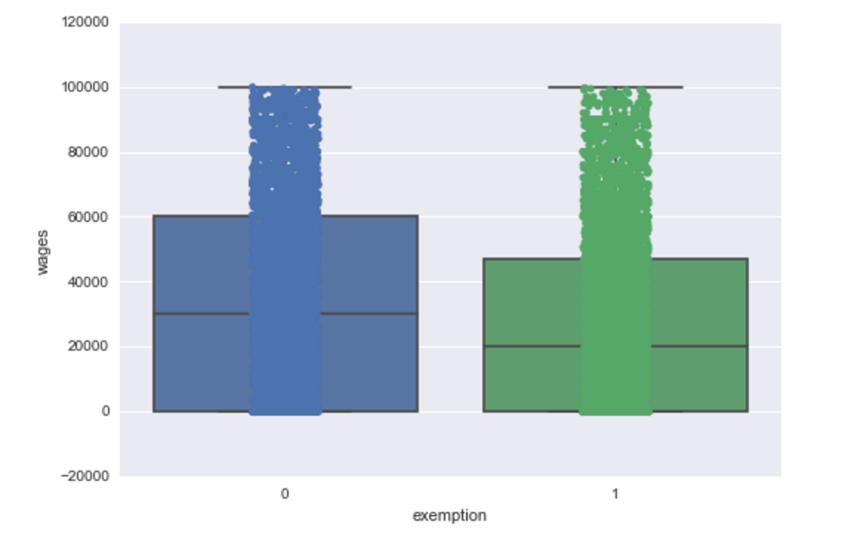
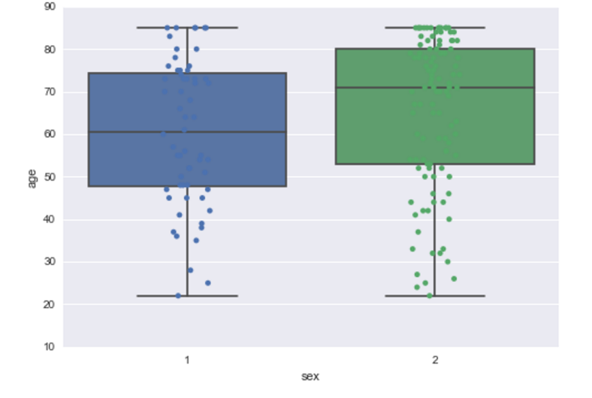
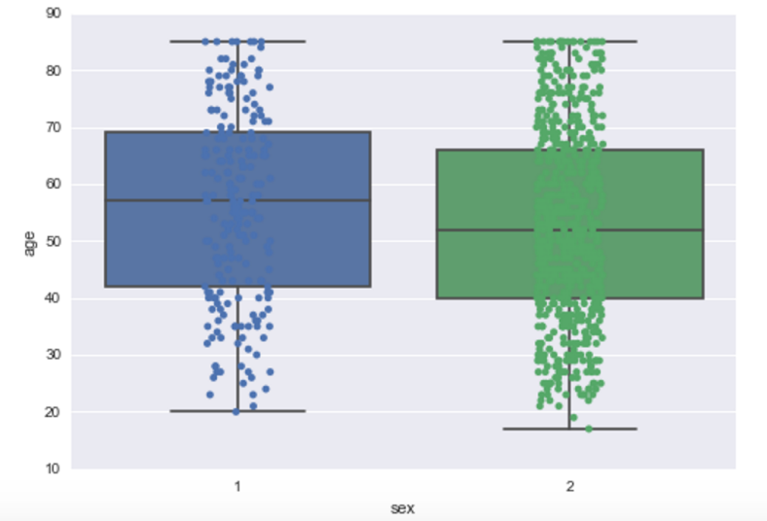
Public housing
HUD
HUD
Public housing
Public housing
HUD

Slide 8
Overall Results
 | Precision Score | Recall Score | F1 Score | F1 Score Train | AUC Score
Decision Tree | 0.54/.78 | 0.56/.76 | 0.55/.77 | 0.944/1.00 | 0.59/.79
Random Forest | 0.559/ .71 | 0.63/.75 | 0.59/.73 | 0.78/.84 | 0.64/76
KNN | 0.58 | 0.59 | 0.588 | 0.933 | 0.62
RF with K-fold | .567 | .633 | .60 | .78 | .66
Linear – R squared of .11
If adds certain features such as units in house, all the number go up by a lot.
KNN- went up slightly with folds
[with all features/with only wage, gender, age]

Slide 9
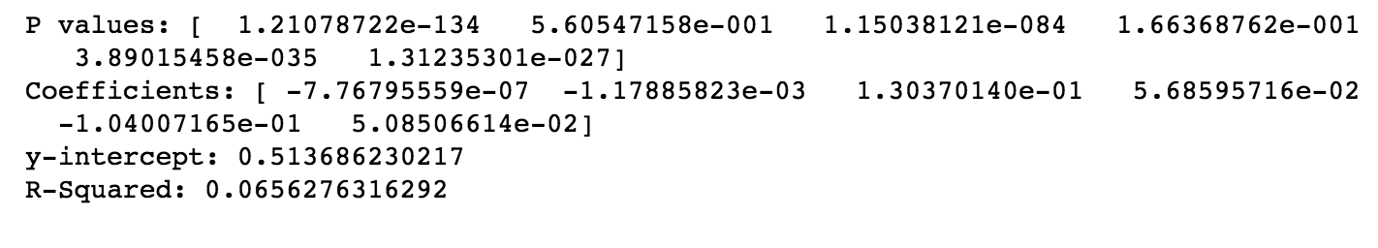
Linear: 'wages', 'age', 'race1_2', 'race1_3', 'race1_4’, 'gender_2’
Very Low R
Data visualization suggests relationship is non-linear
Add controls: POB and units in building and r goes up to 41.
Possible results: wages are highly significant, age is significant, going from male to female is slightly significant.

Slide 10
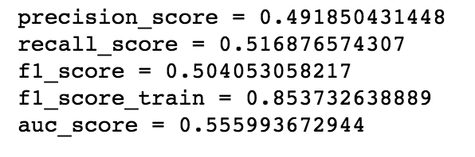
Decision Tree
Model is overfit ➔ high train score but low test score. Decision trees are “aggressive at overfitting”

Slide 11
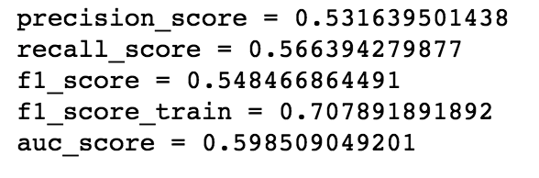
Random Forest
Slightly better fit➔ still over fit.
Score improved when added POB

Slide 12
KNN
Model score of .6939 with 5 neighbors
Model score: .91 with 1 neighbor! .97 if you add units in building. .984 if you add number of toilets.
Still way overfit!
KNN is sensitive to noise.
Limited quantifiable information

Slide 13
Results
Feature Identification
Data Visualization
Interpretation of results
Background research

Slide 14
Results continued…
Model was trying to optimize predictive abilities. Decision tree was the best, but still overfit.
Limitations
Try to look more specifically at individual coefficients, expanding on a logistic regression.
Limitation: little understanding of the effects of each feature
E.g. gender and exemption
Overfitting the model
Future Questions
Add a time series component to analysis and see who is losing exemptions.
Add geographical component?
More robust interpretation.
Notes:
Intpreting KNN versus forest and random

Slide 15
Acknowledgements and citations
John Krauss and Whiter Rent Regulation - http://blog.johnkrauss.com/where-is-decontrol/
Time trends DOF records
Housing and vacancy survey
Ben Hammer at Kaggle for visualization

Slide 16
New Control Status Recode (CSR) |  | New_CSR |  | 01=Owner occupied conventional
(Stabilized is the higher priority than HUD |  |  |  | 02=Owner occupied private cooperative
Regulated in this revision to the CSR. |  |  |  | 05=Public housing
Ex: A unit classified as both |  |  |  | 12=Owner occupied condo
HUD and Stabilized by HPD (City of NY) |  |  |  | 20=Article 4 or 5 building
would now get the final classification as |  |  |  | 21=HUD regulated
Stabilized in this revision. |  |  |  | 22=Loft Board regulated building
(Since the 2005 NYCHVS) |  |  |  | 23=Municipal Loan Program
 |  |  |  | 30=Stabilized pre 1947
 |  |  |  | 31=Stabilized post 1947
 |  |  |  | 80=Other rental
 |  |  |  | 85=Mitchell Lama rental
 |  |  |  | 86=Mitchell Lama cooperative
 |  |  |  | 87=Mitchell Lama type cooperative
 |  |  |  | 90=Controlled
 |  |  |  | 95=In Rem
Place of Householder's Birth | 111 |  |  | 07=New York City
 |  |  |  | 09=U.S., outside New York City
 |  |  |  | 10=Puerto Rico
 |  |  |  | 11=Dominican Republic
 |  |  |  | 12=Caribbean (other than Puerto Rico or Dom. Rep.)
 |  |  |  | 13=Mexico
 |  |  |  | 14=Central America, South America
 |  |  |  | 15=Canada
 |  |  |  | 16=Europe
 |  |  |  | 17=Russia/Successor States to Soviet Union
 |  |  |  | 18=China, Hong Kong, Taiwan
 |  |  |  | 19=Korea
 |  |  |  | 20=India
 |  |  |  | 21=Pakistan, Bangladesh
 |  |  |  | 22=Philippines
 |  |  |  | 23=Southeast Asia (Burma, Cambodia, Laos,
 |  |  |  | Malaysia, Singapore, Thailand, Vietnam)
 |  |  |  | 24=Other Asia
 |  |  |  | 25=Africa
 |  |  |  | 26=All other countries
 |  |  |  | 98=Not reported
Householder's Sex |  | SEX/HHR2 |  | 1=Male
 |  |  |  | 2=Female

Slide 17
Householder's Race |  | RACE1 |  | This is 22 character string with the race in character positions that follow:
(Multiple entries for race are allowed) |  |  |  | 01=White (character positions 1-2)
 |  |  |  | 02=Black or African American (character positions 3-4)
 |  |  |  | 03=American Indian or Alaska Native (character positions 5-6)
 |  |  |  | 04=Chinese (character positions 7-8)
 |  |  |  | 05=Filipino (character positions 9-10)
 |  |  |  | 06=Korean (character positions 11-12)
 |  |  |  | 07=Vietnamese (character positions 13-14)
 |  |  |  | 08=Asian Indian, Pakistani, or Bangladeshi (character positions 15-16)
 |  |  |  | 09=Other Asian (character positions 17-18)
 |  |  |  | 10=Native Hawaiian (character positions 19-20)
 |  |  |  | 11=Other Pacific Islander (character positions 21-22)
 |  |  |  | For example: 0100000400000000000000 = White, Chinese

