Slide 1
Predicting U.S. Election Outcomes
Antuan Weeks

Slide 2
U.S. Presidential Election
Problem: With greater divergence between the two primary parties within U.S., we seek to find the main determinants of voter choice
Data: There is a nice pool of data organized on Kaggle, containing primary results data, region information, demographic data, and more
  Data: https://www.kaggle.com/benhamner/2016-us-election
Hypothesis: The usual indicators of age, race and gender will be large drivers, but I believe there will be other variables discovered that will provide strong prediction of voter choice.
  e.g. voter choice ~ x_1*age + … + x_n*region + b

Slide 3
Background
Part of the intrigue of predicting U.S. election outcomes come from the results of the Median Voter Theorem. Elections are not determined by the extreme positions of the political spectrum, but the central/moderate ones
Economic choice theory includes an assumption of transitive preferences. Simply put, if a voter's top choice is not available for picking, that voter will select the candidate closest to their preferences (e.g. a democratic voter will vote for the democratic nominee and not switch sides/abstain to spite the nominee in the event that the nominee is not their top choice)

Slide 4

Why?
It's hard to sleep with the uncertainty. I am looking to “make my sleep life great again.”

Slide 5
Datasets
51 characteristics for >3000 counties in the United states
column_name description
0 PST045214 Population, 2014 estimate
1 PST040210 Population, 2010 (April 1) estimates base
2 PST120214 Population, percent change - April 1, 2010 to July 1, 2014
3 POP010210 Population, 2010
4 AGE135214 Persons under 5 years, percent, 2014
5 AGE295214 Persons under 18 years, percent, 2014
6 AGE775214 Persons 65 years and over, percent, 2014
7 SEX255214 Female persons, percent, 2014
8 RHI125214 White alone, percent, 2014
9 RHI225214 Black or African American alone, percent, 2014
Primary results from 2016 election cycle
fips state_abbreviation candidate votes
0 1001.0 AL Bernie Sanders 544
1 1001.0 AL Hillary Clinton 2387
2 1003.0 AL Bernie Sanders 2694
3 1003.0 AL Hillary Clinton 5290
4 1005.0 AL Bernie Sanders 222

Slide 6
Process
Acquire Data
Clean Data (field names, var construction, merge/drop)
Analysis
  Intuition
  Decision tree feature selection
  Segregation/de-segregation of dataset by party

Slide 7
Results
Top Predictors (controlling for party/candidate)
  Land area in square miles, 2010
  % Black/African American Alone
  Median value of owner occupied housing
  % Hispanic or Latino
With straightforward model, return MSE ~20%. Can improve this with methods outlined in next steps
When party/candidate are included, we get the expected result that party/candidate is a strong predictor of vote fraction

Slide 8
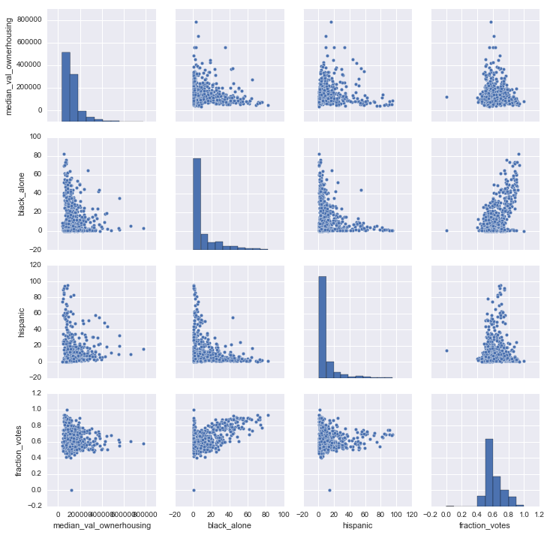
Clinton PairPlots

Slide 9
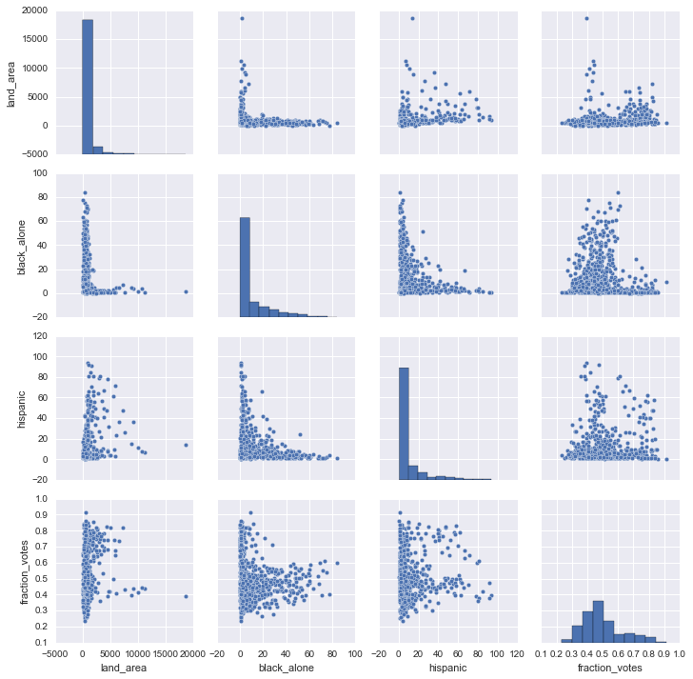
Trump PairPlots

Slide 10
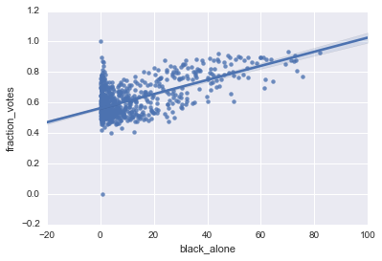
Clinton vs % Black/African American

Slide 11
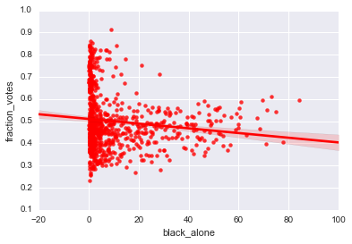
Trump vs % Black/African American

Slide 12
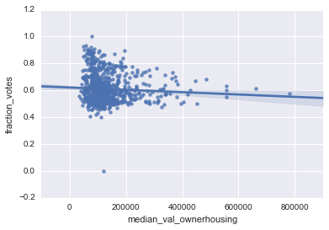
Clinton vs Median Value Owner-occupied housing

Slide 13
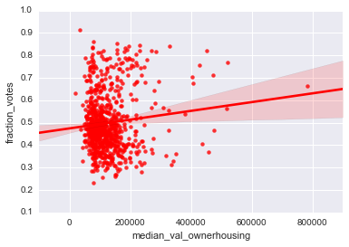
Trump vs Median Value Owner-occupied housing

Slide 14
Next Steps
Apply weights based on electoral college to determine who would win in general election
Expand dataset to look at more election cycles than just the current to capture overall election trends
Refine alternative models that were not successfully implemented here (e.g. Logit, Random Forest)

