Slide 1
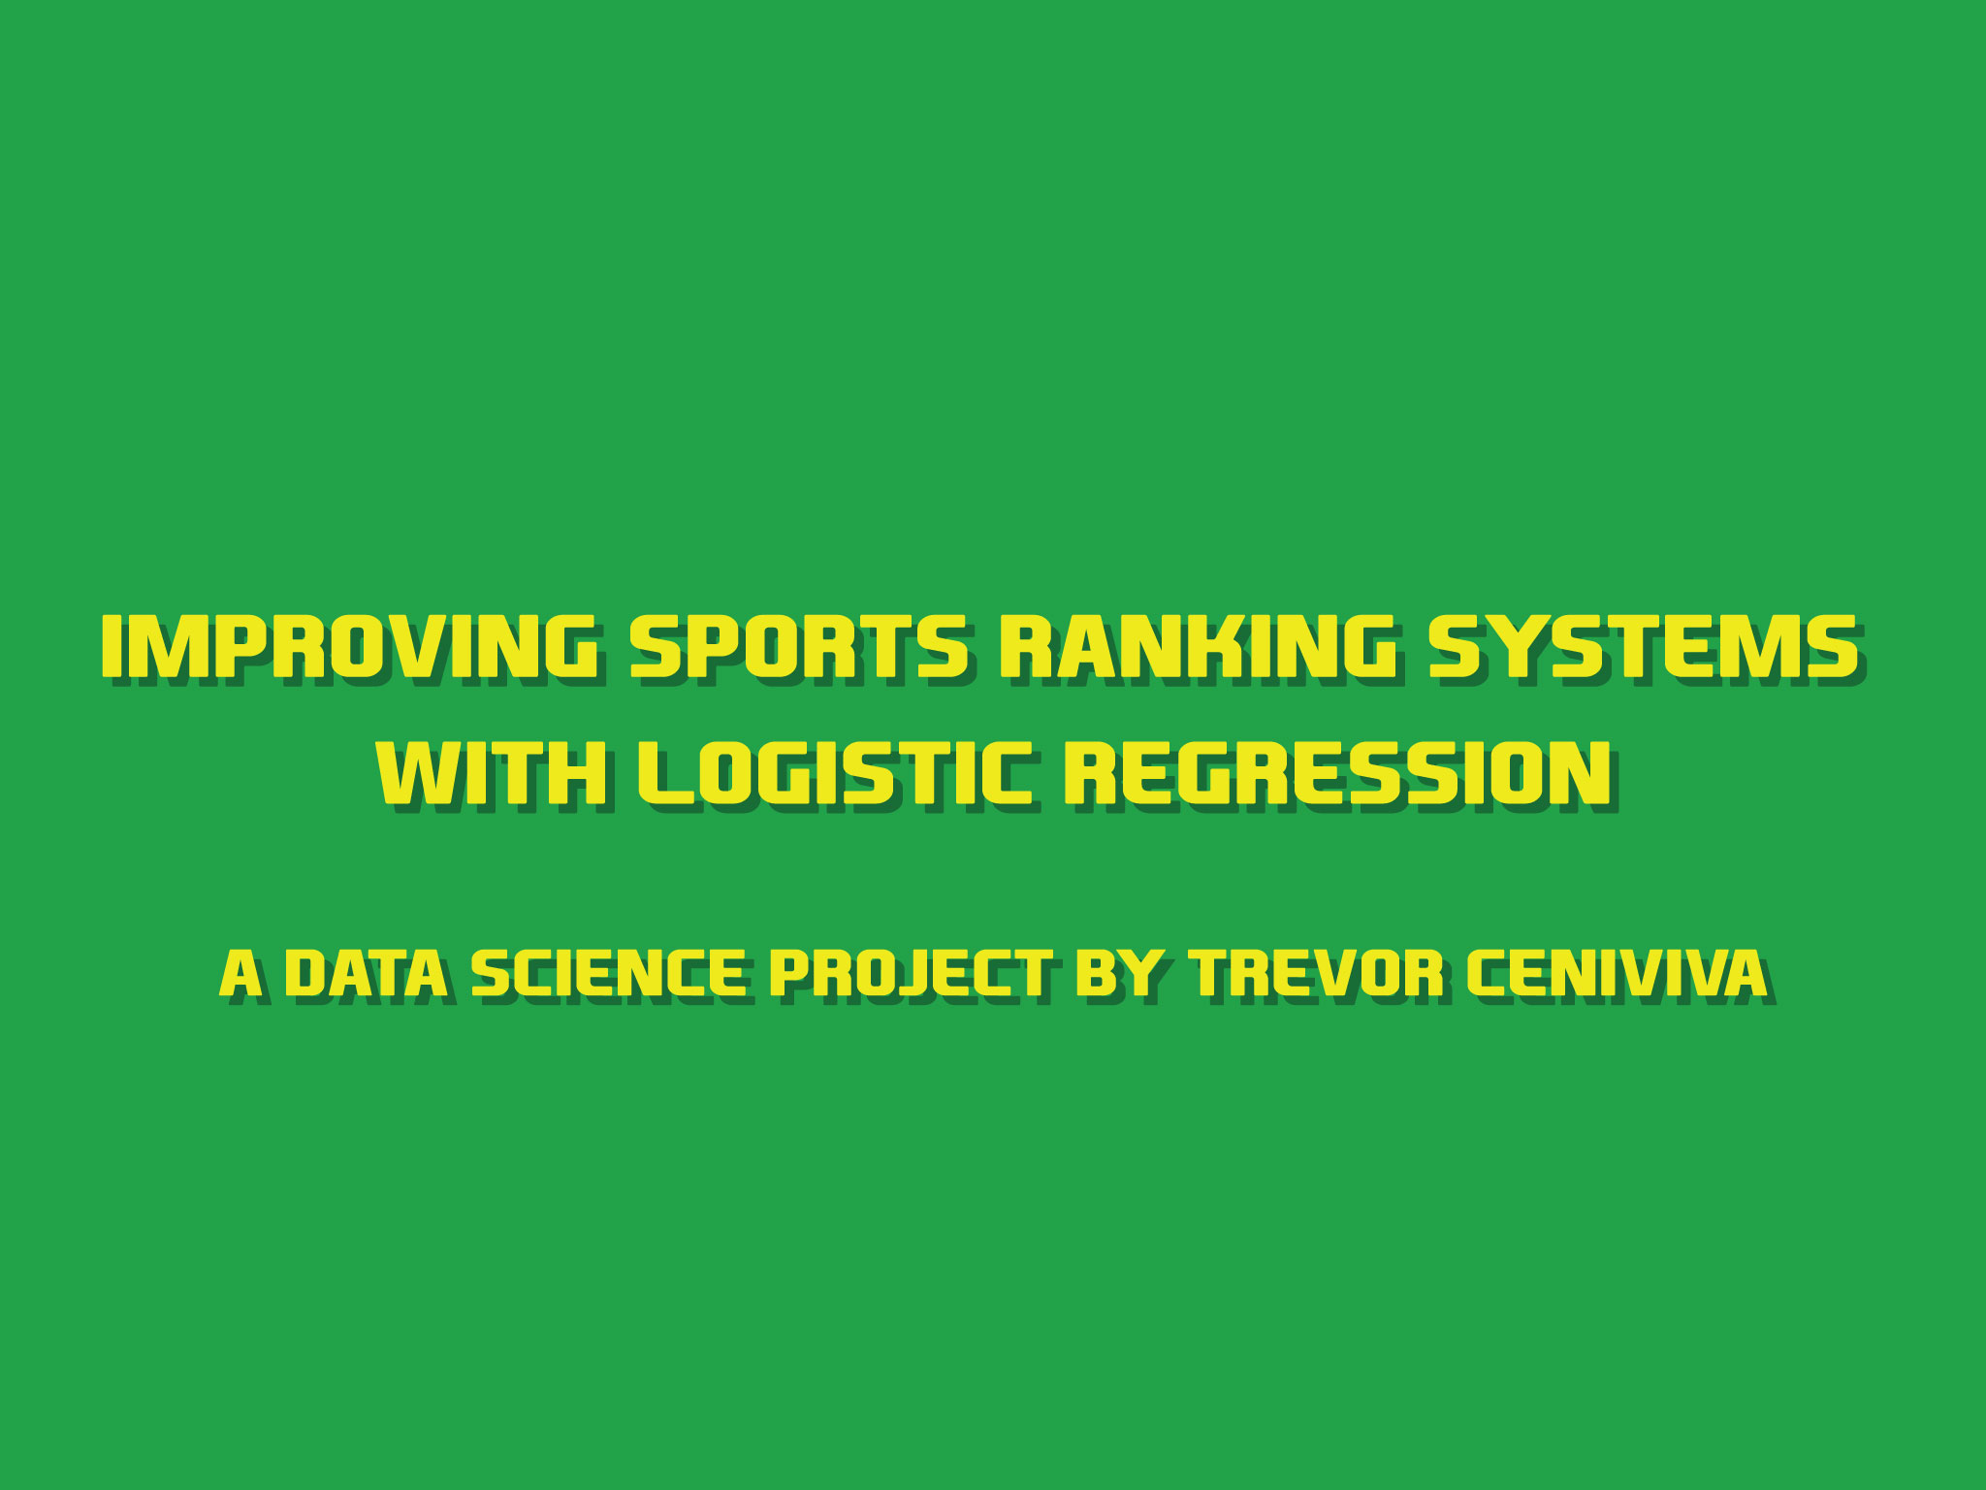

Slide 2
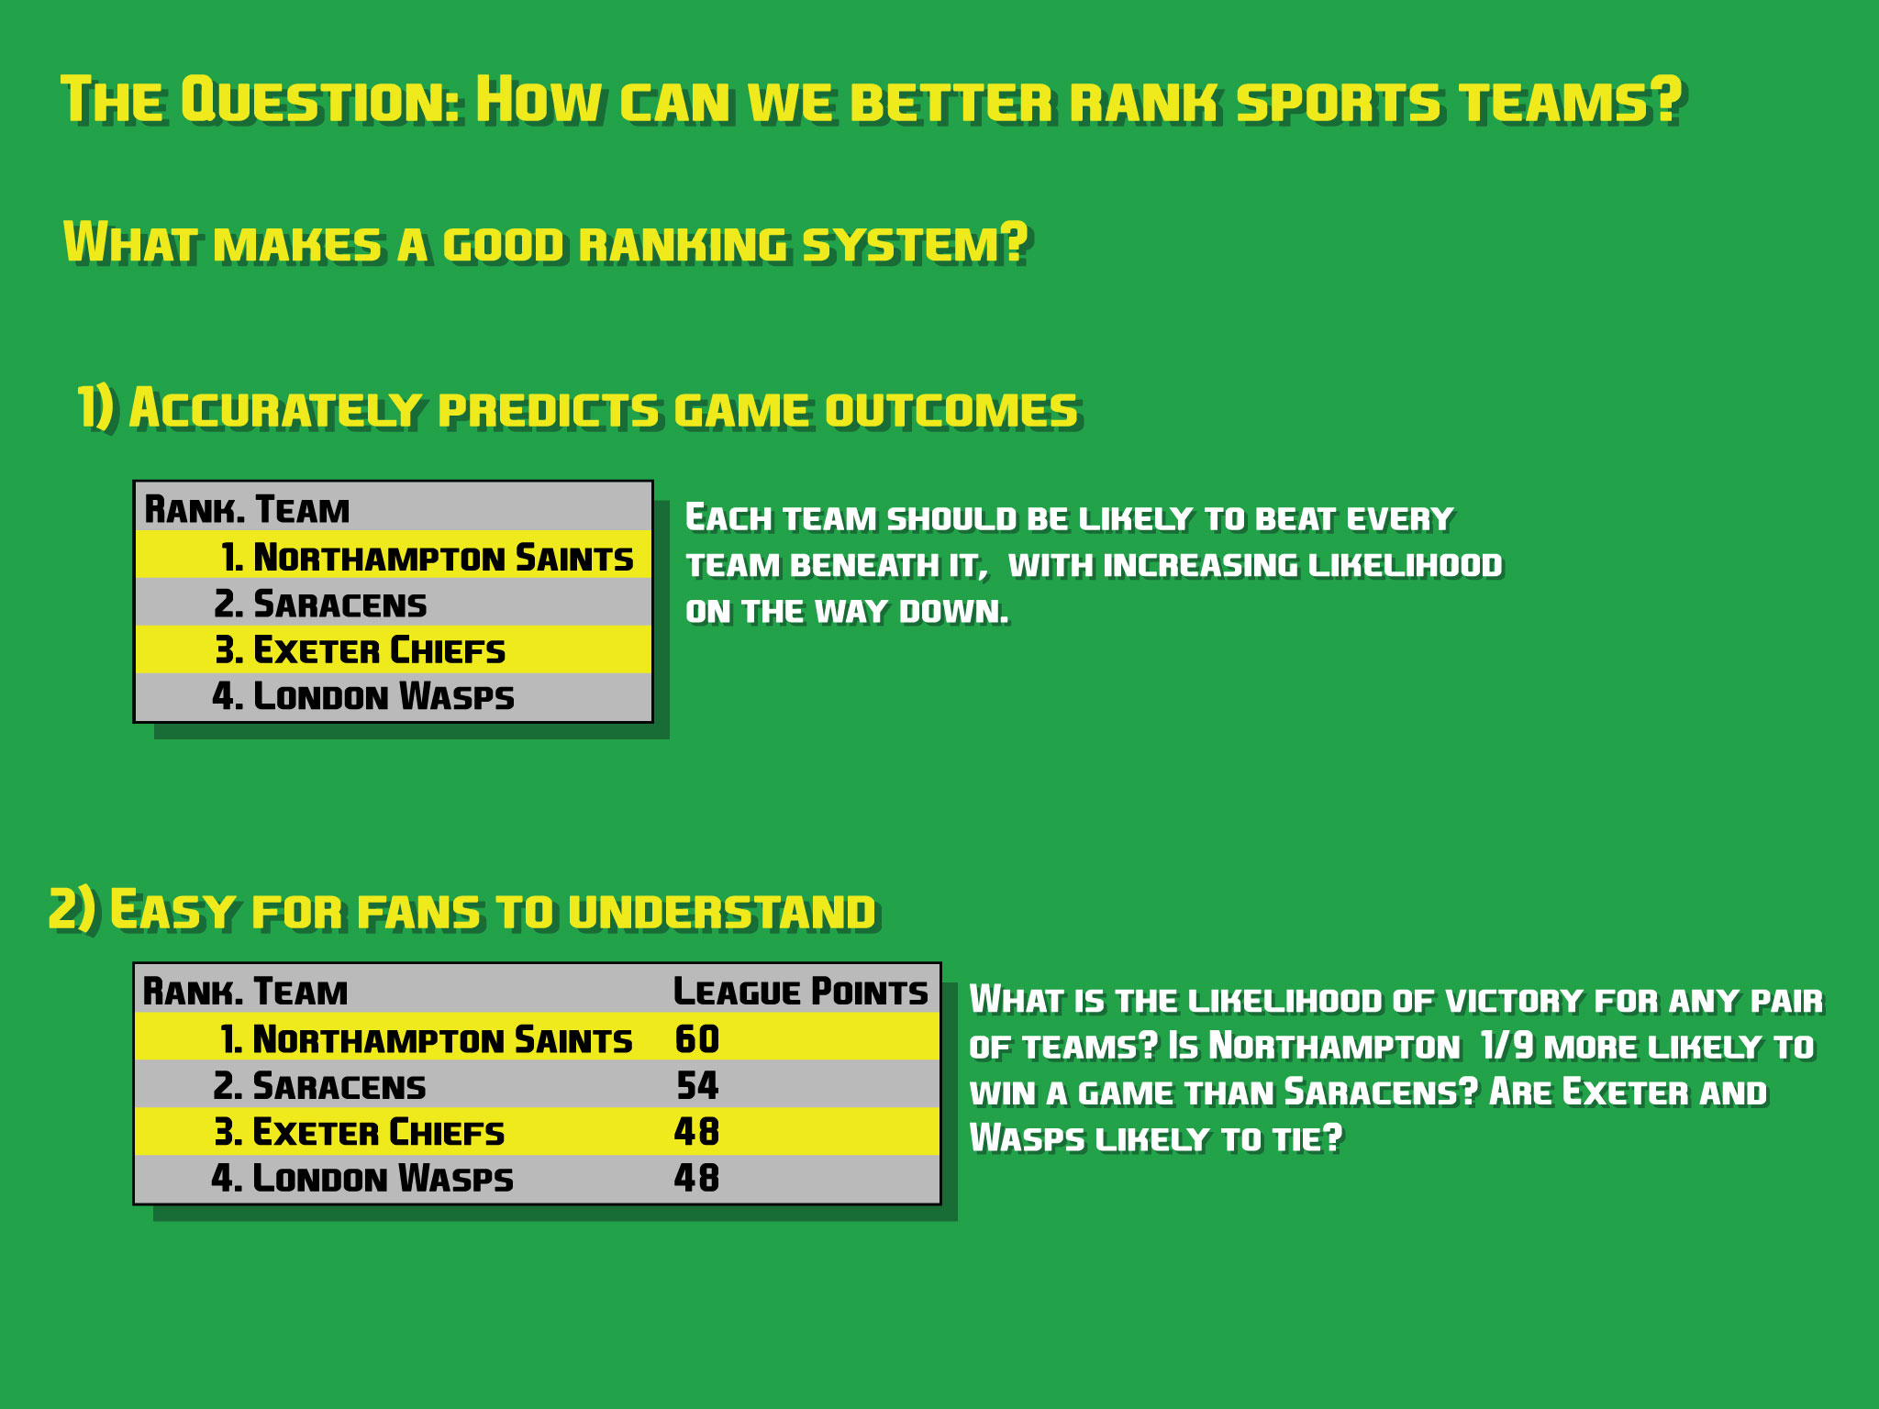
Notes:
So the initial question is how can we better rank sports teams? All sports need to rank the teams in their leagues in order to determine playoffs or select teams for a championship match. What makes a good ranking system? Well, the goal is to always put the teams with the highest likelihood of victory into the final – the two teams that could most likely beat everyone else in the league. Thus, it needs to accurately predict the outcome of future games. Second, I wanted it to be easy for fans to understand. Current systems rely on very simple factors like win-record or point differential. My system will rely on point differential, but also on linear regression. This will complicate things a bit, but the table should still be made easy by using the coefficients to fill in a “strength” column, which the table will be sorted on.

Slide 3
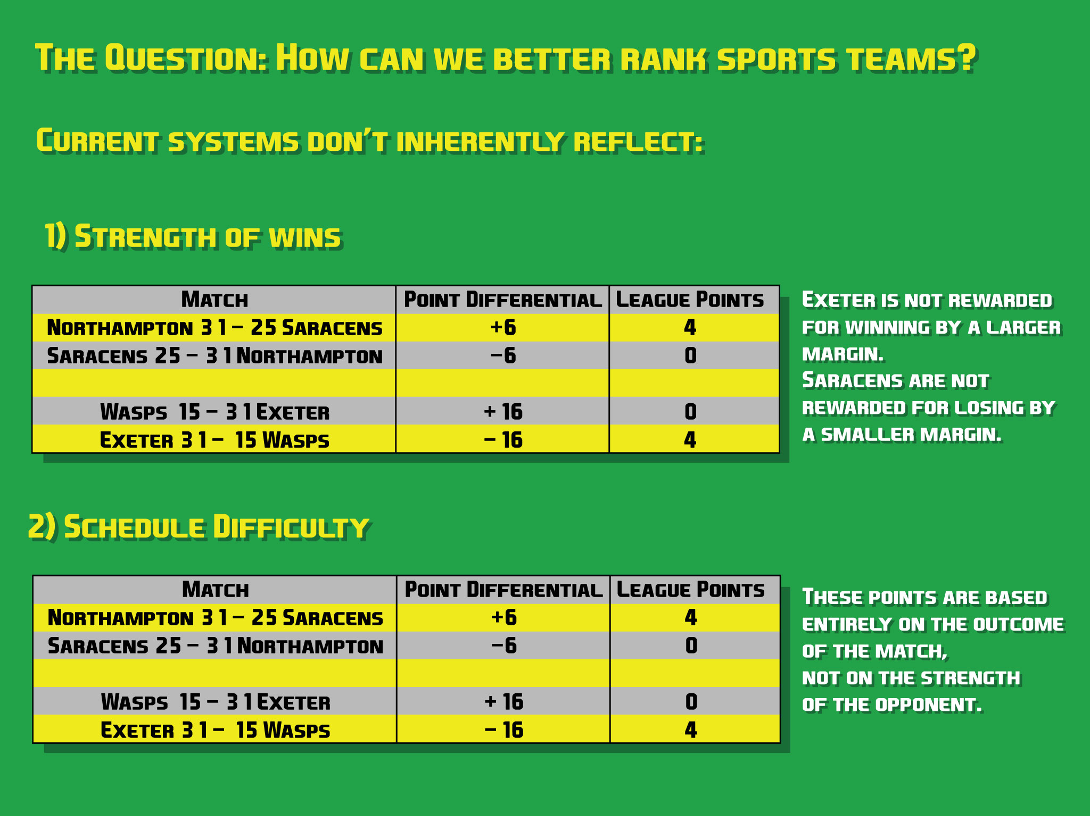
Notes:
Why bother improving current systems? Well, most of them don’t take into account the strength of a victory, and thus have weaker predictive ability. Two teams that are 2-0 go into a matchup equally ranked in many instances, but the team that has a greater point differential might need to be more favored. Furthermore, they don’t inherently take into account the difficulty of a team’s schedule, which also reduces their predictive strength. My model takes into account all games played by all teams to set strengths at the lowest overall error. Thus, big wins over weak teams are balanced out by closer games against stronger teams.

Slide 4

Notes:
From this data, I created a dataframe made up of dumby variables for every team to indicate who was playing in each match, and indicating which team was home. Thus, based solely on which two teams were playing, I attempted to predict what the point differential would be. Because the teams playing were reduced to a binary system, the coefficients should indicate the contribution of either team toward the point differential.

Slide 5
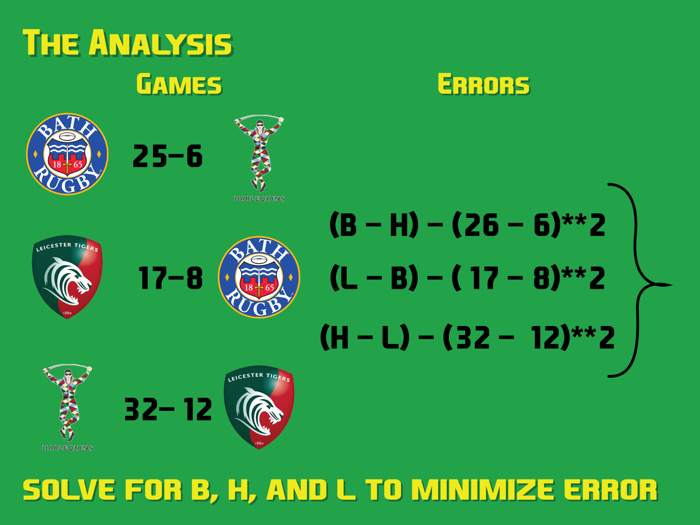
Notes:
Here was the basic design idea. Each team’s strength is meant to indicate their likely points scored. Thus, the difference between strengths should be as close as possible to the actual point difference when those teams play.

Slide 6
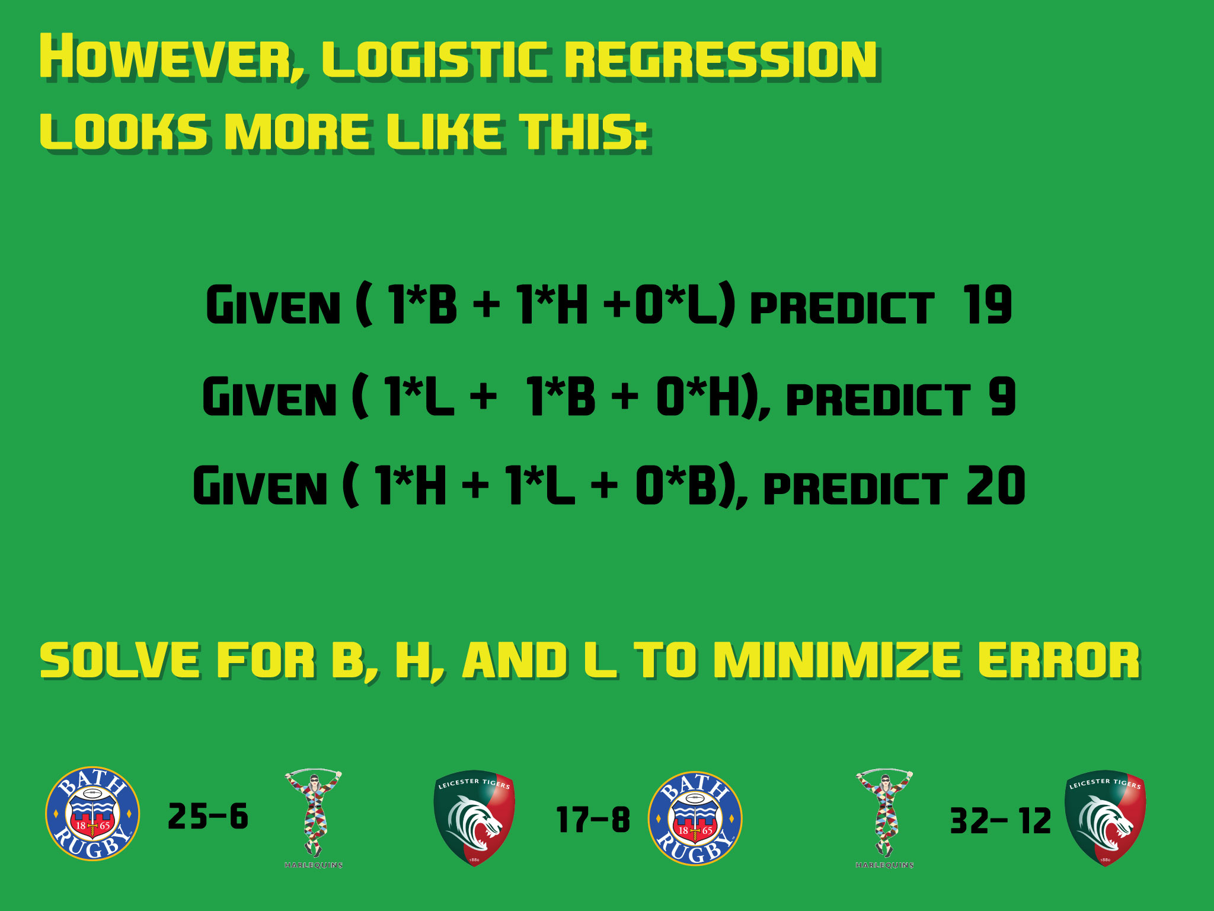
Notes:
However, logistic regression uses simple addition of feature weights. So when two teams play, the strength of one team plus the strength of the other adds up to the prediction. The problem here is that I’m not taking into account the actual strength of the opponent when trying to assign a strength to the original team.

Slide 7
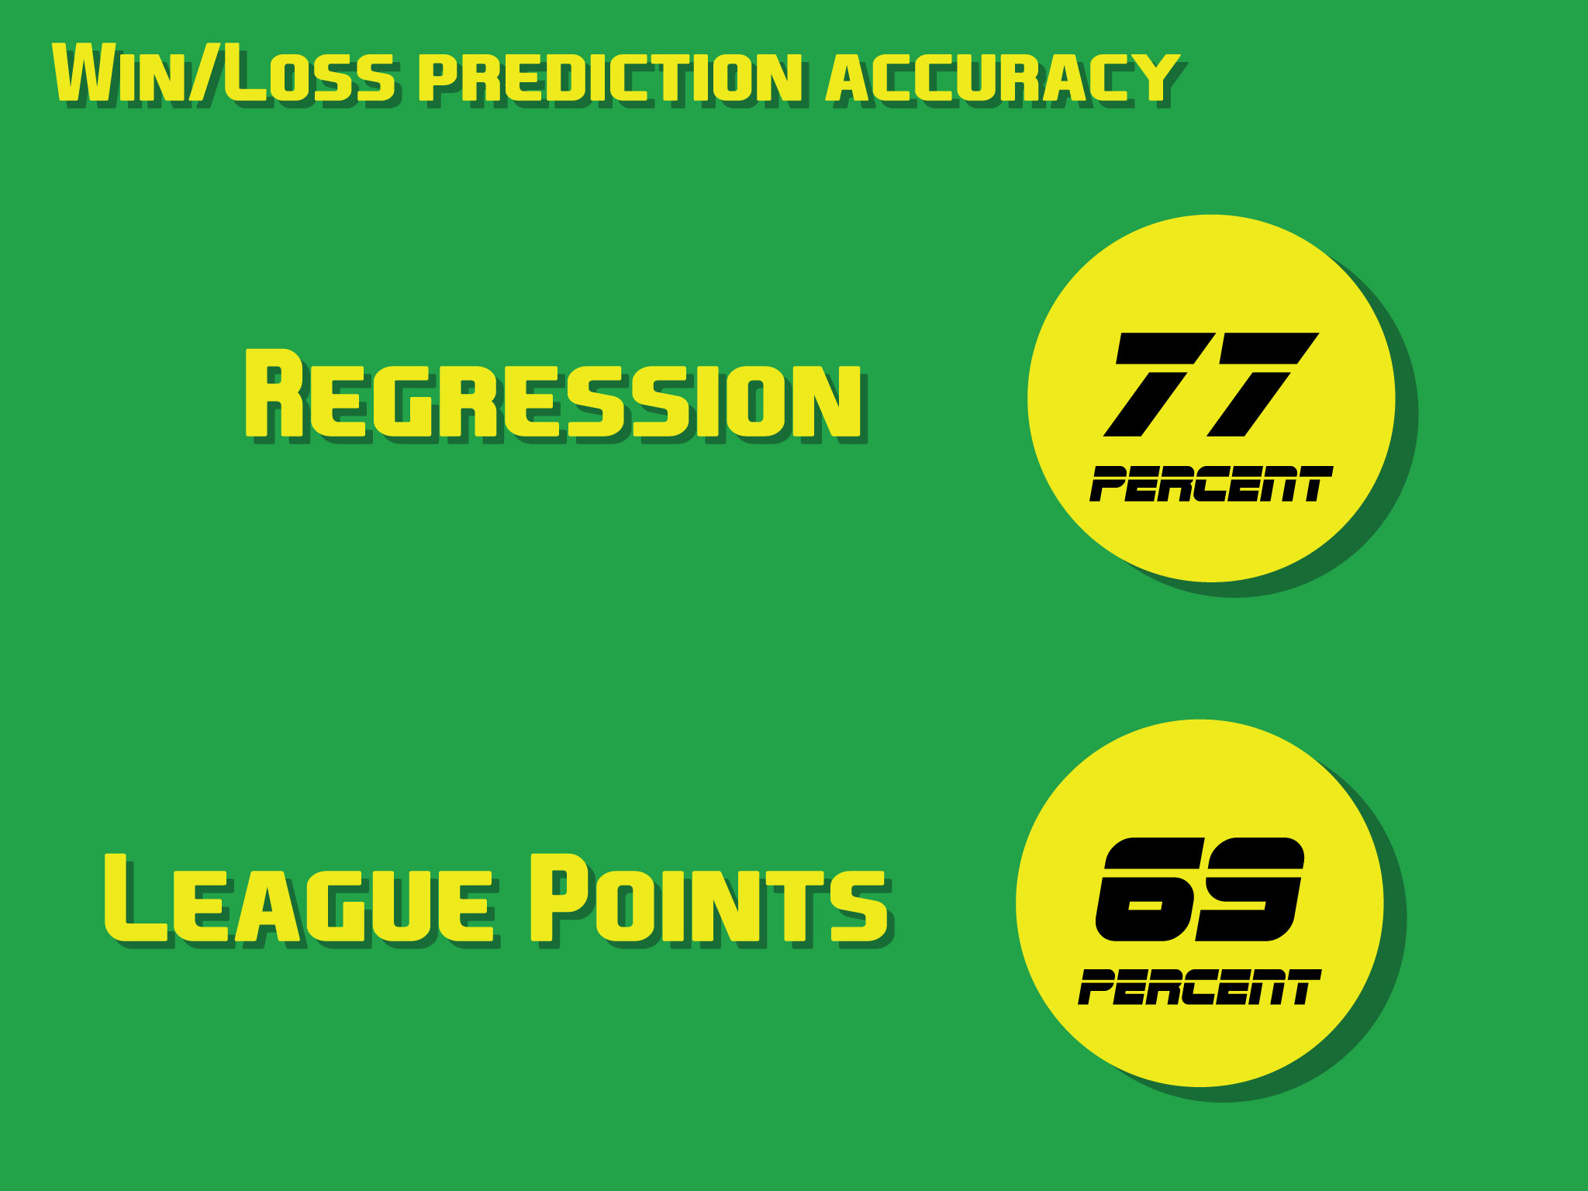
Notes:
Still, using the model I created, I improved on using league points to set the table by 8 percent on average from season to season. Furthermore, my system already improves on the old one by indicating how close the games should be. When league points accurately predicts a win – but does nothing to say how close that win should be, or how much of a blow out it should be – my model shows improvements on that system.

Slide 8
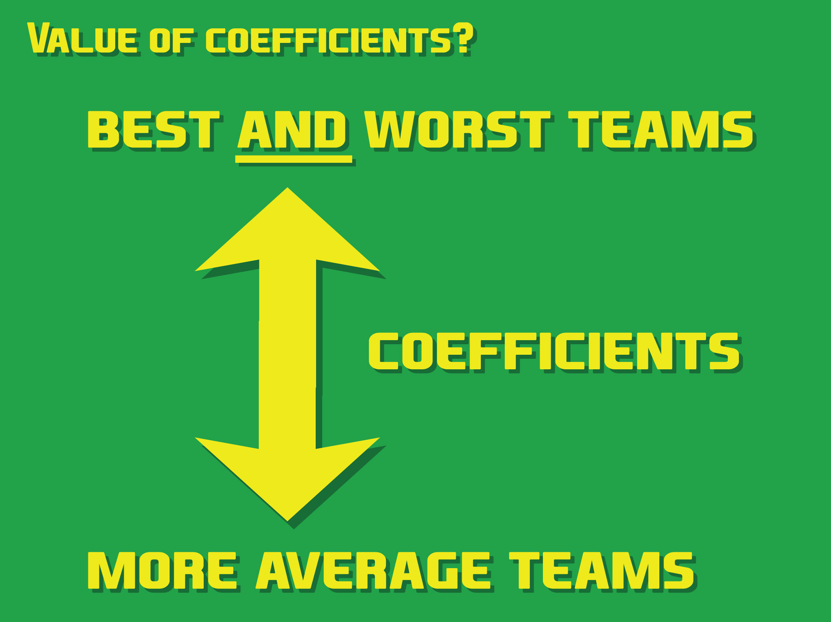
Notes:
However, as discussed above, I did not take into account the strength of the opponent when setting the strength of the main team. This means that both features were to add up to the point differential. So, the teams that win by a lot contribute a lot to the point differential. However, the teams that lose by a lot consistently also contribute to a high point differential. Meanwhile, the average teams don’t contribute very much to the size of the point differential.

Slide 9
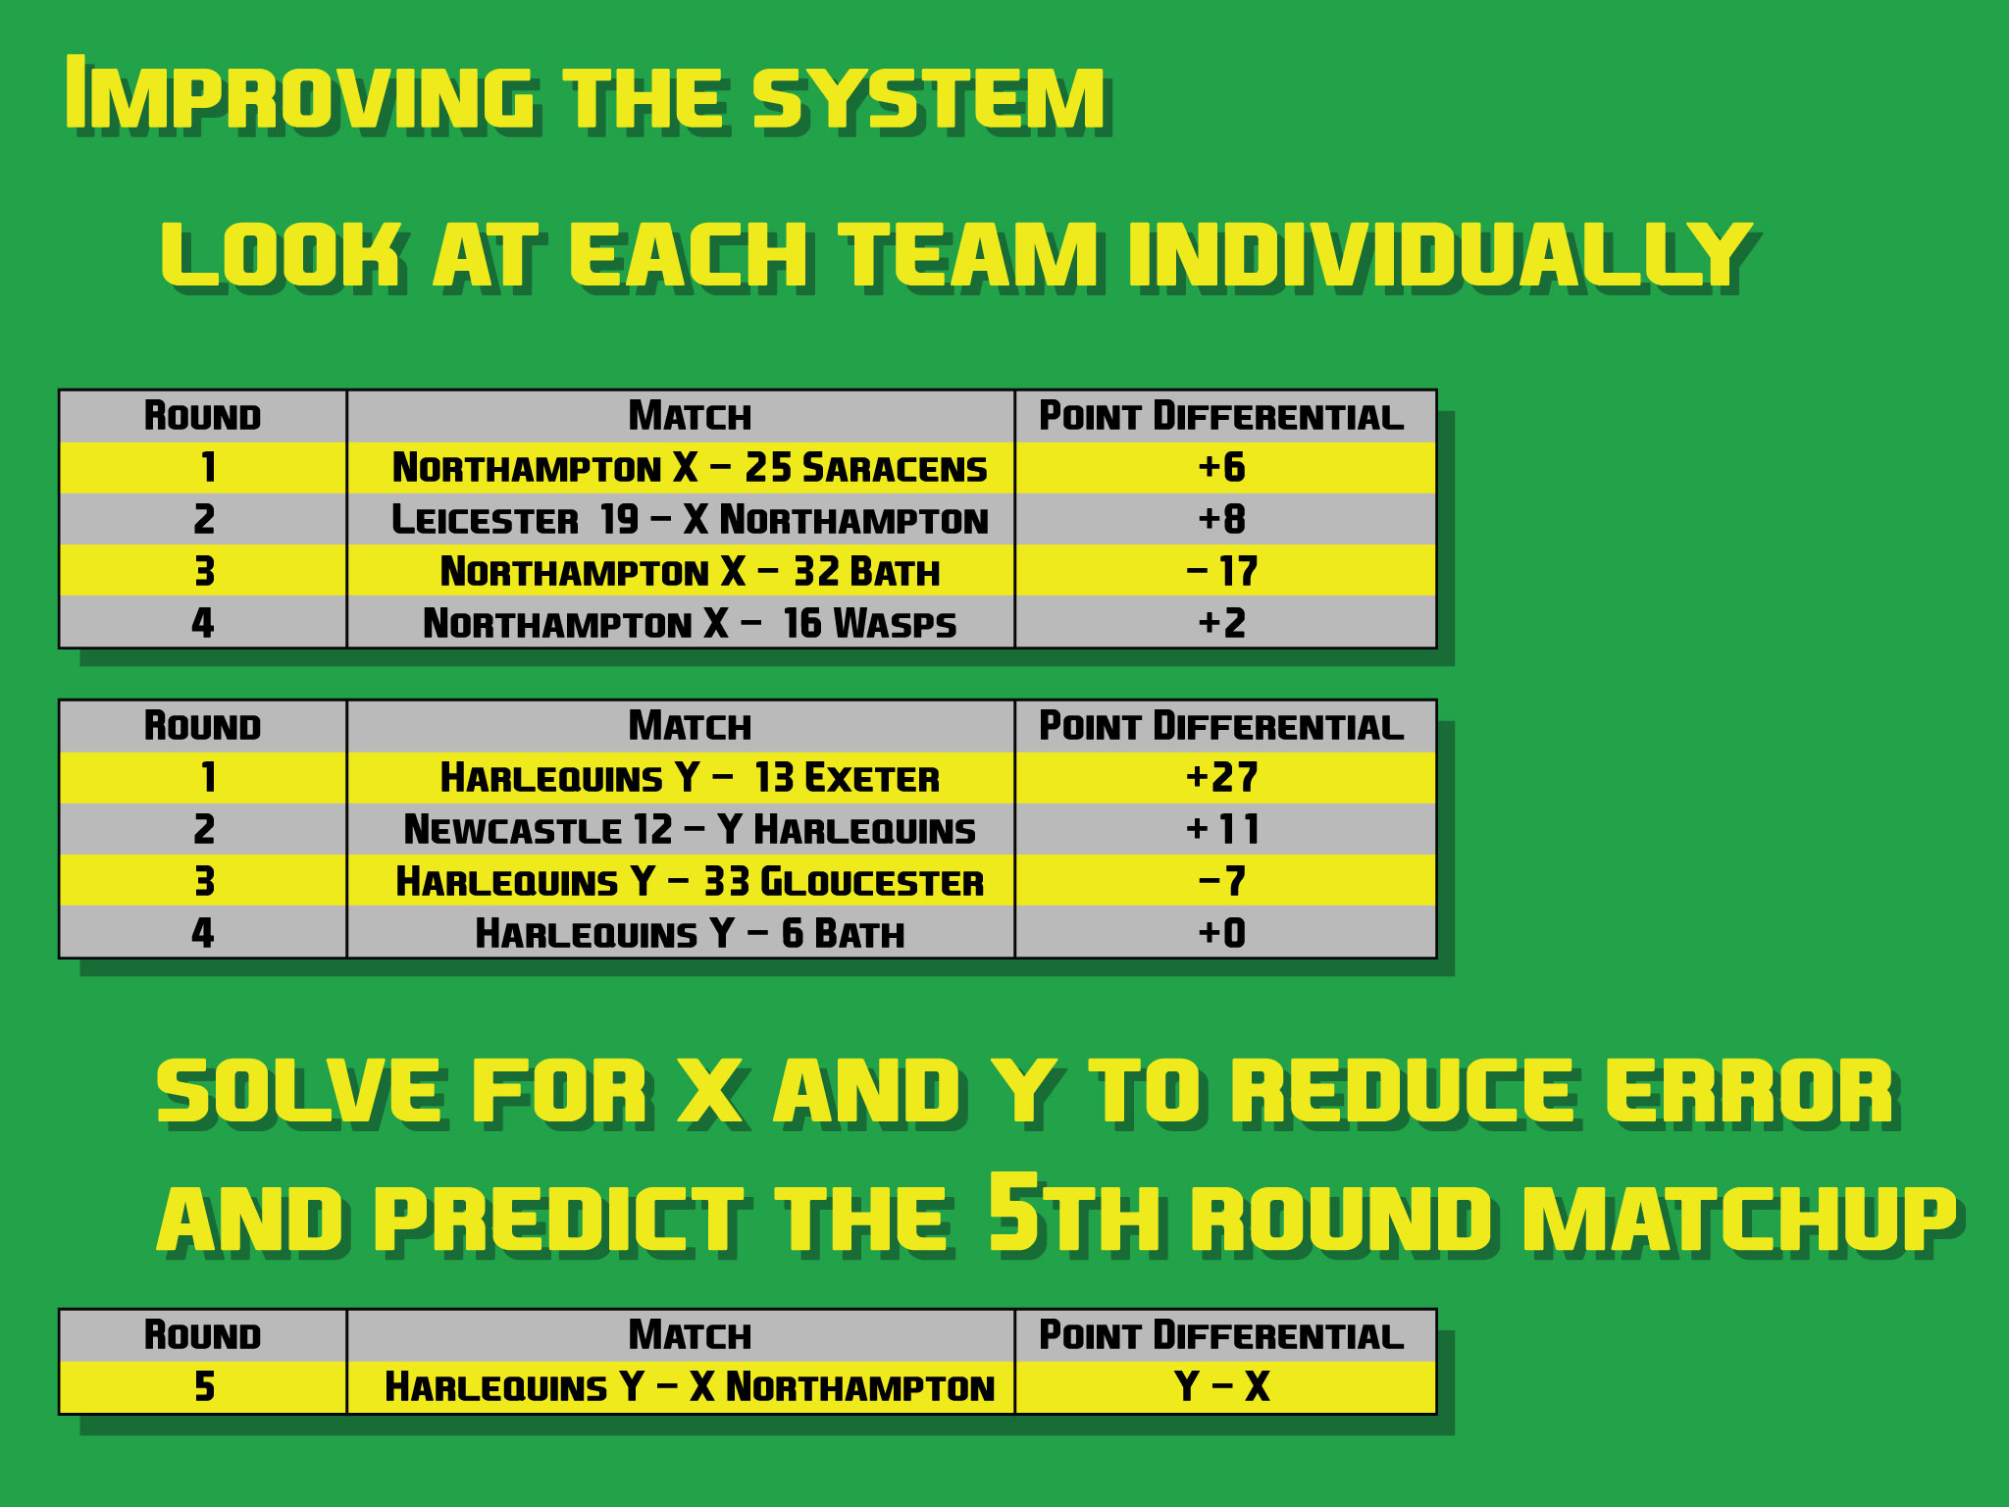
Notes:
So how can I improve the system even further? Well, I need to take into account the actual strengths of the opponents when setting the strength of a single team. This allows me to set the strength of each team independently up through round N.

Slide 10
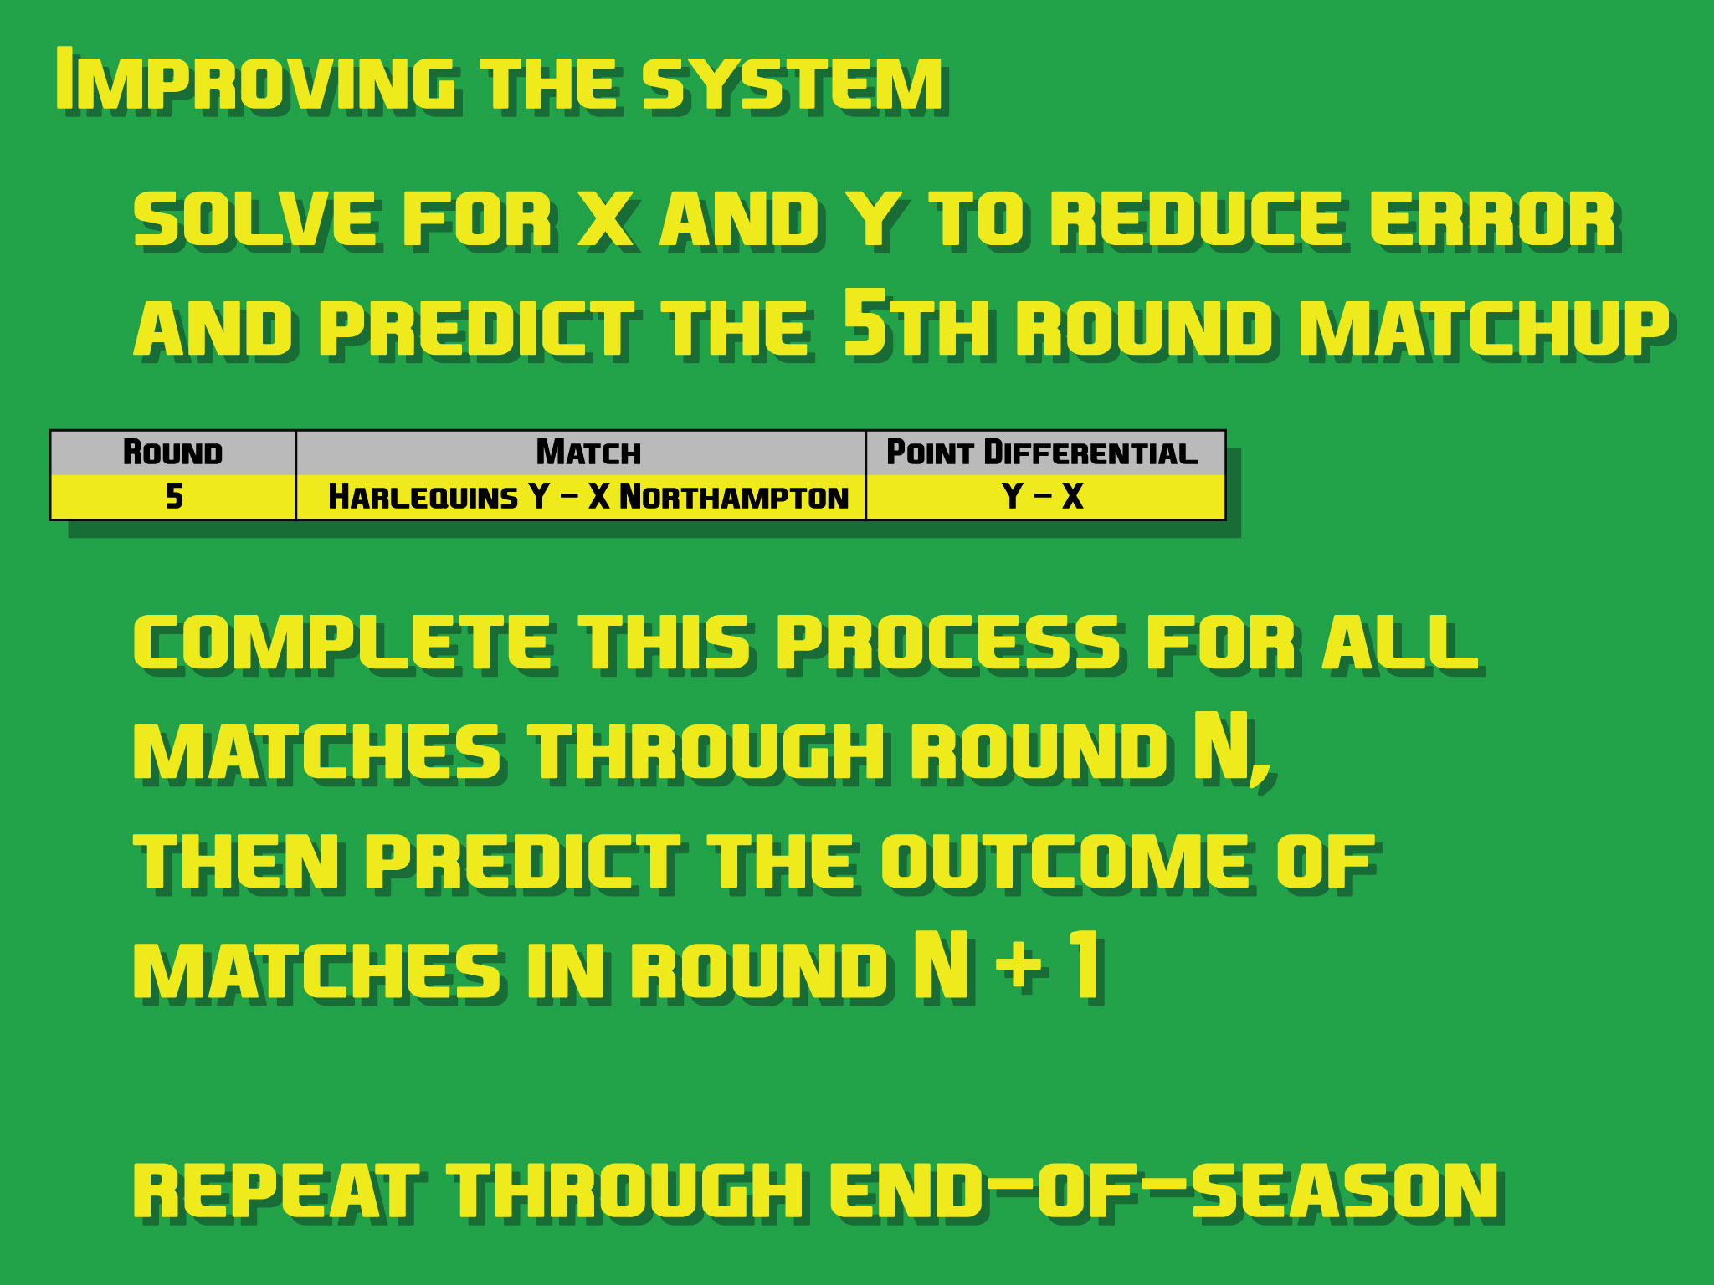
Notes:
I can then use those strengths to predict the games for round N+1. I can repeat this process for all the rounds in a season, and to create tables at any point in the season that will more accurately reflect which teams are most likely to win any head-to-head match. More importantly, it will show a statistically predicted closeness of that match, which the league points system cannot do.

Slide 11


