Slide 1
Rugby Match Predictions
Trevor Ceniviva

Slide 2
The Project
Based on previous matches in a season, can we predict who will win a match between known opponents

Slide 3
Inspiration
Dan Gillick, UC Berkeley PhD, Research Analyst at Google
“How to Predict College Football Games”
Aimed to reduce minimum score difference between prediction and actual
week 1: x vs. y result: 21-3
week 2: y vs. z result: 15-18
week 3: x vs. z result: 10-42
[(Sx - Sy) - (21 - 3)]^2 + [(Sy - Sz) - (15 - 18)]^2 + [(Sx - Sz) - (10 - 42)]^2

Slide 4
Raw Data
5 seasons of matches played in the Aviva Premiership (England’s top league)
Gathered from espnscrum.com
23 columns, 660 games

Slide 5
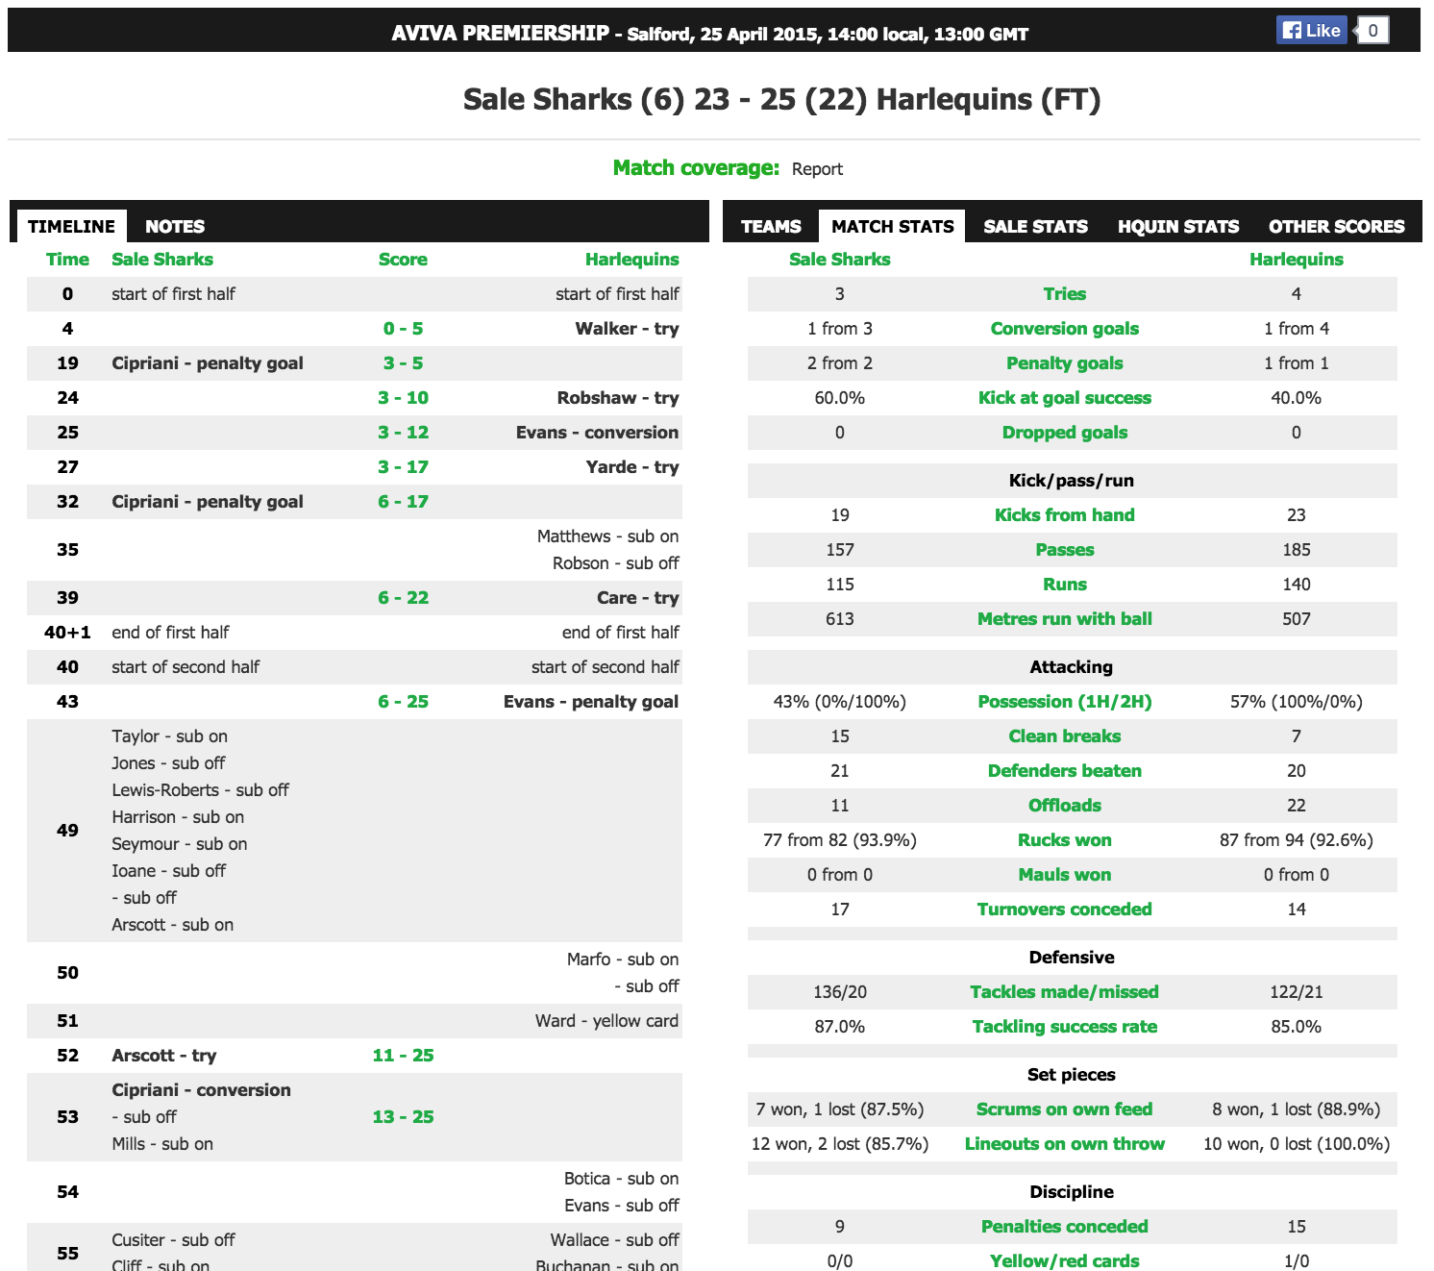

Slide 6
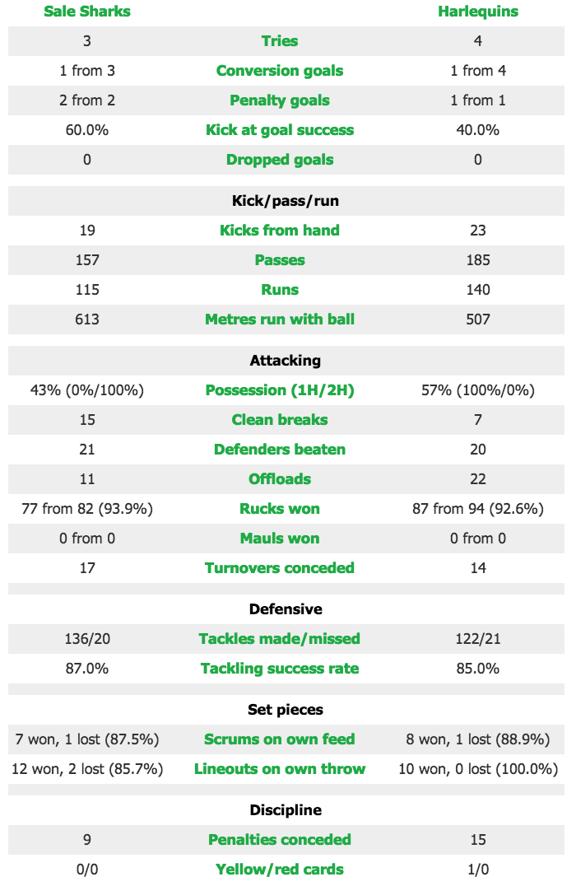
Pretty messy tables here
# from #
won
lost
(%)
/
Missing
Points, winner, point differential

Slide 7
Cleaning
Tackles made/missed
136/20
Split into ‘tackles_made’ and ‘tackles_missed’
Conversion goals
1 from 3
Split into ‘conversions_made’ and ‘conversions_missed’

Slide 8
Cleaning
Mauls & Rucks
1 from 2 (50.0%)
Split into mauls_started, mauls_won, and maul_success; rucks_started, rucks_won, and ruck_success
Scrums & Lineouts
7 won, 1 lost (87.5%)
Split into scrums_won, scrums_lost, scrum_success; lo_won, lo_lost, lo_success

Slide 9
Cleaning
Penalties
10 (1)
Split into penkicks and freekicks
Penalty goals
2 from 2
Split into pen_goals, pen_attempt
Drop goals
Split into drop_goals, drop_missed
Tries
Some of these had a note of (1 penalty try) that had to be removed

Slide 10
New Columns
points
Made up of new columns: try_points, pen_points, con_points
meters_per_run
Made by dividing meters_run / runs
point_diff
Should help show the ‘strength’ of a win
Still working on this

Slide 11
Visualizations
Tons of variables to compare
Do I want to predict Win T/F?

Slide 12
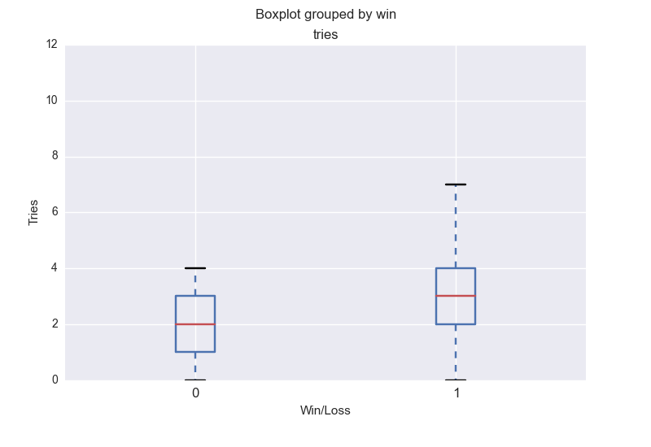

Slide 13
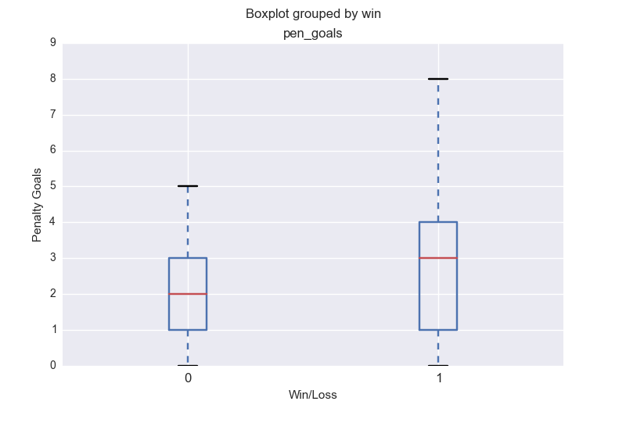

Slide 14
Visualizations
Do I want to look at “team strength”?

Slide 15
“Strength”
This will simplify everything down to a single number, intended to predict the point dominance over opponent
By comparing strengths, we can predict which of two teams will win

Slide 16
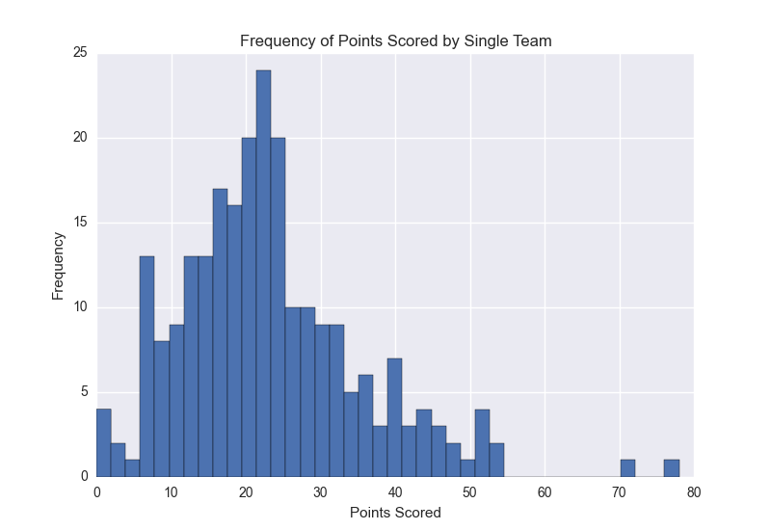

Slide 17
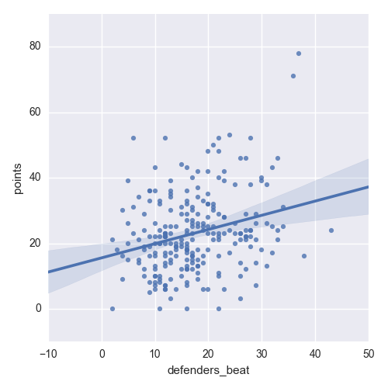

Slide 18
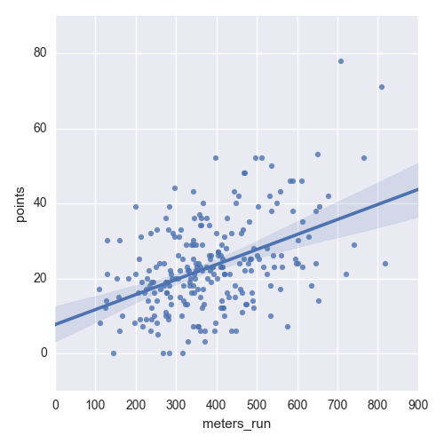

Slide 19
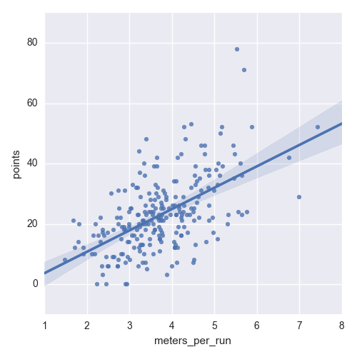

Slide 20
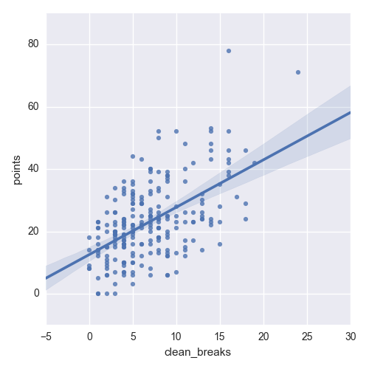

Slide 21
Where we’re going
“Strength” prediction model
Strength = point dominance over opponent
Use results of first 8 games to predict game 9
Use results of first 9 games to predict game 10, and so on
Do this for all 5 seasons
Compare this against using a blanket “win-loss” model
Team with more wins predicted to win

