Slide 1
Exploring Seattle’s 911 Calls
By: Trenton creamer

Slide 2
Learning Objective
To build a model that was able to identify trends in 911 call events and be able to predict when they are most likely to occur in the day.
This could better help police and emergency workers to be adequately staffed and resourced during times of the day based on frequency of when events may occur.

Slide 3
Data Source
https://data.seattle.gov/Public-Safety/Seattle-Real-Time-Fire-911-Calls/kzjm-xkqj
1.8M 911 calls since created
32000 911 calls since the beginning of this year
2500 911 calls in April when I pulled the data

Slide 4
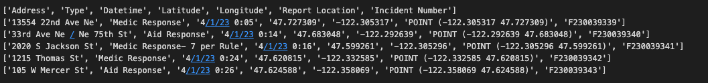
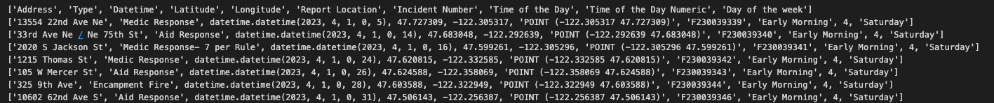
Data Source Continued

Slide 5
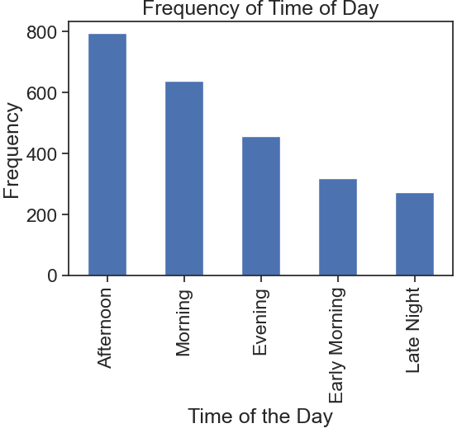
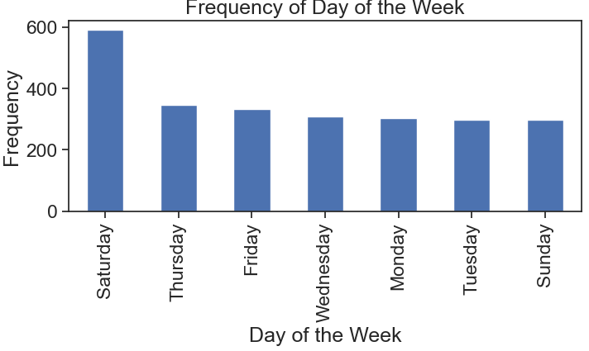
Visualizations

Slide 6
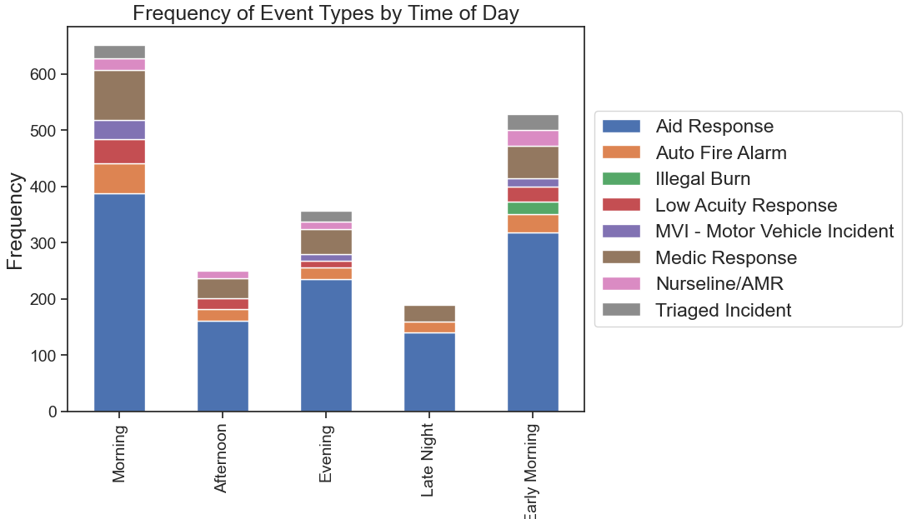
Top event by time of day

Slide 7
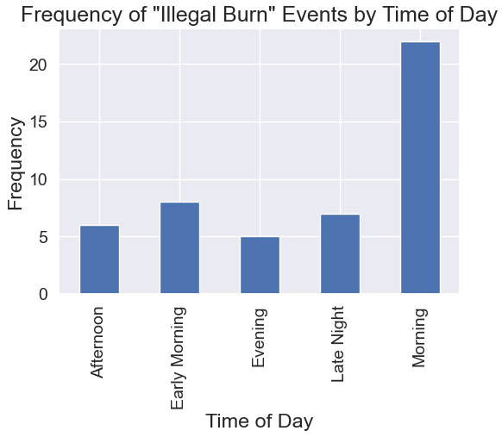
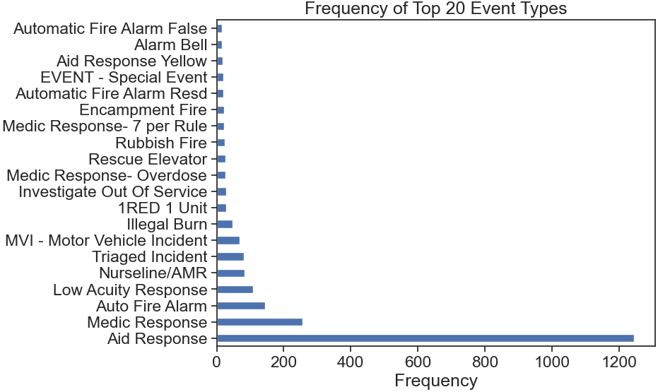
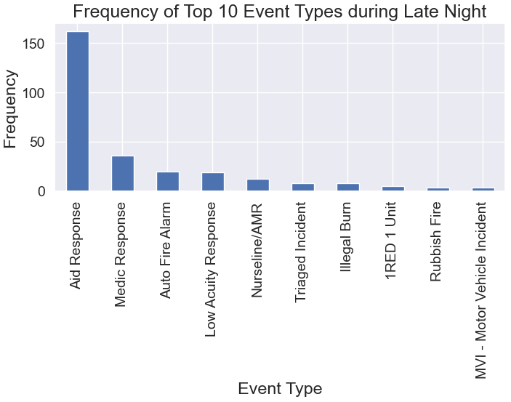
Visualization continued

Slide 8
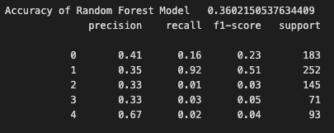
ML models used
Random Forests
33% before tuning
36% after tuning, performed better with a lower amount of n_estimators.
Precision of Early Morning Events highest
Naïve Bayes
Initial accuracy of 17%
35% after smoothing

