Slide 1
Travel Diary

Slide 2
Team
Aleš Woska (vedoucí)
Jaroslav Kubát
Pavel Pilař
Luca Mecella
Simone Chiappa

Slide 3
System architecture
System architecture is based on MCV architecture and it has 4 packages like is shown on a picture below. Packages are: Client – contains aplication clients (web and mobile), Server – Aplication server – aplication server, ensures aplication funcionality, Data – ensure data storage, 3rd Party Components – Google and Facebook APIs.

Slide 4
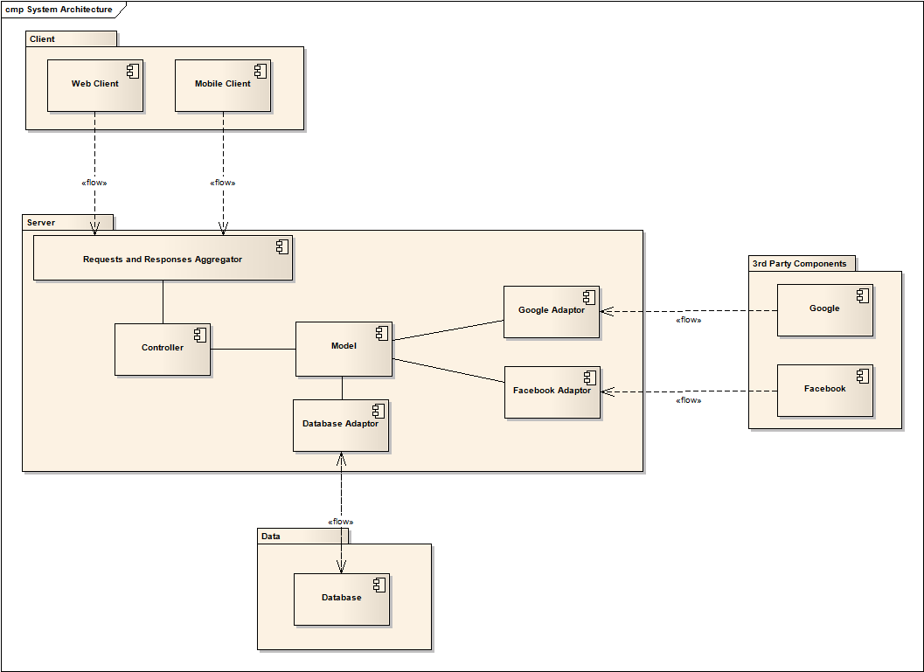
System architecture – diagram

Slide 5
Deployment diagram
Deployment model shows which parts of system runs on which devices.

Slide 6
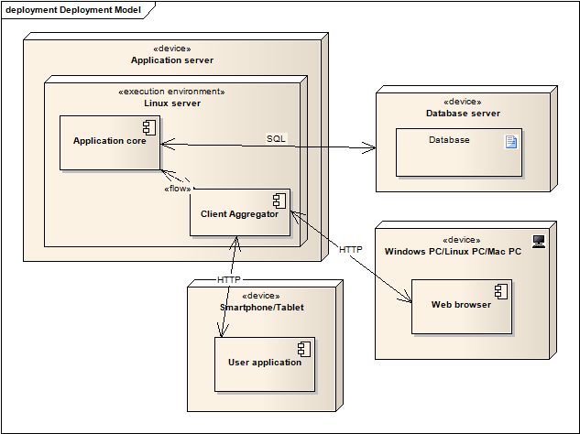
Deployment diagram

Slide 7
Component Diagram
Component diagram shows components of system. Their relations and ralations with system architecture. There are three main components corresponding to three main packages of systém architecture.

Slide 8
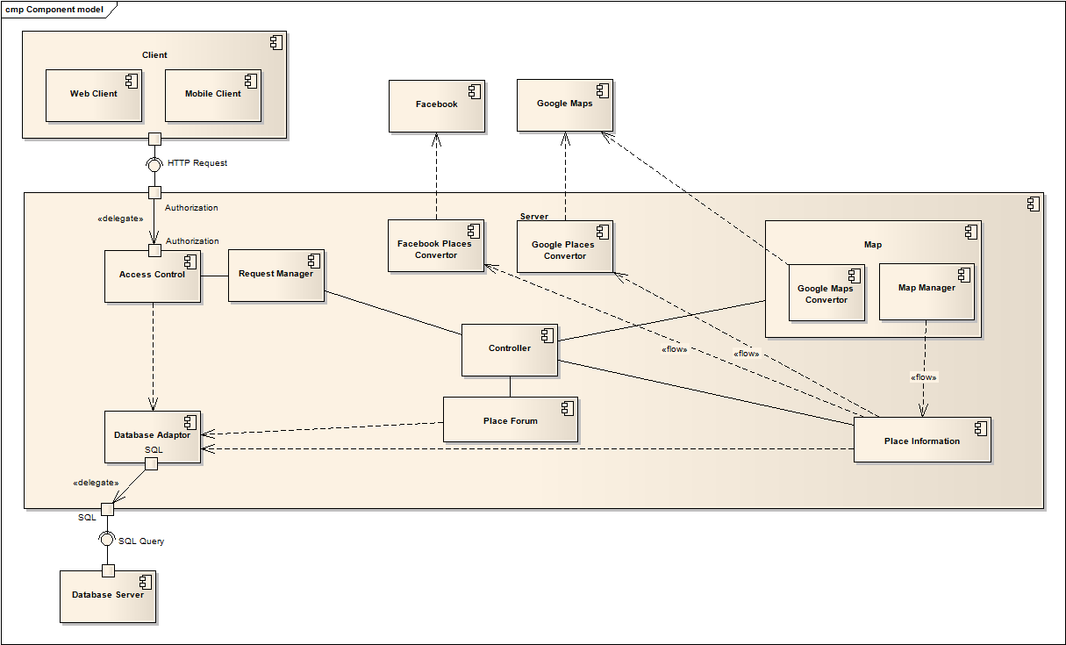
Component Diagram

Slide 9
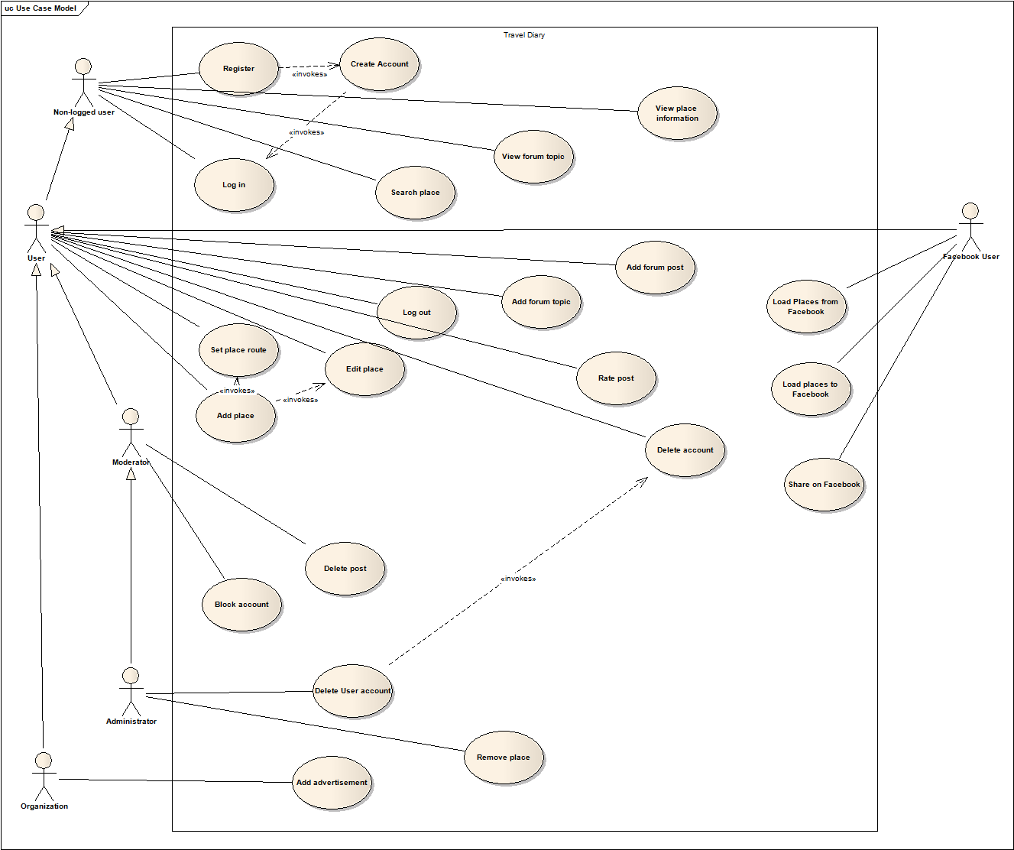
Use Case Model

