Slide 1
SAIL/ACT 入门培训

Slide 2
4. ACT Chapter 2. RV32I 测试逻辑/测试生成

Slide 3
测试文件结构
$ tree riscof-plugins/rv64/riscof_work/
riscof-plugins/rv64/riscof_work/
├── database.yaml ├── Makefile.Reference-sail_c_simulator
├── rv64i_m │ └── I │ └── src │ ├── addi-01.S │ │ ├── addi-01.log │ │ ├── ref.disass
│ │ ├── ... │ │ ├── ref.elf
│ │ └── Reference-sail_c_simulator.signature
│ └── ...
├── spike_simple_isa_checked.yaml ├── spike_simple_platform_checked.yaml └── test_list.yaml

Slide 4
测试 elf 反汇编
00800000000001a0 <inst_0>: 800000000001a0: 00100993 li s3,1 800000000001a4: 00c99993 slli s3,s3,0xc 800000000001a8: fff9c993 not s3,s3 800000000001ac: 80098993 addi s3,s3,-2048 800000000001b0: 01383023 sd s3,0(a6) 00800000000001b4 <inst_1>: 800000000001b4: 00100093 li ra,1 800000000001b8: 01009093 slli ra,ra,0x10 800000000001bc: fff0c093 not ra,ra 800000000001c0: 00008793 mv a5,ra 800000000001c4: 00f83423 sd a5,8(a6)

Slide 5
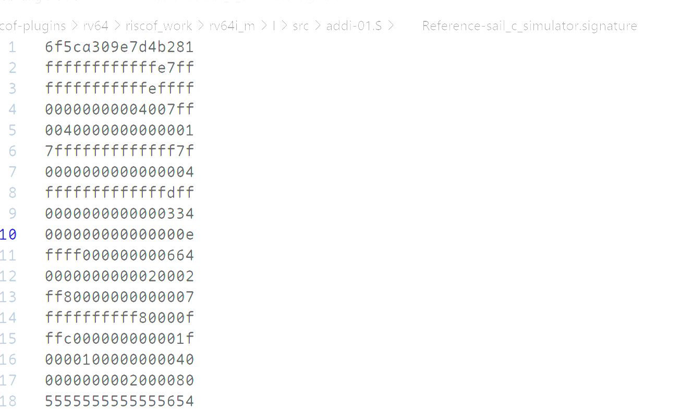
签名文件示例

Slide 6
addi.s 测试脚本参考
RVTEST_CASE(0,"//check ISA:=regex(.*64.*);check ISA:=regex(.*I.*);def TEST_CASE_1=True;",addi)
RVTEST_SIGBASE( x16,signature_x16_1)
inst_0:
// rs1 == rd, rs1==x19, rd==x19, imm_val == (-2**(12-1)), imm_val == -2048, rs1_val != imm_val, rs1_val == -4097, rs1_val < 0 and imm_val < 0
// opcode: addi ; op1:x19; dest:x19; op1val:-0x1001; immval:-0x800
TEST_IMM_OP( addi, x19, x19, 0xffffffffffffe7ff, -0x1001, -0x800, x16, 0, x18)
inst_1:
// rs1 != rd, rs1==x1, rd==x15, imm_val == 0, rs1_val == -65537
// opcode: addi ; op1:x1; dest:x15; op1val:-0x10001; immval:0x0
TEST_IMM_OP( addi, x15, x1, 0xfffffffffffeffff, -0x10001, 0x0, x16, 8, x18)

Slide 7
ADDI 测试生成模板
addi:
sig:
stride: 1
sz: 'XLEN/8'
xlen: [32,64]
std_op:
isa:
- I
operation: 'hex((rs1_val + imm_val) & (2**(xlen)-1))'
rs1_op_data: *all_regs
rd_op_data: *all_regs
rs1_val_data: 'gen_sign_dataset(xlen)+ gen_sp_dataset(xlen,True)'
imm_val_data: 'gen_sign_dataset(12)+ gen_sp_dataset(12)'
formattype: 'iformat'
template: |-
// $comment
// opcode: $inst ; op1:$rs1; dest:$rd; op1val:$rs1_val; immval:$imm_val
TEST_IMM_OP( $inst, $rd, $rs1, $correctval, $rs1_val, $imm_val, $swreg, $offset, $testreg)

Slide 8
sd 指令的基地址和偏移量
00800000000001a0 <inst_0>:
800000000001a0: 00100993 li s3,1 800000000001a4: 00c99993 slli s3,s3,0xc 800000000001a8: fff9c993 not s3,s3
800000000001ac: 80098993 addi s3,s3,-2048
800000000001b0: 01383023 sd s3,0(a6)
00800000000001b4 <inst_1>: 800000000001b4: 00100093 li ra,1 800000000001b8: 01009093 slli ra,ra,0x10 800000000001bc: fff0c093 not ra,ra 800000000001c0: 00008793 mv a5,ra 800000000001c4: 00f83423 sd a5,8(a6)

Slide 9
TEST_IMM_OP 转换为汇编
addi:
sig:
stride: 1
sz: 'XLEN/8'
xlen: [32,64]
std_op:
isa:
- I
operation: 'hex((rs1_val + imm_val) & (2**(xlen)-1))'
rs1_op_data: *all_regs
rd_op_data: *all_regs
rs1_val_data: 'gen_sign_dataset(xlen)+ gen_sp_dataset(xlen,True)'
imm_val_data: 'gen_sign_dataset(12)+ gen_sp_dataset(12)'
formattype: 'iformat'
template: |-
// $comment
// opcode: $inst ; op1:$rs1; dest:$rd; op1val:$rs1_val; immval:$imm_val
TEST_IMM_OP( $inst, $rd, $rs1, $correctval, $rs1_val, $imm_val, $swreg, $offset, $testreg)
#define TEST_IMM_OP( inst, destreg, reg, correctval, val, imm, swreg, offset, testreg) ;\
TEST_CASE(testreg, destreg, correctval, swreg, offset, ;\
LI(reg, MASK_XLEN(val)) ;\
inst destreg, reg, SEXT_IMM(imm) ;\
)
#define TEST_CASE(testreg, destreg, correctval, swreg, offset, code... ) ;\ code ;\ RVTEST_SIGUPD(swreg,destreg,offset) ;\ RVMODEL_IO_ASSERT_GPR_EQ(testreg, destreg, correctval)
注意执行顺序
code 在前，指令先执行，签名后更新
Notes:
签名是验证的核心逻辑，签名是怎么生成的？ 我们已 addi rd rs1 imm 为例开始追踪，他的测试代码如下 追踪调用流程找到 RVTEST_SIGUPD

Slide 10
TEST_IMM_OP 转换为汇编
#define TEST_CASE(testreg, destreg, correctval, swreg, offset, code... ) ;\ code ;\ RVTEST_SIGUPD(swreg,destreg,offset) ;\ RVMODEL_IO_ASSERT_GPR_EQ(testreg, destreg, correctval)
00800000000001a0 <inst_0>:
800000000001a0: 00100993 li s3,1
800000000001a4: 00c99993 slli s3,s3,0xc
800000000001a8: fff9c993 not s3,s3
800000000001ac: 80098993 addi s3,s3,-2048
800000000001b0: 01383023 sd s3,0(a6)

Slide 11
签名更新
RVTEST_SIGUPD(swreg,destreg,offset)
#define RVTEST_SIGUPD(_BR, _R, ...) ;\
.if NARG(__VA_ARGS__) == 1 ;\
.set offset,_ARG1(__VA_OPT__(__VA_ARGS__,0)) ;\
.endif ;\
SREG _R,offset(_BR)
#define SREG sw/sd/sq
Notes:
这个基地址和偏移量都是哪里来的?

Slide 12
5. ACT 签名/验证 策略

Slide 13
ACT 测试原理
Ref(参考实现)
Ref.signature
test.S
test.elf
end
测试程序
DUT(被测实现)
DUT.signature
Ref 默认是 sail, 如果不支持，可以替换为 spike 等实现
Notes:
ACT 核心对比测试流程大致如下, 然后过一下流程图，（描述流程图） 每一步指令的运行都会生成一个签名，isac 会对比签名的不同

Slide 14
6. ACT 测试逻辑 Chapter 12.3. Sv32

Slide 15
TODO

Slide 16
Thanks

Slide 18
基址偏移哪里来？
addi:
sig:
stride: 1
sz: 'XLEN/8'
xlen: [32,64]
std_op:
isa:
- I
operation: 'hex((rs1_val + imm_val) & (2**(xlen)-1))'
rs1_op_data: *all_regs
rd_op_data: *all_regs
rs1_val_data: 'gen_sign_dataset(xlen)+ gen_sp_dataset(xlen,True)'
imm_val_data: 'gen_sign_dataset(12)+ gen_sp_dataset(12)'
formattype: 'iformat'
template: |-
// $comment
// opcode: $inst ; op1:$rs1; dest:$rd; op1val:$rs1_val; immval:$imm_val
TEST_IMM_OP( $inst, $rd, $rs1, $correctval, $rs1_val, $imm_val, $swreg, $offset, $testreg)
#define TEST_IMM_OP( inst, destreg, reg, correctval, val, imm, swreg, offset, testreg) ;\
TEST_CASE(testreg, destreg, correctval, swreg, offset, ;\
LI(reg, MASK_XLEN(val)) ;\
inst destreg, reg, SEXT_IMM(imm) ;\
)
instr_dict =
gen.correct_val(
gen.valreg(
gen.testreg(
gen.swreg(
gen.gen_inst(
op_comb,
val_comb,
node
)
))))
#define TEST_CASE(testreg, destreg, correctval, swreg, offset, code... ) ;\ code ;\ RVTEST_SIGUPD(swreg,destreg,offset) ;\ RVMODEL_IO_ASSERT_GPR_EQ(testreg, destreg, correctval)
Notes:
签名是验证的核心逻辑，签名是怎么生成的？ 我们已 addi rd rs1 imm 为例开始追踪，他的测试代码如下 追踪调用流程找到 RVTEST_SIGUPD

Slide 19
addi:
sig:
stride: 1
sz: 'XLEN/8'
xlen: [32,64]
std_op:
isa:
- I
operation: 'hex((rs1_val + imm_val) & (2**(xlen)-1))'
rs1_op_data: *all_regs
rd_op_data: *all_regs
rs1_val_data: 'gen_sign_dataset(xlen)+ gen_sp_dataset(xlen,True)'
imm_val_data: 'gen_sign_dataset(12)+ gen_sp_dataset(12)'
formattype: 'iformat'
template: |-
// $comment
// opcode: $inst ; op1:$rs1; dest:$rd; op1val:$rs1_val; immval:$imm_val
TEST_IMM_OP( $inst, $rd, $rs1, $correctval, $rs1_val, $imm_val, $swreg, $offset, $testreg)
instr_dict =
gen.correct_val(
gen.valreg(
gen.testreg(
gen.swreg(
gen.gen_inst(
op_comb,
val_comb,
node
)
))))

Slide 20
#define TEST_STORE(swreg,testreg,index,rs1,rs2,rs2_val,imm_val,offset,inst,adj) ;\
LI(rs2,rs2_val) ;\ 目标寄存器，无所谓
addi rs1,swreg,offset+adj ;\ rs1_val（base） = swreg + offset
LI(testreg,imm_val) ;\
sub rs1,rs1,testreg ;\ base = swreg + offset - imm_val
inst rs2, imm_val(rs1) ;\ 地址 = swreg + offset
nop ;\
nop
#define TEST_IMM_OP( inst, destreg, reg, correctval, val, imm, swreg, offset, testreg) ;\
TEST_CASE(testreg, destreg, correctval, swreg, offset, ;\
LI(reg, MASK_XLEN(val)) ;\
inst destreg, reg, SEXT_IMM(imm) ;\ 地址 = swreg + offset
)
#define TEST_CBO(swreg,rs1,inst,imm_val) ;\
LI(rs1,imm_val&(RVMODEL_CBZ_BLOCKSIZE-1)) ;\ 地址 = imm_val(基地址)
add rs1,rs1,swreg ;\ rs1 = swreg + imm_val
inst (rs1) ;\
nop ;\
nop ;\ swreg += RVMODEL_CBZ_BLACK_SIZE (比 imm_val 大一点)
ADDI(swreg, swreg, RVMODEL_CBZ_BLOCKSIZE)
#define TEST_PREFETCH(swreg,rs1,inst,rs1_val,imm_val) ;\
LI(rs1,rs1_val) ;\ 地址 = rs1_val(基地址)
add rs1,rs1,swreg ;\ 地址 += imm_val(偏移量)
inst (imm_val&(RVMODEL_CBZ_BLOCKSIZE-1))(rs1) ;\
nop ;\
nop ;\
ADDI(swreg, swreg, RVMODEL_CBZ_BLOCKSIZE)

Slide 21
swreg offset 生成
gen = Generator(formattype,op_node,opcode,randomize,xlen,flen,iflen,base_isa,inxFlag)
op_comb = gen.opcomb(node)
val_comb = gen.valcomb(node)
instr_dict =
gen.correct_val(
gen.valreg(
gen.testreg(
gen.swreg(
gen.gen_inst(op_comb, val_comb, node)))))
logger.info("Writing tests for :"+str(label))、
my_dict = gen.reformat_instr(instr_dict)
gen.write_test(fprefix,node,label,my_dict, op_node, usage_str, max_inst)
curr_swreg = available_reg[0]
offset = 0
for i in range(len(instr_dict)):
if 'swreg' not in instr_dict[i]:
instr_dict[i]['offset'] = str(offset) + '*' + suffix
offset += stride
if offset*stride_sz > 2047:
offset = 0
instr_dict[i]['swreg'] = curr_swreg

Slide 22
测试宏
#define LI(reg, imm) ;\
.if ((absimm>>IMMSGN)==0) /* fits 12b signed imm (properly sgnext)? */ ;\
li reg, imm12 /* yes, <= 12bit, will be simple li */ ;\
.elseif ((absimm+ (cry << IMMSZ) >> WDSGN)==0)/*fits 32b sgnimm?(w/ sgnext)?*/;\
lui reg, (((immx>>IMMSZ)+cry) & LIMMMSK) /* <= 32b, use lui/addi */ ;\
.if ((imm&IMMMSK)!=0) /* but skip this if lower bits are zero */ ;\
addi reg, reg, imm12 ;\
.endif

