Slide 1
Statistical Analysis of 911 Call Data
Analyzing the impact of continuity of operations decisions made in the face of the sars-cov2 pandemic

Slide 2
Tony Dunsworth
Database Administrator for the City of Alexandria
Data Analyst for Department of Emergency and Customer Communications
Masters Candidate: Western Governors University

Slide 3
Problem and Hypotheses
Is there a statistically significant difference in the median call processing times in response to the Department of Emergency and Customer Communications (DECC) of the City of Alexandria’s efforts to preserve the continuity of service to their constituents in response to the SARS-COV2 pandemic?
H0: There is no statistically significant difference in population means meaning the department’s actions had no impact on call processing times.
HA: There is a statistically significant difference in the population means meaning the department’s actions did impact call processing times.

Slide 4
City of Alexandria
A city of approximately 159,000 people in Northern Virginia
Suburb of Washington, D.C.
Department of Emergency and Customer Communications
Responsible for answering 911 and 311 calls for the city
Answered over 66,000 911 calls in 2020
Staff of approximately 60 people

Slide 5
Timeline of Continuity Efforts
Beginning March 2020: Shifts split between primary and backup call centers to allow for cleaning of unused facility to reduce transmission risk. Also started health screenings of employees.
06 March 2020 (End of Week 10): Emergency Desktop Kits are deployed to remote call-takers answering calls on the non-emergency lines.
15 March 2020 (End of Week 11): Remote call-takers now cleared to answer calls arriving on the 911 lines.
End of March 2020 (Late in Week 13): First isolation bubble created at the primary call center. Volunteers locked down in the center for 10-day stints. First isolation bubble operated through May 2020.
16 April to 24 April 2020 (Weeks 16 & 17): Second isolation bubble created at a local hotel. Volunteers locked down at the hotel during this period.
Beginning 04 May 2020 (Week 19): Use of a contracted licensed tele-nurse service to assist in the triage of certain medical calls to reduce time call-takers spent in initial triage.

Slide 6
Data Collection and Cleaning
Data was collected from a SQL Server 2016 database supporting the city’s Computer Assisted Dispatch software.
The data was collected and preliminary cleaning was completed through a SQL query.
After exporting the data into a .csv file, the file was imported into Rstudio and converted into a data frame.
The four dependent columns; QueueTime, DispatchTime, ProcessTime, and CallTime were created in R.
All rows where any of the dependent variables were of a value less than 0 were eliminated from the data frame.
After this final cleaning, categorical variables were converted to factors for analysis.

Slide 7
Analysis: Normality Testing
In order to determine the proper tests to use for the computed dependent variables, they were tested for normality.
Three normality tests were performed.
The first is a density plot.
The second is a QQ plot.
The third and final test is the Anderson-Darling test. This was used over a more preferred test as the preferred test could not handle ties without having to estimate the p value.

Slide 8
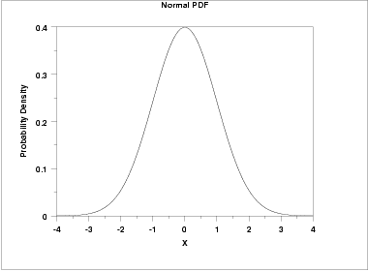
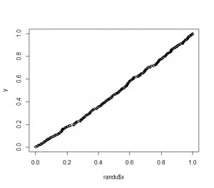
Normal Distribution Profile

Slide 9
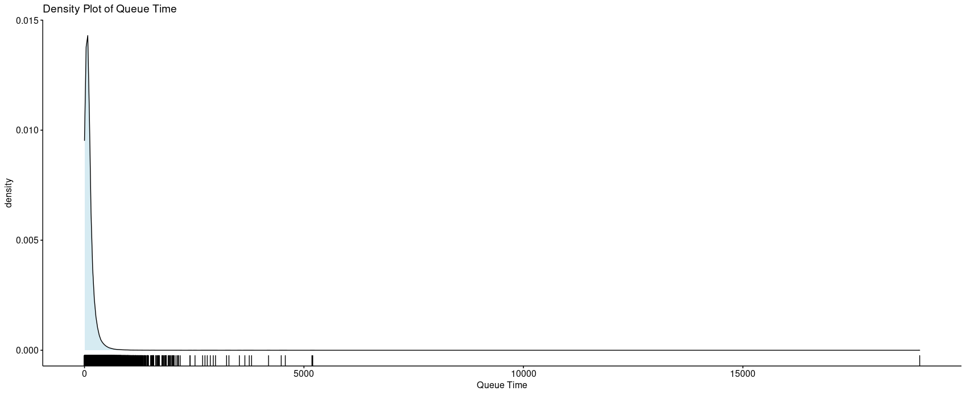
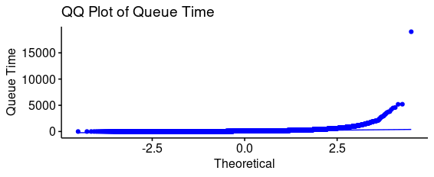
QueueTime

Slide 10
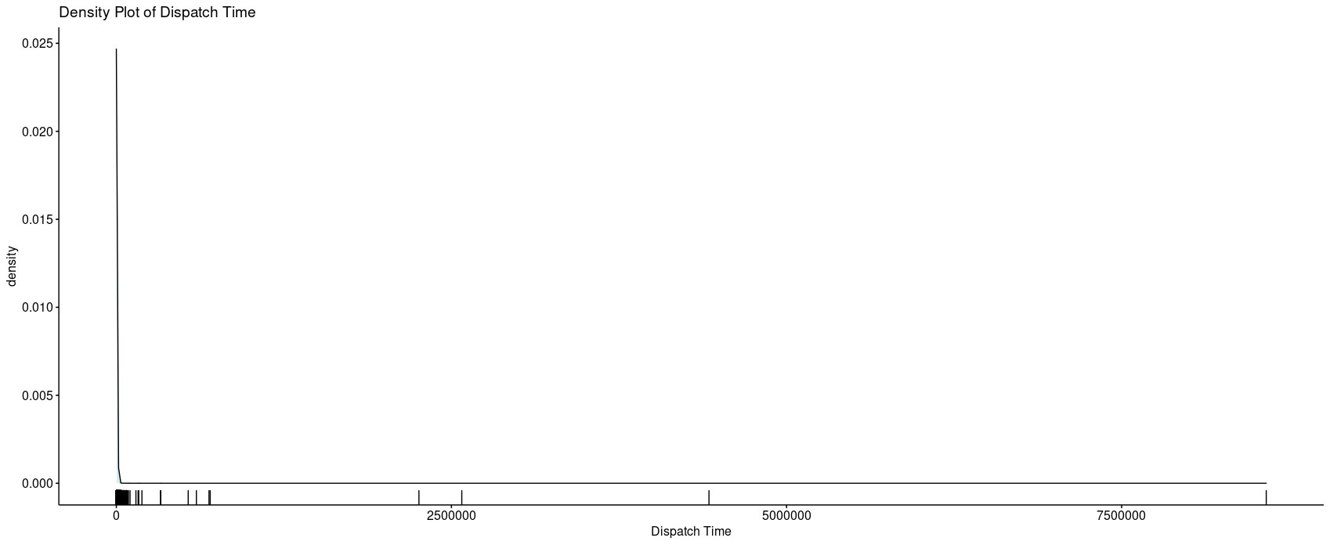
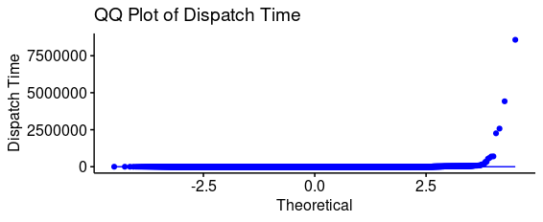
DispatchTime

Slide 11
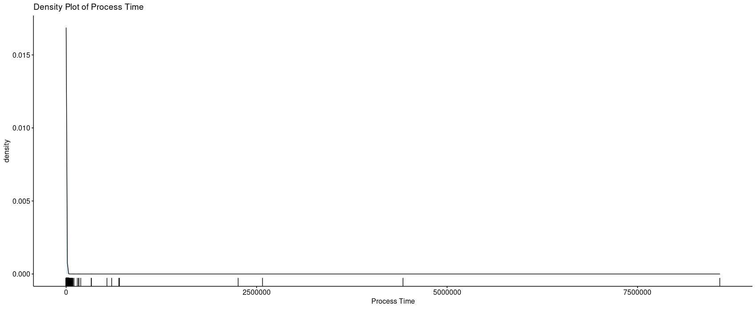
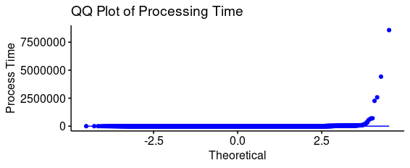
ProcessTime

Slide 12
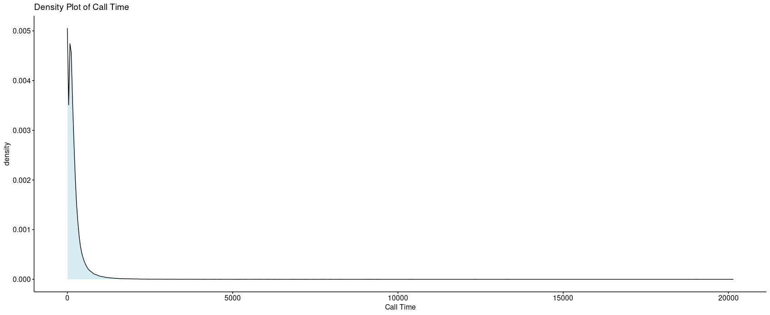
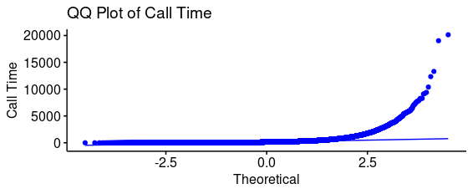
CallTime

Slide 13
Results of normality tests
All four variables show a non-normal distribution with a heavy right skew.
Based on this, the data qualifies for the use of nonparametric tests.
These tests will use population medians rather than population means as the measure of central tendency for analysis.
The medians for the four computed variables are as follows:
Variable | Median
QueueTime | 76 seconds
DispatchTime | 46 seconds
CallTime | 127 seconds
ProcessTime | 150 seconds

Slide 14
Limitations of techniques and tools
Nonparametric tests, while appropriate for this type of data, are not as powerful as their parametric counterparts.
Nonparametric tests do not make assumptions about the structure or distribution of the data.
Nonparametric tests may miss sensitivities between columns in a dataset due to the lack of power.
The Anderson-Darling normality test is not regarded as powerful as the Kolmogorov-Smirnov test. In this data, the K-S test could not handle the ties in the dataset.
The Scheirer-Ray-Hare extension for the Kruskal-Wallis test may be less likely to find an interaction effect significant between independent variables as opposed to the Aligned Rank Transformation ANOVA test.

Slide 15
First analytical tests.
A Kruskal-Wallis test performed on all identified dependent variables using the Year as the independent variable. The results of all 4 dependent variables showed a statistically significant difference in the population means.
Since CallTime and ProcessTime both depend on or encapsulate QueueTime and DispatchTime, only the latter two will be demonstrated in the presentation going forward.
In all 4 dependent variables, the effect size for Year on the computed times were classified as small. Additional independent variables need to be added to see if there is a greater impact to be discovered.

Slide 16
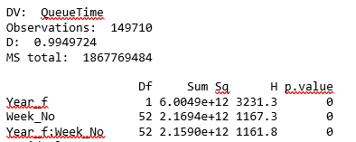
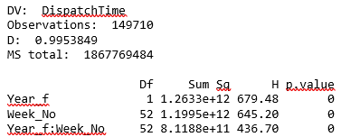
Additional Independent Variable
Since DECC’s reporting structure is built around a weekly report, the Kruskal-Wallis test, via the Scheirer-Ray-Hare test, was extended to include the week number as a independent factor variable.
When these tests were performed, the p value for the results of all dependent variables equaled 0. Therefore, we could reject the null hypothesis and assert there was a significant population preference between the two years on a week to week basis.

Slide 17
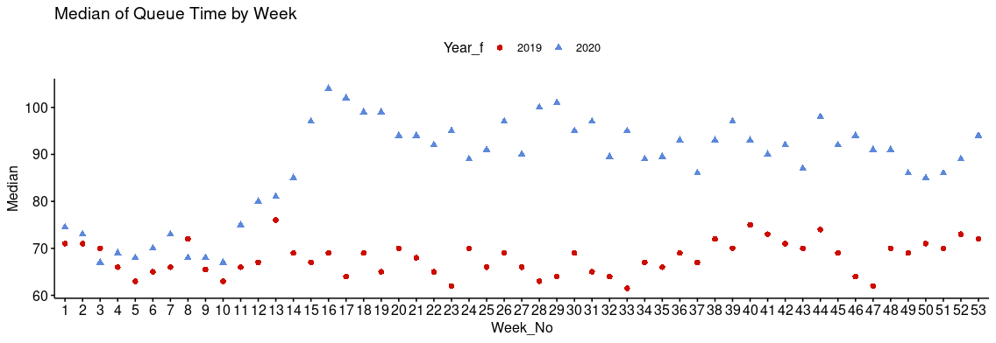
Scatterplot of Weekly Queue for Year

Slide 18
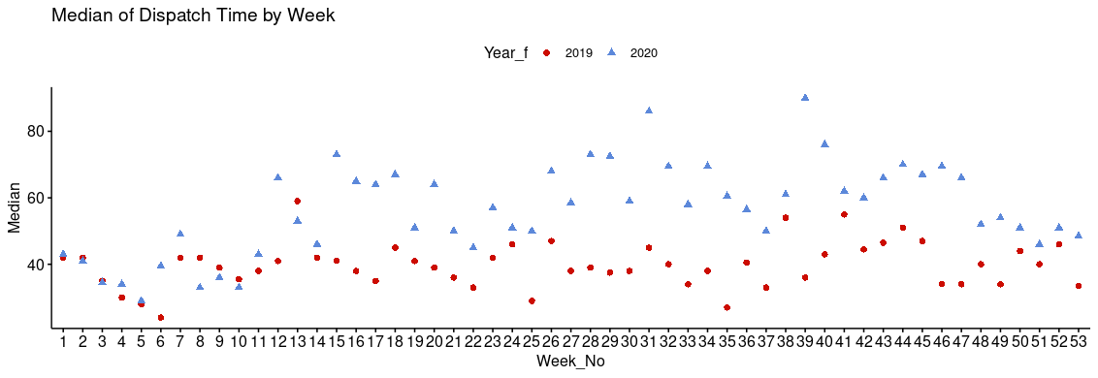
Scatterplot of Weekly Dispatch for Year

Slide 19
Analytical Findings
From week 12 when the call-takers were able to start answering calls from the 911 line through the remainder of the year, the medians for 2020 were significantly higher than the medians for 2019 in all four dependent variables. This peaked for QueueTime, CallTime, and ProcessingTime in weeks 16 and 17 when DECC created the isolation bubble in the hotel. In these cases, connections to the city network had to be established through an ISP which appears to have created a bottleneck impacting the remote workers’ ability to quickly field the calls.
The DispatchTime variable does not show as strong a distance between the medians for 2019 and 2020 until later in the year. Additional independent variables did not illuminate this further. Call volumes remained lower in 2020 than in 2019 through the entire year.
The other continuity of operations actions taken by DECC, while effective for ensuring 911 operations, did not contribute significantly to the change in the call handling and processing times for the floor staff.

Slide 20
Recommendations for the future
1. Since continued use of the remote call-taker program is part of DECC’s new normal operations, the remote workstations need to have NetMotion installed and configured for faster, more stable, and better quality connections to the city network infrastructure. Currently, APD uses NetMotion for its mobile data terminals and DECC management and support staff use the product for remote access to the city network infrastructure with no negative impacts to ability to work.
2. Statistical reports generated for DECC management should be distributed to the floor supervisors so they have a better knowledge of the overall operations of the 911 center. Additionally, DECC can leverage the institutional knowledge owned by the floor supervisors to find additional ways to adapt personnel and workflows to be more responsive and lower median times for call handling and processing back to pre-COVID19 levels.

Slide 21
Expected benefits
With the implementation of the recommendations on the previous slide, DECC and the City of Alexandria should see measurable improvements in the call handling and processing times by the floor staff.
Additionally, DECC should see an improvement in the ability of the call-takers to function as efficiently remotely as they do when in the call centers because of the stability and speed benefits of the NetMotion client.
Finally, leveraging the institutional knowledge and skills of the supervisors and the floor staff to suggest and make improvements to the call handling procedures will also allow DECC to both render better service to the public while testing the suggested improvements to ensure their efficacy.

